Slide 1
Overview of Summer Convection over Central Alabama
Genki R. Kino
University of Hawaii
National Weather Service Birmingham
Kevin B. Laws
8/4/2011

Slide 2
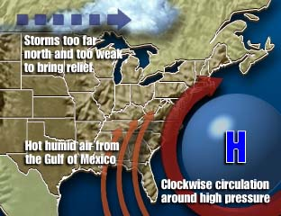
Introduction
Project started in the Summer of 2009
What happens to the weather during the Summer in the SE United States?

Slide 3
Purpose
Dispel the myth of “Random” summertime thunderstorm development
Attempt to identify several triggers for summertime convective initiation
Use detailed surface analyses, along with remote sensing operational tools (GOES, NEXRAD) for boundary identification
Collaborate with the SPoRT Center and surrounding offices to develop an operational forecasting methodology using all available tools and future products

Slide 4
Thunderstorm Ingredients
An ample supply of Moisture
- Gulf of Mexico
Sufficient Instability
- Surface Heating
A source of Lift
- Outflow Boundaries
- Orographic Boundaries
- Sea Breeze Fronts
- Differential Heating
- Shallow / Synoptic Fronts
- Horizontal Convective Rolls
- Unknown Boundaries

Slide 5
Purpose
Dispel the myth of “Random” summertime thunderstorm development
Attempt to identify several triggers for summertime convective initiation
Use detailed surface analyses, along with remote sensing operational tools (GOES, NEXRAD) for boundary identification
Collaborate with the SPoRT Center and surrounding offices to develop an operational forecasting methodology using all available tools and future products
Improve summertime probability of precipitation (PoP) forecasts across central Alabama

Slide 6
Summer of 2009
Understand the summer forecast process
Identify the different types of lifting mechanism that result in the development of summer convection
Analyze surface observations, satellite, and radar on a hourly basis
Notes:
Ideas about summer weather

Slide 7
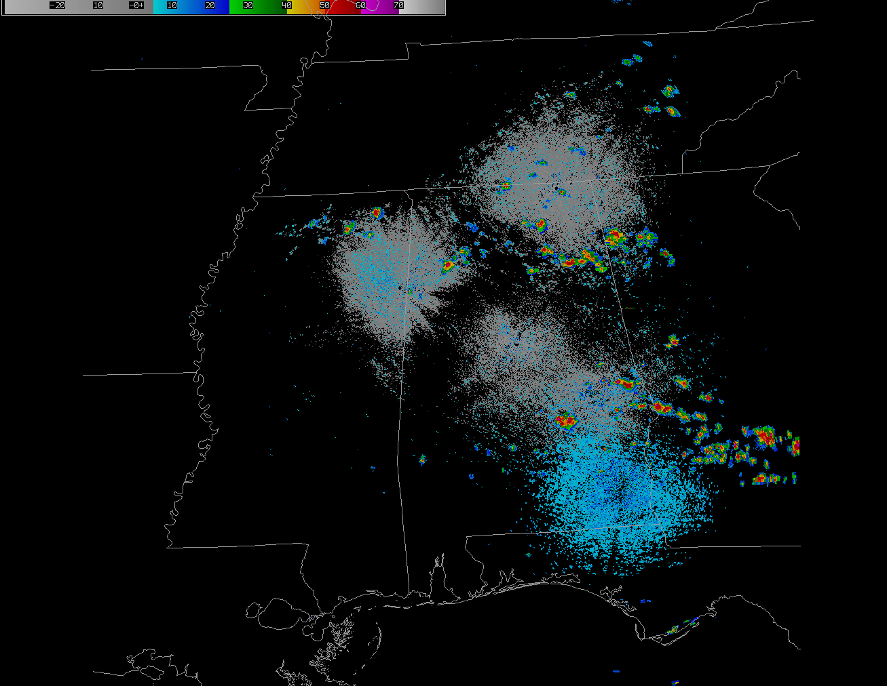

Slide 8
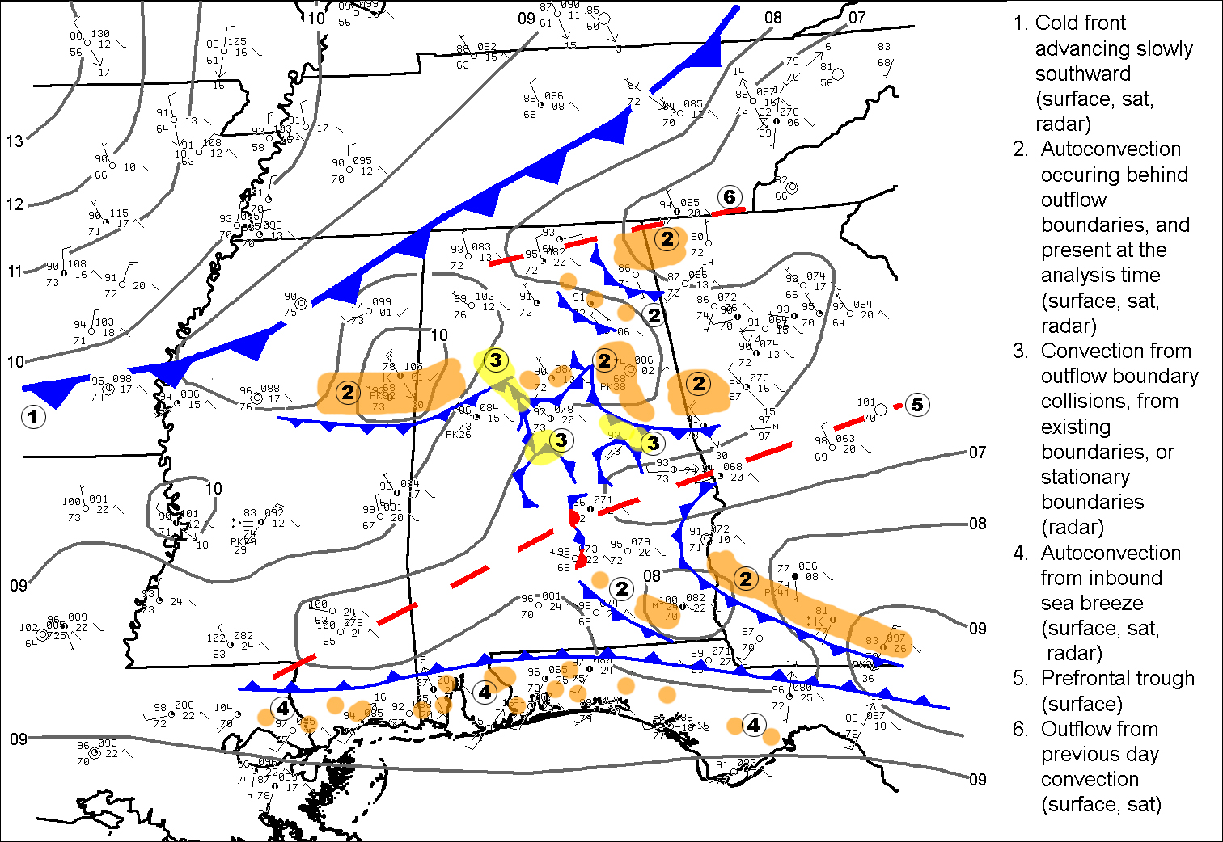
Surface Analysis

Slide 9
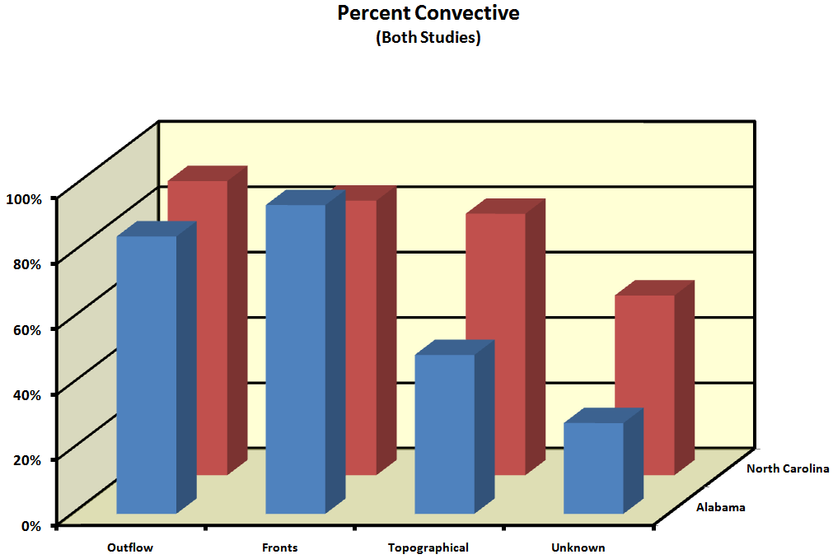
Boundary Statistics from 2009
310
18
72
36
467 Boundaries Identified

Slide 10
Summer of 2010
Focus exclusively on first generation convective initiation
Introduce SPoRT LIS data as a potential data source for identifying mainly unknown boundaries
Develop experimental graphical short term forecasts with forecast polygon areas indicating where convective initiation is likely.
Notes:
Where why how, forecast CI.

Slide 11
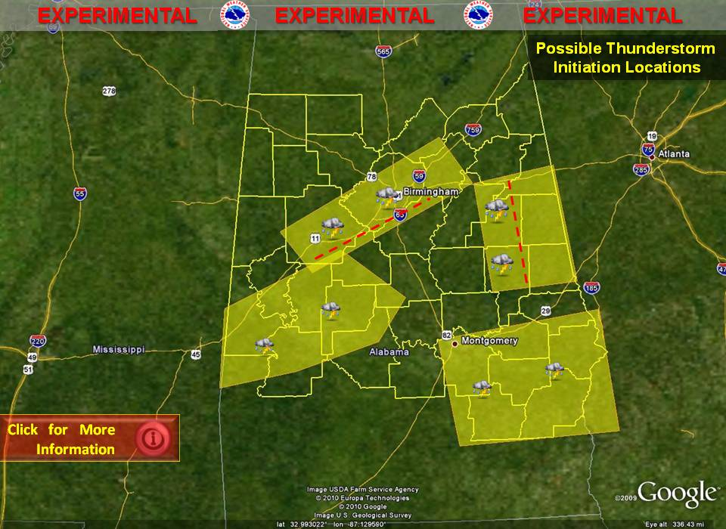
This is an experimental graphicast depicting the areas where thunderstorms
could first develop this afternoon. The graphic is part of a larger project devoted
to the improvement of summertime forecasting throughout the southeast.

Slide 12
2010 Boundaries
Notes:
Using those same days and the 101 polygons issued, this is how our boundary type breaks down.
101 number of boundaries, 84 verified. We verified 84 of 101 polygons.
Our methodology for issuing and verifying polygons included deciding on what boundary type was the reason for the polygon and CI development. Explain chart. Back row is the number of boundaries used to issue polygons divided by type. The front row is the number of those boundaries which verified. Cut down on number of unknown boundaries.

Slide 13
Summer of 2011
Add Skill to Summer PoP forecast – add Experimental Probablity of Precipitation (EPoP)
Look at how the EPoP compared to operational forecasts and climatology PoP
Verification – dispel random convection myth
Calculate Skill Scores – measures the improvement of skill over that of a reference forecast such as climatology

Slide 14
2011 Results
Notes:
6/19 lowered POP’s Did not rain. 6/20 lowered PoP’s 7/6 raised POP’s but no rain.

Slide 15
The Future
SUMMER 2012
Attempt to improve upon midnight shift forecast…leaving the morning update to refine POP
Introduce a mesoscale model through SPoRT?
Introduce methodology regionally through SPoRT partnership
Notes:
Over the next two summers, we want to continue to identify boundaries and go beyond the first generation convection and determine second and third generation CI.
We want to product a gridded polygon with hope of improving the first period POP forecast.
And work with SPoRT to spread this method across the region.

Slide 16
Thank You!
Any Questions?

