Slide 1
Evaluating the Impact of Atmospheric Infrared Sounder (AIRS) Data on Convective Forecasts
Danielle M. Kozlowski
NASA USRP Intern

Slide 2
Background
Motivation
Forecasting convective weather is a challenge for operational forecasters
Current numerical weather models may struggle to properly forecast location, timing, intensity, and/or mode of convection
SPoRT is attempting to improve convective forecasts by creating a real-time modeling system called the SPoRT-WRF that adds unique NASA data and capabilities
Goal of this project is to determine impact of AIRS profiles on SPoRT-WRF forecasts by comparing to NSSL WRF and SPoRT-WRF with no AIRS
Evaluation period: April 25-27, 2011 Tornado Outbreak
Over 450 tornadoes and 300 fatalities occurred over this three day outbreak across 24 states

Slide 3
SPoRT WRF Model
National Severe Storms Laboratory (NSSL) runs a version of WRF that contains specific options conducive for convective forecasting and is used operationally by Storm Prediction Center
SPoRT-WRF uses same domain and model options as NSSL WRF, but with higher-resolution initial and boundary conditions
Unique NASA data added:
4-km Land Information System (LIS) surface characteristics
1-km SPoRT Sea Surface Temperatures (SST)
1-km Moderate-Resolution Imaging Spectroradiometer (MODIS) Greenness Vegetation Fractions (GVF)
45-km AIRS retrieved profiles
Surface data added during cold-start initialization at 0000 UTC
WRF-Var blends AIRS profiles into 9-h SPoRT WRF forecast background

Slide 4
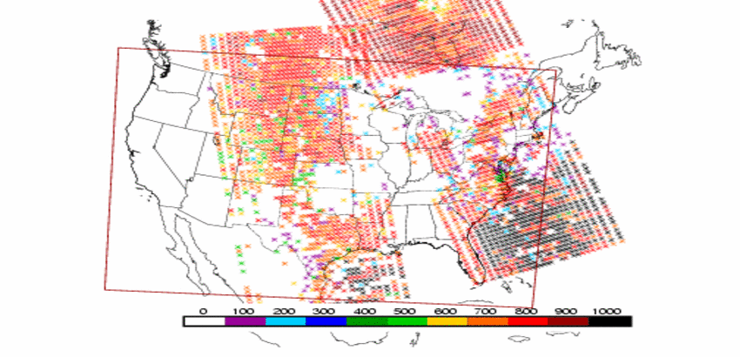
Atmospheric Infrared Sounder (AIRS)
Clouds present, little
to no data assimilation
Hyperspectral sounder aboard NASA’s Aqua polar orbiting satellite
Provides temperature and moisture profiles of the atmosphere, in clear and party cloudy scenes
Quality indicator, P_{best}, approximates cloud level and selects the most favorable data from each profile for assimilation
Highest quality data,
assimilated to the surface

Slide 5
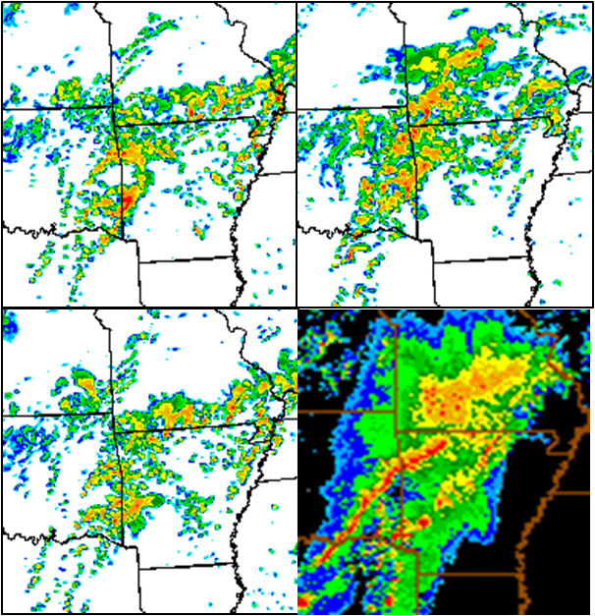
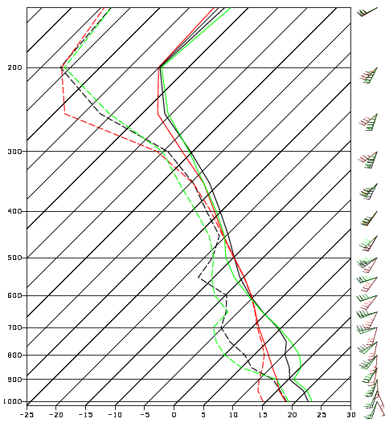
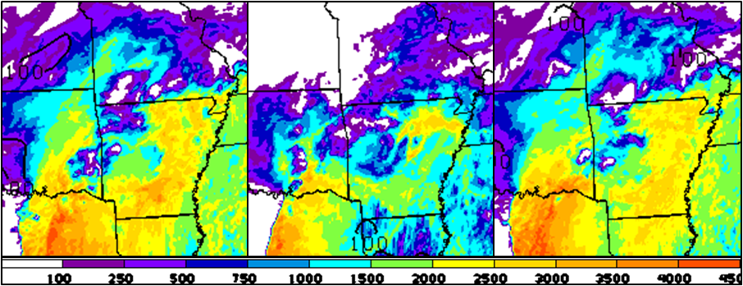
25 April 2011
NSSL
SPoRT
No AIRS
NSSL
SPoRT
NSSL
SPoRT
No AIRS
NSSL and No AIRS produce convective structures but no distinct squall line as is seen in the observed reflectivity
SPoRT WRF has a cooler more moist sounding resulting in the production of the heavy rain over southern Missouri
No AIRS
Observed
Figures for 21-h forecast valid at 21 UTC on 25 April
NSSL
SPoRT
No AIRS
NSSL and No AIRS forecasts have more CAPE, which one would expect to produce more model reflectivity than SPoRT-WRF with lower CAPE

Slide 6
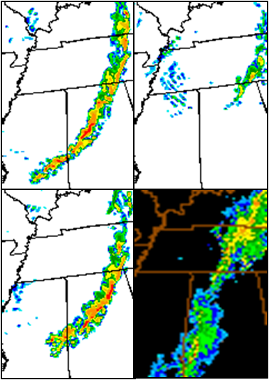
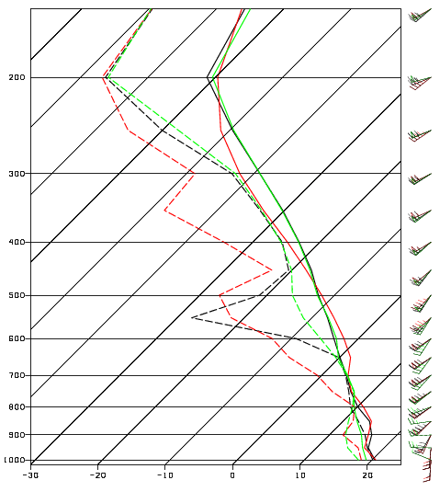
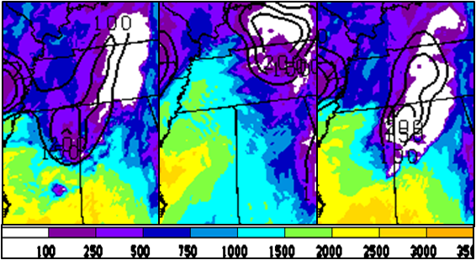
26 April 2011
NSSL
SPoRT
NSSL
SPoRT
No AIRS
Late evening and early morning convection is handled well by all three models until 1500 UTC
From 1500 UTC onward, all three models poorly forecast the precipitation location and intensity
SPoRT-WRF has the driest sounding which would reduce convection
No AIRS
Observed
Figures for 15-h forecast valid at 15 UTC on 26 April
NSSL
SPoRT
No AIRS
NSSL and No AIRS have near 2500 J/kg CAPE with little convective inhibition (CIN), which likely helps form a large convective line of storms across Alabama

Slide 7
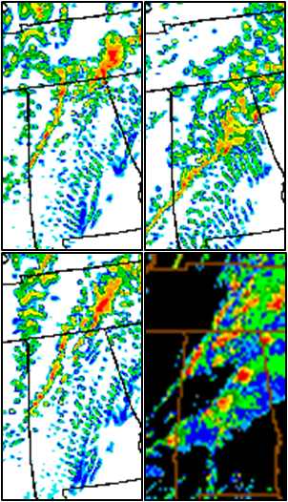
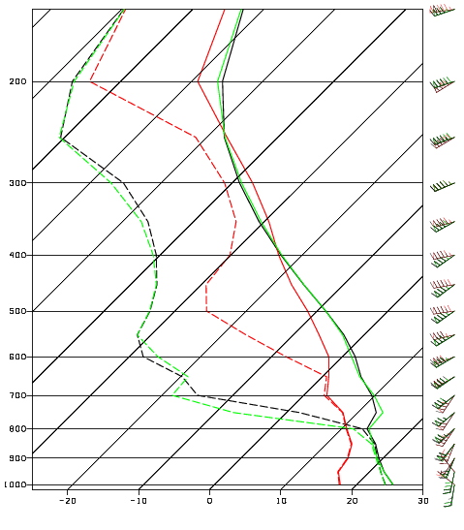
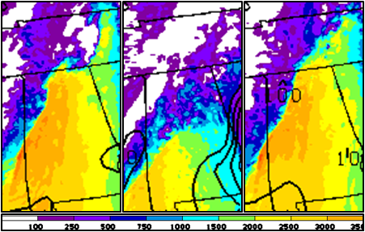
27 April 2011
NSSL
SPoRT
NSSL
SPoRT
No AIRS
All three models predict a significant severe weather outbreak, but none forecast the location and track of exact super cells
SPoRT-WRF too fast with frontal passage
NSSL and No AIRS have better cold front location but still a bit too fast
No AIRS
Observed
Figures for 24-h forecast valid at 00 UTC on 28 April
NSSL
SPoRT
No AIRS
CAPE gradient represents location of cold front
Cold front verified in sounding wind field, SPoRT winds out of the northwest

Slide 8
Conclusions
Assimilation of AIRS thermodynamic profiles into the SPoRT-WRF does impact convective forecasts, but with mixed results
Increased precipitation in 25 April case
Decreased convection in 26 April case
Frontal speed in 27 April case
Performing a 3-day case study did not show enough evidence to determine which model handles severe weather forecasting the best
Additional analysis is needed in order to demonstrate what changes at the assimilation time show up in the forecasts at later times to determine whether AIRS data has a positive or negative impact on convective forecasts

