Slide 1
Developing and Evaluating RGB Composite MODIS Imagery for Applications in National Weather Service Forecast Offices
Hayden Oswald¹ and Andrew Molthan²
University of Missouri, Columbia, Missouri¹
NASA SPoRT Center, Huntsville, Alabama²

Slide 2
Motivation
The volume of satellite data available to forecasters has increased as new instruments and techniques have emerged.
The GOES-R satellite will provide a significant increase in data.
RGB compositing is a more effective way to visualize satellite data than single channel products alone.
RGB compositing can highlight features in the data that may not be visible in single channel products.
MODIS data was used to provide a preview of GOES-R capabilities.

Slide 3
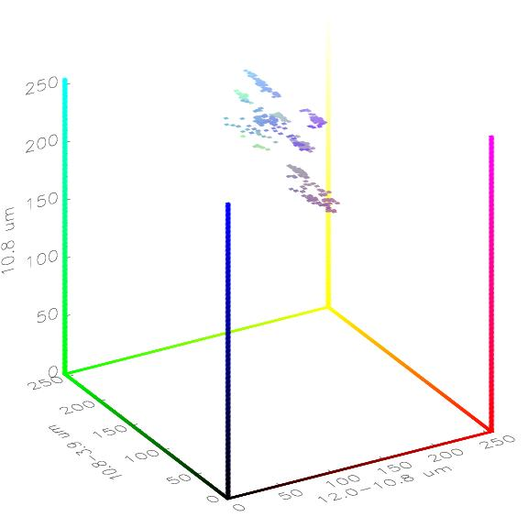
RGB Imagery
The colors in RGB images have direct physical correlations.
A channel or channel difference is assigned to a color (red, green, or blue).
The contribution of each color to a pixel in the image is proportional to the contribution of its assigned channel/channel difference.
EUMETSAT has developed RGB techniques for use with SEVIRI which have been adapted to MODIS by SPoRT.
We will discuss RGB imagery in the context of two RGB products.
Notes:
*This figure is an example from the nighttime microphysics product. This shows how channels are assigned to colors, and the possibilities for colors as each channel’s contribution varies.

Slide 4
Nighttime Microphysics
Current observations and satellite products do not resolve nocturnal fog clearly.
Current satellite techniques
Single channel (10.8µm)
SPoRT spectral difference (10.8µm-3.9µm)
Nighttime Microphysics product helps to distinguish among high clouds, low clouds, and fog.
Utilizes MODIS channels/channel differences
12.0µm-10.8µm
10.8µm-3.9µm
10.8µm

Slide 5
Case Study: 24 November 2010, 0815Z 11 μm Infrared Image
Visibility
< 3 mi.
3 – 5 mi.
5 – 10 mi.
Notes:
**Add a stand-alone legend for visibility reports.** Fog is contained in the red box but difficult to see. Distinguishing factor is obscuration of underlying terrain.

Slide 6
Case Study: 24 November 2010, 0815Z 11 μm – 3.9 μm Spectral Difference Image
Visibility
< 3 mi.
3 – 5 mi.
5 – 10 mi.
Notes:
**Stand-alone visibility legend. Mention color differences**The spectral difference image immediately draws the user’s attention to the Southeast and separates the shield of high clouds. Bright yellows mark the region of fog, but there are no details in the imagery which indicate the presence of the stratus band or the depth of the fog.

Slide 7
Case Study: 24 November 2010, 0815Z Multispectral Nighttime Microphysics image
Visibility
< 3 mi.
3 – 5 mi.
5 – 10 mi.
Notes:
Fog is shown by blue-green swath across southeast. False detection is eliminated, fog depth is discernible, and stratus band is visible.

Slide 8
Nighttime Microphysics Summary
Advantages
Nighttime microphysics imagery incorporates channels used in single channel and spectral difference products.
Extent and depth of fog events is more clear than in single channel imagery.
Provides a preview of GOES-R capabilities.
Disadvantages
Unconventional color scheme.
Appearance can be influenced by surface temperatures.
Conclusion
The nighttime microphysics product provides a better technique for nocturnal fog detection than current techniques.

Slide 9
Air Mass
Air mass product helps to distinguish among synoptic-scale features, such as fronts and jets.
Utilizes MODIS channels/channel differences:
6.2 µm-7.3 µm
9.7 µm-10.8 µm
6.2 µm (inverted)
Current techniques
Single channel water vapor imagery (GOES 6.7 µm)

Slide 10
Case Study: 16 April 2011, 0315Z 6.8 μm Water Vapor Image
Notes:
*Jet, front, comma head signature.

Slide 11
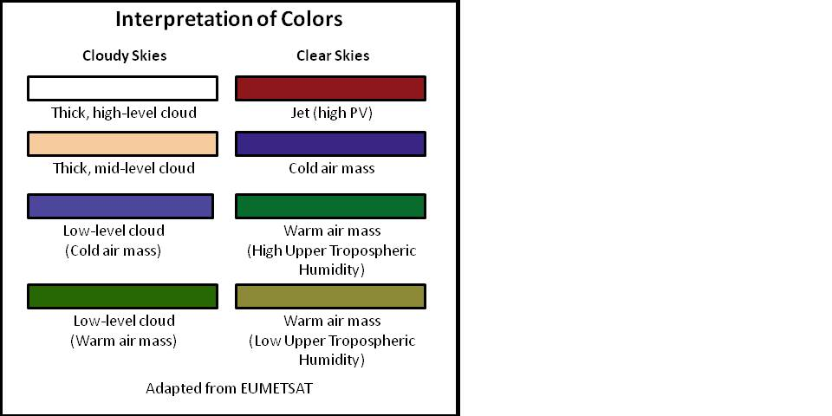
Case Study: 16 April 2011, 0315Z Air Mass Multispectral Image
Notes:
Can see jet, high/mid level clouds, and warm sector plume.

Slide 12
RUC Analysis Comparison
Notes:
*Compare placement of jet, vorticity, and thermal ridge.

Slide 13
Air Mass Summary
Advantages
RGB color characteristics increase certainty when identifying features.
A wider range of features is visible in this imagery.
Combines several channels into one product
Can be used to identify vorticity maximums in some cases
Provides a preview of GOES-R capabilities
Disadvantages
Clouds can obscure frontal boundaries.
Lower clouds can have similar colors as the air masses.
Conclusion
The air mass product efficiently combines a larger volume of data to provide the operational community with a more versatile, accurate diagnostic tool than water vapor imagery.
Notes:
In summary, I believe that these and other multispectral compositing techniques have operational utility and are an efficient way to utilize current and future satellite data.

Slide 14
Conclusion
The volume of available satellite data will continue to increase, especially after the implementation of GOES-R.
Efficient methods must be employed to utilize available data to its full potential.
RGB compositing provides a way to optimize multiple satellite data with a single product.
The nighttime microphysics product is an improvement to current nocturnal fog detection techniques.
The air mass product supplements water vapor imagery.
The NASA SPoRT Center will continue developing RGB satellite products for transition to NWS forecast offices.

