Slide 1


Update on SPoRT Short-term Forecasting Activities
WRF Microphysical Adjustments
Land Information System
High-res SST Forecast Impacts
Lightning Warning / Nowcasting
WRF Lightning Forecasts
Contributions to WRF EMS
AIRS Assimilation
Scatterometer Assimilation
(Lapenta visit, 24 March 2010)
transitioning unique NASA data and research technologies to operations

Slide 2
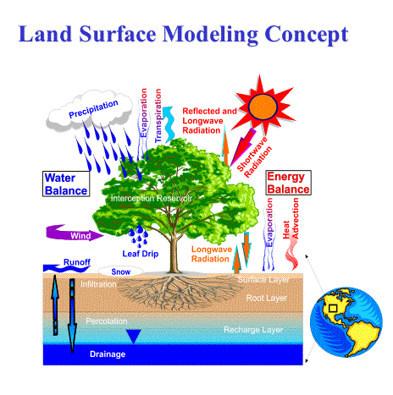
Land Surface Modeling with LIS
Precip Verification Study over SE U.S.
  LIS land surface initialization vs.
  interpolated NAM
  Application of non-standard
  verification methods
Real-time LIS/Noah at SPoRT
  Output to initialize WRF EMS runs
  Diagnostics for NWS BHM CI study
Incorporate MODIS veg composites
into LIS (underway)
transitioning unique NASA data and research technologies to operations

Slide 3
10 Jun 2008 Sensitivity Example
0-10 cm soil moisture SST Differences
transitioning unique NASA data and research technologies to operations

Slide 4
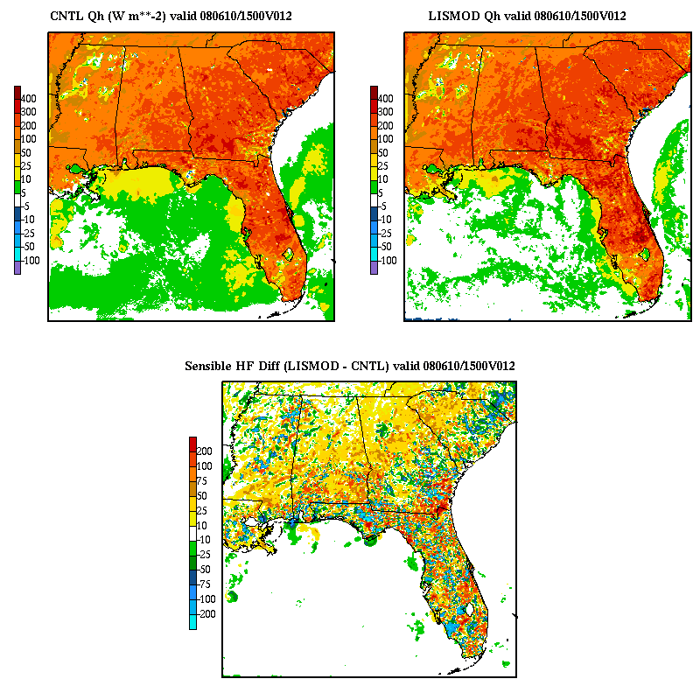
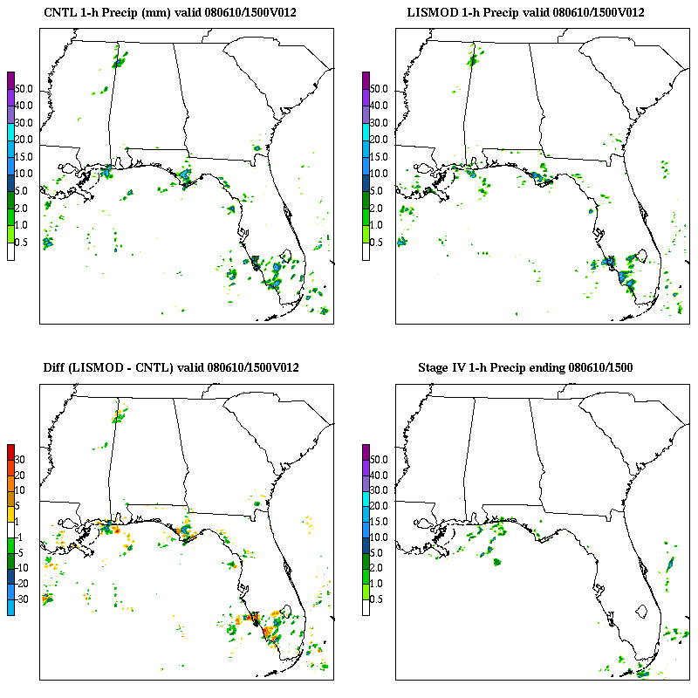
10 Jun 2008: 12−24 hour forecasts
Sensible Heat Flux 1-hour Precipitation
CNTL
LISMOD
DIFF
Stage IV
transitioning unique NASA data and research technologies to operations

Slide 5
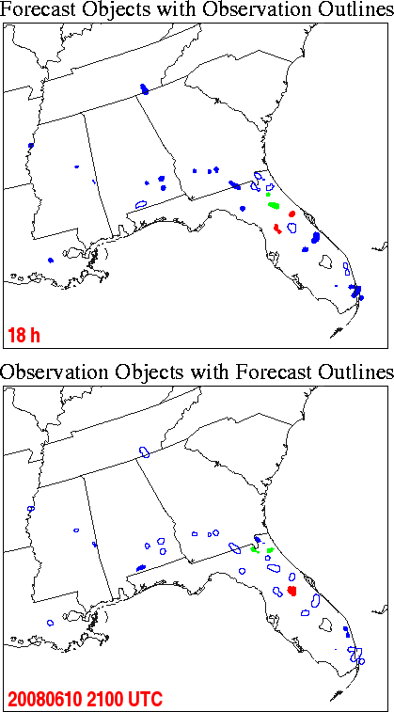
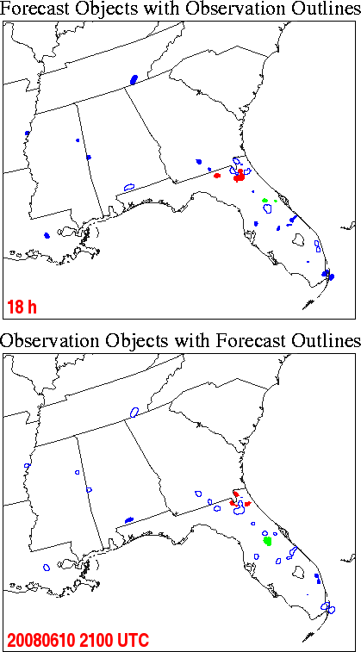
10 Jun: MODE 10-mm/(1 h) Precip Objects
Matched
Forecast
Objects
(“hits”)
Control
LISMOD
Matched
Observed
Objects
transitioning unique NASA data and research technologies to operations

Slide 6
10 Jun: MODE 10-mm/(1 h) Precip Objects
Un-matched
Forecast
Objects
(false alarms)
Control
LISMOD
Un-matched
Observed
Objects
(misses)
transitioning unique NASA data and research technologies to operations

Slide 7
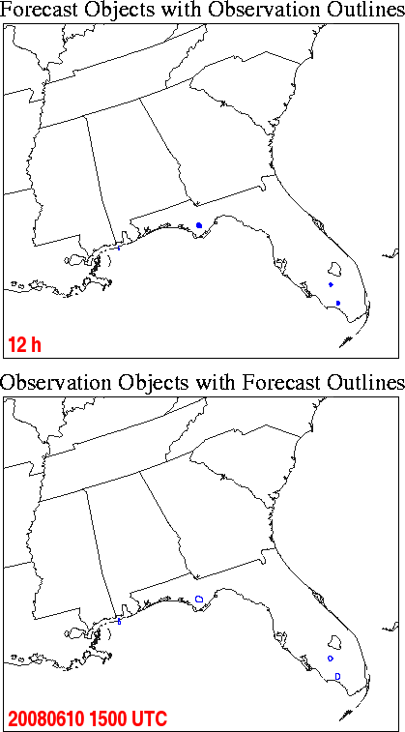
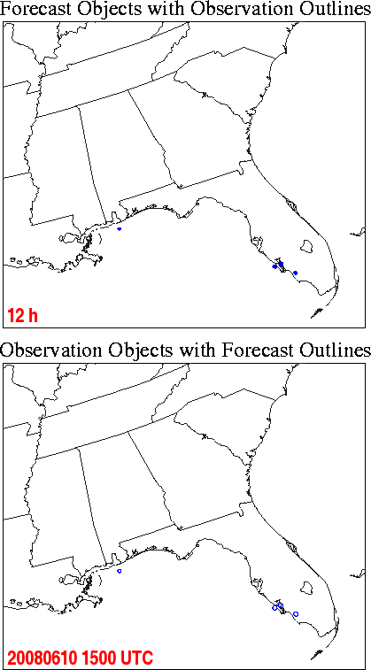
10 Jun: MODE 10-mm/(1 h) Precip Objects
 | Control |  | LISMOD
Fcst hour | Grid Area Match | Grid Area Un-match | Grid Area Match | Grid Area Un-match
12 | 0 | 115 | 0 | 115
13 | 0 | 93 | 0 | 64
14 | 0 | 222 | 0 | 108
15 | 0 | 492 | 0 | 474
16 | 0 | 802 | 232 | 587
17 | 388 | 544 | 606 | 653
18 | 419 | 1039 | 470 | 711
19 | 108 | 1122 | 186 | 916
20 | 318 | 680 | 271 | 674
21 | 394 | 301 | 382 | 646
22 | 0 | 596 | 110 | 424
23 | 28 | 632 | 30 | 501
24 | 0 | 328 | 0 | 417
Control
LISMOD
transitioning unique NASA data and research technologies to operations

Slide 8
MET/MODE 1-h Precip Object Verification:
(Un-)Matched Differences by Model Run, 12−24 h Forecasts
Quantity (mean # grid points per model run) | Control | LISMOD | Difference (LISMOD – Control) | % Change
5-mm Matched | 11,911 | 12,045 | 134 | 1.1%
5-mm Unmatched | 17,750 | 17,175 | -575 | -3.2%
10-mm Matched | 2,456 | 2,562 | 106 | 4.3%
10-mm Unmatched | 6,798 | 6,538 | -260 | -3.8%
25-mm Matched | 60 | 60 | 0 | 0%
25-mm Unmatched | 549 | 505 | -44 | -8.0%
Quantity | # Forecasts Improved | # Forecasts Degraded
5-mm matched | 39 | 41
5-mm unmatched | 56 | 25
10-mm matched | 37 | 39
10-mm unmatched | 48 | 33
25-mm matched | 13 | 8
25-mm unmatched | 46 | 32
transitioning unique NASA data and research technologies to operations

Slide 9
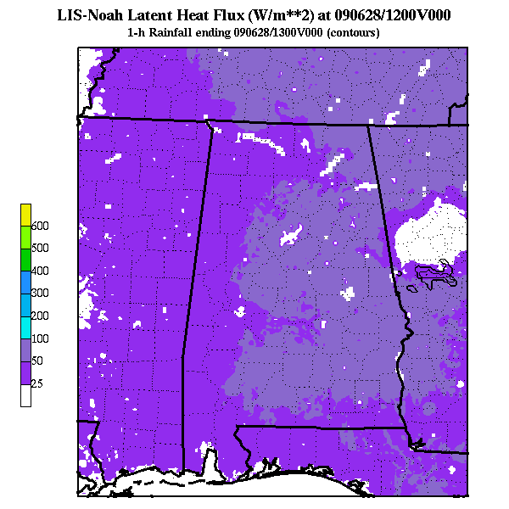
Real-time LIS/Noah at SPoRT
3-km LIS over southeast U.S.
  Spin-up run; restarts 4x per day
  Hourly output posted to ftp site
LIS output for diagnostics
  Readily displayable in AWIPS II
  NWS BHM: Convective initiation
  Other short-term forecasting issues
  (low temps, fire weather, etc.)
Future plans
  Expand 3-km to near CONUS
  1-km high-res nest for BHM CI study
transitioning unique NASA data and research technologies to operations

Slide 10
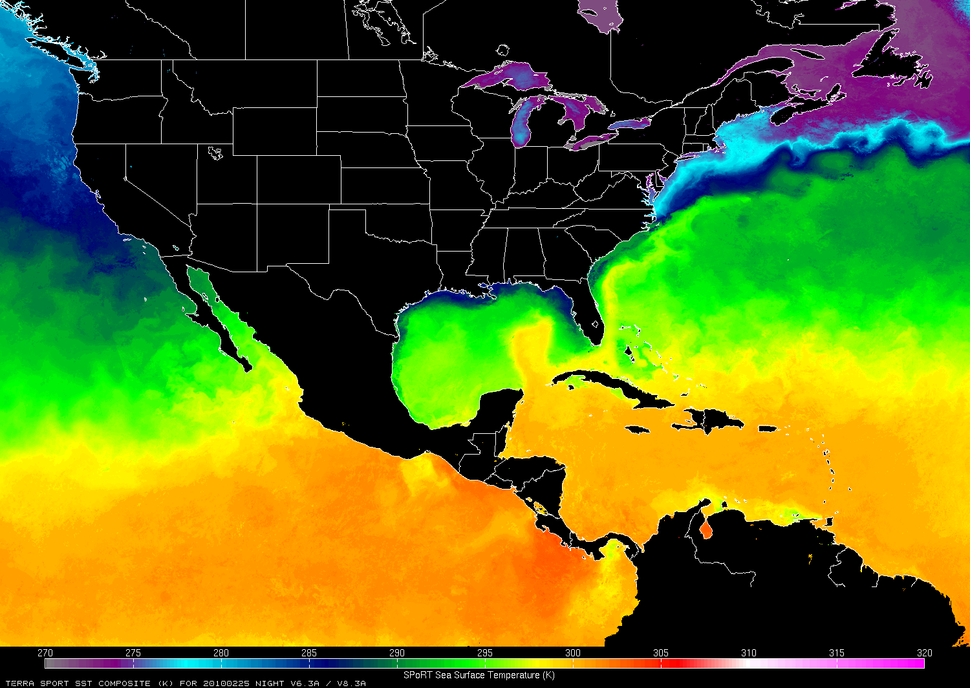
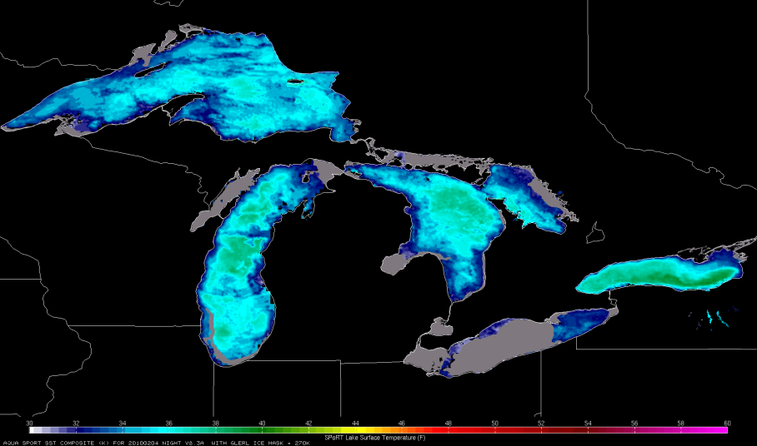
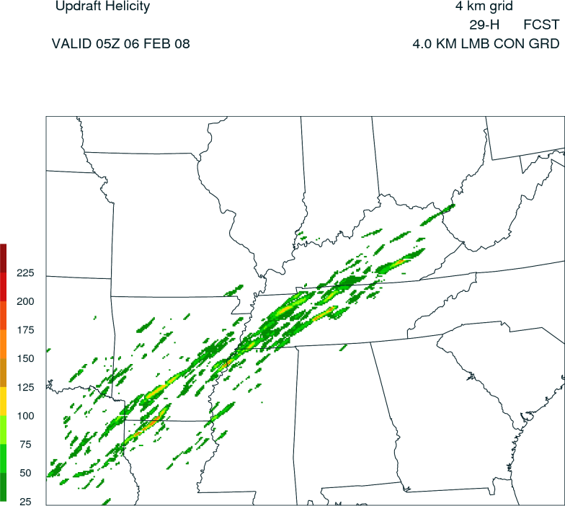
Contributions to the WRF EMS v3.1
SPoRT datasets for initializing the WRF
Environmental Modeling System (EMS)
  High-res, 1-km enhanced SSTs (MODIS+AMSR-E)
  Great Lakes sea ice mask
  LIS 3-km land surface initialization fields
Experimental output fields (Dembek – ARW core)
  Max output interval base reflectivity
  Max output interval 10-m wind speed
  Max output interval updraft helicity
  Max output interval updraft/
  downdraft speed
  McCaul’s Forecast lightning threats*
  (implemented only into NSSL/WRF)
NOAA/GLERL Ice Mask
Super Tuesday
Tornado outbreak
transitioning unique NASA data and research technologies to operations

Slide 11
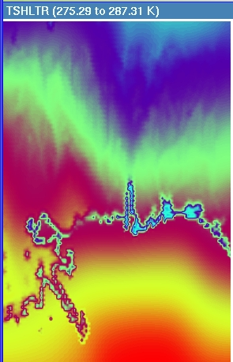
Improved Initial 2-m Temp in WRF EMS (NMM) using SPoRT SSTs and Land Surface fields
LAPS/NAM
transitioning unique NASA data and research technologies to operations

Slide 12
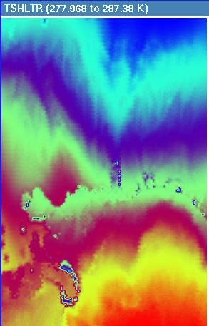
Improved Initial 2-m Temp in WRF EMS (NMM) using SPoRT SSTs and Land Surface fields
LAPS + SPoRT SSTs
transitioning unique NASA data and research technologies to operations

Slide 13
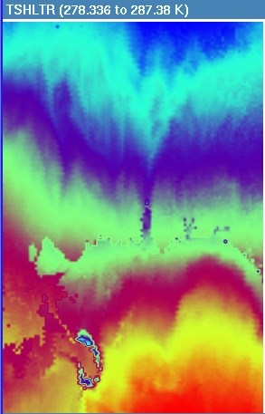
Improved Initial 2-m Temp in WRF EMS (NMM) using SPoRT SSTs and Land Surface fields
LAPS + SPoRT SSTs
+ LIS Tskin
transitioning unique NASA data and research technologies to operations

Slide 14
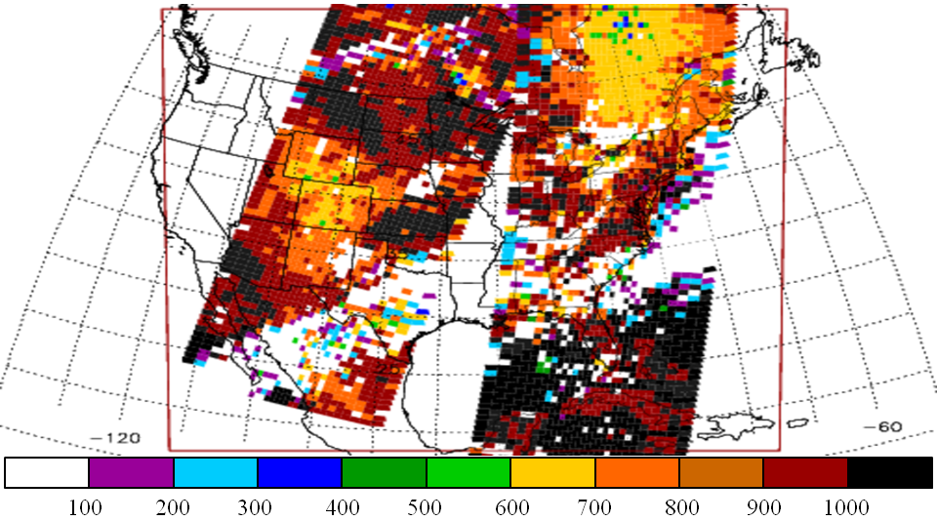
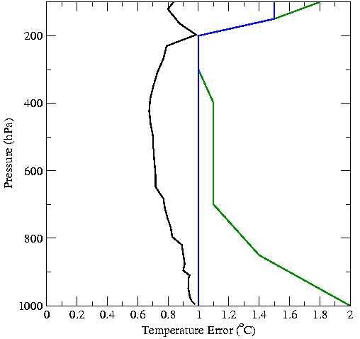
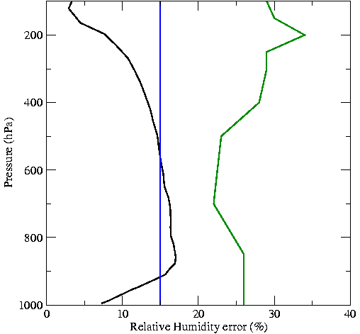
Methodology for Profile Assimilation
AIRS QI’s for 17 Jan 2007
L2 Version 5 temperature and moisture profiles
28-level standard product
Land and water soundings w/ separate errors
Quality control using P_{best} value in each profile
Sensitivity study assimilating only AIRS profiles
Current Analysis Error Characteristics
BKGD
AIRS water
AIRS land
WRF-Var from NCAR
B-matrix from “gen_be”
WRF initialized with 40-km NAM at 0000 UTC (cold start)
12-km analysis and model grid
Short WRF forecast used as background for analysis
transitioning unique NASA data and research technologies to operations

Slide 15
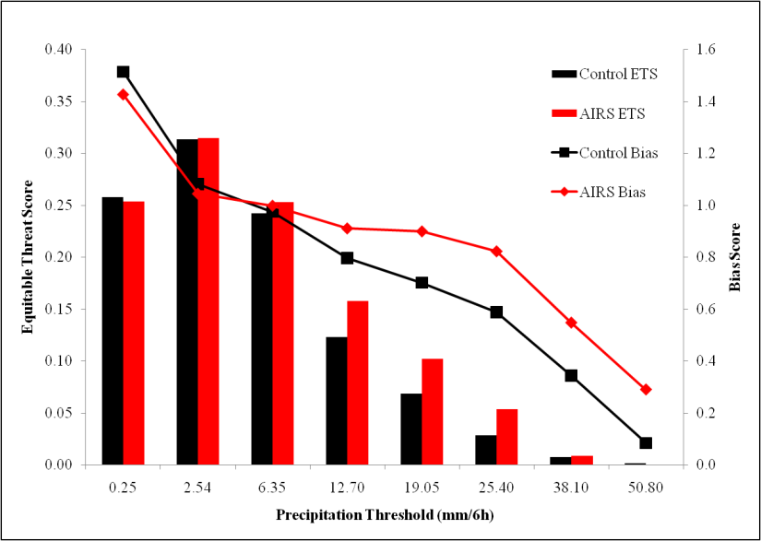
Profile Precipitation Verification
Combined forecast results for 12-48 hr forecasts of precipitation for 37-days from winter 2007
Equitable Threat Score shows forecasted and observed precipitation matches
  Improvement at all thresholds except lightest
  Best results for moderate thresholds (28% at 12.7 mm/6h, 14% at 19.05 mm/6h, 90% at 25.40)
Bias score shows F/O
  Improved (closer to 1) for all thresholds
transitioning unique NASA data and research technologies to operations

Slide 16
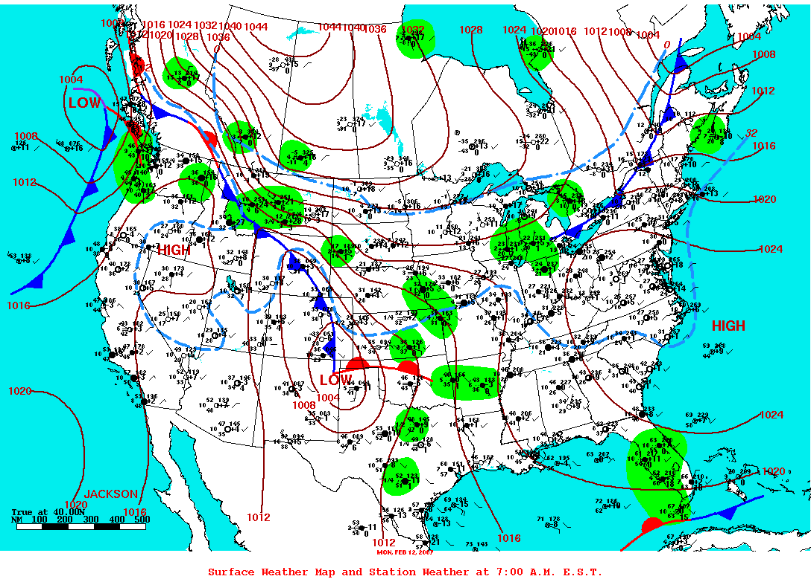
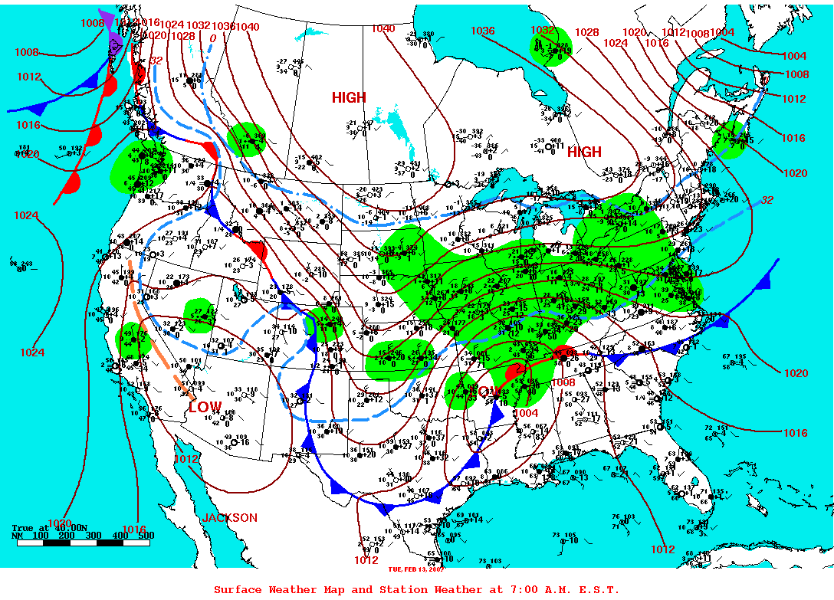
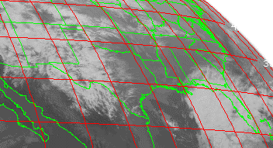
12-13 February 2007 Case
2/12/07 1200Z Surface Analysis
2/13/07 1200Z Surface Analysis
Developing front draped across Texas
2/12/07 0742-0800Z AIRS
2/12/07 0800Z GOES IR Image
High-quality AIRS profiles in clear skies ahead of front
Pressure (hPa)

Slide 17
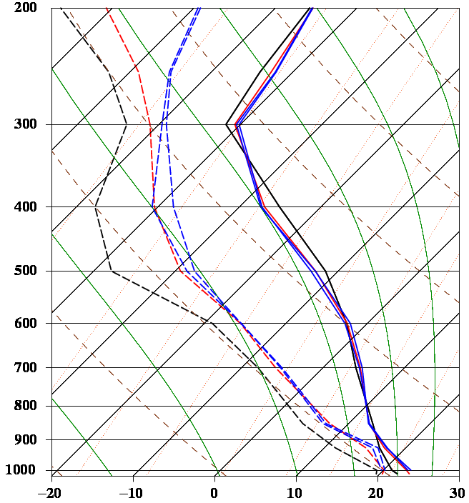
3DVAR Analysis Modification
Gulf of Mexico soundings at ≈08 UTC on 12 February 2007
Figure at right shows how assimilation of AIRS temperature and moisture profile impacts a sample Skew-T
Warms near-surface; cools upper levels
Result is a more unstable sounding
Entire column is moistened
Mid-level cooling
Low-level warming
BKGD
AIRS
ALYS
Pressure (hPa)
transitioning unique NASA data and research technologies to operations

Slide 18
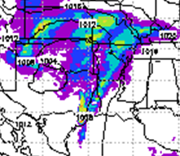
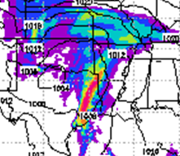
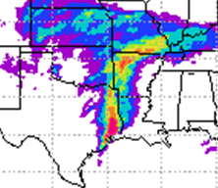
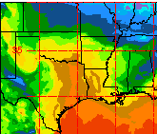
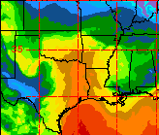
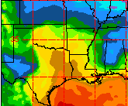
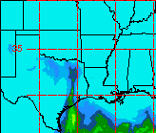
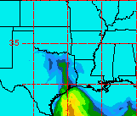
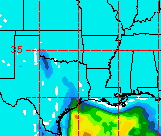

Improved Precipitation Forecasts
24-h forecast valid 00Z 2/13/07
Convective precipitation in Eastern Texas
  Control (upper left) produces some rain but does not capture significant precipitation
  AIRS (upper middle) reproduces convective precipitation line
Better representation of lower level moisture
CAPE values above 1800 J/kg in NAM analysis (lower right)
  AIRS (lower middle) nicely represents CAPE
  Control run (lower left) gives no hint of higher CAPE values
Control
Control + AIRS
Analysis “Truth”
50.80
6-hr precip.
38.10
25.40
19.05
12.70
6.35
2.54
0.25
1000 hPa T_{d}
CAPE
transitioning unique NASA data and research technologies to operations

