Slide 1

Tools for Tropical Coverage and More at The Weather Channel
Dr. Rick Knabb
Tropical Program Manager
Daniel Dix
Senior Weather Graphics Engineer
The Weather Channel
8 December 2010

Slide 2
Topics
2010 hurricane season review
On-air use of geostationary satellite imagery
Microwave satellite imagery
Satellite imagery processing at TWCC

Slide 3

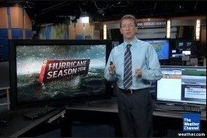

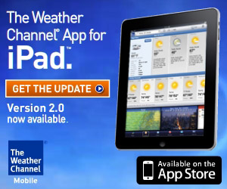
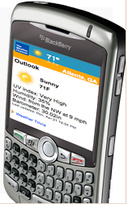
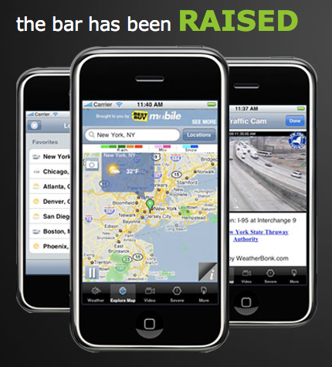
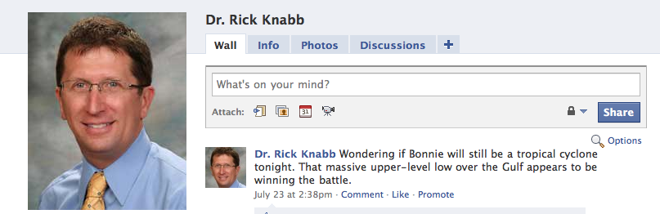
The Weather Channel is more than TV

Slide 4
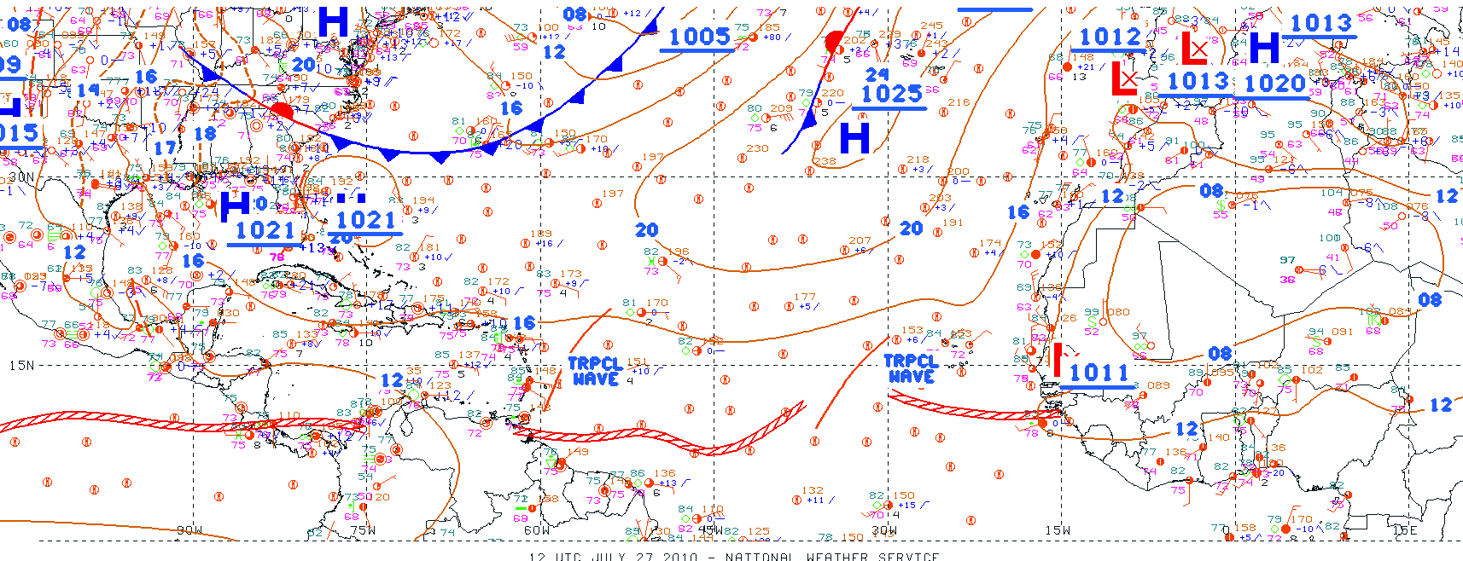
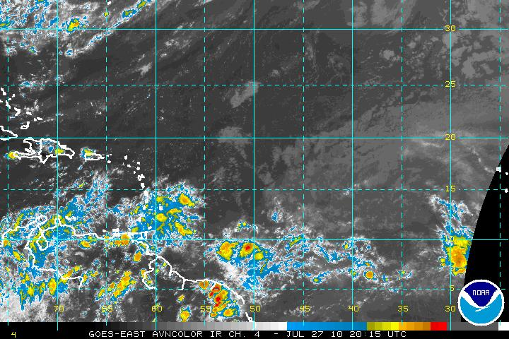
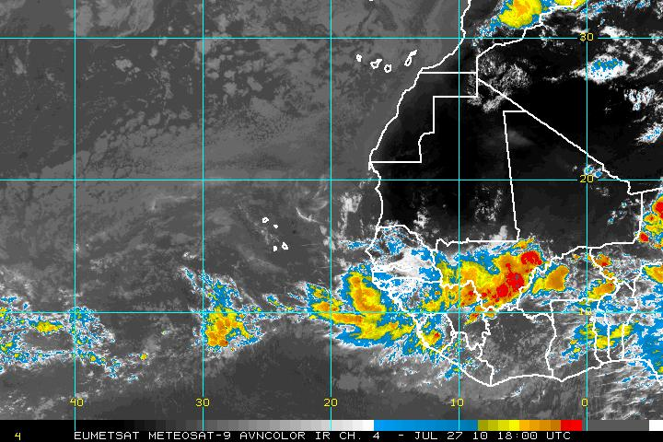
Tracking Weather Features in the Tropics All Year

Slide 5
Key NHC Changes for 2010
  Extended lead time for coastal watches/warnings
    Watches issued 48 hours out, warnings 36 hours
  Saffir-Simpson Hurricane Wind Scale
    References to non-wind hazards removed

Slide 6
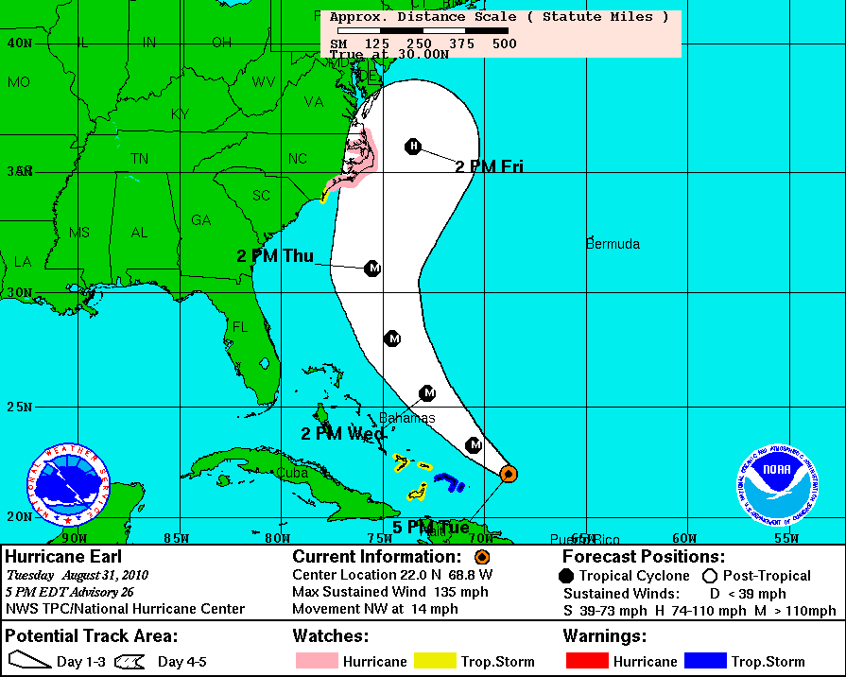
Hurricane Watch > 48 h in advance
Credit:
NHC

Slide 7
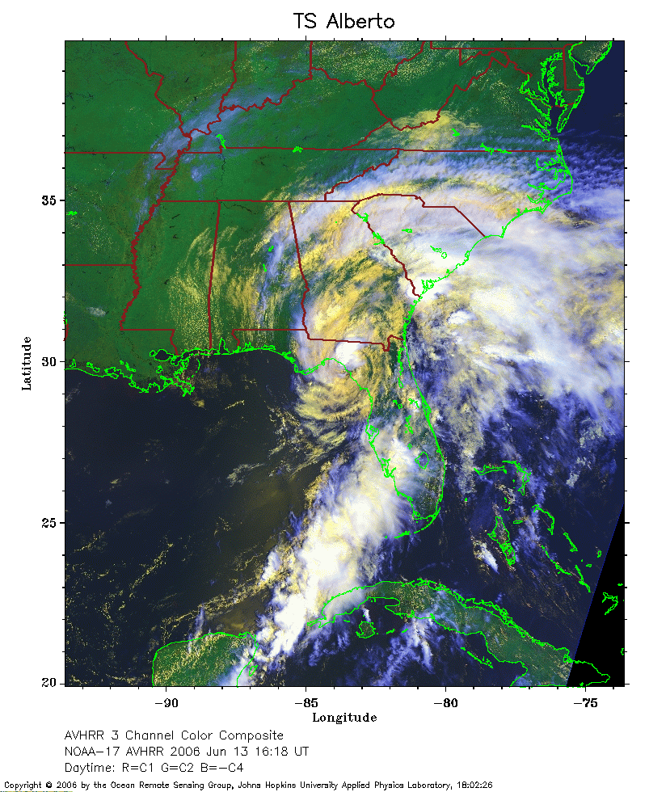
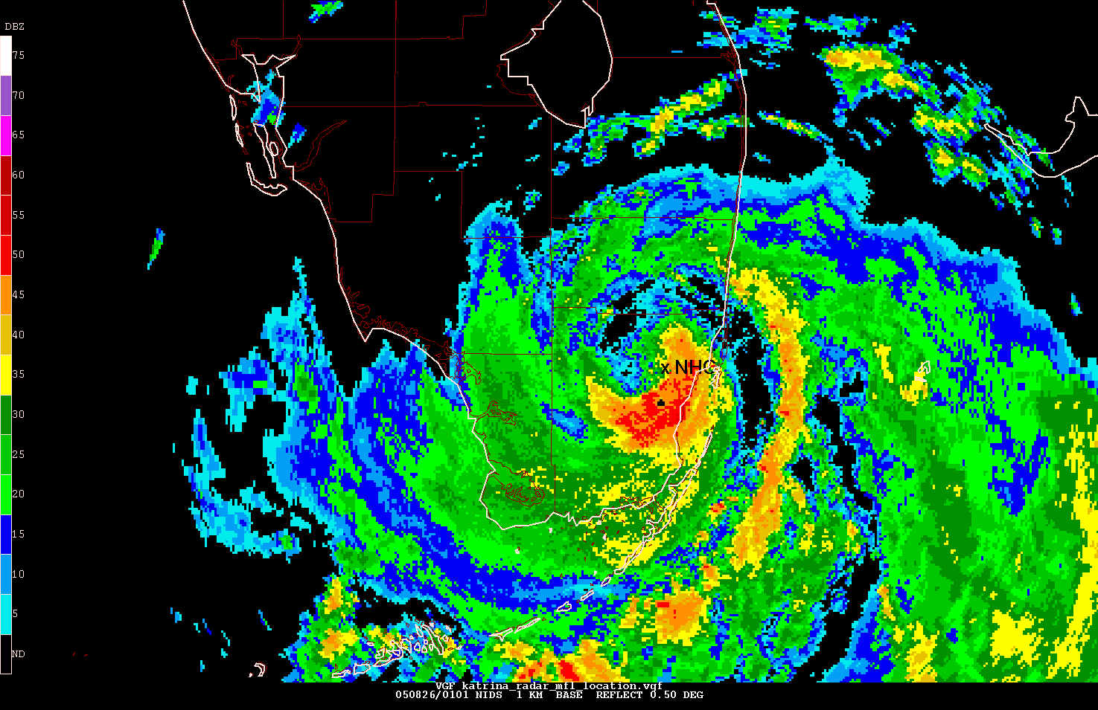
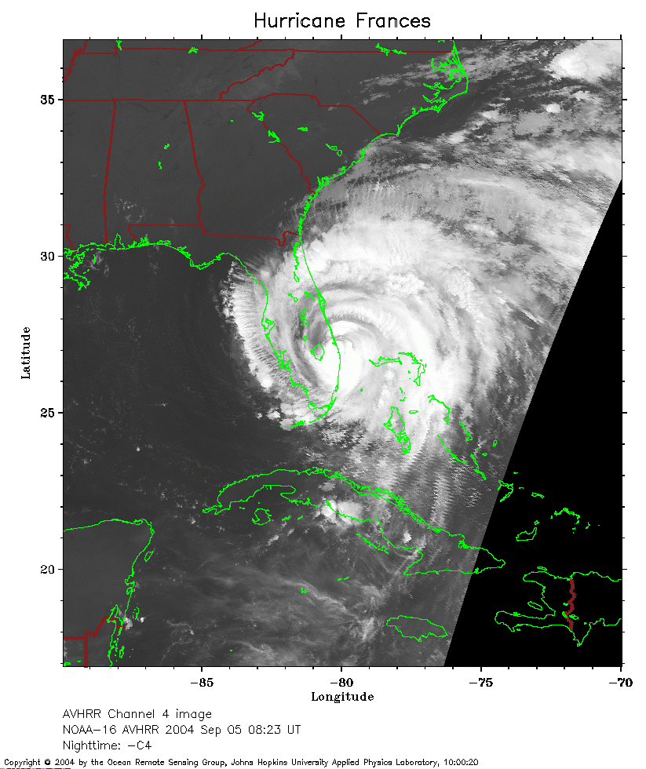
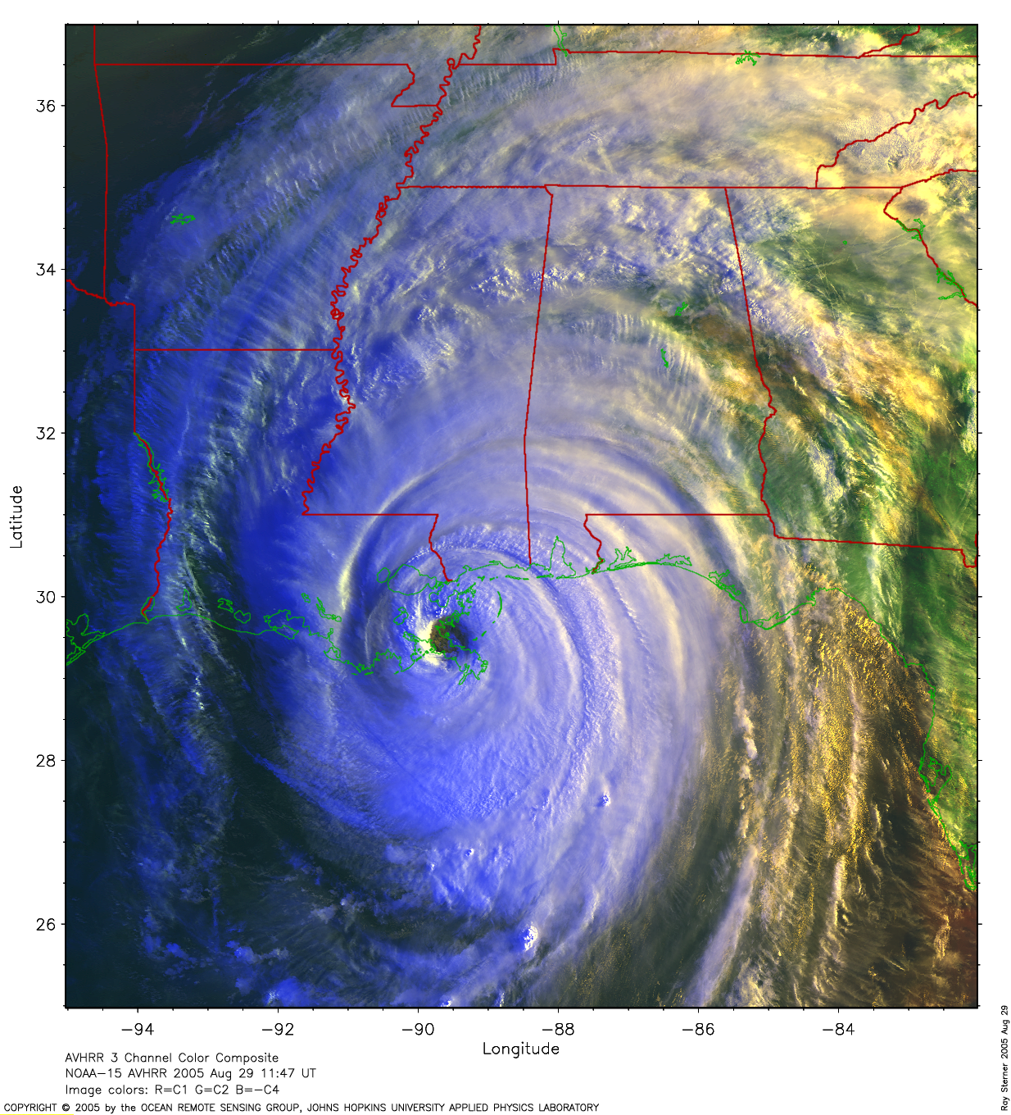
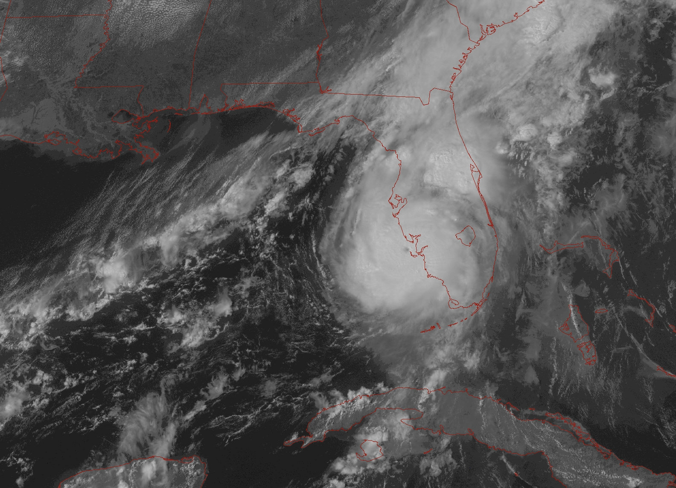
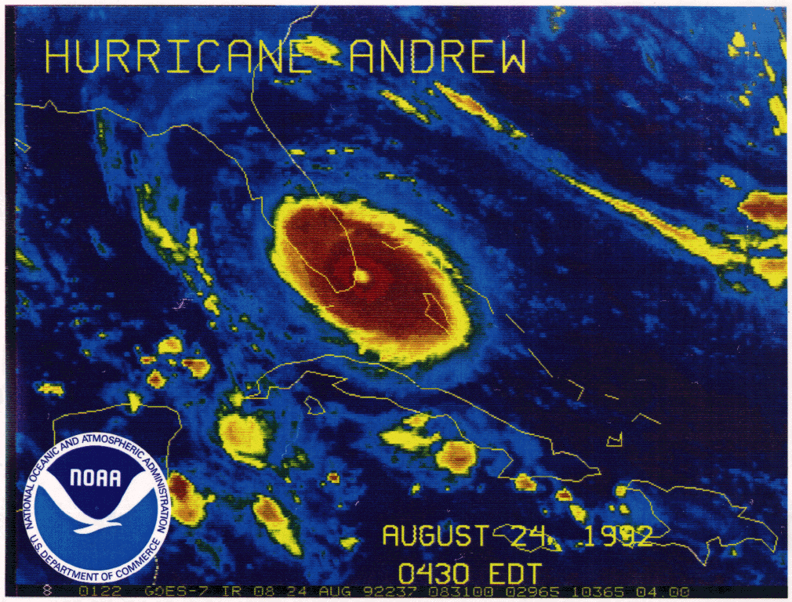
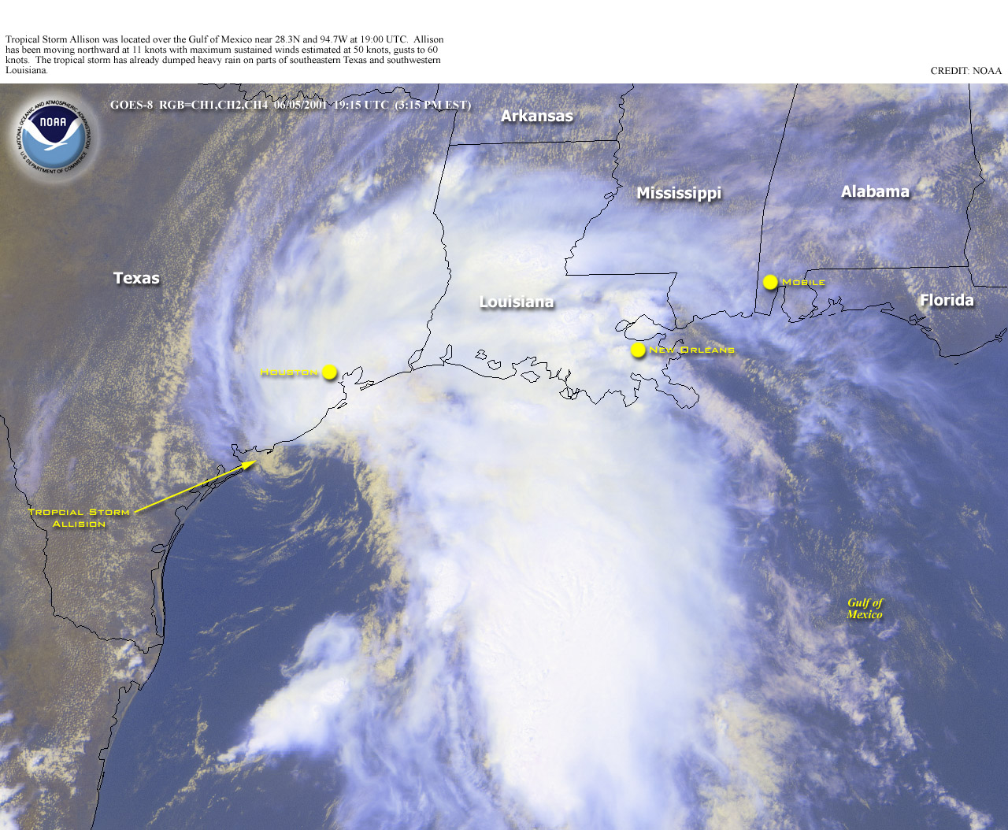
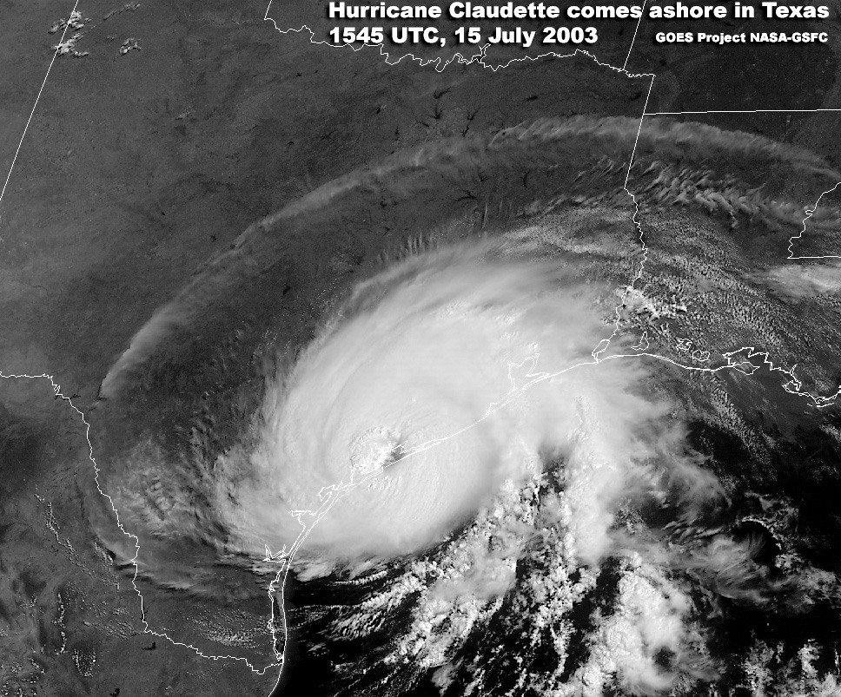
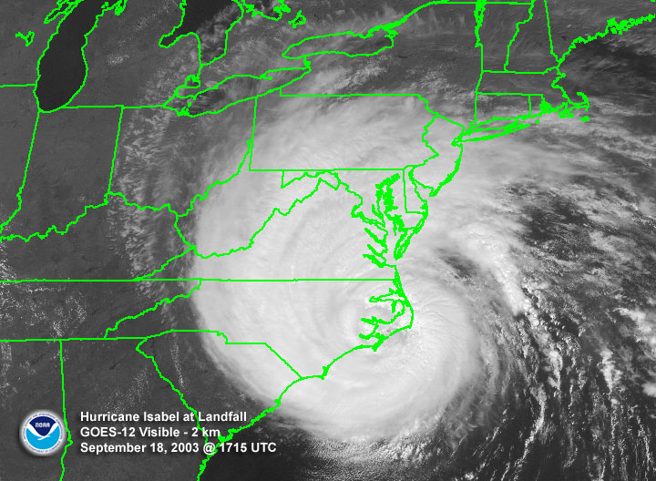
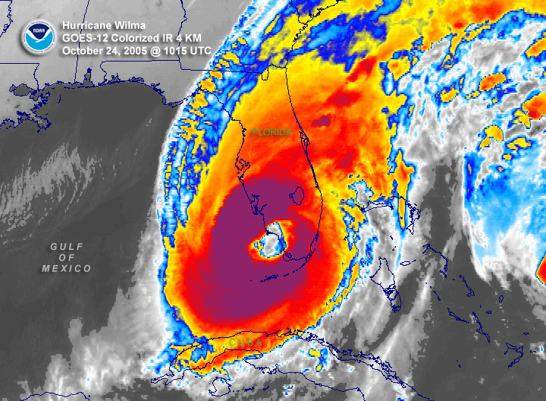
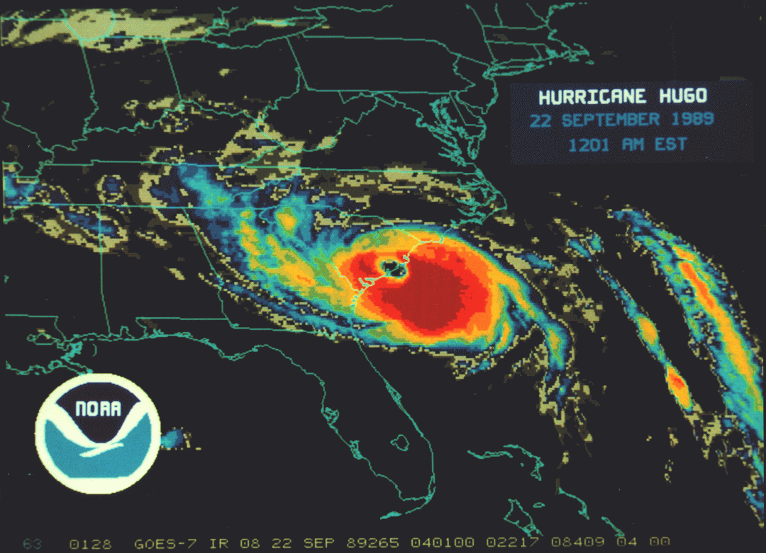
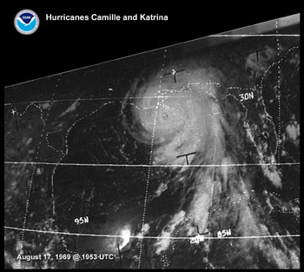
Saffir-Simpson Hurricane Wind Scale
with historical examples at landfall
Major hurricanes
Tropical
Storm
39-73 mph
Category 1
74-95 mph
Category 2 96-110 mph
Category 3
111-130 mph
Category 4 131-155 mph
Category 5
>155 mph
Alberto
2006
Katrina
2005 (FL)
Frances
2004
Katrina
2005 (LA)
Charley
2004
Andrew
1992
Allison
2001
Claudette
2003
Isabel
2003
Wilma
2005
Hugo
1989
Camille
1969
Some
Extensive
Devastating
Catastrophic

Slide 8
La Nina
Credit:
CPC

Slide 9
Historical ENSO Episodes
Credit:
CPC

Slide 10
ENSO episodes based on ONI
Credit:
CPC

Slide 11
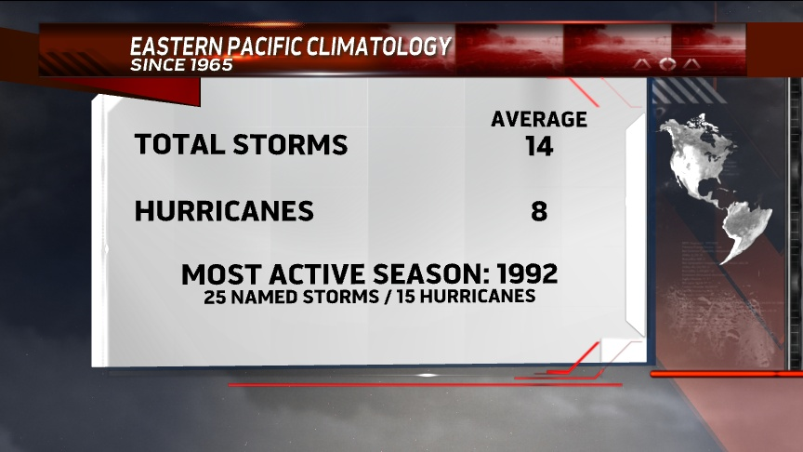
2010
7
3
Only 3 TS, 1 H after July 1 (averages 9 and 5)
Second October since 1971 with no TCs, other was 1995

Slide 12
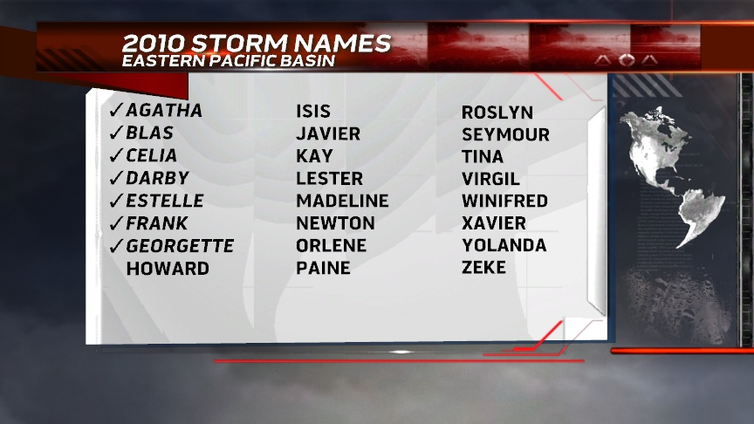
MH
MH
H
There were 5 additional Tropical Depressions
TS Agatha and TD 11-E combined to cause about 300 fatalities in northern Central America

Slide 13
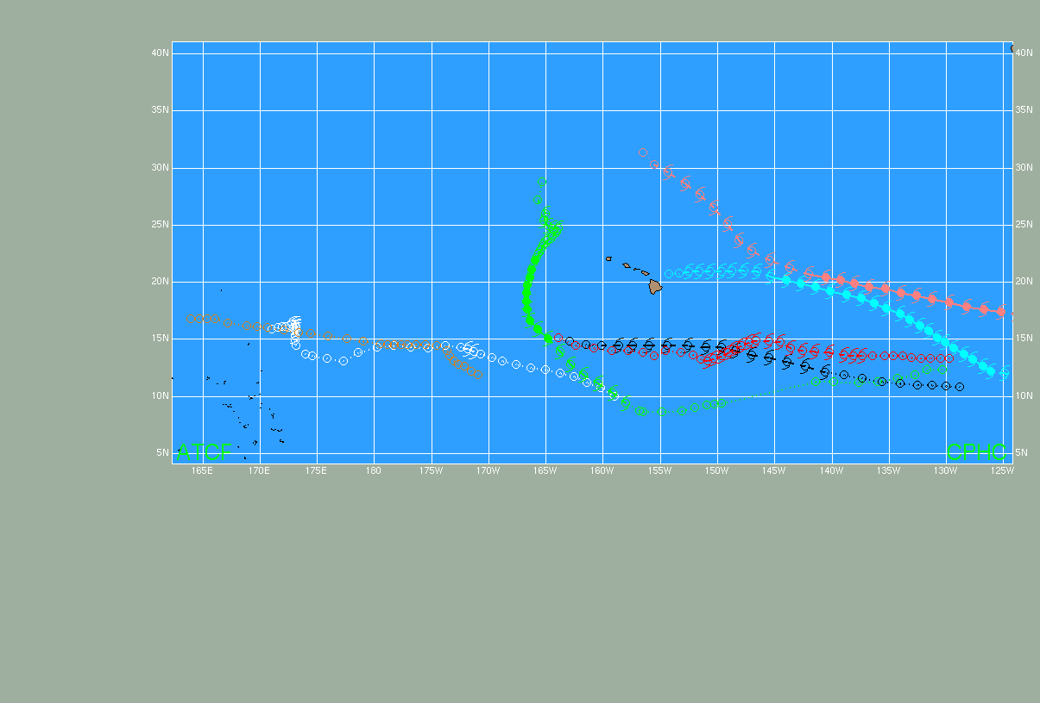
MH Neki
18-26 Oct
H Felicia
8-11 Aug
H Guillermo
16-19 Aug
TS Maka
10-12 Aug
TS Lana 30 Jul – 3 Aug
TS Hilda 23-27 Aug
TD Two-C
28-29 Aug
2009 Central North Pacific Tropical Cyclone Tracks
(El Nino Year)
2010: No tropical cyclones (La Nina year)
for the first time since 1979

Slide 14
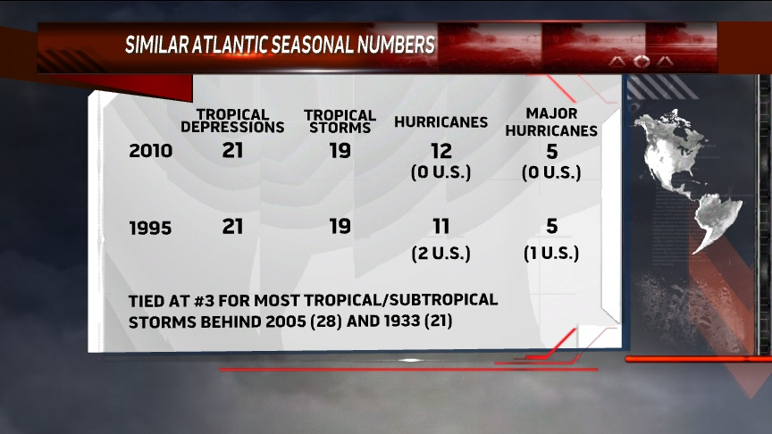

Slide 15
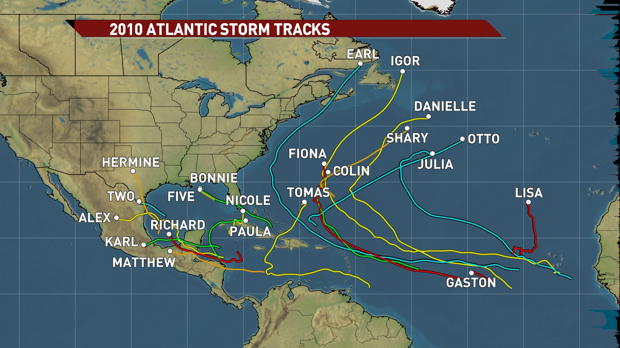

Slide 16
40%
60%

Slide 17
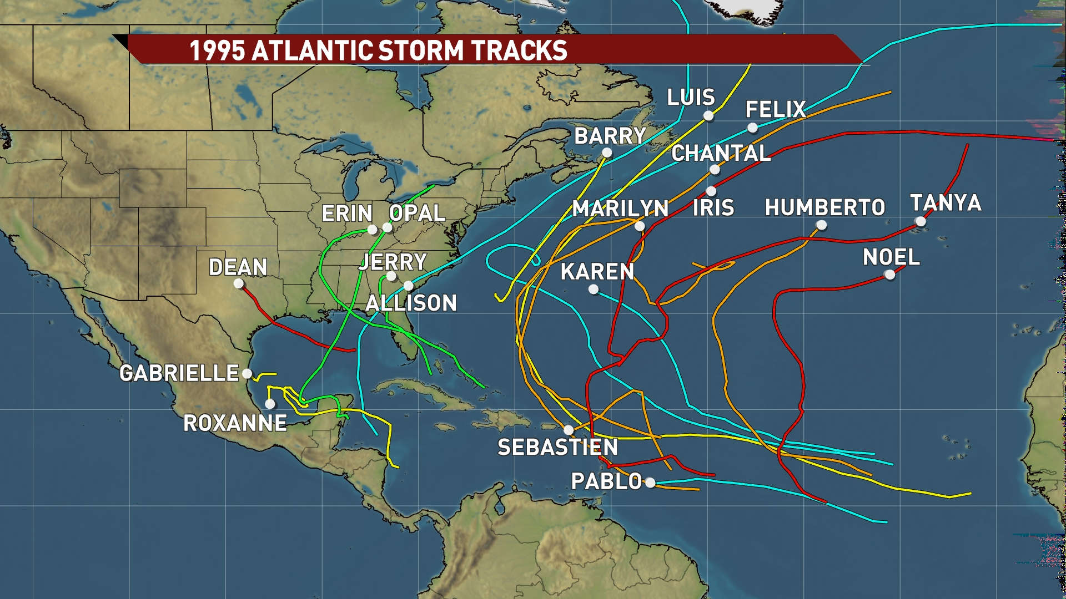
40%
60%

Slide 18
Oil spill area and Haiti were of special concern from start

Slide 19
Season started fairly slow –
4th storm formed Aug 21 near its avg date

Slide 20
Five major hurricanes formed within 3 weeks

Slide 21
Four TCs brought TS conditions to U.S.

Slide 22
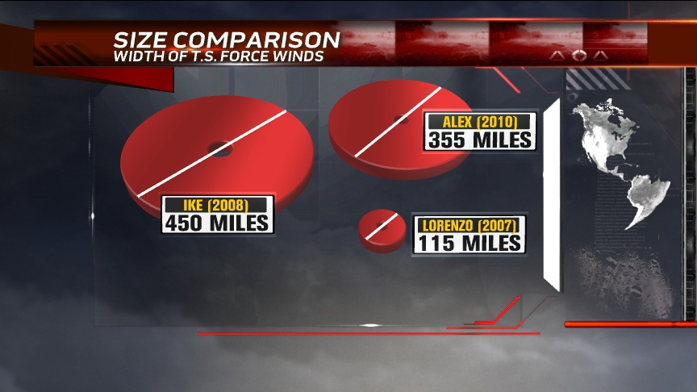

Slide 23
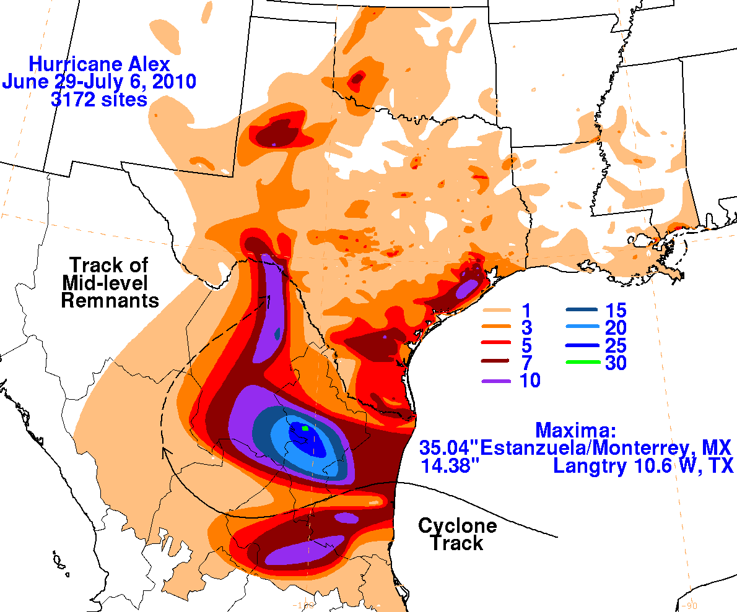
Credit:
HPC

Slide 24
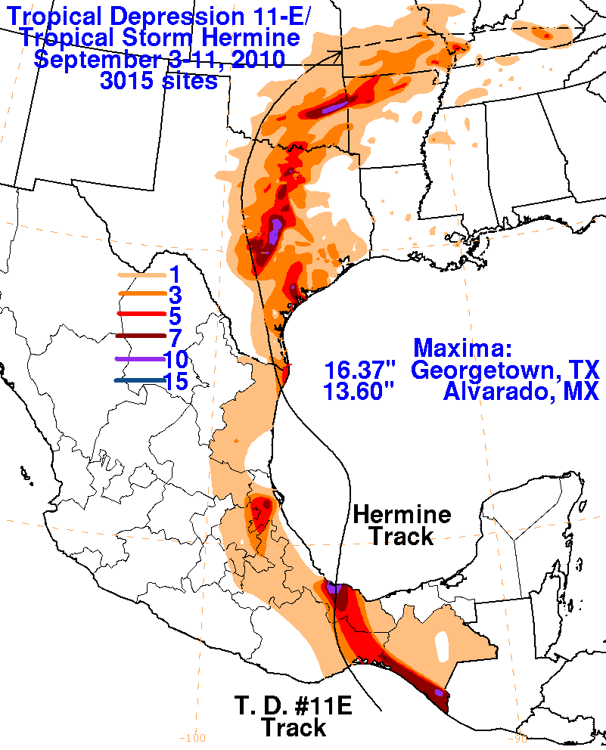
Credit:
HPC

Slide 25
2010 Atlantic Hurricane Season – U.S.
Total U.S. death toll about 14
No hurricane landfall in U.S. for second straight year, first time since 2000-01
Since Ike (2008), 18 consecutive Atlantic hurricanes without U.S. hurricane landfall (22 in 1999-2002)
No major hurricane landfall in U.S. for fifth straight year, first time since 1910-14

Slide 26
2010 Hurricane Season – International
Mexico: 6 TCs, including 2 hurricanes, one of them major, and at least 91 total fatalities
  Monterrey (Alex) and Veracruz (Karl) areas hit hard
Central America: 6 TCs, more than 400 dead with the most in Guatemala
Caribbean: 6 TCs, about 50 fatalities
  Earl – Rains in U.S. Virgin Islands, direct impact to British V.I.
  Otto – Rains and floods in Virgin Islands and Puerto Rico
  Nicole – Flooding in Jamaica
  Tomas – Hit Barbados/St. Lucia, grazed Haiti, more rains for PR/VI
Bermuda: 4 TCs, only impacts from Igor
Canada: Earl (winds) and Igor (winds, floods)
Philippines, Taiwan, China: Super Typhoon Megi
Burma/Myanmar: Cyclone Giri

Slide 27
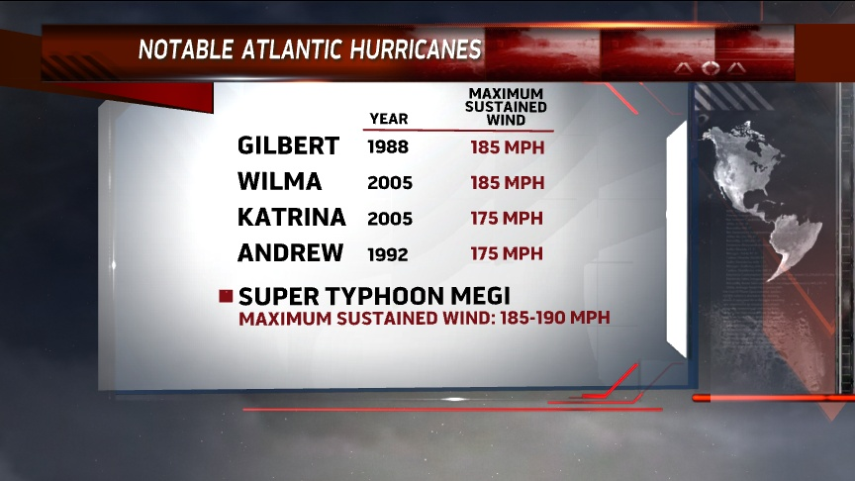

Slide 28
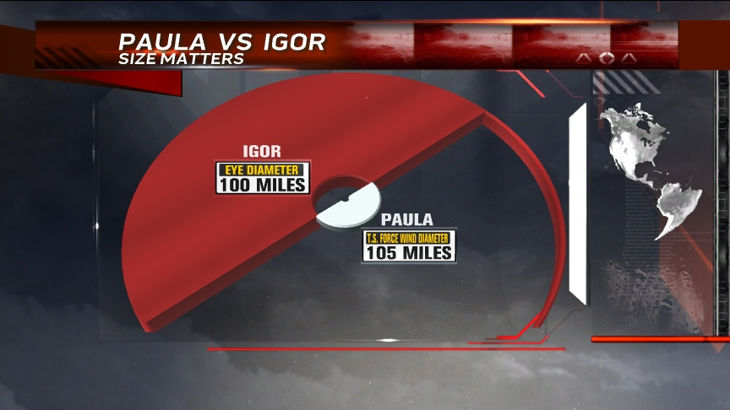
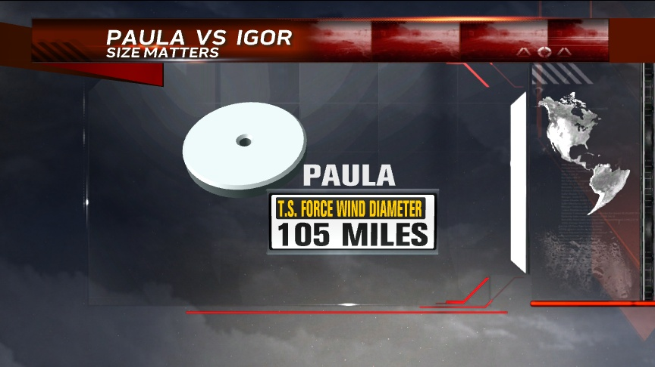
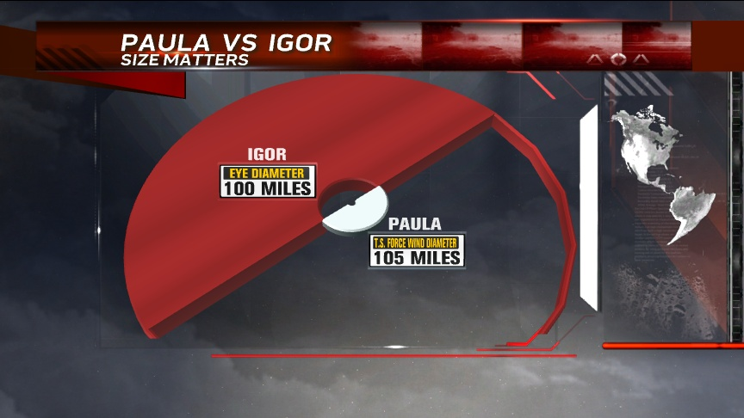

Slide 29
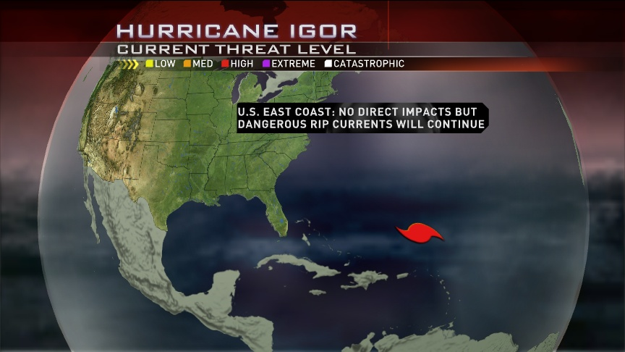
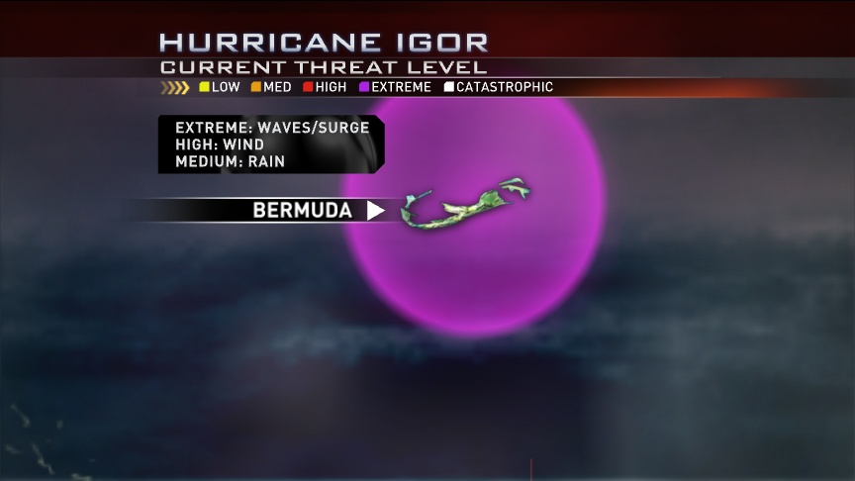

Slide 30
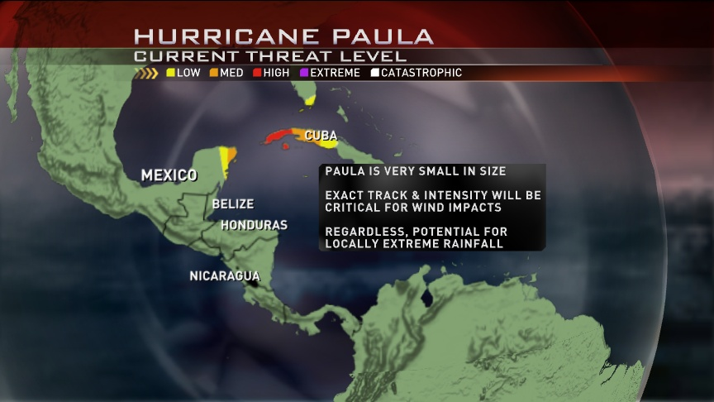

Slide 31
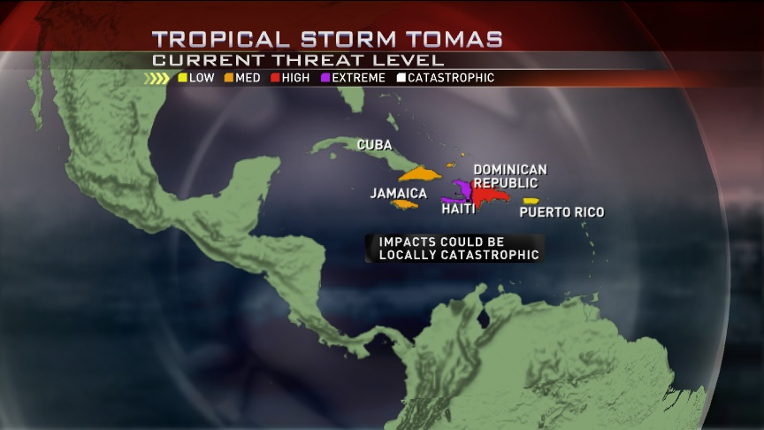

Slide 32
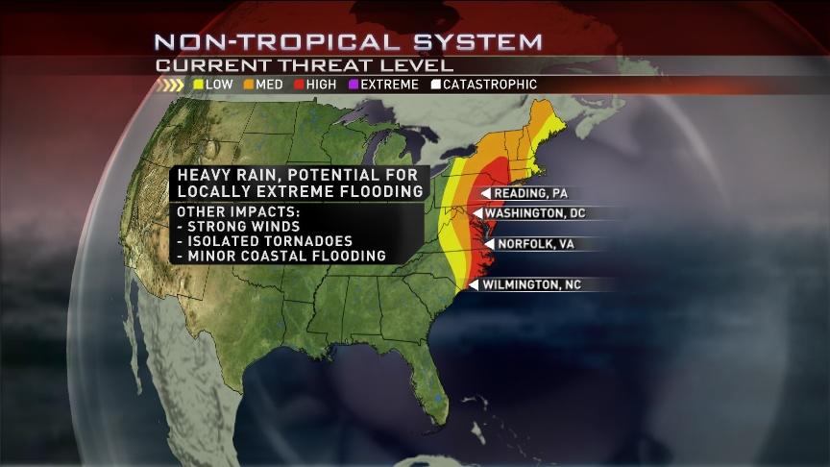

Slide 33
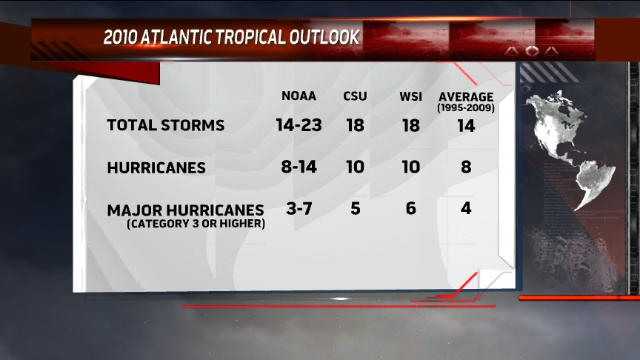

Slide 34
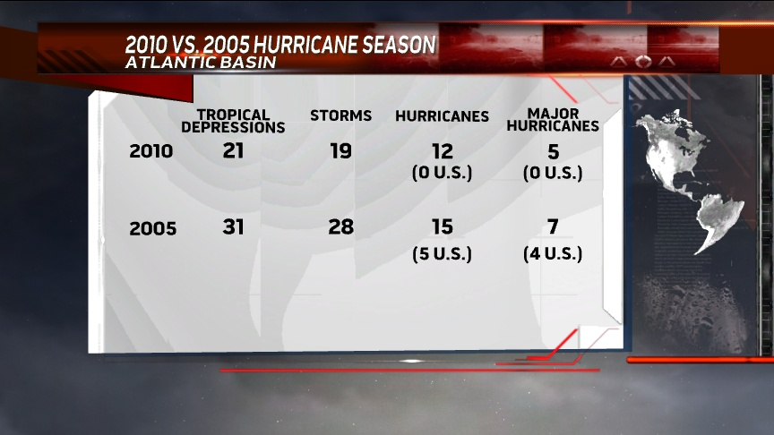

Slide 35
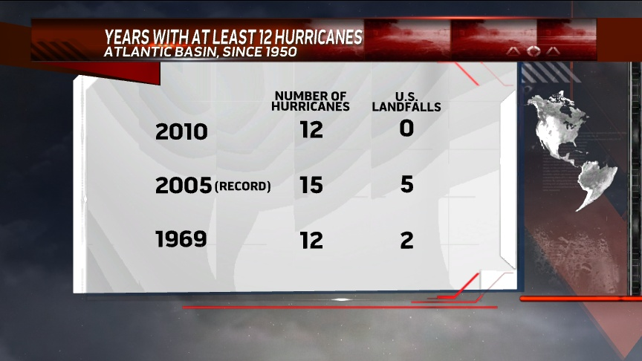

Slide 36
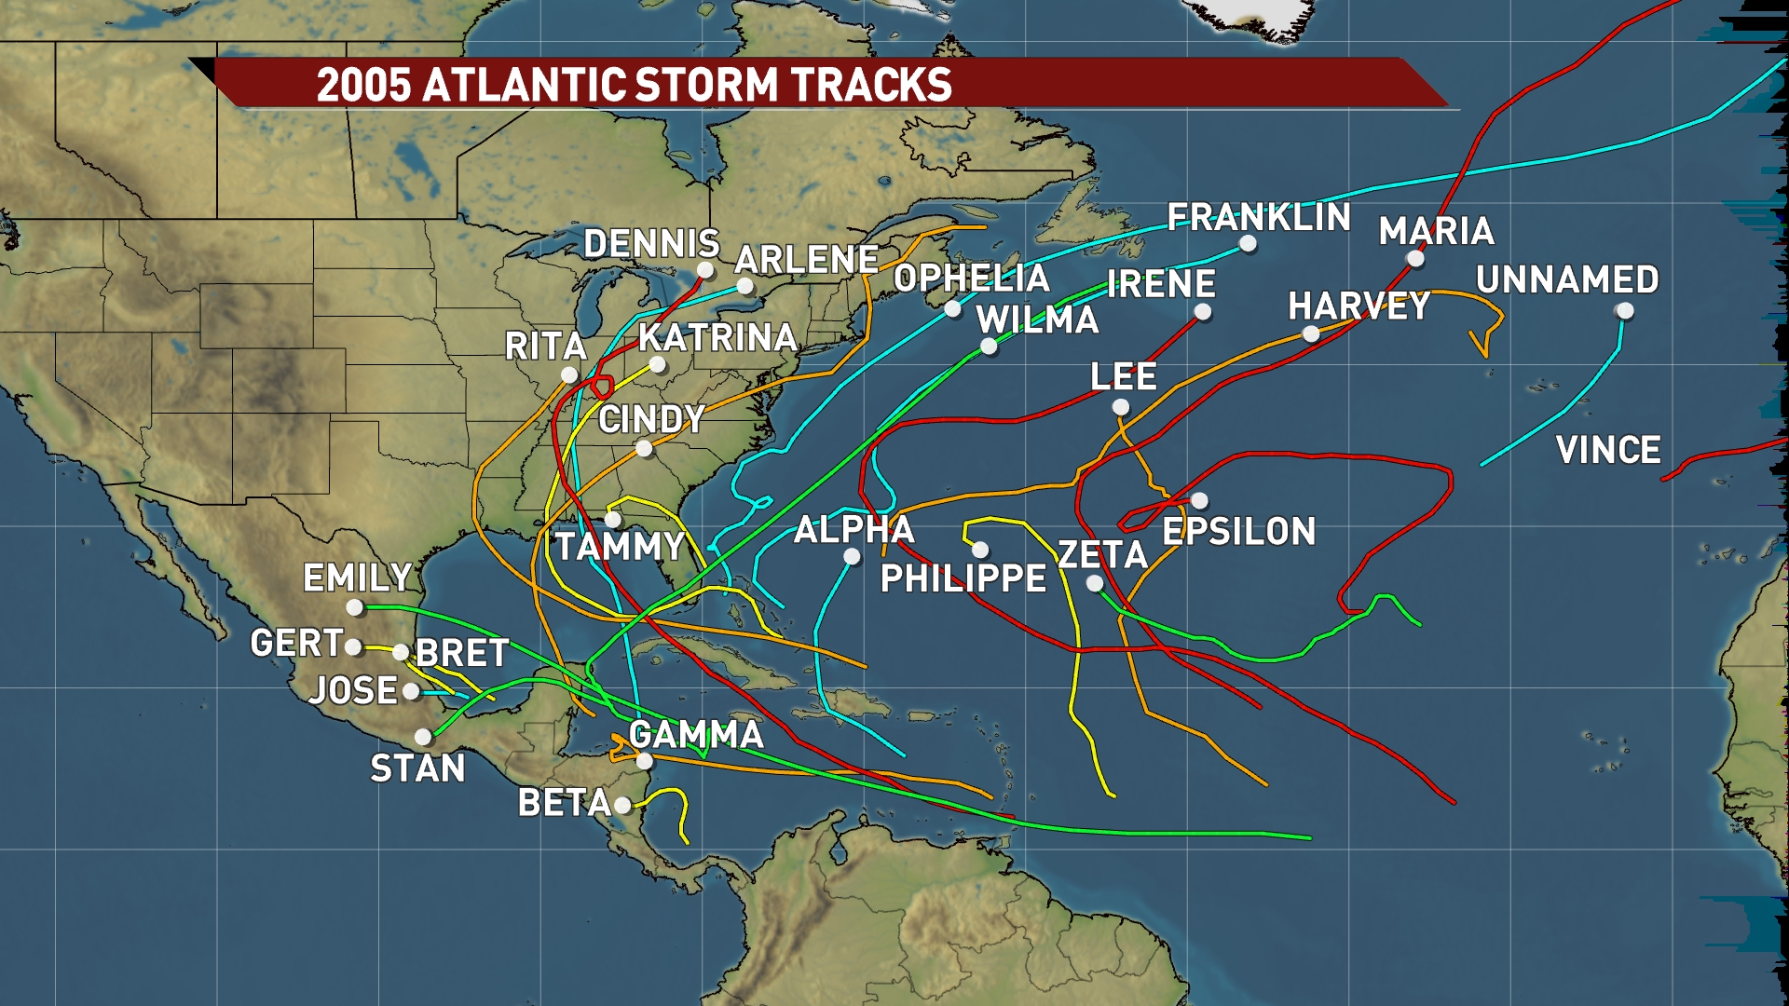

Slide 37
Some Hurricane Preparation Challenges
  Seasonal forecasts are of no value for preparations
  Preparations must occur before we are certain about what, if any, impacts will affect a specific area
  Preparations must be made not just for the storm itself, but for also for the potentially lengthy aftermath
  Damage depends not just on the forces of the storm, but on where structures are built, how well they are built, and what additional protective actions are taken before the storm arrives

Slide 38
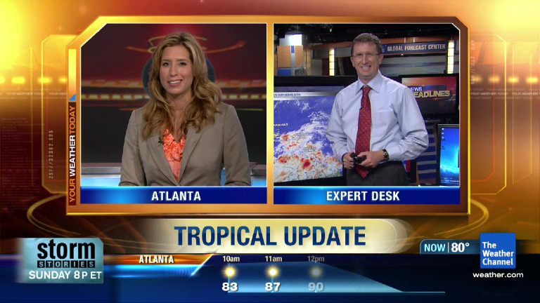
On-air use of geostationary imagery

Slide 39
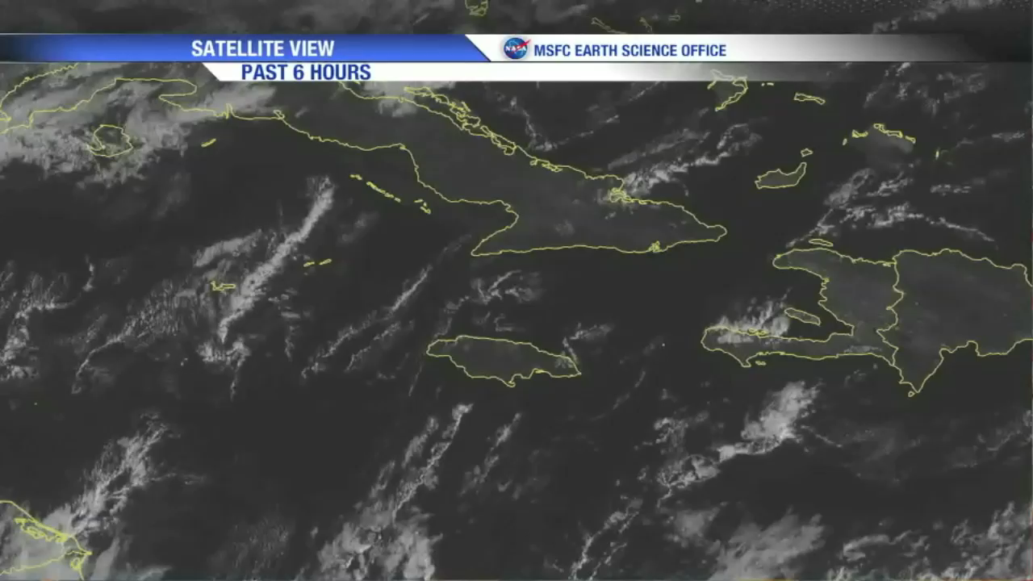
Hi-Res visible floater

Slide 40
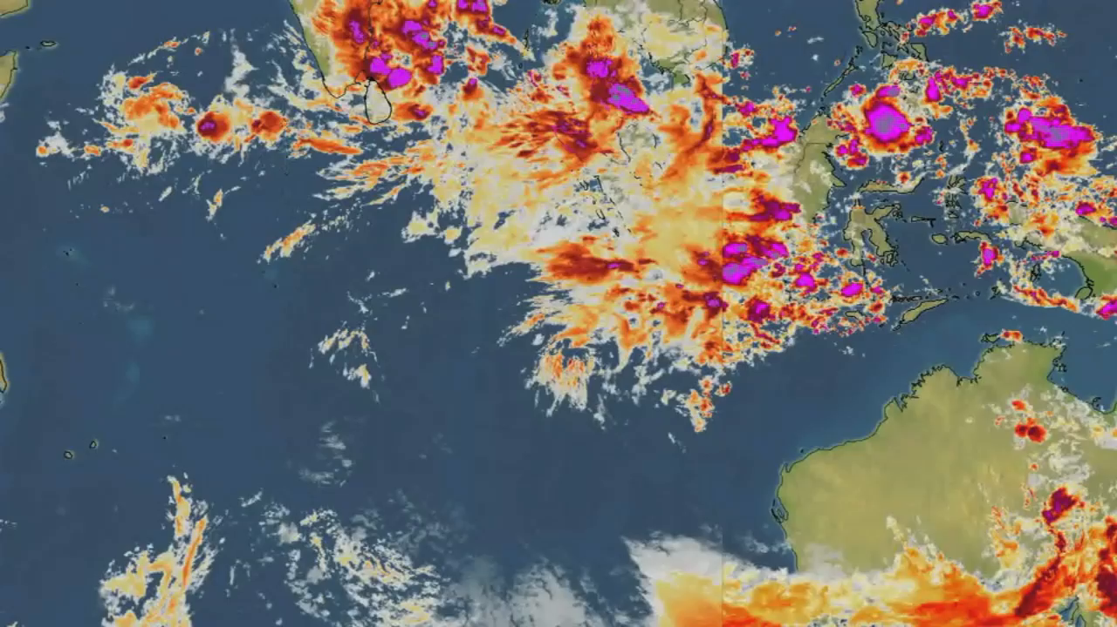
Indian Ocean

Slide 41
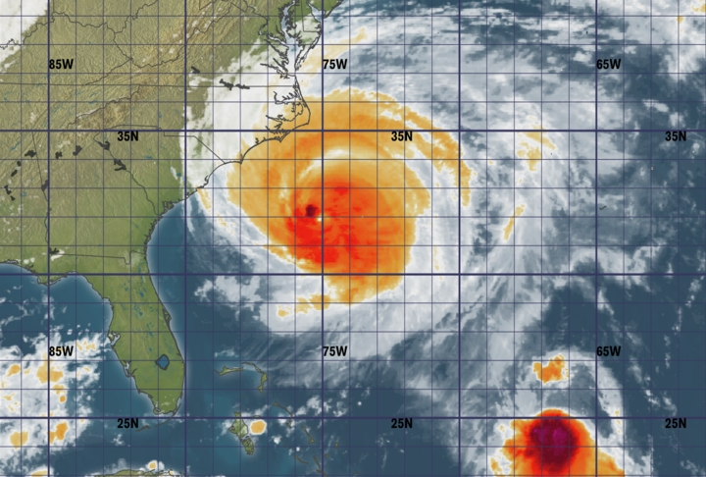
IR snapshot of Hurricane Earl (2010)

Slide 42
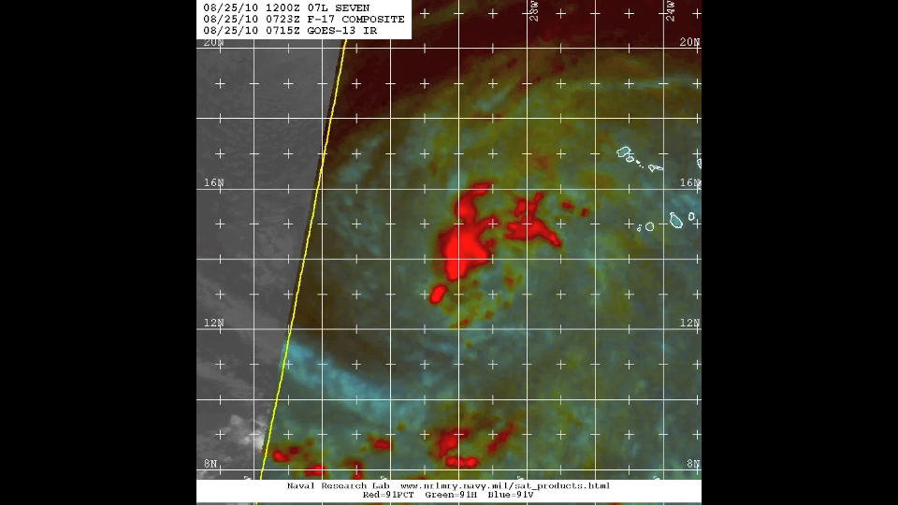
Microwave “loop” of Earl (2010)

Slide 43
Challenges with microwave imagery
  Lack of continuous coverage from near-polar-orbiting satellites
  Available over systems of interest only occasionally, often with large gaps in time between images, some with only partial coverage of tropical cyclone circulation
  Not transmitted “operationally”, must access via external web pages

