Slide 1
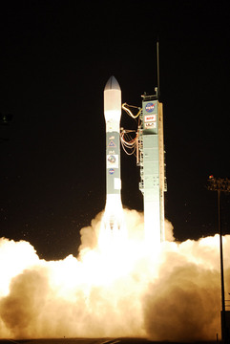
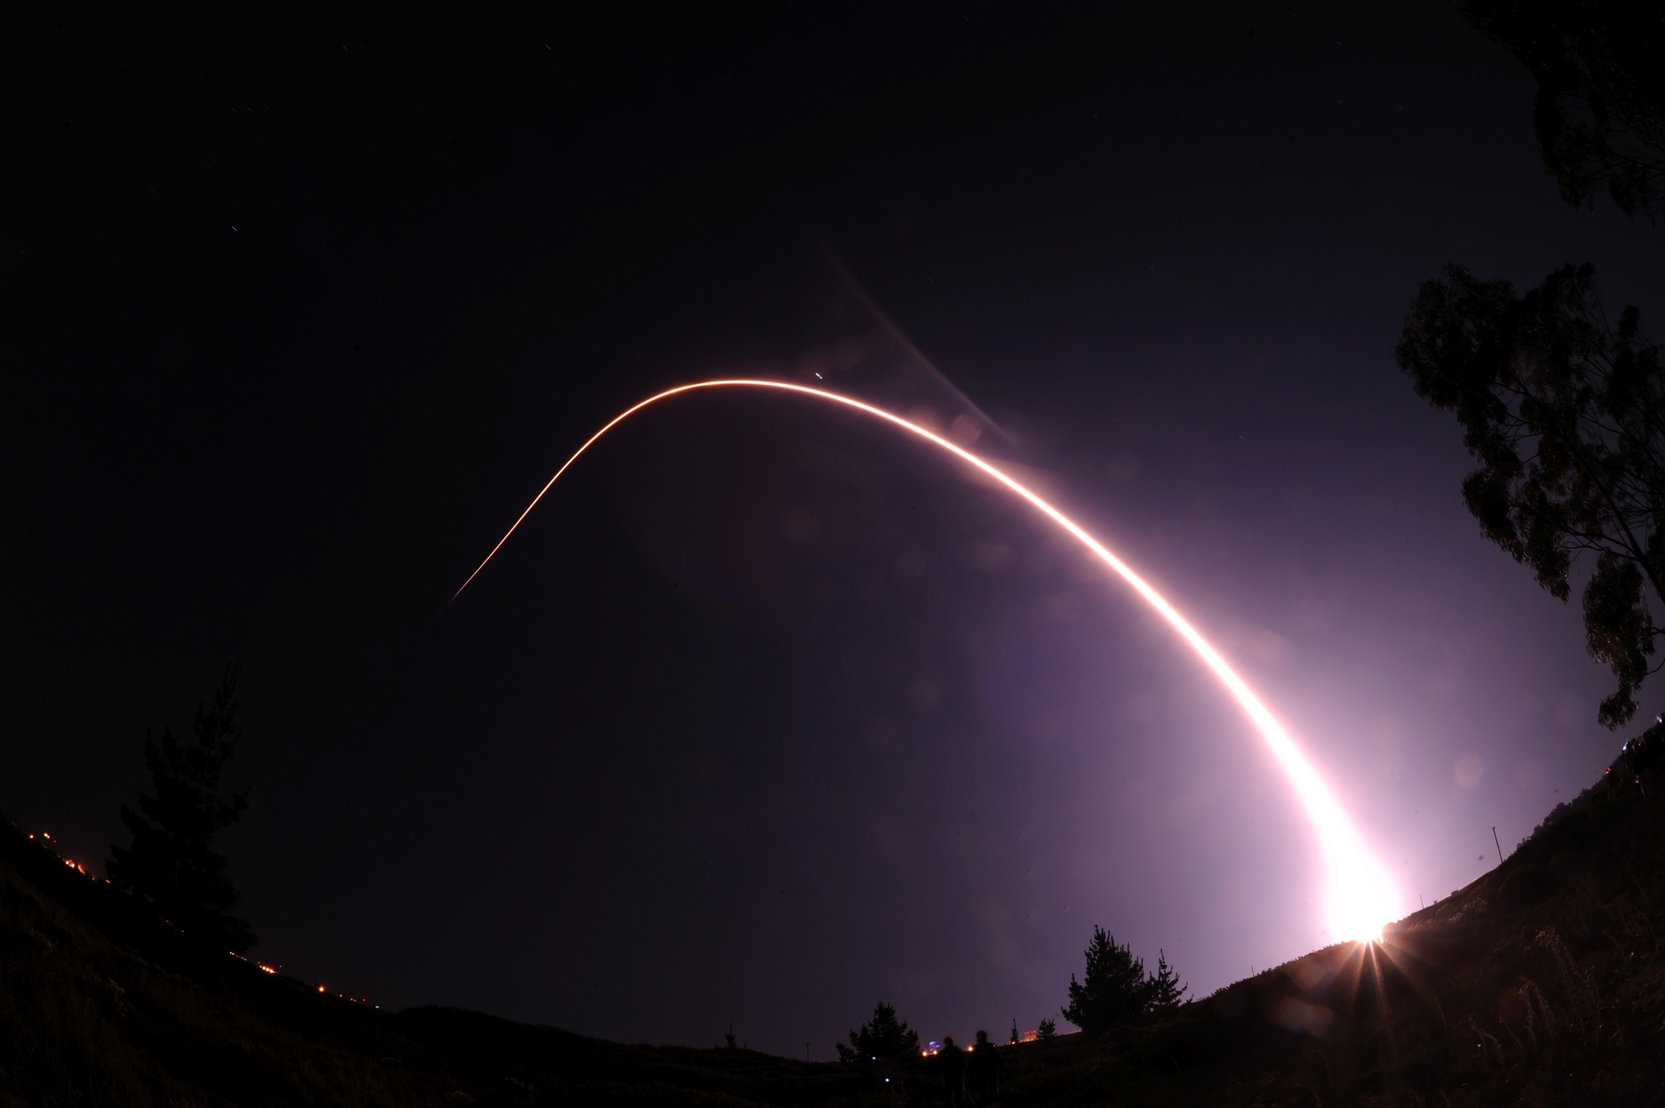
SPoRT Applications of
Suomi NPP Data
a seminar by
Gary Jedlovec, NASA / MSFC
and SPoRT colleagues
Matt Smith, UAH / ITSC
Andrew Molthan, NASA / MSFC
Frank Lafontaine, Raytheon
Kevin McGrath, Jacobs
Bob Atkinson, USRA
Additional charts from Mitch Goldberg,
NOAA JPSS Program Scientist
Photos courtesy of Ben Cooper

Slide 2

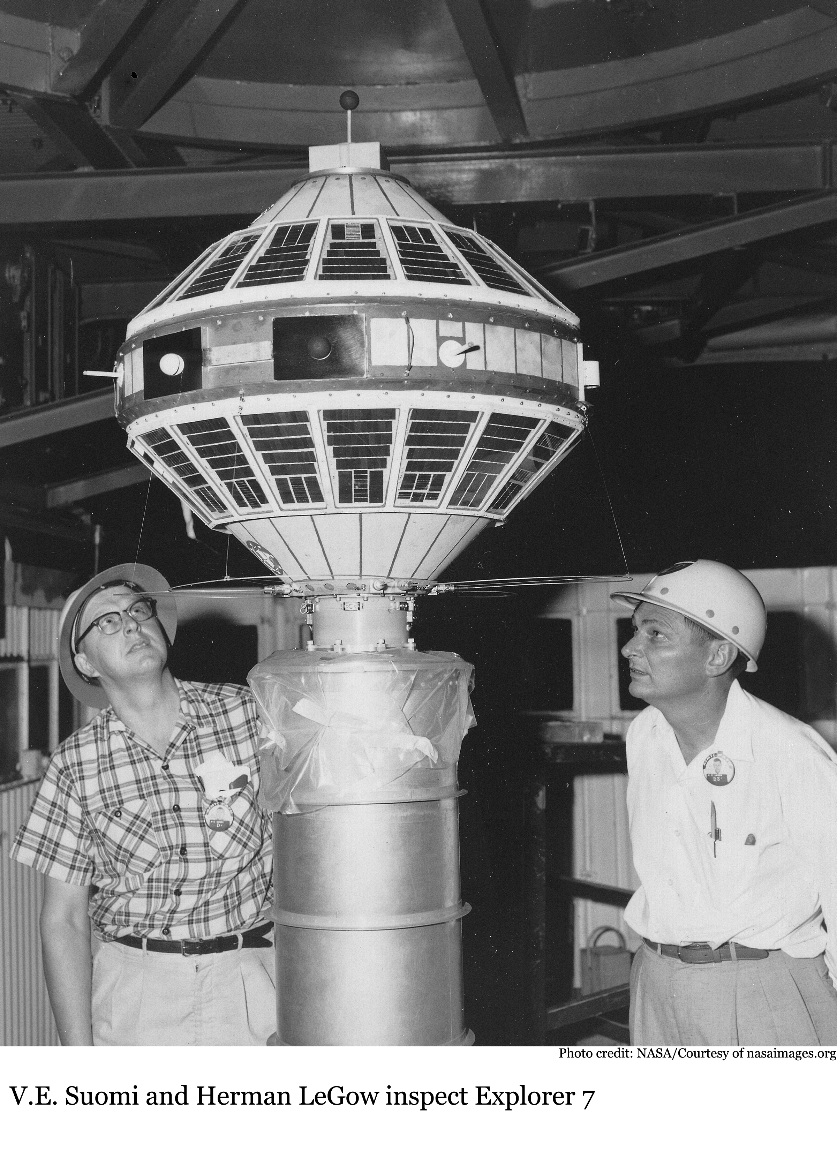
The Suomi National Polar-orbiting Partnership (NPP) satellite was launched by NASA on October 28, 2011 from Vandenburg Air Force Base
Link to Launch Video
(http://www.youtube.com/watch?v=q4GVaafENPs&feature=youtu.be )
http://library.ssec.wisc.edu/SuomiWebsite/index.html

Slide 3
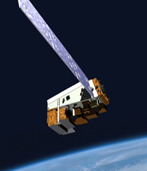
NPP and JPSS
JPSS-1 Satellite
Suomi NPP is the first satellite in the Joint (NOAA/NASA) Polar-orbiting Satellite Series (JPSS), formerly NPOESS
  Maintains continuity of weather/climate observations and critical environmental data from the polar orbit
  NOAA – JPSS provides improved continuity for POES
    HIRS > CrIS
    AMSU > ATMS
    AVHRR > VIIRS
    SBUV2 > OMPS
  NASA – JPSS provides continuity for EOS
    AIRS > CrIS
    AMSU > ATMS
    MODIS > VIIRS
    OMI > OMPS
    CERES > CERES
Modified NOAA Chart

Slide 4
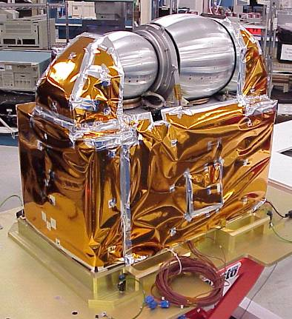
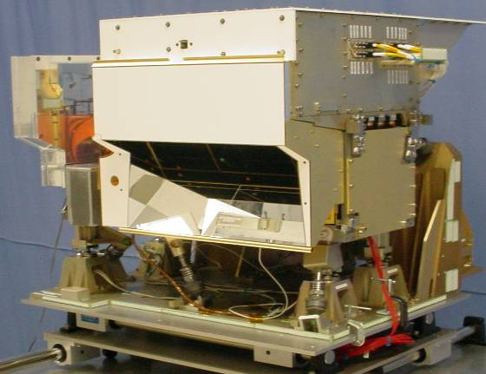
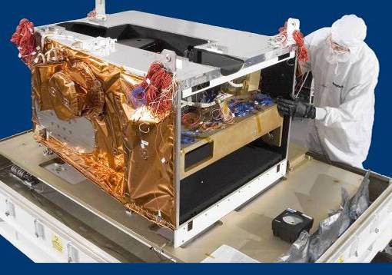
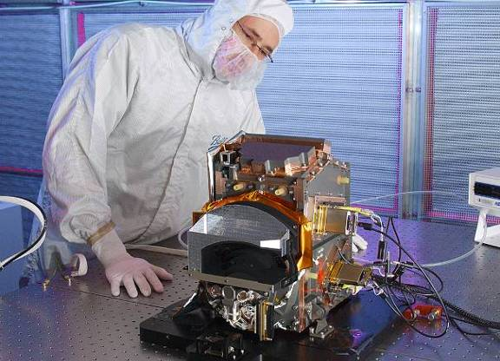
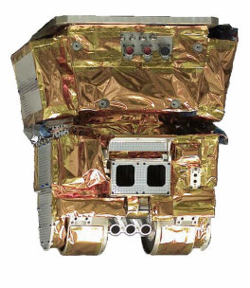
NPP/JPSS Instruments
NPP/JPSS Instrument |  | Benefits to the NOAA Mission
 | ATMS (NGES) | ATMS and CrIS together provide high vertical resolution temperature and water vapor information needed to maintain and improve forecast skill out to 5 to 7 days in advance for extreme weather events, including hurricanes and severe weather outbreaks.
 | CrIS (ITT)
 | VIIRS (Raytheon SAS) | VIIRS provide a large set of parameters including snow/ice cover, clouds, fog, aerosols, fire, smoke plumes, vegetation health, phytoplankton abundance/chlorophyll needed for environmental assessments which impacts human health and key economic sectors (transportation, fishing, energy, agriculture)
 | OMPS (Ball Aerospace and Technology Corp) | Total ozone for monitoring ozone hole and recovery of stratospheric ozone and for UV index forecasts
 | CERES | Provide climate quality measurements of the Earth’s outgoing radiation budget.
Modified NOAA Chart
Joint Polar Satellite System
4

Slide 5
NOAA Operational Polar Program
2011 | 2012 | 2013 | 2014 | 2015 | 2016 | 2017 | 2018 | 2019 | 2020 | 2021 | 2022 | 2023 | 2024 | 2025 | 2026
MetOp-A
MetOp-B
MetOp-C
EPS-SG
Modified NOAA Chart
NOAA-19
NPP
JPSS-1
JPSS-2
Terra
Aqua
5
Joint Polar Satellite System

Slide 6
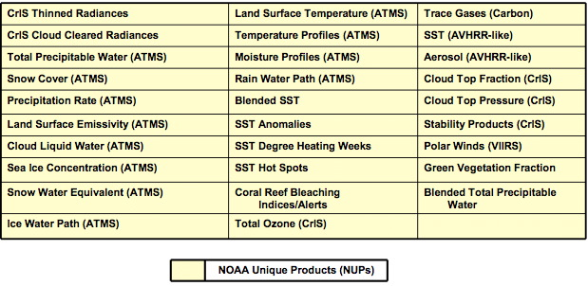
NPP / JPSS Derived Products
ESPC GCOM AMSR-2
(11)
VIIRS (22)
CLOUD LIQUID WATER
PRECIPITATION TYPE/RATE
PRECIPITABLE WATER
SEA SURFACE WINDS SPEED
SOIL MOISTURE
SNOW WATER EQUIVALENT
IMAGERY
SEA ICE CHARACTERIZATION
SNOW COVER/DEPTH
SEA SURFACE TEMPERATURE
SURFACE TYPE
ALBEDO (SURFACE)
CLOUD BASE HEIGHT
CLOUD COVER/LAYERS
CLOUD EFFECTIVE PART SIZE
CLOUD OPTICAL THICKNESS
CLOUD TOP HEIGHT
CLOUD TOP PRESSURE
CLOUD TOP TEMPERATURE
ICE SURFACE TEMPERATURE
NET HEAT FLUX
OCEAN COLOR/CHLOROPHYLL
SUSPENDED MATTER
VEGETATION INDEX
AEROSOL OPTICAL THICKNESS
AEROSOL PARTICLE SIZE
ACTIVE FIRES
IMAGERY
SEA ICE CHARACTERIZATION
SNOW COVER
SEA SURFACE TEMPERATURE
LAND SURFACE TEMP
SURFACE TYPE
OMPS (2)
CrIS/ATMS (3)
O₃ TOTAL COLUMN
O₃ NADIR PROFILE
CERES (4)
ATM VERT MOIST PROFILE
ATM VERT TEMP PROFILE
PRESSURE (SURFACE/PROFILE)
DOWN LW RADIATION (SFC)
DOWN SW RADIATION (SFC)
NET SOLAR RADIATION (TOA)
OUTGOING LW RADIATION (TOA)
Modified NOAA Chart
EDRs with Key Performance Parameters
KEY
JPSS-1
GCOM
Joint Polar Satellite System
6

Slide 7
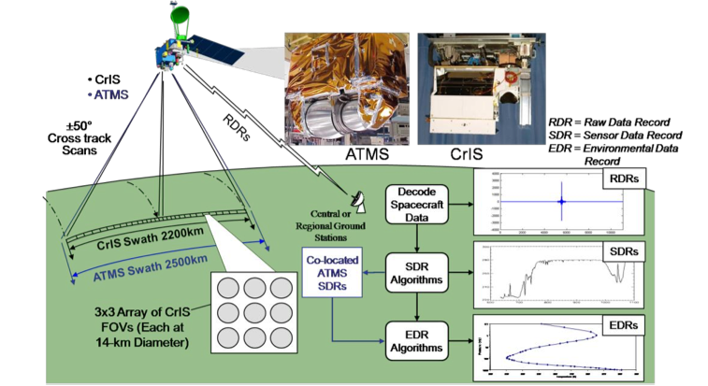
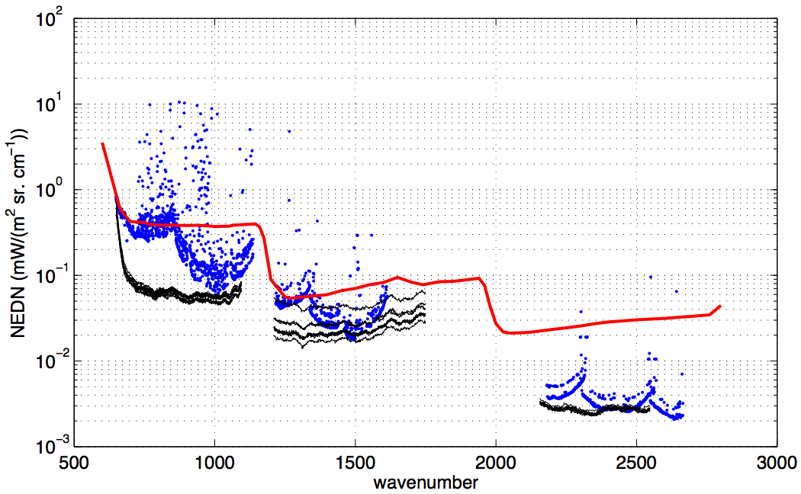
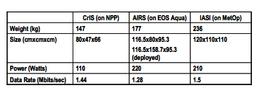
Cross-Track Infrared Sounder (CrIS)
NPP/JPSS
CrIS
Michelson Interferometer: 0.625,1.25,
2.5cm⁻¹ (resolving power of 1000)
Spectral range: 660-2600 cm⁻¹
3 x 3 HdCdTe focal plane passively cooled
(4-stages) to 85K
Focal plane 27 detectors, 1305 spectral channels
310 K Blackbody and space view
provides radiometric calibration
NEDT ranges from 0.05 K to 0. 5 K
AIRS
IASI
CrIS
Modified NOAA Chart
“CrIS LW Noise << AIRS & IASI LW Noise”
7

Slide 8
Advanced Technology Microwave Sounder (ATMS)
Description
Purpose: In conjunction with CrIS, global observations of temperature and moisture profiles at high temporal resolution (~ daily).
Predecessor Instruments: AMSU A1 / A2, MHS
Approach: Scanning passive microwave radiometer
22 channels (23GHz - 183GHz)
Swath width: 2600 km
Co-registration: with CrIS
Modified NOAA Chart

Slide 9
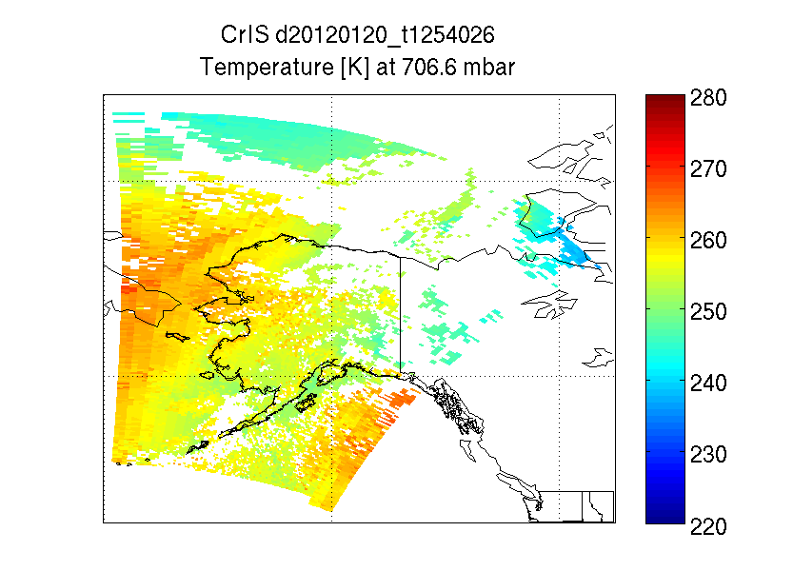
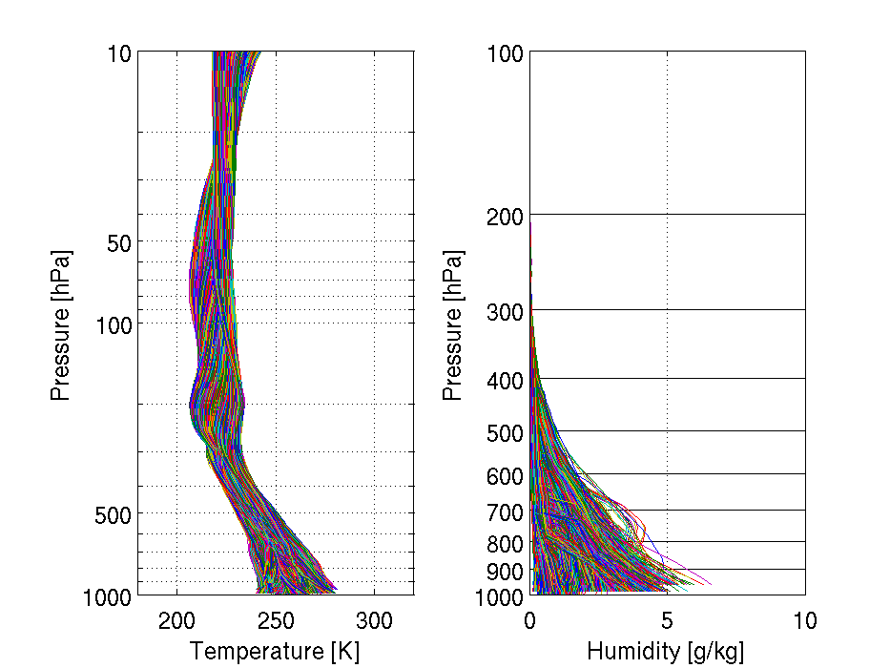
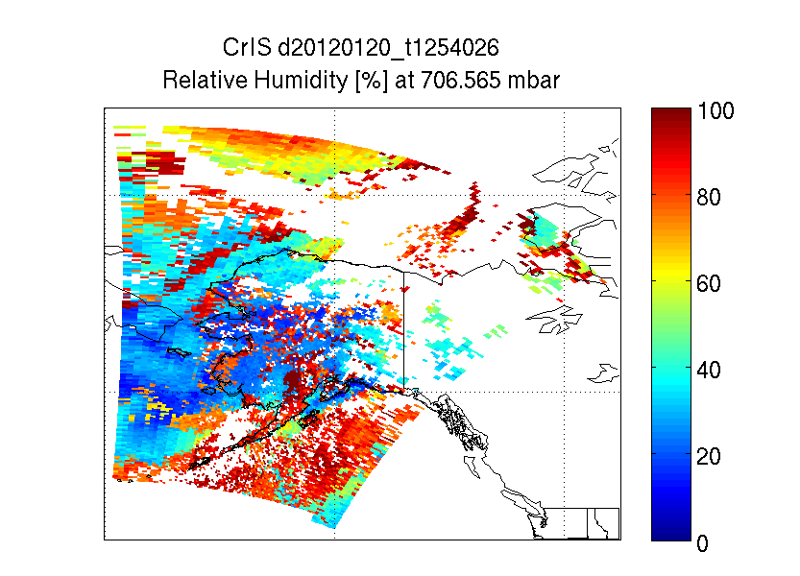
CrIS / ATMS - Temperature and Humidity
20 Jan 2012
Modified NOAA Chart
9

Slide 10
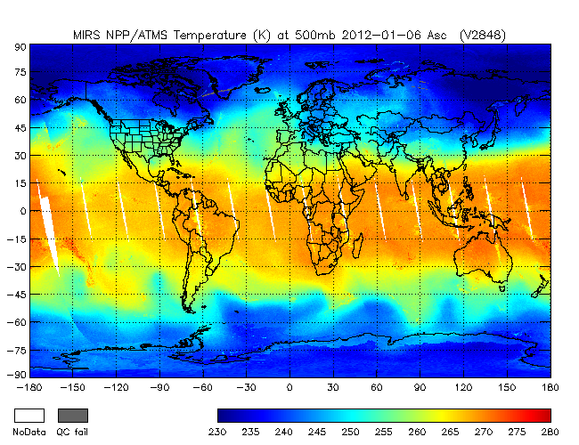
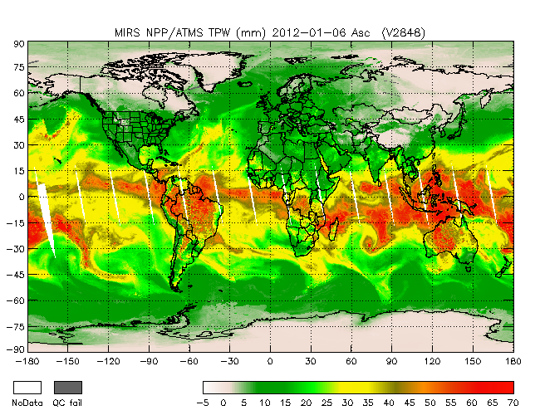
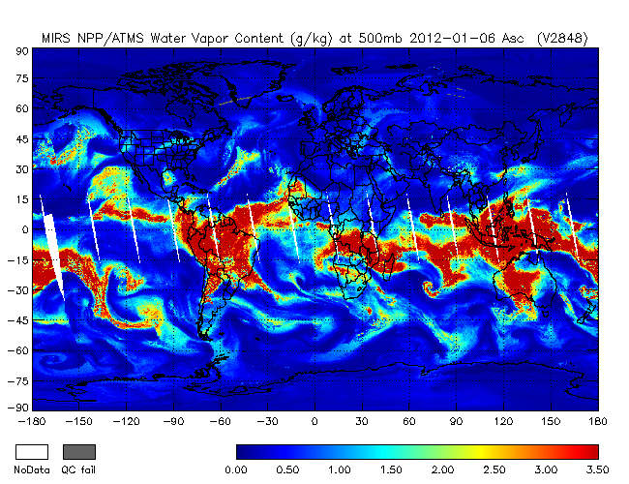
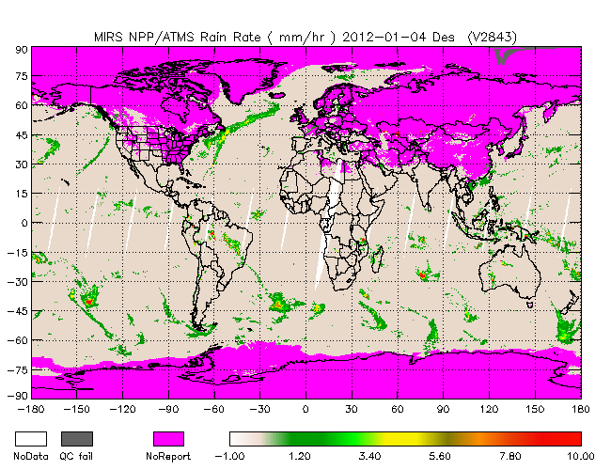
NOAA ATMS Products
T
TPW
WV
RR
Modified NOAA Chart
Courtesy of Sid Boukabara (STAR)

Slide 11
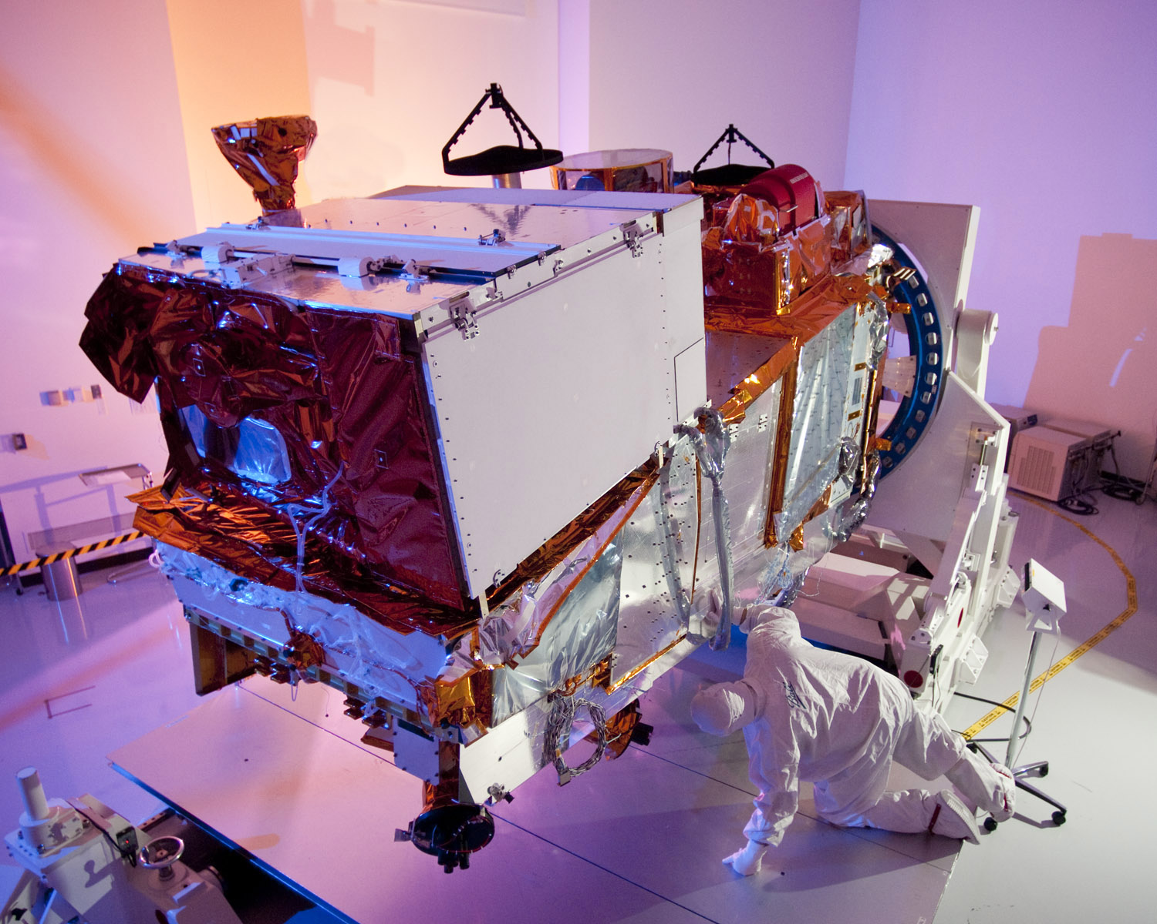
Visible Infrared Imaging Radiometer Suite (VIIRS)
Description
Purpose: Global observations of land, ocean, & atmosphere parameters at high temporal resolution (~ daily)
Predecessor Instruments: AVHRR, OLS, MODIS, SeaWiFS
Approach: Multi-spectral scanning radiometer (22 bands between 0.4 µm and 12 µm) 12-bit quantization
Swath width: 3000 km
Spatial Resolution
16 bands at 750m
5 bands at 325m
DNB
Modified NOAA Chart
VIIRS on NPP

Slide 12
VIIRS Prelaunch Performance
Modified NOAA Chart
Courtesy of H. Oudrari

Slide 13
Heritage Capabilities
WV
Ozone
VIIRS
DNB
MODIS
SeaWiFS
AVHRR
OLS
Low Light Imagery
Modified NOAA Chart
0.4
0.5
0.6
0.7
0.8
0.9
1.2
1.8
2.4
4
6
8
10
12
14
Visible
Breaks in scale
Mid wave IR
Long wave IR
[micron]
13
Credit: Northrup Grumman & Raytheon
Notes:
13

Slide 14
Spatial Resolution Comparisons
Northrup Grumman & Raytheon
Modified NOAA Chart
Because of aggregation VIIRS has much better resolution
away from nadir, pixel area 8 times smaller than AVHRR or MODIS
14
Notes:
14

Slide 15
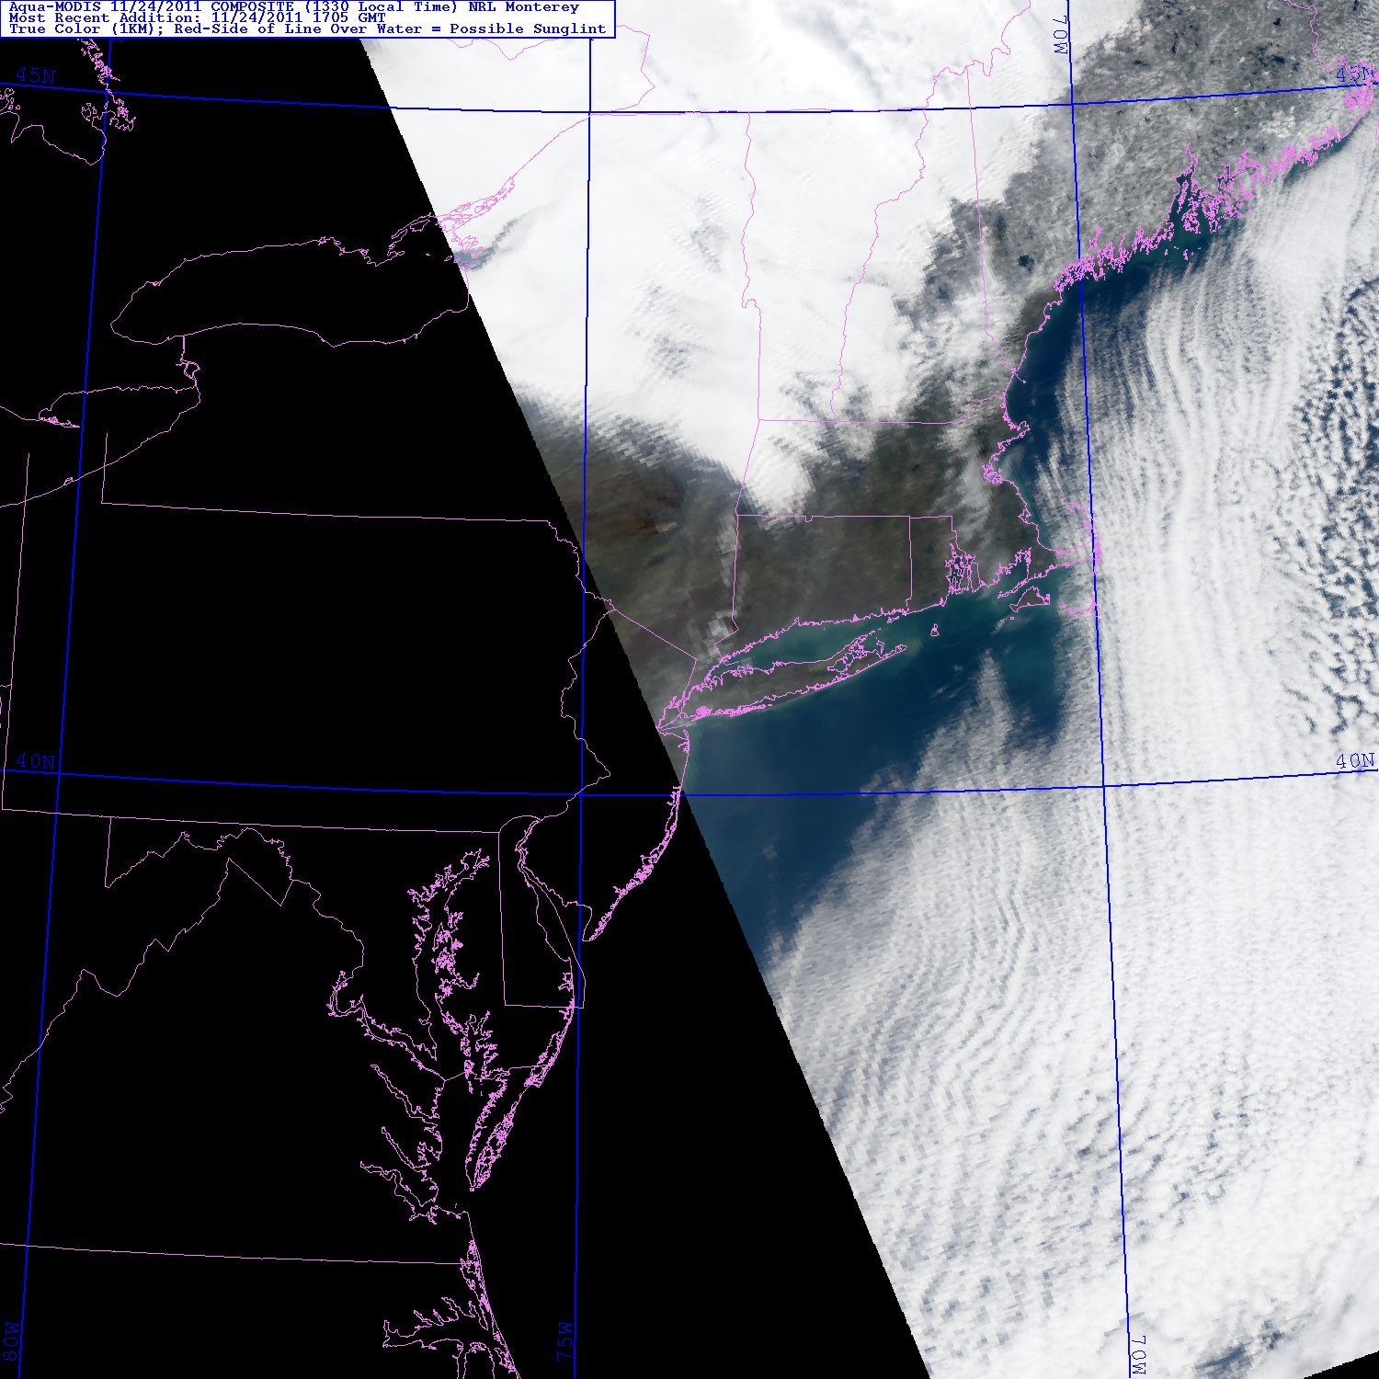
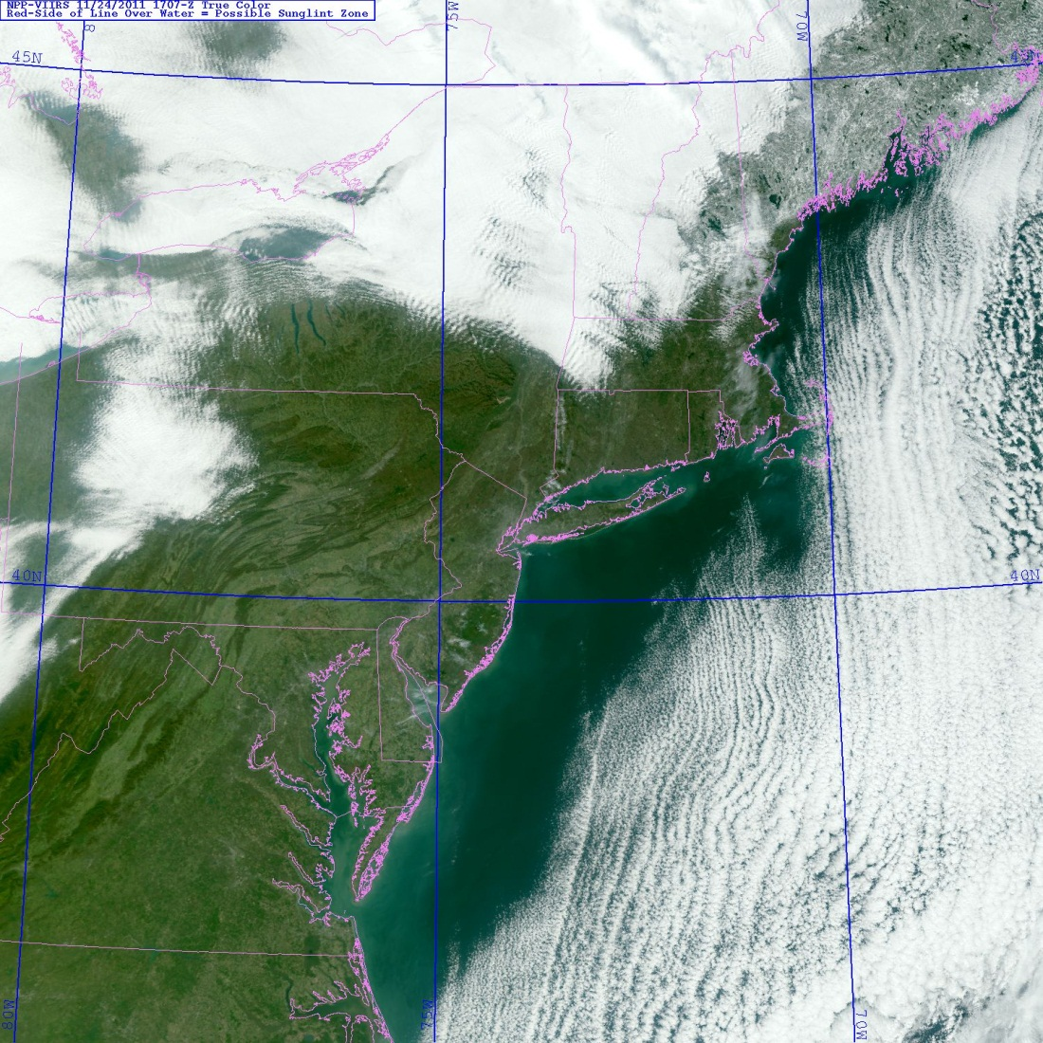
MODIS -/ VIIRS Comparison
True color - Northeast US
Modified NOAA Chart
MODIS
VIIRS
15

Slide 16
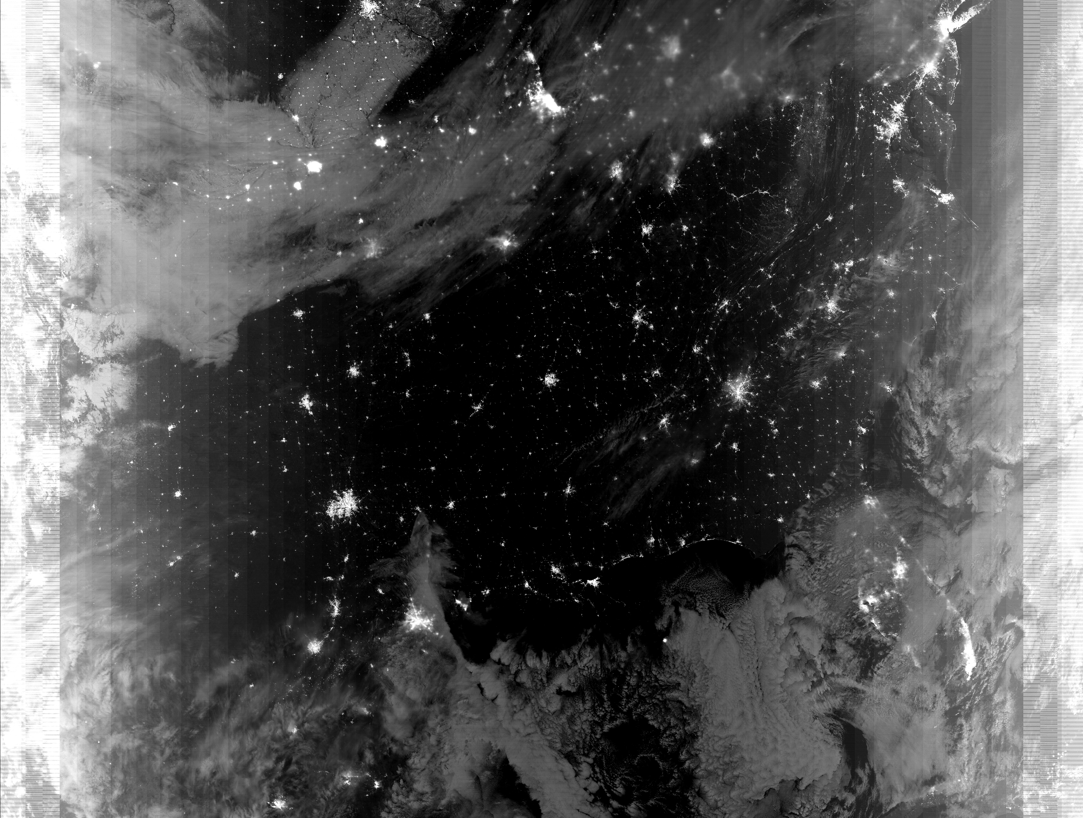
VIIRS Day Night Band
Chicago
Atlanta
Dallas
Miami
New Orleans
Modified NOAA Chart

Slide 17
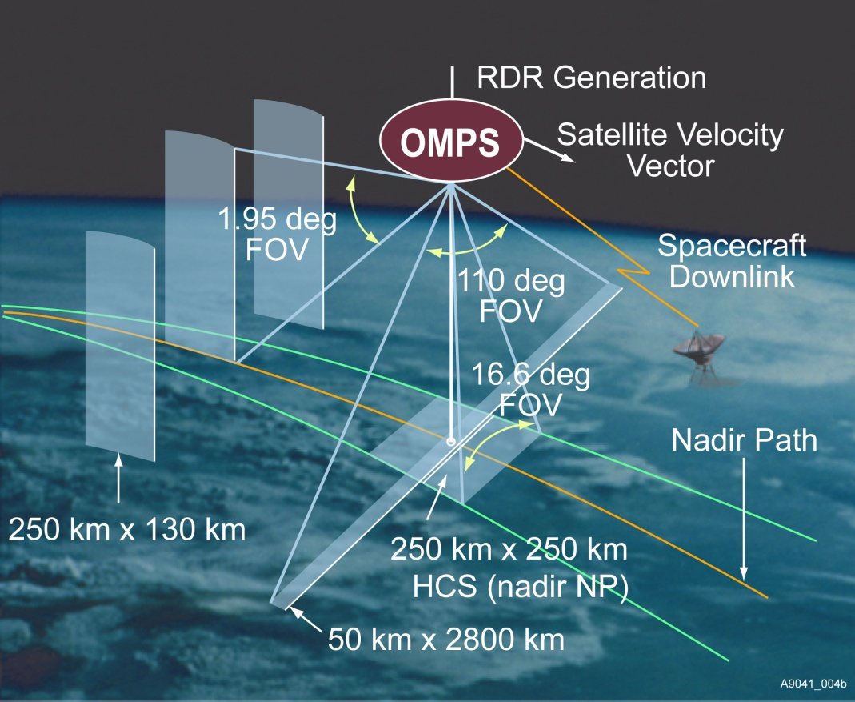
OMPS Instrument Design
Nadir Mapper
UV Backscatter, grating spectrometer, 2-D CCD
TOMS, SBUV(/2), GOME(-2), OMI
110 deg. cross track, 300 to 380 nm spectral,
1.1nm FWHM bandpass
Total Column Ozone, UV Effective Reflectivity,
and Aerosol Index Daily Maps
Nadir Profiler
UV Backscatter, grating spectrometer, 2-D CCD
SBUV(/2), GOME(-2), OMI
Nadir view, 250 km cross track, 270 to 310 nm
spectral, 1.1 nm FWHM bandpass
Ozone Vertical Profile, 7 to 10 km resolution
Limb Profiler
UV/Visible Limb Scatter, prism, 2-D CCD array
SOLSE/LORE, OSIRIS, SAGE III, SCIAMACHY
Three 100-KM vertical slits, 290 to 1000 nm
spectral
Ozone Vertical Profile, 3 KM vertical resolution
Solar diffusers used in calibration
Instrument and FOV
graphics from BATC
Modified NOAA Chart
Notes:
17
Updated schematic from Scott Asbury.
Some changes in numbers (2.23 degrees to 1.9 degrees) and position of components.
Old instrument picture.
Heritage instruments are providing product development, and algorithm and application testing.
For example, SAGE III limb measurements pointing
For example, OMI Products into assimilation systems
CCD Charge-Coupled Device
TOMS Total Ozone Mapping Spectrometer
SBUV Solar Backscatter Ultraviolet instrument
GOME Global Ozone Monitoring Experiment
OMI Ozone Monitoring Instrument
SCIAMACHY SCanning Imaging Absorption spectroMeter for Atmospheric CartograpHY
SOLSE Shuttle Ozone Limb Sounding Experiment
LORE Limb Ozone Retrieval Experiment
OSIRIS Optical Spectrograph and InfraRed Imager System
SAGE Stratospheric Aerosol and Gas Experiment
OMPS` Ozone Mapping and Profiler Suite

Slide 18
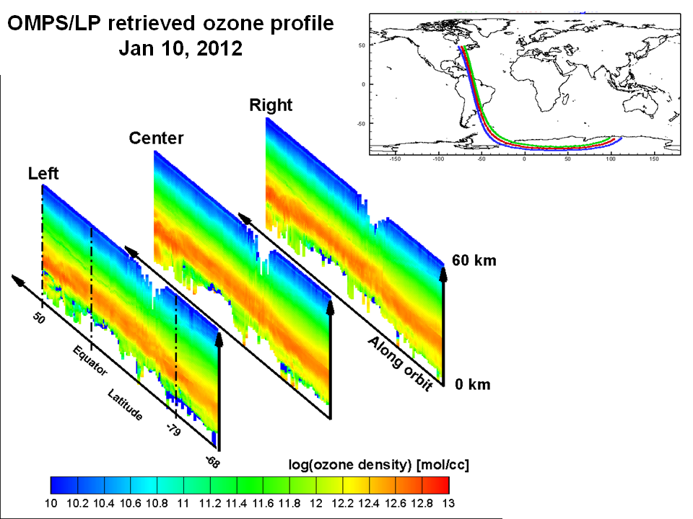
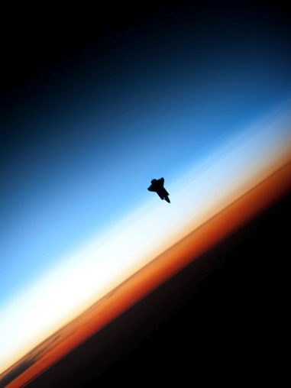
Ozone Profile and OMPS Limb
Modified NOAA Chart
Photo taken from ISS
Notes:
18

Slide 19
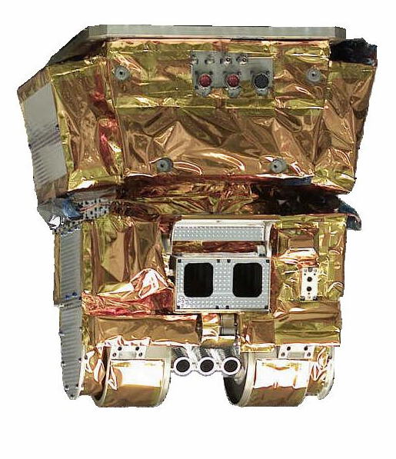
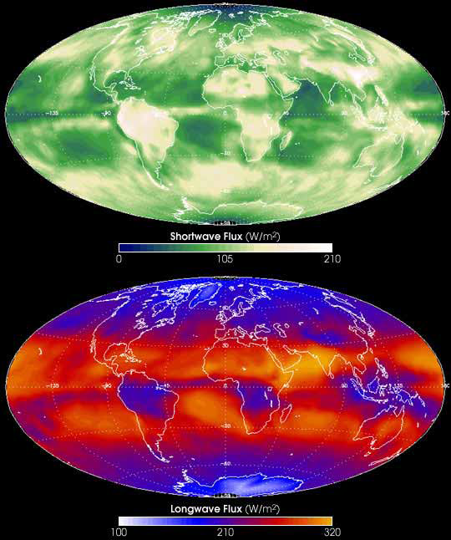
CERES Instrument Overview
18 in.
21 in.
CERES scanning radiometer measuring three spectral bands at TOA
  Total (0.3 to >50 μm)
  Shortwave (0.3 to 5.0 μm)
  Longwave (5 to 50 μm)
Operations, Data Processing, Products, and Science are a continuation of experience developed on
  TRMM (1), EOS Terra (2), EOS Aqua (2), in I&T on NPP
22 in.
 | CERES Value | Allocation | Margin
Mass, kg | 46.8 | 54 | 13.3%
Power: Operational, Watts | 45.85 | 50 | 8.3%
Power: Peak, Watts | 60 | 75 | 20.0%
Power: Survival, Watts | 39.5 | 40 | 1.3%
Heat Transfer - Hot Case, Watts | 4.1 | ±5 W | 18.0%
Heat Transfer - Cold Case, Watts | -1.7 | ±5 W | 66.0%
Data Rate, Kb / sec | 10 | 10 | 0
Pointing Control, arcsec | < 114 | 194 | 41.2%
Pointing Knowledge, arcsec | < 107 | 180 | 40.6%
Primary CERES Climate Data Records
Reflected
Solar
Energy
Emitted
Thermal
Energy
Modified NOAA Chart
Notes:
19

Slide 20
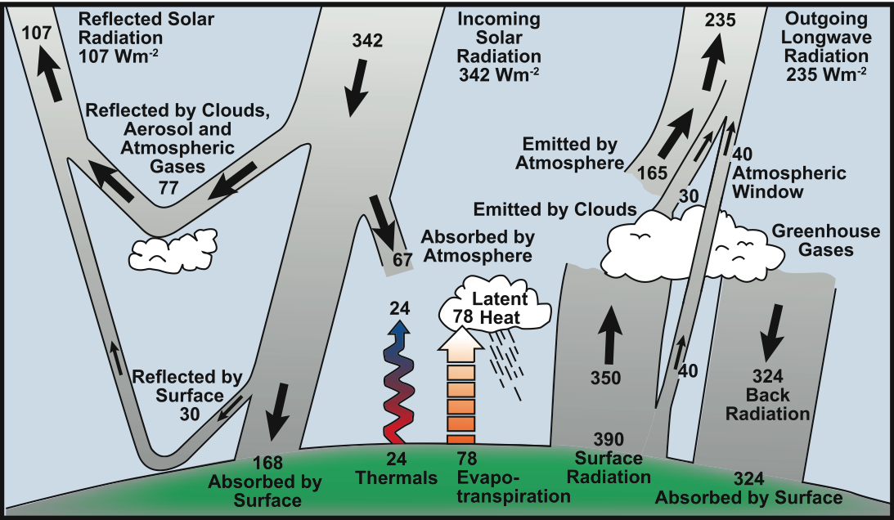
Earth Radiation Budget
CERES Shortwave
TSIS
CERES Longwave
Modified NOAA Chart
From IPCC AR4 FAQ
Notes:
20
FAQ 1.1, Figure 1. Estimate of the Earth’s annual and global mean energy balance. Over the long term, the amount of incoming solar radiation absorbed by the Earth and atmosphere is balanced by the Earth and atmosphere releasing the same amount of outgoing longwave radiation. About half of the incoming solar radiation is absorbed by the Earth’s surface. This energy is transferred to the atmosphere by warming the air in contact with the surface (thermals), by evapotranspiration and by longwave radiation that is absorbed by clouds and greenhouse gases. The atmosphere in turn radiates longwave energy back to Earth as well as out to space. Source: Kiehl and Trenberth (1997).

Slide 21
Application of Suomi NPP Data
JPSS-1 Satellite
NOAA / NESDIS JPSS program asked SPoRT for help with the following activities:
Sustain user engagement
Demonstrate importance of NPP data to the Nation and to critical operational product and services and for improved research
Established a JPSS Proving Ground to focus on improved utilization of NPP/JPSS data for key application areas
Integrate NPP data into the operational environment

Slide 22

Short-term Prediction Research and Transition (SPoRT)
SPoRT is focused on transitioning unique NASA observations and research capabilities to the operational weather community to improve short-term weather forecasts on a regional and local scale.
  Initially worked with WFOs in Southern Region
  SPoRT activities began in 2002 and the first products to AWIPS in February 2003
SPoRT Paradigm
  Match observations to forecast challenges
  Develop and assess solution in “testbed” environment
  Transition solution to decision support system
  Develop/conduct training, product assessment and impact
Benefit
  Demonstrate capability of NASA experimental products to weather applications and societal benefit
  Prepares forecasters for use of data from next generation of operational satellites (NPP/JPSS, GOES-R)

Slide 23
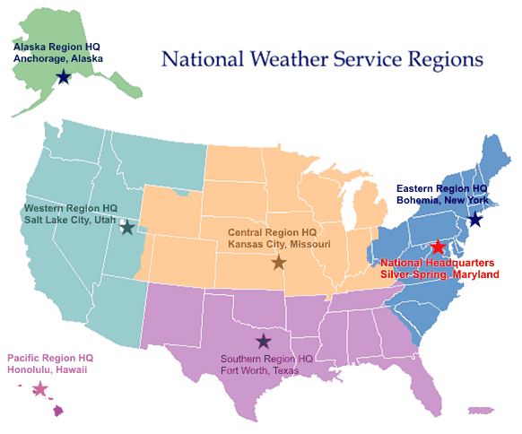
Partnerships and End Users
Partnered with NOAA / University community
  Access to real-time experimental
  data / products
  NASA instruments data and
  model products
  Collaborations with NOAA CIs
  for GOES-R proxy products
End users
  Regular interactions with 20 WFOs
  National Centers and “testbeds”
  Private sector users
Data / transition / dissemination
  Suite of over 30 satellite derived products, analyses, forecast products
  Public ftp, Local Data Manager (LDM)
  AWIPS, NAWIPS, AWIPS2, Google Earth, EVCM
“SPoRT” WFOs
Regional HQs
Collaborating National Centers
Data providers / subject matter experts

Slide 24
SPoRT Focus with NPP
Initially focusing on VIIRS, SPoRT is
using established partnerships for data access and for data disseminate to various WFOs
engaging forecasters in an evaluation of selected products to address specific forecast challenges
demonstrating capabilities in AWIPS / AWIPS II
In the CONUS region, the primary focus is on products which address challenging forecast issues related to convective storm diagnostics, reduction in visibility and ceilings, and unpredicted variations in regional weather due to local surface forcing
In OCONUS, atmospheric and cloud products are being evaluated to address nowcasting issues with additional emphasis on ocean products, particularly SST, ocean color, ice characterization, and snow cover

Slide 25
VIIRS Products and WFO Forecast Challenges
FORECAST CHALLENGE | PRODUCTS | REGIONAL EMPHASIS
Convective storm diagnostics | SDRs, RGB products, cloud properties, cloud-top height, TPW, lightning | CONUS – selected SR and CR WFOs OCONUS – AK and HI
Visibility and ceilings – day and night changes with local variability | SDRs, RGB products, cloud products (base, cover, layers), low cloud/fog/snow discrimination, and AOT, glacier dust | CONUS – selected SR and CR WFOs Alaska Region
Various marine weather issues – sea ice dynamics, freezing sea spray, winds, visibility, etc. | SDRs, RGB products, SST, ocean color, sea ice mapping and characterization | Alaska Region
Local surface forcing – local temperature forecasts, flooding due to snow melt/runoff | SDRs, RGB products, LST, snow cover / depth | CONUS – CR and WR WFOs Alaska Region

Slide 26
VIIRS Products for WFOs
Scientific Data Records (SDRs) – basic channel imagery – wider swath, preserved resolution on edge of scan
Derived red-green-blue (RGB) color composites for the detection of atmospheric and surface features - several standard RGB composites shown by EUMETSAT and others to be of significant value in diagnostic weather analysis.
  dust detection, air mass, and convective storms
  day and night-time microphysical imagery
  natural and false color images (surface features)
The low light visible channel can address snow cover, airborne dust, smoke and clouds, city lights, fires and lightning at night.
Environmental Data Records (EDRs) and NOAA Unique Products (NUPs) provide derived products to address specific forecast issues – only some may be available in real time

Slide 27
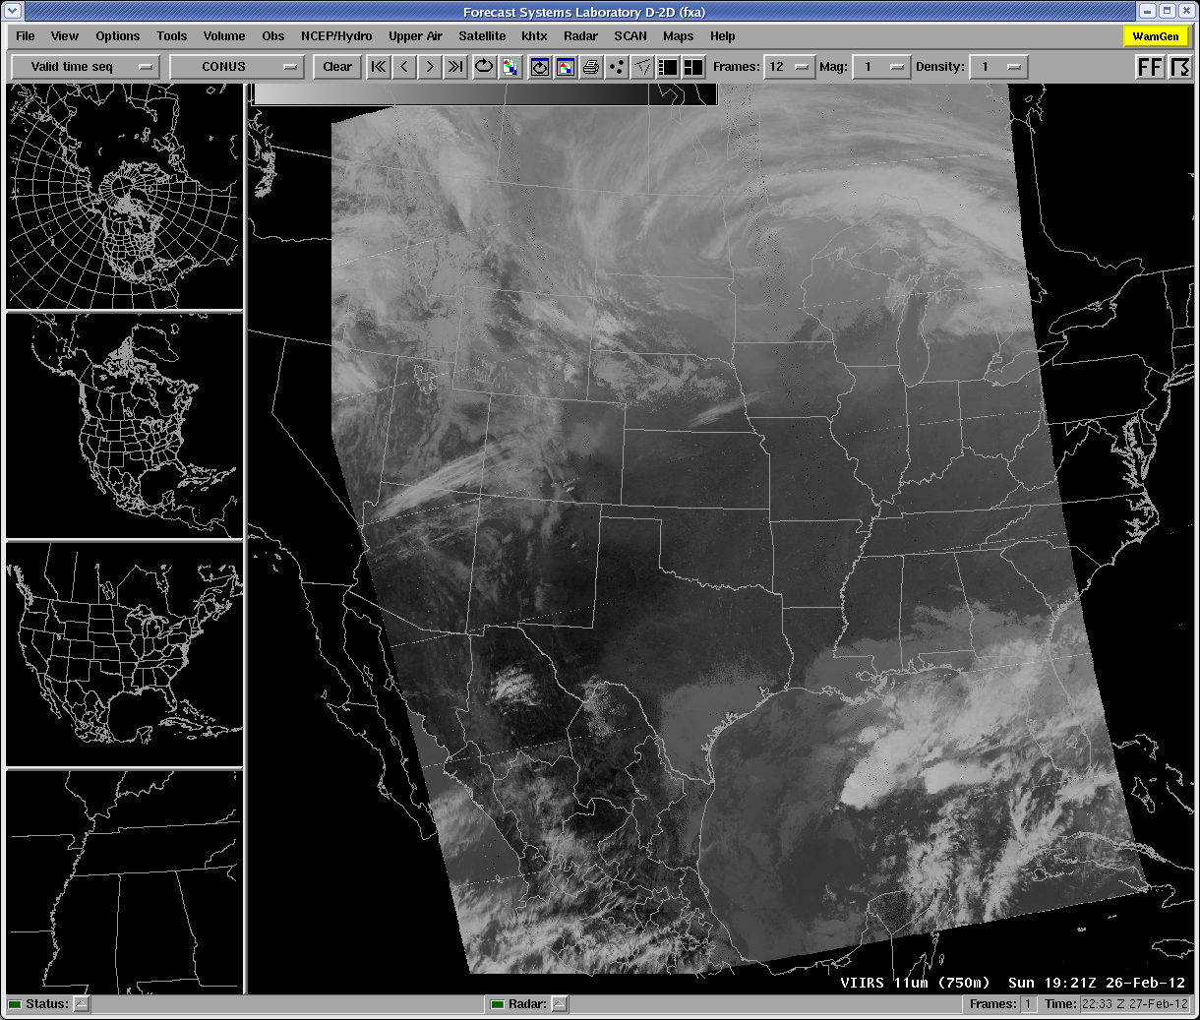
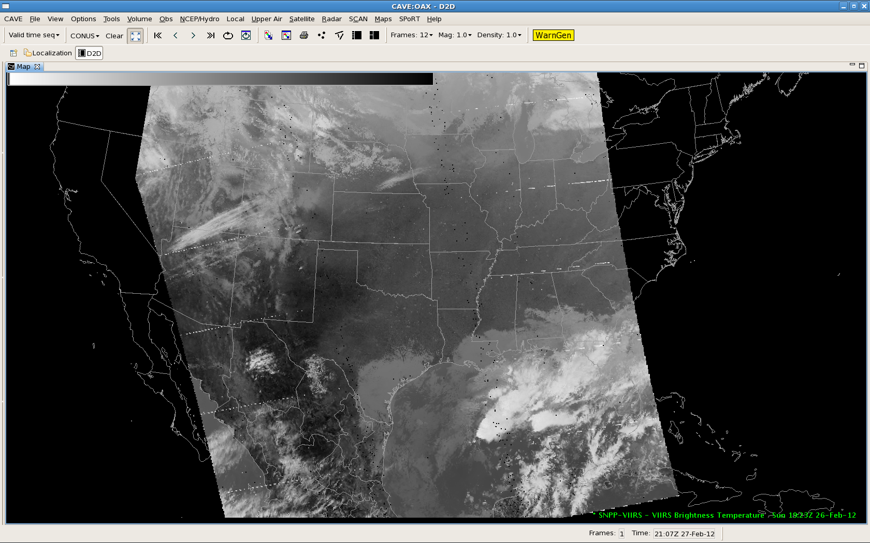
VIIRS Products in AWIPS / AWIPS II
VIIRS imagery in Decision Support Systems (DSS) at various WFOs
D2D in AWIPS
CAVE in AWIPS II

Slide 28
VIIRS Products for WFOs
Scientific Data Records (SDRs) – basic channel imagery – wider swath, preserved resolution on edge of scan
Derived red-green-blue (RGB) color composites for the detection of atmospheric and surface features - several standard RGB composites shown by EUMETSAT and others to be of significant value in diagnostic weather analysis.
  dust detection, air mass, and convective storms
  day and night-time microphysical imagery
  natural and false color images (surface features)
The low light visible channel can address snow cover, airborne dust, smoke and clouds, city lights, fires and lightning at night.
Environmental Data Records (EDRs) and NOAA Unique Products (NUPs) provide derived products to address specific forecast issues – only some may be available in real time

Slide 29
RGB Products
RGB Product | MODIS Channels or differences for R, G, B | VIIRS Channels | SEVIRI Channels | Application
Air Mass | 27-28, 30-31, 27 (inverted) | Cx-Cy*, Cz-M15,Cx (inverted) | 6-7, 9-10, 6(inverted) | Jet Streaks, PV Analysis
Dust | 32-31, 31-29, 31 | M16-M15, M15-M14, M15 | 11-10, 10-8, 10 | Differential Dust from Cloud
Night Microphysics | 32-31, 31-20, 31 | M16-M15, M15-I4, M15 | 11-10, 10- 5 , 10 | Fog/Low Stratus, Thin Cirrus
Day Microphysics | 2, 20 (solar), 31 | I2, I4 (solar), i5(M15) | 3, 5(solar), 10 | Convective, Fog , Fire
True Color | 1, 4, 3 | M5, M4, M3 (or M2) | HRV | Smoke, Land Surface Changes
Natural Color (Land Cover) | 6, 2, 1 | I3, I2, I1 | 4, 3, 2 | Ice/Water Cloud, Vegetation
Day Snow-Fog | 2, 6, 20 (solar) | I2, I3, I4 (solar) | 3, 4, 5 | Snow Melt, Ice Jams
Day Convective Storms | 27-28, 20-31, 6-1 | Cx-Cy*, I4-I5(M15), I3-I1 | 6-7, 5-10, 4-2 | Severe Weather, Water Vapor In/Outflow
Cx, Cy, Cz are corresponding channels from CrIS

Slide 30
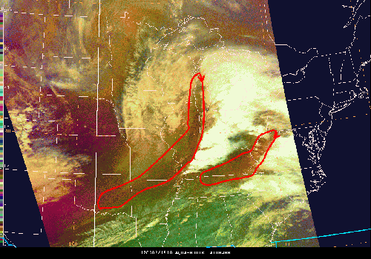
Air Mass Product
Figure 2: This MODIS (Aqua) RGB Airmass image is two hours earlier (1910z on 03/02/12) and shows greater detail in regards to the drying behind the frontal band. This dry air looks to be part of a larger dry punch that originates from lower in the atmosphere, but may also contain some dry stratospheric air (highlighted in the larger red area). Note the extra dry surge that precedes the frontal band (smaller red area) that was associated with earlier supercells that caused significant tornado damage in parts of southern TN and northern AL. Although we only get a few MODIS passes a day, this product is definitely showing much more detail than the GOES-Sounder product.
Color | Band / Band Diff. | Physically Relates to….
Red | 6.7 – 7.3 | Vertical water vapor difference
Green | 9.7- 10.7 | Estimate of tropopause height based on ozone. Polar (tropical) air has higher (lower) ozone concentrations
Blue | 6.7 (inverted, meaning warm to cold scale) | Water Vapor in layer from ~200 – 500 mb
From the Wide World of SPoRT blog
(http://nasasport.wordpress.com)

Slide 31
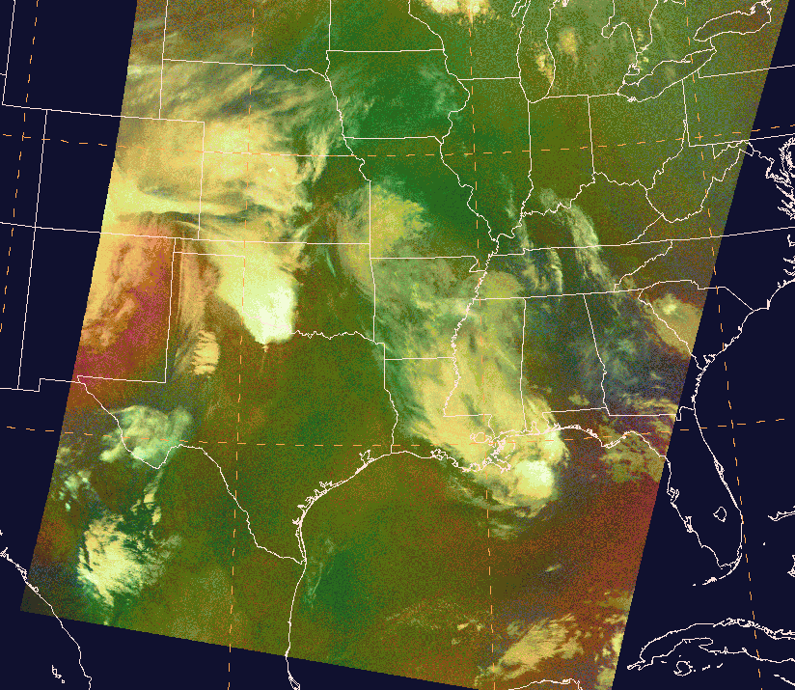
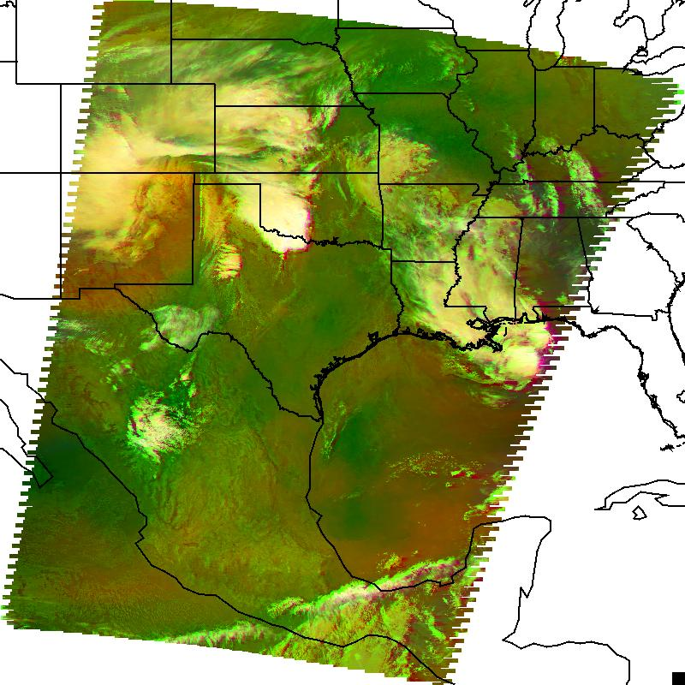
VIIRS / CrIS Air Mass RGB Products
MODIS -- AIR MASS RGB
VIIRS / CrIS -- AIR MASS RGB
April 3, 2012 0807-0815UTC

Slide 32
VIIRS Products for WFOs
Scientific Data Records (SDRs) – basic channel imagery – wider swath, preserved resolution on edge of scan
Derived red-green-blue (RGB) color composites for the detection of atmospheric and surface features - several standard RGB composites shown by EUMETSAT and others to be of significant value in diagnostic weather analysis.
  dust detection, air mass, and convective storms
  day and night-time microphysical imagery
  natural and false color images (surface features)
The low light visible channel can address snow cover, airborne dust, smoke and clouds, city lights, fires and lightning at night.
Environmental Data Records (EDRs) and NOAA Unique Products (NUPs) provide derived products to address specific forecast issues – only some may be available in real time

Slide 33
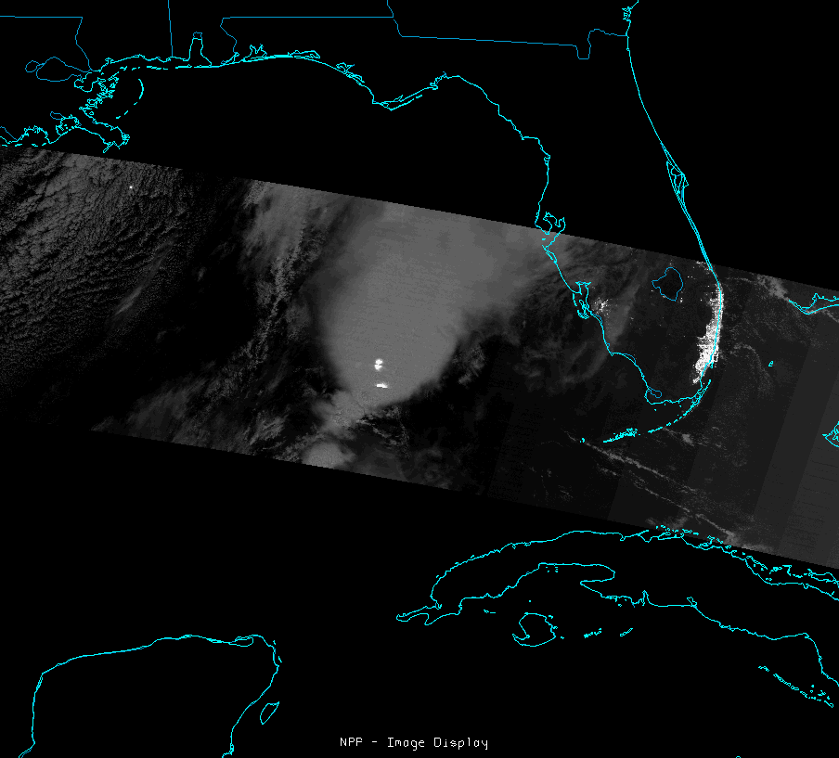
VIIRS Day Night Band (DNB)
Low light sensor “sees” emission from light sources
  cities
  lightning
  fires
moonlight reflected from atmospheric and surface features
  clouds
  fog
  snow
  other reflective surfaces

Slide 34
Status of Activities
Reformatted sample VIIRS imagery and selected products for use in AWIPS / AWIPS II
  continue to work issues with image display
  product generation – hybrid, RGBs, etc.
Established procedures to disseminate products to end users in place
Direct broadcast capabilities for NPP instruments not routinely available
  latency of data 10-16 hours
  limited utility of delayed data for WFOs
Evaluation partners (WFOs) ready to receive data
Working to develop training
Product assessment / impact when data flows to WFOs

Slide 35
Future Activities
Refine / enhance / add VIIRS imagery and products to selected end users
Access and disseminate additional EDRs and NUPs for forecaster evaluation
Address additional forecast issues through the use of other NPP sensors
  use real time ozone mapping with OMPS / CrIS (like currently with AIRS) to better understand storm dynamics
  assimilate CrIS / ATMS temperature and moisture profiles along with AIRS / IASI data for short-term forecast improvement / atmospheric moisture processes
Expand end users to include National Centers

Slide 36
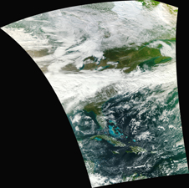


Summary
Suomi NPP instruments offer exciting opportunity for operational weather community, enhancing capabilities from previous sensor systems
Extends NASA capabilities beyond Terra / Aqua for climate research and applications to benefit society
SPoRT leading the way to get this new data in front of forecasters
First VIIRS image. Courtesy of the UW / SSEC.
transitioning unique NASA data and research technologies to operations
Notes:
36

