Slide 1
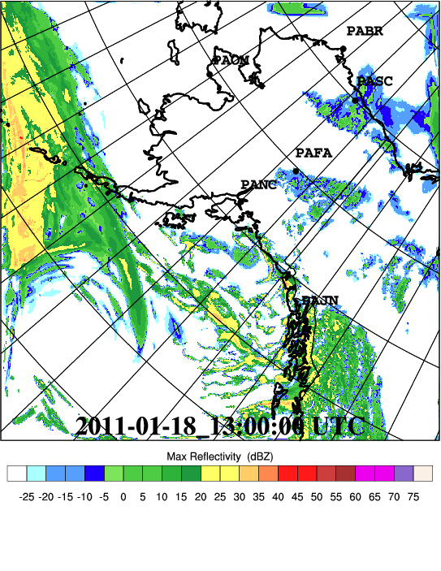
Weather Modeling Activities at Alaska’s Arctic Region Supercomputing Center

Slide 2
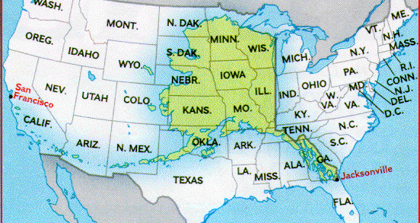
Perspective
Notes:
The State of Alaska covers almost 1.5 million square kilometres
With topography ranging from marine, to broad river valleys, to North America's highest peak, and temperatures that have ranged from -80ºF to +100ºF, the challenges of modeling and studying the weather are immense.
In this large expanse with over 33,000 miles of shoreline - more than that of the entire contiguous United States - population is sparse and weather observations are in short supply. Yet, numerous activities throughout the region are dependent on accurate and timely forecasts of the extreme and highly variable weather.

Slide 3
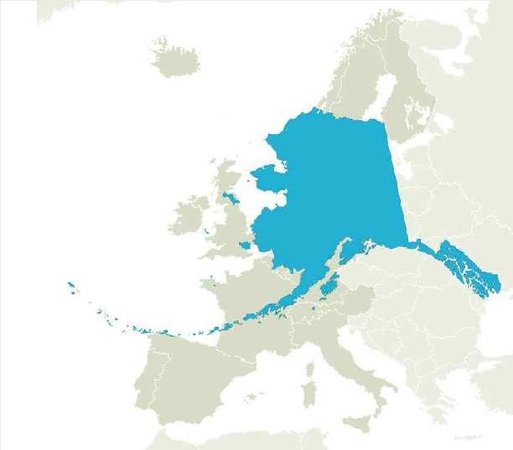
Perspective

Slide 4
A Brief History of UAF/ARSC Real-time WRF
Short-range forecasts
2000 – Tilley/Long MM5
Apr 2001
Apr 2002 – resurrected by Krieger
Feb 2009 – WRF at ARSC
May 2009 – Medium-range
Sep 2004 – Morton/WRF at KMSO
. . .
Aug 2005 –WRF at ARSC/PAFA
Various Renditions
Oct 2009 –HRRR-AK
Summer 2008 – Stuefer smoke forecast

Slide 5
A Brief History of UAF/ARSC Real-time WRF
Short-range forecasts
2000 – Tilley/Long MM5
Apr 2001
Apr 2002 – resurrected by Krieger
Feb 2009 – WRF at ARSC
May 2009 – Medium-range
Sep 2004 – Morton/WRF at KMSO
. . .
First, pre-Alaska
Aug 2005 –WRF at ARSC/PAFA
Various Renditions
Oct 2009 –HRRR-AK
Summer 2008 – Stuefer smoke forecast

Slide 6
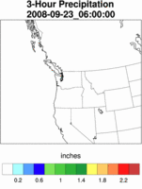
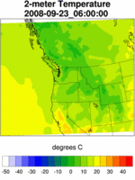
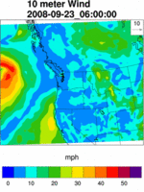
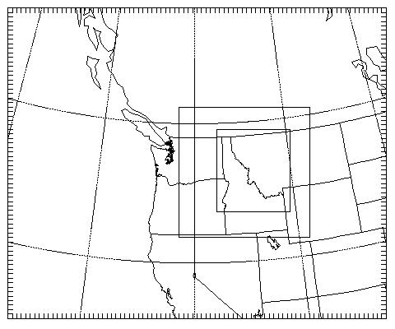
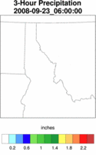
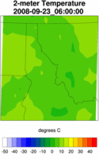
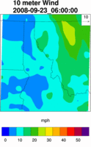
Northern Rockies Mesoscale Model (NRMM)
Nested 36km / 12km / 4km
Initialized and driven by NAM 212 (40km)
hours

Slide 7
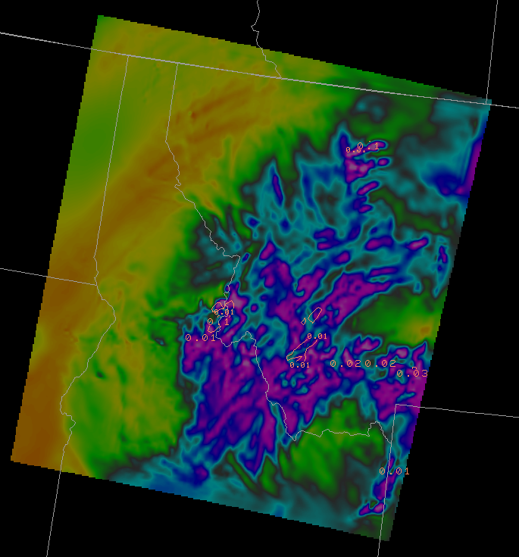
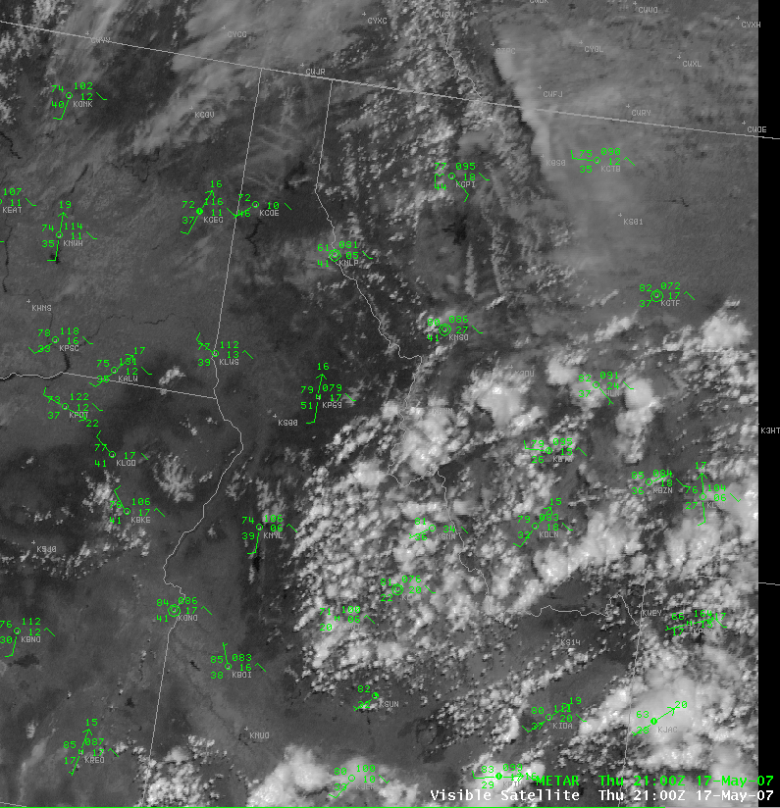
Operational WRF – Missoula NRMM
500 mb RH from NRMM, FH 15
Satellite view of cumulus for same time
Notes:
Over the past year, NRMM has done a fairly consistent job of capturing areas of convective precipitation

Slide 8
Operational WRF – Missoula NRMM
On a consistent basis, NRMM captured summer convective activity “patterns” favorably, to the point that forecasters came to rely on this model
500 mb RH from NRMM, FH 15
Satellite view of cumulus for same time
Notes:
Over the past year, NRMM has done a fairly consistent job of capturing areas of convective precipitation

Slide 9
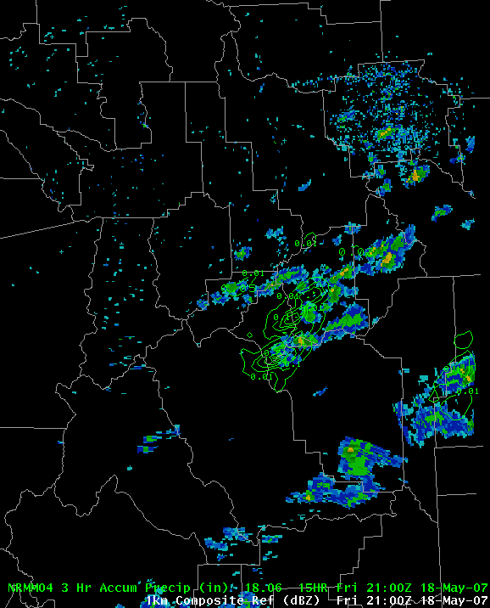
Operational WRF – Missoula NRMM
NRMM FH 15 3hr precip contours superimposed on actual radar

Slide 10
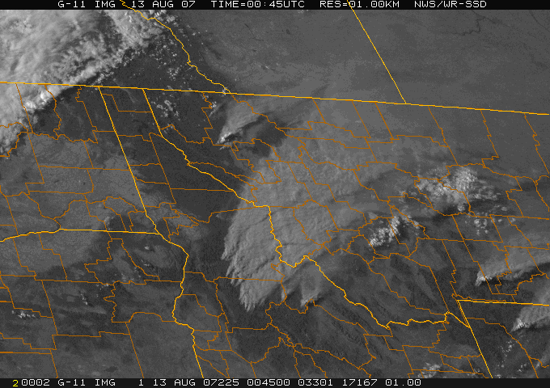
An interesting exception
One day, NRMM was predicting typical afternoon convection, but it didn’t appear
Wildfire smoke (that NRMM didn’t know about), may have inhibited the convection
This suggests the need for more complete atmospheric initialisations

Slide 11
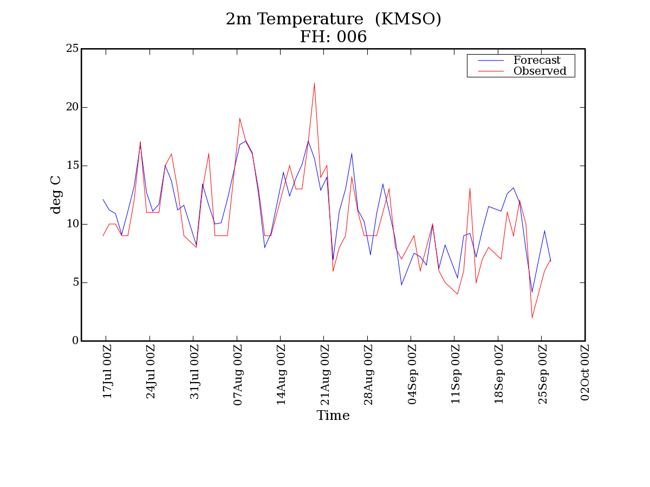
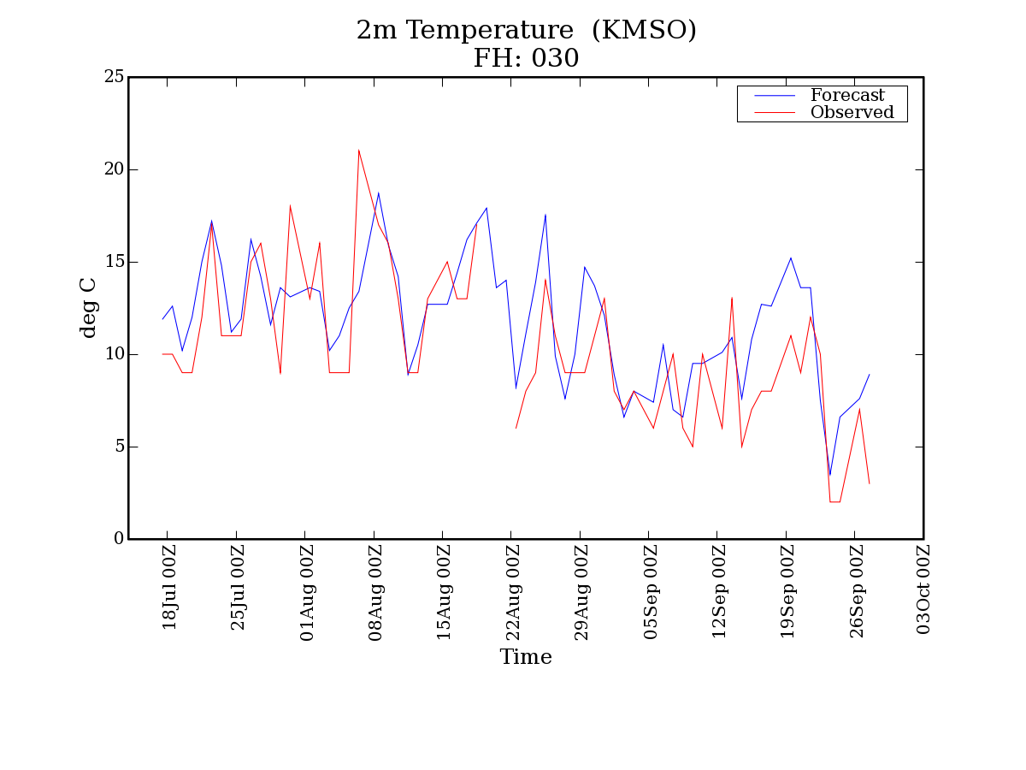
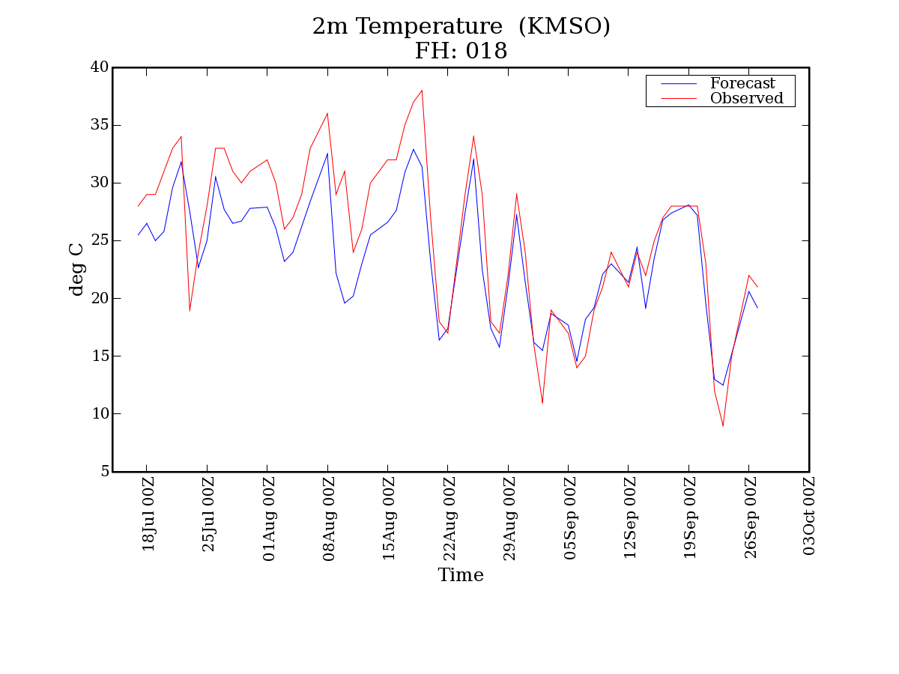
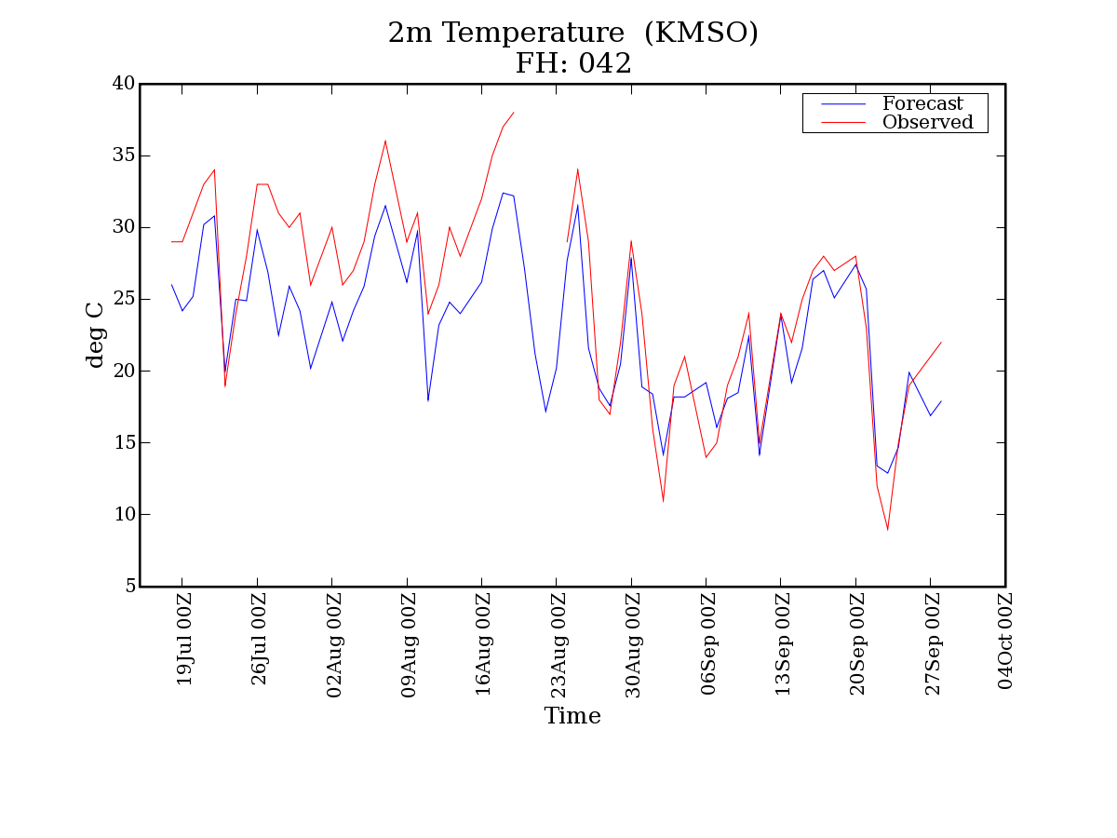
KMSO (2m T) – 3 month period
6am MDT
6pm MDT

Slide 12
KMSO (2m T) – 3 month period
6am MDT
Frequently, NRMM captures the diurnal changes, but fails to capture the extremes in temperature. Is it possible that WRF is too “wet,” moderating temperatures too much?
6pm MDT

Slide 13
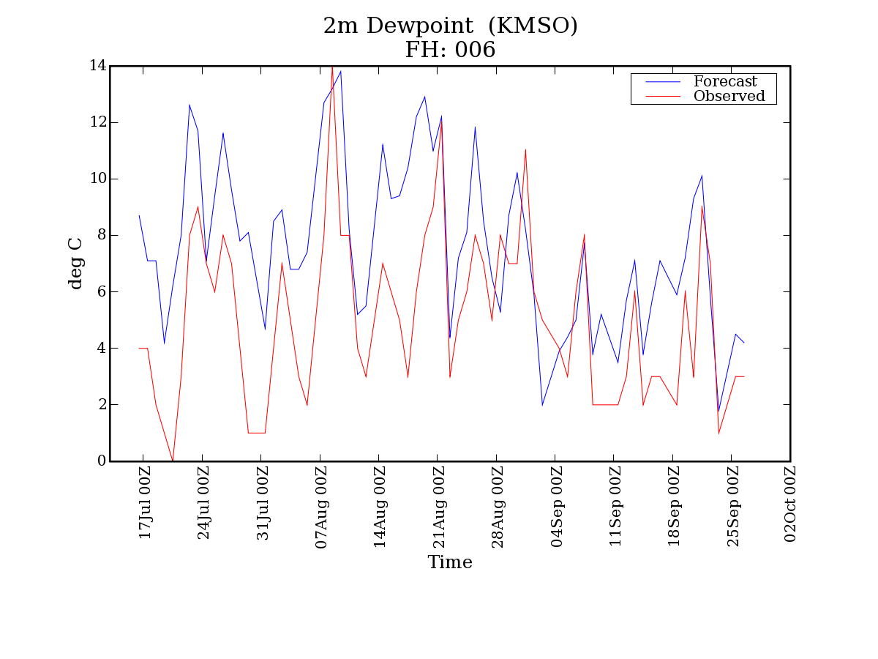
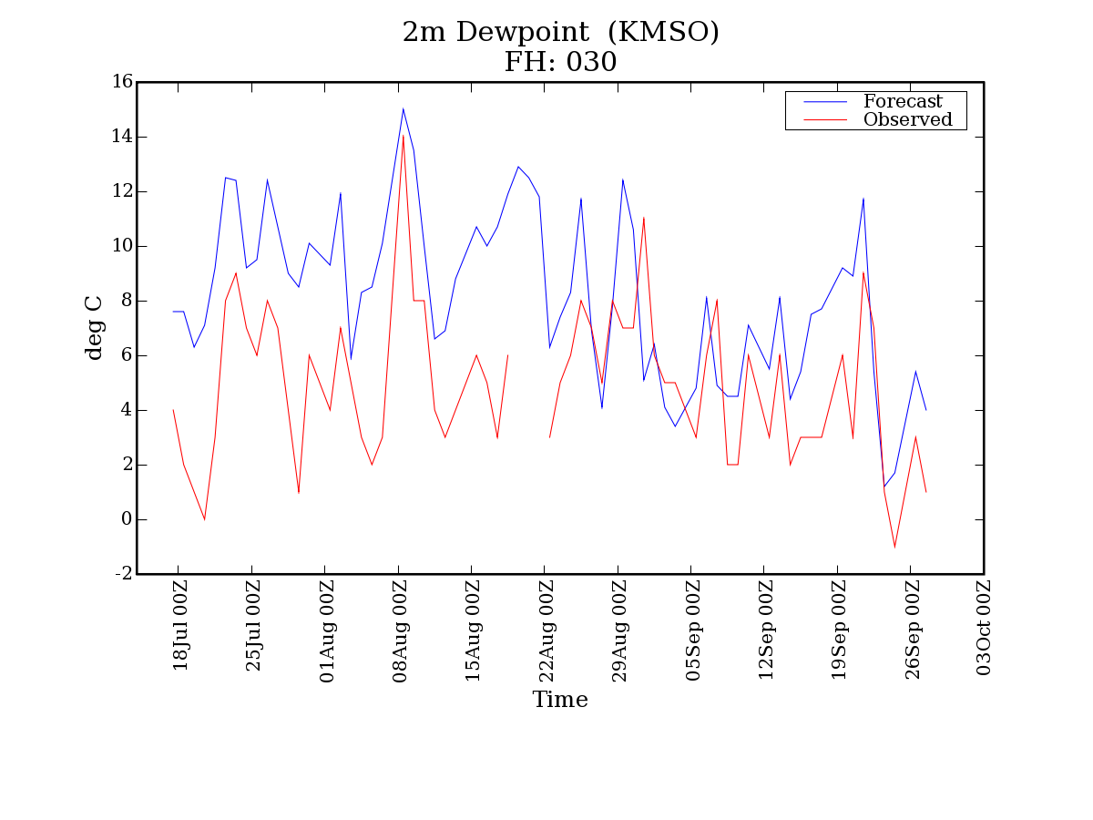
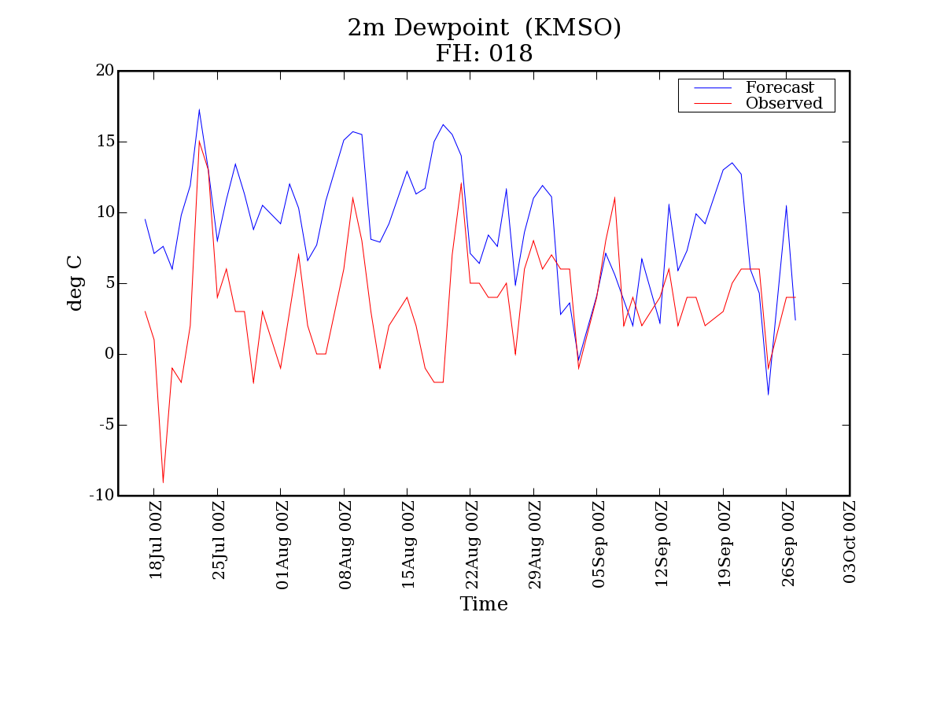
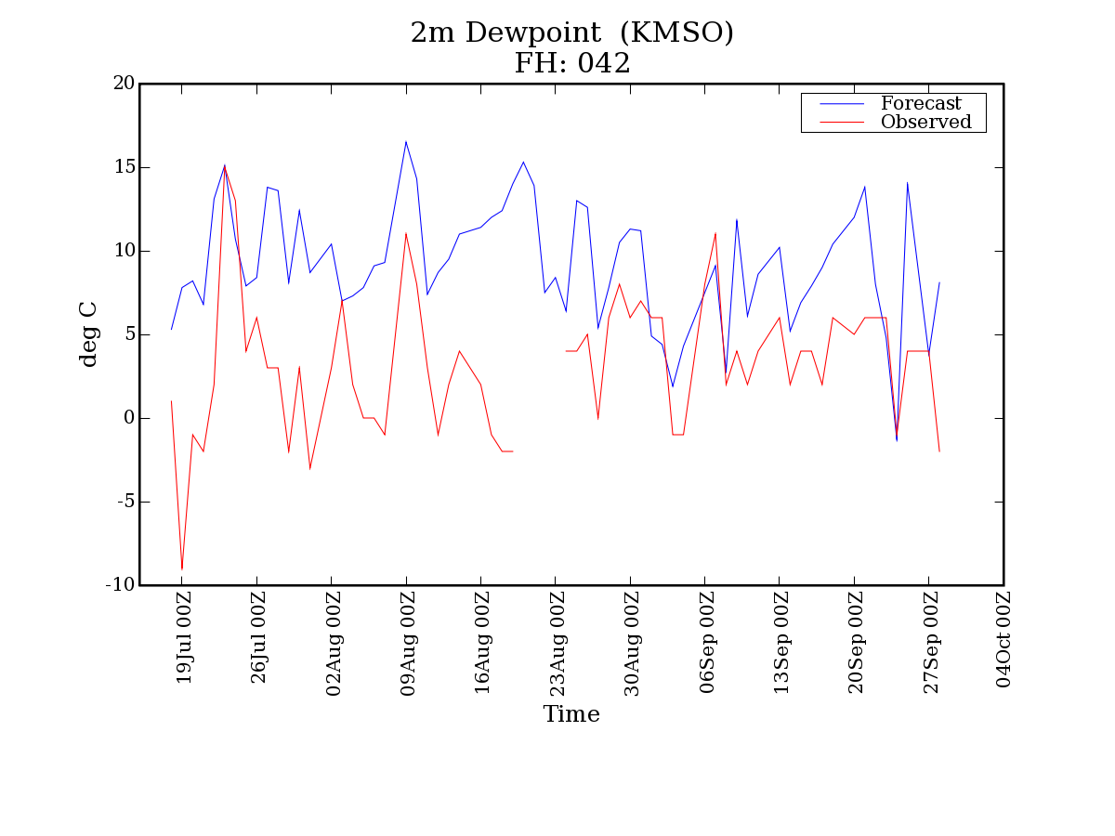
KMSO (2m Dewpoint) – 3 month period
6am MDT
6pm MDT

Slide 14
KMSO (2m Dewpoint) – 3 month period
6am MDT
NRMM tends to be much wetter than observations suggest. The only times that WRF agrees with observed dewpoints are times that atmospheric moisture was advected into the region
6pm MDT

Slide 15
KMSO (2m Dewpoint) – 3 month period
6am MDT
NRMM tends to be much wetter than observations suggest. The only times that WRF agrees with observed dewpoints are times that atmospheric moisture was advected into the region
The reality is that this period was extremely dry, and soil was “bone dry.” NRMM obviously didn’t know this. This suggests the need for much better land surface models.
6pm MDT

Slide 16
A Brief History of UAF/ARSC Real-time WRF
Short-range forecasts
2000 – Tilley/Long MM5
Apr 2001
Apr 2002 – resurrected by Krieger
Feb 2009 – WRF at ARSC
May 2009 – Medium-range
Sep 2004 – Morton/WRF at KMSO
. . .
Aug 2005 –WRF at ARSC/PAFA
Various Renditions
Oct 2009 –HRRR-AK
North to Alaska
Summer 2008 – Stuefer smoke forecast

Slide 17
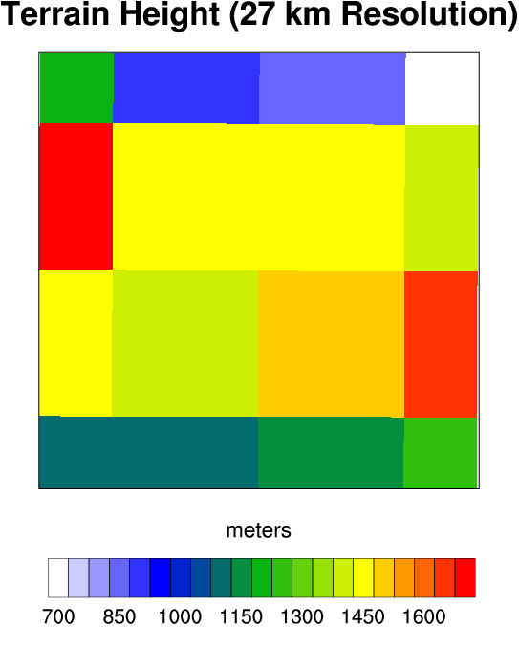
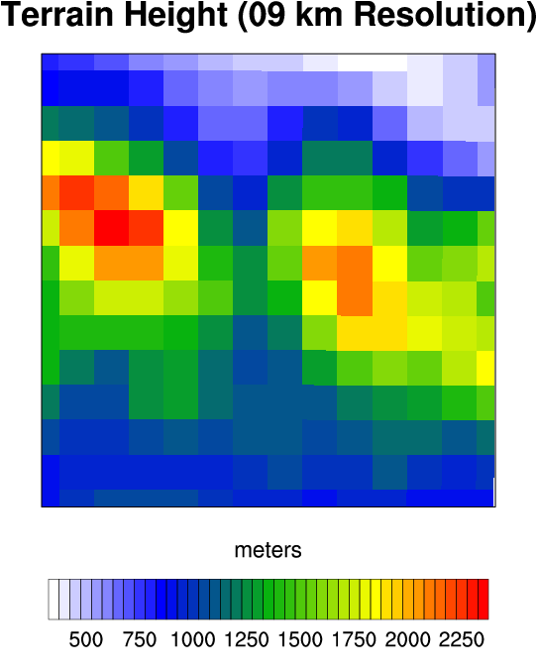
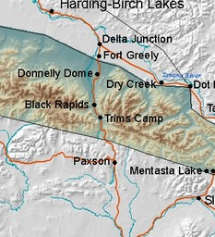
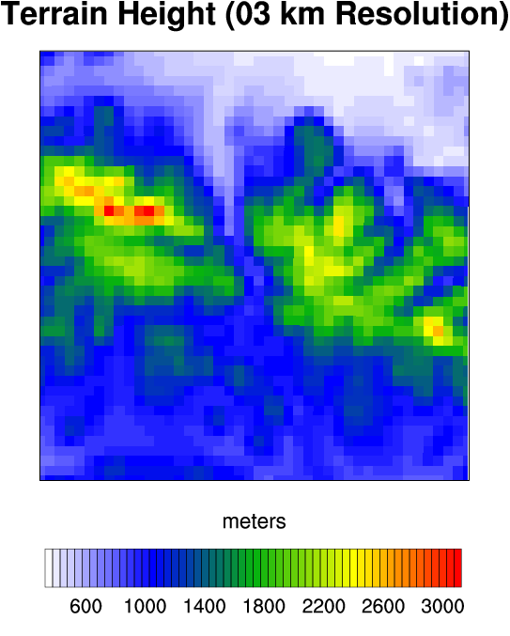
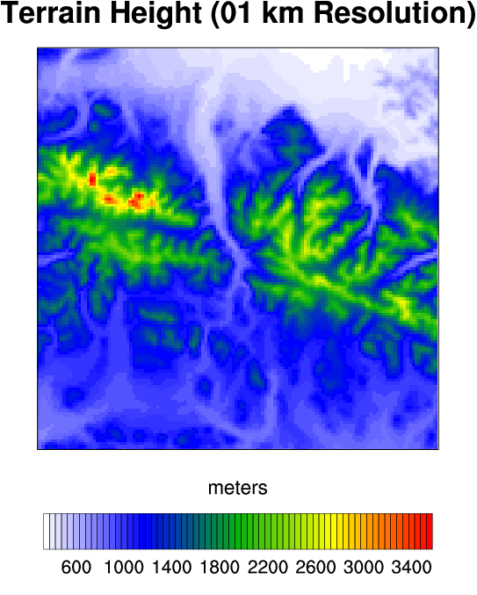
Morton and Mölders Tanana Wind Study
Image obtained from
http://pafg.arh.noaa.gov/zones/zoomd/AKZ226.jpg

Slide 18
Case Studies – Isabelle Pass
Note that only the 1km resolution WRF simulation begins to match the observations. At coarser resolutions Isabelle Pass is not sufficiently resolved to channel the WRF winds realistically
Modelled vs. Actual Elevations
 | 27km | 9km | 3km | 1km | Actual
PAFA | 612 | 485 | 437 | 404 | 433
PAEI | 842 | 559 | 556 | 555 | 528
PABI | 1749 | 1471 | 1263 | 1267 | 1276
TRDA2 | 4408 | 4227 | 3125 | 2526 | 2477
Notes:
The jagged line is the observed wind speed and direction at Trim’s DOT station (just north of Isabelle Pass). At 27km, 9km, and 3km resolution, WRF is not able to adequately resolve the terrain, so forecasted winds are way off. But, at 1km resolution WRF begins to capture the terrain, and the model results are good. You probably don’t want the whole modelled vs. actual elevations chart, but at TRDA2, in particular, you can see that at 27km resolution, WRF seems the local terrain as essentially a “high plains” environment, subject to high, varying winds. Down at 1km resolution, however, WRF finally sees something approaching the “real” terrain, and hence constrains the winds as defined by the topography.

Slide 19
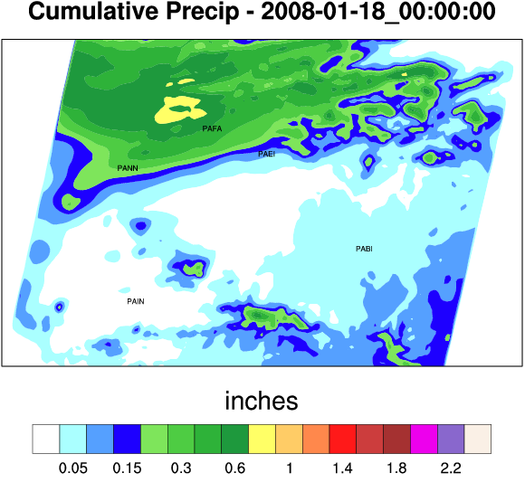
Major Snow Event – 16-17 January 2008
Fairbanks area receives 6-8 inches (over 10 inches in the hills)
Local accumulations
  Ester Dome – 10.4”
  East Ft. Wainwright – 8.3”
  PAFA – 7.4”
  North Pole – 5.8”
  Eielson Housing Units – 5.0”
  Eielson – 1.8”
ARSCwrf forecasted (2km resolution)
Notes:
This was a very localized event with Fairbanks area apparently receiving the brunt of the snowfall. Note a sharp dropoff in snowfall down towards Eielson.

Slide 20
Notes:
A similar model did a very good job of capturing very localized snow around Fairbanks. Caution that in these cold snow events, precip sensors should be viewed cautiously. Nevertheless, note that the 2km nest NAILS the total PAFA precip total. Station pressure follows the trend, and the higher resolution nest comes closer to PAFA’s actual elevation. Modeled temperature doesn’t at all capture the cold air mass hugging the surface initially – based on past experiences, this is really not a surprise.

Slide 21
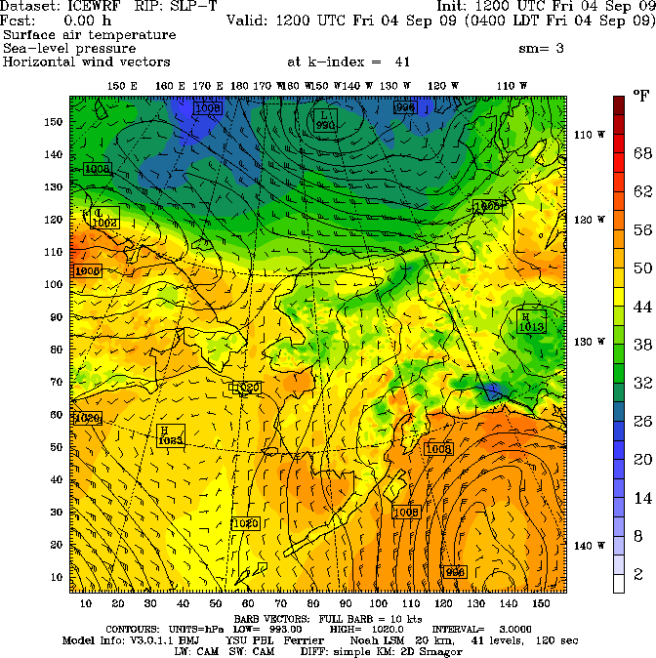
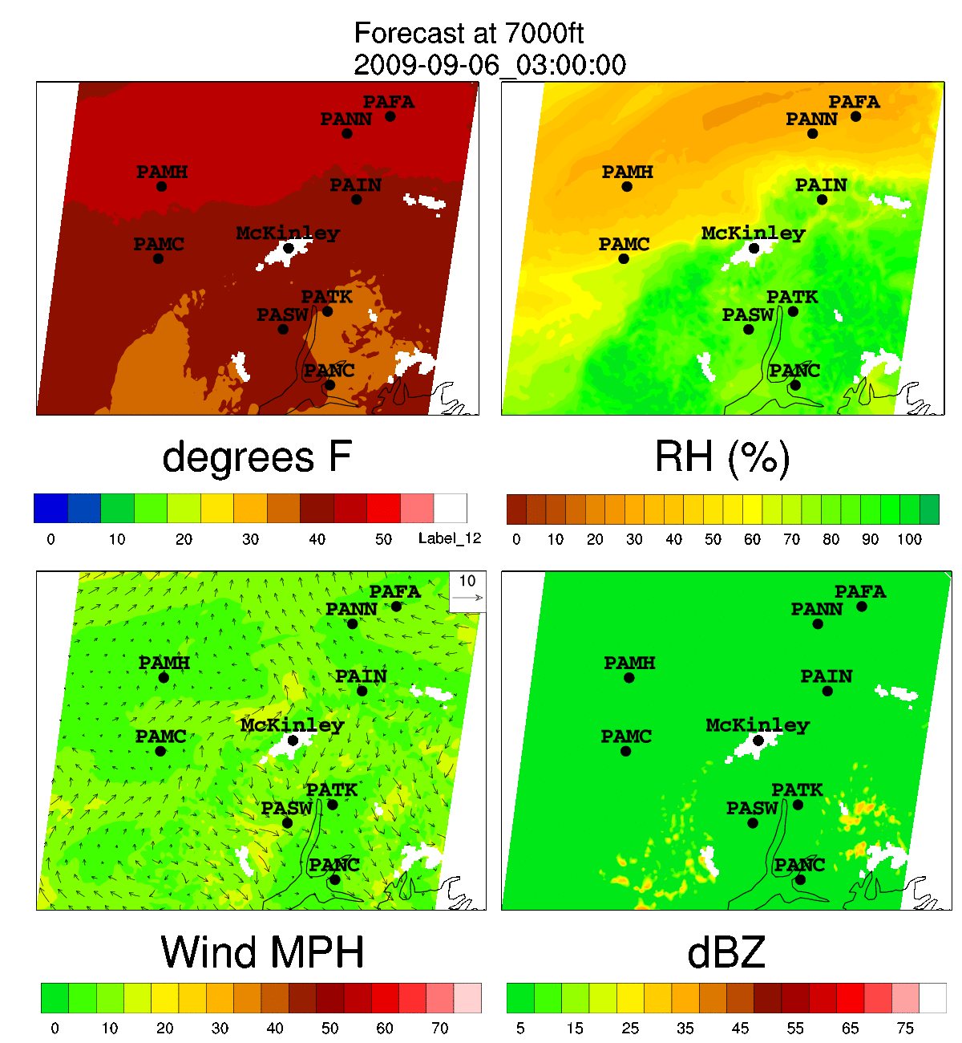
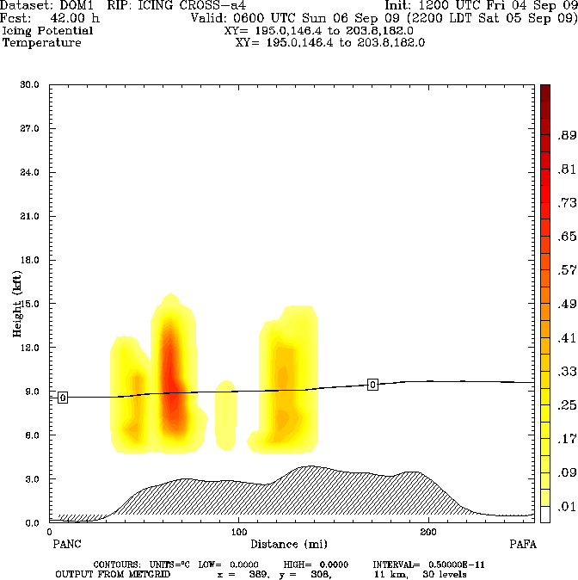
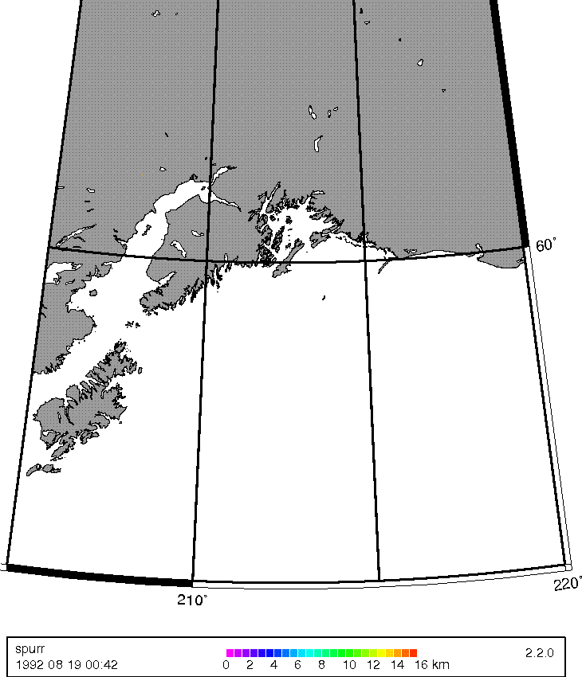
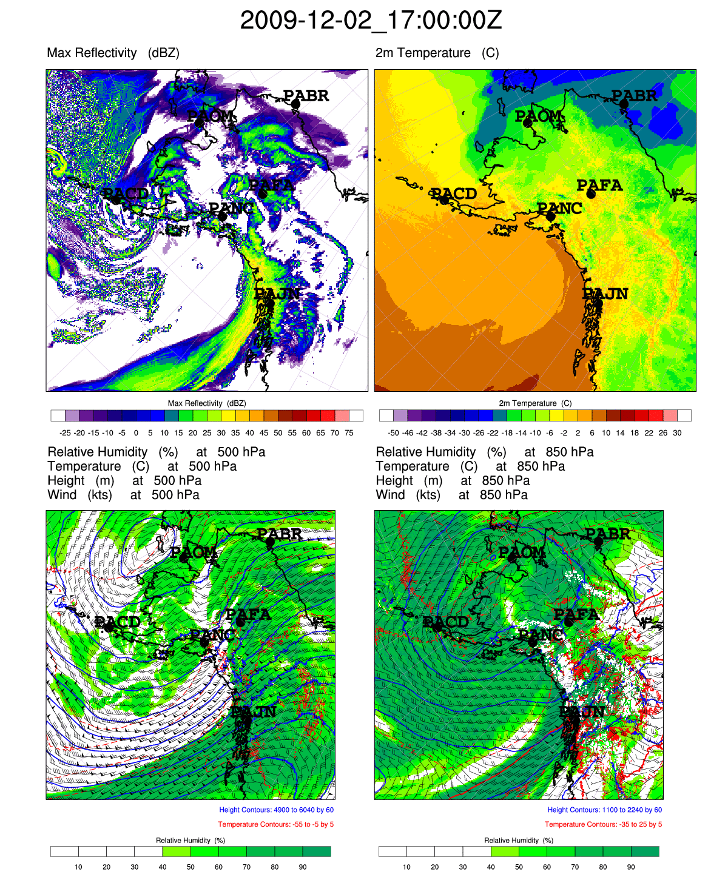
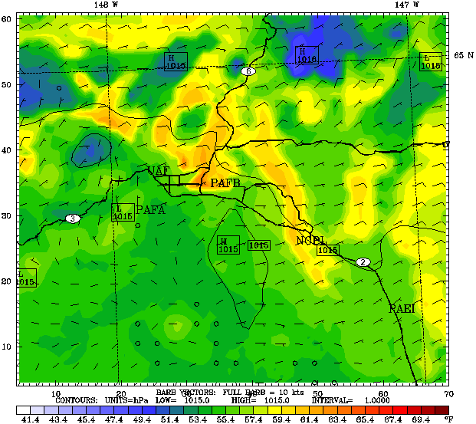
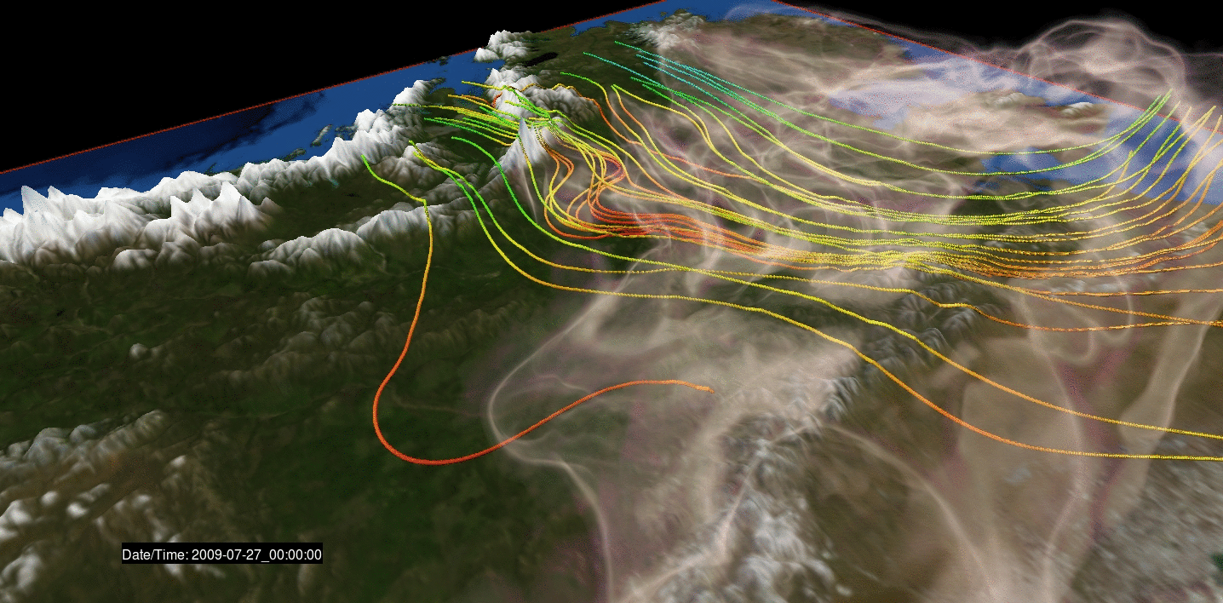
ARSC Weather Forecasts
Real-time
Targeted (McKinley)
Aviation (Icing & Ash)
Air quality for Fairbanks
Wildfire smoke
ARSC HRRR
Notes:
Wide range of real-time forecasts using well over 2 million hours of computer time per year. Long range graphic shows forecast surface temperature, winds and pressure over a 16-day period (this is very experimental – many will claim that these things become useless after three days or so.
Targeted forecasts – example – to support Mt. McKinley summer operations, at the request of US Army and NWS we produced twice daily, high resolution, 10-day forecasts for Mt. McKinley at 7,000, 12,000, 14,000 and 21,000 feet
Aviation – example – icing forecast for route between ANC and FAI. Ash example – forecast ash cloud for Mt. Spurr eruption. ARSC generates high resolution wind fields, which drives Alaska Volcano Observatory’s (AVO) PUFF model for ash tracking. Recall that in late 2005 when Mt. Augustine erupted, ARSC responded within two days to AVO’s request to produce a model with 1km resolution windfields of the region. In-house expertise and computing resources allow us to respond rapidly to such incidents to support critical decision making
Air quality for Fairbanks – investigating the production of high resolution, localized forecasts under conditions of deep inversions for air quality forecasts.
Wildfire smoke – Daily forecasts during the summer to predict the dispersion of wildfire smoke emanating from the numerous fires over the region. This graphic perspective is from NE Alaska, looking to the SW
ARSC HRRR – High Resolution Rapid Refresh – prototyping an Alaska version of the HRRR which runs over the eastern Lower 48. The idea is that short-term forecasts (6-12 hours) are produced frequently (ideally every hour or two) based on an accurate snapshot of the current weather from thousands of surface, radar and satellite observations. Such models are useful in forecasting short-term hazards such as wind shear, turbulence and icing.

Slide 22
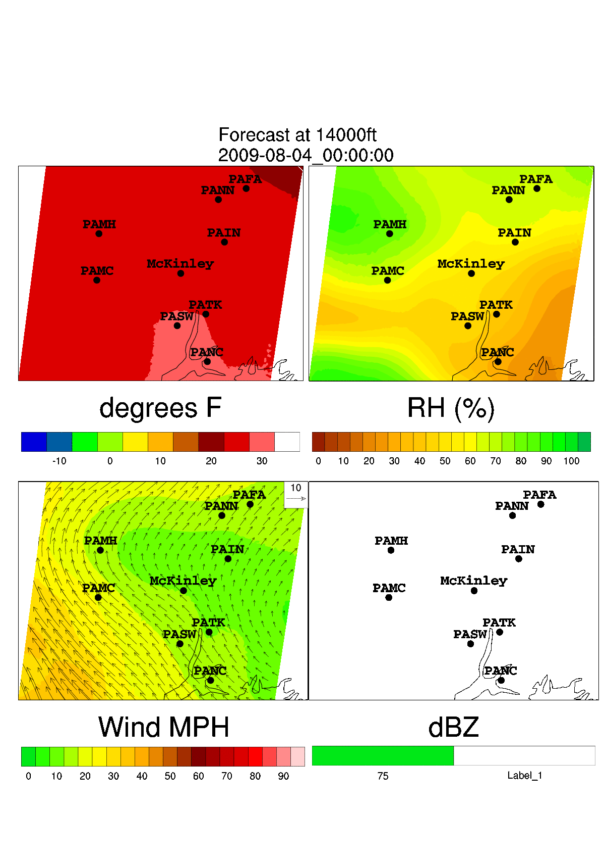
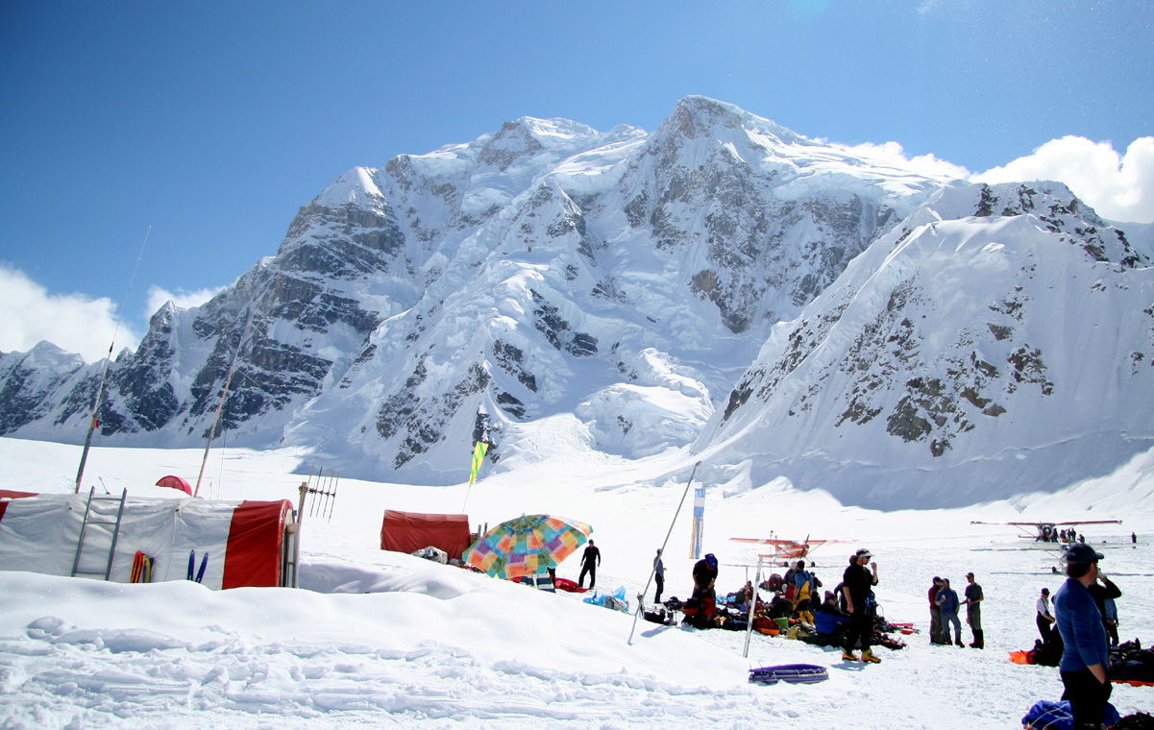
Mt. McKinley Forecasts
Tallest mountain in North America, popular for science and recreation in the summer
At 63ºN, experiences bitter, violent weather any time of year
Daily forecasts for 7,000, 14,000, 17,000 and 20,000 feet

Slide 23
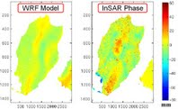
Atmospheric Correction of InSAR Data Using Numerical Weather Prediction Models
Influence of atmosphere seen as main performance limitation for high quality Interferometric Synthetic Aperature Radar (InSAR) techniques in ground deformation monitoring
Assessing performance of WRF to predict atmospheric phase delay signals

Slide 24
High Resolution Climate/Weather Modeling
Increased interest in terrain-resolving climate/weather modeling
  Evolving collaborations with the HIRmod (High-Resolution Atmospheric Modelling in Complex Terrain for Future Climate Simulations) group, Institute for Meteorology at Vienna’s University of Natural Resources and Applied Life Sciences, and others, including NOAA and NCAR
  Setting the stage for the high-res climate simulations of the future
Co-organising February 2012 International Workshop, HiRCOT 2012
Pursuing several projects

Slide 25
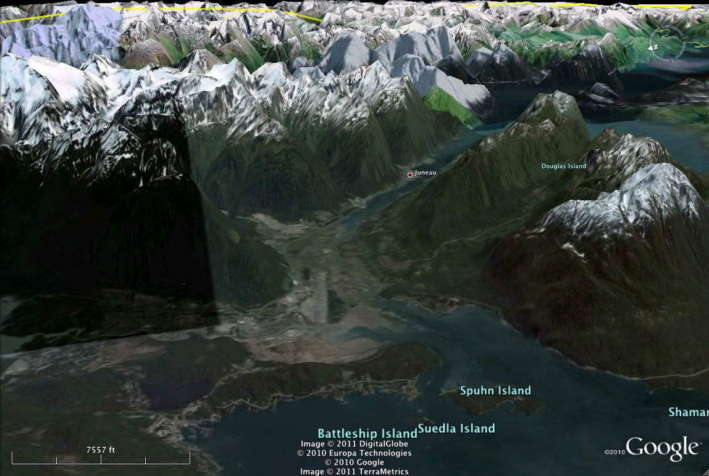
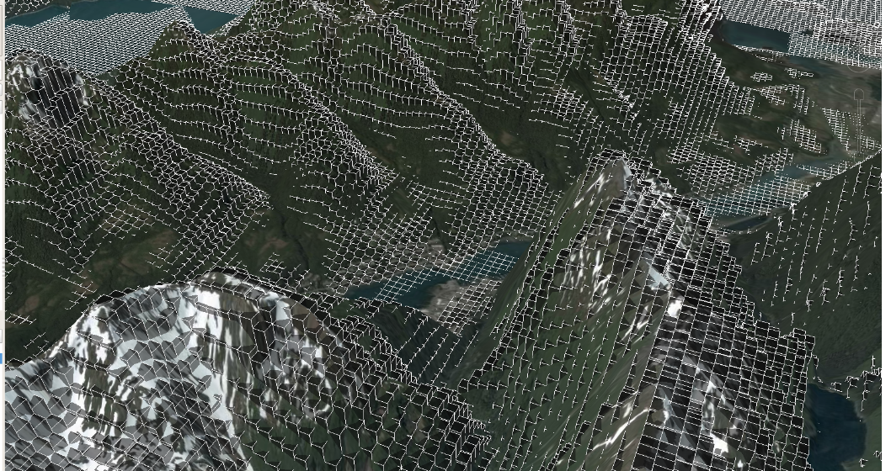
Juneau Wind Shear Study
100 meter resolution
Collaboration between ARSC undergrad, NWS and Vienna group
Award-winning presentation!

Slide 27
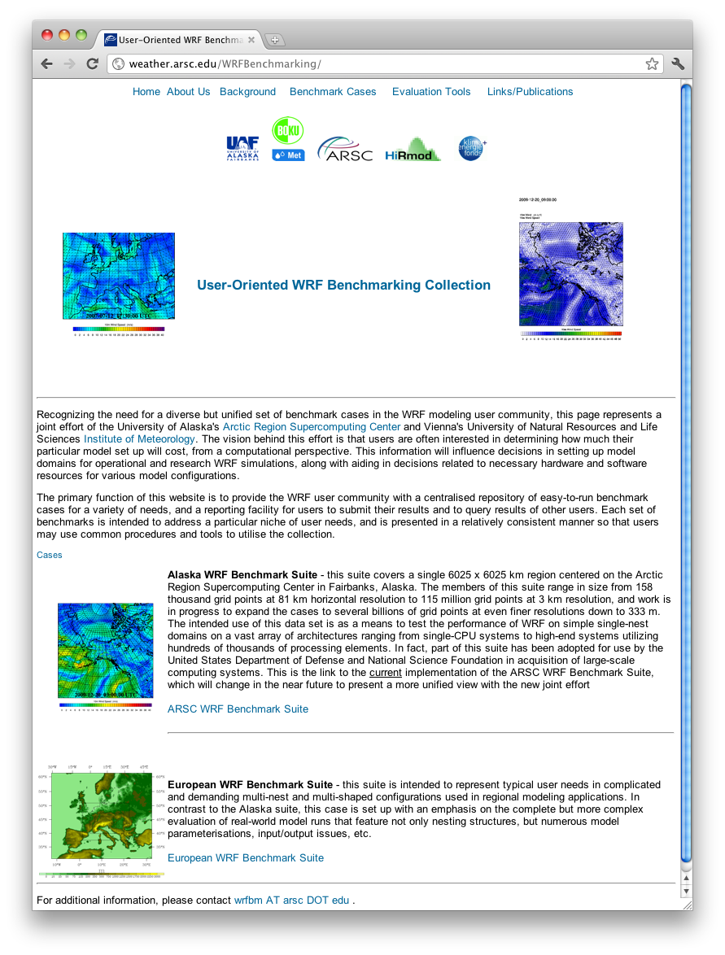
Benchmarking
Understanding and documenting computational resources needed for various high-res simulations
Public repository of benchmark cases

Slide 28
High-Res Climate/Weather Modeling
Continued investigations into next-generation high-resolution modeling in complex terrain (Alaska, Alps, etc.)
  Computational
  Parameterisations
  New datasets
Dynamical downscaling

Slide 29
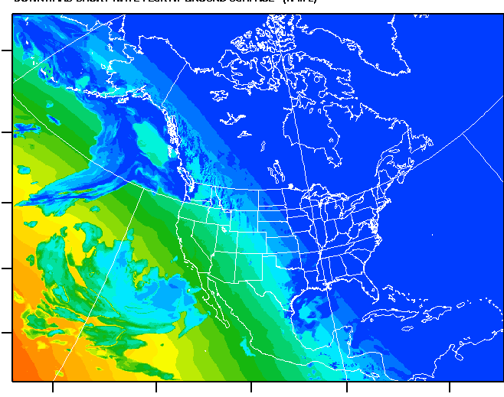
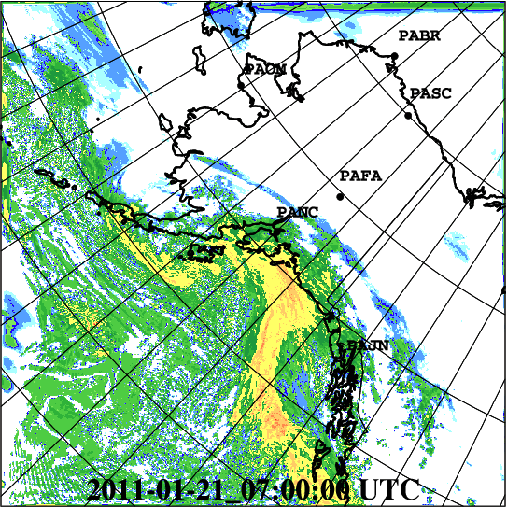
Overview of HRRRAK
24-hr forecasts, 4x daily, 256 cores
1050x1050x51 grid points @ 3km
Initialized by RR, LBC’s from NAM12
Notes:
We use 256 cores on Sun Opteron cluster almost 24 hours a day (2.2 million hours/year) to produce 4 daily 24-hour forecasts
The domain contains over 56 million grid points at 3km resolution
Runs are initialized from the 13km RR native grids, but since these forecasts only go out 15-18 hours, we use the NAM Alaska 11km grids for LBC’s

Slide 30
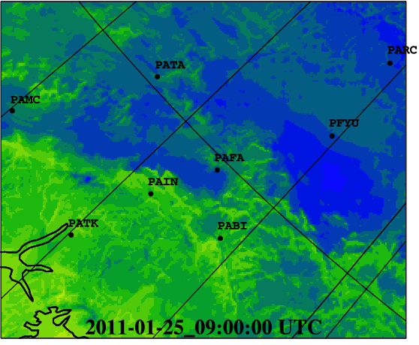
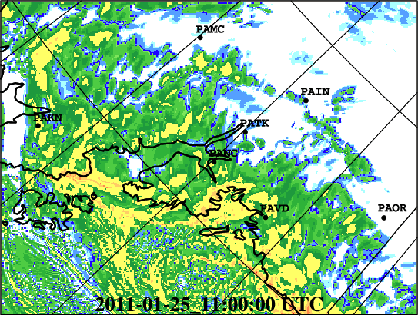
Original Namelist Options
  WSM 3-class simple ice
  RRTM LW physics
  Monin-Obukhov sfclay physics
  Thermal diffusion surface physics
  YSU PBL
  No cumulus parameterization
  Default layers
Notes:
Again, emphasize that we’ve taken an incremental approach where the first steps were to simply deploy all of the pieces (next slide) in a quasi-operational fashion, and THEN, start to modify the domain and namelist for more appropriate model settings.

Slide 31
HRRR-AK Process Flow (00Z Forecast)
Every 6 hours
20:00Z
21:30Z
Lots of postprocessing
FetchAndUngrib
NAM11
Metgrid
NAM11
Real
NAM11
wrfbdy_d01
Done by 02:00Z
Merge
Wrf
wrfinput_d01
21:50Z
GRIB2
Production
FetchAndUngrib
RR
Metgrid
RR
Real
RR
22:00Z
Hourly
20:00Z
21:35Z
Notes:
NOAA/NWS typically likes a forecast to show up shortly after its start time. To facilitate this, we often use old model output for initial and LBC’s so that we have plenty of time to preprocess.
So, we start the pipeline of preprocessing rather early.
RR and AK NAM 11km output is fetched shortly after it is available (hourly for RR, 6 hourly for NAM11).
For a 00Z forecast, the metgrid process takes place at 20Z for both input sets, using whatever is available at the time (this might mean that we use forecasts 4-5 hours old)
We create a wrfinput file from the RR and and wrfbdy file from the AK NAM 11. A utility from WRFDA is used to ramp the LBC’s in wrfbdy to the initial conditions from the RR files.
With a coherent wrfbdy_d01 and wrfinput_d01, WRF starts running at 22Z. A listening process polls for WRF output, and when it sees that the next expected output file is present, it creates GRIB2 output files and puts them on a LDM server for pickup by ARH
Meanwhile, after a job has completed (sometimes days), numerous scripts are activated to create graphics, products, statistics, etc.

Slide 32
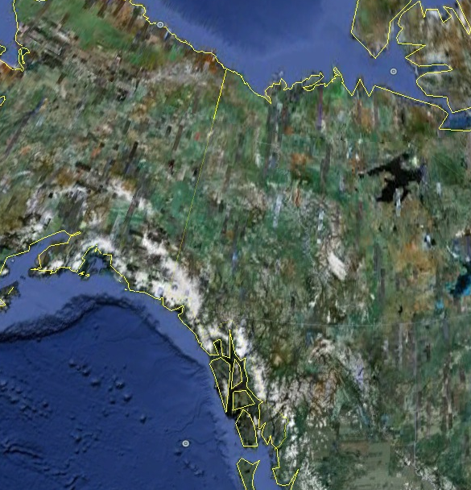
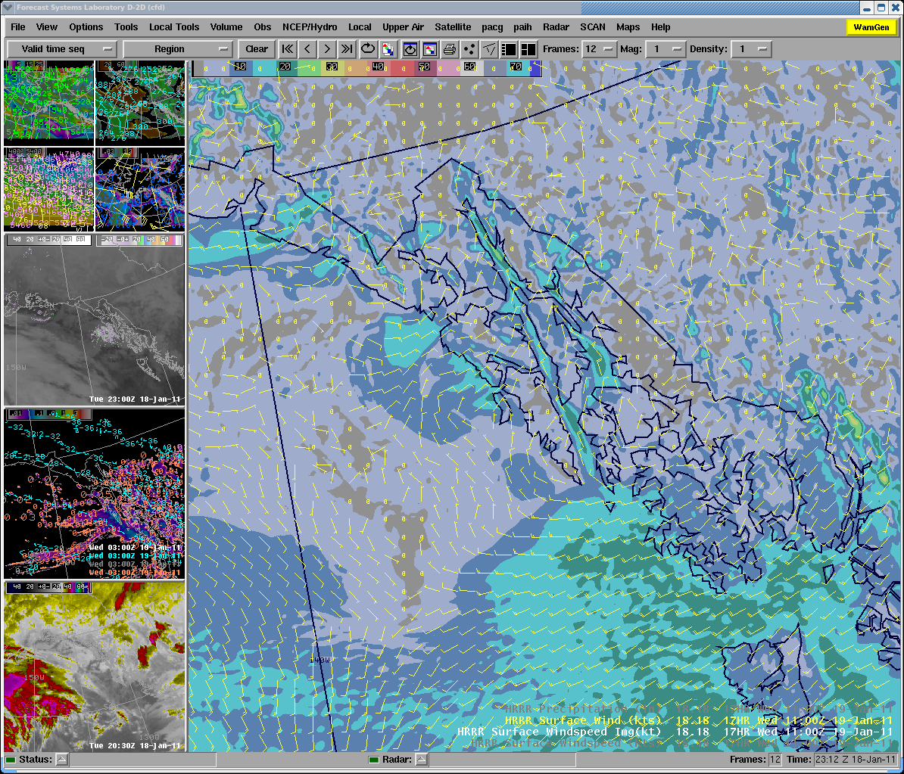
HRRRAK Distribution
ARSC/UAF
Fairbanks
Anchorage
Juneau
WFO Juneau AWIPS
Notes:
Bandwidth in/out of NWS is somewhat restrictive, so we just produce a small number of GRIB2 products for the entire domain, which are picked up by Alaska Region, where George Trojan slices them into patches for the individual CWA’s, then sends them out to the FO’s.
There has been some talk of producing the GFE initialization grids at ARSC, and then shipping those out to ARH, hopefully reducing the data flow.

Slide 33
Recent Efforts
Overall goal was to build an infrastructure to support improvements in the HRRR-AK system
  Build and archive verification products for every forecast
  Build a user-friendly interface (METViewer?)
  Model improvements (within the confines of an operational environment)
    Model levels
    Changes in physics and dynamics
    LSM
  GSI data assimilation

Slide 34
Project Components
Operational verification tools for HRRRAK
  Vision – get processing set up now and save all data for future trend detections. Also, allow for very crude assessments, looking for problem areas for more rigorous studies
  Initially, tools for “eyeballing” trends
  Boxplots, scatterplots, time series, sounding verification, 2D sounding plots, other stations

Slide 35
Verification Post Processing
GDAS prepbufr
HRRRAK netcdf wrfout files
U Wyoming Raobs
Raobs vs HRRRAK Soundings
WRF postprocessor
(wrfout2grib)
FetchPREPBUFRAndDecode
(used PB2NC)
R Scripts
Boxplots
Station time series
Scatter plots
GDAS netCDF
HRRRAK GRIB1
Web graphics with menu
pointstat output
RunForecastPointStat
Archived long-term

Slide 36
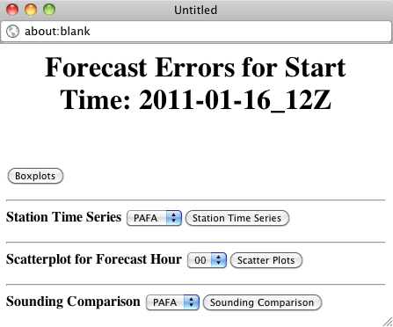
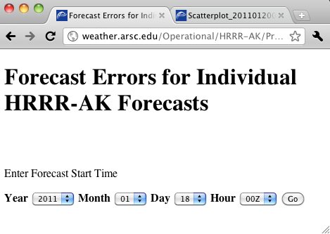
“Verification” Products
Notes:
I continue to call this “verification,” because it seems like NWS does, but I have been warned by others (statistical purists) that this is NOT verification.
After each forecast, and after observations for the entire forecast have become available, we use Model Evaluation Tool (MET) to generate a number of statistics and observations versus forecasts and then, with R, generate a number of plots.
So, we have a crude web interface (no IE) that, for each forecast, allows for various plots to be viewed, as seen in next slides…

Slide 37
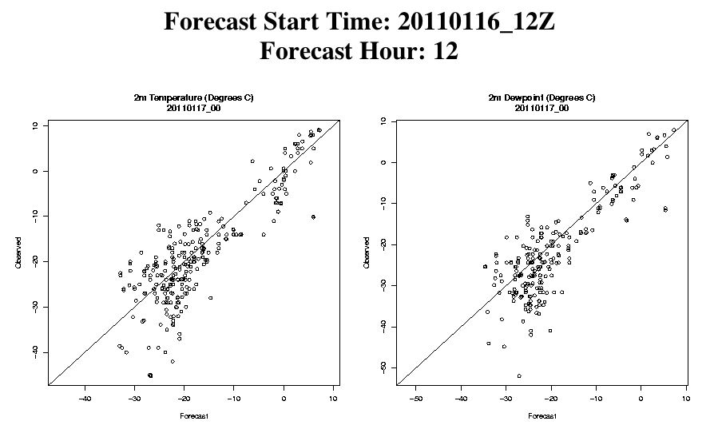


“Verification” Products
Notes:
For each forecast, for T, Td, Wind, SLP, we generate boxplots, scatterplots and time series of obs vs. forecast for a handful of stations.
This is not meant as any kind of rigorous analysis, but as a means to spot-check individual forecasts for potential problem areas

Slide 38

28-day “Verifications”
Notes:
Every week, scripts are automatically executed to go through the MET data from 1-5 weeks prior (28 days) and produce long term plots of surface variable comparisons at a handful of stations.
Currently only implemented for the 00Z forecasts, comparisons are made at the same forecast hour (e.g. FH12, FH18, …) to provide a long-term indication of how the model is comparing to the observations at at the same time within a series of forecasts.

Slide 39

2D Sounding verifications

Slide 40



Raobs vs WRF Soundings
Notes:
Another “verification” product is the comparison of weather balloon soundings with forecast soundings at a handful of raobs sites in the CWA.
After the forecast, and after the observations are available, scripts are run to fetch the raobs data from U. Wyoming, extract a sounding from the related point in the HRRRAK, then produce ASCII tables of both, and a combined plot of HRRRAK and Raobs.

Slide 41
Preliminary Assessment of MET for “verification”
Steep learning curve, but extremely versatile and useful
Need to go much further than domain-wide verification
  Classification into geographical regimes
  Groups of forecasts based on some classification criteria
  The beauty is that we now have all the raw data set up, including MPR’s
Need some sort of database interface for doing specialized verifications over different timespans, regimes, etc.

Slide 42
Namelist Options
  WSM 3-class simple ice, now looking at 3.3.1 version of Thompson graupel microphysics
  RRTM LW physics, Dudhia SW
  Monin-Obukhov sfclay physics
  Thermal diffusion surface physics (need to change soon!), now Noah LSM, looking at RUC
  PBL Physics - YSU, now MYNN 2.5 level TKE, looking at experimental approach
  No cumulus parameterization
  Default layers, now heights of 8, 31, 74, 149, … meters
Notes:
Again, emphasize that we’ve taken an incremental approach where the first steps were to simply deploy all of the pieces (next slide) in a quasi-operational fashion, and THEN, start to modify the domain and namelist for more appropriate model settings.

Slide 43
Project components
Data assimilation with GSI
  Cold start and cycling tests with GDAS surface (and raobs) data
  Use of NASA SPoRT data (AIRS), profiles+radiances
  Issues with GSI – apparent “race” condition when writing/reading some of the temp files (specifics later…)
  Admittedly “black-boxing” it

Slide 44
A quick study in GSI / cold / warm cycling
Question – initialize direct from RR, assimilate, or warm-cycle and assimilate?
Primary goal here – understand the GSI process for cold/warm starting
Preliminary tests to gain insight for future activities
Notes:
The last part of this presentation outlines our VERY PRELIMINARY efforts to get started understanding how to use GSI, and to see if we could get a feel for whether it would be best to initialize HRRRAK directly from RR, add in assimilated data to the 3km initial conditions, and/or whether it might be better to initialize HRRRAK runs from prior HRRRAK runs, making it more of a long-term self-sustained model than a constant RR-influenced model.
Again, this is an exercise more in going through the process than trying – at this point – to get revolutionary results.

Slide 45
FH00 FH06 FH12 FH18 FH24
RR
00Z Control
RR
06Z Control
RR
12Z Control
RR
18Z Control
RR
00Z Cold Start
Obs
Obs
06Z Warm Start
Obs
12Z Warm Start
Obs
18Z Warm Start
Notes:
We set up a series of runs from a single 24-hour period for comparison. Each run had a different start time and/or initialization approach and the question was, in this 24 hour period, how did the forecasts at Hour 24 vary?
The first set of runs, the “Control” runs were a set of RR-initialized runs with no data assimilation. This is essentially how are runs are implemented now.
The second set of runs implements a short cycling procedure, initially starting with RR and assimilated obs, then every 6 hours a new HRRRAK run is started by using the appropriate FH from the previous run, plus data assimilation for updated conditions.

Slide 46
Arbitrary 24 hour forecast
2010-08-05/12Z Surface analysis (courtesy Anchorage Forecast Office
Notes:
Arbitrary forecast chosen that exhibited a couple of interesting synoptic features
Stationary front over the north coast
Developing cyclone in the Yakutat region that culminates later in a sharp cold and then occluded front along the panhandle

Slide 47
GDAS Prepbufr Observations
Notes:
The observations selected were simply those available in the GDAS Prepbufr datasets available for those times. Clearly, it’s an uneven distribution of observations, with heavy skewing towards satellite (QuickScat?) returns. But, in the spirit of this being just a first test, learning how to do things, I proceeded.

Slide 48
FH24, 18Z Warm Start
Sample 2D areal diff analysis
2m Temperature (degC)
10m Wind (m/s)
Notes:
After running all the cases, the first step was just to “eyeball” some 2d difference plots for areas of interest. This set of graphics is just a sample of a number we generated. Here, we’re looking at difference (relative to control run) for 2mT and 10m Wind at Hour 24, using the 18Z Warm start model run.
The above results are somewhat typical, showing larger temperature differences near the north coast stationary front, and wind differences in the vicinity of the panhandle Low.
We used these graphics to help decide where to focus subsequent analysis.

Slide 49
PABR 2m T (degC)
Notes:
We also did a number of plots of bias over the entire domain, but we didn’t feel like any particular signal was evident, so in the interests of time we’re leaving those out of this presention.
So, we looked at time series at select stations in order to gain some insight on behaviour.
In this graphic, we’re looking at Barrow 2m T (that was up near the stationary front). We see that the control runs (those directly initialized by RR) start coming closer to the observed values, presumably because RR itself is providing more up to date initial conditions.
With the warm starts, we see a tendency of the later forecasts to hold on to the signal of the prior, initializing forecast, despite some data assimilation. This is no great surprise either.

Slide 50
PANT 2m T (deg C)
Notes:
Similar behavior at Annette Island (near Juneau). The direct RR-initialized runs improve with more up to date initializations, whereas the warm-start runs just can’t get rid of that initial signal.
Just as I was starting to conclude that direct RR initialization might perform better, just because it’s giving us a lot more up to date data (in the absence of lots of data for assimilation in the regions of interest), Gene suggested that it would be good to look at a case in a very rugged region.
He hypothesized that in these regions, a cold start from 13km RR would force HRRRAK to rebalance the atmosphere to adjust to the 3km terrain, and we’d be inclined to get poor initial conditions. So, this is an area where assimilation at the 3km level might be advantageous.
.

Slide 51
Skagway 2m T (deg C)
Notes:
So, I looked at Skagway (very rugged) and a couple of others, and indeed, there was a different signal. The cold start runs initialized far too low, and the model could never bring the temperatures up to the observed values. However, with the warm start (plus assimilation) approach, the forecast temperatures stayed very close to observed.
Too little work has been done to say anything conclusive, but it’s an interesting observation.

Slide 52

AIRS coverage

Slide 53

Case Study – 24 hr fcst starting at 2011-08-20_00Z

Slide 54
  Temperature at lowest model level (approx 7 meters)
    Control versus GDAS prepbufr
    Control versus GDAS+AIRS profile prepbufr
    Control versus GDAS prepbufr+AIRS radiances

Slide 55






T (lowest level) -- Control (top) / GDAS Prepbufr (bottom)

Slide 56



T (lowest level) -- Control (top) / GDAS Prepbufr + AIRS profiles (bottom)

Slide 57



T (lowest level) -- Control (top) / GDAS Prepbufr + AIRS radiances (bottom)

Slide 58









Control minus GDAS surface
Control minus GDAS surface and AIRS profiles
Control minus GDAS surface and AIRS radiances

Slide 59
  Wind at lowest model level (approx. 7 meters)
    Control versus GDAS prepbufr
    Control versus GDAS+AIRS profile prepbufr
    Control versus GDAS prepbufr+AIRS radiances

Slide 60





Wind (lowest level) -- Control (top) / GDAS Prepbufr (bottom)

Slide 61



Wind (lowest level) -- Control (top) / GDAS Prepbufr + AIRS profiles (bottom)

Slide 62



Wind (lowest level) -- Control (top) / GDAS Prepbufr + AIRS radiances (bottom)

Slide 63






Control minus GDAS surface
Control minus GDAS surface and AIRS profiles
Control minus GDAS surface and AIRS radiances

Slide 64

Initial - Compare against Control FH00

Slide 65

FH24 - Compare against control

Slide 66

FH00 - compare against AIRS profile + Surface

Slide 67

FH24 - Compare against AIRS profile + surface

Slide 68

FH00 - Compare against Control

Slide 69

FH24 - Compare against Control

Slide 70

FH00 - Compare against AIRS profile + surface

Slide 71

FH24 - Compare against AIRS profile + surface

Slide 72












Control
GDAS Prepbufr
AIRS profile +GDAS Prepbufr
AIRS radiances +GDAS Prepbufr

Slide 73
Next slides
Boxplots of GDAS surface obs in various HRRRAK forecasts

Slide 74

Control run

Slide 75

GDAS Prepbufr

Slide 76

AIRS profile + GDAS surface

Slide 77
Next slides
Scatter plots

Slide 78


2m T and Td - Control, FH00

Slide 79


2m T and Td, Control, FH24

Slide 80


2m T and Td, GDAS prepbufr, FH00

Slide 81


2m T and Td, AIRS Profile + prepbufr, FH00

Slide 82


2m T and Td, AIRS profile + prepbufr FH24

Slide 83
Next slides
Raobs vs forecast soundings

Slide 84




PABR FH12
Control
GDAS Prepbufr
AIRS Profile + Prepbufr
AIRS Radiance + Prepbufr

Slide 85




PABR FH24
GDAS Prepbufr
Control
AIRS Profile + Prepbufr
AIRS Radiance + Prepbufr

Slide 86




PANT FH24
GDAS Prepbufr
Control
AIRS Profile + Prepbufr
AIRS Radiance + Prepbufr

Slide 87




PANC FH24
GDAS Prepbufr
Control
AIRS Profile + Prepbufr
AIRS Radiance + Prepbufr

Slide 88




PAFA FH00
GDAS Prepbufr
Control
AIRS Profile + Prepbufr
AIRS Radiance + Prepbufr

Slide 89




PAFA FH12
GDAS Prepbufr
Control
AIRS Profile + Prepbufr
AIRS Radiance + Prepbufr

Slide 90




PAFA FH24
GDAS Prepbufr
Control
AIRS Profile + Prepbufr
AIRS Radiance + Prepbufr

Slide 91
Next plots
Station time series

Slide 92




PAJN - SLP
GDAS Prepbufr
Control
AIRS Profile + Prepbufr
AIRS Radiance + Prepbufr

Slide 93




PAJN -2m T
GDAS Prepbufr
Control
AIRS Profile + Prepbufr
AIRS Radiance + Prepbufr

Slide 94




PAFA -SLP
GDAS Prepbufr
Control
AIRS Profile + Prepbufr
AIRS Radiance + Prepbufr

Slide 95




PAFA -2m T
GDAS Prepbufr
Control
AIRS Profile + Prepbufr
AIRS Radiance + Prepbufr

Slide 96
Setbacks
ARSC funding – originally had multiple supercomputing systems with opportunity to run cases in parallel.
The new reality has us fighting for time on a single system, spending time moving things around
Harder to justify unfunded efforts to keep HRRRAK running

Slide 97
Future
Explore DA more rigorously – good data “should” give better initial conditions
Parallel operational runs of assimilated vs non-assimilated runs
Data mining of all the data we’ve amassed with MET, investigating different regimes, etc.
Continued changes in model configuration

Slide 98
http://weather.arsc.edu/Events/AWS11/

