Slide 1
Session 1: Beginnings
Sixth Meeting of the SPoRT
Science Advisory Committee
Meeting expectations
SPoRT organization and partnerships
SPoRT paradigm
Review of SAC09 recommendations
Notes:
1

Slide 2
Meeting Expectations
Purpose of Review/ Expectations
SPoRT to provide: a comprehensive update to SAC on recent research and transition activities and partner interactions
SAC to provide:
  Feedback on strengths, weaknesses, and accomplishments
  Direction for future activities
  Other program guidance as necessary, including new SAC members
  Report that summarizes meeting and provides recommendations for the future (to be delivered with 3 months of meeting)
Benefits:
  SPoRT scientists – improve focus of activities
  NASA Headquarters program manager (Tsengdar Lee) – program emphasis and justification for funding support
  Beneficiaries, partners, and end users – know that SPoRT is determined to provide best quality / services to those who rely on us!
Notes:
2

Slide 3
Foundation of SPoRT
Mission - Apply NASA and NOAA measurement systems and unique Earth science research to improve the accuracy of short-term weather prediction at the regional / local scale
Goals:
  Evaluate and assess the utility of NASA and NOAA Earth science data and products and unique research capabilities to address operational weather forecast problems
  Provide an environment which enables the development and testing of new capabilities to improve short-term weather forecasts on a regional scale
  Help insure successful transition of new capabilities to operational weather entities for the benefit of society
Vision – to become the focal point and facilitator for the transfer of NASA and NOAA Earth science technologies to the operational weather community with emphasis on short-term forecasting on the regional and local scale
Development
Implementation
Adaptation
Phase I
Phase II
Phase III
IV
FY02
FY05
FY10
FY15
paradigm
relationships
forecast problem
user interaction, assessment,
end user focus
expand partnerships
new data, display systems
new forecast problems
Notes:
3

Slide 4
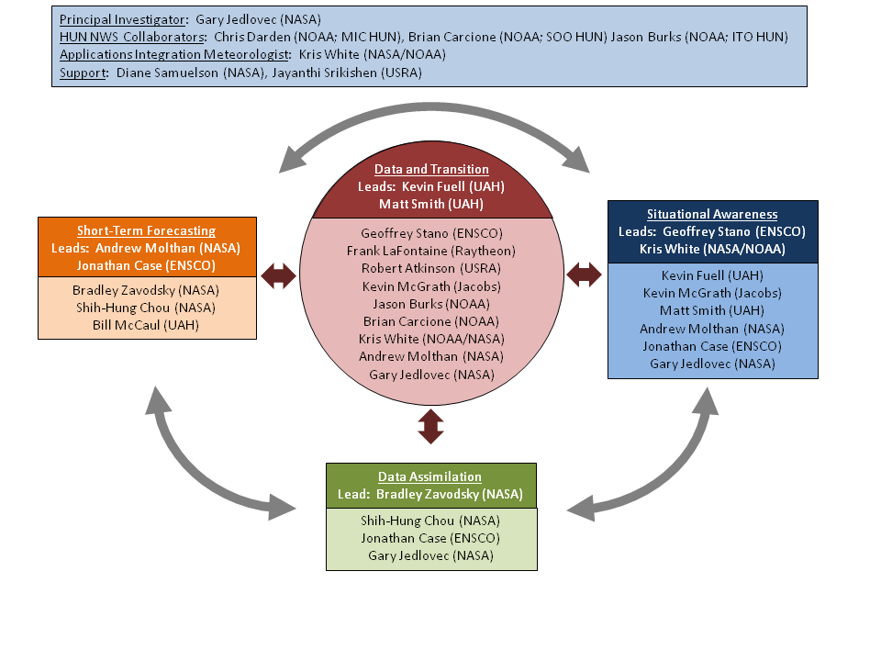
SPoRT Organization
Blend of scientific expertise, forecasting skills, and training experience that directly support SPoRT’s mission
5 Civil Servant FTE’s
8 Res. Associate WYE’s
0.5 NWS FTE
Notes:
FTE = Full-Time Equivalent
WYE – Work-Year Equivalent
4

Slide 5
Partnerships
Collaborative partners - stakeholders and beneficiaries, often providing programmatic or financial support - direct or in-kind
  NASA/SMD/ESD, NOAA/NESDIS, NOAA/JCSDA, NWS/OST, others
Supporting partners - help SPoRT conduct the research and transitional activities by providing capabilities such as technical expertise, computational resources, data, or other enabling capabilities
  NASA LANCE, NASA / GSFC, NOAA/JCSDA, NRL, NESDIS, NSSL, UW/SSEC/CIMSS, CIRA, UAF/GINA, NWS Regional HQs, National Centers, testbeds, WFOs, others)
Collaborating end users
  WFOs
  National Centers
Notes:
5

Slide 6
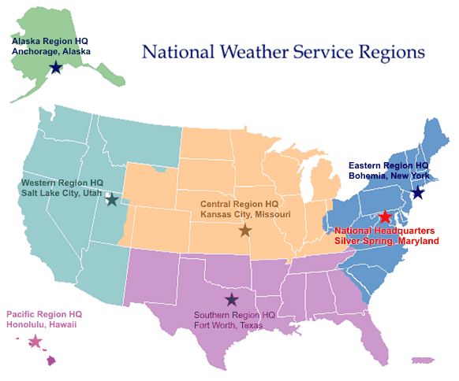
Partnerships
“SPoRT” WFOs
Regional HQs
Collaborating National Centers
Data providers / subject matter experts
Notes:
6

Slide 7
Research to “Operations”
SPoRT Paradigm
match forecast challenge to data/product
develop solution / demonstrate in ”test bed” environment
integrate successful products into user’s decision support tools
create product training
perform product assessment
Keys:
Maintain interactive partnership with end user throughout the process
Need to obtain an end user advocate or “champion”
Ready for full transition
Determine Forecast Issue
Match Forecast Issue to Product
Determine Training Needs
Evaluate Product Impact
Enhance the Product
Has forecast issue been addressed?
Determine forecast problem
Yes
No
Problem been addressed?
Match problem to product
Involve end user in entire process
Assess operational impact
Develop solution
End user training
Test Bed Environment

Slide 8
SPoRT Metrics
We measure success through the following mechanisms
Successful transitions
New products and research capabilities used in decision support systems
Discernible impact of NASA / NOAA data or capabilities in WFO, at National Centers, or in NWP operations
Community recognition
Peer recognition as a community partner and “place to go” for the transition of research capabilities to the operational weather community
Adoption of the SPoRT paradigm by others within our community
Publications
Peer reviewed publications for research, transitional capabilities, and techniques
Publication of transitional results and assessments that include input from our WFO partners and end user community
Reviews by outside committees
Positive biennial reviews by the SPoRT Science Advisory Committee
Notes:
8

Slide 9
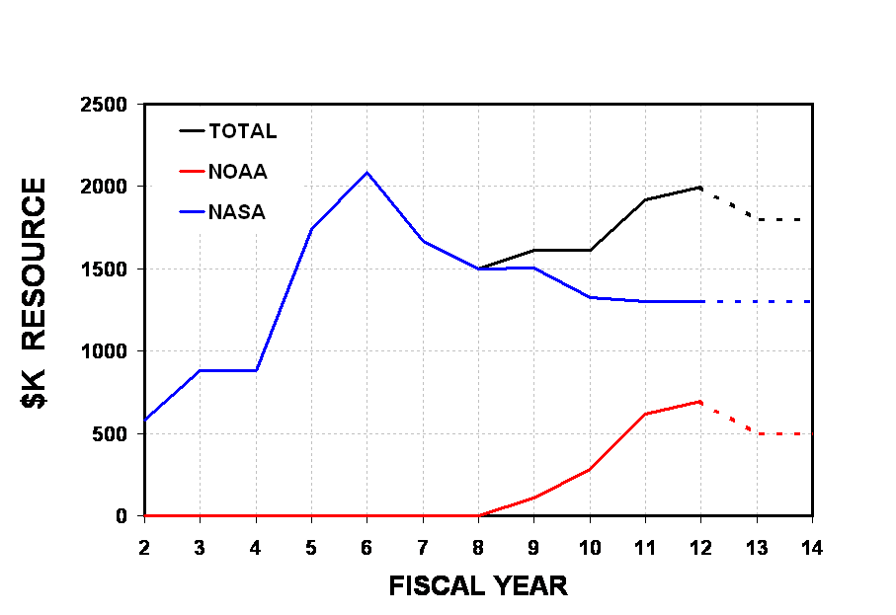
SPoRT Budget
PG funding augments NASA reductions
VIIRS funding

Slide 10
Questions?

Slide 11
Recommendations and SPoRT Response
SAC Meeting – November 2009

Slide 12
Recommendations / Response
Recommendation: SPoRT should broaden its end users to include a nationwide subset of WFOs, N. Centers, RFCs - stay true to mission / vision, remain complementary not competitive with other NOAA entities
Response/Action:
Hosted SSD chiefs in March 2010
  reviewed SPoRT program, strategized on expansion
  SSD chiefs support strategic expansion – want to be kept in the loop
  SPoRT agreed to visit each Region – look for synergy
  visited all but WR, also visited AWC, SPC, OPC, HPC, NHC, and SERFC, AAWC, ARFC,
  Anchorage CWSU, and additional WFOs
  ER / CR – Great Lakes modeling collaboration
  AR (and UAF) – Terra/ Aqua data – SSTs, sea ice product, MODIS imagery (soon)
  WR – ocean surface wind vectors from WindSat
  Expanded participation in the GOES-R / NPP Proving Ground
  several new WFOs, new agreements to evaluate proxy ABI and VIIRS data
  National Centers – suite of RGB products from GOES Sounder / SEVIRI (proxy for ABI)
  enhanced NESDIS and CIRA collaborations for access to data / products
  challenge to participate without being competitive with others (CIMSS, CIRA)

Slide 13
Recommendations / Response
Recommendation: SPoRT should aggressively promote itself as the transition testbed for application of unique NASA data sets to improve situational awareness and short-term forecasting for NOAA/NWS.
SPoRT should provide information on the link of unique NASA data sets to future NOAA data sets from operational satellites (e.g. MODIS to VIIRS, AMSR-E to MIS)
Response/Action:
Enhanced outreach activities
  conference and workshop presence, publications, newsletters, blog
Involvement in proving ground activities used to enhance linkages between research and operational satellite sensors
Suggestion: Include more detail on key milestones and timelines, long-term project implementation plans, and explanation on the importance of the metrics and possible key values in revised Strategic Plan
Response/Action: No update to Strategic Plan is planned at this time.

Slide 14
Recommendations / Response
Recommendation: SPoRT should actively seek out partnerships and collaborative projects with other NOAA/NWS testbeds and use its ability to deliver experimental datasets to the field as a unique strength.
Response/Action: SPoRT expanded collaboration with HWT, started a newly funded activity with JCSDA, and supports the JHT through the GOES-R PG. Continue to look for synergy with HMT.
Recommendation: SPoRT management should gain a high-level understanding of the various requirements and transition processes in NOAA/NWS.
Response/Action: Working to improve this understanding through coordination with NWS / OST.

Slide 15
Recommendations / Response
Tactical Planning / Reporting
Recommendation: SPoRT should replace the biennial report with a smaller Annual Report and make the report available to end users, partners, and stakeholders.
Response/Action: These reports are a big time sink for technical staff. Given limited manpower this is a lower priority than other tasks.
Recommendation: SPoRT should reconsider development of a task or project plan for each project that clearly defines objectives, collaborators, a schedule, milestones, a projected completion date, and the expected deliverable.
Response/Action: Task plans with milestones, deliverables, and level of effort for various individuals have been developed for over 25 tasks. This has helped prioritize activities and has led to greater productivity.

Slide 16
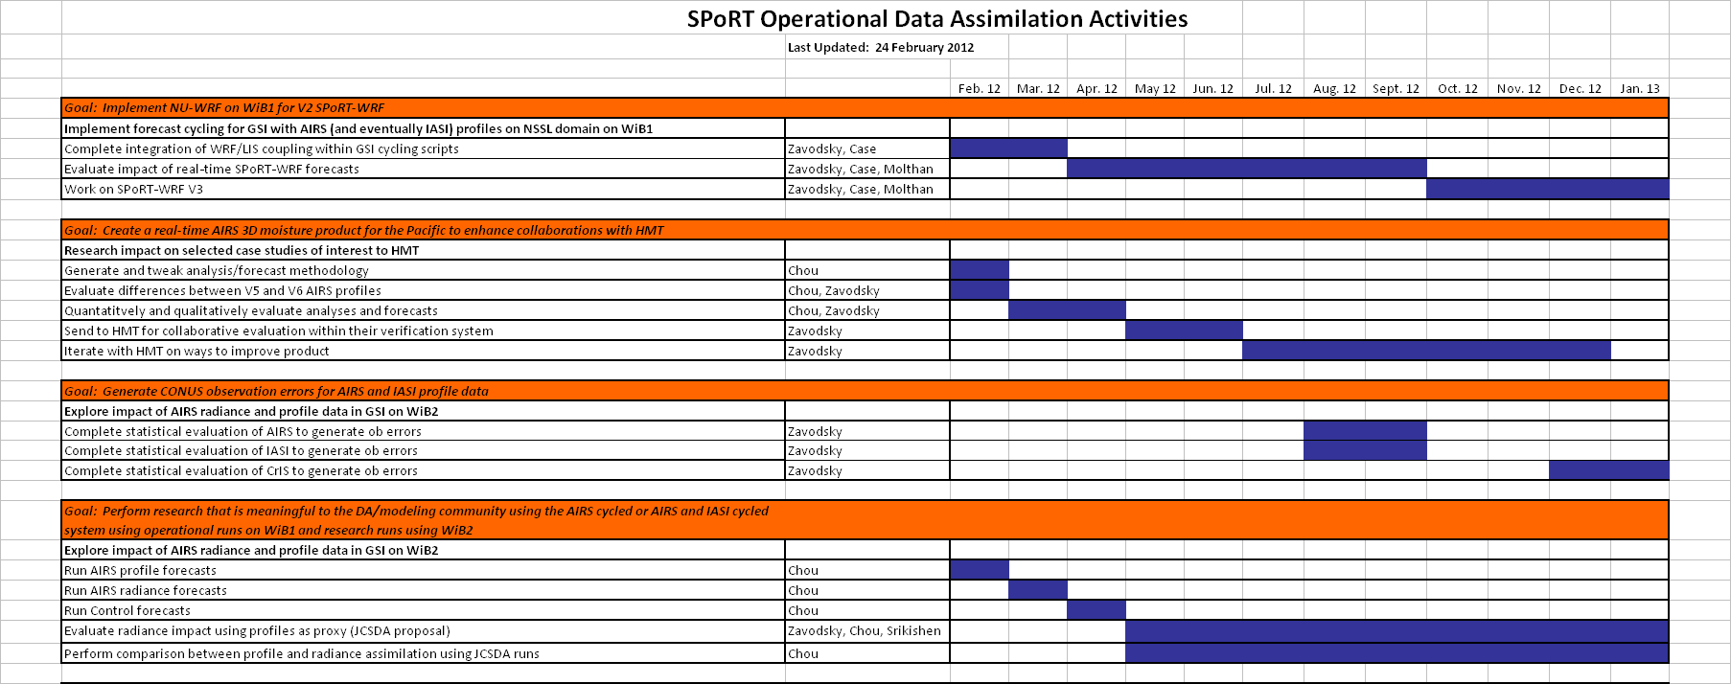
SPoRT Project Activities – Schedule and Tasks
Task list, schedule, deliverables, manpower estimates developed for each major activity (30+)

Slide 17
Recommendations / Response
Miscellaneous:
Recommendation: Include a conference call with a representative sample of customers at future SAC meetings.
Response/Action: This has been planned for the SAC meeting.
Suggestion: SPoRT should consider annual advocate (end user) workshop in Huntsville. The workshops would provide an excellent venue to further communication, exchange ideas, gather requirements, and showcase SPoRT/WFO projects.
Response/Action: SPoRT hosted a virtual workshop in late summer 2011 involving all SR collaborative offices. Other WFOs participated as well. This forum provided great interaction at minimal cost.

Slide 18
Recommendations / Response
Short-term Forecasting
Recommendation: Align short-term forecasting objectives with specific end users.
Response/Action: HWT Spring Program, WFOs through local modeling using WRF EMS, focused collaborative modeling with selected WFOs, focused collaboration with JCSDA
Recommendation: SPoRT should consult with model developers to ensure that the microphysical parameterization research is relevant to the needs of operational NWP in the 2-5 year period.
Response/Action: Not something we have activity pursued.
Recommendation: SPoRT should evaluate optimal use of satellite-based soil moisture products in the Land Information System.
Response/Action: Have evaluated AMSR-E soil moisture before loss of instrument, gearing up for SMAP

Slide 19
Recommendations / Response
Short-term Forecasting (continued)
Recommendation: SPoRT should evaluate work being done by EMC with IASI for application in regional and local WRF models in preparation for CrIS applications.
Response/Action: SPoRT is assimilating IASI profiles, and preparing to use AIRS (from LANCE) and IASI (from NESDIS) to support near-future assimilation within GSI.
Recommendation: SPoRT should establish an understanding of action taken by NESDIS and GCOM for the use of data from the AMSR-II sensor. This would allow SPoRT to assist regions and WFOs to maintain continuity with current AMSR-E capabilities and better prepare for NPOESS VIIRS data.
Response/Action: SPoRT received AMSR-E data from NASA LANCE. LANCE currently does not know if it will have access to AMSR-II. Will continue to evaluate this.

Slide 20
Recommendations / Response
Short-term Forecasting (continued)
Recommendation: Look for further opportunities to collaborate with other scientists and end users, especially in high threat areas such as the Western United States during the summer fire season on the utility of lightning forecasts with WRF.
SPoRT should assess the technical requirements and potential benefits of pursuing this area of research as a means of formulating (or not) a specific research plan. Consultation with EMC and coordination with existing efforts in this area made under the GOES-R Risk Reduction program (including the development of a lightning forward operator) seems like logical first steps.
Response/Action: The activity has been fully transitioned to NSSL for use in their operational WRF models runs. Activity is now funded separately by GOES-R PG.

Slide 21
Recommendations / Response
Situational Awareness
Recommendation:
The SAC believes the data denial experiment regarding inclusion of high resolution SSTs into the local WRF model was an excellent concept and allowed SPoRT to directly quantify the impacts. Broaden the use of this or similar concepts to help quantify the impact of unique NASA data sets.
Response/Action: Refined SST product (larger region), incorporate NESDIS POES/GOES product. Adopted similar approach with LIS (vegetation fraction, etc.)
Recommendation: SPoRT should ensure (through training or other means) users of the blended (hybrid) product understand how to interpret the blended product and the difference between loading the mixed product versus a GOES-only product in the AWIPS menus.
Response/Action: Developed training modules to show this.

Slide 22
Recommendations / Response
Situational Awareness (continued)
Recommendation: When feasible, suggest advocates play a bigger role in training development. Some SOOs may even be willing to produce the first draft of a training segment.
Response/Action: We activity do this – examples (RGBs, hybrid, total lightning)
Recommendation: SPoRT needs to consider the future of ground-based total lightning networks and their role in the future. SPoRT should collaborate with NWS Office of Science and Technology, NSSL, and other interested parties and formalize a project/program to investigate the potential future path of this technology into NWS operations.
Response/Action:
Ground-based LMA used for validation and process studies
Had discussion of this with OST staff during Berchoff visit to SPoRT

Slide 23
Recommendations / Response
Situational Awareness (continued)
Recommendation: SPoRT should tie assessments to metrics or well defined goals in a project plan. Where possible, quantitative measures or summary survey results should be included as well as any qualitative assessment.
Response/Action: We are now able to do this with task descriptions.
Recommendation: SPoRT should clearly state its policy for provision of customized products. The SAC believes SPoRT should continue to provide products for general download via ftp or LDM subject to available resources and the disclaimer, but refrain from providing customized products to commercial interests unless NASA and SPoRT clearly address policy regarding such future requests.
Response/Action: SPoRT continues to work to provide more of its products via anonymous ftp, kml, and web services.

Slide 24
Summary
SPoRT :
  values SAC recommendations and feedback
  has been responsive to SAC recommendations
    provided early feedback on planned response
    implemented majority of ideas
  believes the guidance has made the program much better
  looking forward new guidance from the SAC 2012 meeting

Slide 25
SPoRT Program Highlights
Expanded strategically to involve other NWS Regions and address other forecast issues
  hosted SSD Chief Meeting (March 2010) – endorsement of expansion
  obtained additional GOES-R PG funding -- expanded collaboration with HWT, started a newly funded activity with JCSDA, and support the JHT
Major strides towards transitioning all products to AWIPS II
  collaborations with Raytheon
  attended Raytheon developers workshop
  modified McIDAS plug-in for SPoRT applications (October 2011
  create development team for AWIPS II plug-ins
  hosted Berchoff / OST visit (November 2011)
Significant R & T activities
  13 journal publications (7 as lead author) in last 2.5 years
  many new products to end users
  novel applications of SPoRT data to tornado damage track assessment for the April 27, 2011 SEUS outbreak
Utilizing new instrument / data collaborations to demonstrate weather forecast improvements

