Slide 1


Session 2: Modeling and Data Assimilation
Sixth Meeting of the Science Advisory Committee
28 February - 1 March, 2012
National Space Science and Technology Center, Huntsville, AL
transitioning unique NASA data and research technologies to operations

Slide 2
Relevance to SPoRT
SPoRT focuses on improvements to short-term, regional weather forecasts using unique satellite products and capabilities
  Convection and precipitation, sea/land breezes, temperature forecasts
  SPoRT tools used to address forecast challenges: SPoRT SST Composite, hyperspectral sounder retrieved profiles, LIS, SPoRT MODIS NDVI/GVF composite
Few other groups actively working to transition satellite assets into regional operational models
Complements JCSDA’s global mission on the regional scale
SPoRT’s work feeds back to local and national operational end-users through active collaborations
  Collaborations and modeling projects with WFOs
  Evaluation of SPoRT models at HWT/SPC
  Targeted research activities with EMC through use of NAM Launcher
transitioning unique NASA data and research technologies to operations

Slide 3
Accomplishments Since Previous SAC
“Ensure objectives, targeted end-users, and deliverables are identified both for the project plan and for future SAC reviews”
  Weekly modeling team meetings using project plans
“SPoRT should consult with model developers to ensure that this research is relevant to the needs of the operational NWP in the 2-5 year period”
  SR modeling collaboration (Mobile, Houston WFOs)
  GL modeling collaboration (Gaylord, ER WFOs)
  SPoRT-WRF (HWT/NSSL/SPC; eventually ICs for local WFO runs)
  AIRS radiance/profile investigation (JCSDA/EMC collaboration)
SPoRT modeling and data assimilation has 4 publications, 2 accepted publications, and more than 25 conference presentations/posters since last SAC meeting
transitioning unique NASA data and research technologies to operations

Slide 4
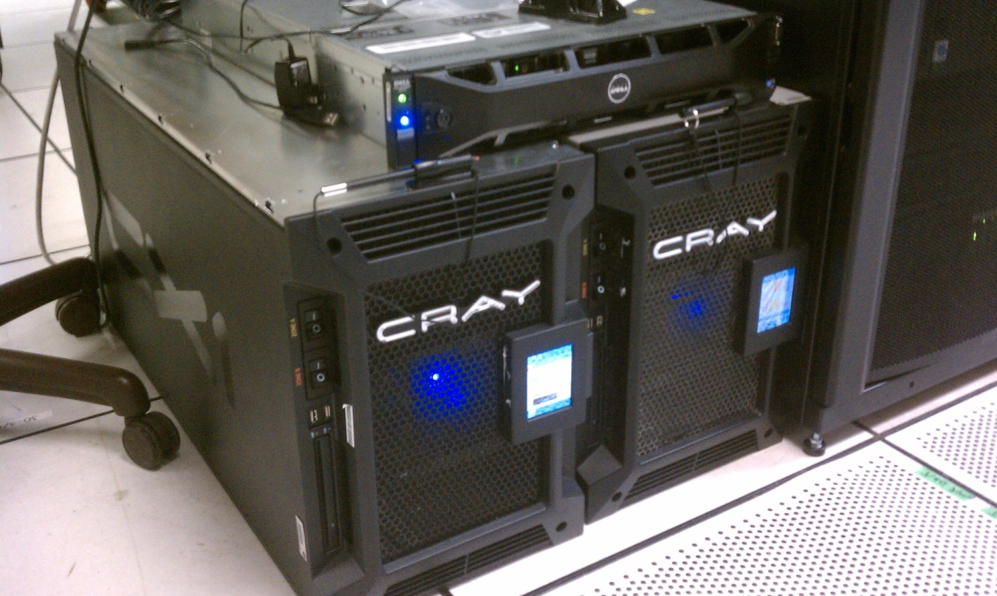
SPoRT Computational Resources
“SPoRT should take into consideration their computing resources”
  Two “Weather in a Box” desktop super computers; no cost from NASA HQ to support real-time modeling applications and R&D activities
  NCCS Discover to support R&D activities
  NCCS “Joint Center in a Big Box” to support JCSDA collaborative activities
  NASA Ames Nebula Cloud to support modeling activities
  Redstone Army Supercomputing Resources to support real-time modeling applications
  All current projects able to run on current resources
8 Compute Nodes
3 GHz Intel Xeon Processors (8 cores total)
24 GB RAM
320 GB 7.2k HDD
InfiniBand Ports and Cables
transitioning unique NASA data and research technologies to operations

Slide 5
Introduction of Speakers
Data Assimilation Cycling with GSI and AIRS (Zavodsky)
The SPoRT NDVI/GVF Dataset and Impacts on Models (Case)
Real-time SPoRT LIS and Applications (Case)
Using High-Resolution SPoRT SST Data and the NASA LIS to Initialize the WRF-EMS at NWS Houston/Galveston (Wood)
The SPoRT-WRF: Transitioning SPoRT Modeling Research (Zavodsky)
transitioning unique NASA data and research technologies to operations

