Slide 1


Real-time SPoRT LIS and Applications in Modeling and Situational Awareness
Relevance / accomplishments since 2009 SAC
Overview of LIS and SPoRT real-time LIS
LIS applications
  Local modeling at SPoRT partners
  Situational Awareness examples (Kris White)
Summary and future
Sixth Meeting of the Science Advisory Committee
28 February to 1 March 2012
National Space Science and Technology Center, Huntsville, AL
transitioning unique NASA data and research technologies to operations

Slide 2

LIS: Relevance to NASA/SPoRT
NASA asset developed by GSFC
LIS benefit to SPoRT end-users
  LSM fields for model initialization
  Situational Awareness / short-term
  forecasting
LIS framework enables use of NASA satellite datasets
  MODIS-derived land cover & vegetation coverage
  Capability to assimilate land-surface satellite products
    Ensemble Kalman Filter algorithm
    Soil moisture, snow-water equivalent, land surface temp
transitioning unique NASA data and research technologies to operations

Slide 3
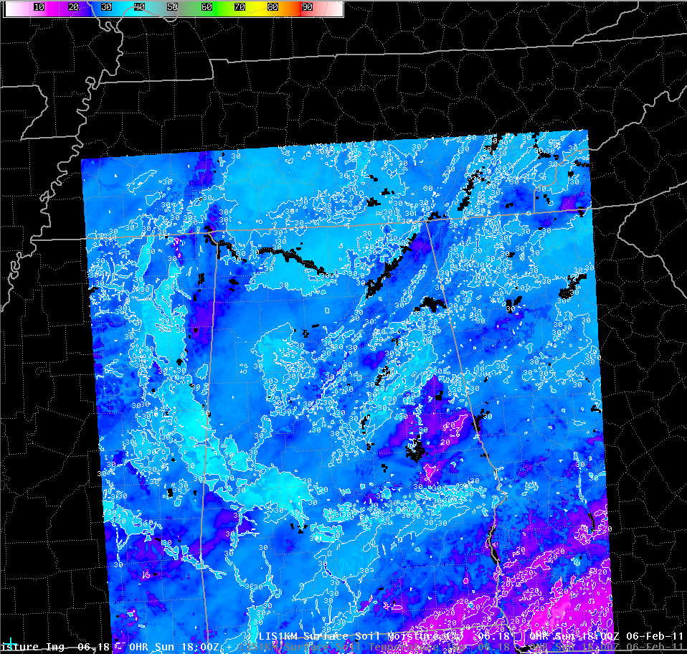
Accomplishments since 2009 SAC Meeting
2009 SAC Recommendations: “SPoRT should evaluate optimal use of satellite-based soil moisture products in the Land Information System”
  Submitted ROSES proposal to study impact of Europe’s Soil Moisture-Ocean Salinity (SMOS) retrievals in LIS (not accepted)
  AMSR-E soil moisture retrievals generally deemed of low quality
Configured real-time 3-km/1-km LIS
  Hourly output in SPoRT LDM & ftp server
  Displayable in AWIPS at WFO HUN and BMX
  Option to initialize WRF EMS with LIS fields
Publications and presentations
  Wea. Forecasting (Dec. 2011 Issue)
  2011 National Weather Association
transitioning unique NASA data and research technologies to operations

Slide 4
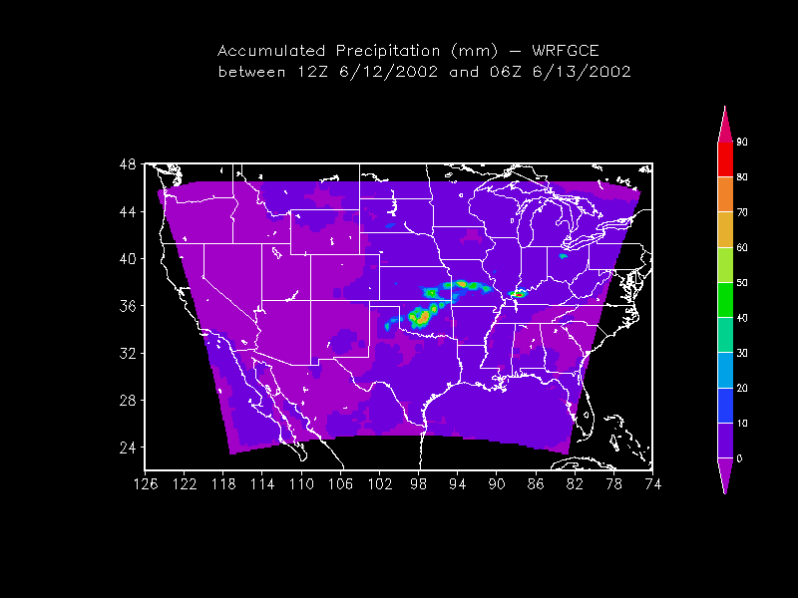
High-Level Overview of LIS
Uncoupled or
Analysis Mode
Coupled or
Forecast Mode
Station Data
NU-WRF
Global, Regional
Forecasts and
(Re-) Analyses
ESMF
Land Surface Models
(LSMs)
Noah,VIC, SIB, SHEELS
Satellite Products
Yellow indicates
components of
SPoRT LIS
SPoRT-WRF to use
coupled system
Data Assimilation
(θv, LST, snow)
LSM First Guess /
Initial Conditions
transitioning unique NASA data and research technologies to operations

Slide 5
Prior SPoRT Modeling with LIS
Sensitivity / initialization experiments:
Case et al. (2008) manuscript in J. Hydrometeor.
  Quantified positive impacts to WRF forecasts over Florida by
  initializing model with LIS land surface output
  Focused on verification of primary meteorological variables
Case et al. (2011) manuscript in Wea. Forecasting
  Precipitation verification using traditional and object-based methods
  Found that 4-km WRF runs initialized with LIS and SPoRT SST
  improved modestly on forecast summer convection in the SE U.S.
SPoRT/MODIS daily GVF sensitivity (previous talk)
  Both offline LIS and coupled LIS/WRF experiments
  SPoRT contributed code to process daily-updated GVF
transitioning unique NASA data and research technologies to operations

Slide 6
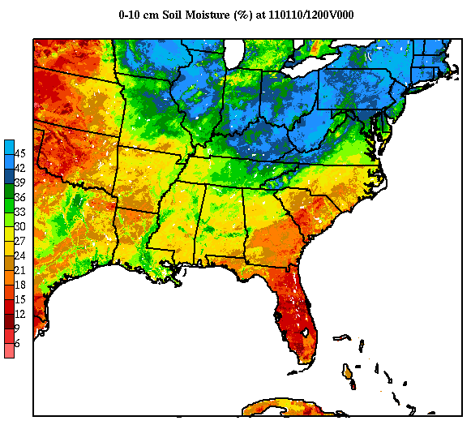
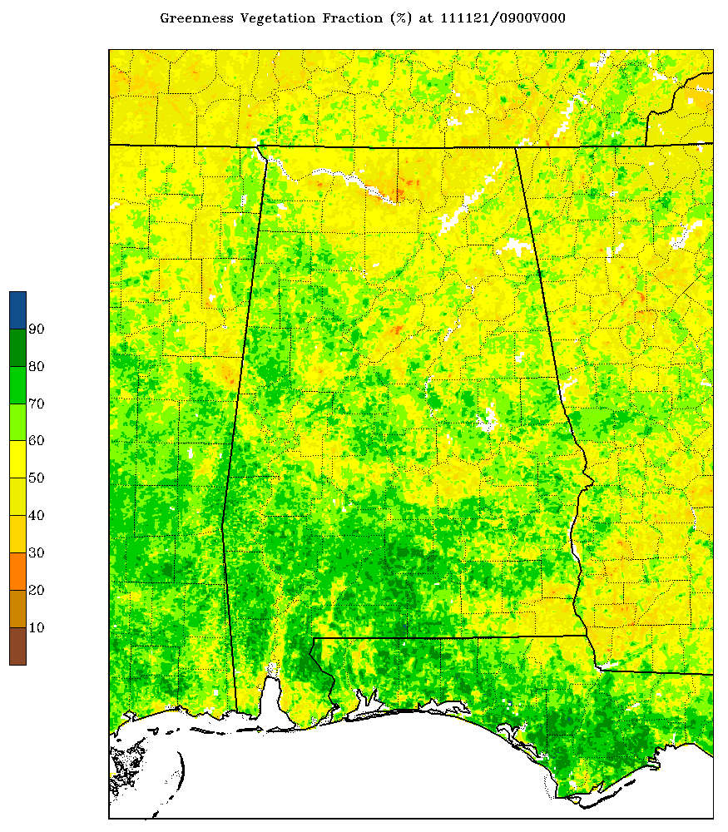
Real-time LIS/Noah at SPoRT
3-km LIS over eastern U.S. /
1-km nest over Alabama
  Spin-up run; restarts 4x per day
  Hourly output to ftp & LDM server
  SPoRT GVFs beginning in April 2011
LIS used in WRF-EMS at WFOs
  HUN, BMX, MOB, MFL, MLB, HGX
LIS output for situational awareness
  NWS BHM: Convective initiation
  NWS HUN: drought monitoring, winter & hydrological applications
transitioning unique NASA data and research technologies to operations

Slide 7
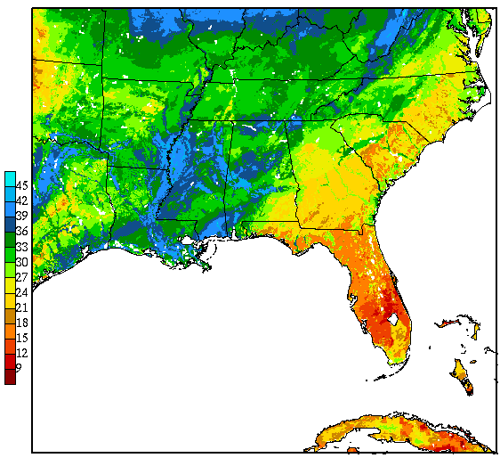
LIS Application: Local Modeling at SPoRT Partners
Miami, FL WFO:
Using LIS and SPoRT SSTs to initialize local model runs
Evaluation underway
Presented at 2011 NWA annual meeting
SPoRT/NWS SR Collaboration:
Houston, TX and Mobile, AL WFOs
Data denial experiments
  WFO runs use LIS, SPoRT SST and SPoRT GVF
  Control runs without data made at SPoRT
SPoRT developed verification scripts to run
in-house at WFO
transitioning unique NASA data and research technologies to operations

Slide 8
LIS Application for Situational Awareness:
Birmingham CI Project
BMX: Extend summer convective initiation (CI) study to include LSM/differential heating boundaries
Summer 1: 2009
  Identify all boundaries that triggered deep convection
  Dispel the myth of “random” summertime thunderstorm development
Summer 2: 2010 (intern student)
  SPoRT LIS introduced to identify gradients in land surface properties
  Experimental short-term forecasts of daily CI (polygons)
Summer 3: 2011
  Experimental PoP compared to operational mid-shift PoP
transitioning unique NASA data and research technologies to operations

Slide 9
Summer 1: Categorization of Boundaries
transitioning unique NASA data and research technologies to operations

Slide 10
Summer 2: Verification of Boundaries
transitioning unique NASA data and research technologies to operations

Slide 11
Summer 3: Summer PoP Forecasts
(Percent Improvement in Afternoon Experimental PoP)
transitioning unique NASA data and research technologies to operations

Slide 12
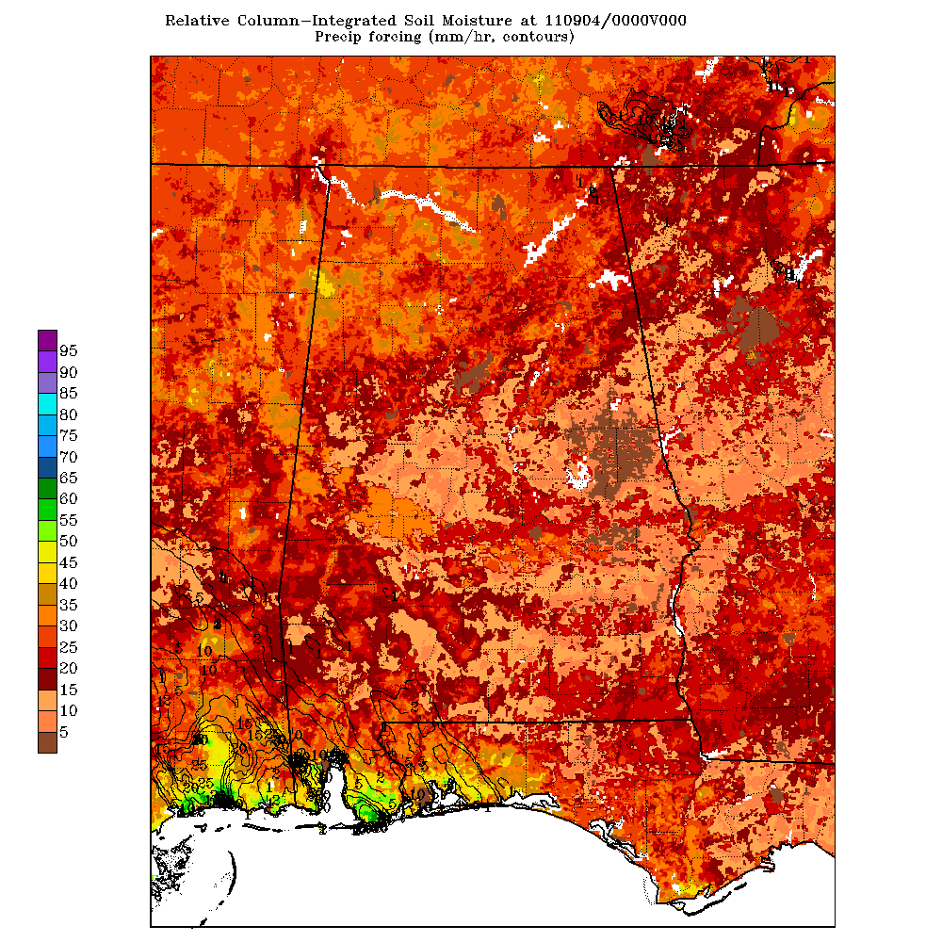
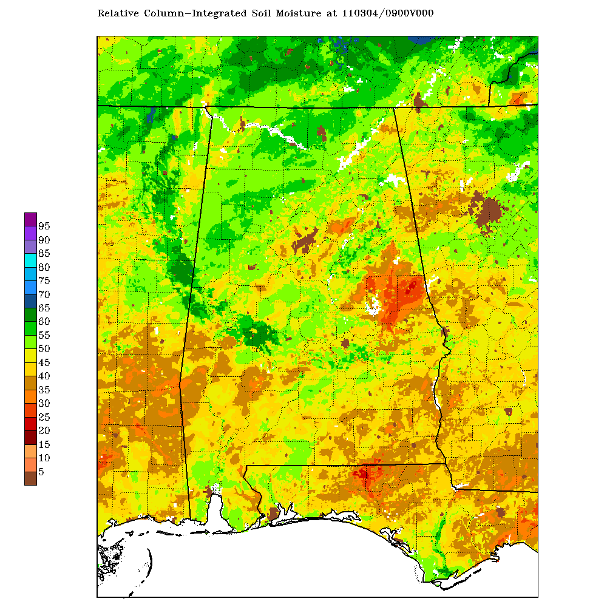
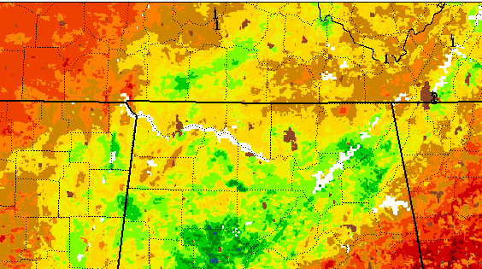
LIS Application for Situational Awareness:
Assessing Flood Potential at HUN WFO
09/04/2011
LIS 1-km Integrated Soil Moisture
Low relative soil moisture (20-40%)
before Tropical Storm Lee.
Soil had large capacity to hold
more moisture.
09/07/2011
After widespread rainfall (4-12”),
relative soil moisture increased to
around 40-55%.
Very little flooding reported
  Steady rain event
  Dry antecedent soils
transitioning unique NASA data and research technologies to operations

Slide 13
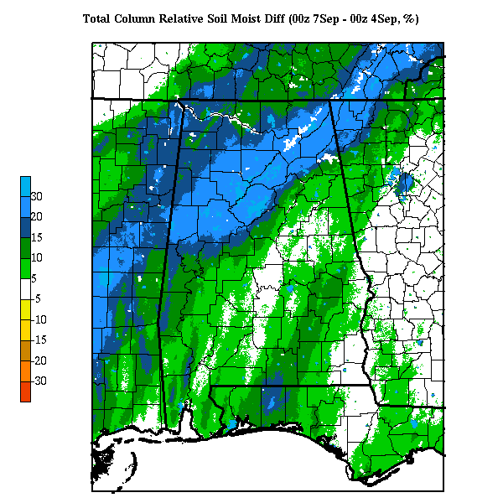
LIS Application for Situational Awareness:
Assessing Flood Potential at HUN WFO
Stage IV rainfall
from T.S. Lee
3-day change in soil moisture
(7 Sep – 4 Sep 2011)
transitioning unique NASA data and research technologies to operations

Slide 14
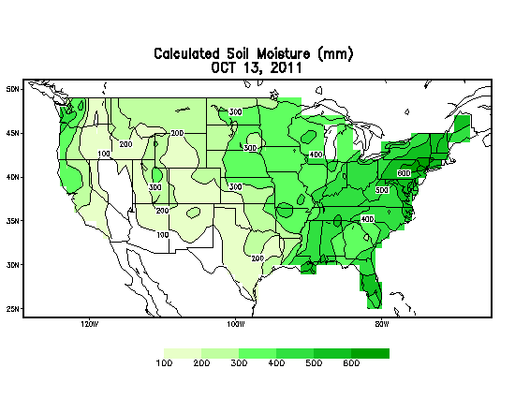
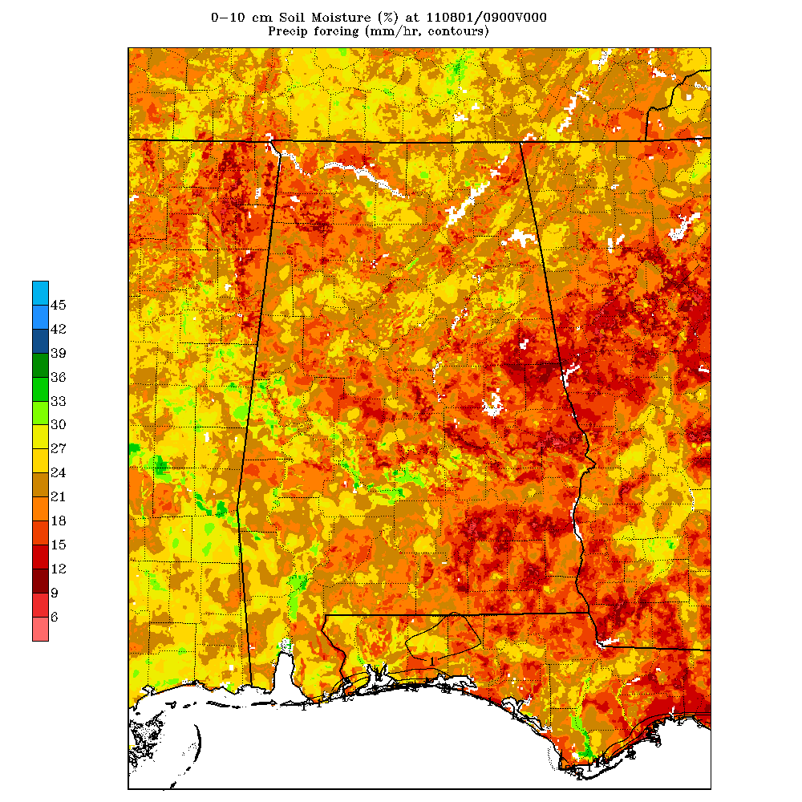
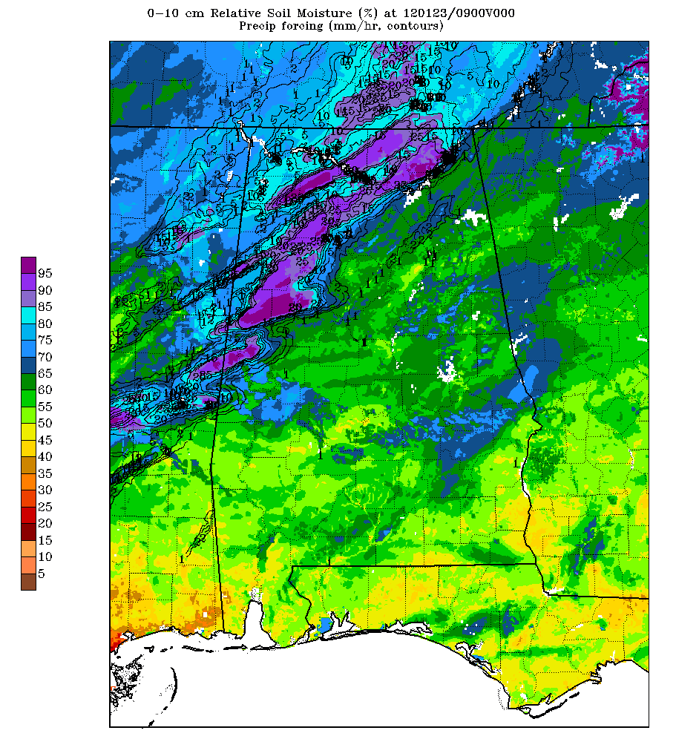
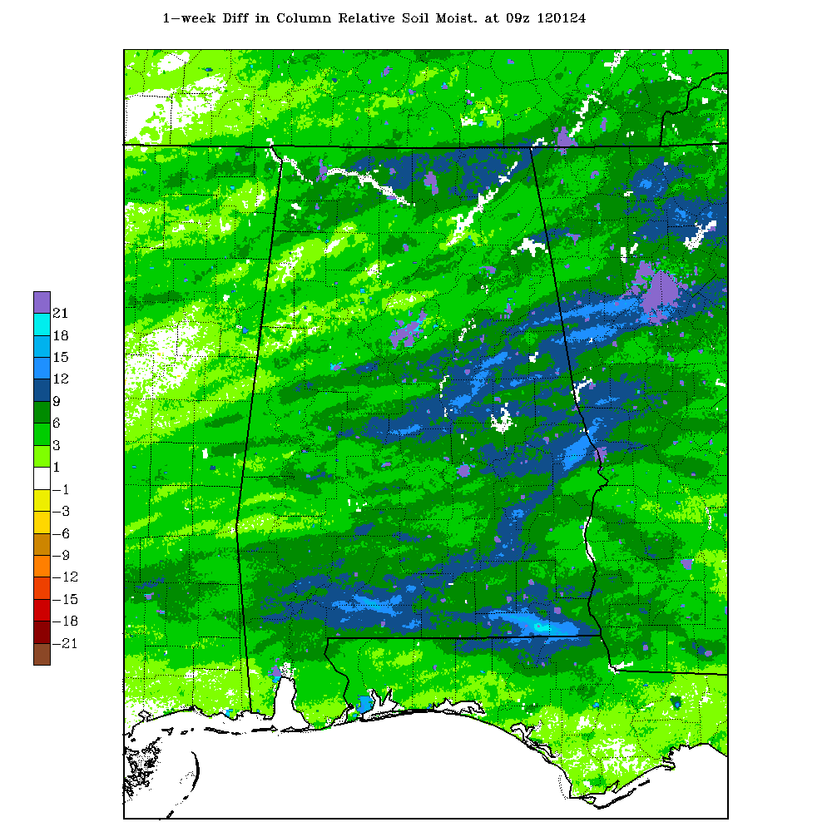
LIS Application for Situational Awareness:
Drought Monitoring at HUN WFO
SPoRT LIS offers superior resolution over climate division data
Kris White (NWS HUN) suggested SPoRT produce real-time 1-week soil moisture change maps
(17-24 Jan 2012 at right)

Slide 15

Summary and Conclusions
Implemented real-time LIS runs at SPoRT
  LSM initialization fields in WRF EMS
  Displayable in AWIPS
CI application at BMX
  LIS/Noah LSM fields introduced in 2010
  Forecasters identified LSM “boundaries” related to differential heating and convective initiation
Flood, drought monitoring at HUN
  T.S. Lee: Low flood potential due to dry antecedent soil moisture
  1-week soil moisture change maps
transitioning unique NASA data and research technologies to operations

Slide 16

Future Work
Short-term
  Reconfigure real-time LIS for CONUS+
    Explore optimal atmospheric forcing;
    use satellite-derived precip (e.g. CMORPH)
  Alaska domain for OCONUS activities
  Develop formal LIS training module
  Southern Region modeling collaboration
Long-term
  Position SPoRT for NASA Soil Moisture-Active Passive mission
  Ramp up on LIS data assimilation capabilities
transitioning unique NASA data and research technologies to operations

Slide 17
Backup Slides
transitioning unique NASA data and research technologies to operations

Slide 18

Real-time LIS: Continued “Spin-up” Run
LIS/Noah LSM run from 1 Jan 2005 to 1 Apr 2010
  3-km/1-km nested grids, 910 x 800; 550 x 700
  Atmospheric forcing
    Hourly NLDAS-1 & 3-h Global Data Assimilation System
    Hourly Stage IV analyses for precip
  Long spin-up allows soil to reach equilibrium state
Re-start run beginning 1 Apr 2010
  Output hourly GRIB-1/2 files for diagnostic purposes
  Each file is ~12/8 MB with grid size and current output fields
    Surface energy balance fluxes
    Evapotrans., skin T, snow-water, canopy water, veg. T
    Soil moisture/temperature at 4 layers: 0-10, 10-40, 40-100, 100-200 cm
    Land parameters (soil/veg type, elevation, GVF, etc.)
transitioning unique NASA data and research technologies to operations

Slide 19
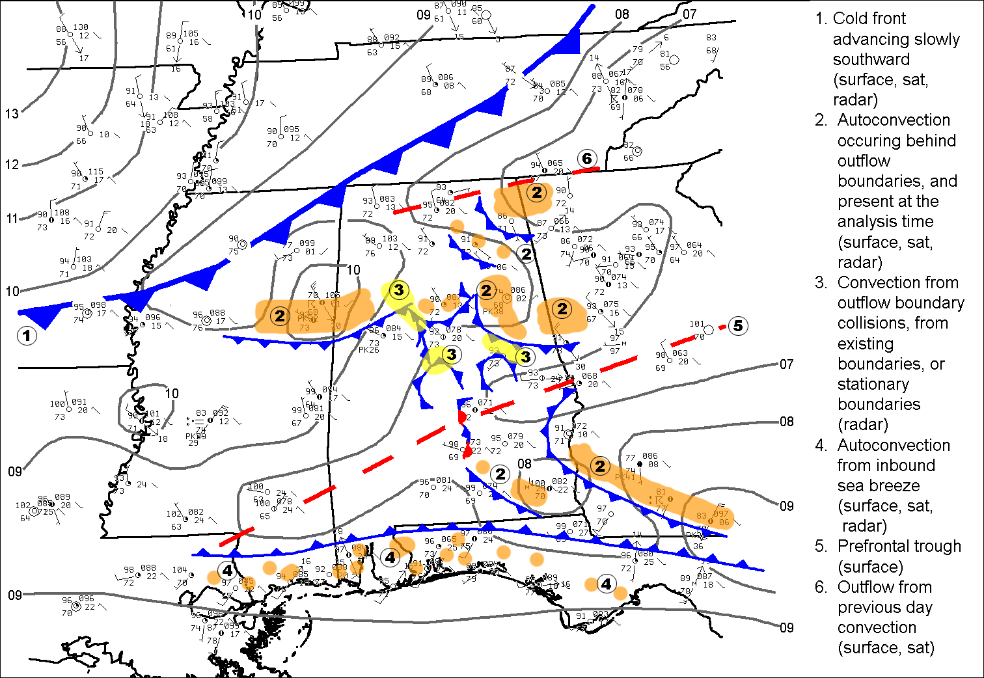
Summer 1: Sample Sfc Analysis

Slide 20
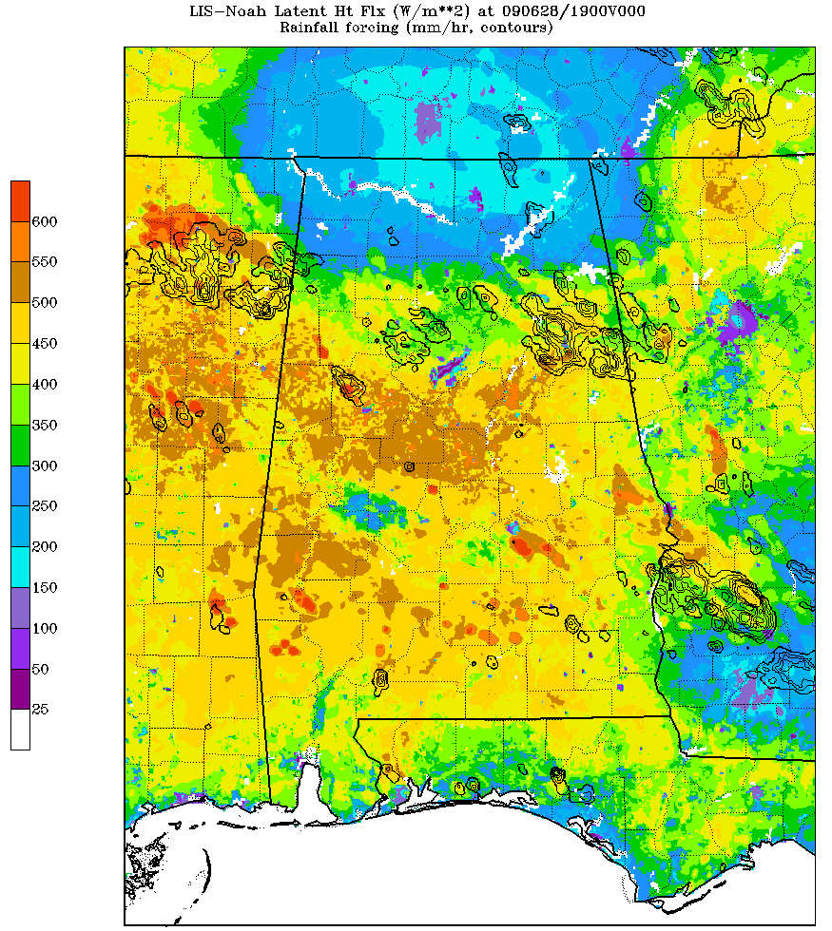
Summer 1: Sample Sfc Analysis (28 June 09)
LIS analysis of latent heat flux at 1800 UTC 28 June 2009, overlaid with Stage IV precipitation.

Slide 21
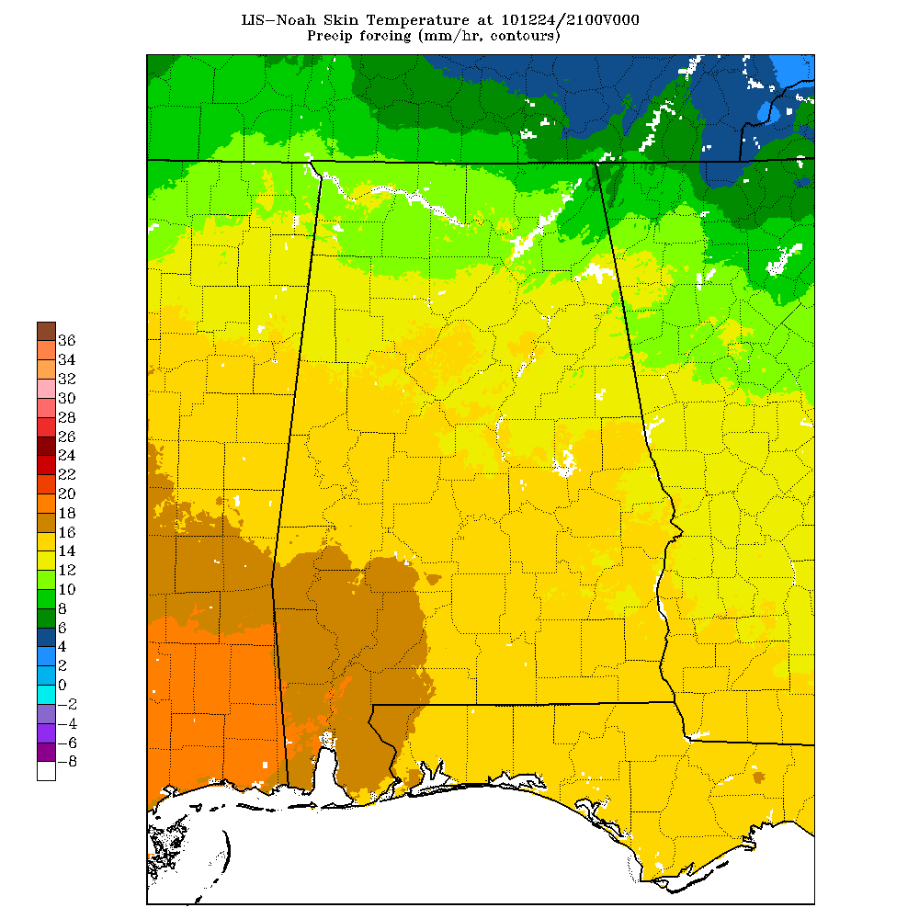
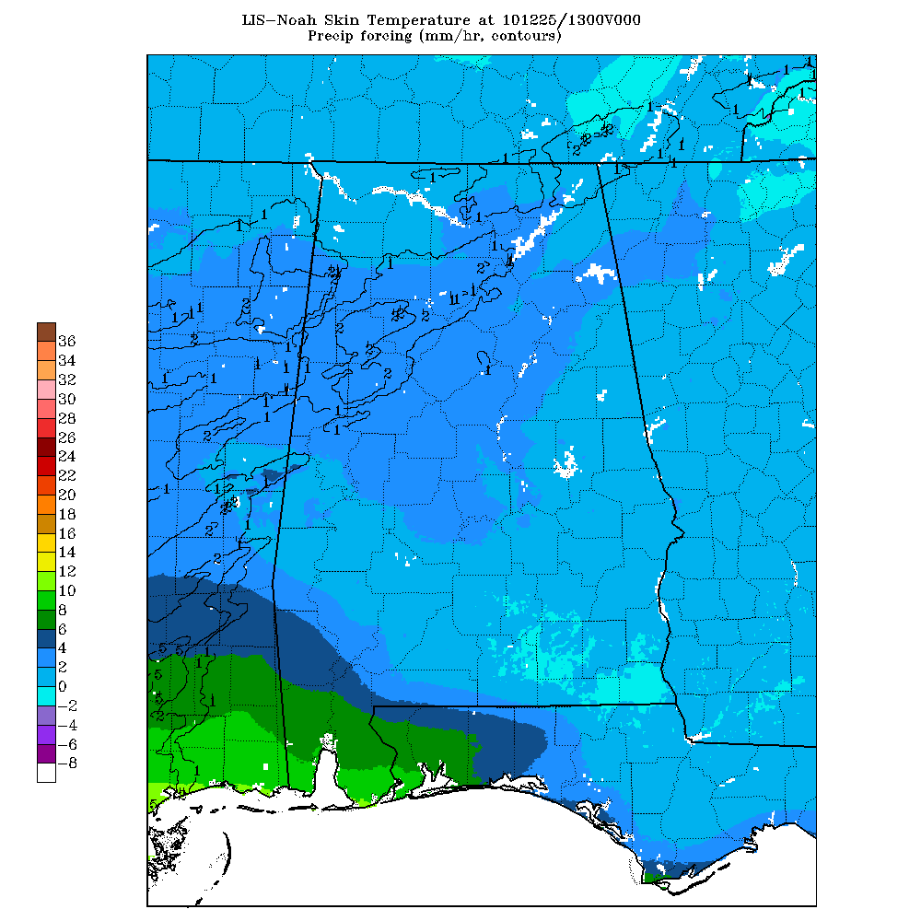
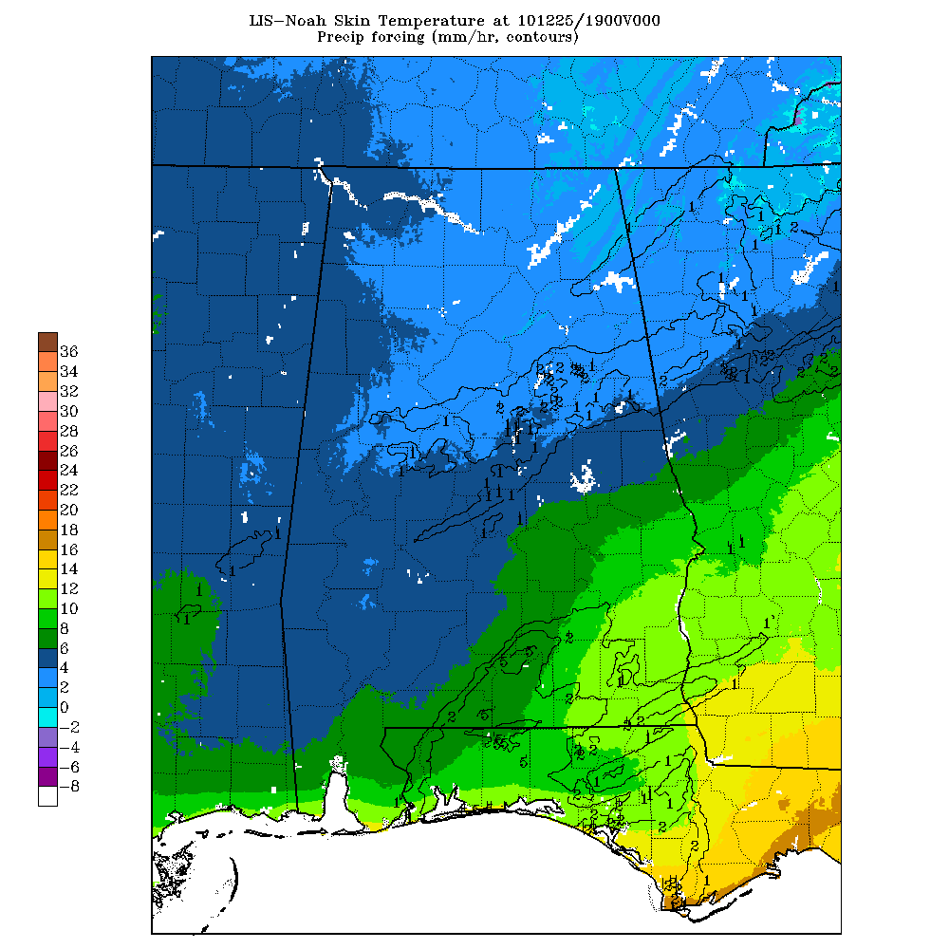
Huntsville WFO LIS Applications:
Winter Weather Forecasting; 25 Dec 2010 Snowfall
21Z/24
13Z/25
19Z/25
Fig 1. Skin Temp at 21Z 24 Dec 2010
Fig 2. Skin Temp at 13Z 25 Dec 2010
Fig 3. Skin Temp at 19Z 25 Dec 2010
T_{skin} relatively warm on 24 Dec (Fig 1); values ~6−10°C from north to south.
Snow fell early AM on 25 Dec; T_{skin} had fallen to around 2°C (Fig 2). Despite above freezing T_{skin}, snowfall rates exceeded melting rate and snow accumulated quickly on surfaces (2 to 3 inches area-wide).
T_{skin} climbed during the day, with values generally around 2−6°C by the early afternoon (Fig 3).
Gradual melting of the snow took place in the afternoon, especially on paved surfaces.
Helps to dispel operational forecast myths of “too warm” for snow to accumulate.
transitioning unique NASA data and research technologies to operations

