Slide 1


The SPoRT-WRF: Transitioning SPoRT Modeling Research
Sixth Meeting of the Science Advisory Committee
28 February – 1 March, 2012
National Space Science and Technology Center, Huntsville, AL
transitioning unique NASA data and research technologies to operations

Slide 2
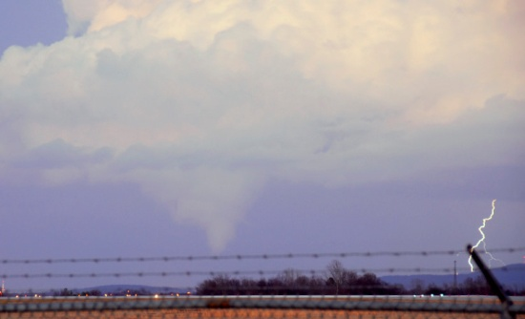
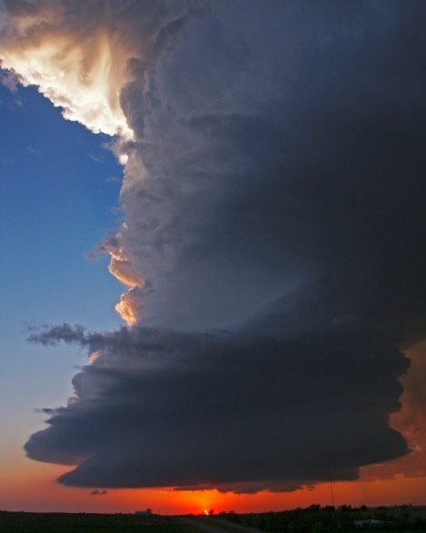
Relevance to SPoRT
Photo by K. McGrath
Accurate forecasting of convection (e.g. timing, intensity, mode, location) often cited as key forecast challenge by WFOs and HWT
Since SPoRT’s inception, different research projects have examined the sensitivity of an individual dataset or capability
The SPoRT-WRF is the first attempt to integrate all of SPoRT’s research into a single real-time modeling system
SPoRT-WRF serves a dual role in supporting R2O:
  HWT/NSSL testbed evaluation enhances collaboration
  Initialization of local models at WFOs supports end-users
Use of “Weather in a Box” resources and NU-WRF enables evaluation of additional NASA capabilities
Photo by K. McGrath
transitioning unique NASA data and research technologies to operations

Slide 3
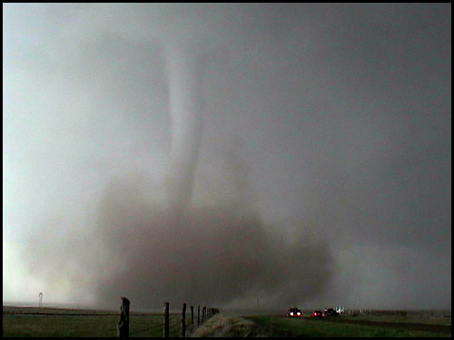
Accomplishments Since Previous SAC
“SPoRT should actively seek out partnerships and collaborative projects with other NOAA/NWS testbeds and use its ability to deliver experimental datasets to the field as a unique strength”
  Diagnostic member evaluated at NOAA’s HWT EFP in 2011
  Feedback from EFP has been used to update the SPoRT-WRF methodology
“Broaden the use of [SST data denial experiments] or similar concepts to help quantify the impact of unique NASA data sets”
  Takes successful data denial experiments and quantifies overall SPoRT data impact
  WRF-EMS does not support data assimilation or WRF/LIS coupling
Conference papers at NWA and AMS regarding evaluation of SPoRT-WRF performance
Photo by K. McGrath
transitioning unique NASA data and research technologies to operations

Slide 4
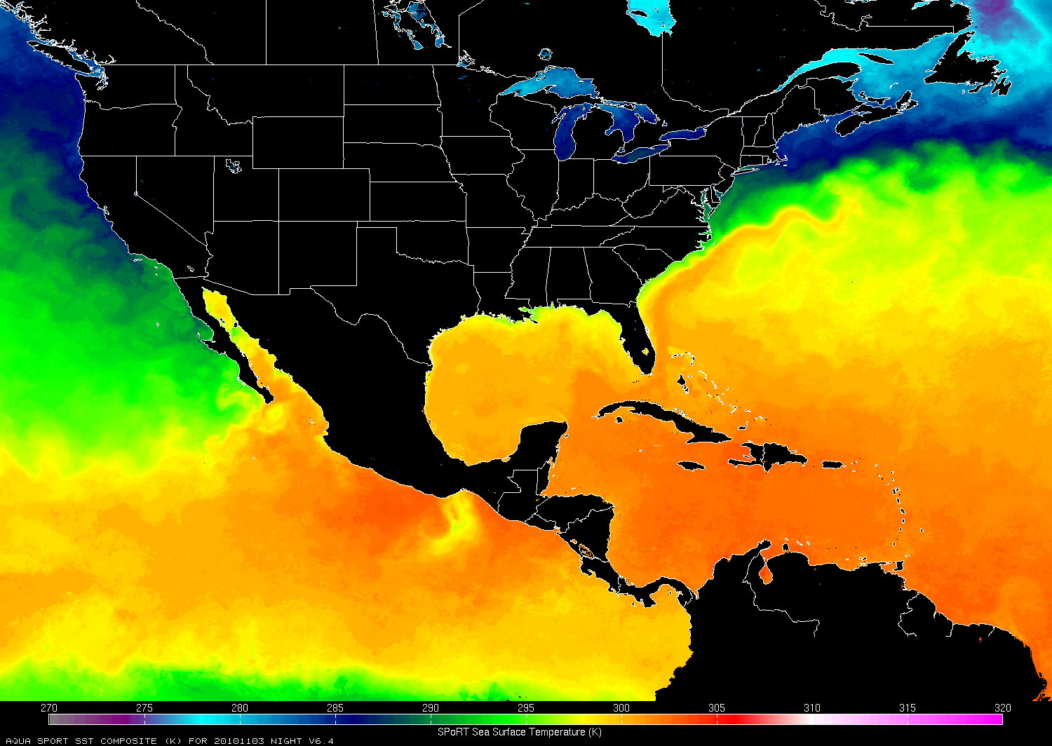
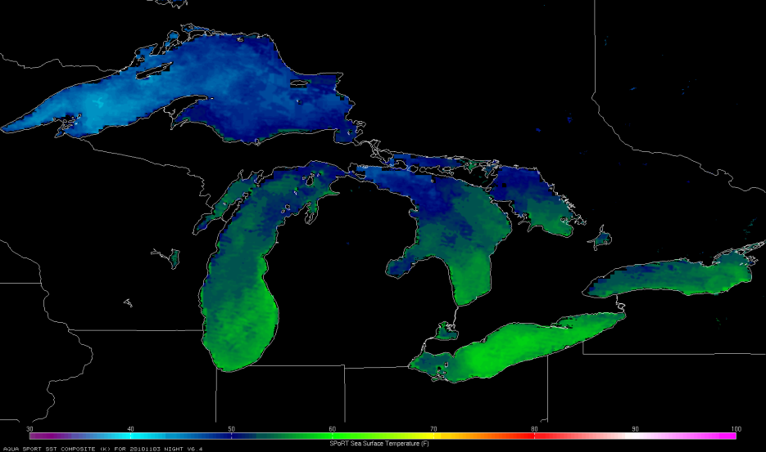
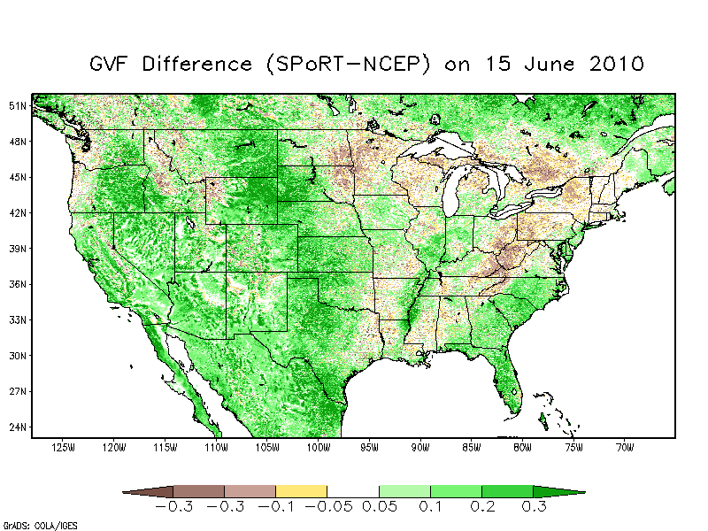
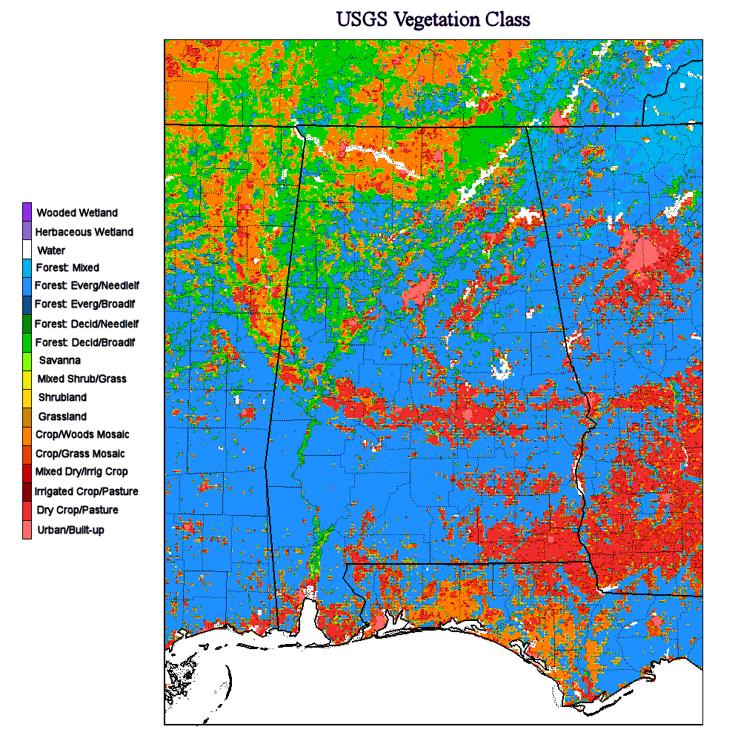
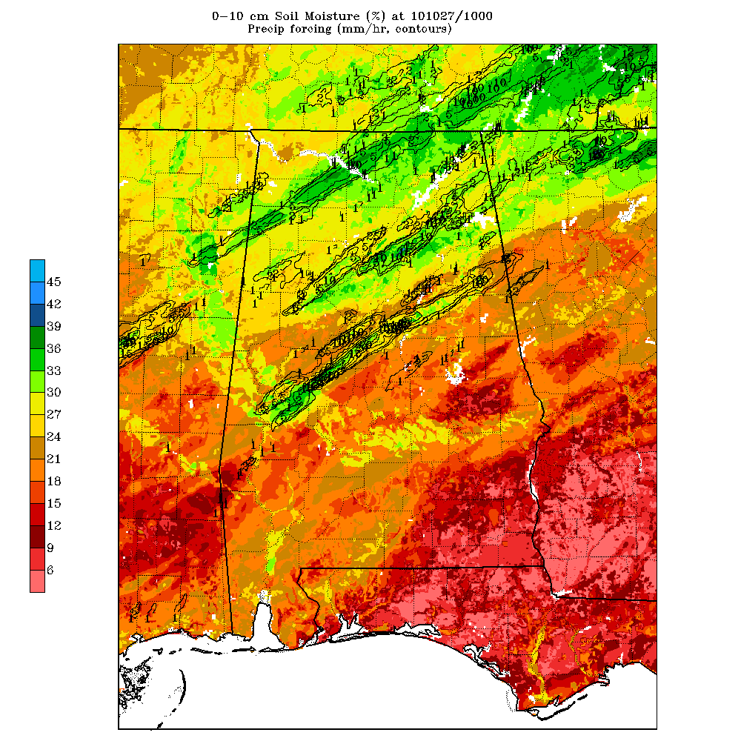
SPoRT-WRF V1 Overview
Identical core, domain, resolution, and physics options as NSSL-WRF used by SPC (expect for higher-resolution ICs and BCs)
Unique NASA datasets and capabilities:
SPoRT SST Composite
Enhances over-ocean fluxes and seabreeze forecasting
AIRS Profiles
Enhances upper-air moisture and stability at asynoptic times to improve heavy precipitation
MODIS GVF Composite
Replaces coarse climatology to enhance energy fluxes for weakly-forced convection
LIS
Enhances soil characteristics and energy fluxes for weakly-forced convection
transitioning unique NASA data and research technologies to operations

Slide 5
SPoRT-WRF V1 Procedure
Initialized each day at 0000 UTC; 36 total forecast hours
Surface datasets integrated into SPoRT-WRF at initialization using a modified version of the NU-WRF Preprocessing System
  MODIS GVFs are incorporated into the system through the LIS
  LIS is run offline once per day to provide land-surface information for model
  SPoRT SSTs are generated offline and brought in as a replacement for the RTG SST product
AIRS profiles assimilated using WRF-Var with 9-h forecast as background
SST Composite generated
Daily LIS
9-hr WRF forecast
AIRS assimilation
27-hr WRF forecast
Delivery to HWT and internal website
00Z
04Z
08Z
12Z
16Z
Current Daily SPoRT-WRF Timeline
transitioning unique NASA data and research technologies to operations

Slide 6
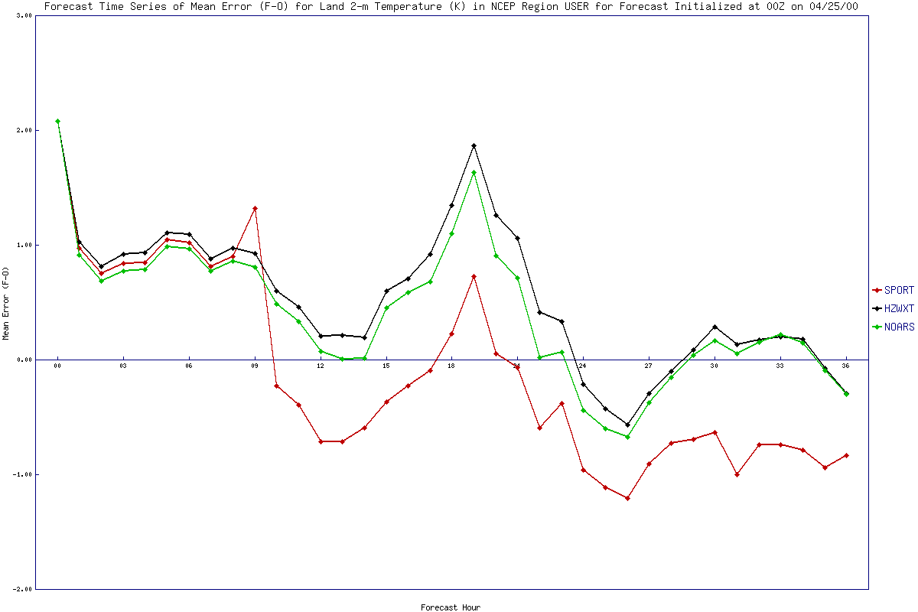
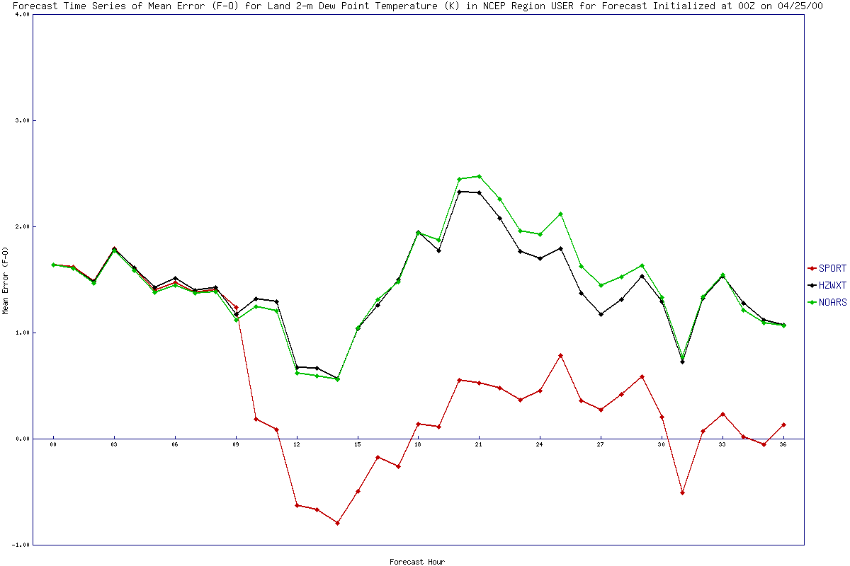
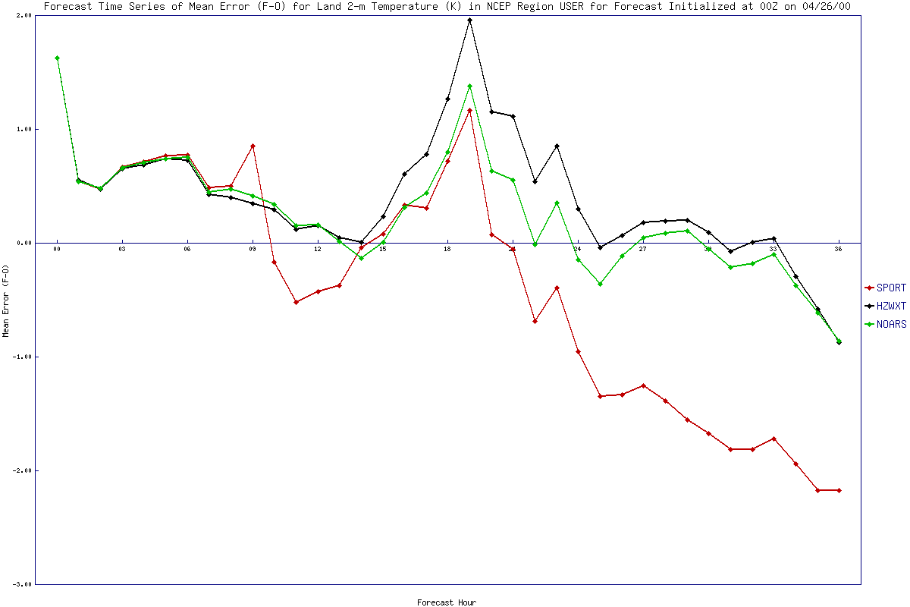
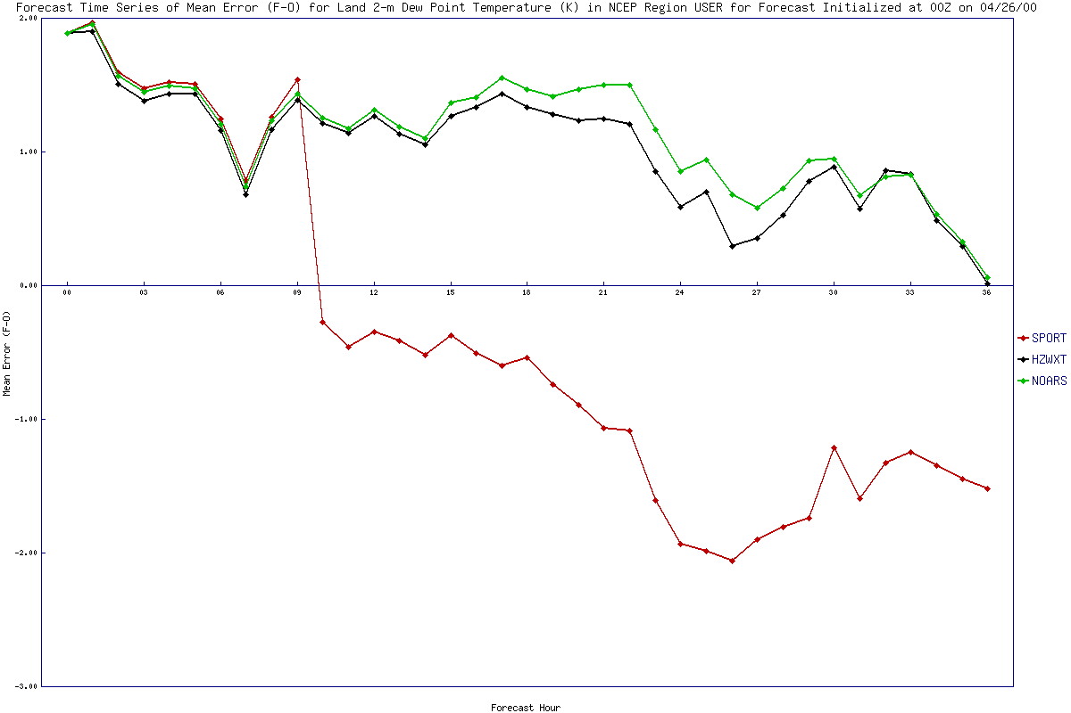
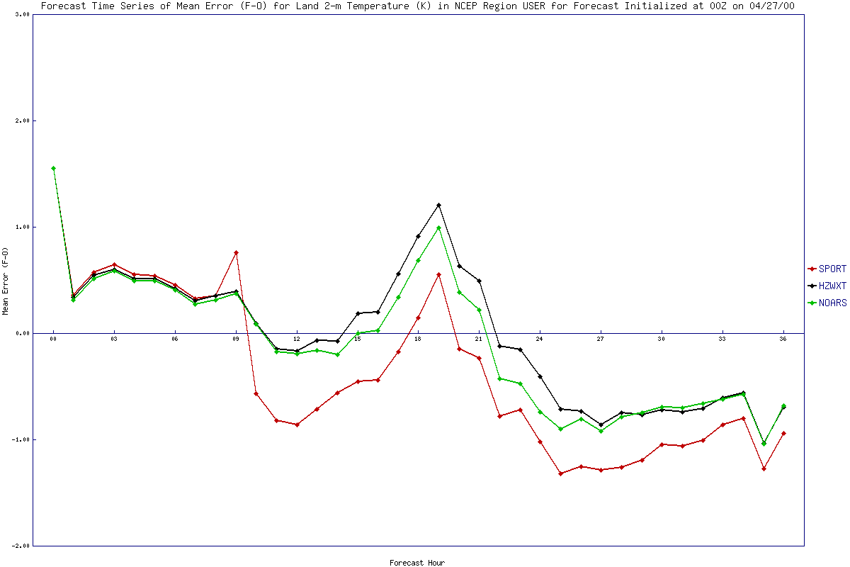
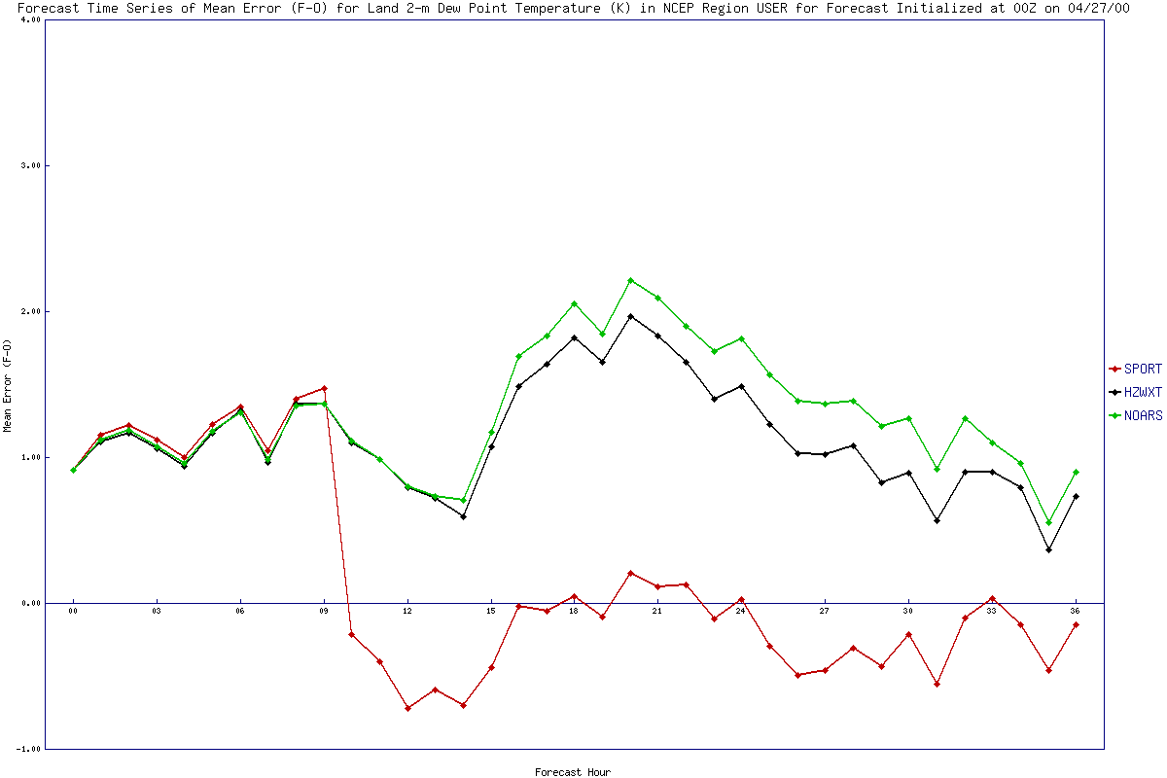
Impact on April 25-27 Forecasts
SPC Tornado Reports 25-27 April 2011
2-m Temperature
2-m Dew Point
NSSL WRF
No AIRS SPoRT-WRF
SPoRT-WRF
April 25
MET used to produce statistical evaluation of surface characteristics for historic tornado outbreak
Conclusion: SPoRT-WRF tends to be have a cool and dry bias for 2-m T and T_{d}
April 26
April 27
Mean Forecast Error (F-O) Compared to METAR, SAO, and Mesonet Observations
transitioning unique NASA data and research technologies to operations

Slide 7
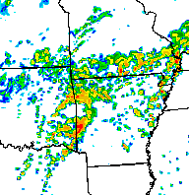
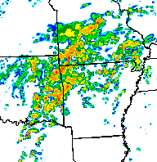

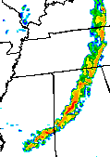
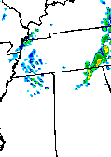




Comparison of Reflectivity Forecasts
1-km Reflectivity at 2100 UTC 25 April 2011
NSSL
SPoRT
Observed
A SPoRT undergraduate summer intern student performed an evaluation of the reflectivity forecasts from the 25-27 April 2011 tornado outbreak
Conclusion: Some convection suppression is seen but mixed results in terms of reflectivity for these cases
1-km Reflectivity at 1500 UTC 26 April 2011
NSSL
SPoRT
Observed
1-km Reflectivity at 0000 UTC 28 April 2011
NSSL
SPoRT
Observed
transitioning unique NASA data and research technologies to operations

Slide 8
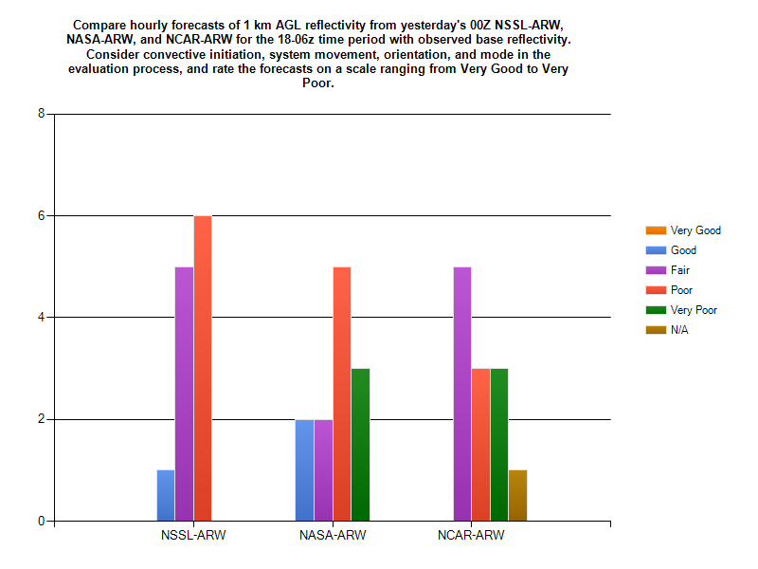
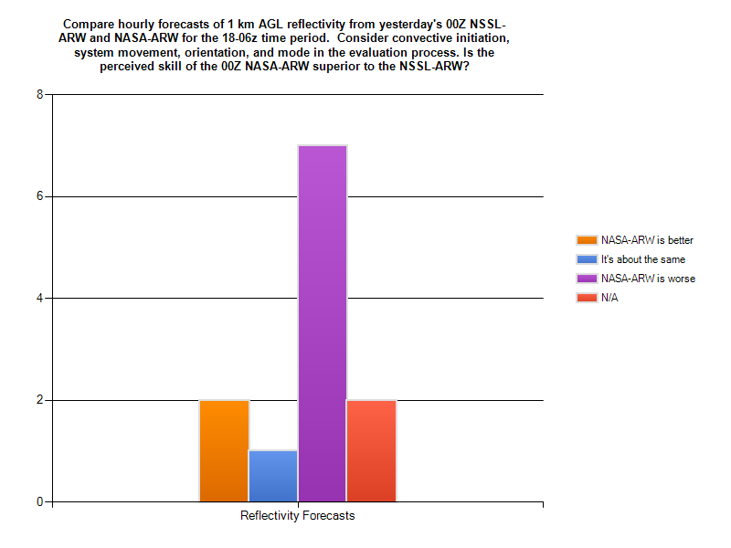
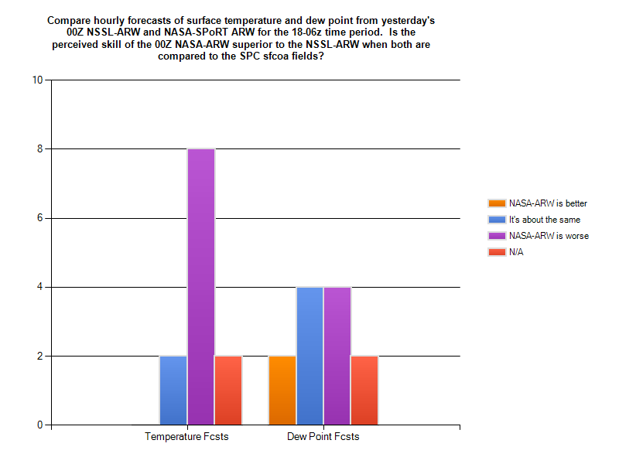
Feedback from Spring Experiment
SPoRT-WRF evaluated at NOAA HWT’s EFP
  Brings together modelers and operational forecasters to subjectively evaluate model performance and discuss the strengths and limitations of regional models and how they should be used operationally
  Case, McCaul, and Zavodsky attended EFP
Each day, participants evaluated a number of regional models
  Overall feedback was that the SPoRT-WRF was too cool and dry and suppressed convection (some good; some bad)
  SPoRT-WRF performed comparably to NCAR-WRF and worse than the NSSL-WRF
Subjective Rating of 18-06Z Forecasts of 1-km AGL Reflectivity
Subjective Comparison of NSSL- and SPoRT WRF for 1-km AGL Reflectivity
Subjective Comparison of NSSL- and SPoRT WRF for T and T_{d}
transitioning unique NASA data and research technologies to operations

Slide 9
SPoRT-WRF V2
Based on HWT EFP participant feedback, model imbalances from assimilation methodology leads to cool and dry bias
SPoRT-WRF V2 Development is complete and ready for 2012 season
  NU-WRF (with WRF/LIS coupling) and Goddard physics schemes
  Continuous cycling methodology using GSI (AIRS & IASI profiles, conventional, satellite)
  Expanded SPoRT MODIS GVF composite domain
Evaluation at 2012 HWT EFP with additional feedback for continued improvements
Daily real-time website completed for posting model output
SST Composite generated
LIS
Delivery to internal website
tm12 to tm00 GSI assimilation
36-hr WRF forecast
21Z
00Z
03Z
06Z
09Z
12Z
00Z Initialized SPoRT-WRF Timeline
transitioning unique NASA data and research technologies to operations

Slide 10

Summary/Conclusions
SPoRT-WRF is a unique configuration of the WRF-ARW that integrates all SPoRT modeling research into a real-time system to address forecast challenge of convection in NWP
Transitioned this real-time forecast to NOAA’s HWT as deterministic model at EFP
Testbed feedback indicated cool, dry bias that appears to suppress convection likely related to methodology for assimilation of AIRS profiles
Development of SPoRT-WRF V2 with new DA strategy, WRF/LIS coupling, and expanded GVFs is complete and ready for 2012 season; future versions will be modified based on feedback
Photo by K. McGrath
transitioning unique NASA data and research technologies to operations

Slide 11

Future Work
Short-term plans:
  Investigate impacts of NASA datasets and model options on convective forecasts
  Evaluate how well SPoRT-WRF performs (both qualitatively and quantitatively) against other operational/real-time models?
  Determine which individual components of the SPoRT-WRF have the largest impact on the performance
  Transition SPoRT-WRF output to select SR Modeling Collaboration offices in form of forecasts and/or initial and boundary conditions for local model runs
Long-term plans:
  Additional research activities that are undertaken by the modeling and DA group will be applied to future versions of the SPoRT-WRF
  By next season, real-time data from Suomi NPP (assimilation of CrIS profiles, VIIRS brought into SST and GVF composites) will be brought into the system
transitioning unique NASA data and research technologies to operations

