Slide 1


NASA SPoRT’s Pseudo Geostationary Lightning Mapper (PGLM)
Sixth Meeting of the Science Advisory Committee
28 February – 1 March, 2012
National Space Science and Technology Center, Huntsville, AL
transitioning unique NASA data and research technologies to operations

Slide 2

What is Total Lightning?
Total Lightning
  Combination of cloud-to-ground and intra-cloud
Total Lightning Activity
31 Individual Storms
Cloud-to-Ground Strikes
Inter-Cloud Flashes
transitioning unique NASA data and research technologies to operations

Slide 3
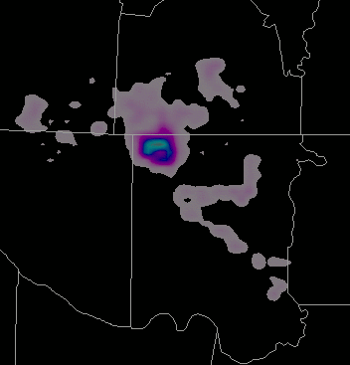
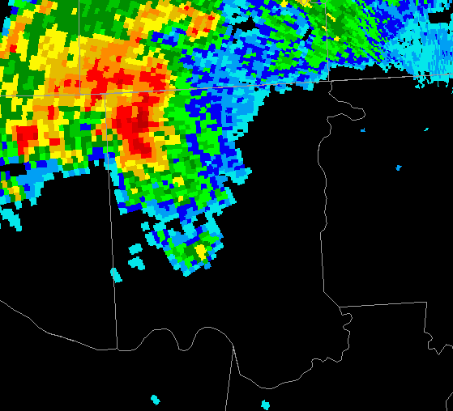
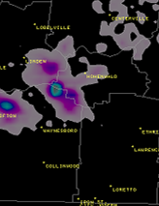
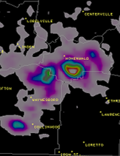
Importance of Total Lightning
EF-1
Source Density
Warning Issued
Lightning Safety
Example
Lightning Jump
Example
  Correlates with updraft strength
  Correlates with incipient severity
  Not point data like NLDN
  Enhance lightning safety
  Enhance situational awareness
transitioning unique NASA data and research technologies to operations

Slide 4
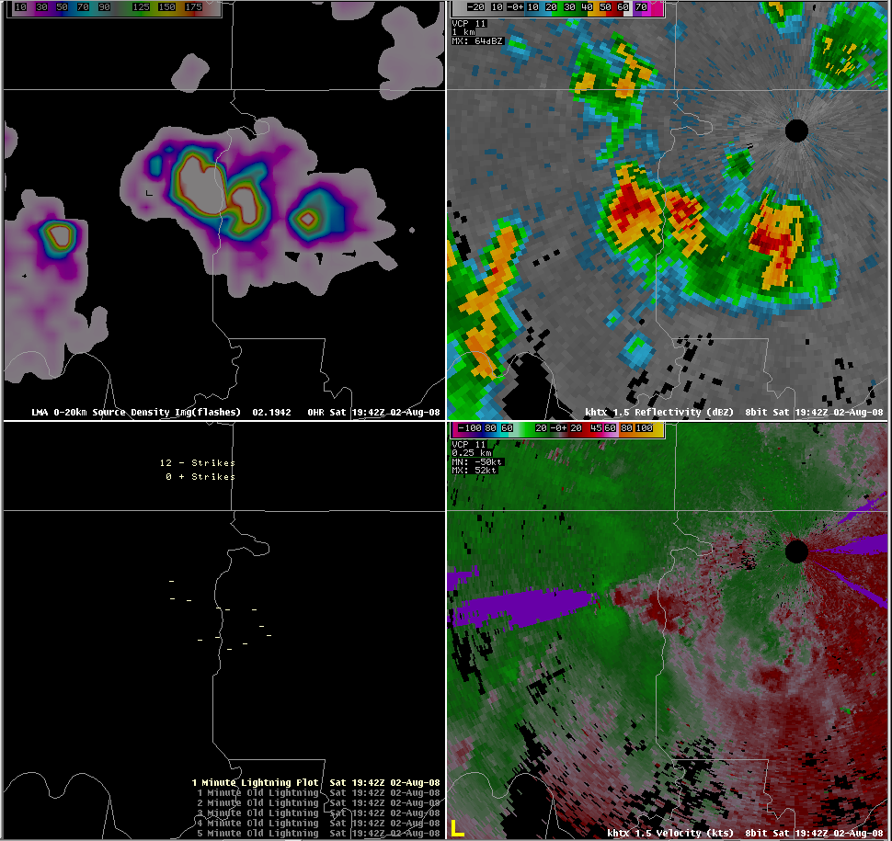
Relevance to SPoRT
Total Lightning
Reflectivity
  LMAs are a major SPoRT activity
  First transition in 2003
  Expanding to multiple networks
  Producing new training modules
  Developing new visualizations
  Preparing for AWIPS II
  Apply experience to GLM
NLDN
Velocity
transitioning unique NASA data and research technologies to operations

Slide 5
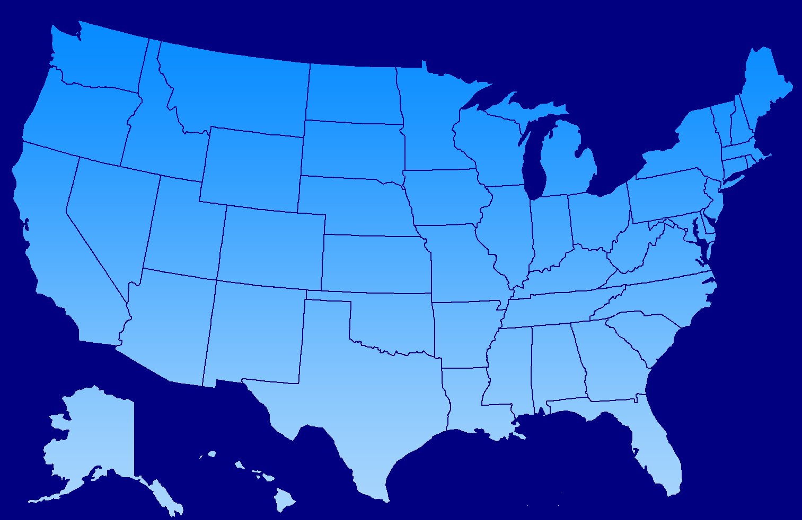
Accomplishments
“Partner with other NOAA/NWS testbeds and nationwide partners” – SAC 2009
LIGHTNING MAPPING ARRAY
TOTAL LIGHTNING NETWORKS
DCLMA
AWC
Dugway
OU
NALMA
TTU
NMTU
SPC
GTU
White Sands
KSC
TAMU

Slide 6
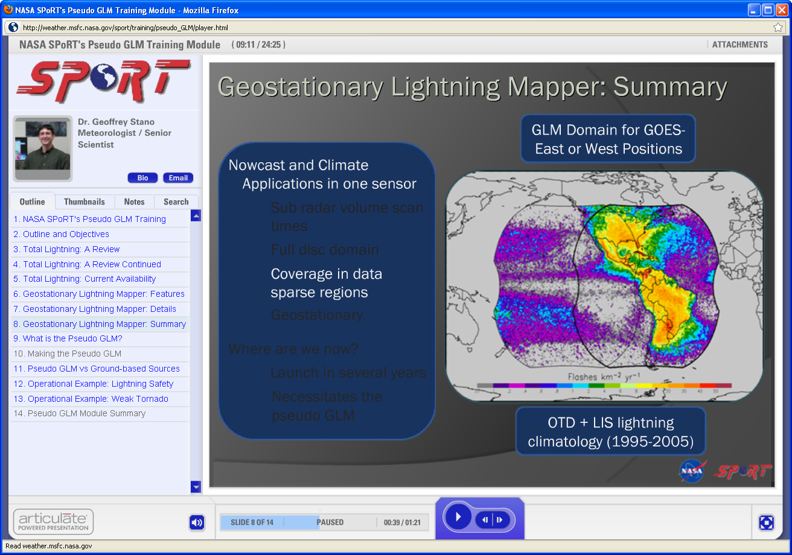
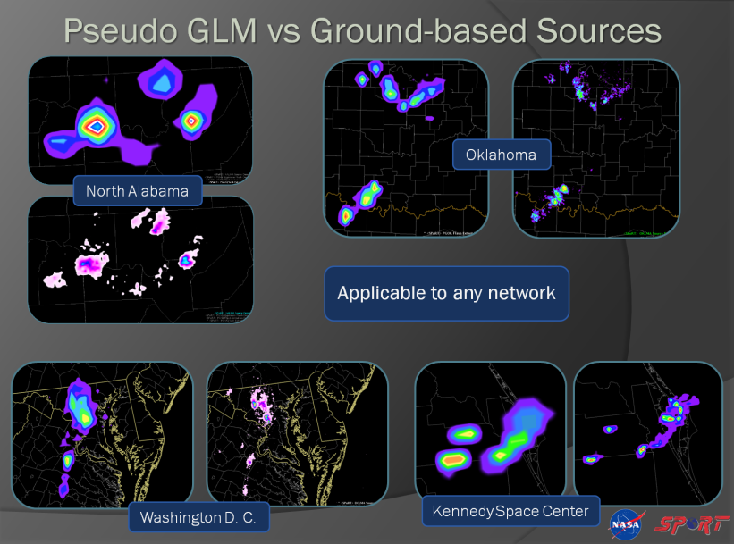
Current GLM Activities
  Funded as part of GOES-R Proving Ground and Risk Reduction
  Spring Program Participant
  Prepare forecasters for GLM
  Created Pseudo-GLM (PGLM)
  Provide training
    Contributions by partners
  Stand-in until GLM proxy ready
Training Module Used for the Spring Program
transitioning unique NASA data and research technologies to operations

Slide 7
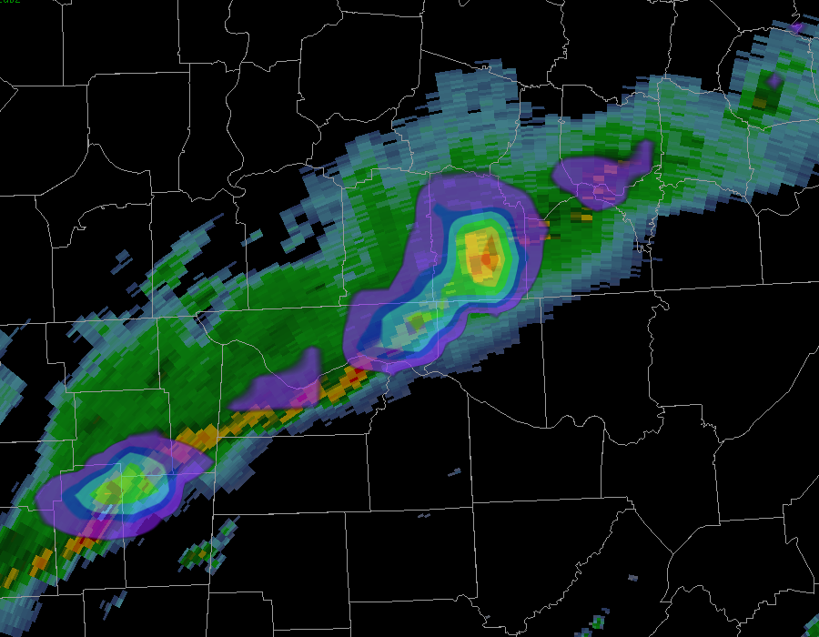
Why Use the PGLM?
  PGLM is NOT a GLM proxy
  Demonstration tool
  Work with select end users
  Total lightning and GLM learning
  Easy to implement
  Focus of discussion
  How to use lower resolution
  Develop operational plans
  Develop display tools
  SPoRT can produce this 24/7
PGLM with radar for Spring Program
transitioning unique NASA data and research technologies to operations

Slide 8
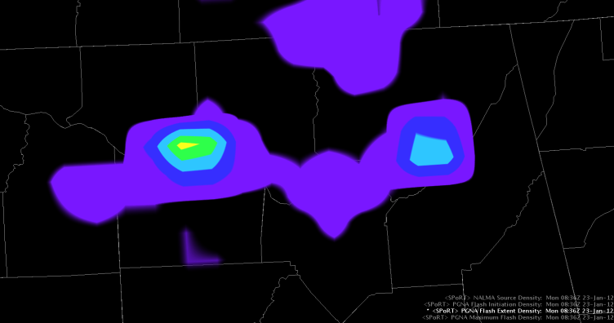
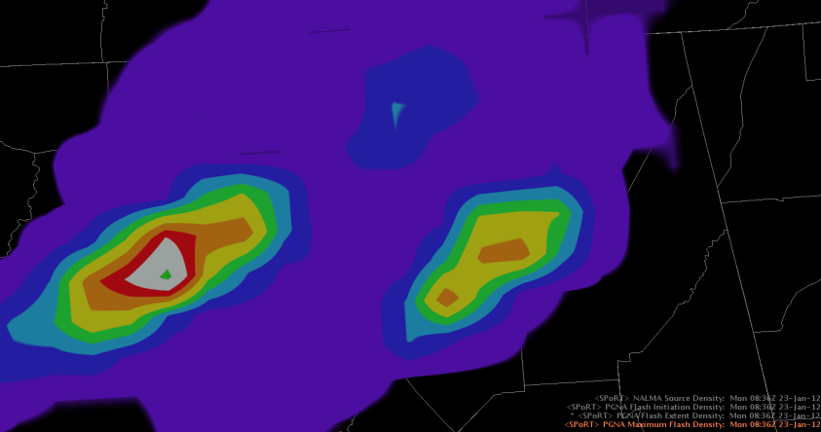
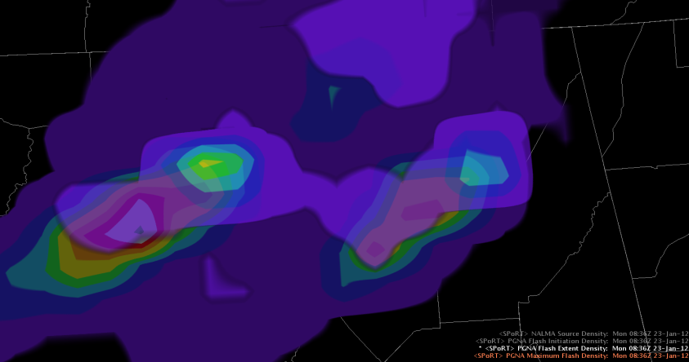
Maximum Flash Density (MFD) Product
30 min Maximum Flash Density
Lightning Safety!
Standard PGLM Flashes
Standard PGLM overlaid on the MFD
30 min MFD
PGLM: 1 MFD: 9
Compare current 2 min PGLM vs 30 min MFD
Plots maximum flash density for each grid box over 30 min
Spatial extent over 30 min
9 Flashes
SUMMARY
MFD is a fast “at a glance” trending tool
Compare 30 min MFD to current 2 min PGLM
If PGLM > MFD, intensifying and vice versa
MFD gives 30 min overview of spatial extent which is very useful for lightning safety
Designed based on feedback from forecasters
8 Flashes
PGLM: 8 MFD: 19
All cells weakening
Threat of cloud-to-ground strike
19 Flashes
Use by overlaying PGLM
PGLM: 17 MFD: 54
Are these strengthening or weakening?
Can loop, use AWIPS II tool, OR
17 Flashes
54 Flashes
Another use for MFD, or density track product
Matches well with 30-30 rule
transitioning unique NASA data and research technologies to operations

Slide 9
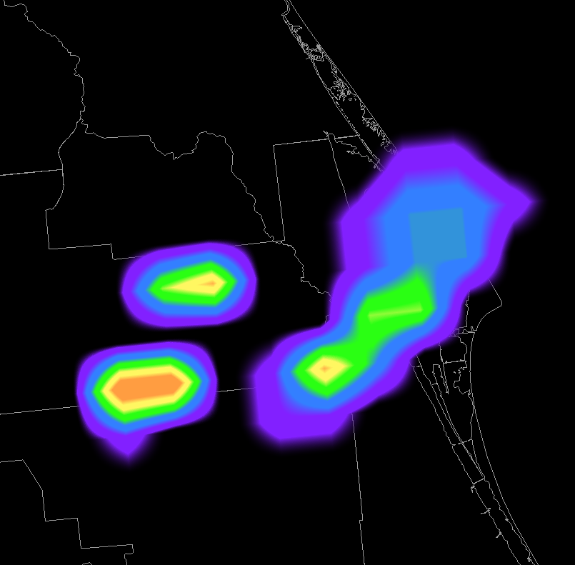
Spring Program Forecaster Feedback
  70% responded PGLM was “relatively easy” to interpret
  54% ranked PGLM an 8 or better for using it in the future
  63% ranked PGLM an 8+ for importance – 94% with a 6+
  Overwhelmingly support a trend tool
  Provided training updates
  Impressed with situational awareness
  Impressed with cloud-to-ground lead time
transitioning unique NASA data and research technologies to operations

Slide 10
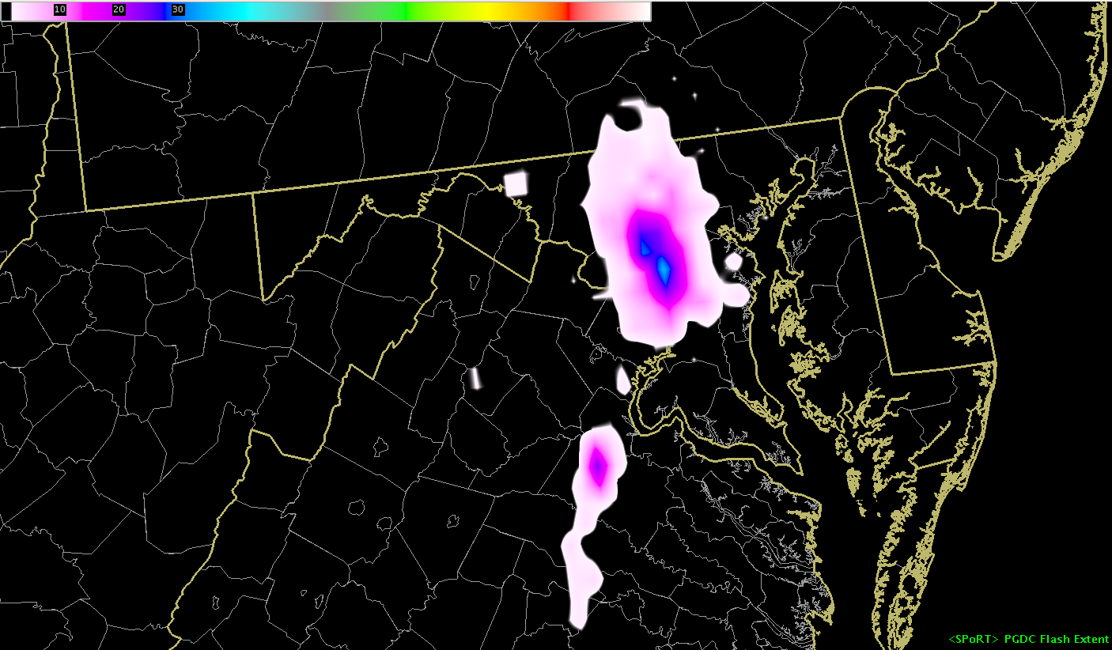
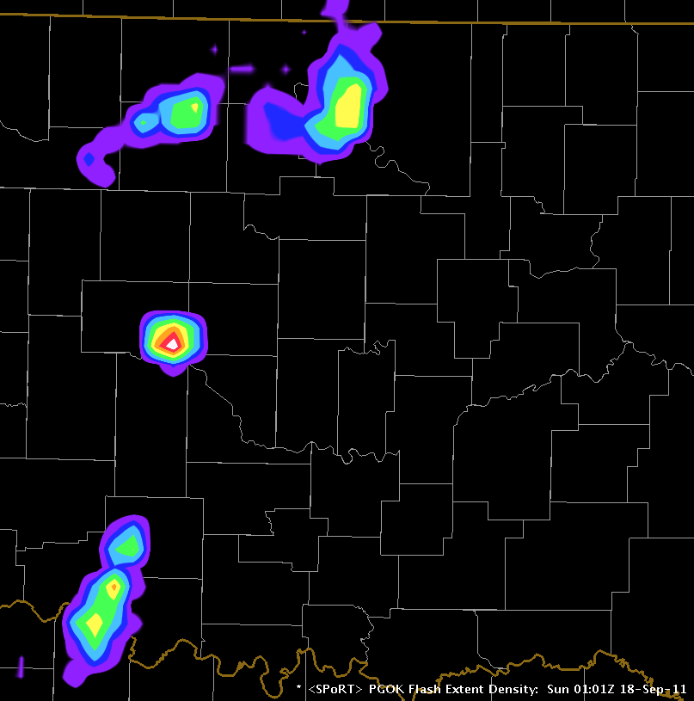
Looking Forward
  The PGLM is main lightning tool
  Ready for 2012 and later
  West Texas LMA will be added
  Update and develop training
  New processing
  Developing new mosaic product
  Incorporating feedback
  AWIPS II (e.g. tracking tool)
  Visiting scientist trips to AWC / SPC
  Transition GLM proxy as appropriate
  Once GLM is launched
  Perform process studies
  GLM validation
Washington DC PGLM
Oklahoma PGLM
transitioning unique NASA data and research technologies to operations

Slide 11
BACKUP SLIDES
transitioning unique NASA data and research technologies to operations

Slide 12
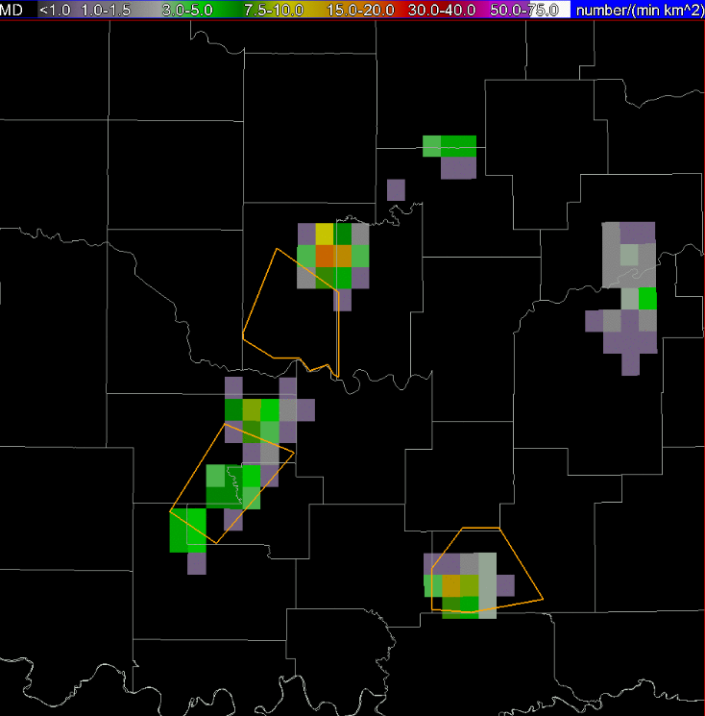
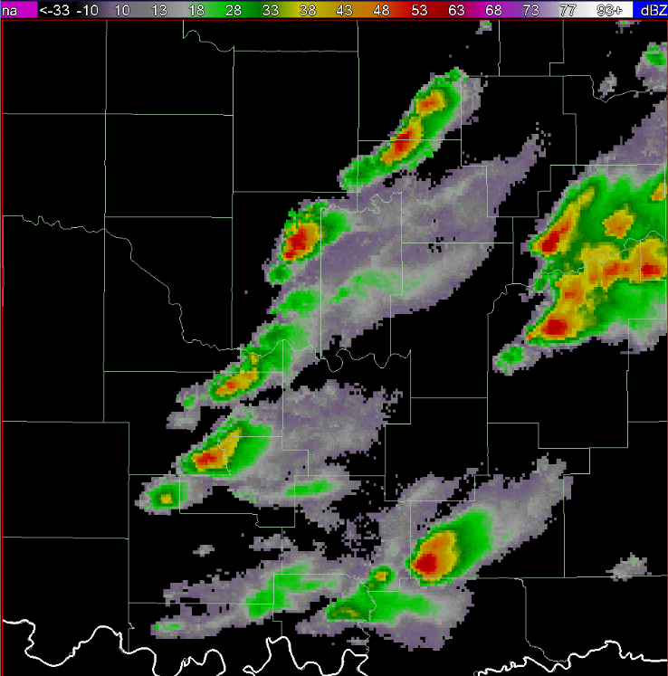
Operational Example
PGLM
Reflectivity
9 Flashes
2209 UTC
transitioning unique NASA data and research technologies to operations

Slide 13
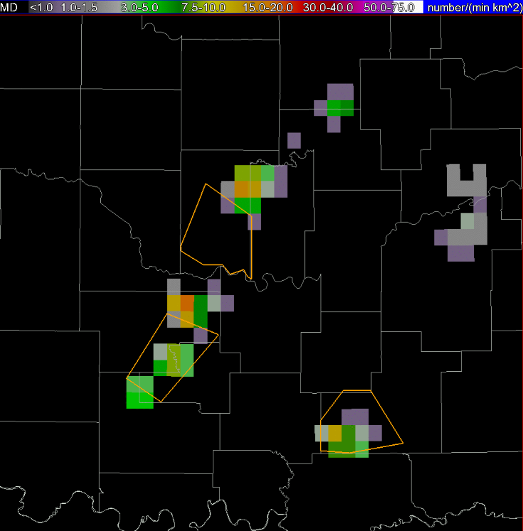
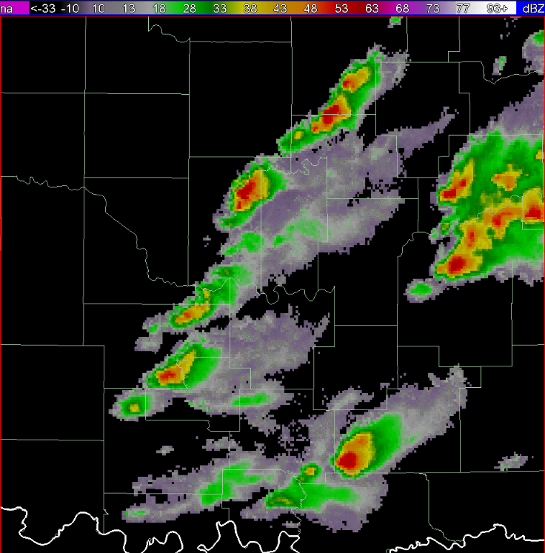
Operational Example
PGLM
Reflectivity
16 Flashes
2212 UTC
transitioning unique NASA data and research technologies to operations

Slide 14
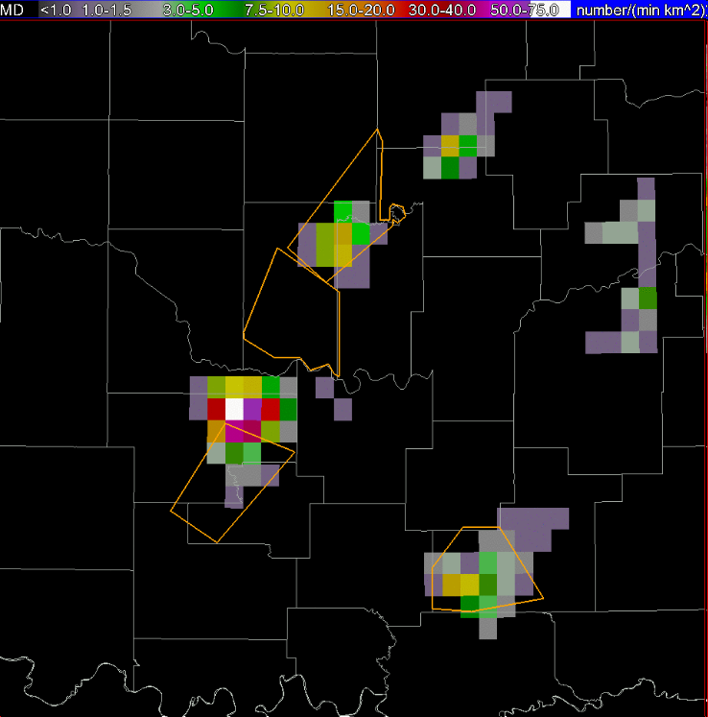
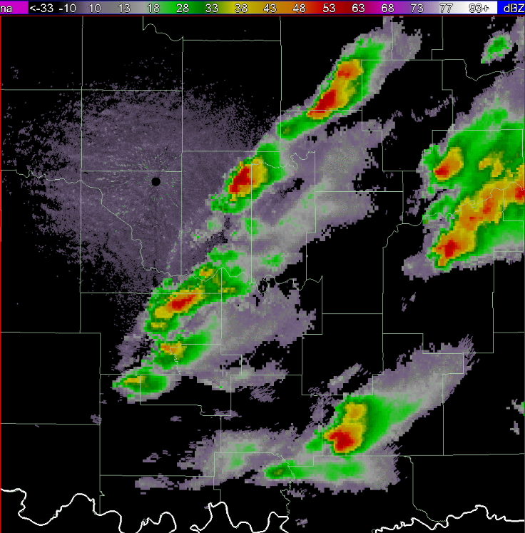
Operational Example
PGLM
Reflectivity
75 Flashes
2220 UTC
transitioning unique NASA data and research technologies to operations

Slide 15
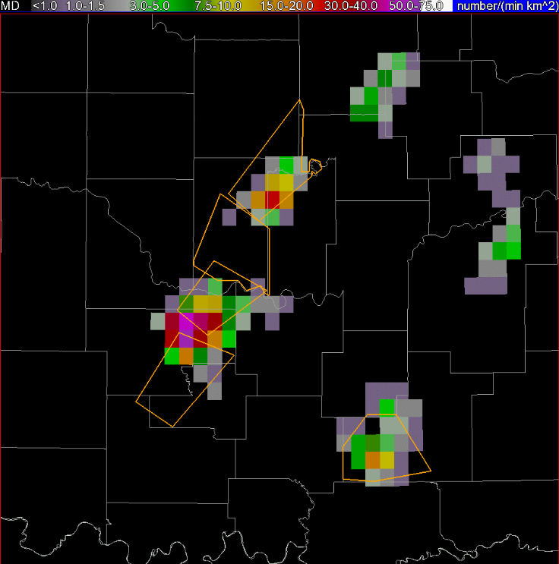
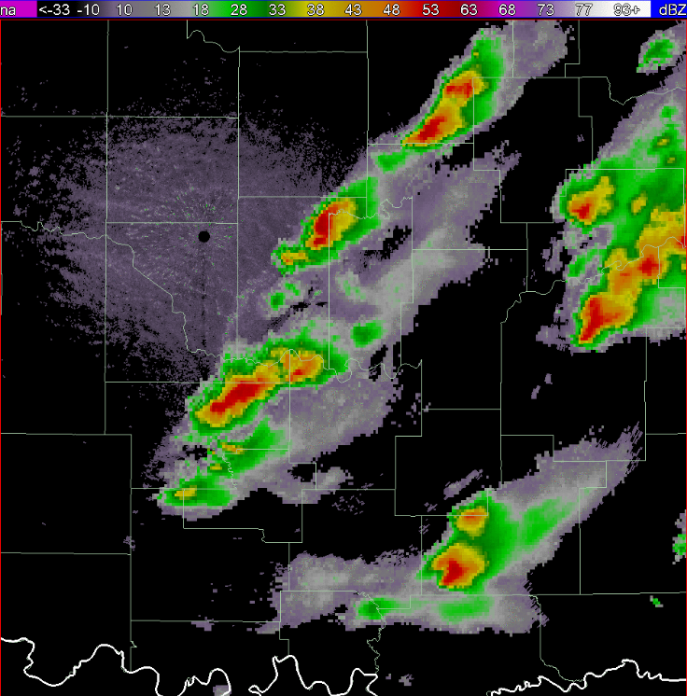
Operational Example
PGLM
Reflectivity
Warning Issued
2226 UTC
transitioning unique NASA data and research technologies to operations

