Slide 1


Development of Multispectral RGB
Satellite Imagery at SPoRT
Sixth Meeting of the Science Advisory Committee
28 February- 1 March, 2012
National Space Science and Technology Center, Huntsville, AL
transitioning unique NASA data and research technologies to operations

Slide 2
Background
Current instrument such as MODIS, and future instruments such as NPP/VIIRS or GOES-R, provide increasing amounts of data in space, time, and wavelength.
Although this increase in data is great for researchers and forecasters, it may present a challenge to the operational user:
  Time limitations as the forecaster is challenged to make use of other high resolution data and new products provided by NWP guidance, radars, social media, etc.
  Data limitations as other new tools compete for bandwidth in dissemination systems.
SPoRT has a long history of providing multispectral products:
  Forecasters in partnering WFOs have already been exposed to true-color and false-color snow/cloud products.
  These products have provided value, once forecasters are trained on how the resulting color combinations can be used to infer features.
transitioning unique NASA data and research technologies to operations

Slide 3
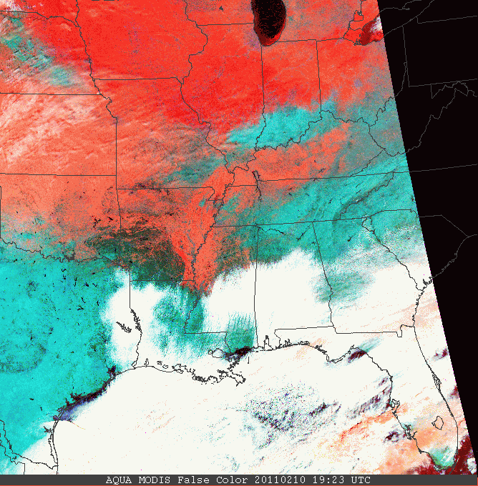
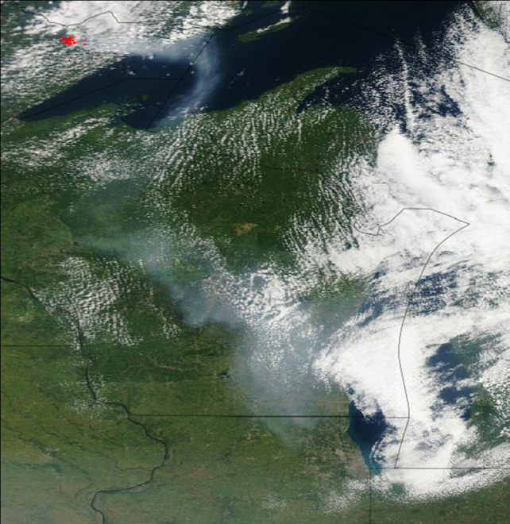
Relevance to NASA/SPoRT
“False Color”
VIS + VIS + NIR
Given our history with multispectral data, SPoRT has expanded this to include other activities.
  Products from MODIS and SEVIRI have served as proxies for future GOES-R capabilities.
  Similarly, products from NPP/VIIRS will add additional examples for the GOES-R era and demonstrate future JPSS capabilities.
  Other applications will be developed from passive microwave data, with future applications to NPP/ATMS, NASA’s Global Precipitation Measurement mission, and similar instruments.
  SPoRT is developing case studies and forecaster training in collaboration with WFOs and NCEP Centers.
snow
land
cloud
wildfire
smoke
“True Color”
VIS + VIS + VIS
Chicago
Figure 1. Examples of multispectral satellite products from MODIS that SPoRT has produced and disseminated to partnering WFOs.
transitioning unique NASA data and research technologies to operations

Slide 4
Accomplishments Since 2009 SAC Meeting
Previous Meeting:
  Included the representation of some multispectral products by WFO partners.
  WFOs such as Great Falls, MT and Albuquerque, NM have used false color snow products to monitor snow events and subsequent melt.
SAC Comments:
  Encouraged continued development of these products, training provided to WFO partners, and new ways of using these for decision support activities.
2009-2011 Emphasis:
  Development of new multispectral (RGB) products based upon EUMETSAT guidelines for SEVIRI data.
  Development of techniques that can make these 24-bit image products available within AWIPS, NAWIPS, and AWIPS-2 systems.
  Partnering with GOES-R PG/CIRA to assist them with NAWIPS display capabilities at NCEP Centers.
  Working with the GOES-R Proving Ground to assist in disseminating products for evaluation.
transitioning unique NASA data and research technologies to operations

Slide 5
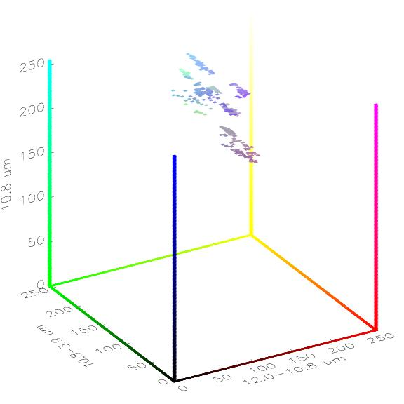
RGB Composite Technique
Through collaboration with SPoRT, forecasters are already familiar with multi-channel satellite imagery.
New technique:
  Combine additional channels or channel differences into products tuned for other applications.
  Image colors identify specific phenomena (e.g. fog)
SPoRT uses the EUMETSAT guidelines for RGB production so that training and products are consistent.
Fog / Stratus
Goal: Separates features by color
Cloud-Free
Cloud Top Temperature
11-3.9 μm Fog Detection
Cloud Microphysics
transitioning unique NASA data and research technologies to operations

Slide 6
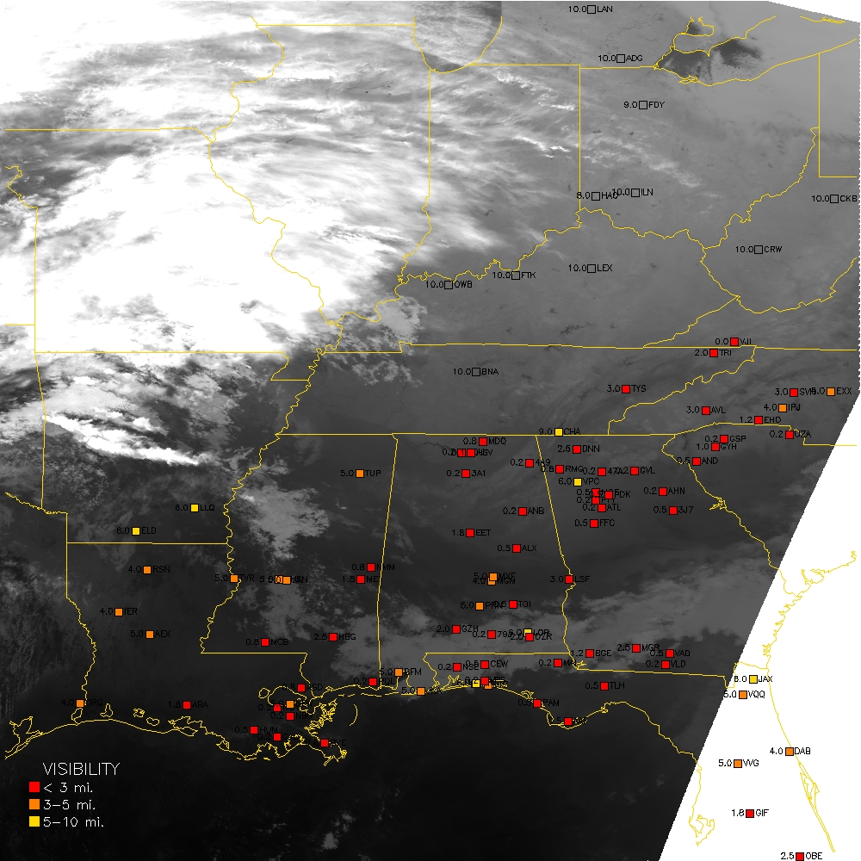
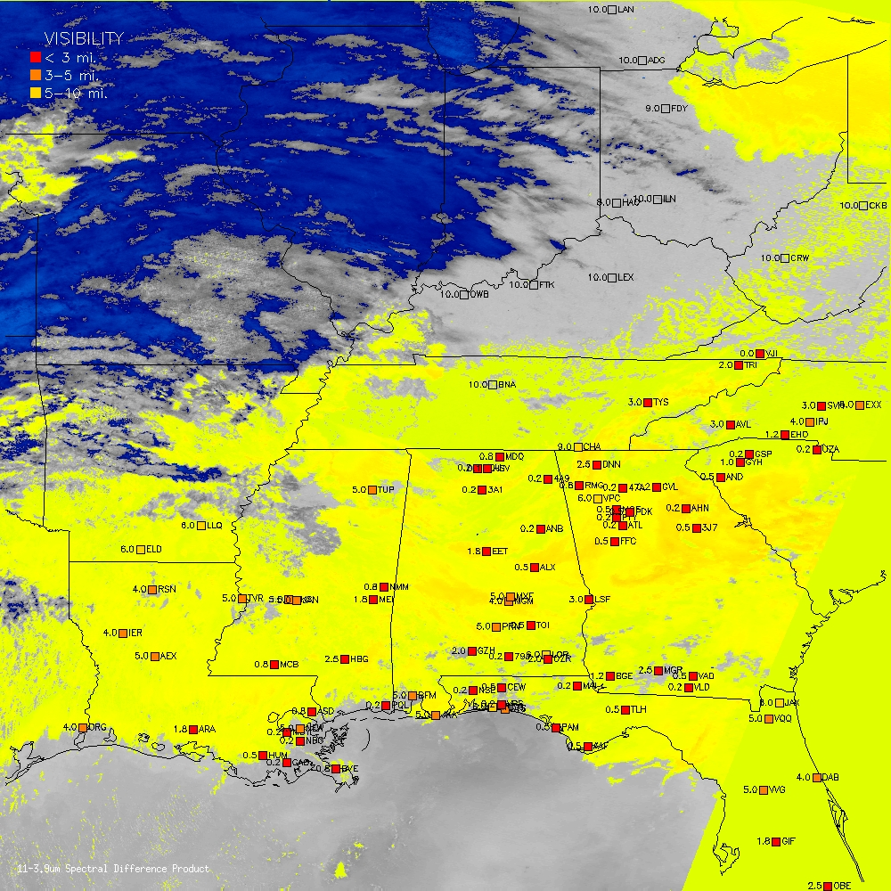
Example: Fog Detection
Single Channel Infrared – Fog Detection
Channel Difference – 11-3.9 μm
Color enhancement to single 11 μm (MODIS)
Color enhancement to standard channel difference product.
transitioning unique NASA data and research technologies to operations

Slide 7
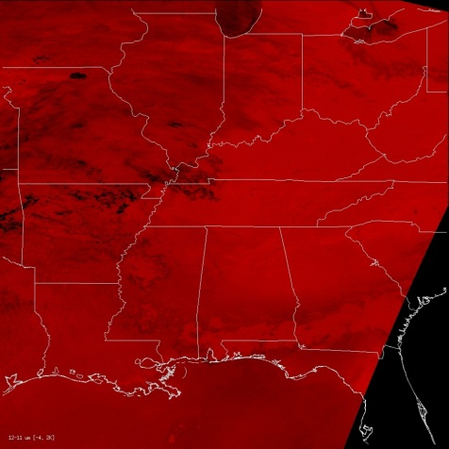
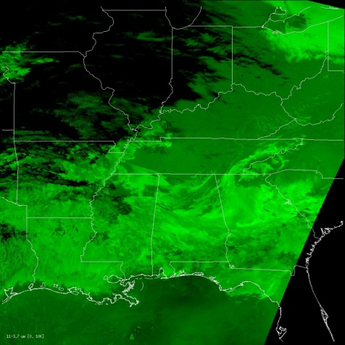
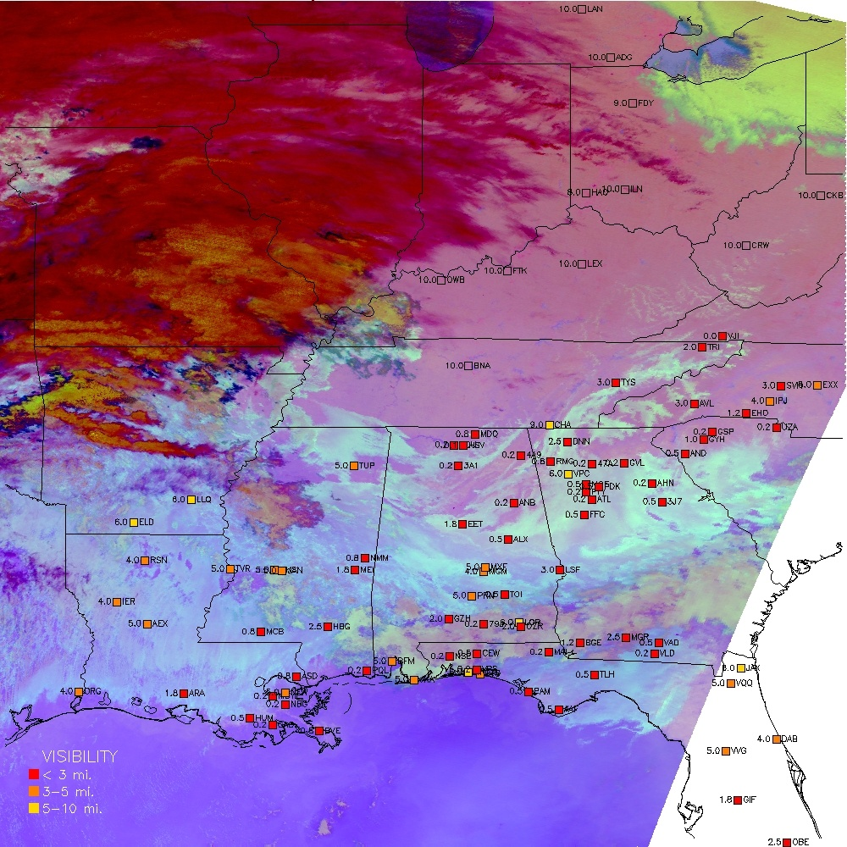
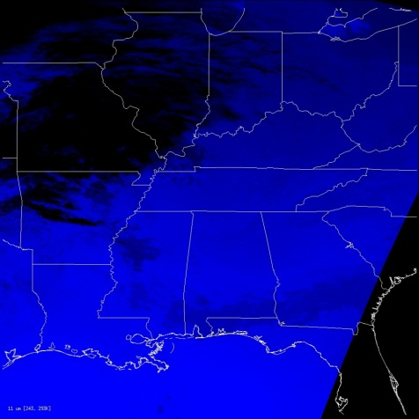
RGB Example: Fog Detection
“Night Microphysics” – Fog Detection
cold, low clouds
high cirrus
cool, cloud free land
R: 12.0-10.8 μm
G: 10.8-3.9 μm
dense fog
coastal stratus
warm open waters
B: 10.8 μm
R: 12-11 μm, G: 11-3.9 μm, B: 11 μm
Combines 3 channels of information.
transitioning unique NASA data and research technologies to operations

Slide 8
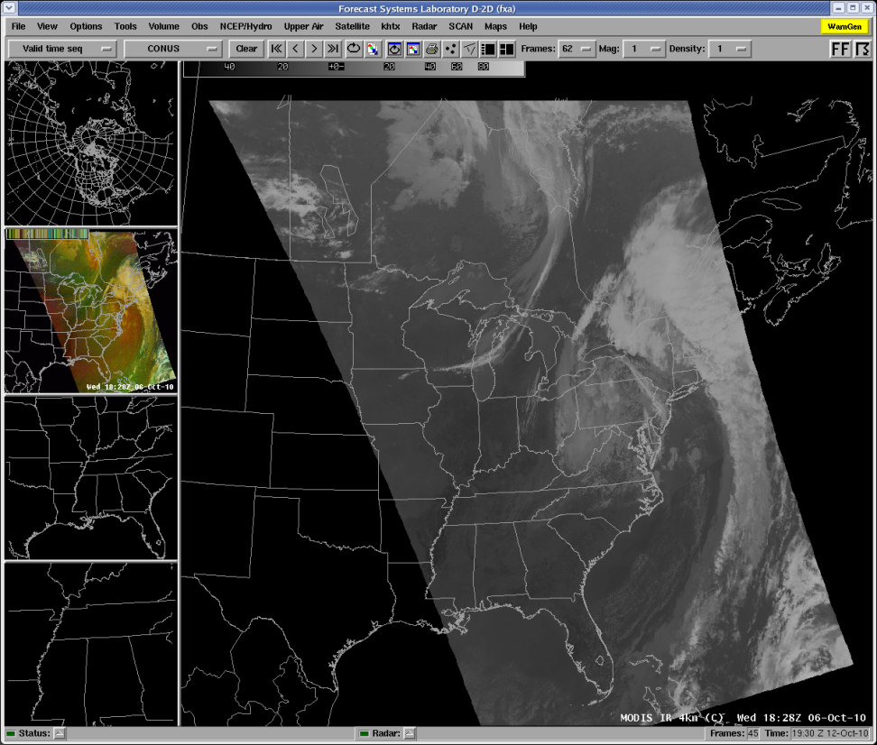
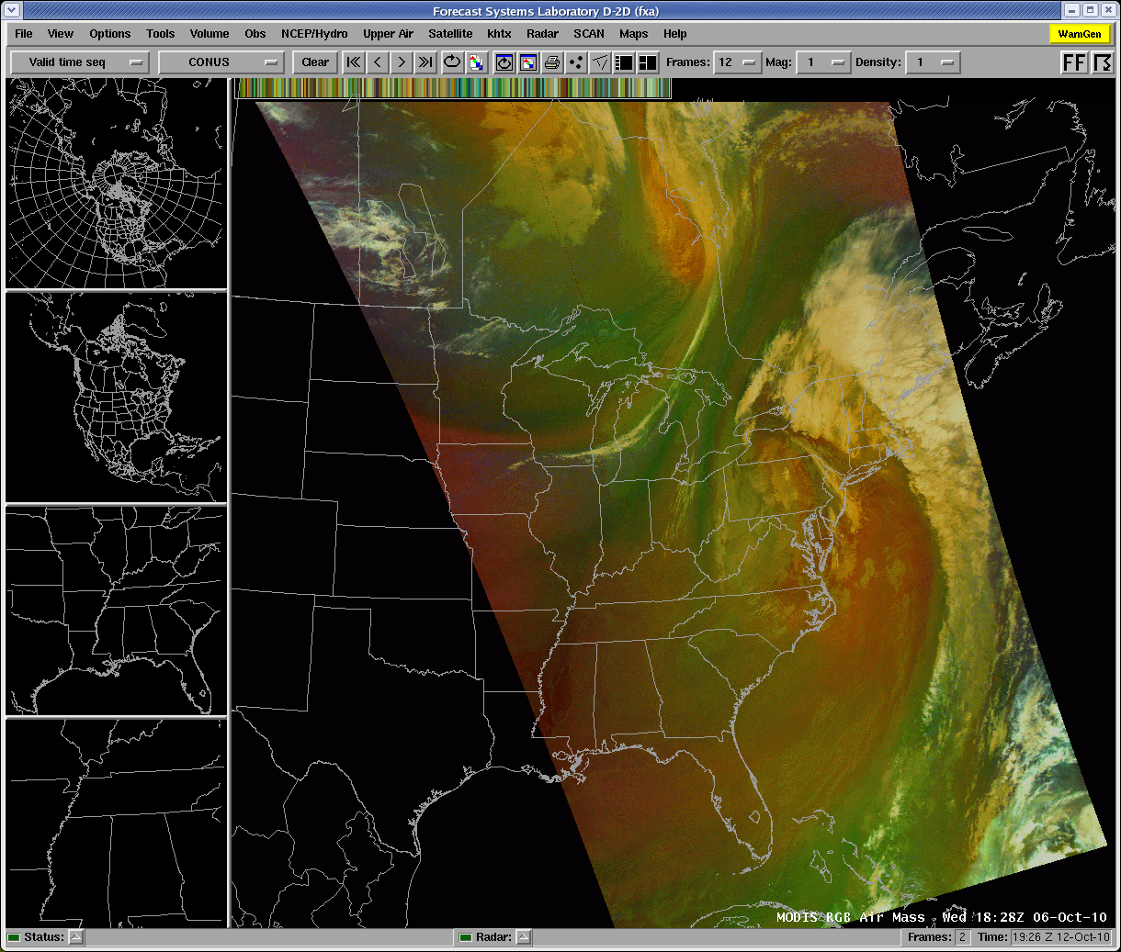
RGB Example: Synoptic Features
Single Channel Water Vapor – Features
“Air Mass” – Feature Detection
L
L
cooler, drier
L
warm, moist
L
warm, dry
warm, moist
Single Channel Water Vapor – Features
R: 6.2 µm-7.3 µm, G: 9.7 µm-10.8 µm, B: 6.2 µm
Combines 4 channels of information.
transitioning unique NASA data and research technologies to operations

Slide 9
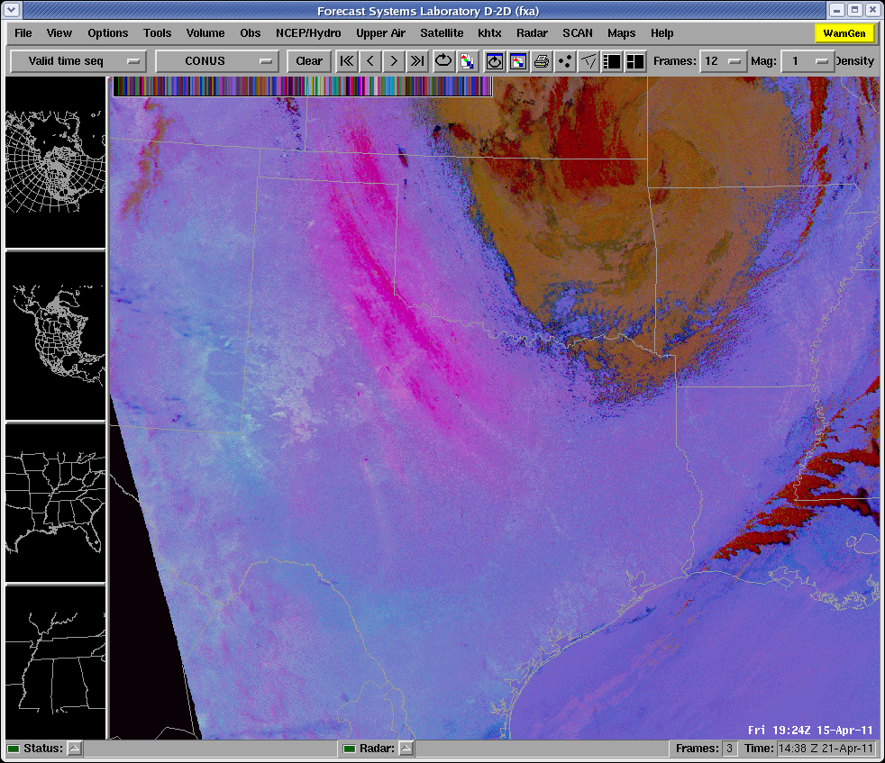
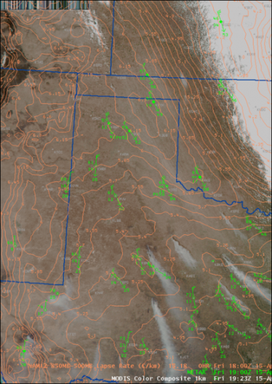
Dust and Smoke Discrimination
Through partnerships with WFOs, SPoRT will transition MODIS RGB products for evaluation.
  These may have additional value in Alaska where polar orbits are more frequent
Some RGBs will have very specific applications – but still provide value in addition to other products.
Dust Detection and Wildfire Discrimination
dust
?
fires
fires
R: 12-11 μm, G: 11-8.7 μm, B: 11 μm
Combines 4 channels of information.
transitioning unique NASA data and research technologies to operations

Slide 10
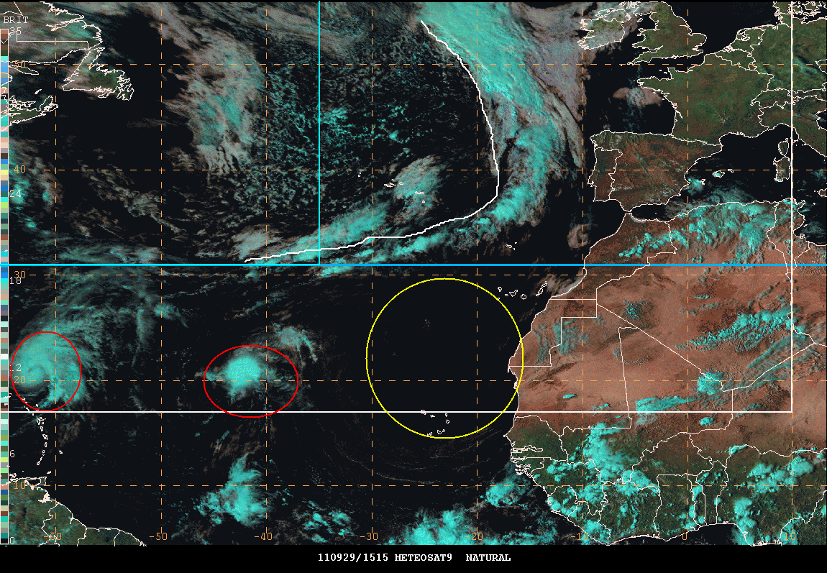
Collaborations with NOAA Centers
Examples from the GOES-R Proving Ground
SPoRT and CIRA provide Meteosat-9/SEVIRI RGB products to NOAA National Centers to demonstrate future GOES-R capabilities.
Subsidence?
Dust?
“Ophelia”
“Phillipe”
EUMETSAT/SEVIRI “Natural Color” RGB Composite
transitioning unique NASA data and research technologies to operations

Slide 11
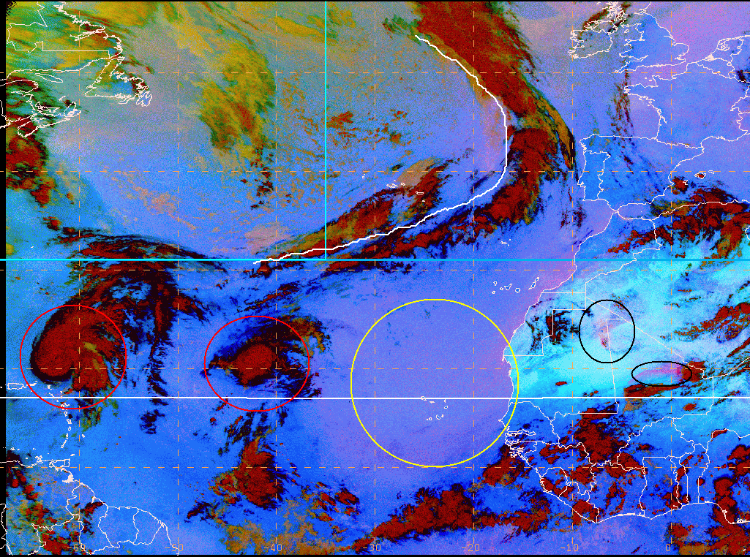
Collaborations with NOAA
Examples from the GOES-R Proving Ground
EUMETSAT/SEVIRI “Dust” RGB Composite
SPoRT developed a technique to display these products in both NAWIPS and AWIPS for NOAA National Centers use.
outflows / dust
cloud free
widespread dust
“Ophelia”
“Phillipe”
Image analysis courtesy of Michael Folmer / NOAA-HPC/GOES-R PG
transitioning unique NASA data and research technologies to operations

Slide 12
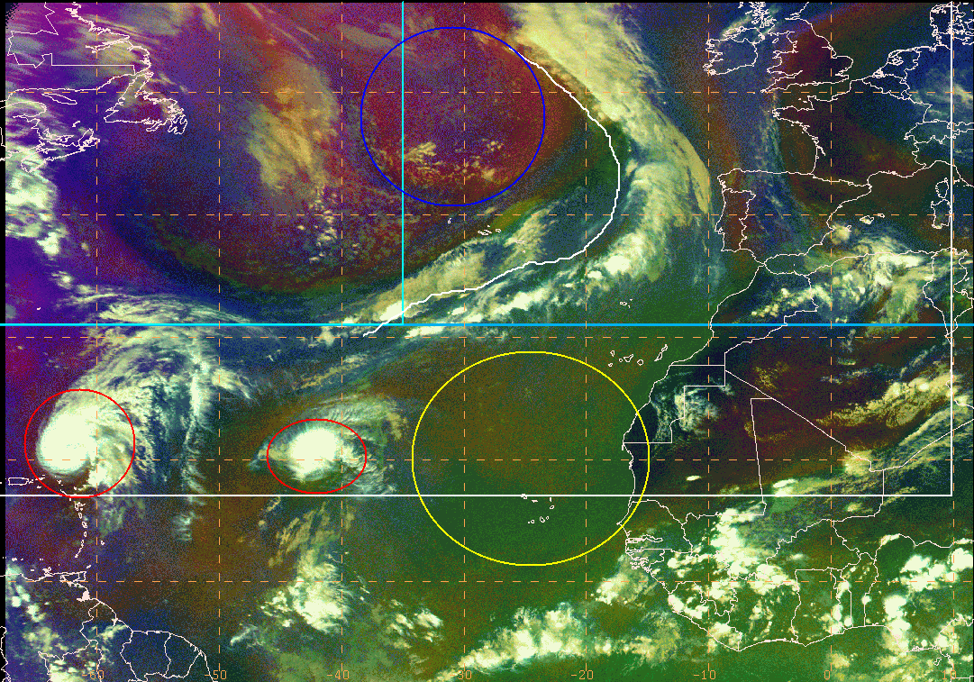
Collaborations with NOAA
Examples from the GOES-R Proving Ground
EUMETSAT/SEVIRI “Air Mass” RGB Composite
cold and dry polar air
outflows / dust
warm, dry subsidence
“Ophelia”
“Phillipe”
Image analysis courtesy of Michael Folmer / NOAA-HPC/GOES-R PG
transitioning unique NASA data and research technologies to operations

Slide 13
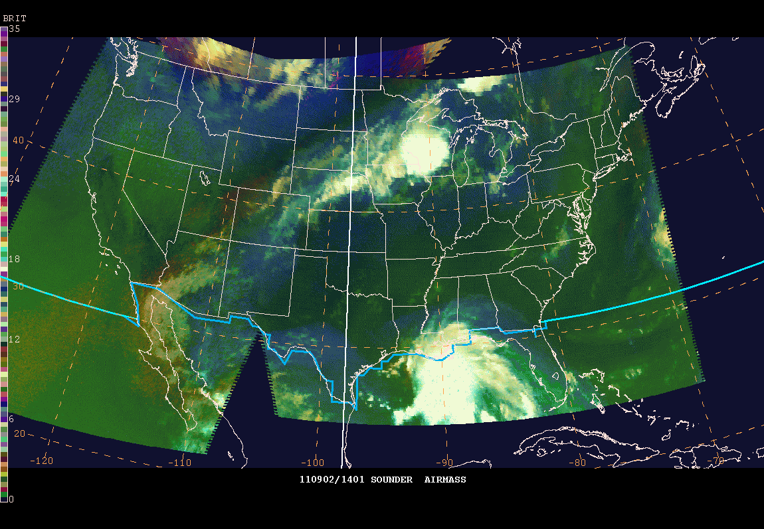
Collaborations with NOAA
Examples from the GOES-R Proving Ground
Evolution of Tropical Storm Lee
Example of CIRA GOES-Sounder “Air Mass” RGB used in NHC Proving Ground
Courtesy of Jack Beven/NHC, 2011 NWA
transitioning unique NASA data and research technologies to operations

Slide 14
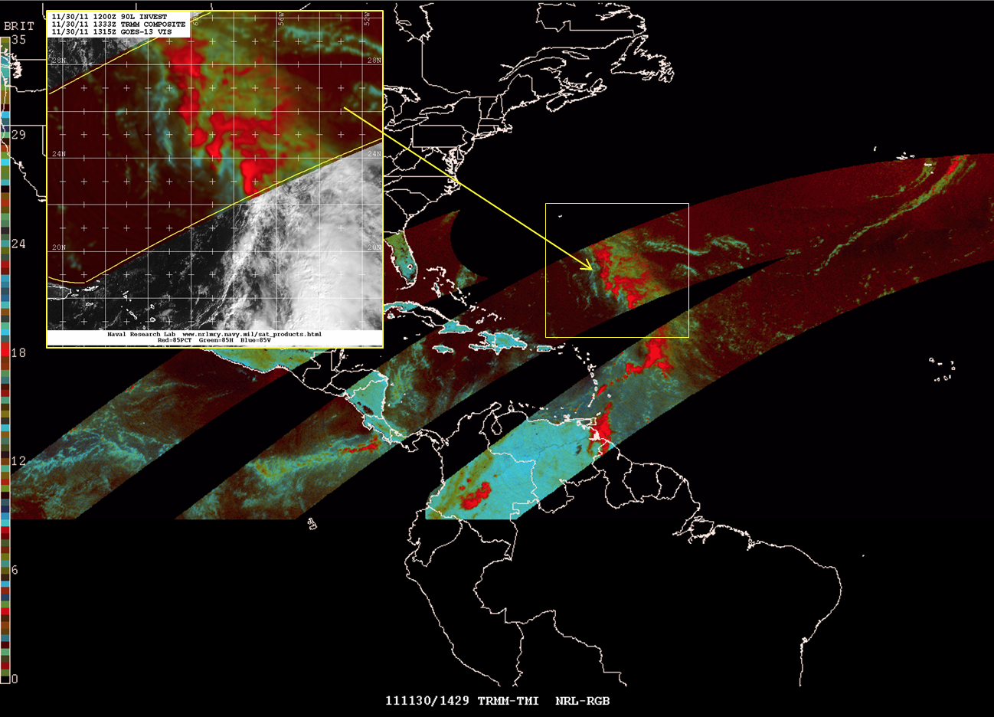
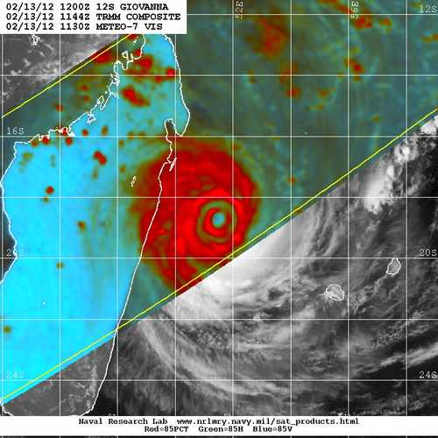
Collaborations with NRL
Passive Microwave Applications
Goals:
Improved use of great NRL products within the operational system.
Extend applications beyond tropical cyclones.
“Off-Season Example”
SPoRT is working with NRL to develop useful passive microwave composites in NAWIPS.
Current: TRMM-TMI, SSM/I, SSMI/S
Future: Incorporate ATMS, GPM, VIIRS Low Light
“Giovanna”
February 13, 2012
transitioning unique NASA data and research technologies to operations

Slide 15
RGB Product Suite
Current and Future Applications
Product | Instruments | Purpose
Air Mass | SEVIRI, MODIS, GOES Sounder | Air mass type discrimination
Dust | SEVIRI, MODIS, VIIRS | Blowing or suspended dust
Night Microphysics | SEVIRI, MODIS, VIIRS | Fog and low clouds
Day Microphysics | SEVIRI, MODIS, VIIRS | Fog and low clouds
Day Snow/Fog | SEVIRI, MODIS, VIIRS | Fog, low clouds, and snow
Daytime Storms | SEVIRI, MODIS, VIIRS | Identifies convective storms
Natural Color | SEVIRI, MODIS, VIIRS | Approximates a true color image
True Color | MODIS, VIIRS | True color, photograph image
False Color Snow | MODIS, VIIRS | Discriminate clouds from snow
Low Light Composites | VIIRS | Unique nocturnal imagery (CIRA, NRL)
Passive Microwave | TRMM, DMSP, ATMS, GPM | Tropical cyclone and other applications
transitioning unique NASA data and research technologies to operations

Slide 16
Summary and Conclusions
In the past two years, SPoRT has rapidly expanded capabilities in producing and disseminating multispectral satellite imagery.
These activities have expanded SPoRT’s role in NCEP Centers and will offer new opportunities in collaboration with WFO partners.
Formal training and evaluation periods will be executed in collaboration with the GOES-R Proving Ground and with partnering offices.
transitioning unique NASA data and research technologies to operations

Slide 17
Questions?
transitioning unique NASA data and research technologies to operations

