Slide 1
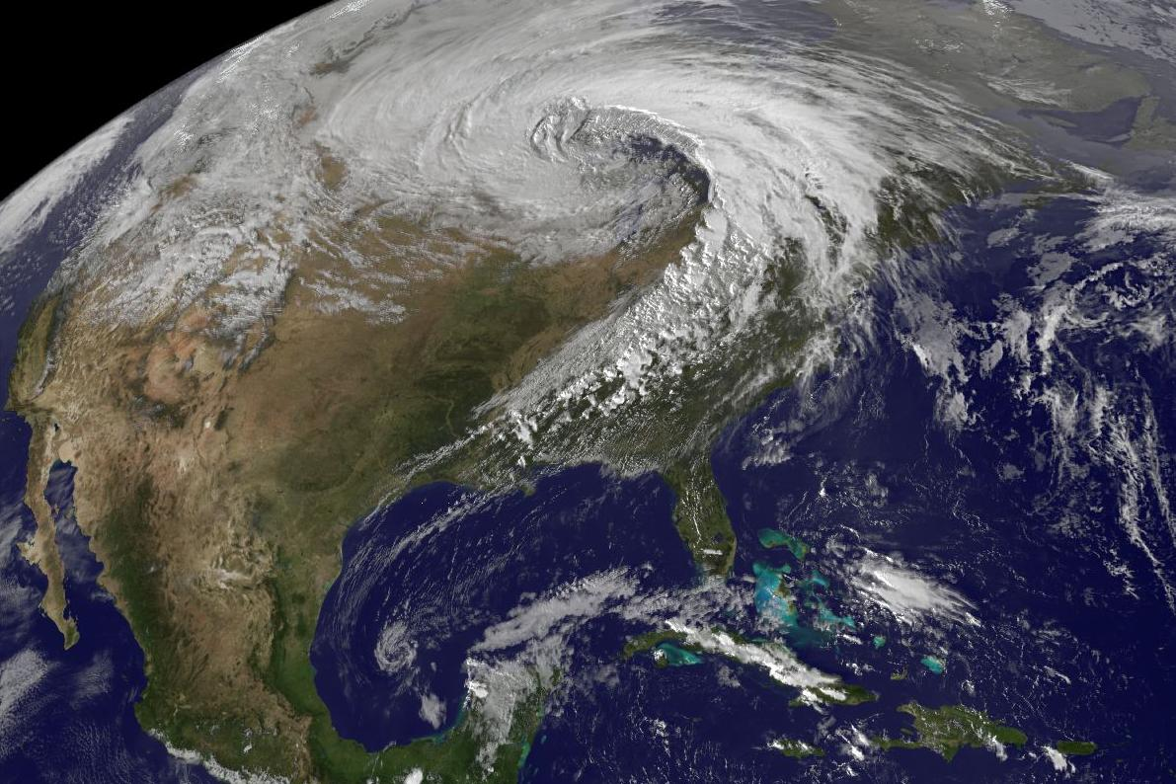
RGB Airmass Product Usage at the HPC/OPC/SAB GOES-R Proving Ground
Michael J. Folmer
“Satellite Champion” at HPC/OPC/SAB
Contributions from David Novak (HPC), Joseph Sienkiewicz (OPC), and Jamie Kibler (SAB)
Sixth Meeting of the Science Advisory Committee
02/28/12
1

Slide 2
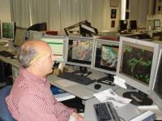
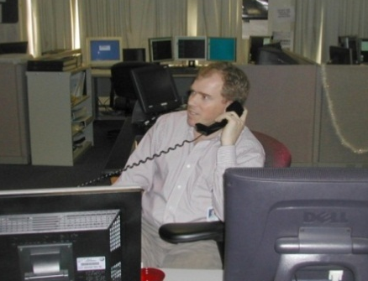
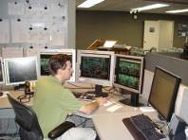
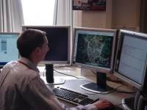
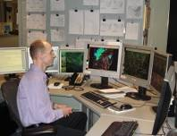
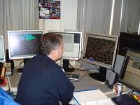
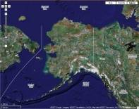
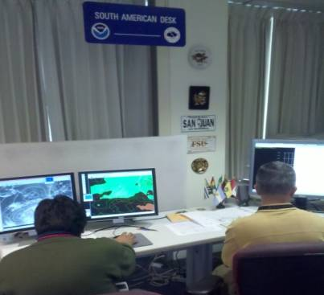
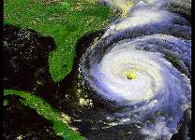
HPC GOES-R Proving Ground Operations
Broad variety of responsibilities
NWS QPF GPRA
QPF
QPF
Winter Weather
Winter Weather
Medium Range
Medium Range
Day 0 – 7 forecast guidance
Model Diagnostics
Model Diagnostics
Short Term Weather
Surface Analysis
Short Term Weather
Surface Analysis
International
Tropical
Alaska Med. Range
Tropical
Alaska Med. Range

Slide 3
Strong System forming on 02/24/12
GOES-Sounder RGB Airmass
GOES-E Water vapor

Slide 4
Strong System forming on 02/24/12 GOES-Sounder RGB Airmass with the 12z NAM 500 mb Absolute Vorticity Initialization Overlaid

Slide 5
Strong System forming on 02/24/12 GOES-Sounder RGB Airmass with the 06z GFS 500 mb Absolute Vorticity Forecast at 12z Overlaid

Slide 6
Strong System forming on 02/24/12 MODIS RGB Airmass Product
Airmass product valid 1545z 02/24/12
Airmass product with
gfs pw forecast

Slide 7
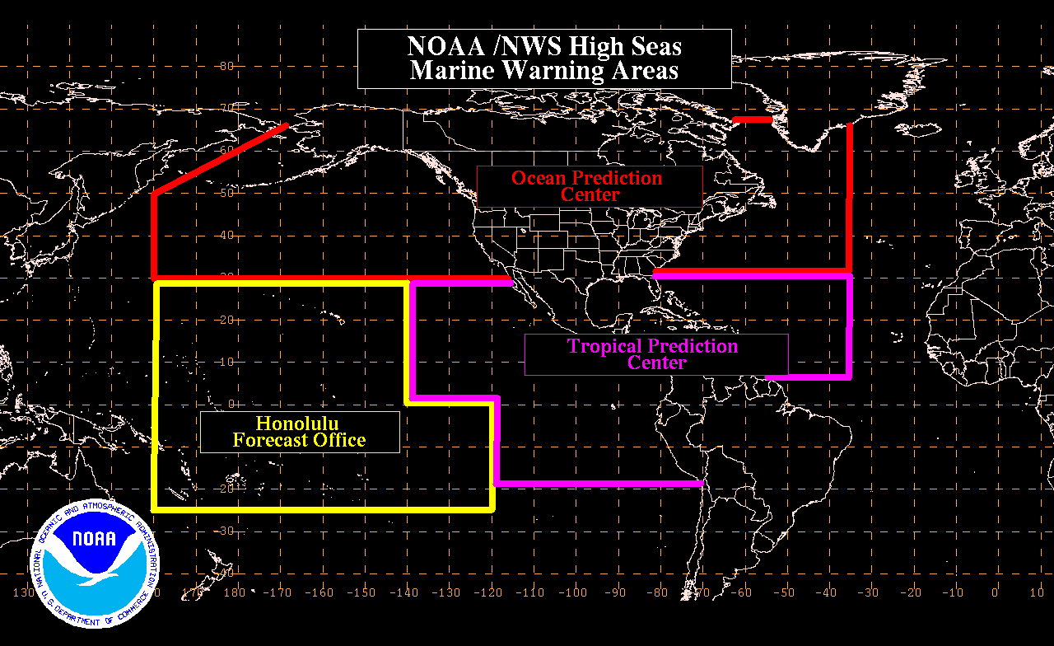
OPC GOES-R Proving Ground NOAA Forecast Responsibility
http://www.weather.gov/om/marine/home.htm
http://www.opc.ncep.noaa.gov/
National Hurricane
Center
http://www.nhc.noaa.gov/marine_forecasts.shtml
http://www.prh.noaa.gov/hnl/pages/marine.php
High Seas Warning Categories
GALE – 34-47 knots Force 8/9
STORM – 48-63 knots Force 10/11
HURRICANE FORCE - >64 knots Force 12

Slide 8
OPC Forecast Functions
Atlantic High Seas Pacific High Seas
Atlantic Offshore Pacific Offshore
Outlook (Medium Range)
Special Project Support
Antarctica NMFS
USCG Arctic (with AR)
Japan

Slide 9
RGB Airmass Product Usage in Research Strong North Atlantic Storm on 02/01/11
WRF-simulated PBL
Max Wind Gust
SEVIRI RGB Airmass Product with an ASCAT_HI Overlay
Image Courtesy of Benjamin Albright – Howard University
Image Courtesy of Joseph Sienkiewicz – OPC

Slide 10
Strong North Atlantic Storm on 02/03/12 SEVIRI RGB Airmass Product with an OSCAT_HI Overlay

Slide 11
Hurricane Philippe (2011) SEVIRI RGB Airmass
Category 1 (80 knots)
Valid 09z 10/07/11
Extratropical (45 knots)
Valid 00z 10/09/11

Slide 12
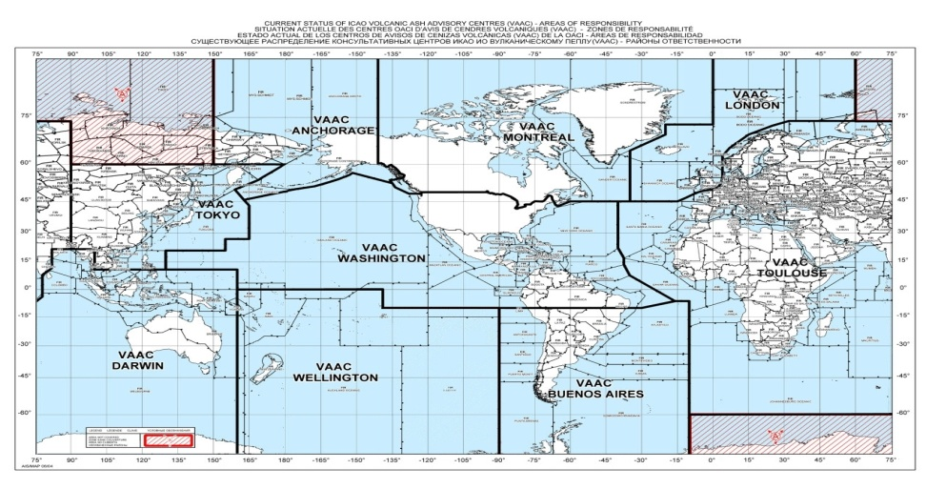
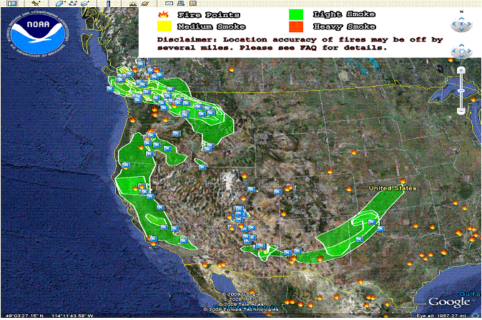
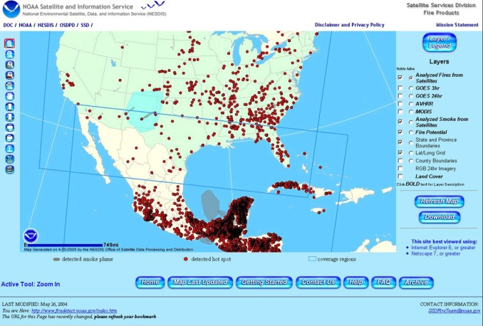
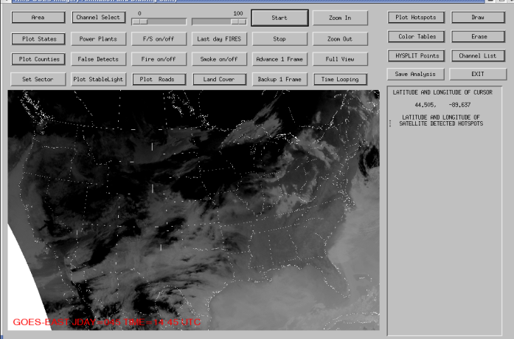
SAB Volcanic Ash Program
Washington VAAC area of responsibility includes the continental US, southward through Central America, the Caribbean, to 10S in South America and the US controlled oceanic Flight Information Region (FIR).
Washington is 1 of 9 VAACs that cover the globe. Other VAACs include Anchorage, Buenos Aires, Darwin, London, Montreal, Tokyo, Toulouse and the Wellington.
Monitoring volcanoes 24 hours a day 365 days a year
http://www.ssd.noaa.gov/VAAC/
SAB Smoke, Fire and Air Quality Program
http://www.ssd.noaa.gov/PS/FIRE/kml.html
http://www.firedetect.noaa.gov/viewer.htm
The Hazard Mapping System

Slide 13
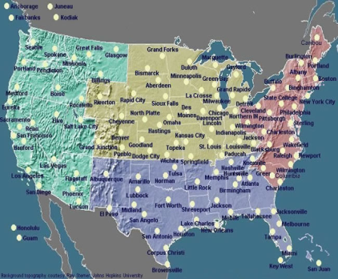
SAB Precipitation Program
24/7/365 monitoring of precipitation with emphasis on satellite analysis, short term trends and rainfall estimates
Supporting NWS WFO/RFCs
Supporting NWS NCEP HPC
heavy rainfall / flash flooding
excessive rainfall area
Precipitation trends
0-6 hr rainfall guidance
satellite rainfall estimates
moderate to heavy winter precipitation
West Coast winter storms
Great Lake snows
http://www.ssd.noaa.gov/PS/PCPN/
SAB Tropical Program
Dvorak Infrared and Visible Satellite Technique
Areas Users
North Atlantic Ocean
Eastern North Pacific Ocean NOAA NHC/CPHC
Central Pacific Ocean
Western North Pacific
Arabian Sea
Bay of Bengal
South Indian Ocean
South Pacific Ocean
Tropical Storms: Global Geostationary and Polar Orbiting microwave satellite data are monitored for the formation, movement, and intensity of tropical storms, hurricanes, and typhoons.
Routine analyses of these storms are relayed to the National Weather Service and many other international agencies such as the Regional Specialized Meteorological Centres (RSMC) forecast Tropical Cyclones.
US Military -JTWC
WMO Regional Specialized Meteorological Centers (RSMC) in Tokyo, New Delhi, Reunion, Brisbane, Perth, Darwin, Fiji and Wellington
Notes:
13

Slide 14
North TX / Southwest OK Dust Storm on 01/22/12
MODIS (Terra) image of dust storm in tx
MODIS RGB Dust image of dust storm in tx

Slide 15
Tropical Cyclone Funso (2012) SEVIRI RGB Airmass
Category 4 (115 knots)
Valid 15z 01/25/12
Tropical Storm (35 knots)
Valid 18z 01/28/12

Slide 16
Tropical Storm Sean (2011) A Storm for All Three Centers

Slide 17
Tropical Storm Sean (2011) MODIS RGB Airmass Product in OPC and TAFB Warning Areas Valid at 1443z 11/07/11

Slide 18
Tropical Storm Sean (2011) MODIS RGB Airmass Product in OPC, SAB, and TAFB Warning Areas - Valid at 0310z 11/10/11

Slide 19
Mention of RGB Airmass Usage in HPC Forecast Discussions
From the 00z Day 2 and 3 QPF discussion at HPC on 01/26/12:
IN ADDITION TO SUFFICIENT CLUSTERING OF SOLUTIONS TOWARD THE PHASED SOLUTION...BOTH WATER VAPOR AND EXPERIMENTAL GOES-R AIRMASS RGB IMAGERY INDICATE SIGNIFICANT DARKENING AND/OR ACCUMULATION OF POTENTIAL VORTICITY ENTERING THE BASE OF THE TROUGH. ~Kenneth James
From the 12z Model Diagnostics discussion at HPC on 02/07/12:
THE NAM...GEM GLOBAL...AND ECMWF ALL HANDLE THIS IMPULSE COMPARABLY. THE GFS AND UKMET ARE FLATTER. THE IMPULSE HAS A WELL DEFINED SIGNATURE ON THE EXPERIMENTAL GOES-SOUNDER RGB AIRMASS IMAGERY THIS MORNING OVER THE PLAINS STATES...WITH A PRONOUNCED DRY INTRUSION INDICATIVE OF ITS ROBUSTNESS. WILL RELY ON THE LARGER CONSENSUS SUPPORTING THE MORE DEFINED SYSTEM. ~James Cisco

Slide 20
Summary of RGB Usage at the HPC/OPC/SAB Proving Ground
The GOES-Sounder RGB Airmass and MODIS RGB Airmass products are proving to be useful in operations at HPC for the Model Diagnostics and Day 2-3 QPF desks.
The SEVIRI RGB Airmass product is getting much use in OPC operations, especially for the Atlantic High Seas desk.
The MODIS RGB Dust & Airmass products along with the GOES-Sounder and SEVIRI versions are getting attention from SAB for multiple uses
There is much interest in additional coverage in the Pacific and Alaska.
Collaborative Activities (GOES-R Visiting Scientist Proposal):
Michael Folmer to visit SPoRT in May 2012 to learn about products, AWIPS II capabilities, and support training efforts.
Andrew Molthan to visit HPC/OPC/SAB in September 2012 to follow up on training efforts and incorporate AWIPS II capabilities.

