Slide 1
NASA Data and Products
Sixth Meeting of the Science Advisory Committee
28 February – 1 March 2012
National Space Science and Technology Center, Huntsville, AL

Slide 2
Relevance to SPoRT
NASA had a strategic plan for SPoRT when begun in 2003
work with NASA data to provide NWS forecasters unique data that was unavailable from NOAA
SPoRT showed that EOS data had weather applications other than climate
Situational Awareness for short-term forecasts
Forecasters have frequent issues for which we can provide help
Focused on Southern Region WFOs, creating partnerships with personnel providing feedback to us
SPoRT paradigm
With expansion since the 2009 SAC, NASA data are used at most of our 24 WFOs

Slide 3
Products to End Users
NASA
OTHER
INSTRUMENT / PRODUCT | RESOLUTION | END USER | FORECAST PROBLEM
Combined Instrument products
Multi-sensor SST composite | 2 km (NA coastal regions) | WFOs | Short-term forecasts
Blended TPW (from CIRA)* | 16 km (NH) | WFOs | Atmos. Rivers, precip.
GOES
NESDIS Aviation products* | 4 km (CONUS) | WFOs | Situational awareness
GOES-R
pGLM product suite | 10 km / 2 minutes | HWT | Severe weather, lightning
GOES-MODIS hybrid | 500 m, 1 km | WFOs | Situational awareness
GOES-MODIS RGB hybrid | 500 m, 1 km | WFOs | Situational awareness
Proxy QPE (NESDIS) | 4 km | WFOs | Precipitation
RGB products – SEVIRI, MODIS, GOES Sounder | 1 – 10 km | Nat. Ctrs. | Situational awareness
UAH Convective Initiation | 1 km | WFOs / NC | Convection, rain
Passive Microwave
TRMM 37 (V/H), 85 (V/H), comp. | 12.5 – 25 km | NC, WFOs | Precip., atmos. dynamics
SSMI(S) 37 (V/H), 85 (V/H), 91V | 12.5 – 25 km | NC, WFOs | Precip., atmos. dynamics
SSMI(S) RGBs – 37/85, 37PCT | 12.5 – 25 km | NC, WFOs | Precip., atmos. dynamics
new
new
new
new
* NESDIS version of products now available in AWIPS via SBN. Red text indicates a future near-term product

Slide 4
Products to End Users
NASA
OTHER
INSTRUMENT / PRODUCT | RESOLUTION | END USER | FORECAST PROBLEM
MODIS (Terra & Aqua)
Imagery (vis, 3.9, 6.7, 11 µm) | 4 km, 1 km, 500 m (state), 250 m (WFO scale) | WFOs | Situational awareness
RGB products (true, false color) | 4 km (CONUS), 1 km (reg.), 500 m (state) | WFOs, NC | Obstructions to visibility, snow cover
Derived image products
clouds (mask, CTP, phase) | 4 km (CONUS) | WFOs | Situational awareness
fog / low cloud (11 – 3.9 µm ) | 4 km (CONUS), 1 km (reg.) | WFOs | Visibility, hazards
LST, LI, TPW | 4 km (CONUS), 1 km (reg.) | WFOs | Atmospheric stability, surface forcing
Temporal composite images
SST daily | 2 km | WFOs | Coastal processes, lake effect precipitation
Non-image data
HMS/FIRMS fire/ burn areas¹ | CONUS | WFOs | Smoke, visibility, flooding
AMSR-E² (Aqua)
Rain rate, cloud water | 5 km (CONUS); 21 km | WFOs | Coastal weather, data voids
SSTs | 38 km (CONUS) | WFOs | Coastal weather
Total lightning data
LMAs (4) – total lightning | 2 km(2 min) / 1 km(1 min) | WFOs | Severe weather, safety
new
Available in AWIPS II only 2. Products no longer available

Slide 5
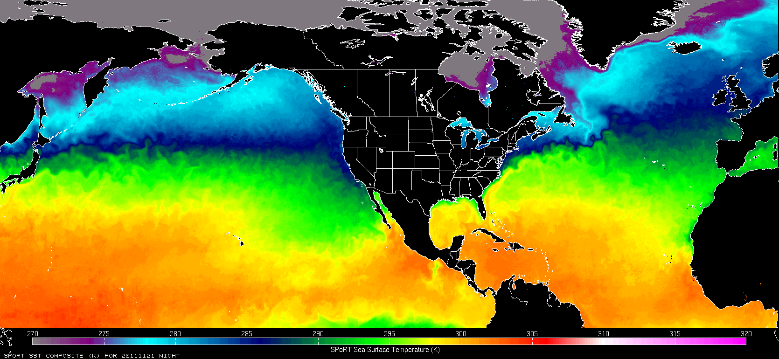
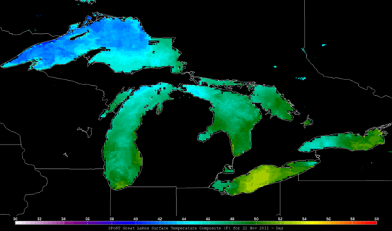
Sea Surface Temperatures
2 km resolution, weighted by source and age
2x/day (AM/PM) to capture diurnal variation
Alaska Subset
  Ice Desk
  GeoTIFF
Great Lakes subset
  Eastern Region
  Ice mask from Great Lakes Env. Research Lab

Slide 6
Products to End Users
NASA
OTHER
INSTRUMENT / PRODUCT | RESOLUTION | END USER | FORECAST PROBLEM
MODIS (Terra & Aqua)
Imagery (vis, 3.9, 6.7, 11 µm) | 4 km, 1 km, 500 m (state), 250 m (WFO scale) | WFOs | Situational awareness
RGB products (true, false color) | 4 km (CONUS), 1 km (reg.), 500 m (state) | WFOs, NC | Obstructions to visibility, snow cover
Derived image products
clouds (mask, CTP, phase) | 4 km (CONUS) | WFOs | Situational awareness
fog / low cloud (11 – 3.9 µm ) | 4 km (CONUS), 1 km (reg.) | WFOs | Visibility, hazards
LST, LI, TPW | 4 km (CONUS), 1 km (reg.) | WFOs | Atmospheric stability, surface forcing
Temporal composite images
SST daily | 2 km | WFOs | Coastal processes, lake effect precipitation
Non-image data
HMS/FIRMS fire/ burn areas¹ | CONUS | WFOs | Smoke, visibility, flooding
AMSR-E² (Aqua)
Rain rate, cloud water | 5 km (CONUS); 21 km | WFOs | Coastal weather, data voids
SSTs | 38 km (CONUS) | WFOs | Coastal weather
Total lightning data
LMAs (4) – total lightning | 2 km(2 min) / 1 km(1 min) | WFOs | Severe weather, safety
new
Available in AWIPS II only 2. Products no longer available

Slide 7
Products to End Users
NASA
OTHER
INSTRUMENT / PRODUCT | RESOLUTION | END USER | FORECAST PROBLEM
MISCELLANEOUS
LIS hourly products | 1-3 km | WFOs | CI, drought / hydrology
WindSat OSWV | 25 km | WFOs | Situational awareness
ASTER imagery³ | 15 m | WFOs | Tornado damage tracks
3D analysis fields from GSI | 12 km | WFOs | Weather forecasting
OMI (Aura)
NESDIS SO₂⁴ | Native resolution in NAWIPS | W. VAAC | Volcanic ash monitoring
AIRS (Aqua)
Carbon monoxide | 15 km | WFOs | Fires, air quality
VIIRS (SNPP)
Imagery (vis, 3.9, 6.7, 11 µm) | 750 m (state), 375 m (WFO) | WFOs | Situational awareness
RGB products (SEVIRI suite) | 750 m (state) | WFOs | Obstructions to visibility, snow cover, fog, smoke
DNB (low light) | 375 m | WFOs | Situational awareness
Derived image products
EDRs | various | WFOs | Situational awareness
new
new
new
new
Not real-time data Red text indicates a future near-term product
Full transition of software

Slide 8
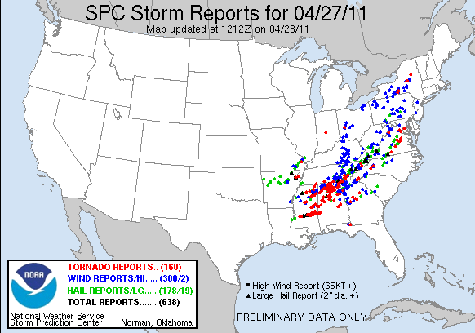
Observing Tornado Tracks
After the tornadoes of April 27-28, several WFOs had the daunting task of surveying the damage.
SPoRT assisted with MODIS and ASTER imagery to detect changes in surface foliage.

Slide 9
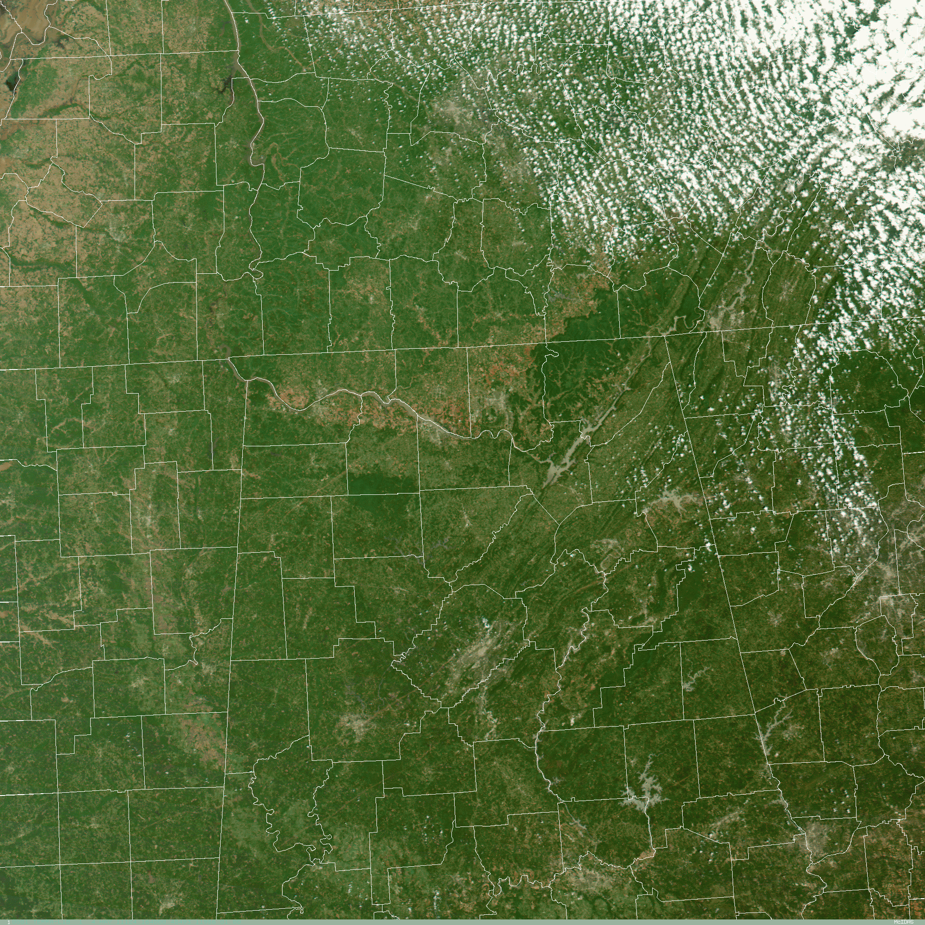
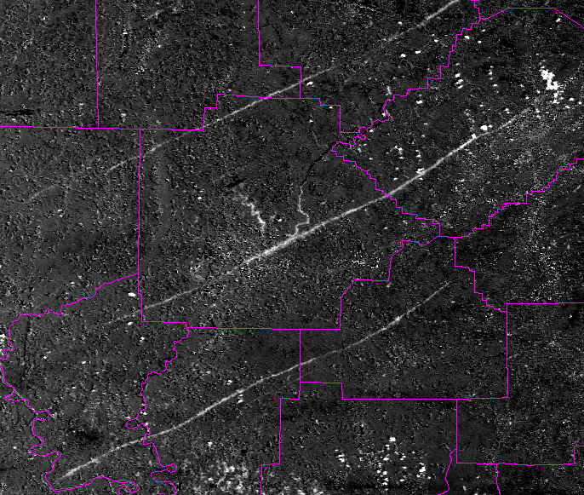
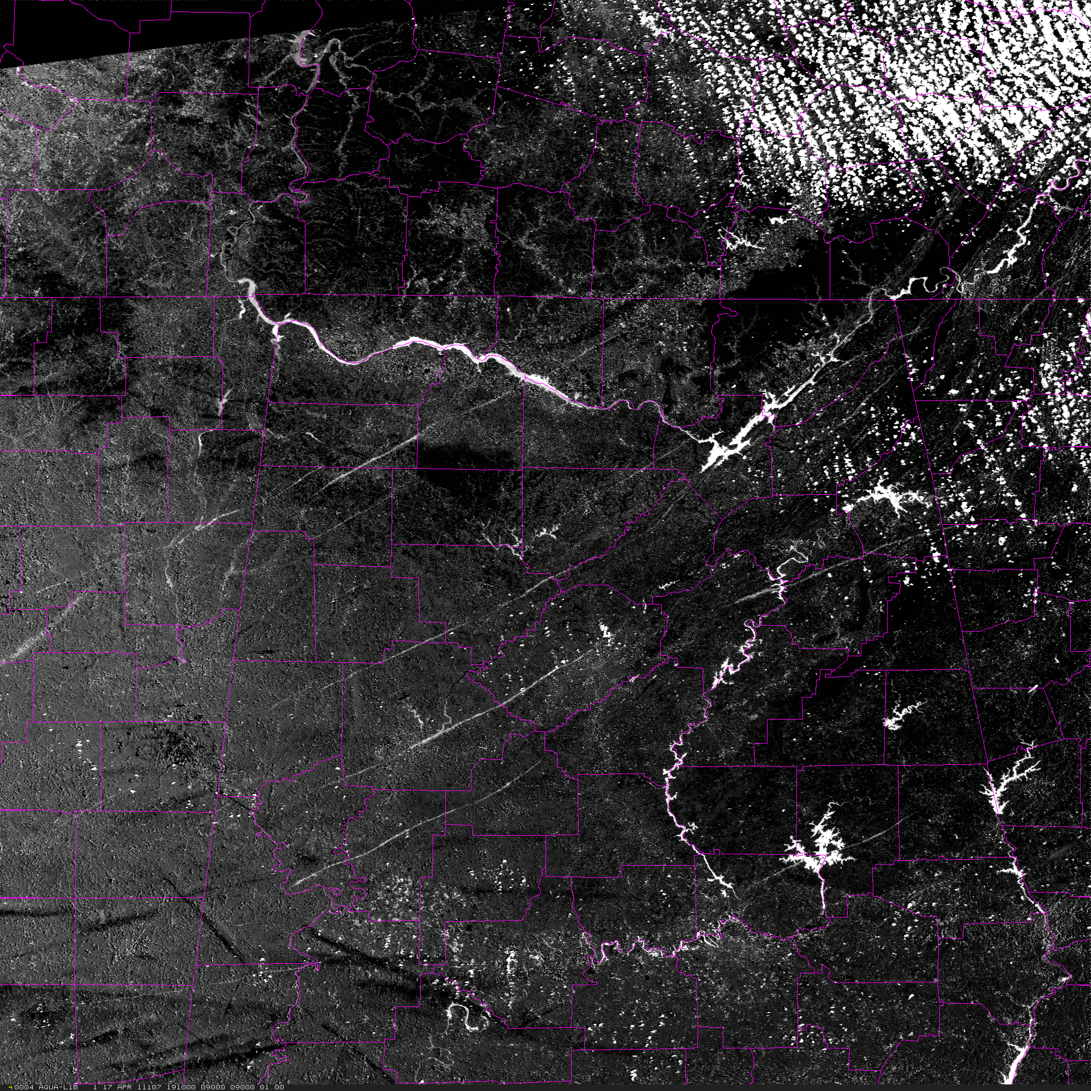
MODIS Before & After Difference Images
MODIS single channel (green) at 250m
MODIS image from April 17 (Aqua) and May 4 (Terra)
  geo-locate
  rectify to same coordinate system
  take temporal difference at each point in space
Most tornado tracks become very easy to see.
NWS forecasters used this image to help identify and assess track location for 21 out of 22 tornados that produced EF2 or greater damage.

Slide 10
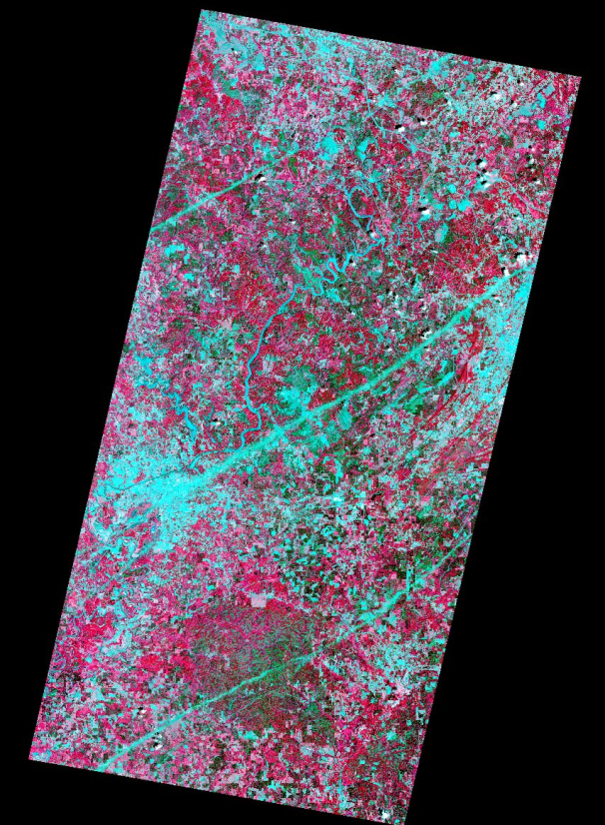
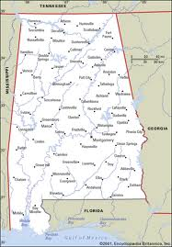

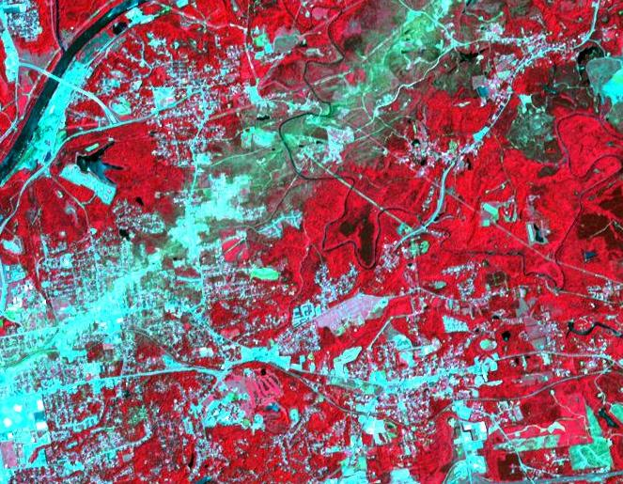
ASTER imagery
Aboard Terra
Vis 15 m resolution
IR 60/90 m resolution
On-demand instrument
  Pointable
  View is requested
SPoRT requested acquisition of several swaths after the April 27th events. BHM and HUN offices used the data to check completeness of assessments.
Jasper EF-3
Tuscaloosa EF-4
B’ham
Tuscaloosa
Demopolis EF-3

Slide 11
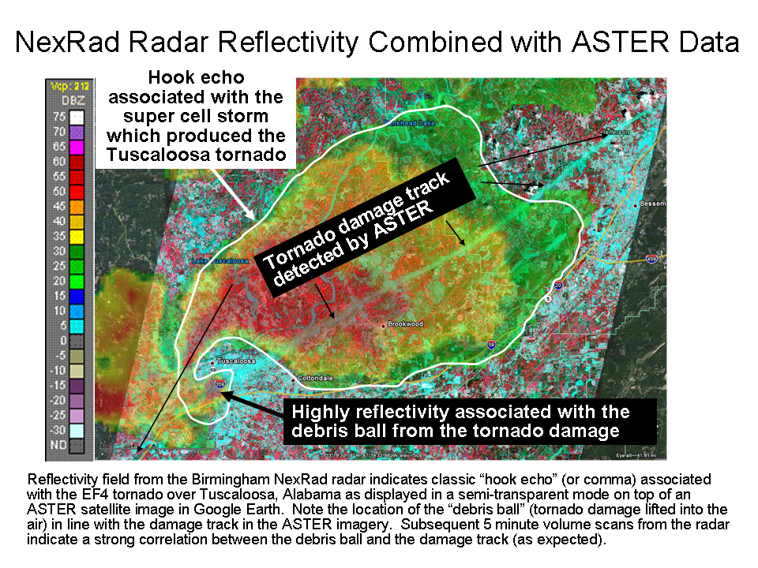
ASTER imagery

Slide 12
Future Work
Continue transition of current NASA products to AWIPS II
Expand dissemination to AK & Pac Regions
  Hybrids, products, KML
Develop new Hybrid products
  VIIRS, RGBs
Continue activities with ASTER, MODIS, and VIIRS for significant tornado events
Integrate RGB products
Increase use of NASA/LANCE and satellite Direct Broadcast
Provide CO and O₃ (AIRS) to National Centers
Consider new satellite data that addresses forecast issues
  SMAP, GPM, SNPP(ATMS, CrIS)

Slide 13
Questions ?

Slide 14
Background
Earth Observing System (EOS) sensors
  MODIS (VIIRS)
    Terra/1999 and Aqua/2002
    Various products (True color, Fog detection, SST, Tornado tracks, etc.)
  ASTER
    Terra/1999
    Tornado tracks
  AIRS (CrIS)
    Aqua/2002
    Regional forecasting model (WRF)
  AMSR-E (AMSR2)
    Aqua/2002 – spun down October 2011
    [Sea Surface Temperature, Passive Microwave]

