Slide 1


Total Lightning Applications
Sixth Meeting of the Science Advisory Committee
28 February – 1 March 2012
National Space Science and Technology Center, Huntsville, AL
transitioning unique NASA data and research technologies to operations

Slide 2
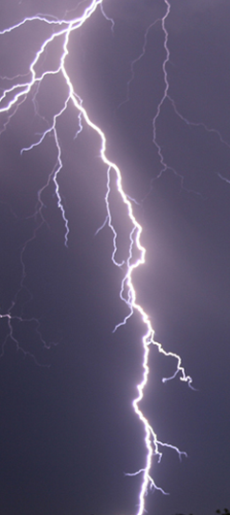
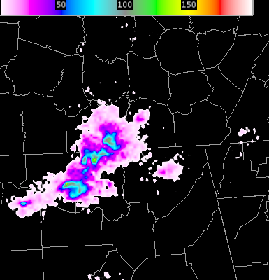
Relevance to SPoRT
Several LMAs operated by NASA
Improved situational awareness
  “At a glance” analysis
  See what storms may be intensifying
  Improved severe weather warnings
Improves lightning safety
  First cloud-to-ground strike lead time
  Spatial extent of storms
Leverage expertise with other SPoRT activities
  GOES-R GLM activities
transitioning unique NASA data and research technologies to operations

Slide 3
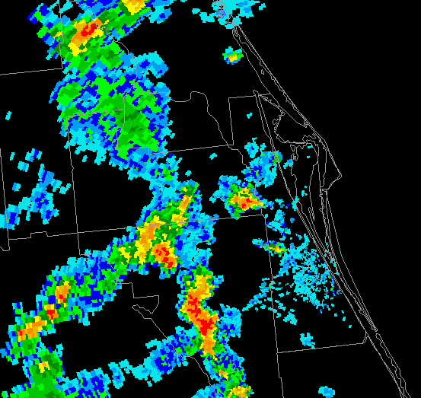
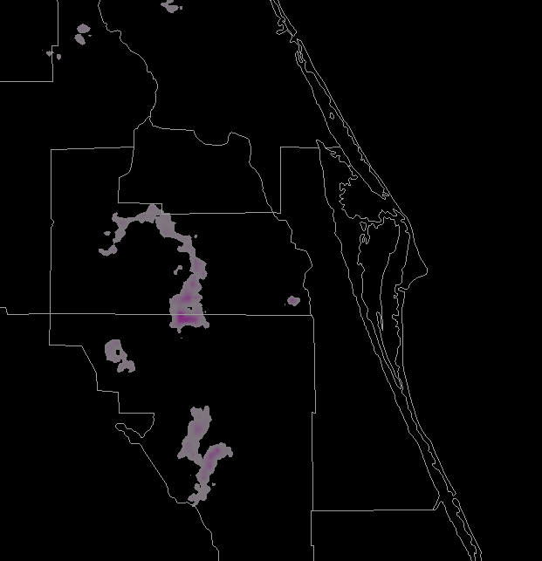
Accomplishments
“Lightning is a major strength of SPoRT” – SAC 2009
Partnered with Kennedy Space Center
  Supports WFO Melbourne, Florida
Visits to NWS Eastern Region
  Discuss expanded role with DCLMA
  Training modules provided
transitioning unique NASA data and research technologies to operations

Slide 4
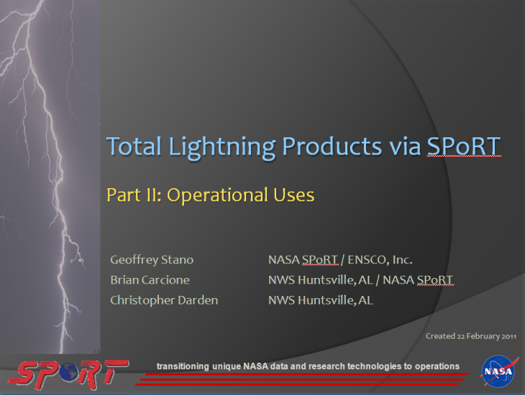
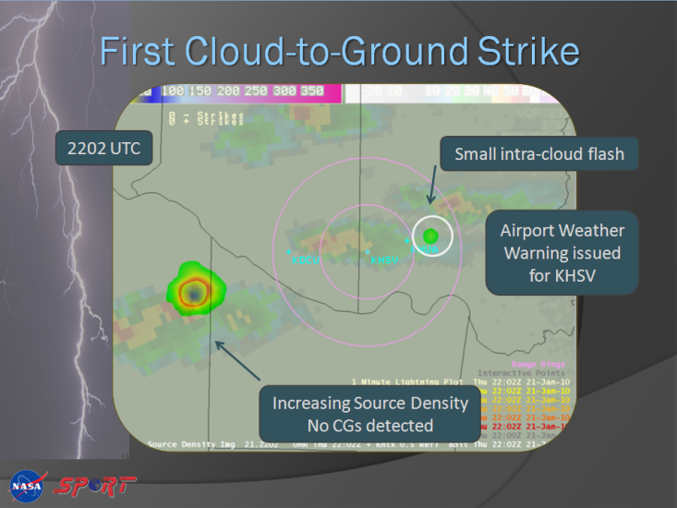
Accomplishments
“Advocates should play a bigger role in training” – SAC 2009
  8 operational examples provided by WFO partners in upcoming total lightning module
  WFOs guiding new product development
“Partner with other NOAA/NWS testbeds” – SAC 2009
  Developing ties with AWC and SPC
  Invitation to AWC’s Summer Experiment
transitioning unique NASA data and research technologies to operations

Slide 5
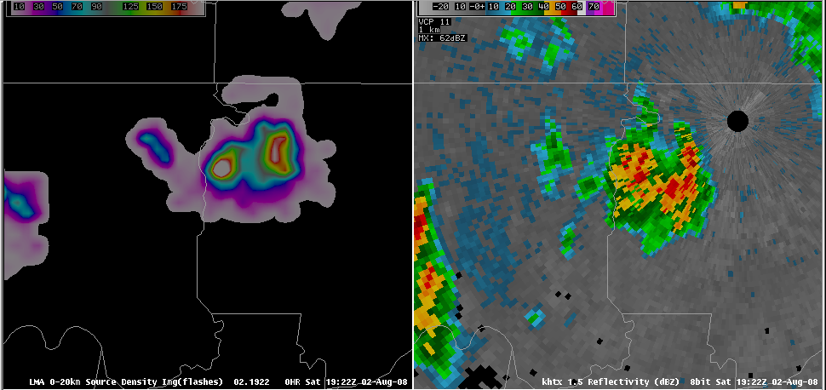
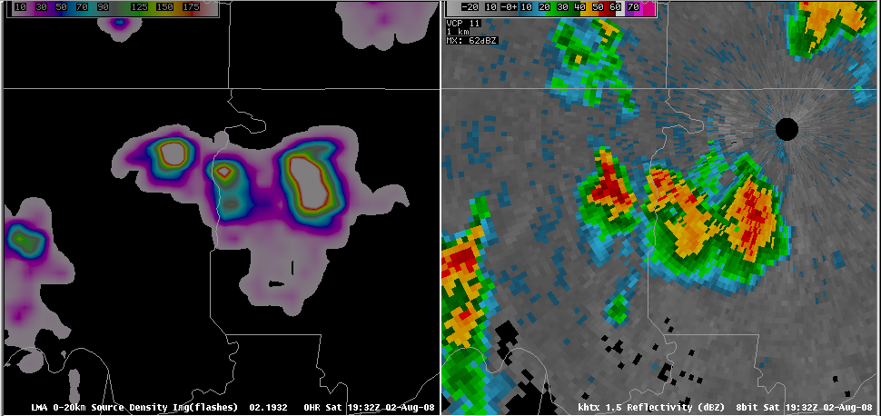
Traditional Use
1922 UTC
Correlation between lightning production and storm updraft
  Lightning linked to ice mass
  Stronger updrafts = more lightning
Rapid increase in lightning means:
  Rapidly intensifying updraft
  Precursor to severe weather
Rapid increase is a lightning jump or surge
66 sources
1932 UTC
324 sources
Severe hail several minutes later
transitioning unique NASA data and research technologies to operations

Slide 6
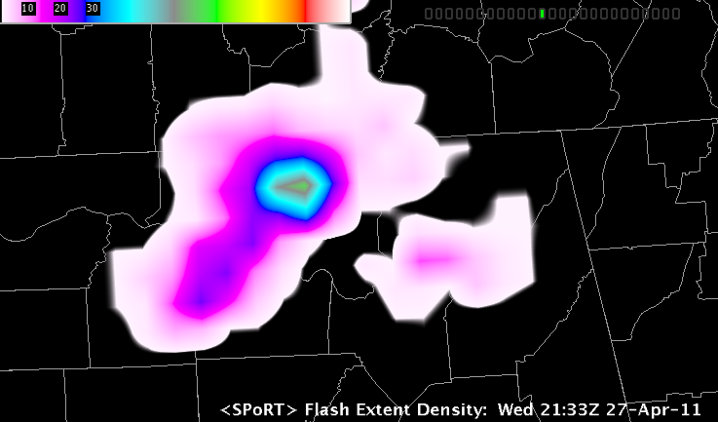
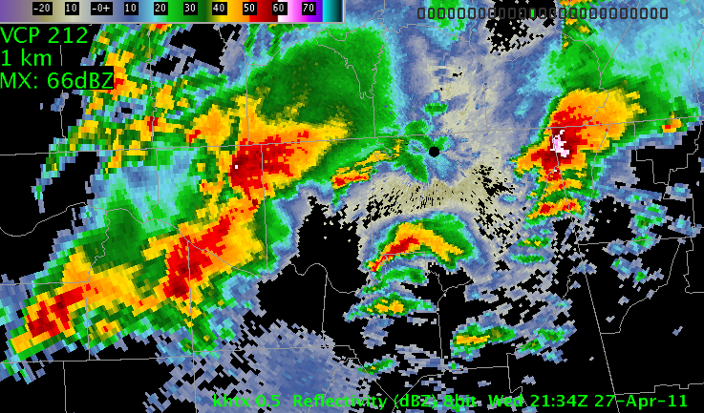
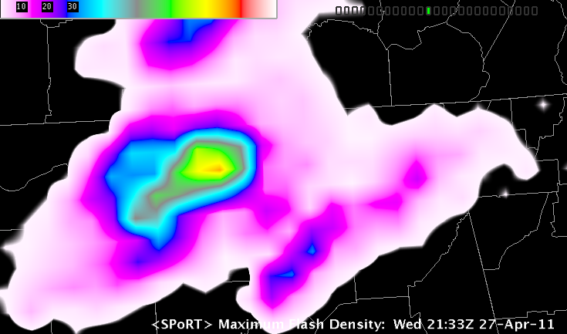
Expanded Uses
2134 UTC
2133 UTC
Flash Densities
Reflectivity
  SPoRT expanding uses
  Possible from training and active feedback
  End users fully integrate data
  Discussions focus on new products and utilities
2103 –
2131 UTC
Max Flash Density
transitioning unique NASA data and research technologies to operations

Slide 7
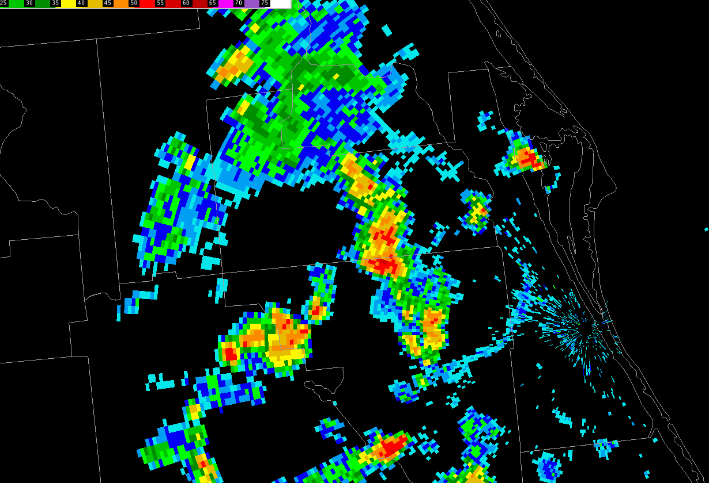
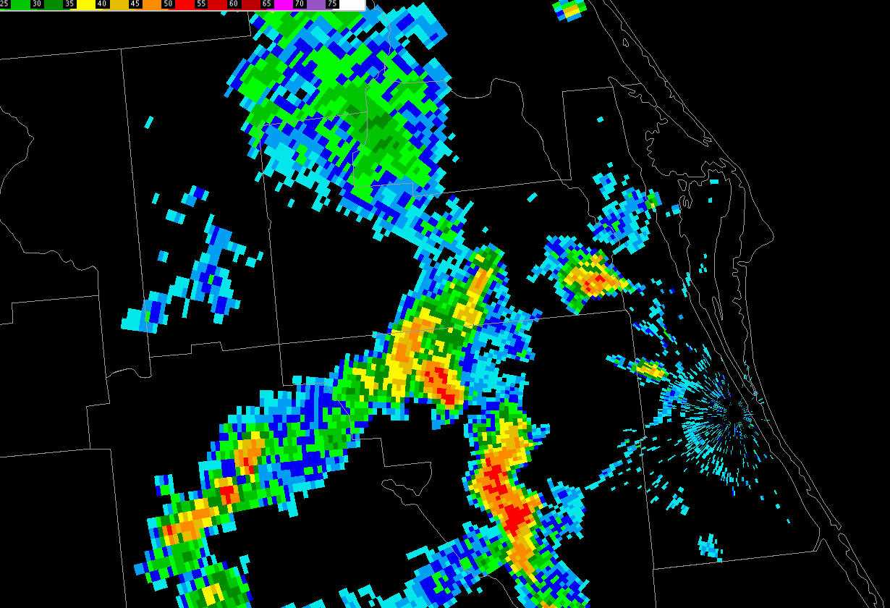


Expanded Use Example: Safety!
1849
UTC
1923
UTC
Strong storms around Orlando
Separated charge aloft
Dissipated but anvils remain
Still charged 90 min later
Flash tapped into this charge
1923
UTC

Slide 8
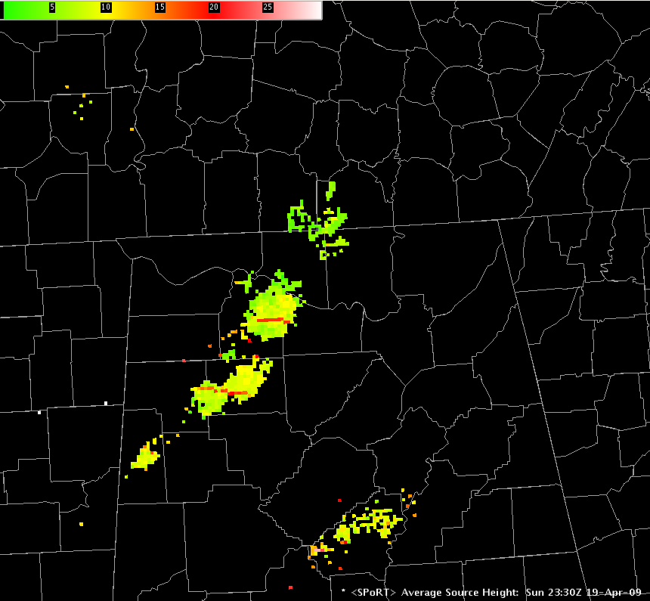
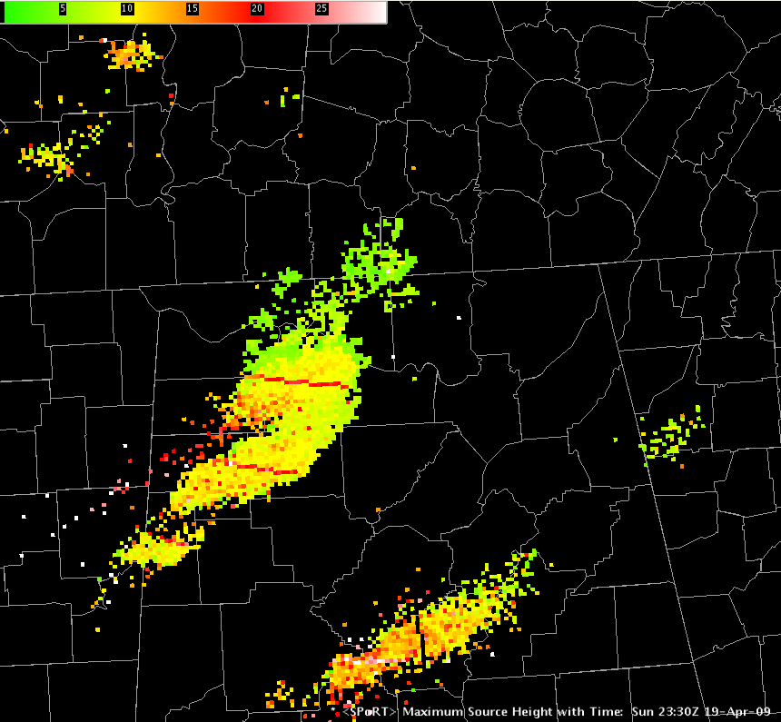
Development Example
Average source height
  Better core observation
  Observe updraft strengthening
  Still gives spatial data
Maximum height with time
  Like the max flash density
  Compare to instant product
Max Source Height (30 min)
Average Source Height
transitioning unique NASA data and research technologies to operations

Slide 9
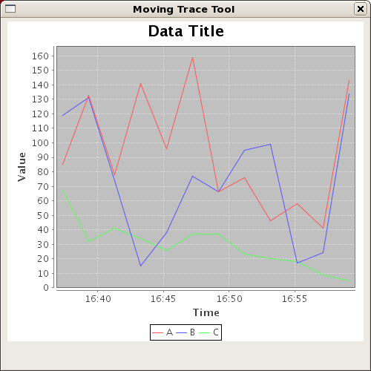
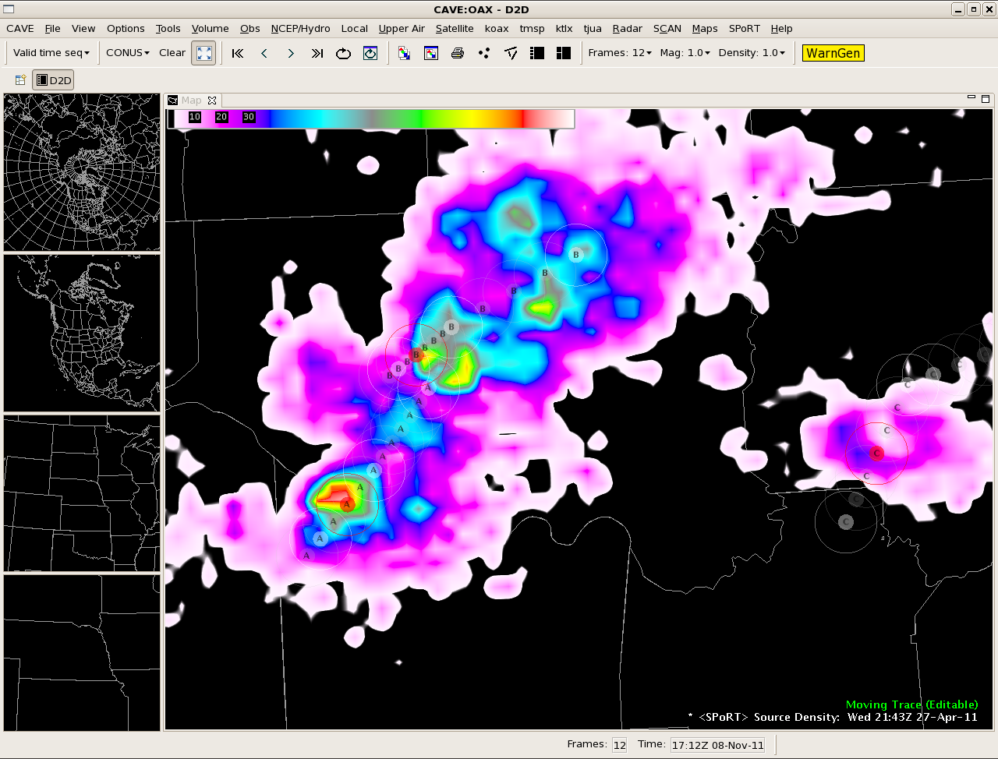
Development: Tracking Tool
WFO Huntsville heavily involved in a “lightning tracker”
Visualize a time series of lightning data
transitioning unique NASA data and research technologies to operations
Notes:
Courtesy of Jason Burks

Slide 10
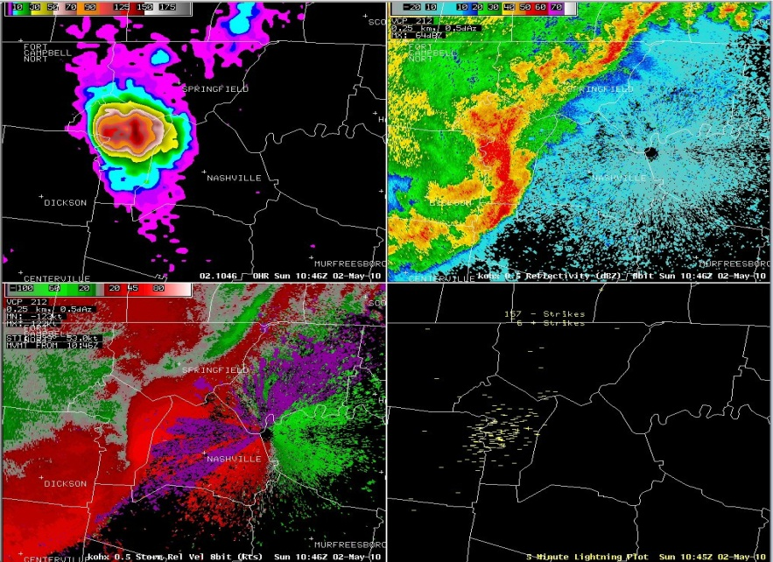
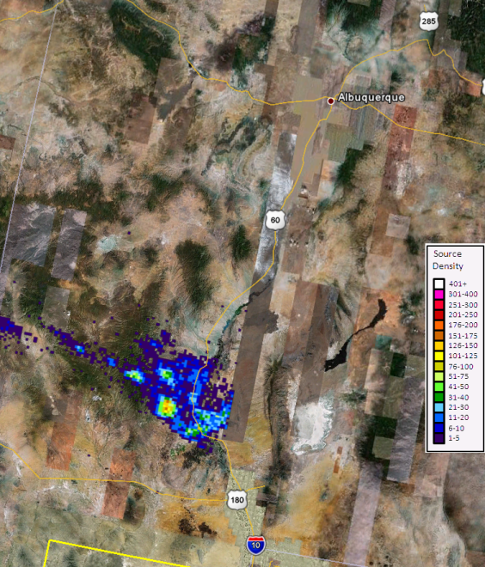
Looking Forward
AWIPS II plug-ins (lightning jump)
Training for new products
Evaluation of new products
Stronger ties with DCLMA
Expansion to other networks
New web graphics
Melbourne case study project
Directly apply to GOES-R activities
Prepare for GLM era
  Verify GLM observations
  Operational model
  Dual-pol radar (UAH)
  White Sands
transitioning unique NASA data and research technologies to operations

Slide 11
Questions
  E-mail
  geoffrey.stano@nasa.gov
  SPoRT Webpage
  weather.msfc.nasa.gov/sport
  weather.msfc.nasa.gov/sportblog
transitioning unique NASA data and research technologies to operations

