Slide 1
Product Training
Science Advisory Committee
February 28 – March 1, 2012
National Space Science and Technology Center, Huntsville, AL

Slide 2
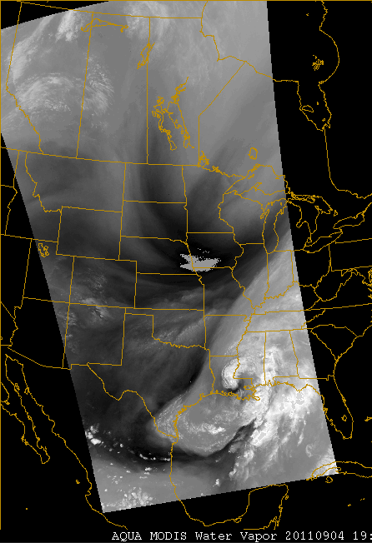
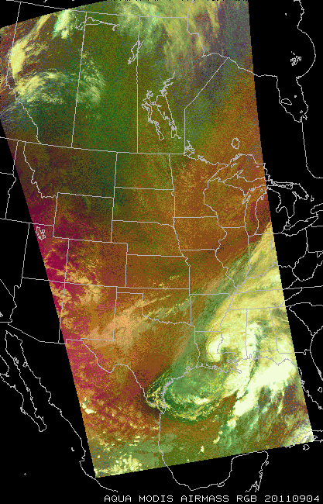
Relevance to NASA/SPoRT
The “T” in SPoRT does not stand for “training” so why do it?
Key part of supporting the transition of products
  Provide information on products to be tested and evaluated
  Communicate to wider audience the lessons learned from initial testing
  Demonstrate utility and application to a forecast issue
Bottom line: These are adult learners who mainly want to know how to apply the product in the workplace.
What is an RGB composite?
Notes:
Adult learners: While the science details are interesting, they want the application to their work.
- Need science background for this, but detailed science training is provided by other groups.

Slide 3
Accomplishments since 2009 SAC (1 of 2)
Recommendation
Actions by SPoRT
Suggestion: When feasible, suggest advocates play a bigger role in training development. Some SOOs may even be willing to produce the first draft of a training segment.
ABQ advocate examples included in Hybrid training
HUN SOO and others providing content to total lightning applications module
SOO peer to peer sharing during monthly coordination calls
MLB and MFL providing feedback to CI product

Slide 4
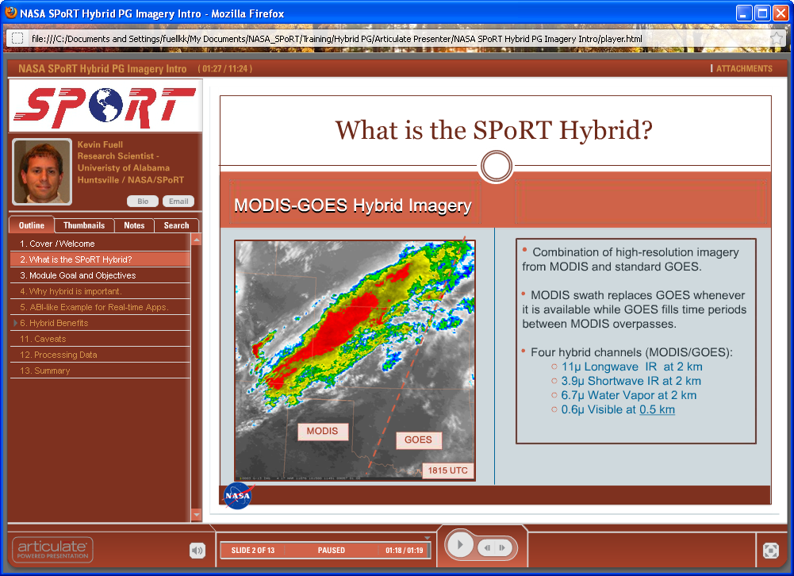
Accomplishments since 2009 SAC (2 of 2)
Recommendation
Actions by SPoRT
SPoRT should ensure (through training or other means) users of the blended product understand how to interpret the blended product and the difference between loading the mixed product versus a GOES-only product in the AWIPS menus.
Other means:
Demo during WFO visits & calls
Blog posts by SPoRT as well as WFO advocates

Slide 5
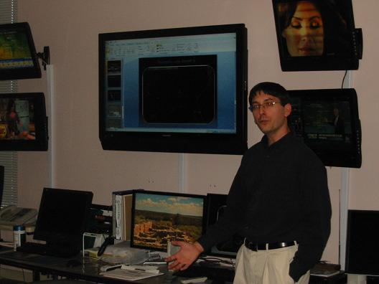
Training Approach / Methodology
Self-paced modules
(via Articulate Presenter)
  Appeals to multiple learning styles
Quick Reference Guides
  “Just in time training” concept
  Basics to get started
Teletraining and Site Visits
  Answer questions
  Hands-on use of data
SPoRT workshops / coordination calls
  Gets end users involved
  Science sharing by end users
Geoffrey Stano presenting in operations area of Albuquerque, WFO regarding total lightning and relevant NASA EOS data sets
Notes:
Bottom line:
Hands on with users to better understand the gaps in product knowledge and/or application – hence, can develop more effective training materials for all SPoRT partners
Regular communication and training to keep collaborations strong and consistent. Leads to better evaluation of product. Shows our commitment to understanding how NASA EOS data best applies to their forecast issues.
Sept 2010 CIRA experts participated in coordination call to explain changes in blended TPW product

Slide 6
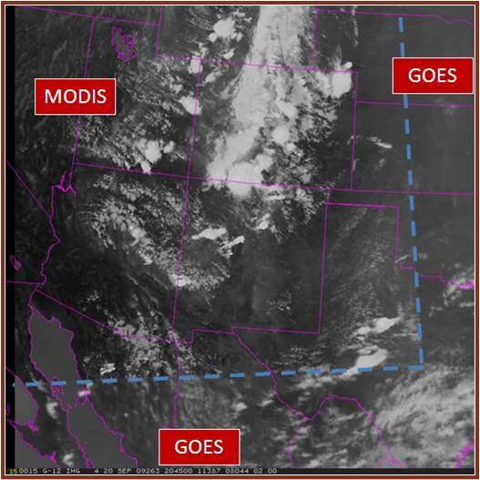
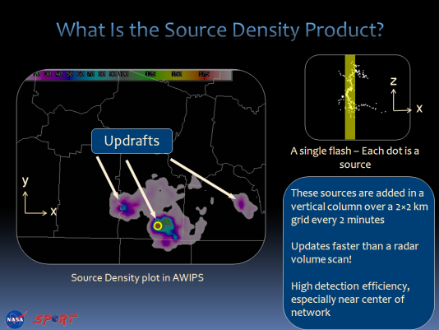
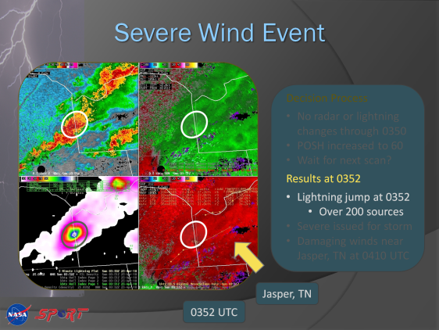
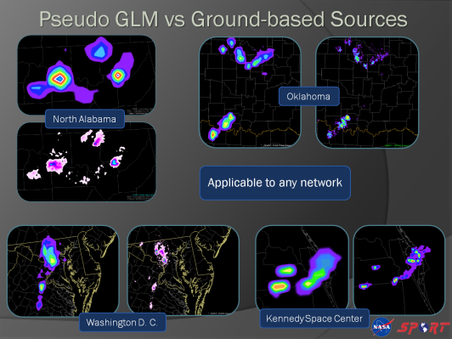
Self-paced Modules
Hybrid
Full-fledged training modules
  More than a “quick start”
  Audio, Animation, Interaction
  Provide examples (often from users!)
Available on NOAA’s Learning Management System
  Forecasters earn credit
Emphasis on short, direct training
  Aim for 10-20 minutes
Let’s listen in for a moment
  Link to Hybrid module launcher
Total Lightning I & II
Pseudo-GLM

Slide 7
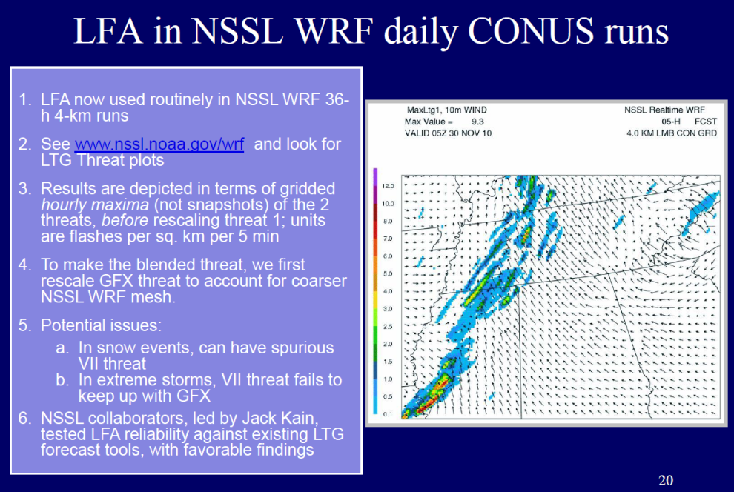
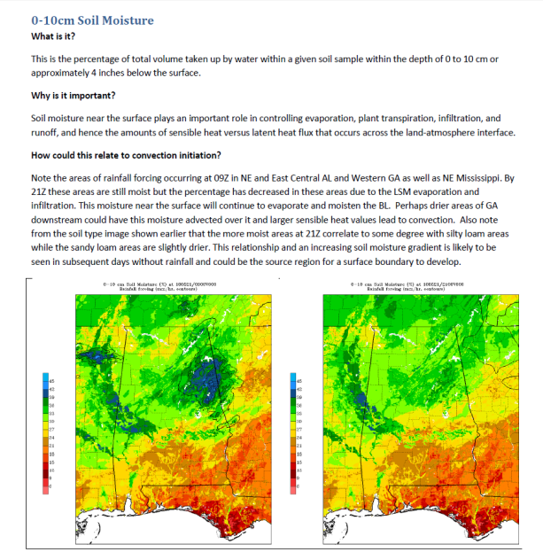
Quick Reference Guides
Designed for “on the fly” use
  Gives the basics
Layout can vary
  Presentation or guide book style
  Both have quick examples
Usually no added audio
Form the core for a full module
Lightning Forecast Algorithm
  Use model microphysics for better lightning parameterization
  Guidance to characterize WRF lightning threat
Land Information System
  Describe output fields
  Use as diagnostic tool to highlight relation with convective initiation
LIS Guide for BMX CI Project
LIS Soil Moisture 0-10cm

Slide 8
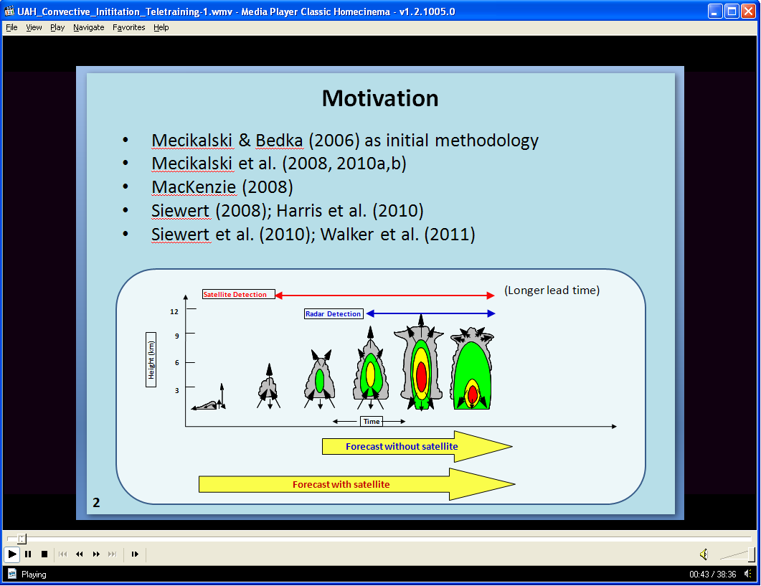
Teletraining
Used for Convective Initiation via University of Alabama Huntsville (UAH)
Part of SPoRT PG work to help GOES-R AWGs transition products to users
Mature PPT by UAH
UAH teletraining at monthly call with WFOs, and had Q&A
WFOs requested a second session and it was recorded and posted to web
In prep for testbed by HUN, MLB, MFL and to get user feedback and interest before next spring evaluation
Also, see Coordination Call topics
Playback of recorded teletraining via Windows Media Player. 17 minutes of presentation and 20 minutes of discussion/questions with forecasters.

Slide 9
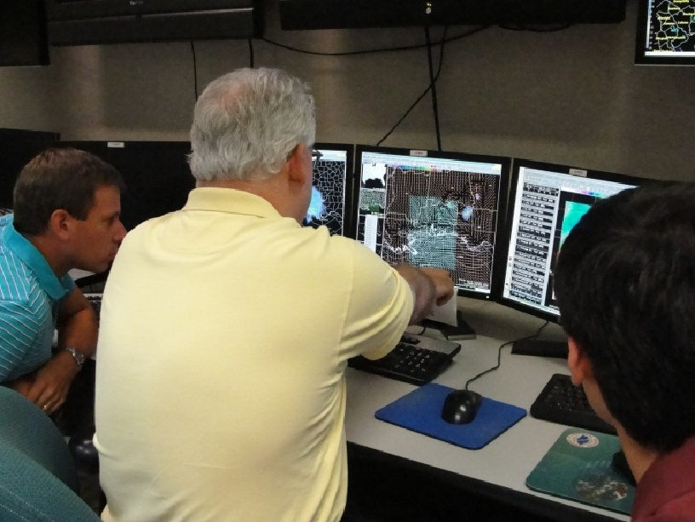
WFO Coordination Calls and Visits
Coordination Calls
Often topic specific
  LIS, enhanced SST composite,
  CIRA B-TPW (by experts), Hybrid,
  P-GLM, new total lightning products, RGB imagery, UAH CI
WFOs share application of data
Visits
Tailored training to forecast staff for their forecast interests
Meet advocates and have more detailed discussions about products
Over a dozen visits since 2009 SAC
Science and Operations Officer Jeff Medlin at NWS Mobile shows model output from the local WRF EMS, initialized with NASA LIS data.

Slide 10
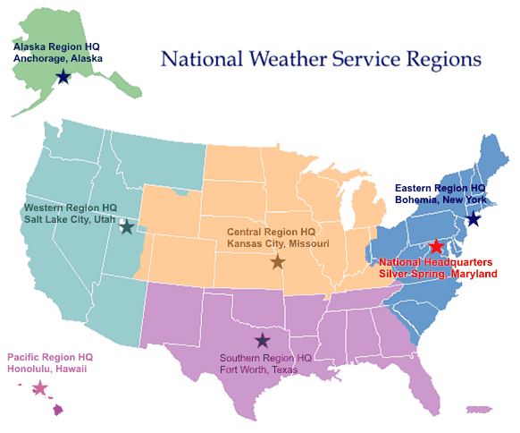
Visits by SPoRT 2010-2012
Partner visits
Expansion visits
Collaborating WFO
CRHQ & AWC (9/10)
SOO Workshop (2/11)
Partner Regional HQ
Real-Time Data Source
HWT (May of 10 and 11)
ERHQ (8/10)
ARHQ, RFC, AAWC, and WFOs (9/10)
SAB (6/11)
TFX (7/10)
RAH (1/12)
MFL (4/11)
NHC (4/11)
PRHQ (7/10)
JAN, LIX, MOB, LMRFC (8/11)
BMX (6/11)
MOB (5/10)

Slide 11
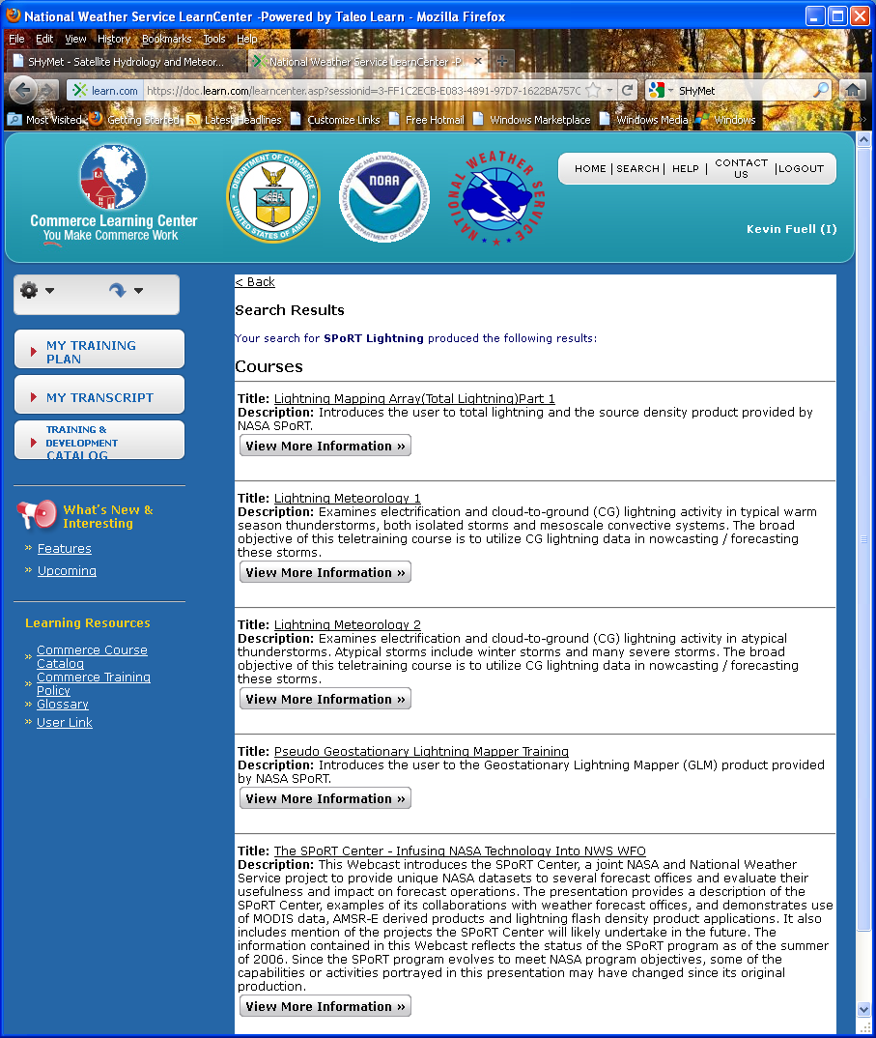

Training Interactions with NOAA
NOAA Learning Management System
  SPoRT modules can be taken via LMS for credit
  Work with NWS/OCWWS/FDTB to fulfill LMS requirements, such as a quiz
COMET Environmental Satellite Resource Center
  Globally searched resource
NWP by COMET
  Mesoscale dataset impacts to local modeling (ongoing)
Future:
  Collaborate with Operational Proving Ground (NWSTC) to test new tools and techniques
  (e.g. Lightning trend tool in AWIPS II) related to GOES-R
NOAA LMS
Total Lightning
Pseudo-GLM
SPoRT Program

Slide 12
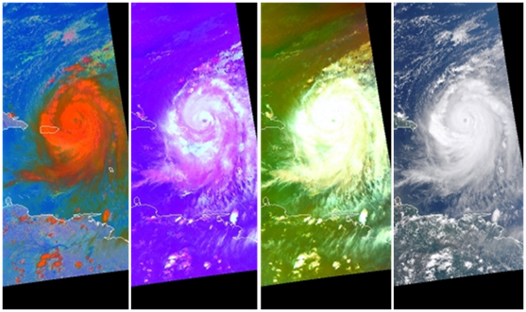
Ongoing & Near Future Work
WindSat
Creating web module with current data and comparisons to past SeaWinds from QuikSCAT
Prepare Western and AK Region users for an evaluation period
Total Lightning
New products and tools based on WFO testbed evaluations
  Application of Max Density
  AWIPS II cell tracking tool
LIS and LFA
Full web module with audio based on initial Quick Guide
VIIRS
New capabilities (e.g. Day/Night band)
Both atmos. and ocean product applications (compliments other training)
RGB Imagery
For WFOs as well as Nat. Centers
  Air mass, NT Micro., Dust, etc.
Collaboration w NHC, HPC, OPC, SAB
F
f

Slide 13
End of Training presentation
Some supplemental slides may follow

