Slide 1
Product Assessment
Science Advisory Committee
February 28 – March 1, 2012
National Space Science and Technology Center, Huntsville, AL

Slide 2
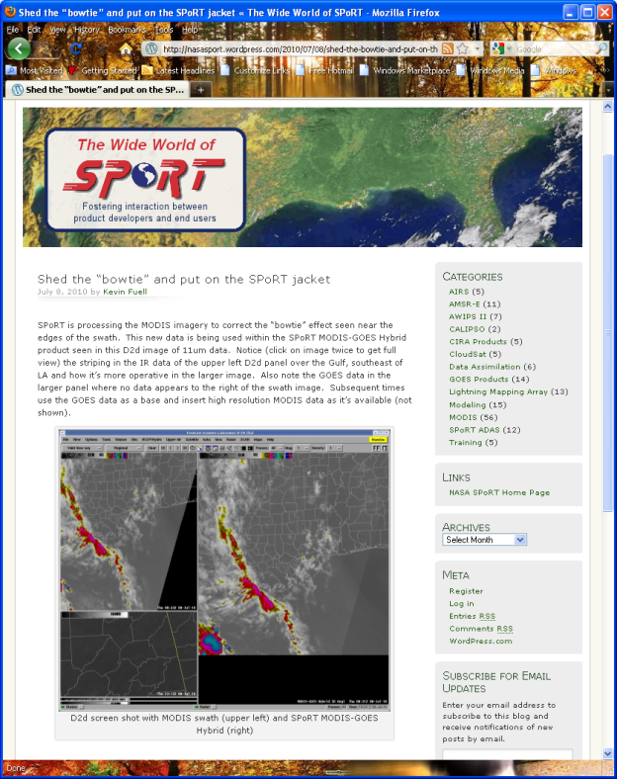
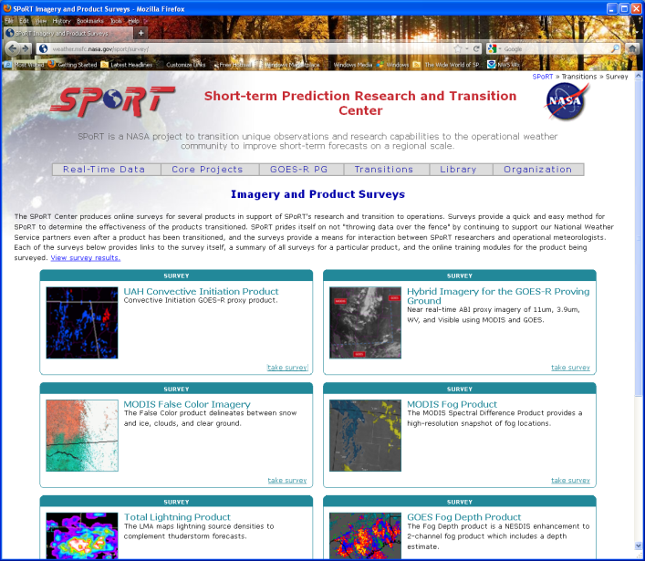
- Assessments -
Relevance to NASA/SPoRT
Improve success rate for transitions
  Determine product value/impact
  Are user interpreting and using the product appropriately
Fosters end user participation and buy-in
  “We care what you think, and are open to making changes”
Benefits to developers
  Discover new uses or caveats
  Possible derivatives or modifications to product
  Is it ready for full transition?
SPoRT Blog
SPoRT online feedback forms
Notes:
Adult learners: While the science details are interesting, they want the application to their work.
- Need science background for this, but detailed science training is provided by other groups.

Slide 3
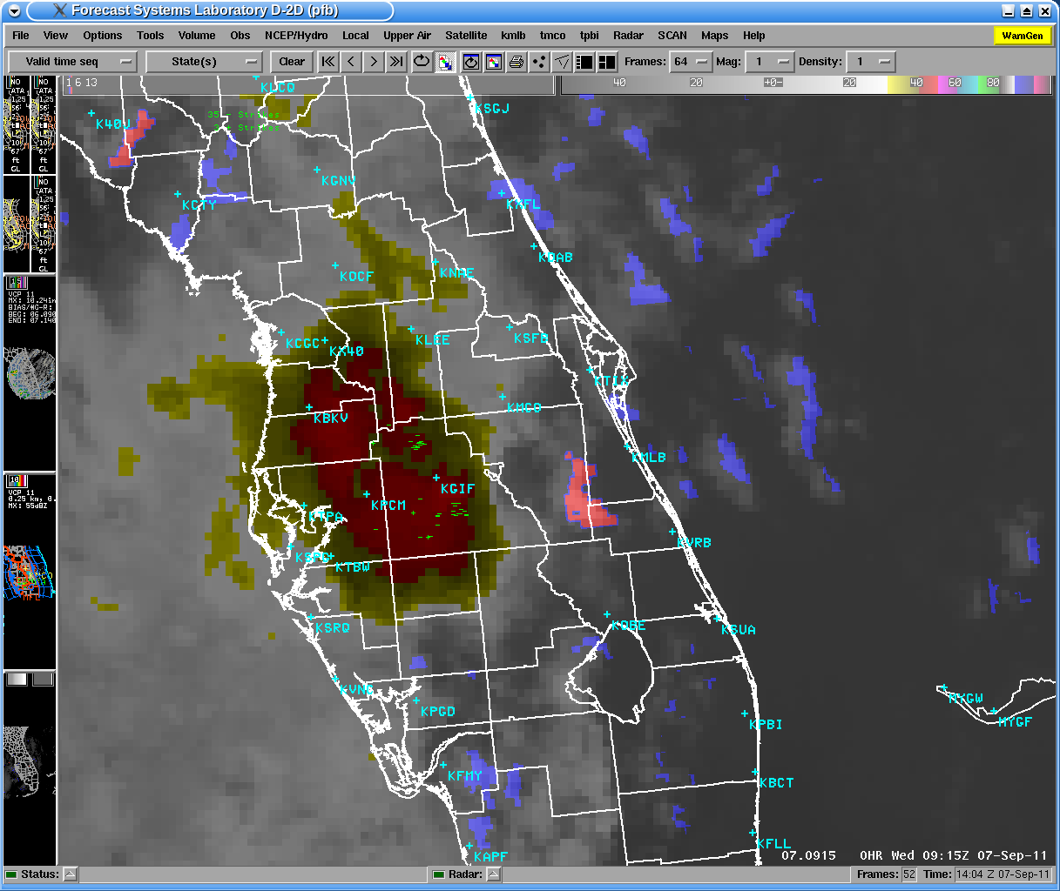
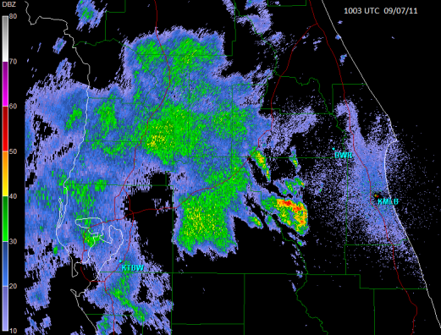
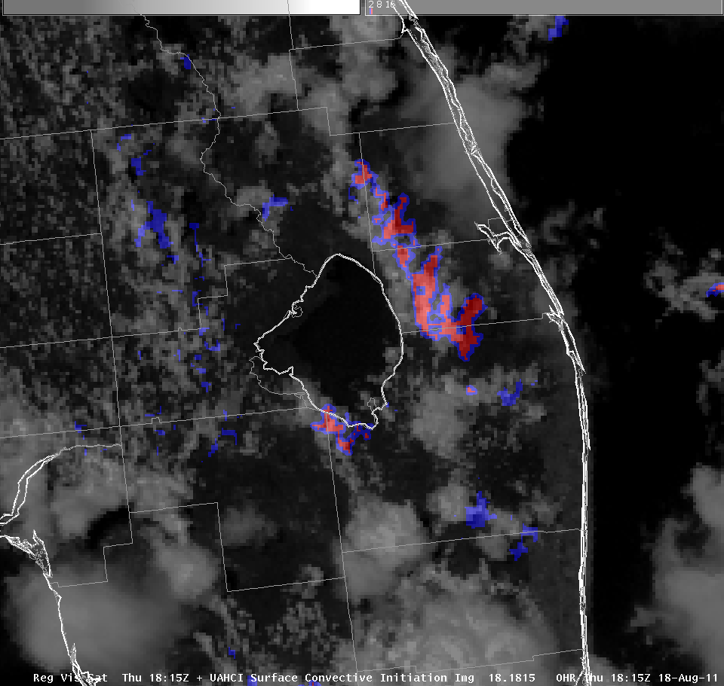
What Is An Assessment?
CI Feedback from Melbourne
Many avenues for assessment
  Wide World of SPoRT Blog
  Web-based surveys
  Workshops sponsored by SPoRT
  Intensive observation periods
  Partner conference presentations
  Joint journal articles
  Coordination call presentations
  Submitted events for training
  Comments direct to SPoRT staff
Several recently conducted
  Hybrid, pseudo-GLM, SPoRT WRF, Land Information system, convective initiation
Notes:
Adult learners: While the science details are interesting, they want the application to their work.
- Need science background for this, but detailed science training is provided by other groups.

Slide 4
Accomplishments since 2009 SAC
Recommendation:
SPoRT should tie assessments to metrics or well defined goals in a project plan. Where possible, quantitative measures or summary survey results should be included as well as any qualitative assessment.
Actions by SPoRT
Have started to use simple project tracking with milestones that includes product assessment
Quantitative survey results during GOES-R Proving Ground work with Hybrid imagery
Qualitative assessments from users
  Blog posts with images
  User case example write-ups submitted to SPoRT

Slide 5
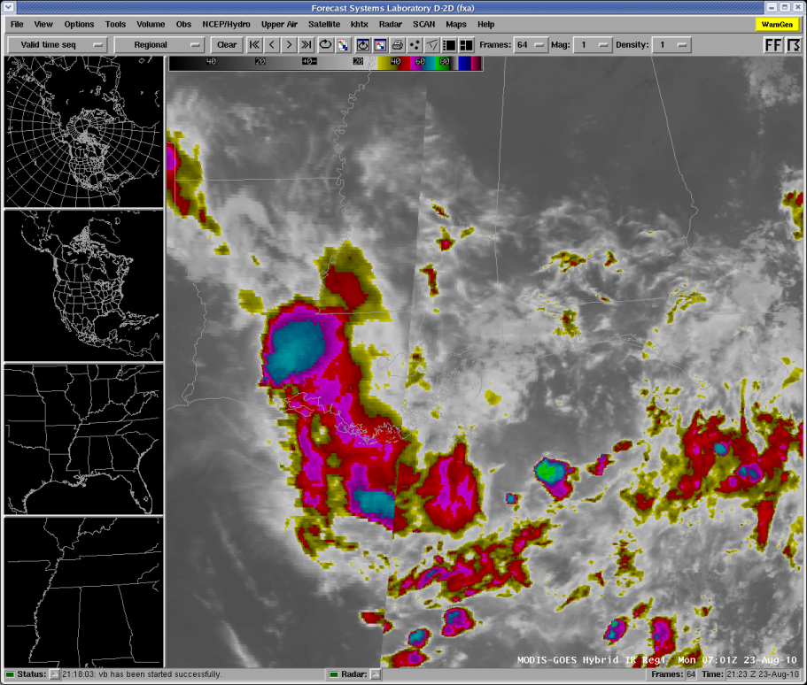
Hybrid General Results
38 feedback submissions
28 recommended hybrid to others
Majority of use in the categories of low clouds and convection
Each product at 13+ reviews with vis. getting the most
28 of 38 indicated the impact was either some, noticeable, or large
Contributions from all PG WFOs & SMG
  ABQ, CRP, HGX, HUN, JAN, MLB, MRX, OHX
GOES
MODIS

Slide 6
Hybrid Assessment Background

Slide 7
How was the Hybrid Imagery Used?

Slide 8
User Feedback – Hybrid Impact

Slide 9
Hybrid Potential Issues/Caveats
Water Vapor value range differences can cause imagery to jump to lower values
Latency of inserted MODIS image can be large for visible imagery (not as noticeable for other channels)

Slide 10
Hybrid Assessment
– User Comments
Identification of cold cloud top area
Enhanced view of blowing dust
Improved spatial definition of fire hot spots and smoke
Improved location and orientation of approaching fronts
Better cloud coverage and structure in vis.

Slide 11
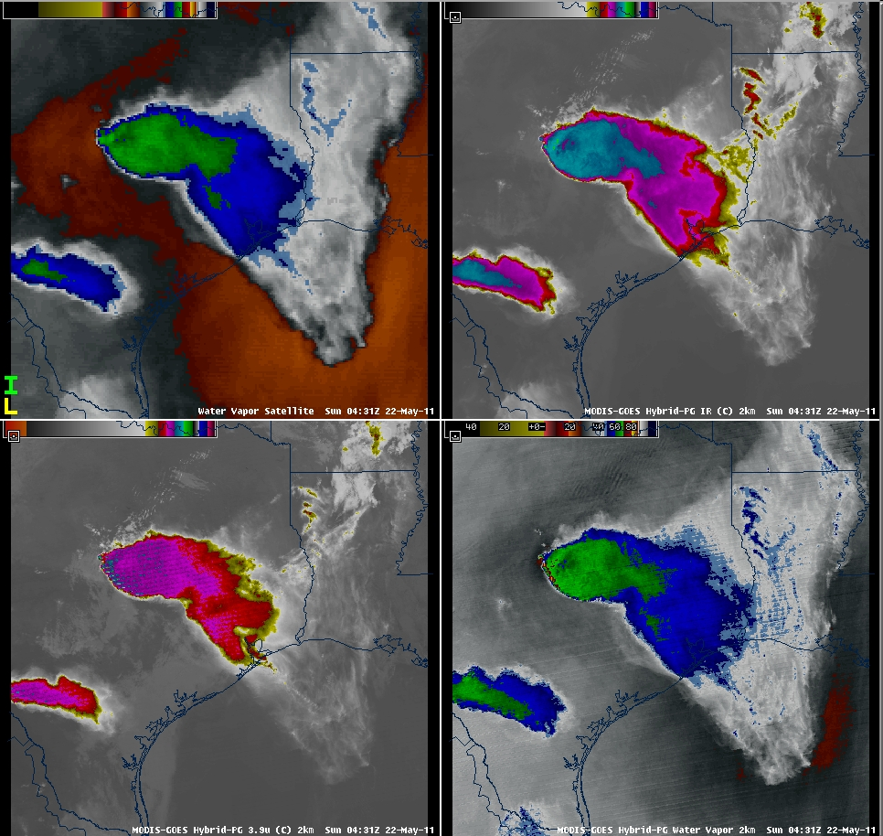
Hybrid Blog Posts
GOES WV
Hybrid 11µm
WFOs have contributed many posts describing their use of the product and its impact.
HGX case (WV imagery)
  Waves to the north of T-storm
  Dry air to west of storm
  Enhanced V signature and overshooting top better defined
  Impact: increase confidence of severe wx (hail reported)
Hybrid 3.9µm
Hybrid WV
Notes:
A comment from another WFO said that this was a great reminder to not just be focused on radar b/c satellite imagery provides some insight as well.

Slide 12
Future Assessments
Short term
WindSat
RGBs at WFOs
  Air Mass, Night-time microphysics, Dust
Pseudo-GLM
  3rd year at HWT
  SPC, AWC
New version of Convective Initiation
Long Term
Flash Density
RGBs at NHC and other National Centers
Hybrid Imagery (MODIS and VIIRS)
Hybrid RGB Imagery
NESDIS Quantitative Precipitation Estimate
CIRA Layered TPW

Slide 13
End of Assessment presentation
Some supplemental slides may follow

