Slide 1


SPoRT AWIPS II Activities
Sixth Meeting of the Science Advisory Committee
28 February - 1 March, 2012
National Space Science and Technology Center, Huntsville, AL
transitioning unique NASA data and research technologies to operations

Slide 2
Relevance to SPoRT
SPoRT’s task integrally involves getting data to forecasters in their native Decision Support System.
SPoRT pioneered AWIPS efforts.
Our plan is to be on the leading edge of AWIPS II development.

Slide 3
Accomplishments since SAC 2009
6 plugins developed for SPoRT products
  Lightning Mapping Array
  Lightning Tracking Tool
  MODIS Fires (FIRMS)
  Hazard Mapping System (HMS) Smoke
  HMS Fire
  Satellite (McIDAS)
    Many SPoRT products
  Convective Initiation (UAHCI)
Raytheon TIM at Omaha Office (Aug 2011)
NWS Corporate Board (Dec 2011)
Presented at 2012 AMS

Slide 4
Programming in AWIPS I
Limited scope of programmers
Most users could only modify
  Data
  Configuration
  Menus
  Shell/Perl scripts
  Database mods

Slide 5
Enter AWIPS II
Raytheon Technical Services Co. (RTSC)
NWS Technology Infusion (AWIPS follow-on)
Open source, Java-based
Service Oriented Architecture
Extensible, Plugin-based
Result: a collaborative environment

Slide 6
AWIPS II Plugin Architecture
DATA
HDF5
Data
EDEX
CAVE
Visualization
PostgreSQL
EDEX plugin - handles data ingest; persists data in internal storage (HDF5 files) and writes metadata in the PostgreSQL database.
DATA plugin - simply the container handling the data/metadata objects.
VISUALIZATION plugin - communicates with the DATA plugin to retrieve data and write to CAVE resources.
Notes:
EDEX Environmental Data Exchange
CAVE Common AWIPS Visualization Environment

Slide 7
Programming experiences
Learning AWIPS II framework required significant time and effort
Frequent Raytheon releases usually meant changing our plugins
Lack of documentation made it more difficult
Software management tools will be required

Slide 8
Future Work
Complete creation of plugins, colormaps, menus, bundles for all current AWIPS I SPoRT products
Create and/or extend plugins for upcoming datasets
  Improve RGB with true 24-bit visualization
  3D visualization efforts
  Multi-byte datasets

Slide 9
Questions ?

Slide 10
Backup slides

Slide 11
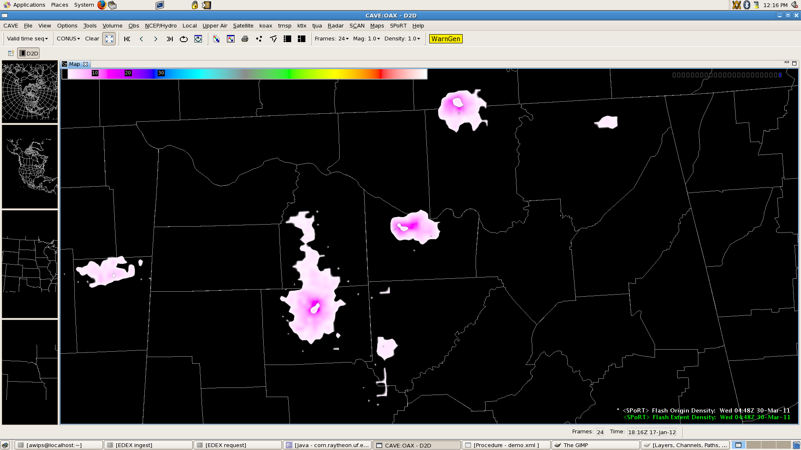
Lightning Mapping Array
Total lightning data from Lightning Mapping Arrays (LMAs) is 3-Dimensional, only viewable in AWIPS I as model data. We expect to make use of future AWIPS II 3-D capabilities.
LMA data is generated as ASCII, but we create NetCDF files – requiring a new EDEX plugin.

Slide 12
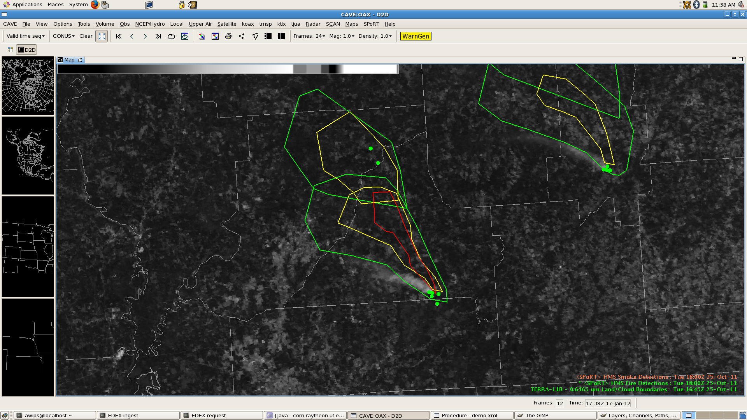
NOAA HMS: Smoke & Fire
NOAA’s Hazard Mapping System (HMS) Hot Spot and Smoke data required new plugins because they both needed special visualization (time-grouping) and special ingest code.

Slide 13
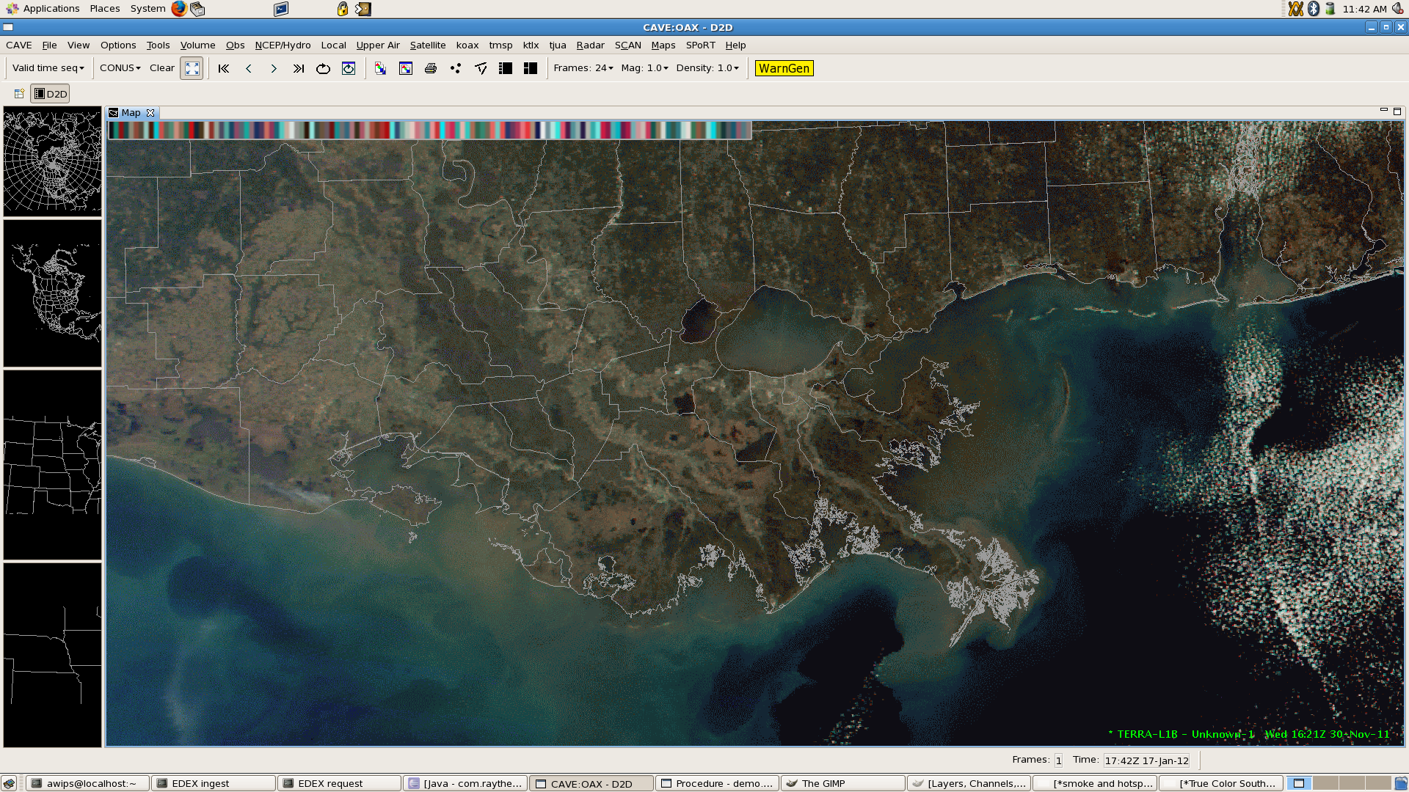
Satellite / McIDAS AREA
SPoRT uses a lot of data in McIDAS “AREA” format.
We extended Raytheon’s McIDAS ingest plugin and leveraged the existing satellite plugin for visualization.

Slide 14
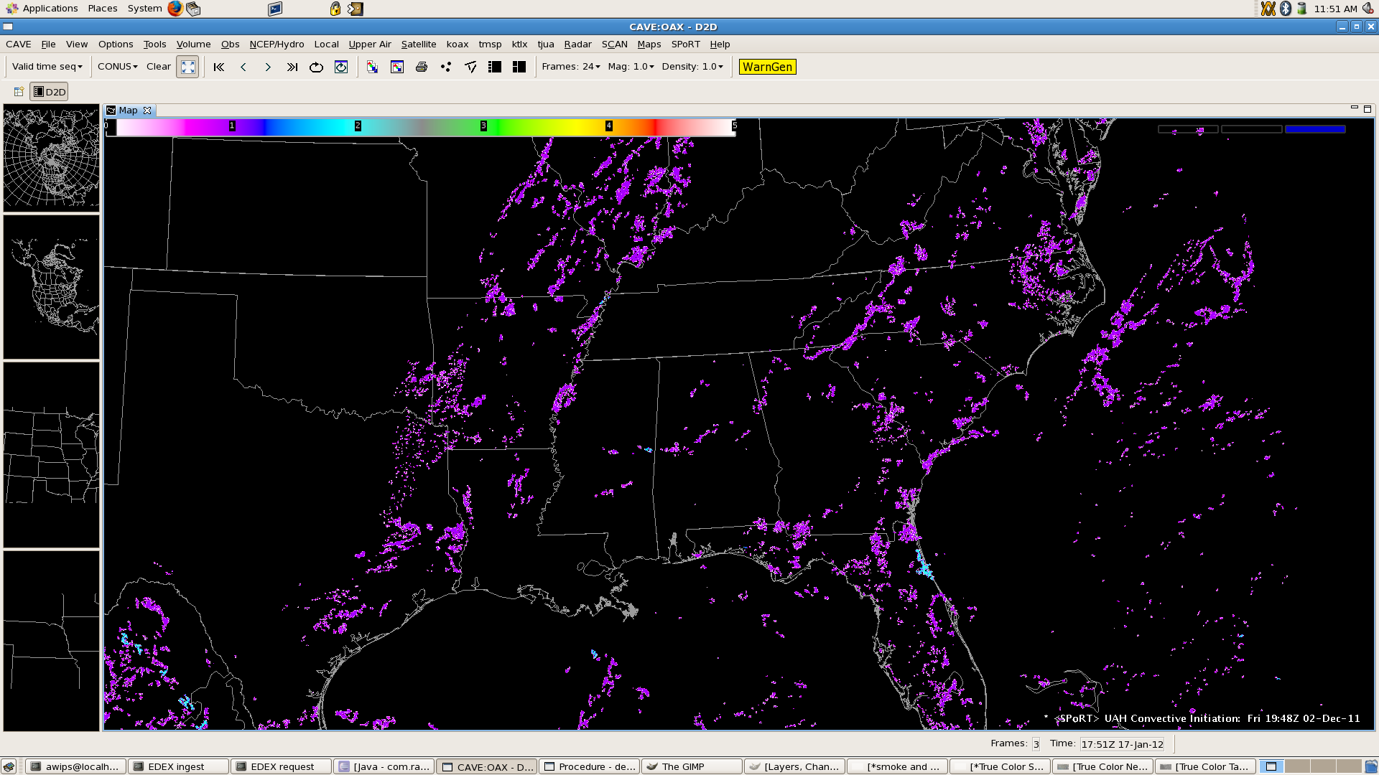
Convective Initiation
A GOES-based data set generated at UAHuntsville for short-term forecasts of convection.
Data is provided in NetCDF format. We needed both EDEX and CAVE visualization plugins.

Slide 15
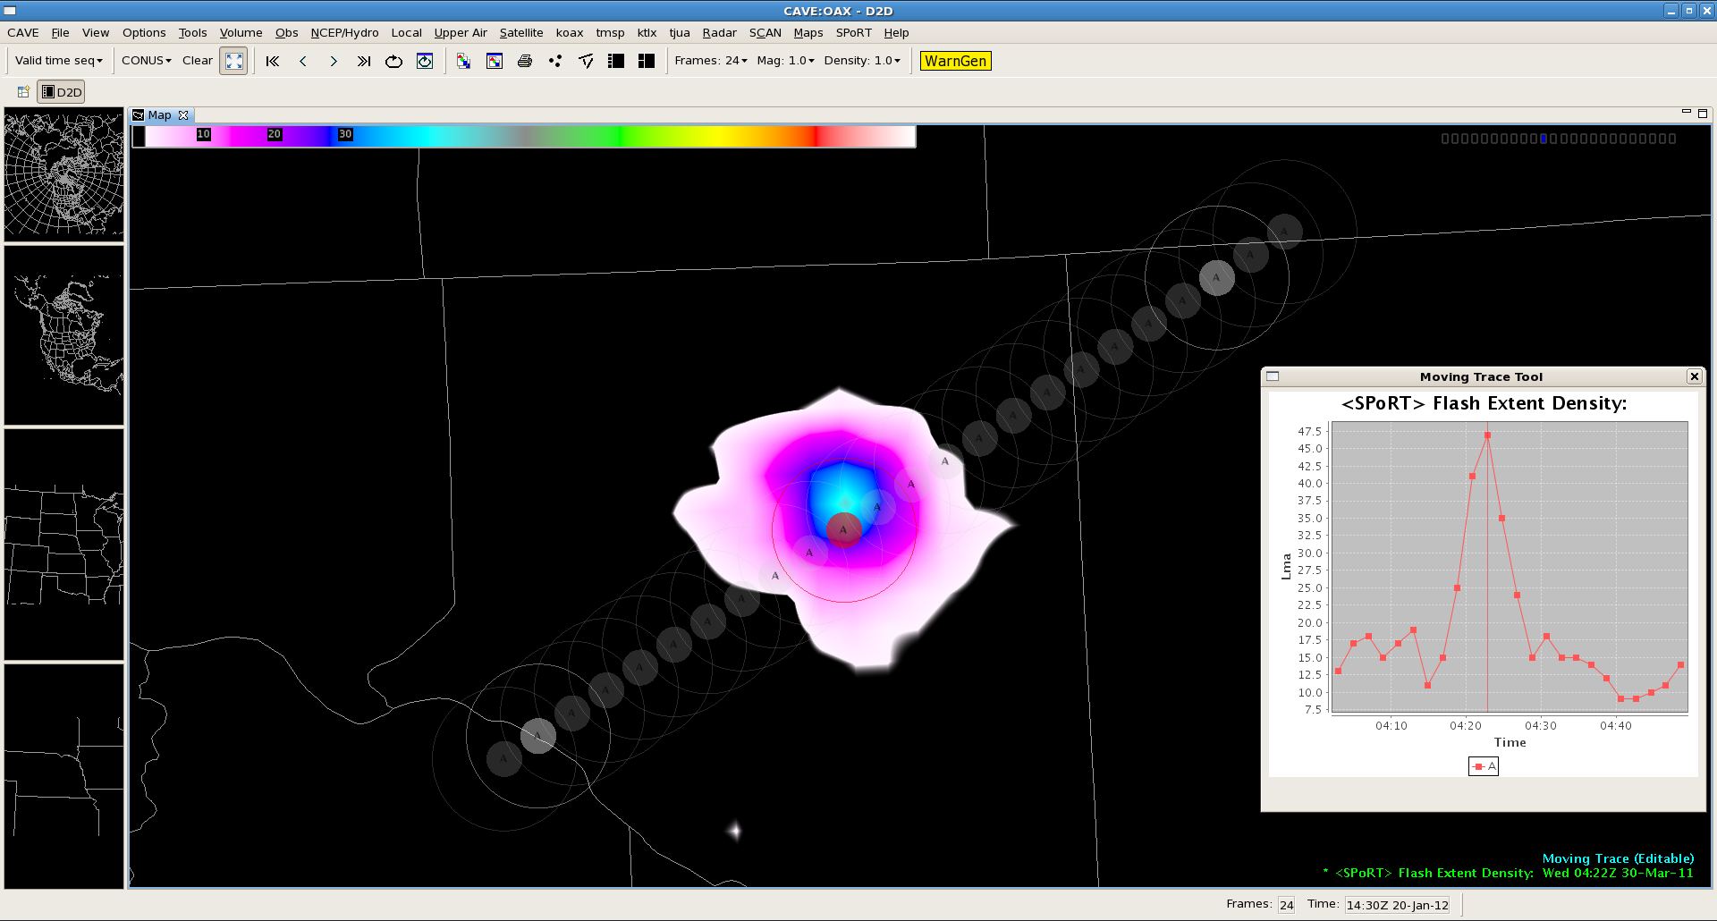
Lightning Tracking Tool
Research shows that total lightning jumps can precede severe weather. Forecasters need to quickly track several storms separately, tracking their electrical activity.
-Track multiple cells
-Variable radii
-Easily adjustable cell path
-Color-coded chart for each cell track
-Extrapolation for new data (frames)

Slide 16
What’s needed for AWIPS II developers
All Application Developers
  Java; Python; Eclipse; XML; Subversion
Application Integrators
  JMS(Qpid); ESB (Camel); MicroEngine
Database Access Developers
  Java DAO; Hibernate; Spring; EDEX; HDF5
Graphical Interface Developers
  CAVE; Eclipse RCP; SWT+Jface; SVG
-from the AWIPS II Software Development Guidelines document
Notes:
XML - Extensible Markup Language
ActiveMQ - Message Queue
ESB – Enterprise Service Bus
DAO – Data Access Object
EDEX – Environmental Data Exchange
CAVE – Common AWIPS Visualization Environment
RCP – Rich Client Platform
SWT – Standard Widget Toolkit
SVG – Scalable Vector Graphics
Jface - UI toolkit

Slide 17
ASCII->NetCDF | LMA, LDAR, PGLM | NASA, OU, NMTech
ASCII | MODIS hotspots | UM FIRMS
ASCII | POES/GOES hotspots | NOAA Hazard Mapping System
ASCII (KML) | POES/GOES smoke plumes | NOAA Hazard Mapping System
NetCDF | Convective Initiation | UAHuntsville
McIDAS AREA | Satellite | NASA/SPoRT, UW/SSEC
Binary->NetCDF | WindSat | NRL/ SPoRT
Binary | Multi-byte | UW/SSEC, UAF, NRL, NESDIS, etc.

