Slide 1
Passive Microwave and Upcoming GPM Activities
Science Advisory Committee Meeting
26 – 28 August, 2014
National Space Science and Technology Center, Huntsville, AL

Slide 2
Relevance to SPoRT and Our Partners
1
A partnership has existed between SPoRT – NRL – NHC for 3 to 4 years.
SPoRT transitioned NRL products into NHC’s NAWIPS decision support system. NHC desired this capability to ease their need of using their long standing use of NRL web page for the products; while very useful, having the data in NAWIPS provided extra benefits.
Provides information in data sparse regions, mainly over water bodies. Also can give details for precipitation structure, type, and intensity when and where conventional IR cannot.
In the past year SPoRT has expanded these capabilities to other National Centers.

Slide 3
Forecast Challenges for Passive Microwave Observations
2
Current Users and Applications
NHC, TAFB, SAB, CPHC
Hurricane monitoring (eye location/existence, ice/rain extent and inferred intensity)
Precipitation extent, rate, and type (stratiform / convective)
Precipitation in data voids, cyclone location and intensity
Potential Users and Applications
Coastal WFOs
Precipitation extent, rate, and type in radar-void areas
Alaska WFOs and RFC
Sea ice formation, movement, and melt
Sea Ice extent and edge
WFOs in General
Snow melt, snow cover extent and depth
Land surface temperatures in snow free adjacent areas
SPoRT
Sea Surface Temperatures - Inclusion into the SPoRT SST Composite

Slide 4
Current Products Disseminated
3
Historically, SPoRT has processed passive microwave data from NRL
1B --- Level 1B, swath brightness temperatures
1C --- Level 1C, intercalibrated swath brightness temperatures (not applicable)
2A --- Level 2A, swath precipitation rates (other products also available)
RGB’s --- Level 1B and 1C PCT’s at 37GHz and 89GHz (SPoRT)
Current latencies in hours (from satellite overpass to the end user):
Instrument | Level-1B | Level-1C | Level-2A | RGBs | Notes
TMI | 2.5 | n/a | 2.7 | 2.7
AMSR2 | 2.0 | n/a | n/a | 2.2 | AMSR-E now n/a
SSM/I | 2.0 | n/a | 2.2 | 2.2
SSMIS | 2.0 | n/a | 2.2 | 2.2 | F16, F17, F18
Latencies are approximate, differences mostly attributable to distribution sizes (granules -> orbits)

Slide 5
Product Generation Process
4
Constant query for data via ftp from NRL (soon from GSFC)
Level 1 and 2 products are geo-located to a common projection
RGB products are generated
Data sent to the LDM for distribution to forecast offices and images to the SPoRT web page for internal monitoring and the public
Data products for AWIPS-II, N-AWIPS, and soon in the SPoRT Web Mapping Service (WMS)

Slide 6
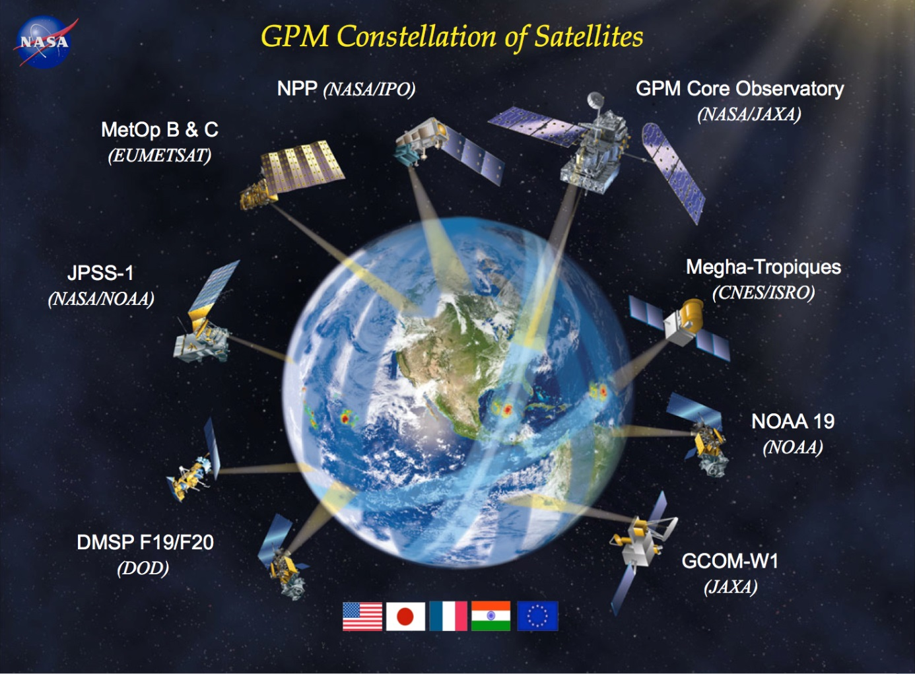
The GPM Constellation
5
GPM Core (NASA)
GMI
DPR
GPM Constellation Partner Instruments
ATMS (NASA/NOAA)
MHS (NOAA)
AMSR2
SSMIS
SAPHIR
Notes:
SAPHIR is on the “Megha-Tropiques” satellite. Six channels: 183 +/- (6x)

Slide 7
Near-Future Products
6
GPM Constellation will allow for passive microwave products from twelve instruments (eleven which we will utilize), providing a greater number of overpasses per day
1B --- Level 1B, swath brightness temperatures
1C --- Level 1C, intercalibrated swath brightness temperatures
2A --- Level 2A, swath precipitation rates (other products also available)
RGB’s --- Level 1B and 1C PCT’s at 37GHz and 89GHz (SPoRT)
Latency in hours --- Green: From GSFC now, Gold: From NRL now, Blue: From GSFC, U/C
Instrument | Level-1B | Level-1C | Level-2A | RGBs | Notes
TMI | n/a | 1.5 | ✓* | ✓* | Short-term availability
AMSR2 | n/a | 1.5 | ✓* | ✓*
SSMIS | n/a | 1.0 | ✓* | ✓* | F16, F17, F18
MHS | n/a | 1.5 | ✓* | ✓* | NOAA-18, NOAA-19, METOP-A, METOP-B
ATMS | n/a | 1.5 | ✓* | n/a
SAPHIR | n/a | 2.0 | n/a | n/a | No plans to use (183 GHz only)
GMI | 0.5 | 0.7 | 1.0 | 0.8
Latencies are approximate, differences mostly attributable to distribution sizes (granules -> orbits)
* to be determined, likely a small fraction later than the 1C products

Slide 8
Early GMI Applications
7
Forecaster Feedback
Mark DeMaria (NHC) commented that the inclusion of passive microwave data into the NHC/Tropical Proving Ground was one of the most broadly accepted and welcomed data sets.
Forecaster at CPHC on Hurricane Iselle (Aug 2014): “We've definitely been looking at the GMI imagery on NAWIPS and through the NRL TC webpage”.
89GHz RGB from GPM of Hurricane Iselle in E. Pacific as viewed from NHC NAWIPS display

Slide 9
Summary
8
Continuing and adding partnerships
Migrating to use of the GPM Constellation
Disseminating products in N-AWIPS, AWIPS-II, and WMS
Largest impact to date at NHC and CPHC
Promotes use of NOAA & NASA microwave imagery/data

Slide 10
GPM Data Release Schedule
A
June 16th – GMI Level 1 Brightness Temperature swath data.
July 14th – GMI Level 2 Precipitation Rate swath data. This includes precipitation rates estimated using the Goddard Profiling algorithm (GPROF14).
Early September – DPR Level 2 precipitation rate data will be released via PPS and JAXA. This includes three-dimensional swath data from the DPR Ka- and Ku-band radars.
Mid-September - The DPR-GMI Level 2 combined product will be released.
December 2014 – NASA’s Level 3 Integrated Multi-Satellite Retrievals for GPM (IMERG) will be released with all available data. This gridded product will have a resolution of 0.1 degrees and updated every 30 minutes from 60⁰N-60⁰S. This will be discussed further in the M&DA session.

