Slide 1
Ozone and Ozone Anomaly
Science Advisory Committee Meeting
26 – 28 August, 2014
National Space Science and Technology Center, Huntsville, AL

Slide 2
Outline
1
Forecast Challenge & Motivation
Ozone Products
Transition to National Centers
New Product Development
Future Goals
Further Air Mass RGB Validation
Summary
Top: AIRS total column ozone
Bottom: AIRS ozone anomaly

Slide 3
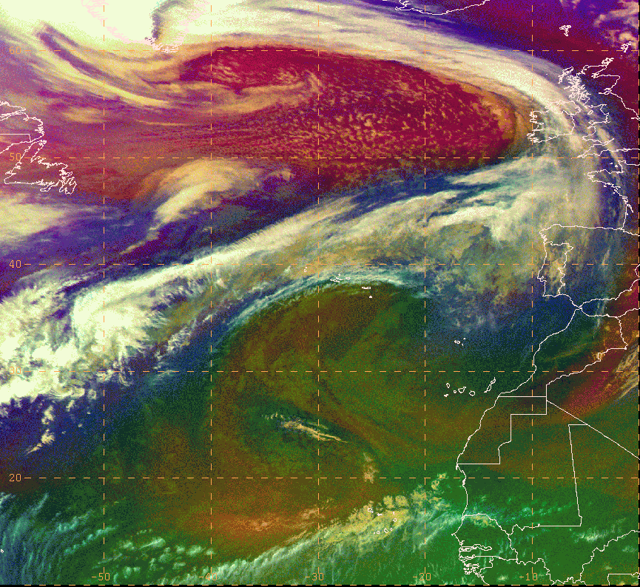
Forecast Challenge & Motivation
2
OPC has used the Air Mass RGB product since 2012
To enhance forecaster situational awareness of cyclogenesis and stratospheric driven high wind events
As a proxy to prepare for GOES-R ABI capabilities
The GOES-R/JPSS PG satellite liaison and National Center forecasters expressed a need for quantitative products to enhance understanding and training of the qualitative RGB
SPoRT specializes in unique applications of NASA data
Suspected stratospheric dry air drawn into mid-latitude cyclone

Slide 4
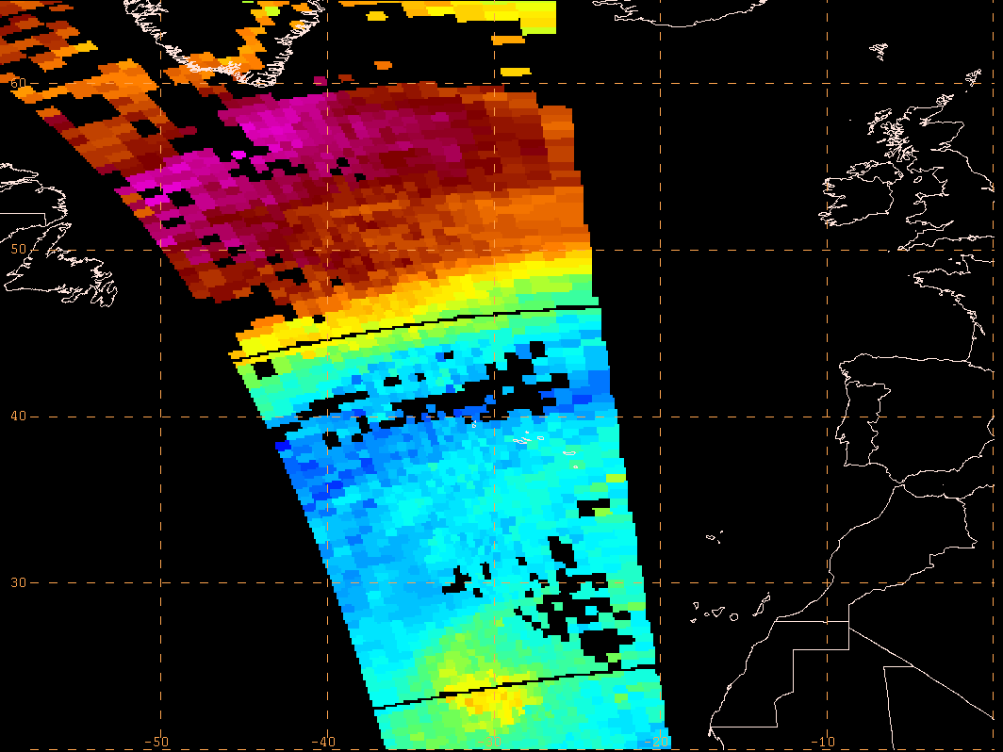
Forecast Challenge & Motivation
3
Suspected stratospheric dry air drawn into mid-latitude cyclone
AIRS O₃ provides confidence stratospheric air present
Legacy AIRS ozone retrievals can be used to
Enhance interpretation and increase forecaster confidence in the Air Mass RGB before GOES-R launch
Demonstrate capabilities of next-generation JPSS CrIS retrievals
SPoRT has worked with GOES-R/JPSS Proving Grounds to develop/transition ozone products in N-AWIPS format to OPC

Slide 5
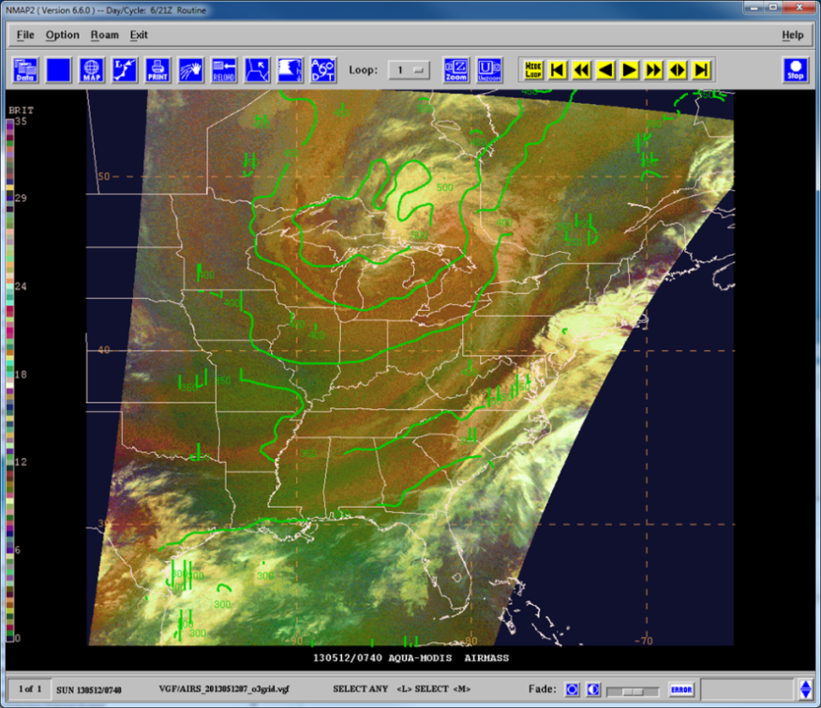
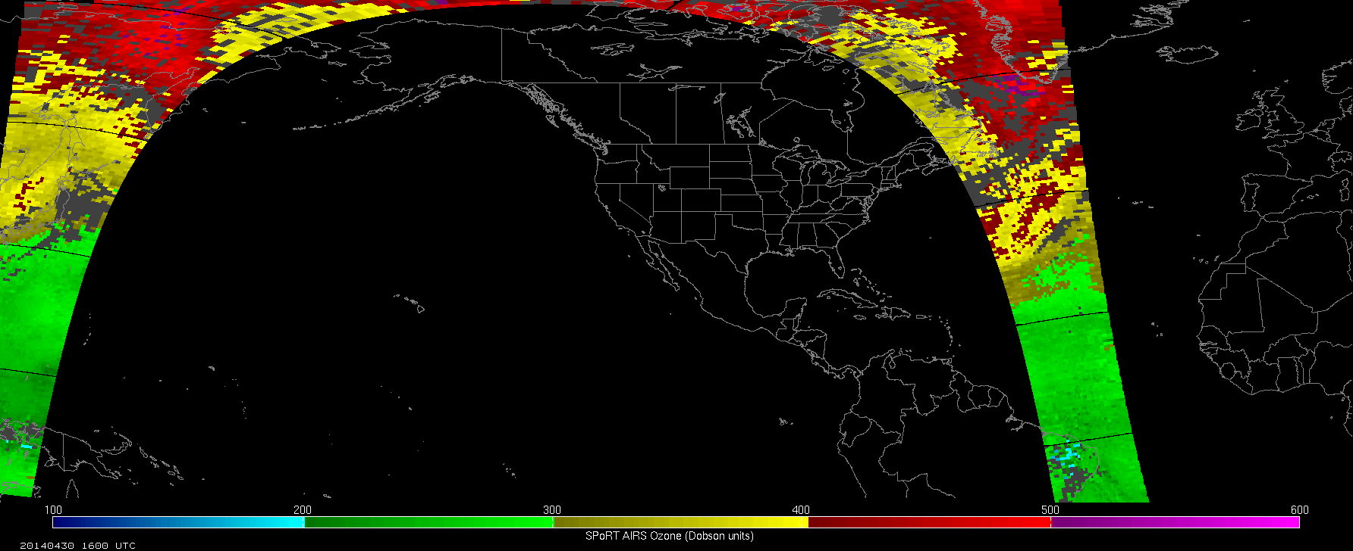
Ozone Products
4
SPoRT produces 2 products in image and gridded format:
Total Column Ozone
Ozone Anomaly
Product is provided in hourly swaths:
Products have a 4-hour latency to utilize all granules
Advantage is hemispheric coverage for OPC’s domain
AIRS O₃ gridded format overlaid on MODIS RGB product
AIRS data obtained from NASA Land Atmosphere Near Real-time Capability for EOS (LANCE) with latency between 60 and 200 minutes
AIRS O₃ image format on NW hemisphere domain

Slide 6
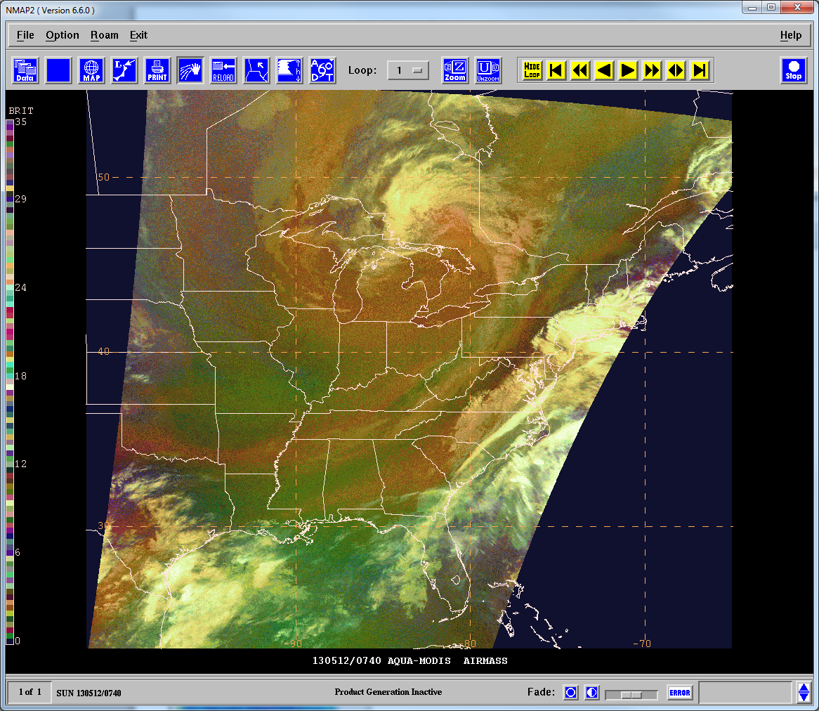
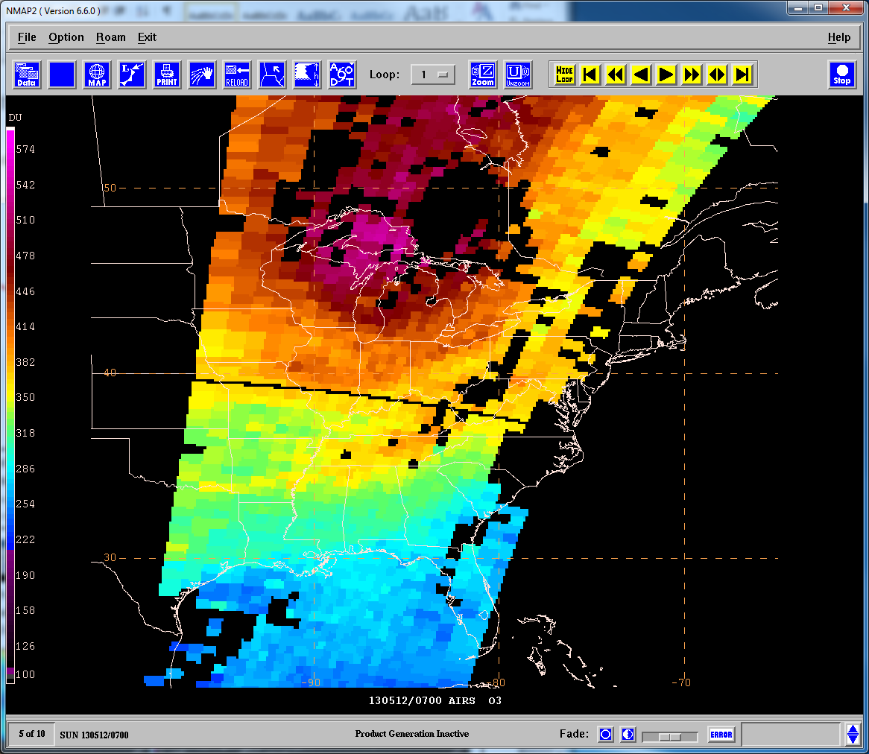
Example 12 May 2013
5
SPoRT MODIS Air Mass RGB shows a region of red/orange coloring surrounding the low pressure center
AIRS Total Column Ozone confirms high ozone values
How do we know if these high ozone values represent stratospheric air or are within the climatological range?
Suspected stratospheric air (red/orange)
High ozone values (red/orange)
Missing values due to clouds

Slide 7
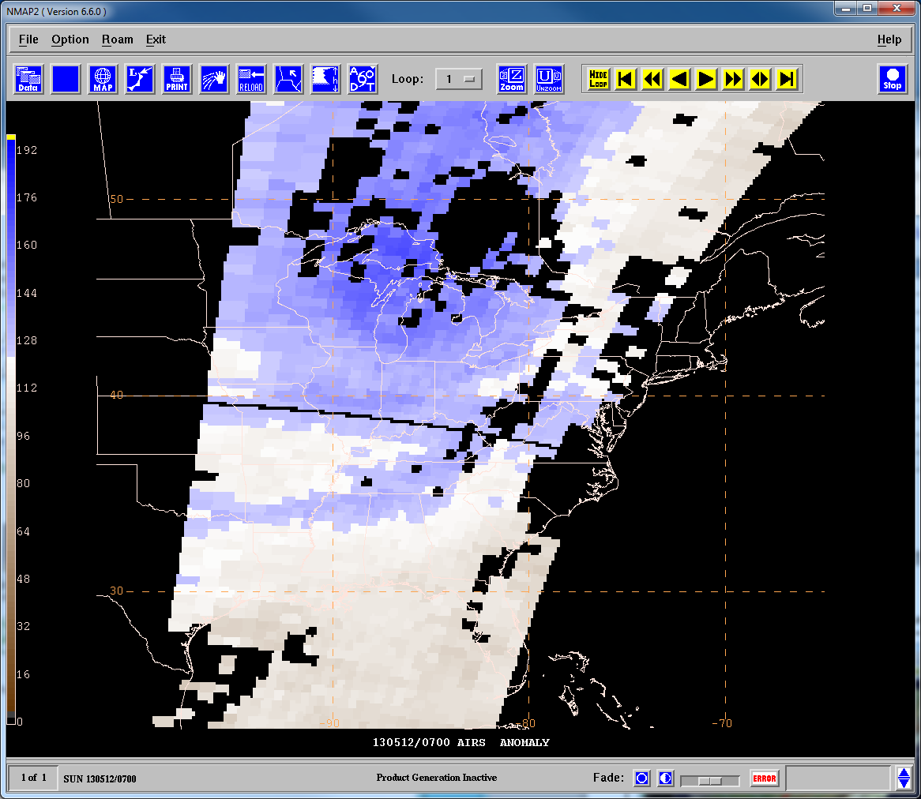
Ozone Anomaly Product
6
Ozone varies seasonally and spatially:
High ozone values could still range within climatology
High ozone values could be misinterpreted as stratospheric
The AIRS Ozone Anomaly product clarifies the presence of stratospheric air based on:
Van Haver et al. 1996: Stratospheric air has ozone values at least 25% larger than the climatological mean
Ziemke et al. 2011: Global and zonal monthly mean climatology of stratospheric ozone derived from the NASA Microwave Limb Sounder
Blue shading of values ≥ 125% confirms high O₃ represent stratospheric air

Slide 8
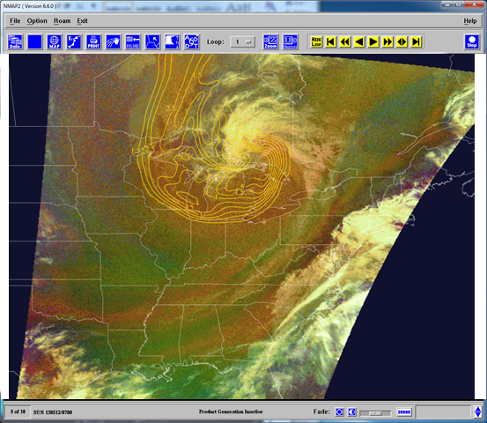
Example 12 May 2013
7
High ozone values (red/orange)
Suspected stratospheric air (red/orange)
SPoRT AIRS Ozone Anomaly product created as a percent of normal (0-200%)
$$PON=\frac{TCO}{climo} x 100$$
Shades of blue represent stratospheric air (ozone values $≥125\%)$
Blue shading confirms stratospheric air

Slide 9
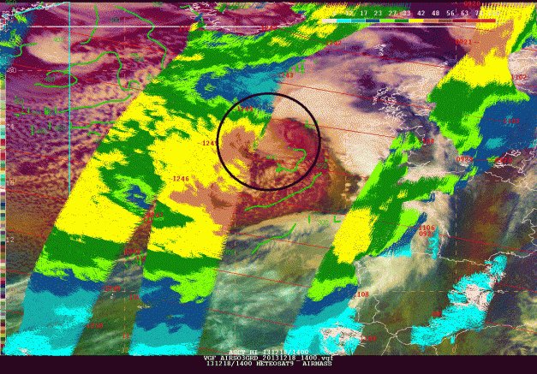
Transition to National Centers
8
AIRS ozone products evaluated at OPC, WPC, SAB winter 2013-2014
Forecaster Feedback
“Reinforce the evidence from RGB of the descent of stratospheric air with tropopause folding.”
“This has allowed me to have confidence in assessing the RGB Airmass product and also in conjunction with gridded GFS output that a perceived PV anomaly is real or not.”
High ozone values > 400 DU suggest potential vorticity anomaly and descending stratospheric air creating high winds near the comma head
SEVIRI RGB Air Mass image, AIRS Total Column Ozone (green contours), and ASCAT winds valid at 1400 UTC on 12/18/13. The black circle highlights the descending stratospheric intrusion near the comma-head/bent back front. Image courtesy of Michael Folmer
Satellite Liaison at NOAA/NWS WPC/OPC/TAFB and NOAA/NESDIS SAB

Slide 10
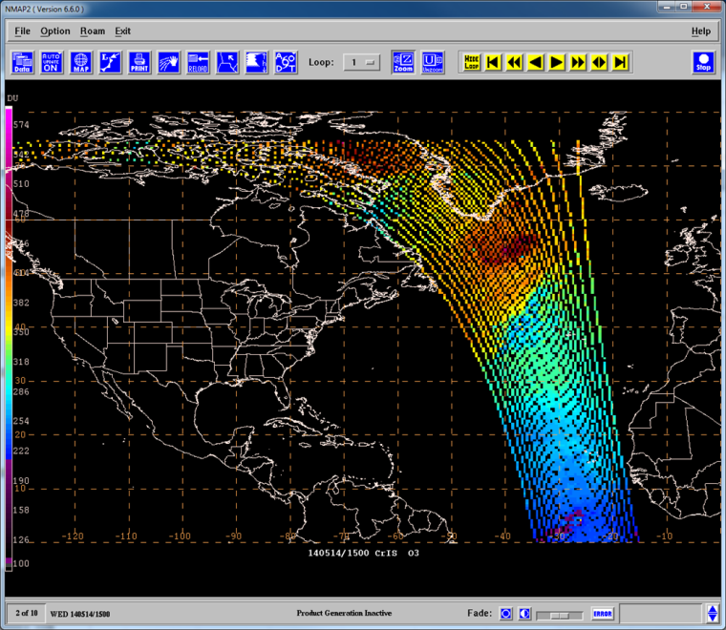
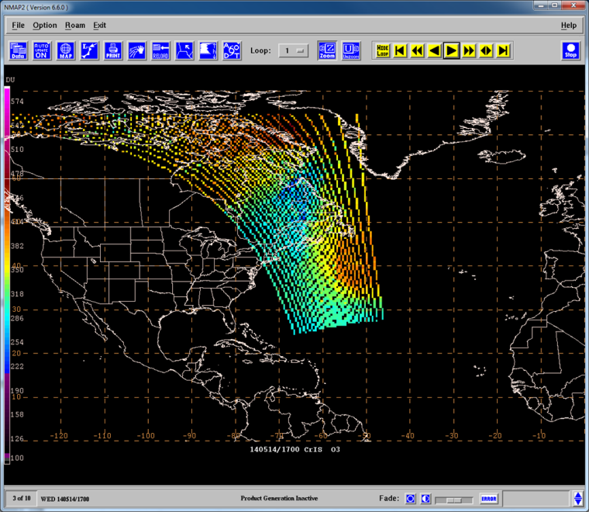
New Product Development
9
Expanding suite of ozone products to include CrIS
Initial use of CrIMSS until NUCAPS CrIS is available
Data obtained from SSEC PEATE server at an 8-hour latency to produce hourly swaths on a hemispheric domain
Hopefully NUCAPS CrIS ozone retrievals will be transitioned to OPC Fall 2014
How will including CrIMSS increase temporal and spatial coverage compared to using only AIRS?
1500 UTC
CrIMSS Total Column O3 14 May 2014
1700 UTC
CrIMSS Total Column O3 14 May 2014

Slide 11
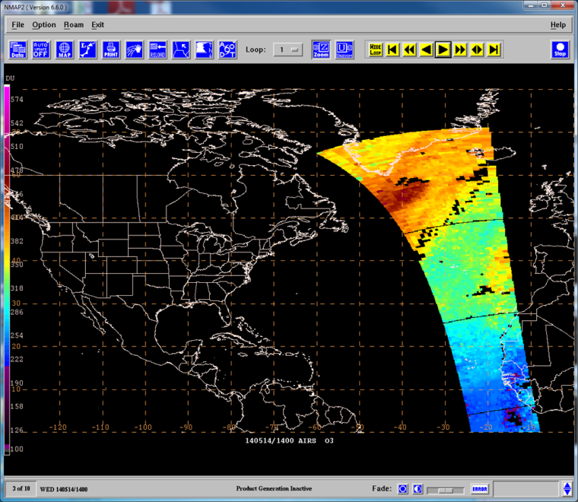
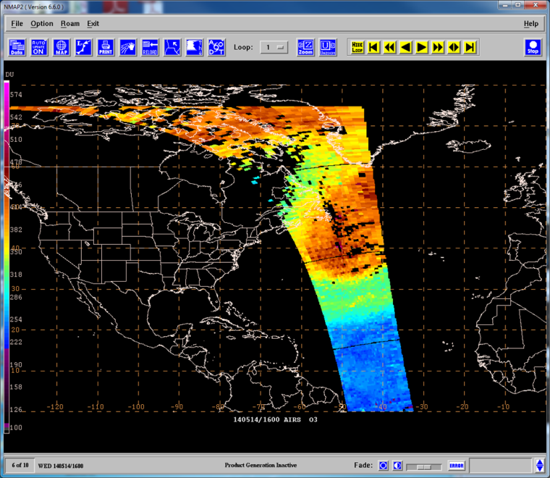
New Product Development
10
Demonstrates increased temporal coverage of GOES-R ABI
Spatial coverage now includes most of the North Atlantic
Differing latencies still problematic
Need to refine the display of CrIMSS to match AIRS
1400 UTC
1500 UTC
Similar O3 feature & Coverage farther west
AIRS Total Column O3 14 May 2014
CrIMSS Total Column O3 14 May 2014
1600 UTC
1700 UTC
Coverage farther west & shows where feature ends
AIRS Total Column O3 14 May 2014
CrIMSS Total Column O3 14 May 2014

Slide 12
Future Goals
11
Current training includes a quick guide
expand forecaster training to include a short module
Make the products available in AWIPS-II
Currently funded joint SPoRT/CIRA/CIMSS GOES-R visiting scientist project to explore products in National Centers Perspective AWIPS-II
Adjust product according to forecaster feedback after the winter demonstration at OPC
Expand the ozone products to other instruments
Increase temporal & spatial coverage with AIRS, IASI, CrIS retrievals once NUCAPS is available
Work with NESDIS STAR to generate anomalies from their TOAST/TACO products which combine UV/IR ozone retrievals
“There may have been 1 occasion where 1 pass did line up over the US with the spot I was interested in. In that case, it was helpful in reaffirming my suspicions on whether stratospheric air was present. Otherwise, the passes were few and far between and not particularly timely. If there was greater coverage of passes and not as much of a lag, it would certainly be useful.”

Slide 13
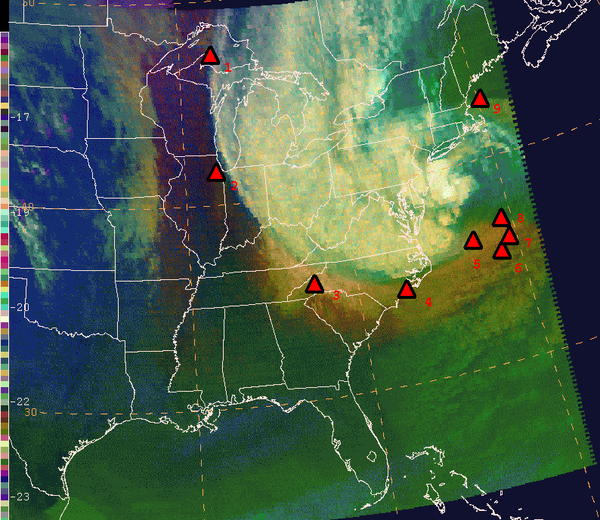
Further Air Mass RGB Validation
12
Use of profiles to further validate RGB products in preparation for GOES-R ABI
Would forecaster access to profiles/swaths on individual levels enhance confidence and interpretation of qualitative products?
1801 UTC 29 October 2012 GOES Sounder Air Mass RGB
1812-1824 UTC 29 October 2012 AIRS O3 Anomaly
Mid- & Upper- level Dry Air
High O3 down to ~250 mb
1812-1824 UTC 29 October 2012 AIRS T, q, O3 profiles

Slide 14
Summary
13
SPoRT has worked with GOES-R/JPSS Proving Grounds to develop/transition ozone products in N-AWIPS format to OPC
Legacy AIRS ozone retrievals have been used to enhance interpretation and increase forecaster confidence in the Air Mass RGB before GOES-R launch as well as demonstrate capabilities of next-generation JPSS CrIS retrievals
Based on forecaster feedback SPoRT plans to expand the ozone products to other instruments to increase temporal and spatial coverage

