Slide 1
Session 3.3: Total Lightning in NOAA’s Proving Ground
Science Advisory Committee Meeting
26 – 28 August, 2014
National Space Science and Technology Center, Huntsville, AL

Slide 2
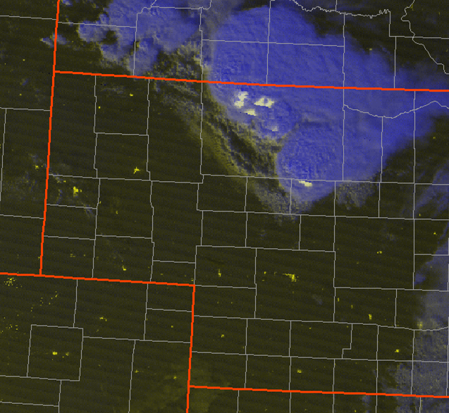
Overview
1
What is total lightning?
History and relevance with SPoRT
How is this applied to the Proving Ground?
Results and Successes
Future Work
Lightning in the VIIRS Day-Night Band RGB Composite

Slide 3
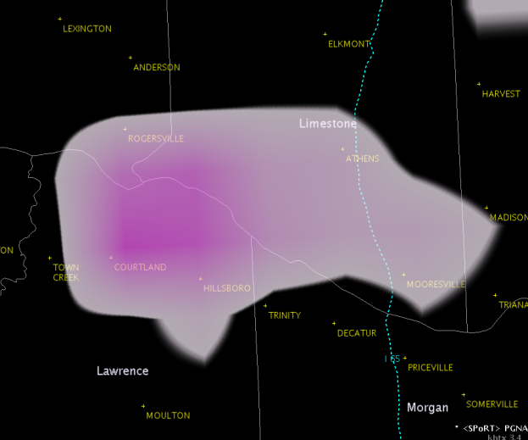
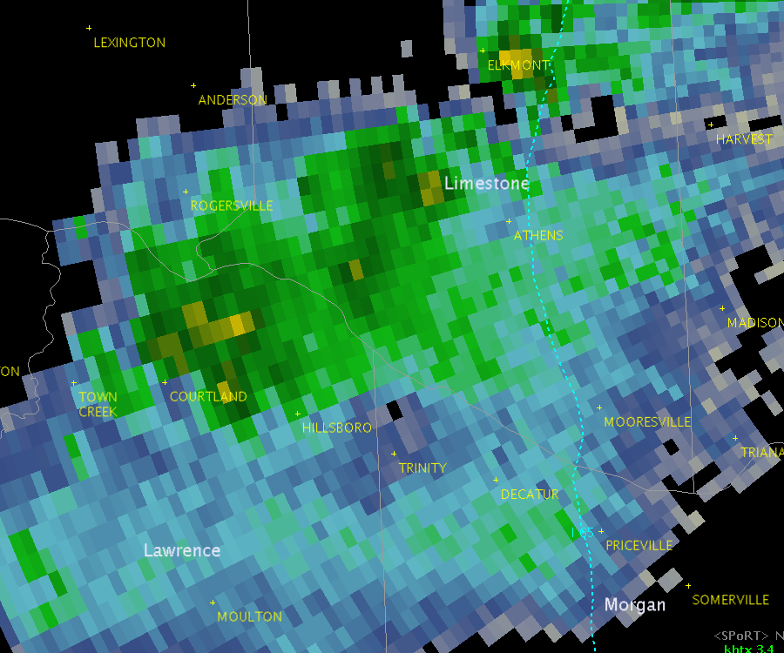
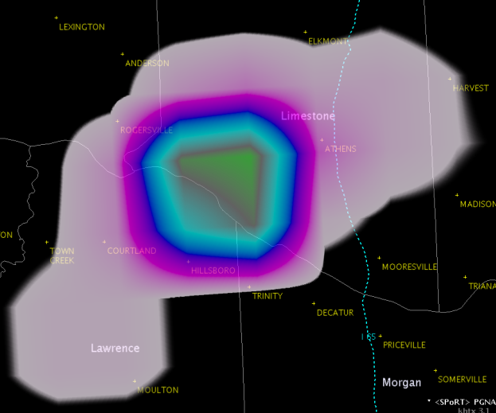
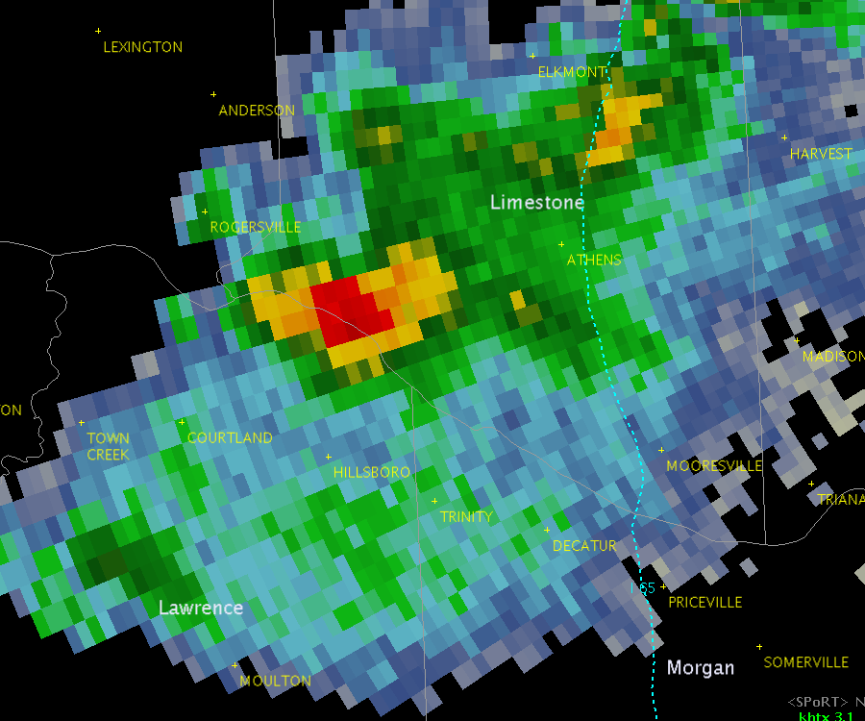
Total Lightning in a Flash
2
Total lightning
Cloud-to-ground plus intra-cloud flashes
More observations that cloud-to-ground alone
Rapid increases = Lightning Jumps
Precursors to severe weather
Much more though
Lightning safety
Aviation applications
12 Flashes
1442 UTC
Total Lightning
3.4° Reflectivity, ~20 kft
64 Flashes
1450 UTC
1451 UTC

Slide 4
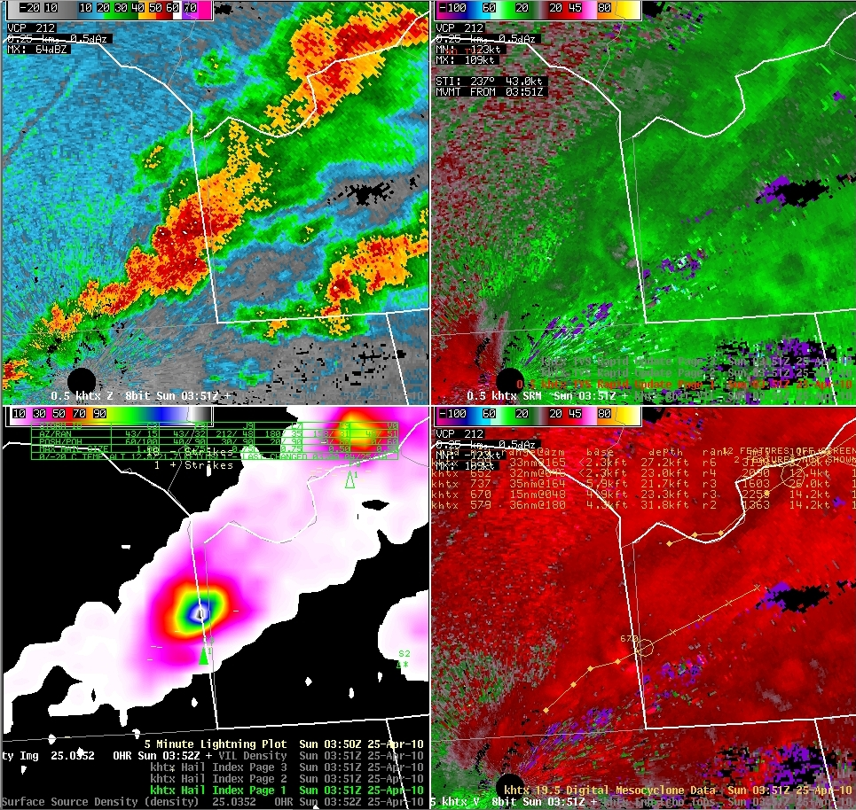
History and Relevance
3
Original core SPoRT activity
2003 with NASA’s North Alabama Lightning Mapping Array (NALMA)
Expanded to NASA’s KSC and Washington D.C. networks
Relevance to SPoRT
Forecasters: Improve severe weather decision support
NASA’s NALMA NASA directly addresses this issue
Collaboration highly active 11 years later
Effort has resulted in training, assessments, and new products
Lightning jump example submitted by WFO Morristown, TN

Slide 5
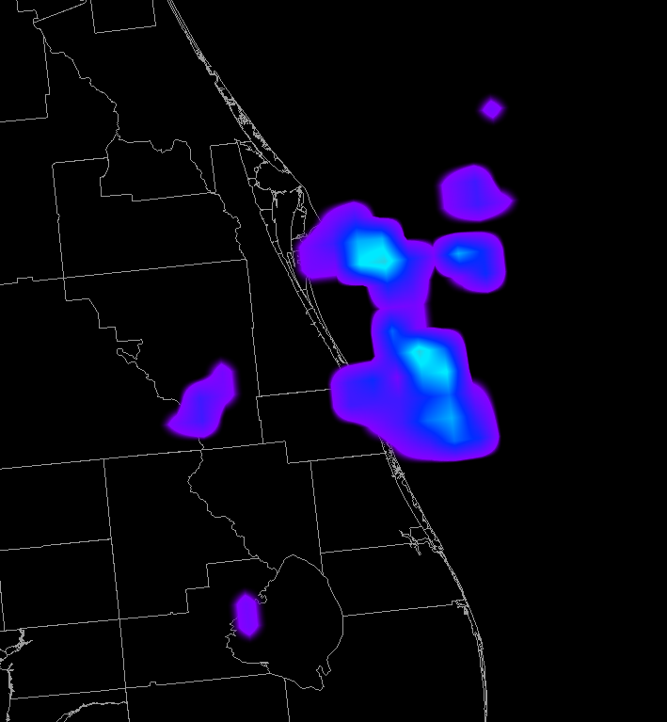
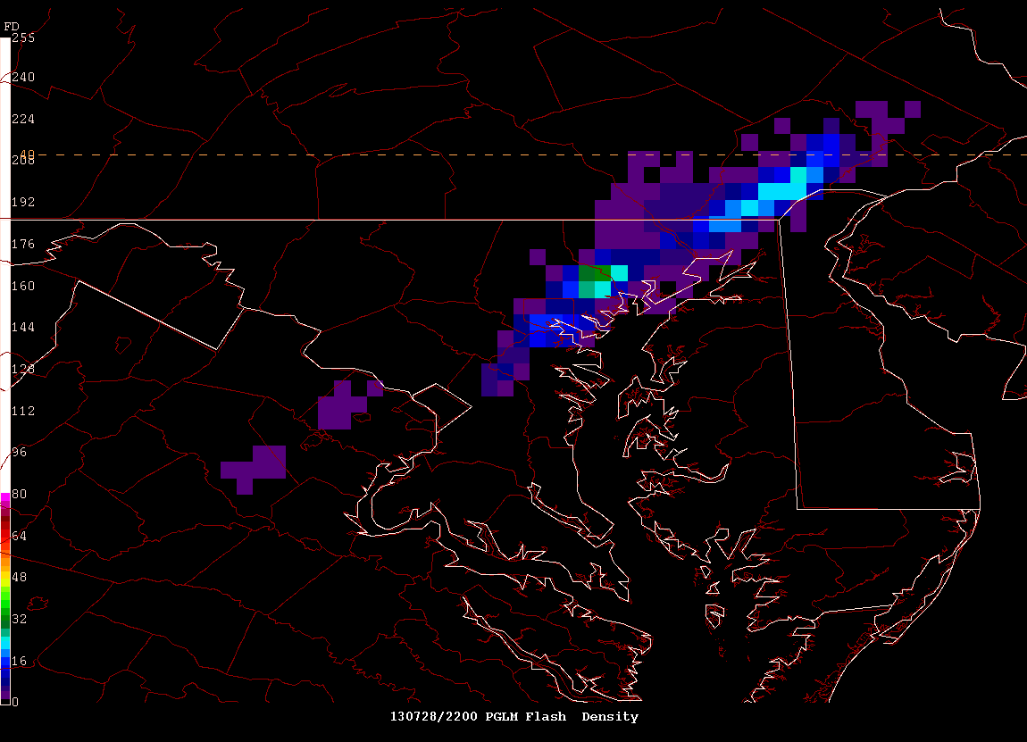
Ties to the Proving Ground
4
SPoRT is a leader in operational use of total lightning
Proving Ground preparing forecasters for the Geostationary Lightning Mapper (GLM)
LMAs demonstrate GLM well
PG could not use AWG proxy
Not real-time, only one network
SPoRT developed the pseudo-GLM (PGLM) product in 2009
Synergistic with SPoRT core activities
De facto demonstration product for Proving Ground
Sample PGLM imagery in AWIPS II
Sample PGLM imagery in NAWIPS for National Centers

Slide 6
What is the Pseudo-GLM?
5
Convert LMA data to flashes
Assign to GLM resolution grid (8 km)
Sum all flashes in grid box
Drawbacks
Not an exact proxy for GLM
GLM optical, PGLM uses VHF
Actual GLM display may differ
Advantages
Real-time, any LMA
Excellent training tool
Integrate lessons learned
y
x

Slide 7
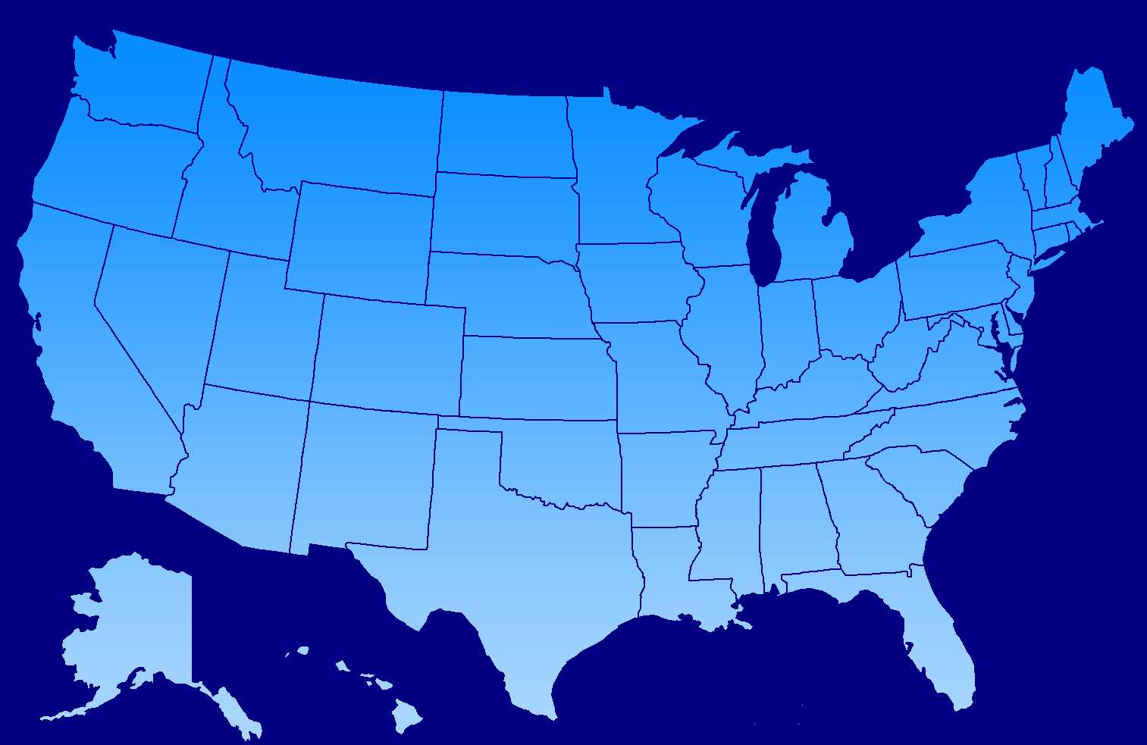
Preparing the Forecaster Community
6
Collaborative LMA
Expanding partnerships
More LMAs
Strong support from Visiting Scientist Proposals
Operational end user
Sterling
Mt. Holly
Wakefield
State College
Boulder
Cheyenne
Denver CWSU
Aviation Weather Center
Storm Prediction Center
Albuquerque WFO & CWSU
Huntsville
Morristown
Nashville
Houston WFO & CWSU
SMG
Melbourne

Slide 8
Preparing the Forecaster Community
7
End user specific training
Integrate with formal Proving Ground activities …
Hazardous Weather Testbed, Aviation Weather Testbed, Operations Proving Ground
Active coordination with Satellite Liaisons
Proving Ground support for National Centers and OCONUS
… but also SPoRT specific activities
National Center PGLM module
Hazardous Weather Testbed PGLM module

Slide 9
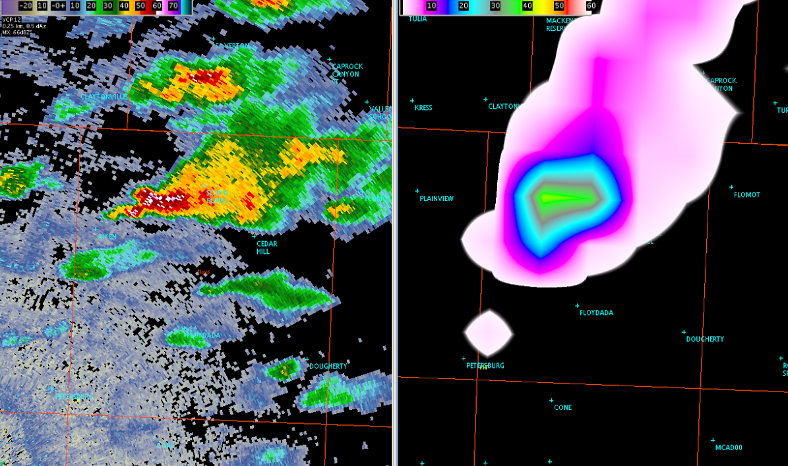
Hazardous Weather Testbed
8
SPoRT activity since 2009
Provide data, products, training
Responses have led to:
New color curves
Max density product
Moving trace tool with MDL
Forecasters appreciate:
Rapid update
Ability to “triage” storms
Storm dynamics insight
Forecaster quote: “The strongest updraft this evening showed marked ramp up of flashes to 40 just as the storms 50 dBZ core reached 26.25. Although the storm didn’t reach severe criteria, it was beneficial that the Flash Extent Density updates in 1 minute intervals, which lets the warning forecaster monitor for rapid updraft development between radar volume scans. This storm resulted in a report of dime size hail.”

Slide 10
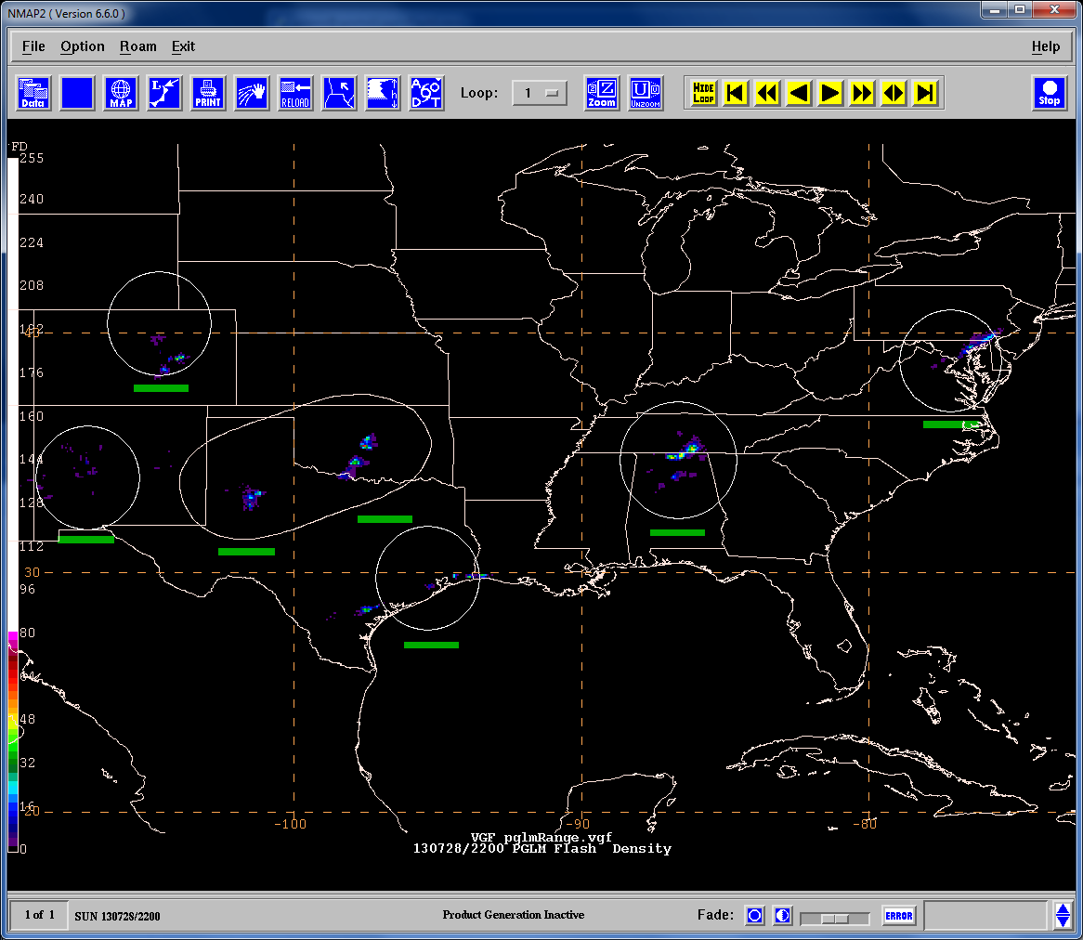
National Centers
9
SPoRT first to reach out to National Centers to prepare for GLM
2012 VSPs to Aviation Weather Center and Storm Prediction Center
Needed different display
PGLM mosaic in NAWIPS
All available LMAs in one file
Interactive process
Altered color curve
Changing file format
Effective range rings
“Quick look” network status
Sample PGLM mosaic image in NAWIPS.
Notes:
Note that we created the PGLM mosaic

Slide 11
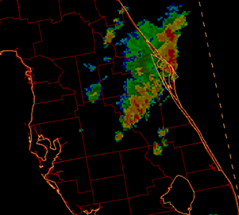
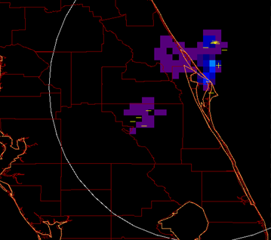
National Center Example
10
Aviation Weather Testbed 2013
PGLM observations versus radar and NLDN
Noted NLDN in the main line
PGLM showed spatial extent
Lightning well behind line
Could impact how AWC issues Convective SIGMETS (i.e., expanded coverage)
Strong convection with trailing stratiform region
Note active lightning behind convective line
NLDN only in main core
NAWIPS radar reflectivity
PGLM Mosaic over Central Florida
Notes:
Note that we created the PGLM mosaic

Slide 12
2014 SPoRT Assessment: Results
11
Numerous new partners
First effort to bring lightning to CWSUs and operational use of new networks
Formal report pending, based on 40 surveys
Key Results: Strong support for data, confidence in use from training, and diverse applications
Take away: GLM has large potential impact in operations once launched
Forecaster Confidence
Impact of Total Lightning
Reported Activities

Slide 13
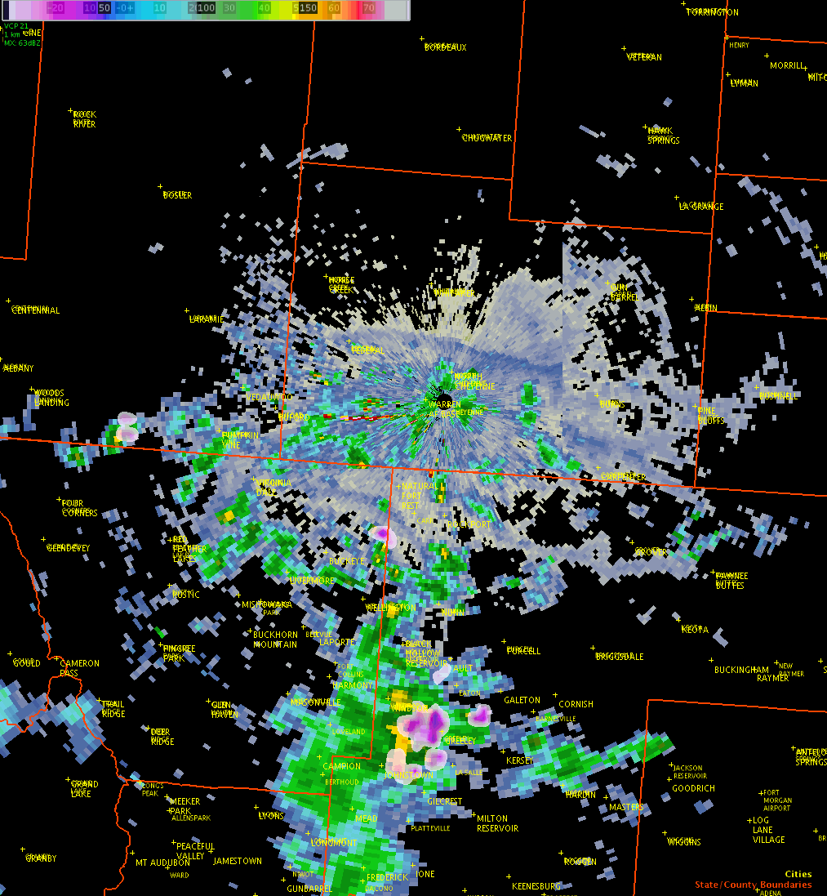
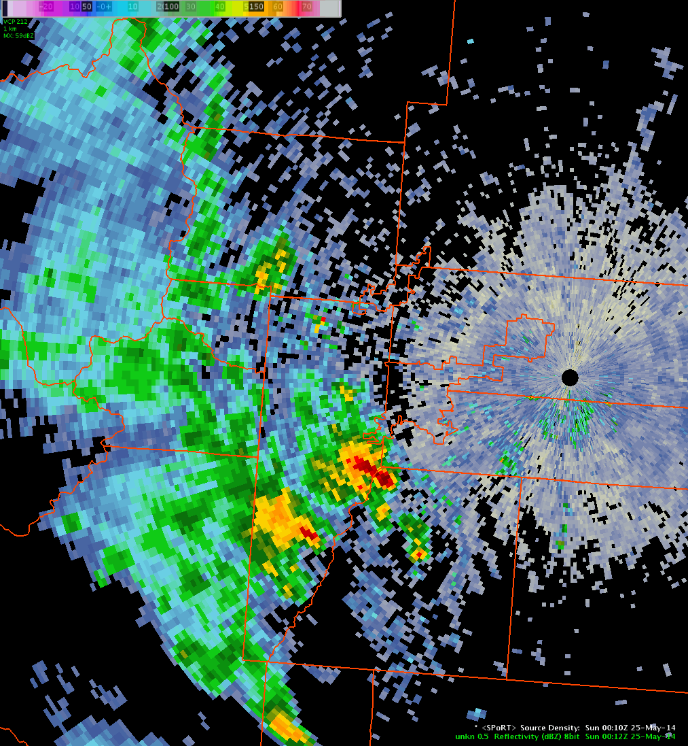
SPoRT 2014 Assessment: Examples
12
CWSU Denver
Greatest use monitoring Terminal Radar Approach Control (TRACON) routes
“… useful to monitor storms to brief the Traffic Management Unit on gate [air route] open / closure decisions.”
“Total lightning source density enabled [ZDV to issue] a warning to the Traffic Management Coordinator that a hole southeast of Denver in a thunderstorm line was closing, and would impact [aircraft] arrivals.”
Cheyenne Frontier Days Rodeo
Largest outdoor rodeo in world
10 days, 200+ thousand visitors total
“The WFO was providing weather support to the Laramie County Emergency Manager on the evening of July 20th. Convection developed south of Cheyenne, moving north producing some total lightning. The activity remained greater than 15 miles from Frontier Park and [the data] proved extremely useful in enhancing situational awareness and forecast confidence throughout the event.
Notes:
Use separate images on wall to show the examples here. Note, the CYS case the storms are very distant from the city, but the point still stands

Slide 14
Additional Successes
13
SPoRT continues to expand operational use of total lightning
Numerous collaborations for data and WFO participation
“Non-traditional” partners: National Centers, CWSUs, aviation
Community coming to SPoRT for aid: Alaska Region, possible ENTLN
Provided subject support to upcoming COMET module
Diversified operational use
Recent assessment highlighted numerous uses and can apply to GLM!
More than lightning jumps and severe weather!
Lightning safety, aviation, impact decision support, flood warnings
Publications
Total lightning in Moore tornado – Published
3 more pending (The PGLM, Long flashes, AWC applications)

Slide 15
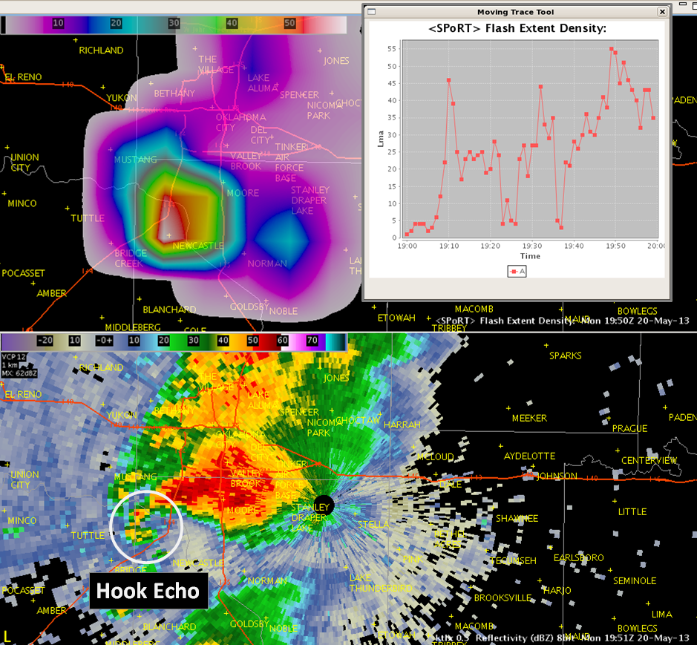
Future Activities / Opportunities
14
Continue training support
Report assessment results
Decision support, such as AWIPS II
Post GLM launch applications
Integration with ground networks
Evaluation and verification
Downscale GLM data with ground observations
Automated safety algorithms
International opportunities
Support NASA’s SERVIR group
Support Meteosat’s GLM work
Toronto, Canada LMA network
PGLM in AWIPS II (top) with tracking tool (top inset) with the corresponding radar reflectivity (bottom) for the 20 May 2013 Moore, Oklahoma tornado at 1950 UTC.
Notes:
Note that meteogram tool will be covered by Jason

Slide 16
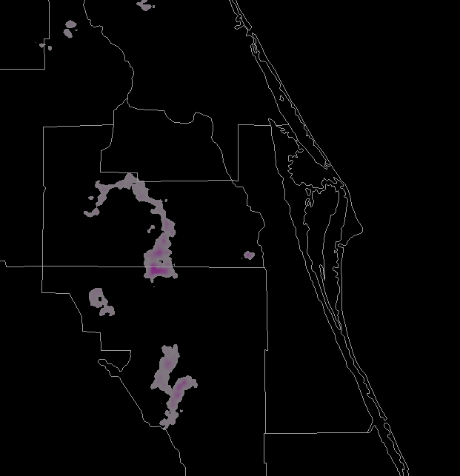
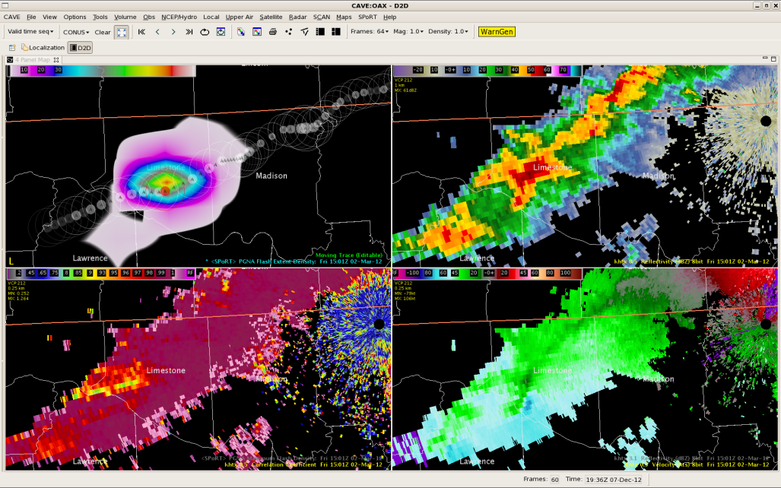
Questions?
15
(Above) Total lightning in AWIPS II at WFO Melbourne showing a 40 km long flash.
(Above) PGLM mosaic in NAWIPS for National Centers.
(Right) PGLM and radar in AWIPS II for the Hazardous Weather Testbed.

