Slide 1
OCONUS Activities
Science Advisory Committee Meeting
26 – 28 August, 2014
National Space Science and Technology Center, Huntsville, AL

Slide 2
SPoRT OCONUS Background
2009 SAC recommended “careful expansion” beyond Southern Region. Later, PG asked for more OCONUS applications.
Alaska & Pacific Regions, Puerto Rico involved in QPE, Hybrid and some RGBs
Early work in AK involved transition of SPoRT SST Composite
“Ice Desk” decreased prep time of their own product by ~60%
Lead in to ABI-type products (Hybrid, QPE, RGB) and JPSS/S-NPP products (DNB)
Visits to AK/HI
OCONUS PG meeting in 2010, 2011, 2013, JPSS Meeting 2012
SPoRT staff visited all AK WFOs and RFC in 2013 in prep for QPE and Aviation RGB Assessments and to meet with University of Alaska Fairbanks/GINA staff
Prepared Virtual Machine plan
Provided AK forecasters with info on GOES-R/JPSS and specific product training
VSP 2014 to Pacific Region has established plan for QPE Assessment & other work
Notes:
Fairbanks established SPoRT PG suite in AWIPS I in only few days (ahead of visit) with others to follow shortly. Most SPoRT products in AWIPS II at AFB and AFC.

Slide 3
AK Transition and Assessment
QPE
Already described by A. LeRoy
Hybrid GEO/LEO Imagery
ABI capability, S-NPP utility
“Very popular”
NtMicro. RGB for Aviation and Cloud Analysis
Very new to most users
Dec 2013 - ~15 Feb 2014
Nighttime Microphysics and Day-Night Band RGBs
Compare to traditional GOES 11-3.9µ difference,
Focus on identification of fog
Loop of the SPoRT GEO/LEO Hybrid 11-3.9um imagery that includes MODIS and VIIRS data from 1030Z to 1345Z on 15 Nov 2013

Slide 4
Feedback Results - Impact
Assessment Results -NtMicro
Between the 3 products, the NtMicro RGB was the preferred product by far (~80%)
72% indicated NtMicro RGB as primary product for fog/low clouds
Impact on Aviation (general): 82% said some to very large
Impact to distinguish fog from low clouds: 85% said some to very large

Slide 5
Feedback Results - Impact
Assessment Results – Day-Night Band
Included with NtMicro submissions
Impact on Aviation (general): 64% said some to very large
Had multiple uses, but usually was not the preferred product for aviation.
Notes:
Graphic of user feedback and /or comments
See 20131224_1255 as clear look at Anchorage
Can see snow, sea ice, lights

Slide 6
User Comments –a few examples
Dec 12 (AFC): “As a new user I find it difficult to interpret all of the subtle variations in color in the RGB Nighttime Microphysics Imagery. I do believe with regular practice and experience with the product that this will become a little easier.” (Advocated for a probability product due to individual color interpretation differences)
Dec 17 (AFC): “Standard IR was very useful due to surface temps being near -20F, hence using it complementary to the SPoRT imagery.”
These very cold temperatures and increased summer daylight limit NtMicro RGB. SPoRT is looking to testbed the EUMETSAT-developed 24-hr Microphysics RGB

Slide 7
Recommendations from Assessment
Users need more training examples and experience with Nighttime Microphysics and Day-Night Band RGB imagery
NtMicro does provide value and other satellites could be used if data were made available
NOAA 18 & 19 POES, MetOp A & B (via AVHRR instrument)
Applications/Feedback limited by product frequency (more of an issue for DNB product)
Derived DNB products for unique situations (e.g. disasters, smoke, etc.) likely to increase operational use.

Slide 8
RGB Imagery – new product for testing
24-hr Microphysics
VIIRS swath over AK
12.0µm-10.8µm
10.8µm-8.7µm
10.8µm
The green component uses 8.7 instead of 3.7µ channel
Range of green component difference is half of NtMicro RGB so less distinction between low cloud features
Less noisy in cold scenes
Able to use in day compared to NtMicro
Can see features progressing in loops for the N. half of Alaska

Slide 9
RGB Imagery – new product for testing
Nighttime Microphysics
24-hr Microphysics
Daytime
Less variation of cloud features in 24hr Micro
Nighttime

Slide 10
SPoRT PG Suite for AK
AFC and AFB are among the first 10-15 WFOs transitioned to AWIPS II
Among the first 4 WFOs receiving SPoRT products
MODIS/VIIRS RGB Suite
MODIS: Dust, NtMicro, True Color, Snow/Cloud, Air Mass
VIIRS: Dust, NtMicro, True Color, Snow/Cloud, DNB(Rad), DNB(Refl)
Sea Surface Temperature (SST)
SST, Latency
CIRA Layered Precipitable Water (LPW) – East Pacific to Africa
Sfc-850mb, 850-700mb, 700-500mb, 500-300mb, Total
NESDIS Quantitative Precipitation Estimate (QPE)
15min, 1hr, 3hr, 6hr, 12hr, 1day, 3day, 7day

Slide 11
Collaborations with UAF/GINA
Virtual Machines for SPoRT
Processing locally at GINA via Direct Broadcast data accessed onsite
SPoRT Code transferred to GINA VMs
Products made via VMs
VIIRS RGBs (MODIS coming new h/w)
GEO/LEO Hybrids w/ MODIS&VIIRS
Value of VMs
Reduced latency and file “traffic”
Processing issue resolution via SPoRT partnership
Terra de-stripping coefficients (right)
Plan to Integrate with CSPP

Slide 12
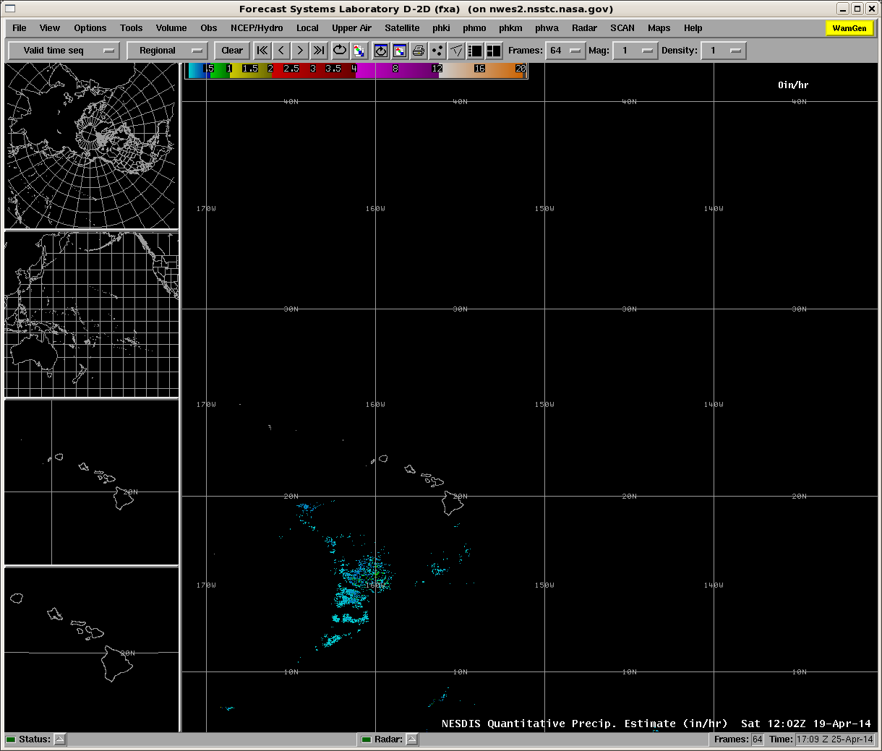
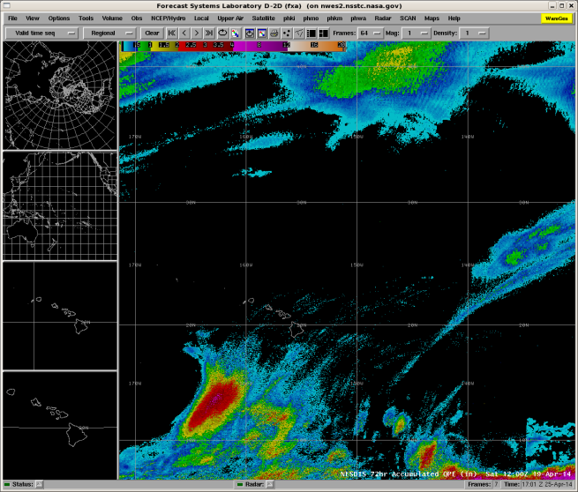
Pacific Region
Pacific Region is most recent collaboration
Coordinated with region headquarters on visiting scientist proposal
Accepted and first trip occurred 5-9 May 2014
Discussed collaborations with headquarters and met with forecasters at the co-located WFO Honolulu and Central Pacific Hurricane Center
Initial focus
GOES-R Quantitative Precipitation Estimate (QPE)
Sea Surface Temperature Composite
Passive microwave discussed
QPE
15 min rain rate (in/hr)
QPE 3 day accumulation (in)

Slide 13
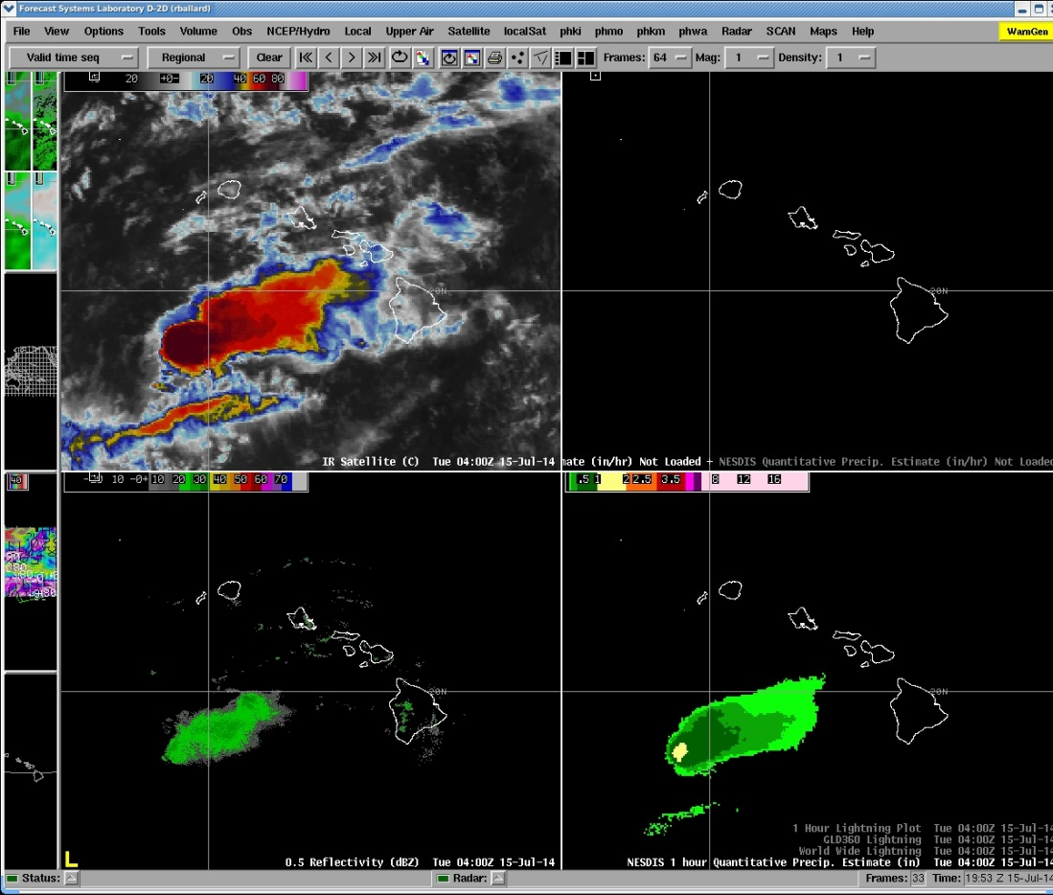
Initial Visit
Corrected AWIPS display
SSTs very popular
Used by Central Pacific Hurricane Center on Tropical Storm Wali to forecast intensity
QPE is newest activity
Support satellite analysis product
Insight on storm dynamics?
Modify wave forecasts
GOES IR
Image courtesy of Robert Ballard – SOO WFO Honolulu
Radar Reflectivity
1 hr QPE (in)
QPE example in AWIPS demonstrating modified color curve to better match radar estimates.

Slide 14
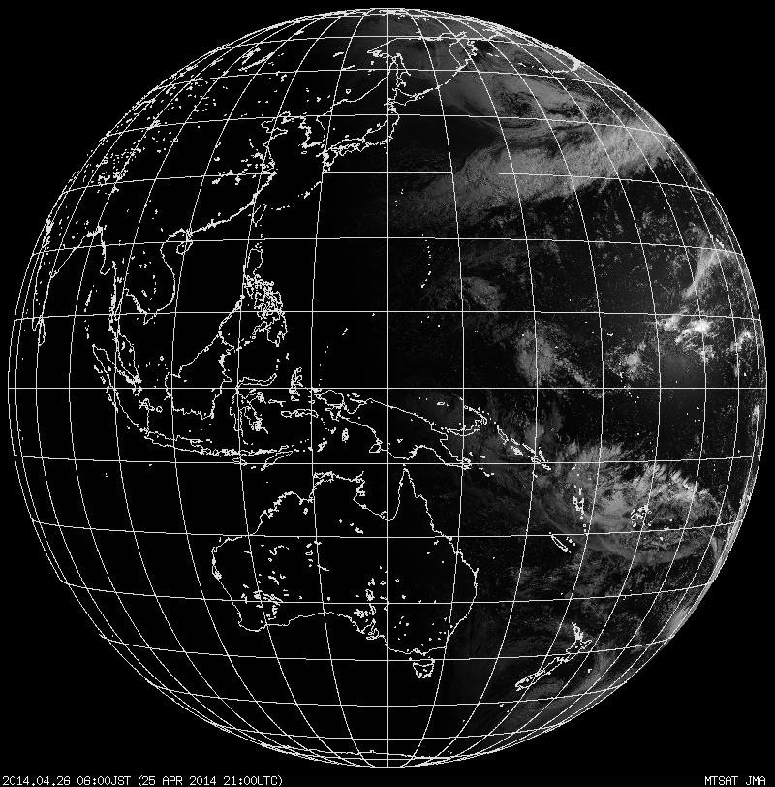
Continued Collaborations
Assess QPE during wet season
Training module
Assess QPE with current GOES to
Assess operational uses
Determine updates
Create baseline for comparison to new missions
Pacific Region will benefit from Japan’s Himawari
Nearly identical to GOES-R ABI
Test baselined products (like QPE)
WFO Guam likely a key player
Himawari Field of View
Guam
Hawaii

Slide 15
SPoRT OCONUS – Future PG Activities
Transition of complementary niche products - RGBs, SSTs, Hybrid (including VIIRS), DNB (Reflectance), QPE
AWIPS II at 2/3 AK WFOs, AAWU, RFC, PRHQ
QPE Transition, Training, Assessment for HFO, Oct/Nov 2014
NESDIS Snowfall Rate Assessment in AK, Oct 2014 (ROSES 2013)
Testbed and Assessment of 24hr Microphysics RGB in AK, Winter 14/15

