Slide 1
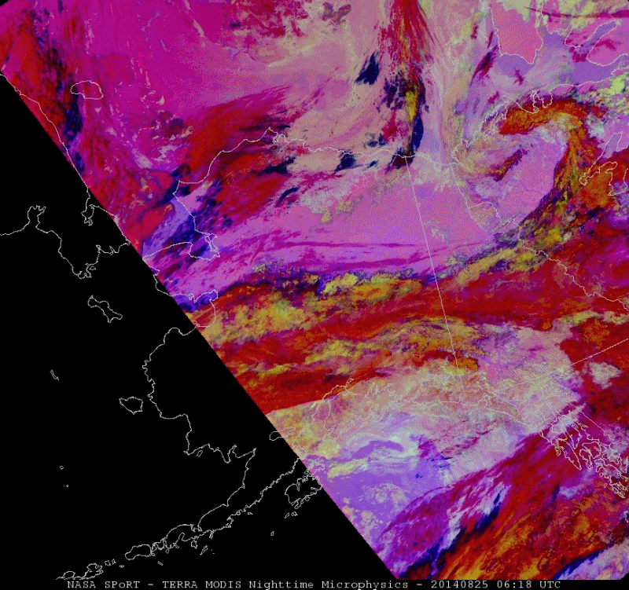
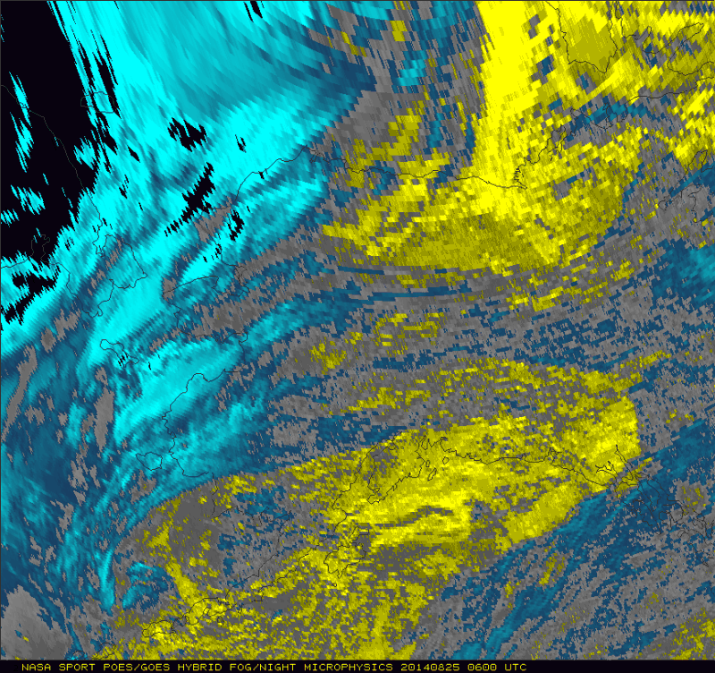
VIIRS and MODIS NtMicro. AK Loop
GEO/LEO Fog/NtMicro. AK Loop
25 Aug 2014 0600Z-1330Z
25 Aug 2014 0600Z-1330Z
Notes:
Only during slide 3

Slide 2
AK NtMicro Assessment
A forecaster from AFC evaluated the impact of the NtMicro as “very large” for differentiating between fog and low clouds on 10 Dec 2013. The high resolution GEO/LEO Hybrid imagery (right) clearly shows areas of fog/low cloud throughout the eastern portion of the image, and the NtMicro (left) helps distinguish the fog in low lying areas and in the valleys from the low, thicker clouds.
Notes:
Only during slide 4

Slide 3
VIIRS 24hr Micro. AK Loop
3 Aug 2014
1158Z – 2334Z
Notes:
Only during slide 9

