Slide 1
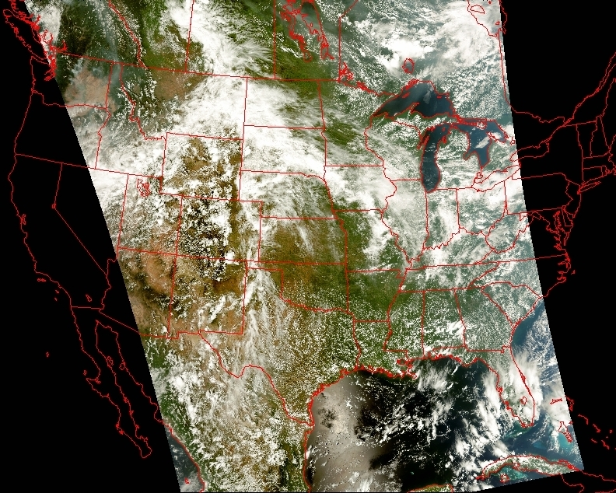
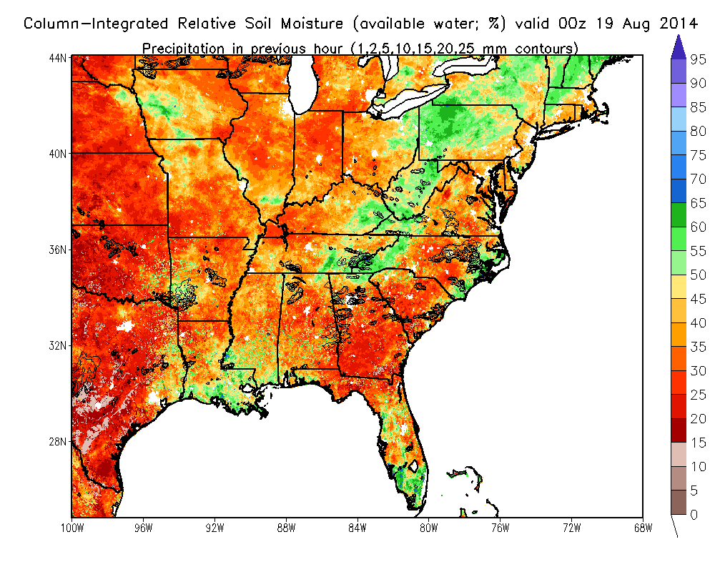
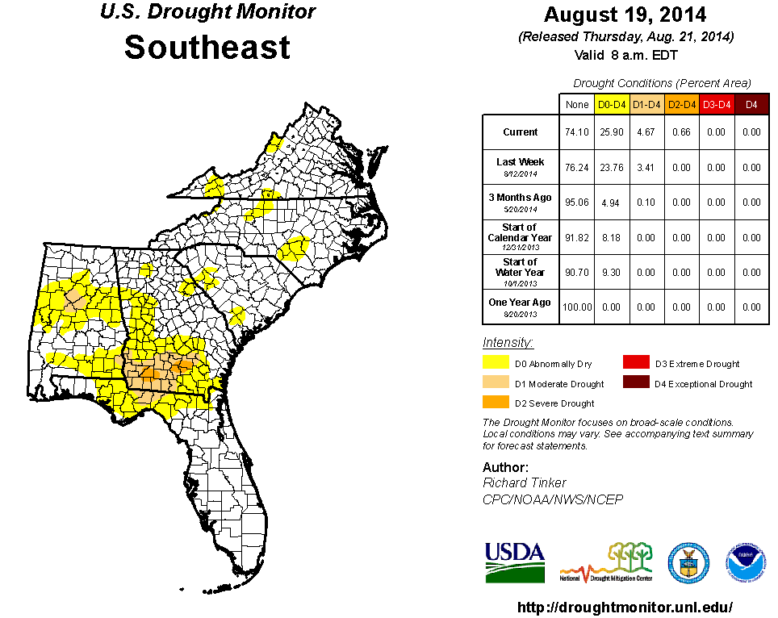



Real-time SPoRT-Land Information System and Green Vegetation Fraction
SPoRT-LIS
soil moisture and developing
MDT drought
Science Advisory Committee Meeting
26 – 28 August, 2014
National Space Science and Technology Center, Huntsville, AL

Slide 2
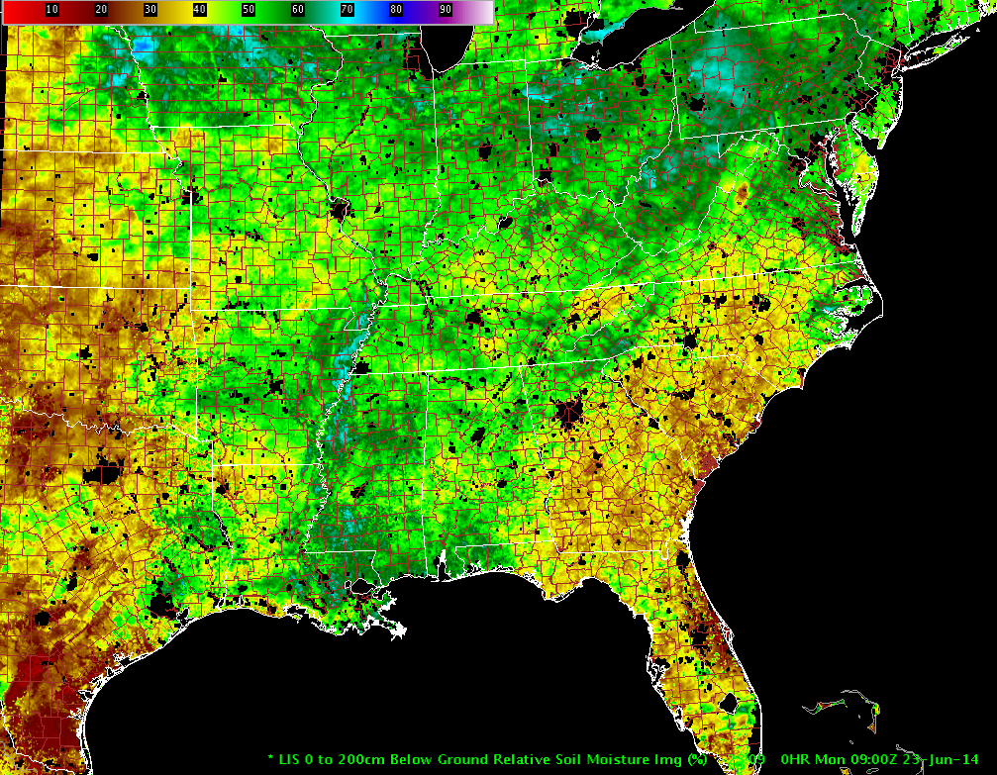
Relevance/Outline
2
Relevance of Land Information System (LIS) activities: Improved soil moisture estimates address numerous forecast challenges
  NWP of sensible weather elements leading to sea breezes, convection, etc.
  Situational awareness for assessing drought and areal flood potential
Brief background on LIS
“Operational” SPoRT-LIS and MODIS
Green Vegetation Fraction (GVF)
LIS for situational awareness
  Drought and areal flooding in testbed
  LIS assessment
Ongoing and future activities
Figure captions should be italicized 14-point Calibri in a color that stands out from figure/slide background
SPoRT-LIS total column soil moisture displayed in AWIPS II

Slide 3
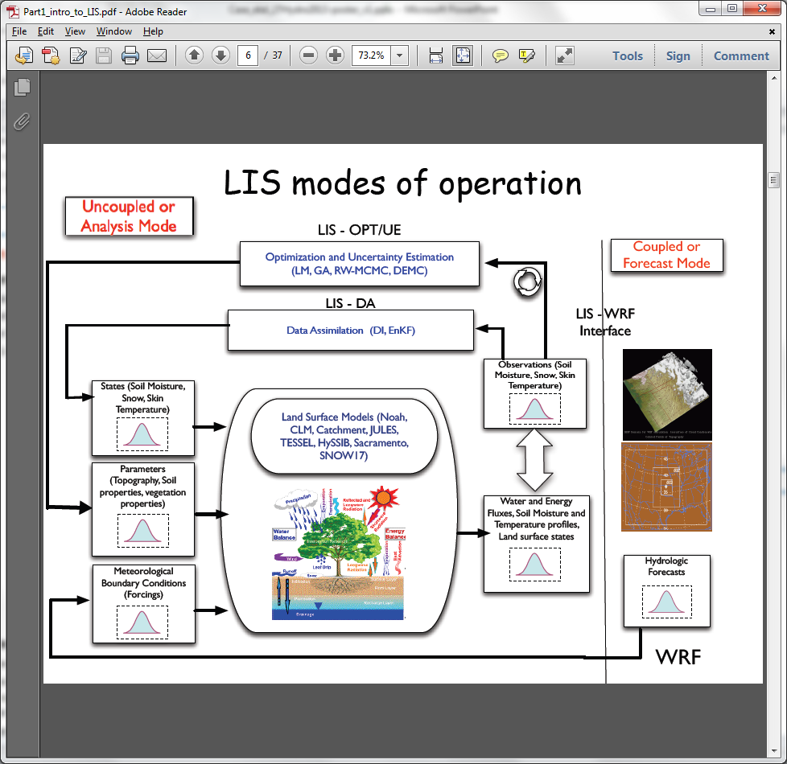
Brief Background on LIS
3
Ability to run multiple LSMs
  Noah LSM used in SPoRT runs

Slide 4
Brief Background on LIS
3
Ability to run multiple LSMs
  Noah LSM used in SPoRT runs
Offline or coupled modes
  Offline: apart from NWP model; driven by atmospheric analyses
  Coupled: LIS run within NASA Unified-WRF (NU-WRF) system

Slide 5
Brief Background on LIS
3
Ability to run multiple LSMs
  Noah LSM used in SPoRT runs
Offline or coupled modes
  Offline: apart from NWP model; driven by atmospheric analyses
  Coupled: LIS run within NASA Unified-WRF (NU-WRF) system
Optional capabilities
  Land surface data assimilation*
  Land surface Verification Toolkit*
  Optimization/uncertainty analysis
Previous SPoRT publications have shown LIS utility in NWP
*Current/future SPoRT ventures

Slide 6
SPoRT-LIS Real-time Configurations
4
Running Noah LSM at ~3-km resolution with real-time MODIS GVF
Notes:
Note that SPoRT-LIS runs use operational (Stage IV), recent operational (NLDAS-2) or soon-to-be operational (MRMS) products to drive the land surface model integrations.

Slide 7
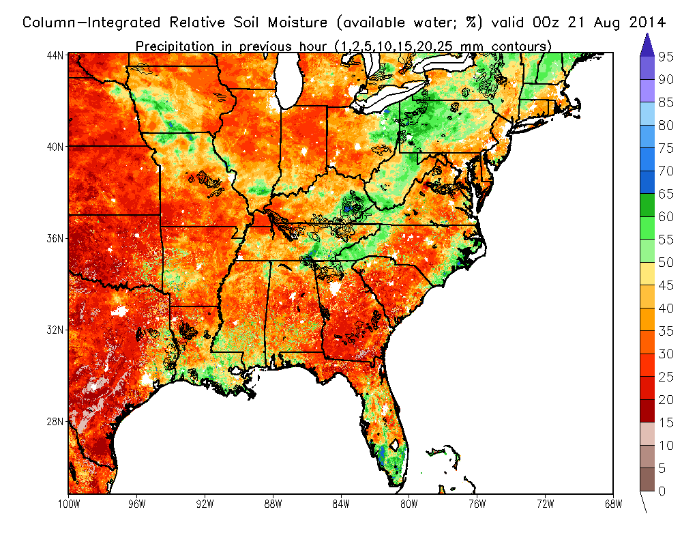
SPoRT-LIS Real-time Configurations
4
Running Noah LSM at ~3-km resolution with real-time MODIS GVF
“Operational” Southeast U.S. domain
  Driven by NLDAS-2/Stage IV precip
  Data used for both local modeling in WRF/EMS and display in AWIPS II
  Used in current LIS assessment
Notes:
Note that SPoRT-LIS runs use operational (Stage IV), recent operational (NLDAS-2) or soon-to-be operational (MRMS) products to drive the land surface model integrations.

Slide 8
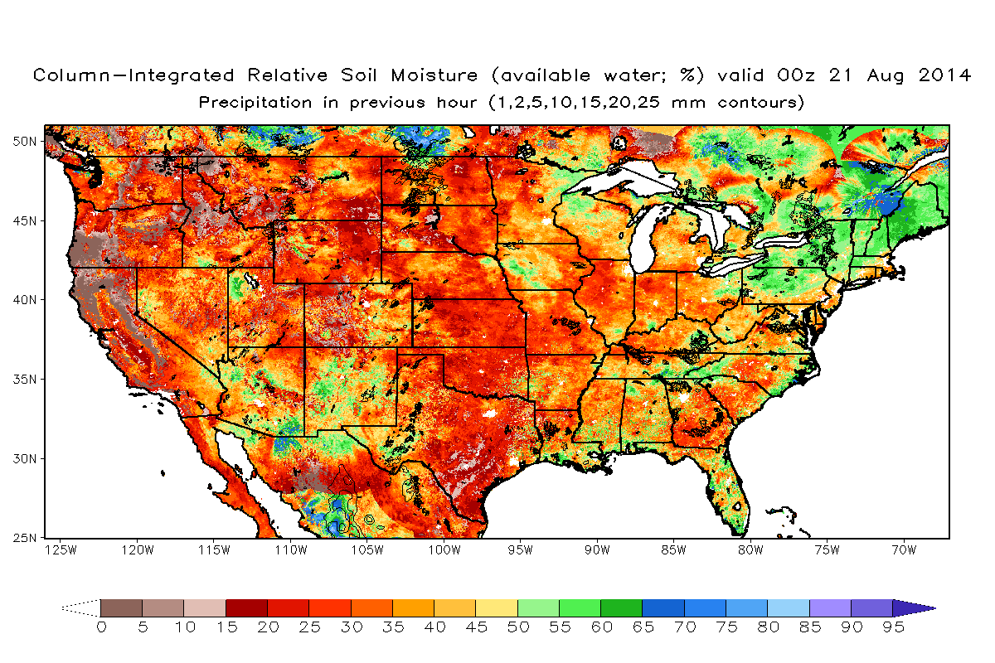
SPoRT-LIS Real-time Configurations
4
Running Noah LSM at ~3-km resolution with real-time MODIS GVF
“Operational” Southeast U.S. domain
  Driven by NLDAS-2/Stage IV precip
  Data used for both local modeling in WRF/EMS and display in AWIPS II
  Used in current LIS assessment
Experimental CONUS domain
  Interest from SPoRT western partners
  Driven by NLDAS-2/MRMS* precip
*Multi-Radar Multi-Sensor 1-km QPE
Notes:
Note that SPoRT-LIS runs use operational (Stage IV), recent operational (NLDAS-2) or soon-to-be operational (MRMS) products to drive the land surface model integrations.

Slide 9
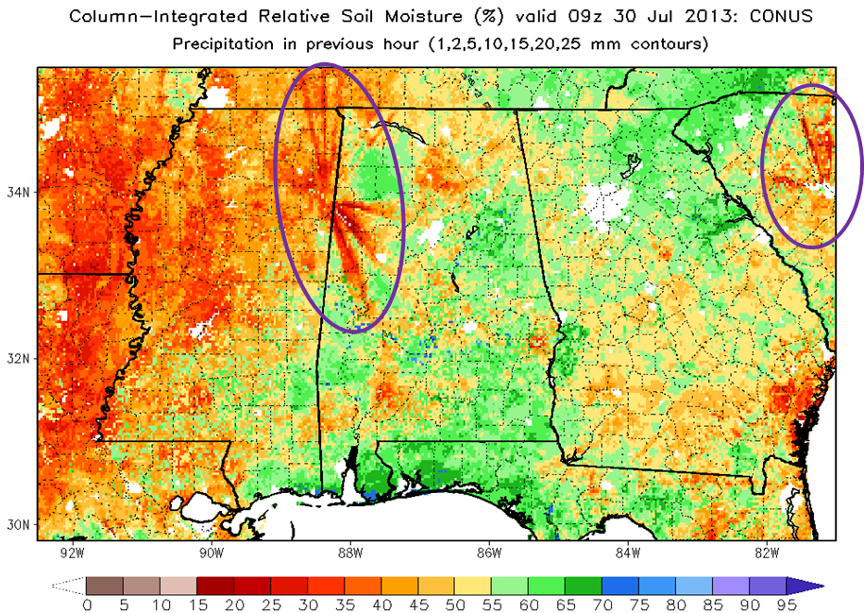
SPoRT-LIS Real-time Configurations
4
Running Noah LSM at ~3-km resolution with real-time MODIS GVF
“Operational” Southeast U.S. domain
  Driven by NLDAS-2/Stage IV precip
  Data used for both local modeling in WRF/EMS and display in AWIPS II
  Used in current LIS assessment
Experimental CONUS domain
  Interest from SPoRT western partners
  Driven by NLDAS-2/MRMS* precip
  MRMS quality concerns (e.g., radar
  beam blockage) preclude use in LSMs
Artificial soil moisture
patterns from long-term
LIS integration using
1-km MRMS hourly precip
*Multi-Radar Multi-Sensor 1-km QPE
Notes:
Note that SPoRT-LIS runs use operational (Stage IV), recent operational (NLDAS-2) or soon-to-be operational (MRMS) products to drive the land surface model integrations.

Slide 10
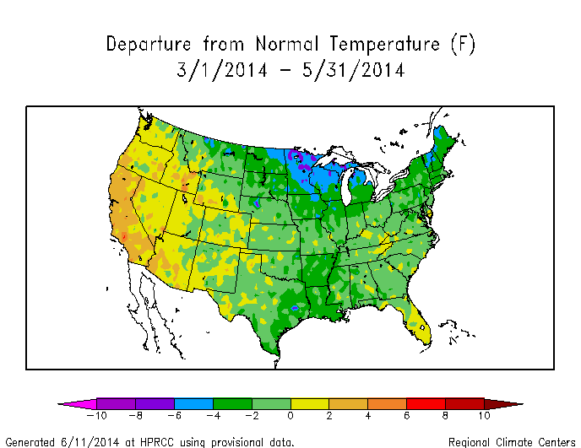
Brief Background on MODIS GVF
5
Once-daily ~1-km NDVI composites, similar to SST methodology
Conversion to GVF for use in LIS-Noah LSM and WRF/EMS
Case et al. IEEE TGRS publication: March 2014
  Higher MODIS GVF over western U.S. in Summer 2010 led to drier soil moisture in LIS-Noah
  Improved MCS forecast in WRF model for Midwest severe weather case
Well below average
temperatures during
Spring 2014

Slide 11
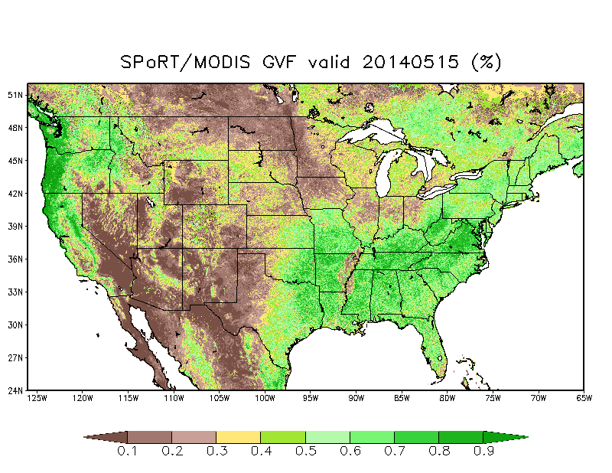
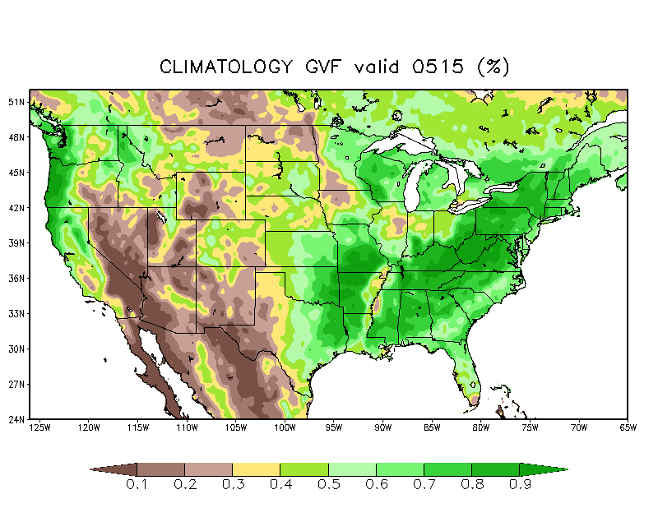
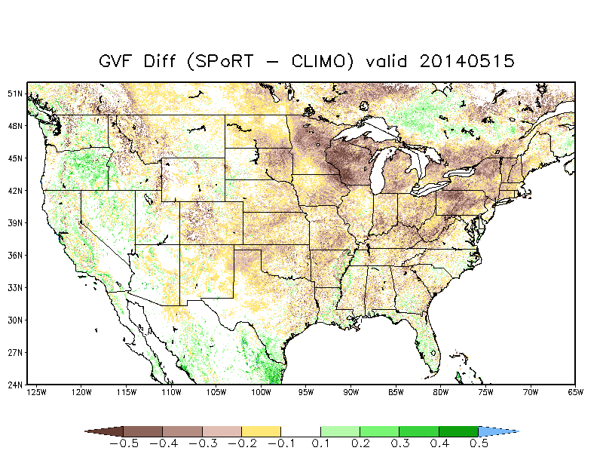
Brief Background on MODIS GVF
5
Once-daily ~1-km NDVI composites, similar to SST methodology
Conversion to GVF for use in LIS-Noah LSM and WRF/EMS
Case et al. IEEE TGRS publication: March 2014
  Higher MODIS GVF over western U.S. in Summer 2010 led to drier soil moisture in LIS-Noah
  Improved MCS forecast in WRF model for Midwest severe weather case
Well below climo
MODIS GVF

Slide 12
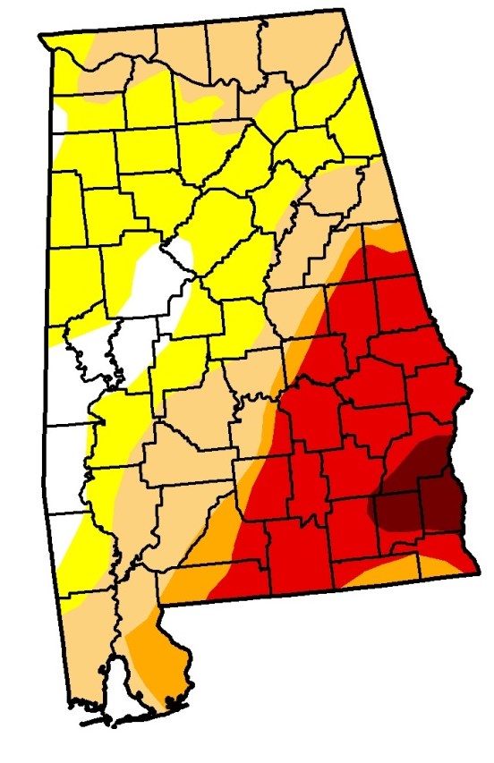
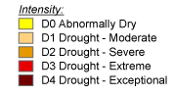
SPoRT-LIS in Testbed Mode:
Drought Monitoring at NWS HUN
6
U.S. Drought Monitor
depiction for Alabama – 5/1/2012
DeKalb
County

Slide 13
SPoRT-LIS in Testbed Mode:
Drought Monitoring at NWS HUN
6
U.S. Drought Monitor
depiction for Alabama – 5/1/2012
LIS total column soil moisture depicted locally degraded soil conditions over DeKalb county (below)
DeKalb
County

Slide 14
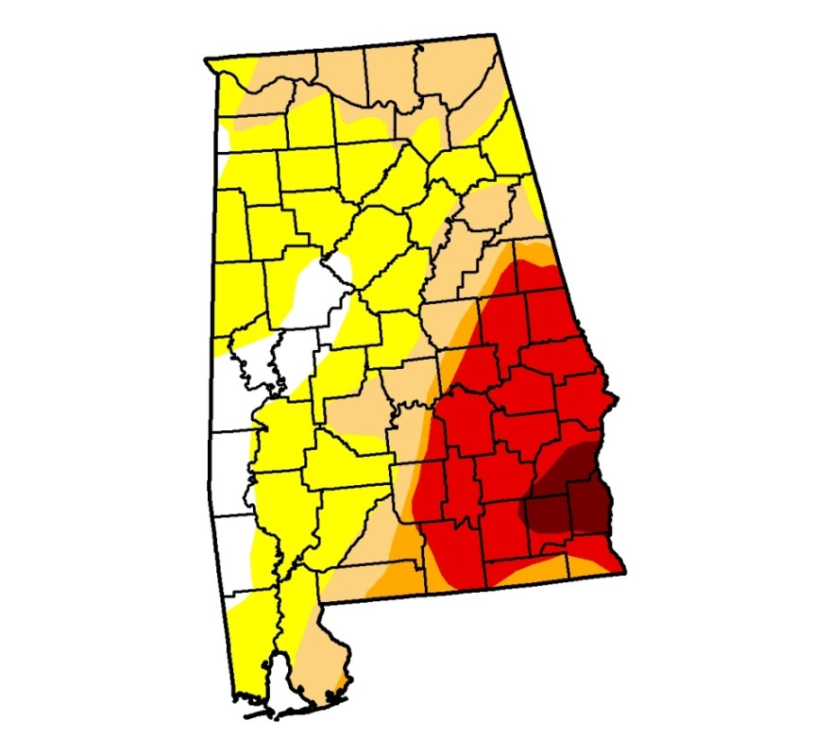
SPoRT-LIS in Testbed Mode:
Drought Monitoring at NWS HUN
6
U.S. Drought Monitor
depiction for Alabama – 5/1/2012
LIS total column soil moisture depicted locally degraded soil conditions over DeKalb county (below)
U. S. Drought Monitor
depiction for Alabama – 5/8/2012
DeKalb
County
DeKalb County
Notice the expansion of D1 into southern DeKalb County and adjacent areas.

Slide 15
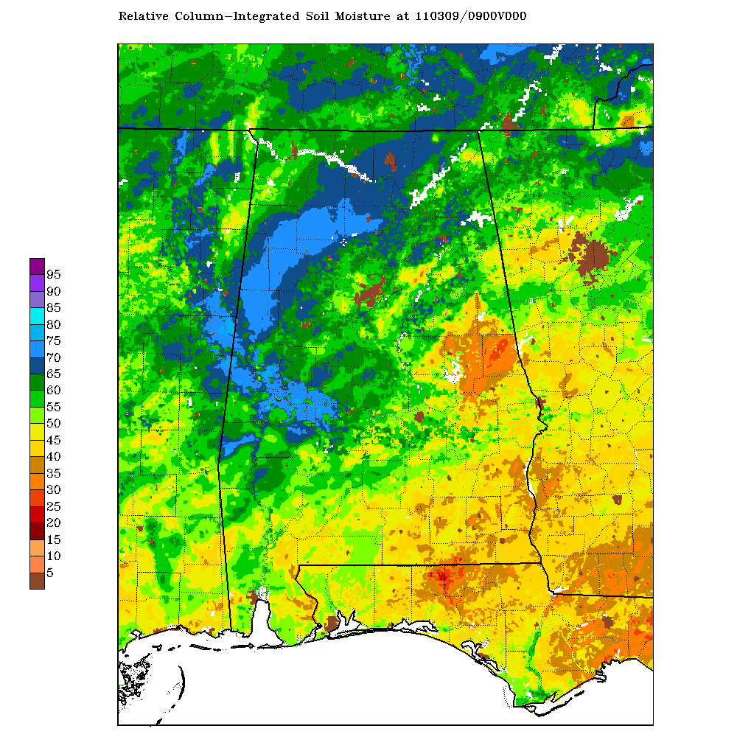
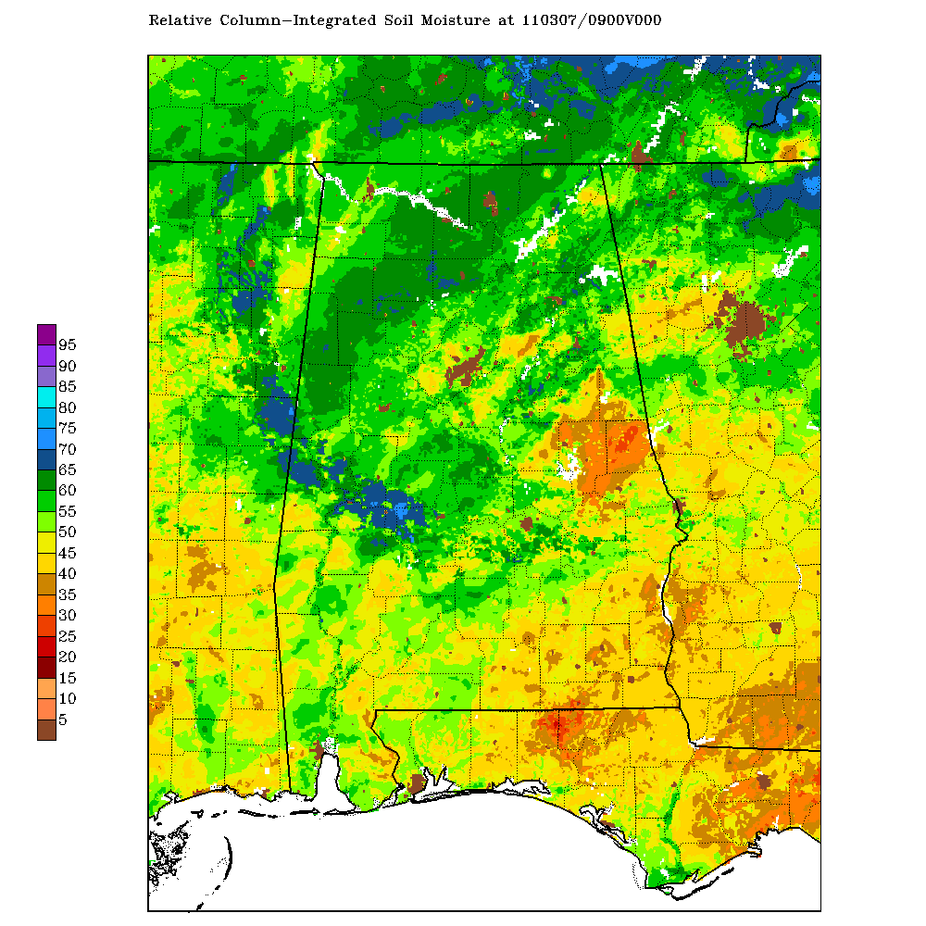
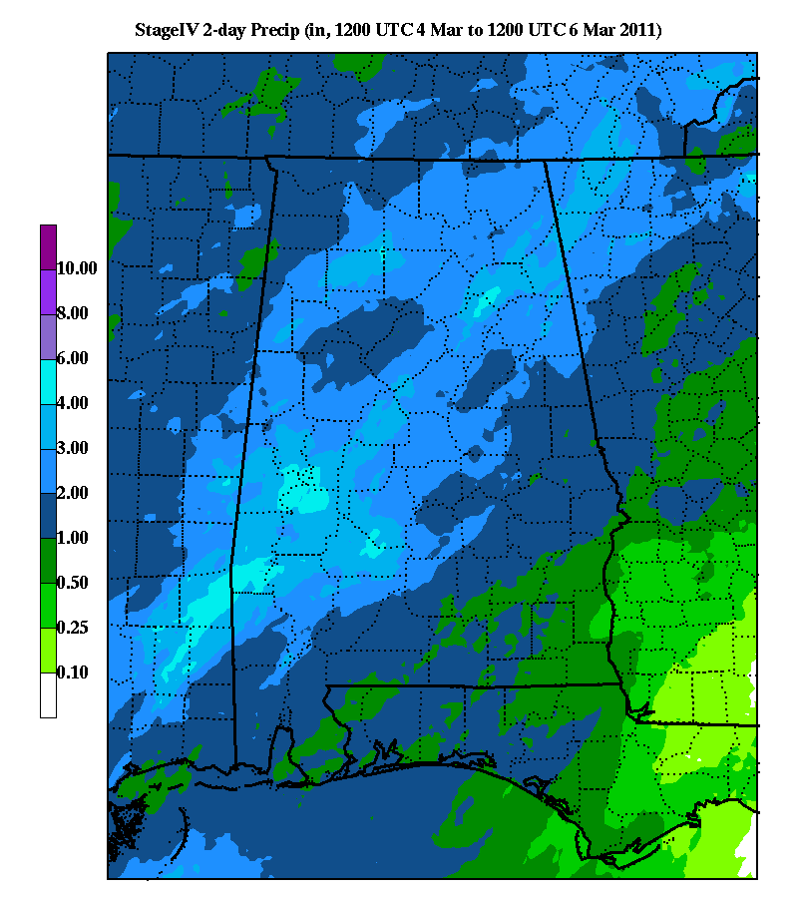
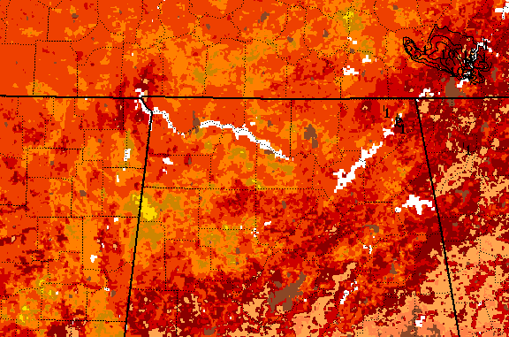
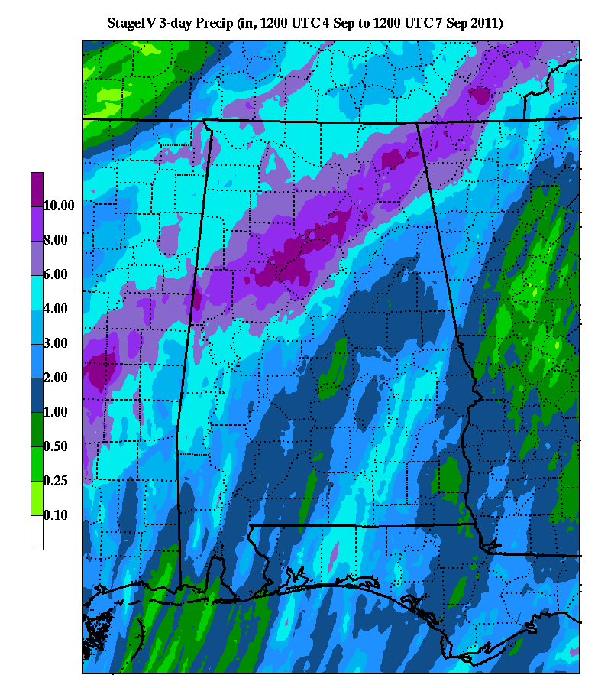
LIS for Monitoring Flood Potential
7
March Event
Moderate antecedent soil moisture
Moderate-heavy precipitation
September Event
Low antecedent soil moisture
Heavy precipitation

Slide 16
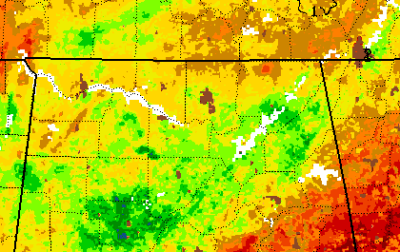
LIS for Monitoring Flood Potential
7
March Event
Moderate antecedent soil moisture
Moderate river flooding and numerous flooding reports
Moderate-heavy precipitation
September Event
Low antecedent soil moisture
Heavy precipitation
Isolated minor flooding

Slide 17
LIS for Monitoring Flood Potential
7
March Event
Moderate antecedent soil moisture
Moderate river flooding and numerous flooding reports
Moderate-heavy precipitation
September Event
Low antecedent soil moisture
Heavy precipitation
Isolated minor flooding
Contrasting antecedent soil moisture likely played a strong role in the different outcomes
Local, subjective analysis of several events suggests typical moderate-heavy synoptic rainfall events over deep-layer relative soil moisture values exceeding 55-60% will lead to more substantial moderate or heavier flooding events

Slide 18
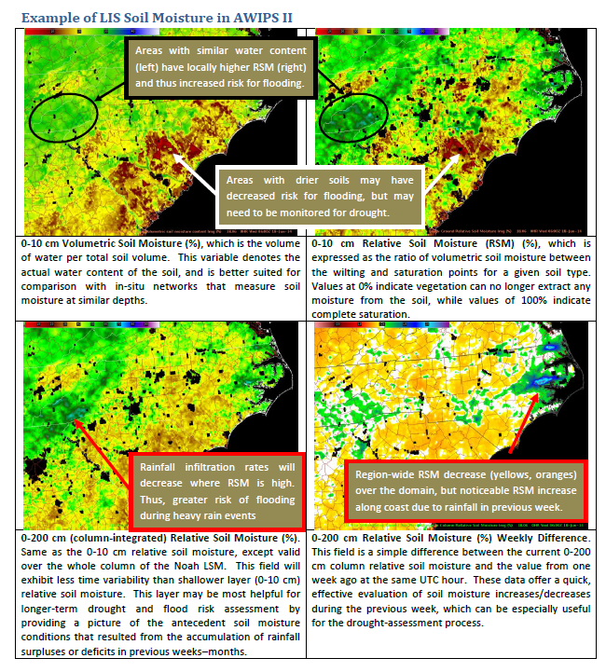
Ongoing LIS Assessment
8
Objective: Based on testbed success, evaluate SPoRT-LIS real-time soil moisture in decision support for drought monitoring and areal flood potential at additional NWS WFOs
Assessment details
  Time period: August − October 2014
  WFOs: Houston, Huntsville, Raleigh
  Training for assessment: LIS Primer and
  Applications modules; Quick Guide (right)
  AWIPS II config instructions provided
User feedback as of 23 Aug:
  8 surveys
  2 blog posts

Slide 19
Current / Future LIS Activities
9
Upgrade to LIS version 7
  Catches up SPoRT with NASA Goddard LIS development team
  Routine verification with Land surface Verification Toolkit (LVT)
Soil moisture climatology for anomaly products
  Put current soil moisture in proper context (e.g., NLDAS-2 products)
Incorporate global NESDIS/VIIRS GVF and GPM IMERG precip
  Code already written to ingest VIIRS GVF into LIS and WRF
  Extend to international applications
    OCONUS SPoRT partnerships and SPoRT/SERVIR collaboration
    Facilitated by these global S-NPP and GPM datasets
Transition soil moisture data assimilation into SPoRT-LIS
  SMOS and SMAP retrievals
  Clay Blankenship, next presentation
Collaborate with National Water Center/NOAA River Forecast Centers

Slide 20
Questions and Comments
10
Science Advisory Committee Meeting
26 – 28 August, 2014
National Space Science and Technology Center, Huntsville, AL

Slide 21
Backup Slides
11
Science Advisory Committee Meeting
26 – 28 August, 2014
National Space Science and Technology Center, Huntsville, AL

Slide 22
SPoRT-LIS Real-time Strategy
12
SEUS: NLDAS-2 + Stage IV
CONUS: NLDAS-2 + MRMS
1 June 2010
t − 4 days
t = current
Goal: Produce unique, high-resolution Noah LSM output for real-time modeling and situational awareness applications
  Constraint: Latency limitations of “optimal” analyses
  (NLDAS-2; 4-day latency)
  Need variety of atmospheric input to produce real-time output

Slide 23
SPoRT-LIS Real-time Strategy
12
SEUS: NLDAS-2 + Stage IV
CONUS: NLDAS-2 + MRMS
SEUS: GDAS + Stage IV
CONUS: GDAS + MRMS
GFS forcing
1 June 2010
t − 4 days
t = current
Goal: Produce unique, high-resolution Noah LSM output for real-time modeling and situational awareness applications
  Constraint: Latency limitations of “optimal” analyses
  (NLDAS-2; 4-day latency)
  Need variety of atmospheric input to produce real-time output
Strategy for SPoRT-LIS
  Run long-term LIS with optimal atmospheric analysis input
  Re-start with alternative analyses/short-term forecasts
  Continually cycle as new analyses become available in real time
  Incorporate real-time MODIS GVF in place of climatology GVF

Slide 24
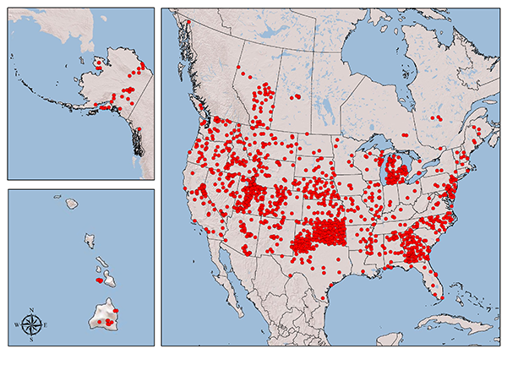
Verification with LIS7 / LVT
13
Texas A&M’s North American Soil Moisture Database (NASMD)
  Collection of various regional/state soil moisture in situ observations
  Supported by LVT / LIS7
Other variables for verification in LVT
  Flux tower networks (e.g., AmeriFlux, ARM-SGP)
  Snow networks (e.g., SNOTEL)
Variety of accuracy, spatial and
ensemble-based diagnostics
SPoRT is spinning up on LIS7 to
enable use of LVT for evaluating
LSM configurations and data
assimilation results
NASMD soil moisture obs

Slide 25
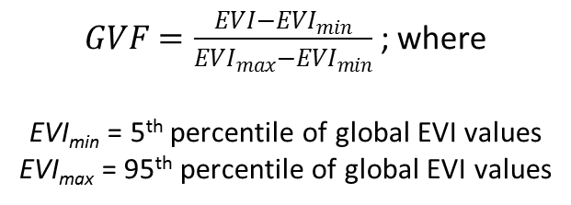
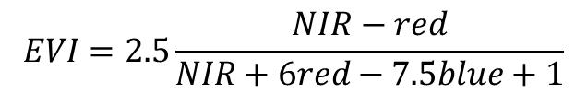

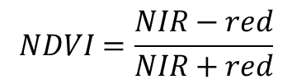
NOAA/NESDIS 4-km Global VIIRS GVF
14
Future daily real-time Green Vegetation Fraction (GVF) product
  Global coverage at 4-km resolution (10000 x 5000); netcdf4
  Updated daily with previous week of VIIRS swath data
    Surface reflectance composites based on view-angle adjustments
    Max value from previous 7 days retained for each daily composite
    GVF computed from Enhanced Vegetation Index (EVI); 3 channels (NIR, red, blue)
NESDIS/VIIRS formulation:
SPoRT/MODIS current formulation:
$$EVI=2.5\frac{NIR−red}{NIR+6red−7.5blue+1}$$
$$NDVI=\frac{NIR−red}{NIR+red}$$
$GVF=\frac{EVI−{EVI}_{min}}{{EVI}_{max}−{EVI}_{min}}$ ; where
EVI_{min} = 5th percentile of global EVI values
EVI_{max} = 95th percentile of global EVI values
$GVF=\frac{NDVI−{NDVI}_{min}}{{NDVI}_{max}−{NDVI}_{min}}$ ; where
NDVI_{min} = 5th percentile of NDVI values
for a given land-use type
NDVI_{max} = 90th percentile of NDVI values
for a given land-use type

Slide 26
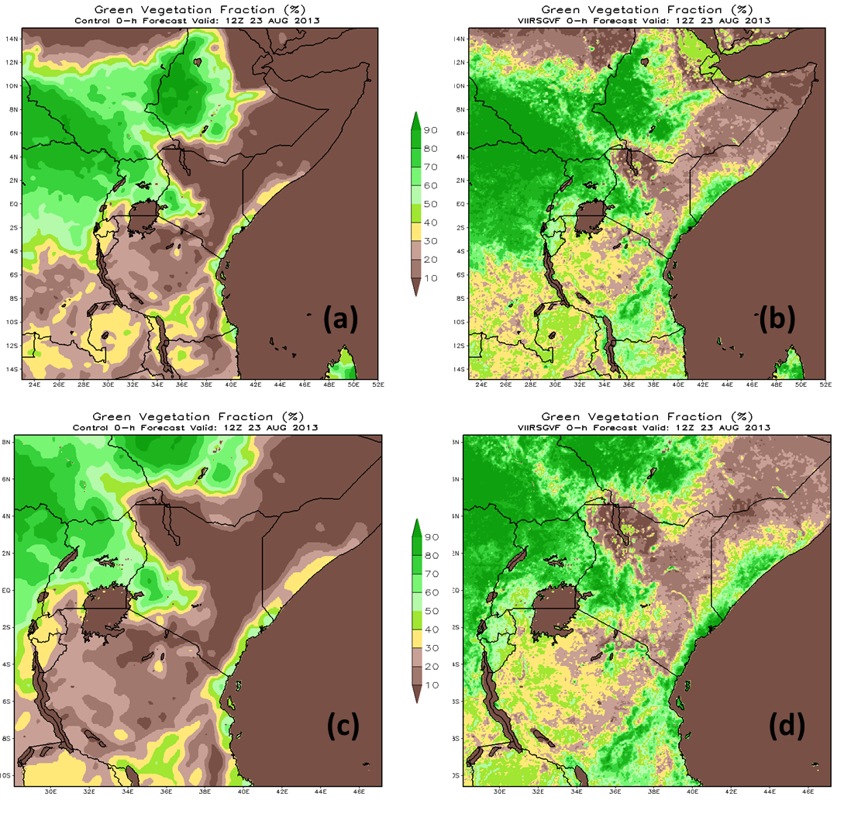
VIIRS GVF Test Run in WRF: 23 Aug 2013
15
Good correspondence
between GVF climo
(left columns) and
VIIRS GVF (right columns)
VIIRS GVF provides much
more detail in complex
terrain of east Africa

Slide 27
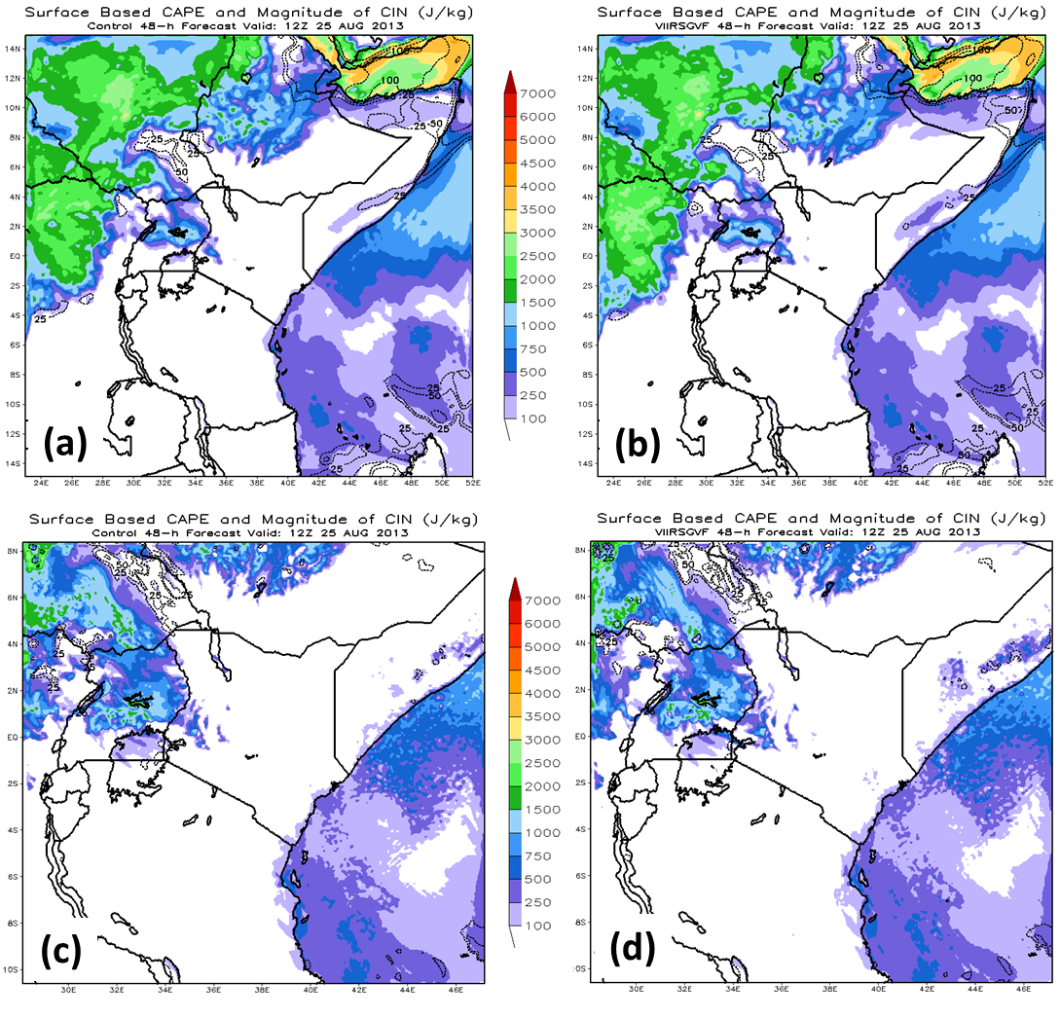
VIIRS GVF Test Run in WRF: 23 Aug 2013
15
Good correspondence
between GVF climo
(left columns) and
VIIRS GVF (right columns)
VIIRS GVF provides much
more detail in complex
terrain of east Africa
Simulated sfc CAPE shows
sensitivity to different
input GVF (as expected)
Red = lower VIIRS GVF
than climo → lower CAPE
Blue = higher VIIRS GVF
than climo → higher CAPE

