Slide 1
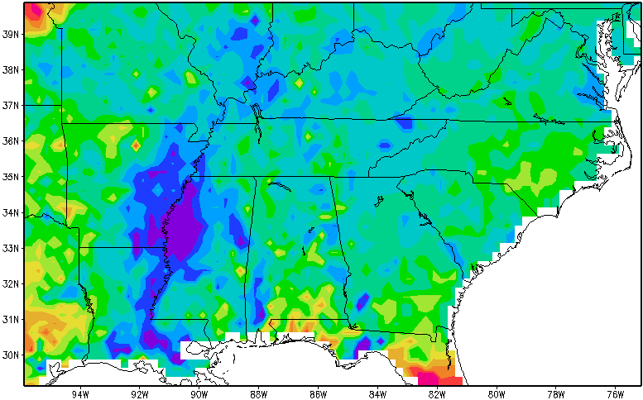
Soil Moisture Data Assimilation
Science Advisory Committee Meeting
26 – 28 August, 2014
National Space Science and Technology Center, Huntsville, AL

Slide 2
Goals Soil Moisture Data Assimilation
Forecast Challenge
Available moisture affects humidity, sensible/latent heating, diurnal heating rate, and convection
Objective
Improve soil moisture estimates for regional NWP applications and situational awareness
Improve LIS soil moisture by assimilating satellite retrievals
Use LIS output to initialize NWP
Sensible HF
2m Dewpoint
PBL Height
CAPE
Impact of using high-resolution LIS boundary conditions in WRF (rather than NAM fields). From Case et al. 2008
Notes:
J. L. Case, W. L. Crosson, S. V. Kumar, W. M. Lapenta, and C. D. Peters-Lidard, “Impacts of high-resolution land surface initialization on regional sensible weather forecasts from the WRF model,” J. Hydrometeor., vol. 9, no. 6, pp. 1249-1266, December, 2008.

Slide 3
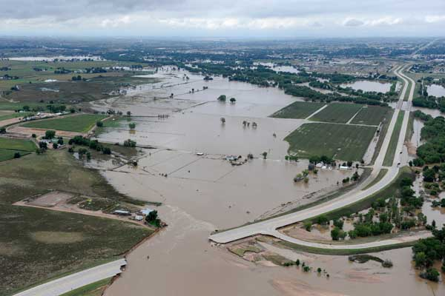
Other Applications
Drought Monitoring
Flood Forecasting
Streamflow prediction
Public health

Slide 4
SMOS and SMAP
L-band radiometers (and radars) can be used to estimate soil moisture in the top layer (~5 cm) of soil.
L-band (1.4 GHz) sees deeper in the soil, and performs better in dense vegetation than higher frequency instruments like AMSR-E (6-10 GHz).
Currently assimilating retrievals from European Space Agency’s Soil Moisture and Ocean Salinity (SMOS) satellite
Preparing for assimilation of NASA Soil Moisture Active/Passive (SMAP) retrievals
Launch in early 2015
Combined (radar/radiometer) product available at a higher resolution (9 km)
We are members of the SMAP Early Adopters team
Notes:
Advantages of the science team include: contact with science team and staying up on the learning curve; allowing us to share early results and keep up with other groups’ research; and increased recognition which may benefit proposals

Slide 5
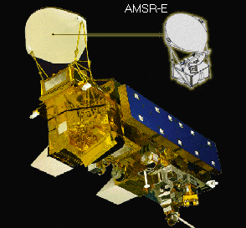
Soil Moisture Instruments
Name | AMSR-E | SMOS Soil Moisture and Ocean Salinity | SMAP Soil Moisture Active/Passive
Agency | NASA/JAXA | ESA | NASA
Launch |  | 2009 | Nov. 2014
Orbit | Polar | Polar | Polar
Sensor Type | Passive | Passive | Passive | Active | Combined
Frequency | 6.9 GHz (C-band) | 1.4 GHz (L-band) | 1.41 GHz | 1.2 GHz
Resolution | 56 km | 35-50 km | 36 km | 3 km | 9 km
Accuracy | 6 cm³/cm³ | 4 cm³/cm³ | 4 cm³/cm³ | 6 cm³/cm³ | 4 cm³/cm³

Slide 6
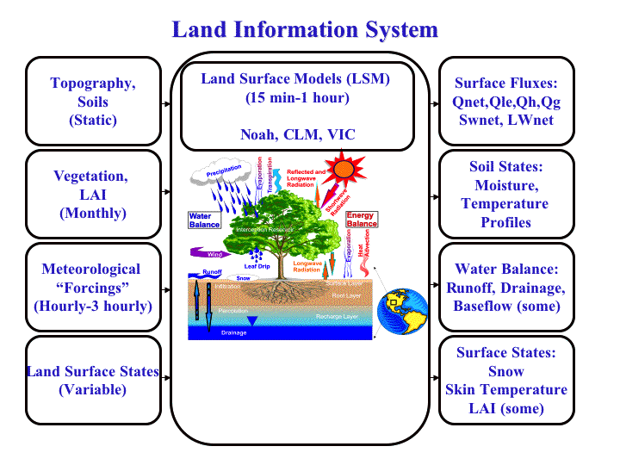
Soil Moisture Assimilation in LIS
Noah LSM (in LIS) produces “operational” soil moisture/temperature states and surface fluxes of water and sensible/latent heat.
Use data assimilation of SMOS/SMAP soil moisture retrievals to improve model states
We plan to implement this in near-real-time SPoRT LIS to improve product for end users
Notes:
“operational” = used by end-users for decision-making

Slide 7
Data Assimilation with EnKF
LIS has a built in Ensemble Kalman Filter
EnKF combines the model background and observations to make analyses
Relative weighting is controlled by the specified observation error and by the ensemble spread
Implemented EnKF assimilation of SMOS data
Read SMOS data files
QC based on model state and data flags for precipitation, RFI, data quality, frozen soil, snow cover, and high vegetation
Ongoing experiments to tune run-time settings including perturbations, number of ensemble members
Bias correction by CDF Matching
Capability of implementing landcover-dependent correction.

Slide 8
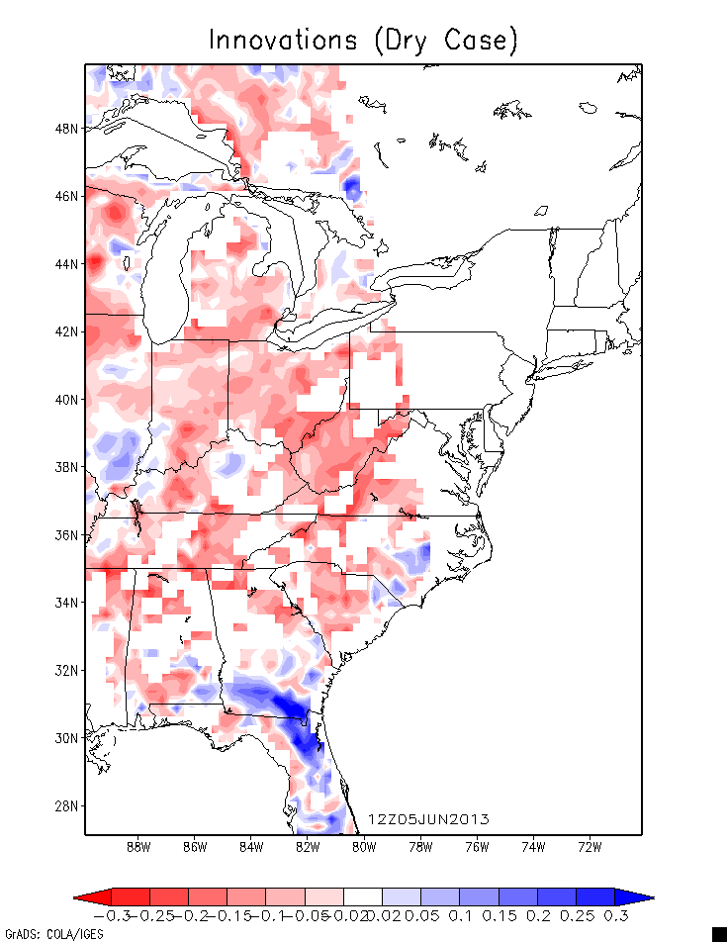
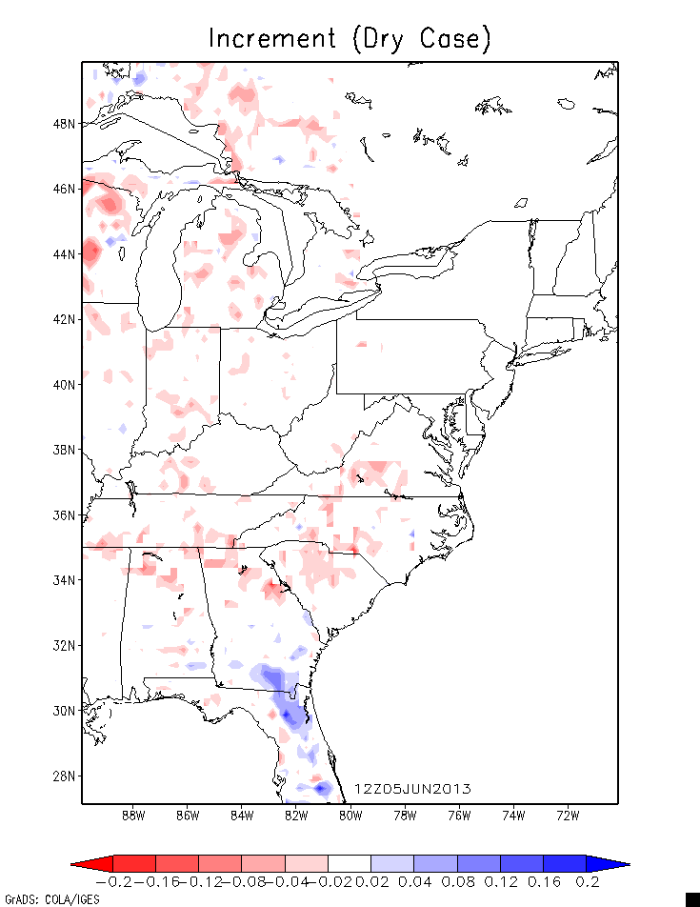
Bias Correction
Initial tests had large dry bias in observations, so that only extreme rain events had correct sign.
Discussions with other researchers confirmed need for bias correction
Innovations (Uncorrected)
Implemented CDF matching correction for SMOS retrievals.
Assimilating retrievals (not radiances) lets us use established methodology
Increments
Uncorrected innovations (observations minus model) and increments. Red=dry bias in retrievals.

Slide 9
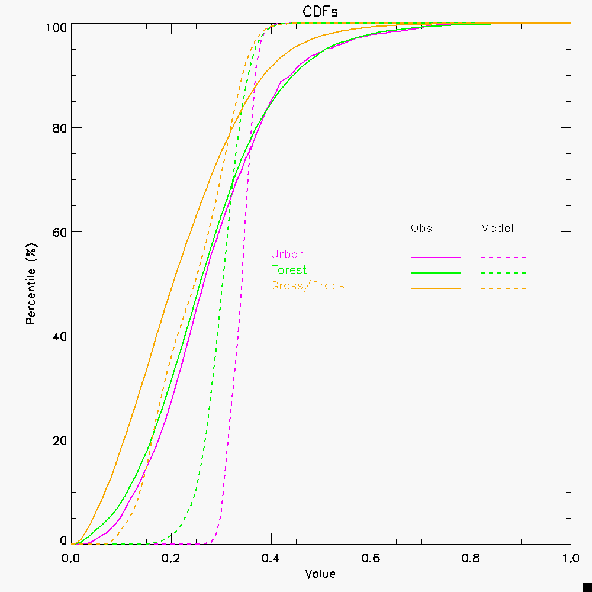
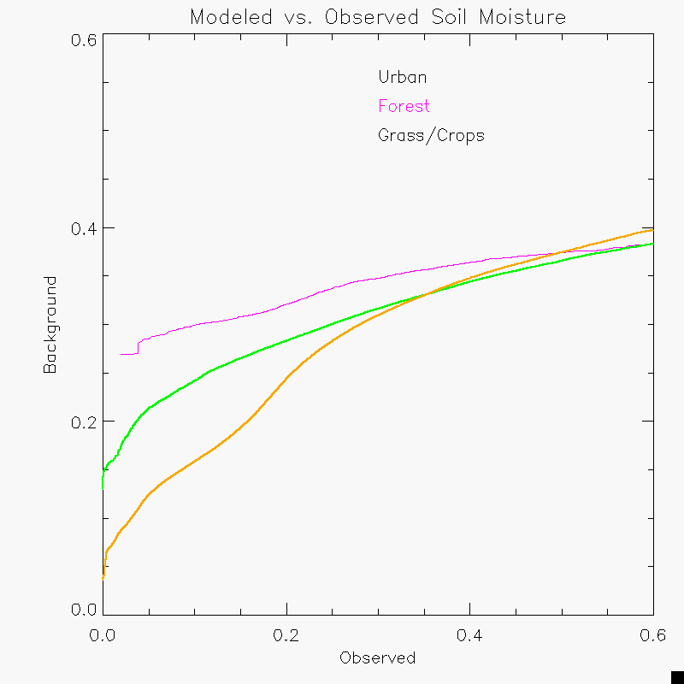
Bias Correction
CDFs of Soil Moisture Observations and Model
Correction Curves for 3 vegetation categories
LIS can apply point-by-point correction curves. To increase the background dataset size, we are aggregating points by landcover type. We will also explore correction at each point and aggregating by soil type.
9

Slide 10
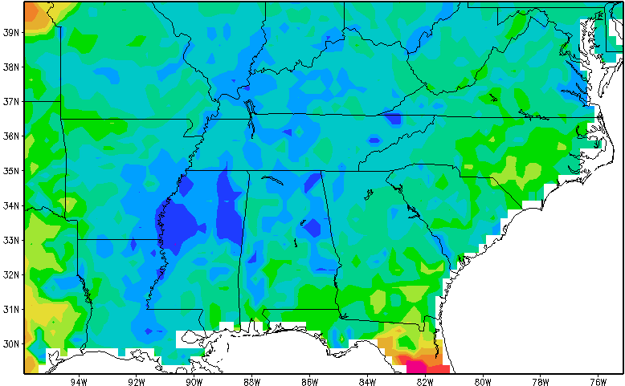
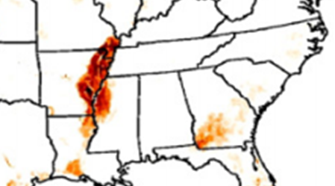
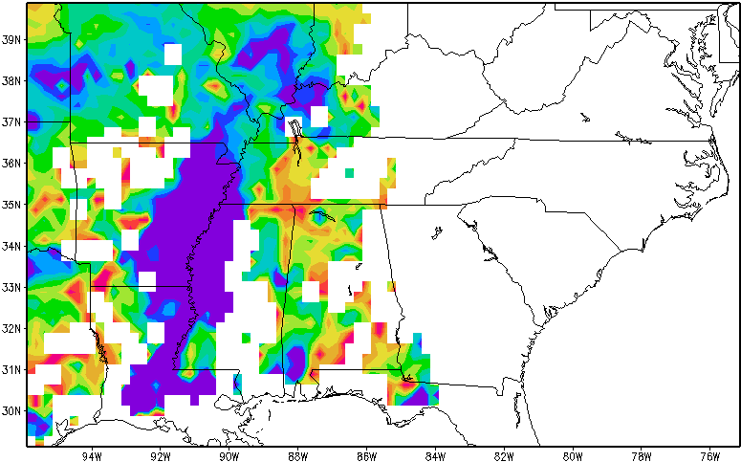
Irrigation Case Study
Modeled Soil Moisture
Map of Irrigation Areas
Model soil moisture concentration forced only by precipitation and misses magnitude of irrigation-saturated MS Valley
April 1, 2013
SMOS Observations of Soil Moisture
From U. of Frankfurt-FAO (Ozdogan 2001)
SMOS observes irrigated fields
Test Impact on NWP using coupled LIS-WRF
Implications for regional climate modeling
Impacts of changing land-use, precipitation patterns
Integrated Soil Moisture Analysis
Blended analysis of model and observations better represent irrigated area and should result in improved weather and hydrologic modeling

Slide 11
Current and future plans
Testing DA for higher resolutions (grid cells << observation size)
Use in SPoRT high-resolution LIS runs.
Validate analyses
TAMU North American Soil Moisture Database
Test Impact of assimilating SMOS retrievals on NWP using coupled runs in NU-WRF
Impact on boundary layer for a quiescent day
Active convection case
Validation over a longer time period
Look at both sensitivity and forecast accuracy
Implement with SMAP retrievals
Questions?

Slide 12
Thank You
Questions?

Slide 13
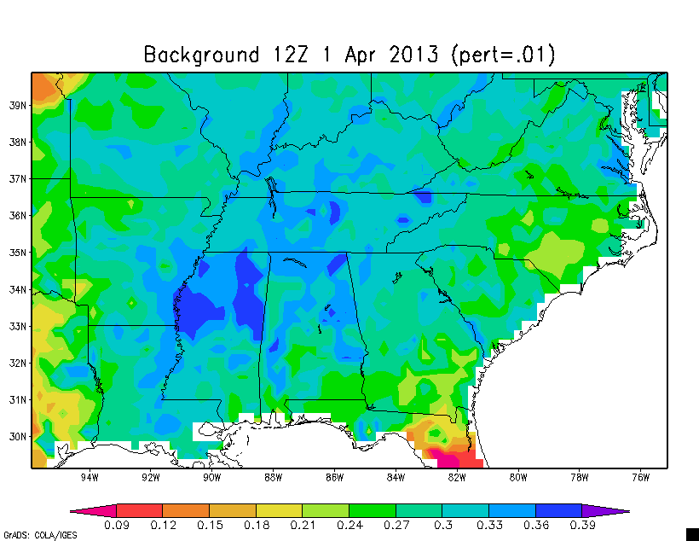
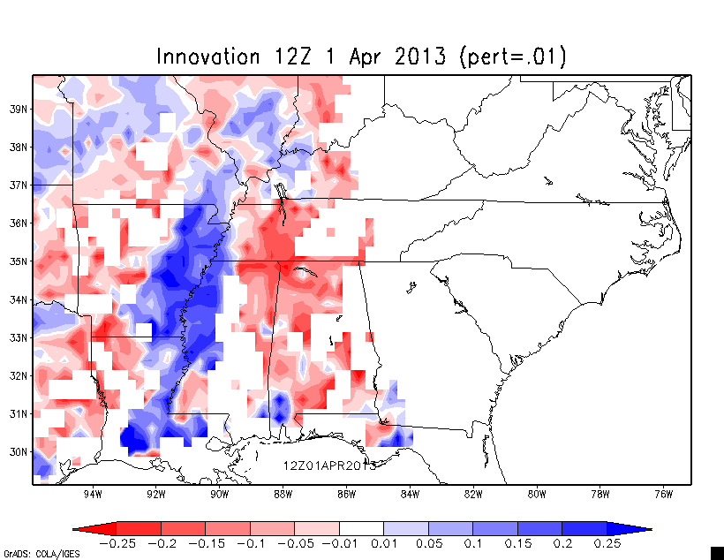
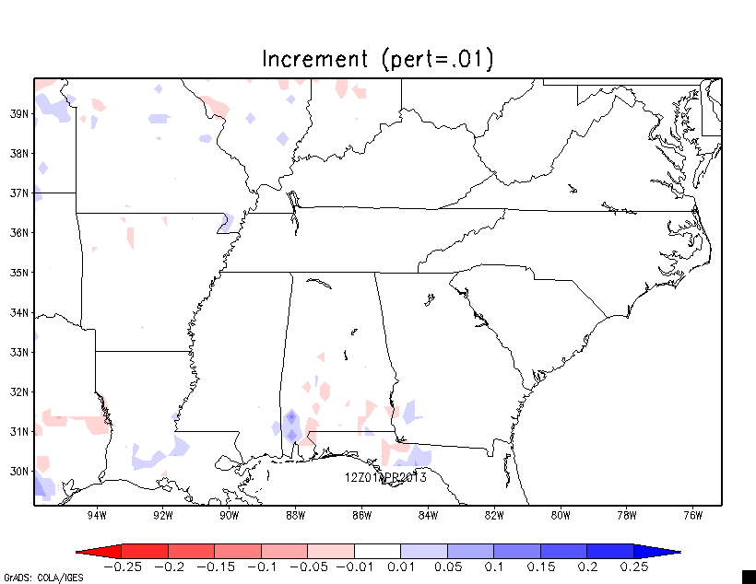
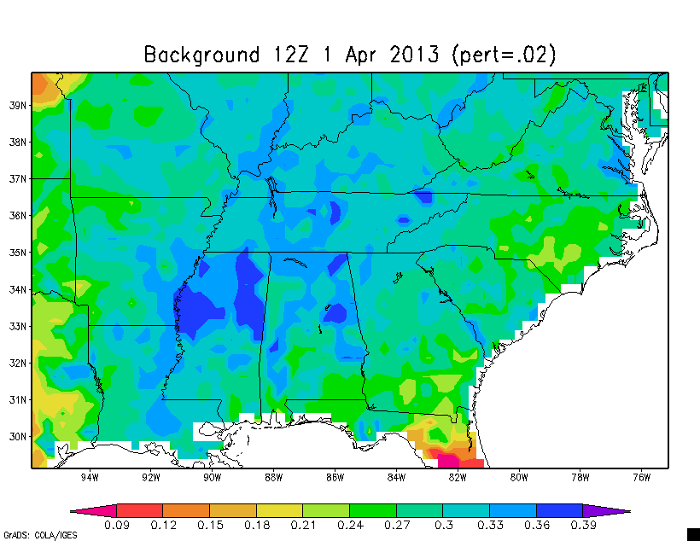
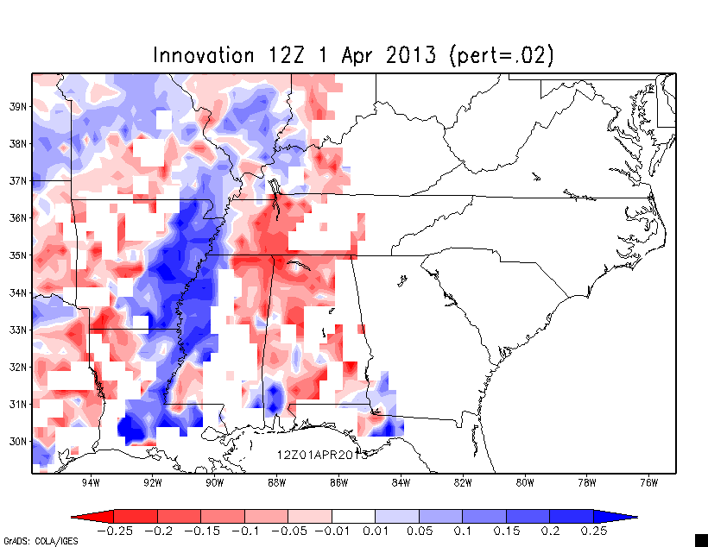
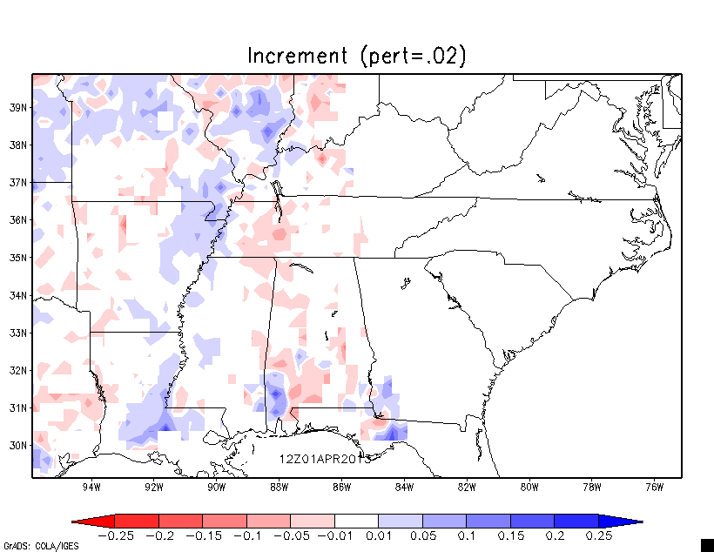
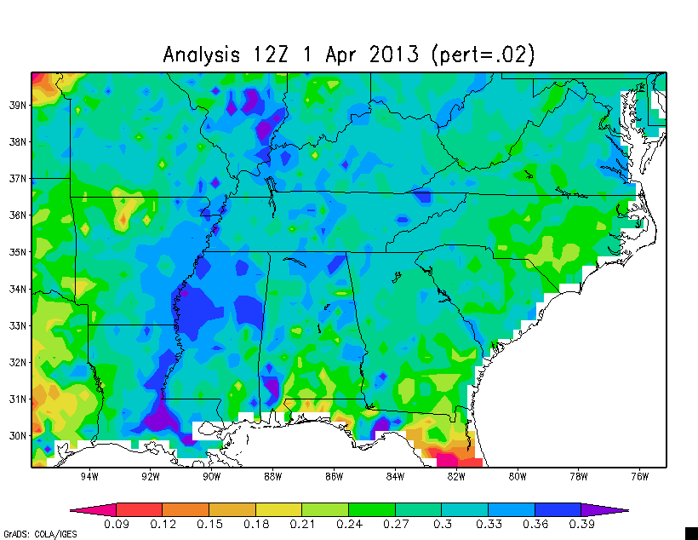
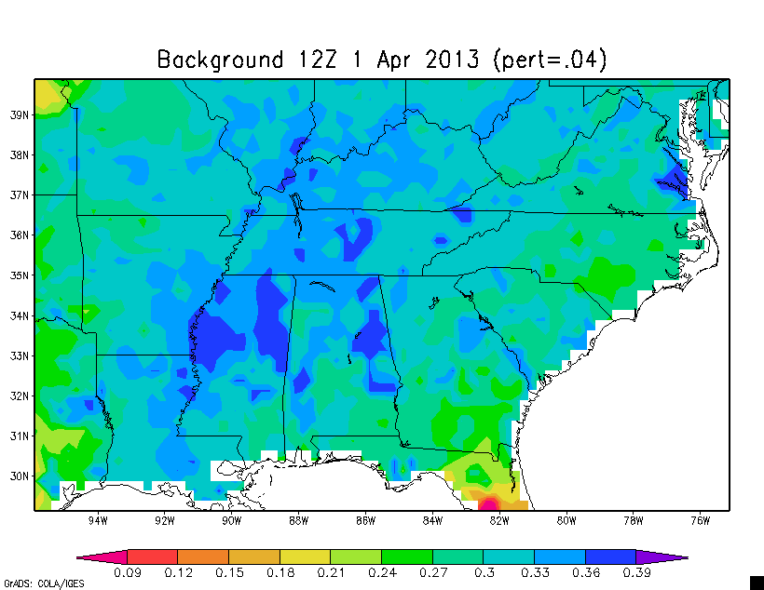
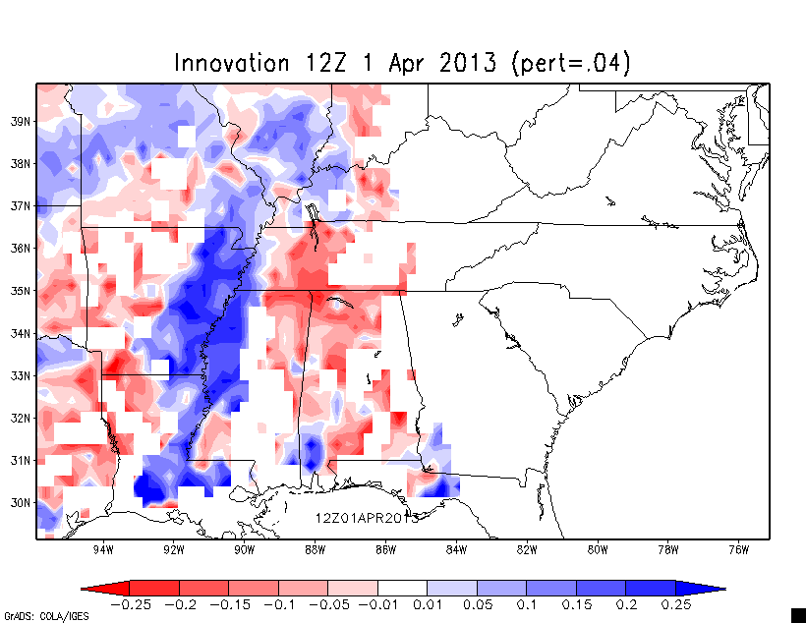
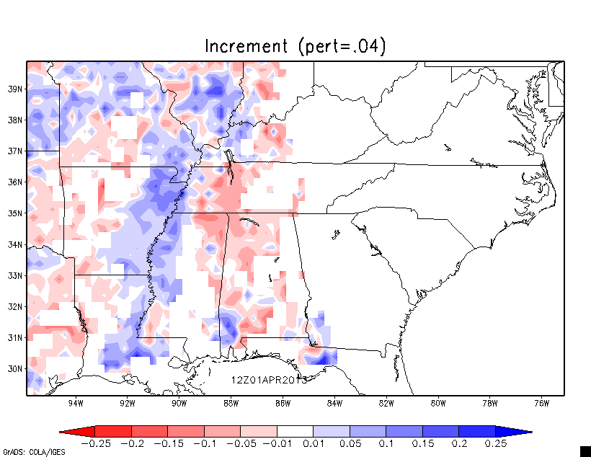
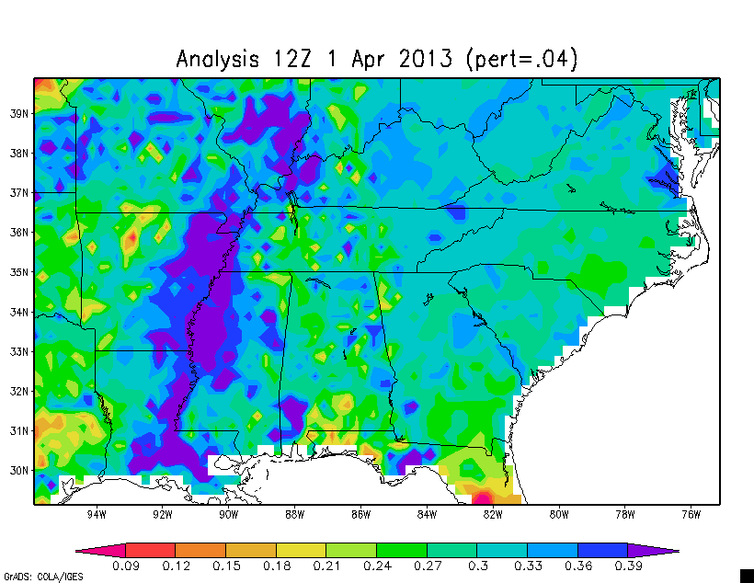
Perturbation Tests

