Slide 1
Meeting Expectations, SPoRT Overview, Review of 2014 SAC

Slide 2
Objectives/Benefits of SAC
SPoRT scientists – improve focus of activities
NASA Headquarters program manager – help guide program emphasis
NOAA program managers – help guide program emphasis to better serve needs
SAC – scientists / managers learn more details of the SPoRT program for expanding potential collaborations
Beneficiaries, partners, and end users – know that SPoRT is determined to provide best quality / services to those who rely on us!

Slide 3
Meeting Expectations
SPoRT team will provide:
Comprehensive review of major SPoRT activities since the last SAC meeting (August 2014)
Details and highlights of other activities have been reported on in various reports (electronic copy distribution of 2014 Annual Report, product assessments, and quarterly reports)
Opportunity for end user feedback on SPoRT Research to Operations (R2O) process (Session 5 on Wednesday morning)
Each major scientific session includes 45 minutes to allow the SAC to document comments and start draft of report
Recommendations from 2016 SAC will be used to craft updated Strategic Plan

Slide 4
Meeting Expectations
SAC will provide:
Feedback on SPoRT strengths/weaknesses, accomplishments/failings, and opportunities/threats
Guidance on organizational structure, partners, end users (as necessary) including potential new SAC members
Direction and emphasis of future activities
Preliminary feedback at end of the review
Summary report that provides recommendations for the future (to be delivered within 3 months of the meeting)

Slide 5
SPoRT Mission and Goals
Mission: - Apply NASA and NOAA measurement systems and unique Earth science research to improve the accuracy of short-term weather prediction at the regional / local scale
Goals:
Evaluate and assess the utility of NASA and NOAA Earth science data and products and unique research capabilities to address operational weather forecast problems
Provide an environment which enables the development and testing of new capabilities to improve short-term weather forecasts on a regional scale
Help insure successful transition of new capabilities to operational weather entities for the benefit of society

Slide 6
SPoRT Vision
Vision - to become a focal point and facilitator for the transfer of NASA Earth science datasets, products, and technologies to operational decision makers with emphasis on short-term forecasting on the regional and local scale
Development
Implementation
Adaptation and Growth
New Partnerships
Phase I
Phase II
Phase III
Phase IV
FY02
FY05
FY10
FY15
FY20
paradigm, relationships, forecast problems
user interaction, assessment,
end user focus
expand NOAA/NWS partnerships, new data display systems, new forecast problems
expand to select new government / international partners, new data dissemination, new Earth Science missions
SPoRT has many new opportunities and faces robust challenges in Phase IV of the program. We have the leadership, scientific / training expertise, and ambition to lead NASA and the broader science community to address their research to operations (R2O) / applications (R2A) needs to benefit society.

Slide 7
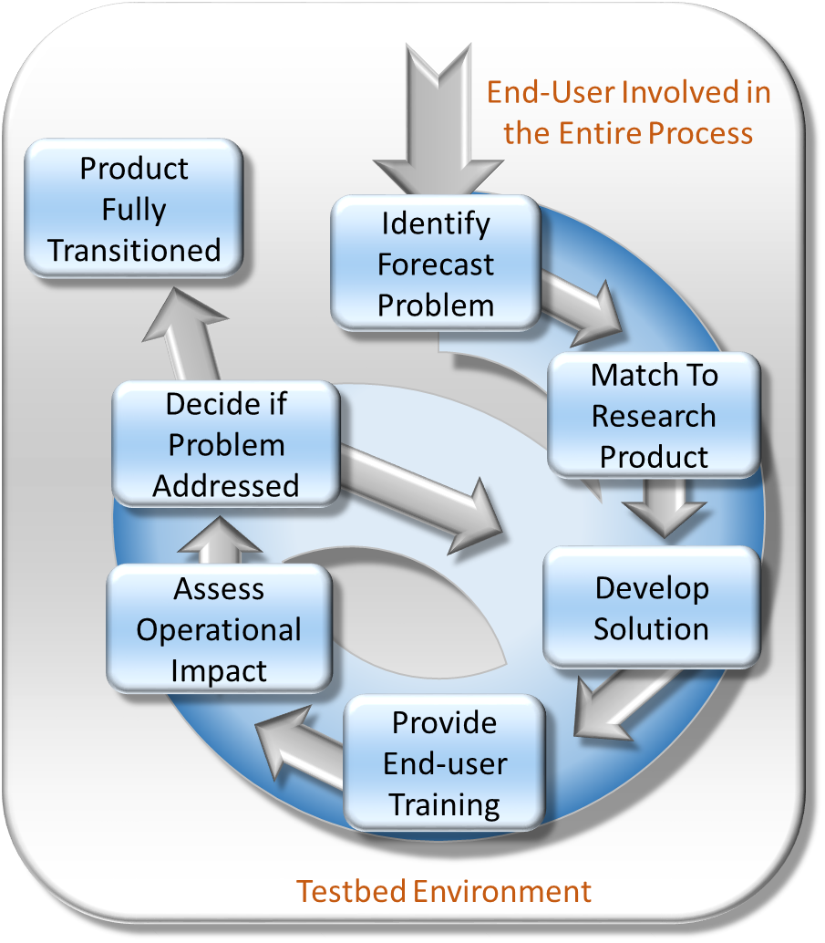
SPoRT R2O/O2R Paradigm
Bridge the “Valley of Death”
Can’t just “throw data over the fence”
Maintain interactive partnerships with help of specific advocates
Integrate into user decision support tools
Create product training
Perform targeted product assessments
Concept has been used to successfully transition more than 40 satellite datasets to operational users for nearly 15 years
Other groups in the community have adopted this paradigm

Slide 8
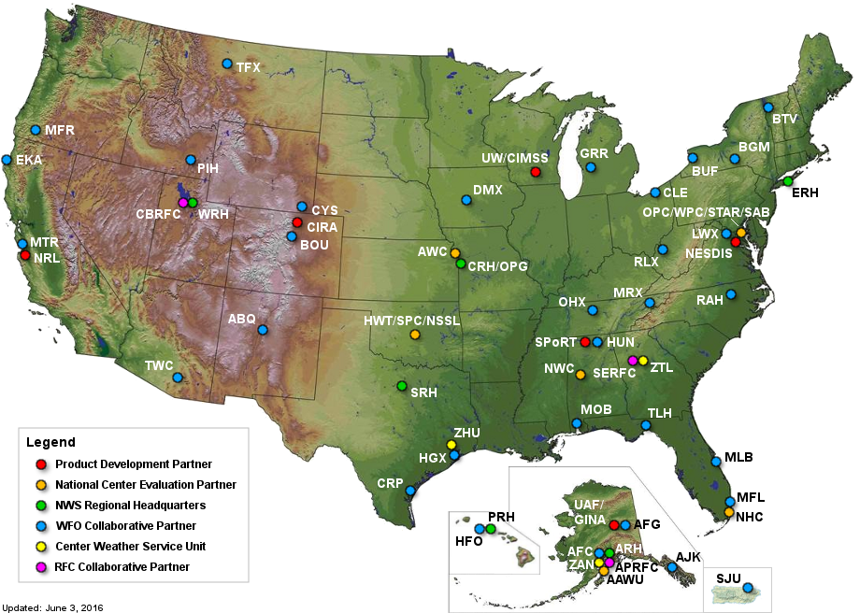
Current Partnerships
National Centers
for Environmental Prediction
Over 30 NWS WFOs
and All Regional Headquarters
Aviation Weather Center
NOAA Cooperative Institutes
as Data Delivery and
Product Development Partners
SPoRT collaborates with NOAA Cooperative Institutes to develop and distribute products to partnering NWS WFOs and National Centers/Testbeds, providing unique data and modeling capabilities to support daily forecasting operations

Slide 9
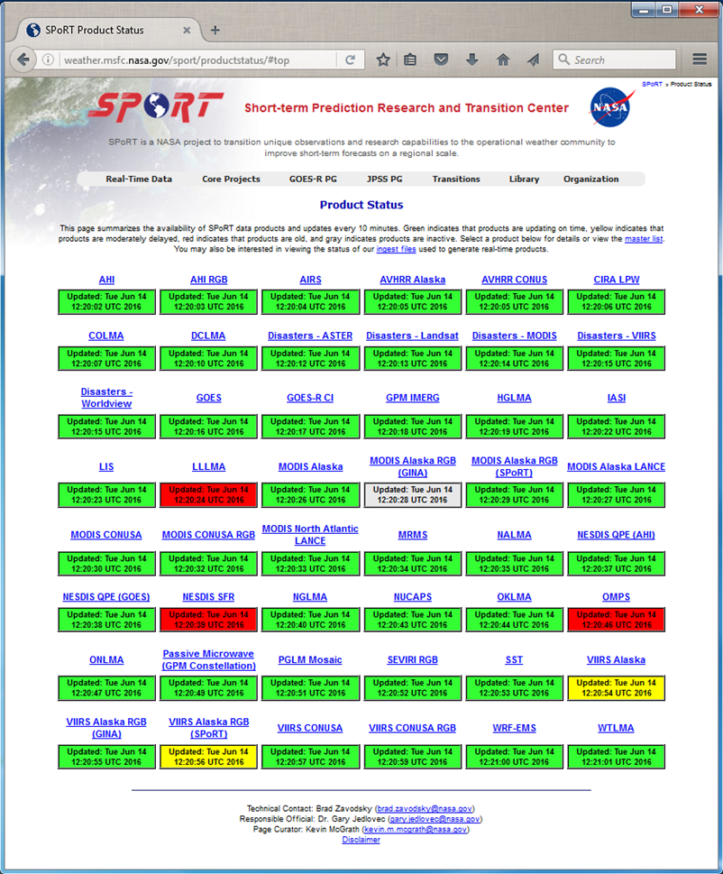
Data Approach
SPoRT provides experimental data to NWS users by LDM, FTP, and WMS depending on application
Uses “backdoor” to provide data into AWIPS
Not a 24/7 “operational” data provider but do our best to maintain data feeds because product reliability is a key to product demonstration and use by operational forecasters
Monitor our product ingest and status for all experimental products going to a customer

Slide 10
SPoRT Expertise
Remote Sensing
Perform targeted research activities to exploit unique capabilities of NASA satellites and technologies to solve specific weather forecasting challenges
Lightning
Modeling and Data Assimilation
Disasters
Decision Support Systems
Support for product dissemination to AWIPS, N-AWIPS, WMS, etc.
Transitions, Training, and Assessment
Apply unique R2O/O2R paradigm for transitioning data and obtaining valuable feedback from NWS forecasters

Slide 11
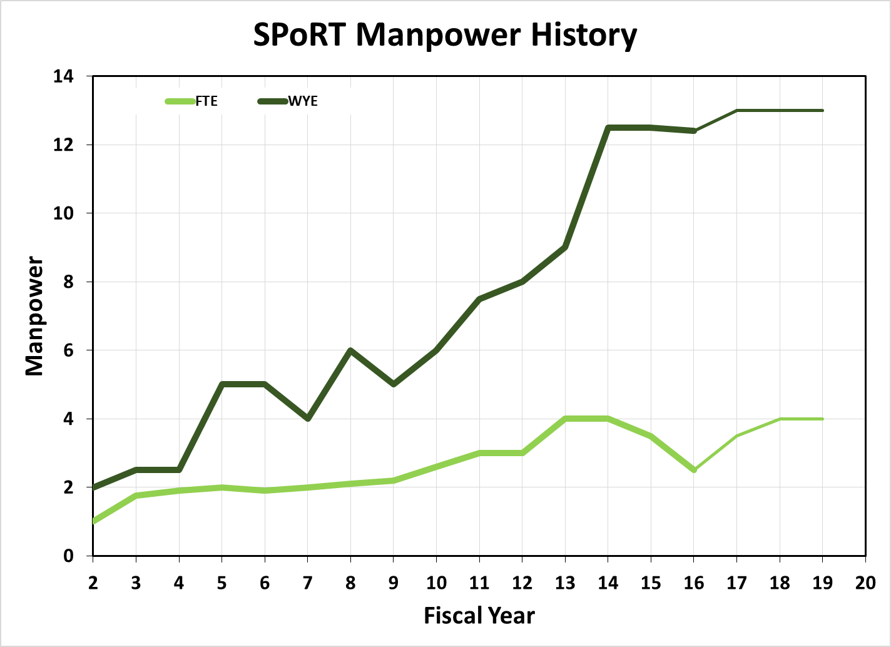
SPoRT Team Makeup
Civil service scientists (4 current) – Zavodsky, Molthan Co-PIs
Former PI, Dr. Gary Jedlovec, became MSFC ESO Manager in February 2016
Former Co-PI, Jason Burks, took opportunity with NOAA’s Meteorological Development Lab (MDL) in April 2016
New remote sensing scientist position in the final stage of being filled
Hydrology modeling position to be posted in USAJobs soon
Research associates - USRA, UAH, Jacobs, Raytheon, ENSCO (13)
Graduate Students – UAH (1)
Two recent graduate students were hired by SPoRT as UAH research associates
Applications Integration Meteorologist – NWS (1)
IT systems administration – Dynetics (3; shared ESO)
Resource analyst – Al-Razaq (1; shared ESO)
Equivalent Staffing
2.5 FTE
12.4 WYE

Slide 12
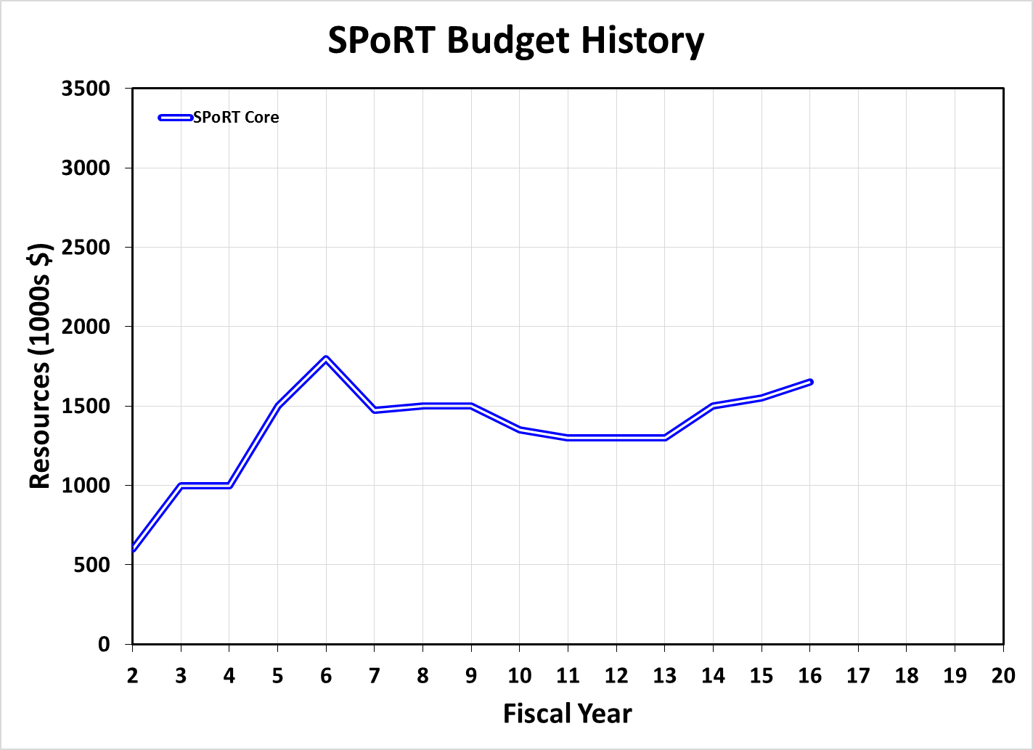
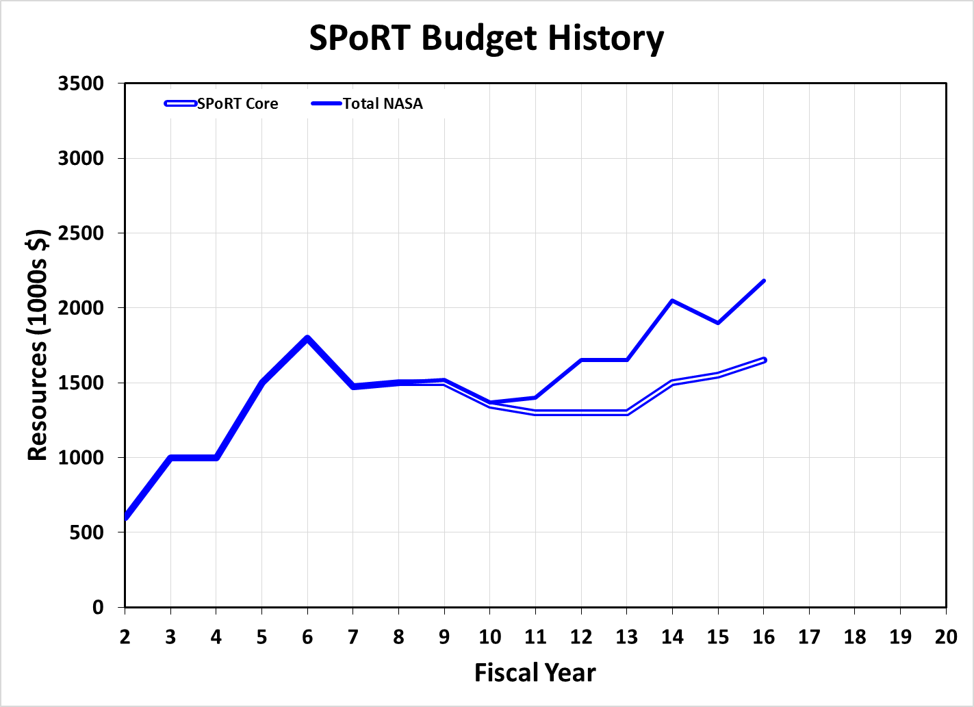
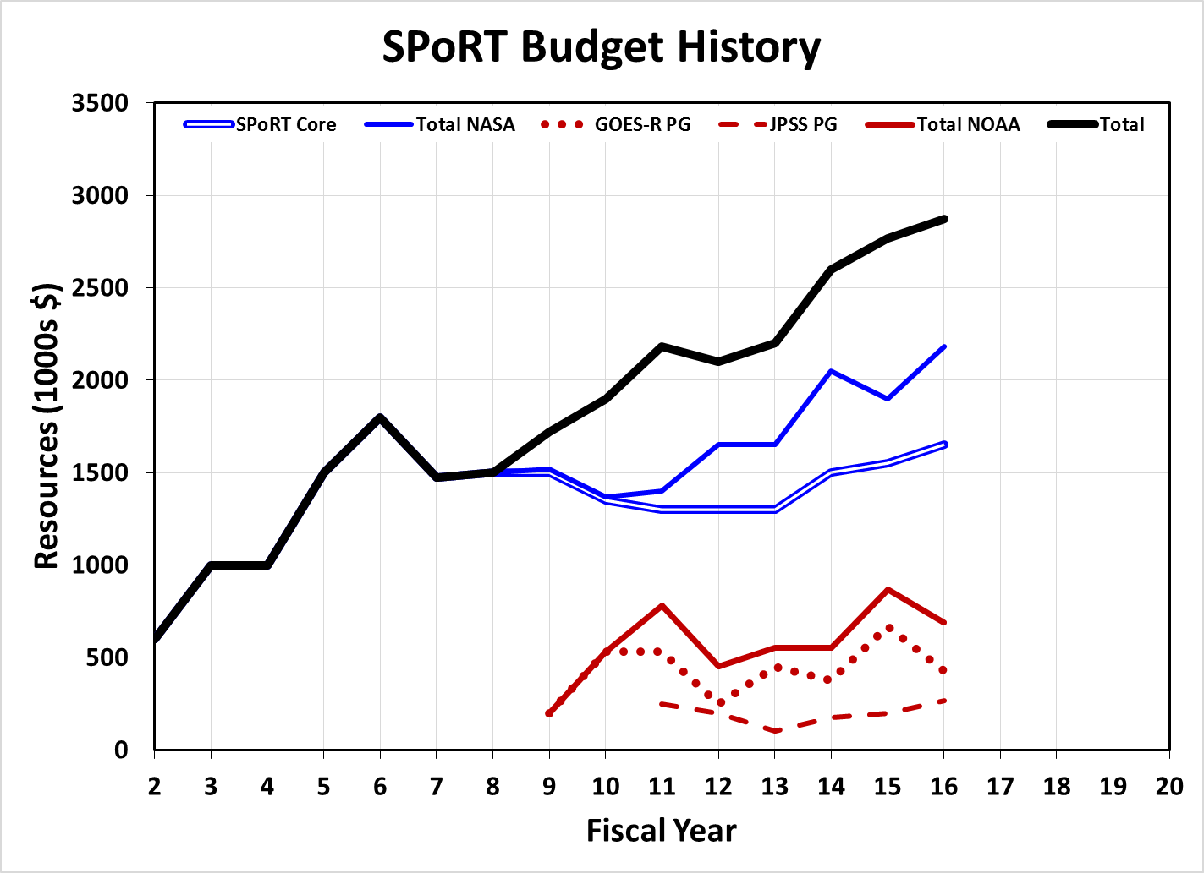
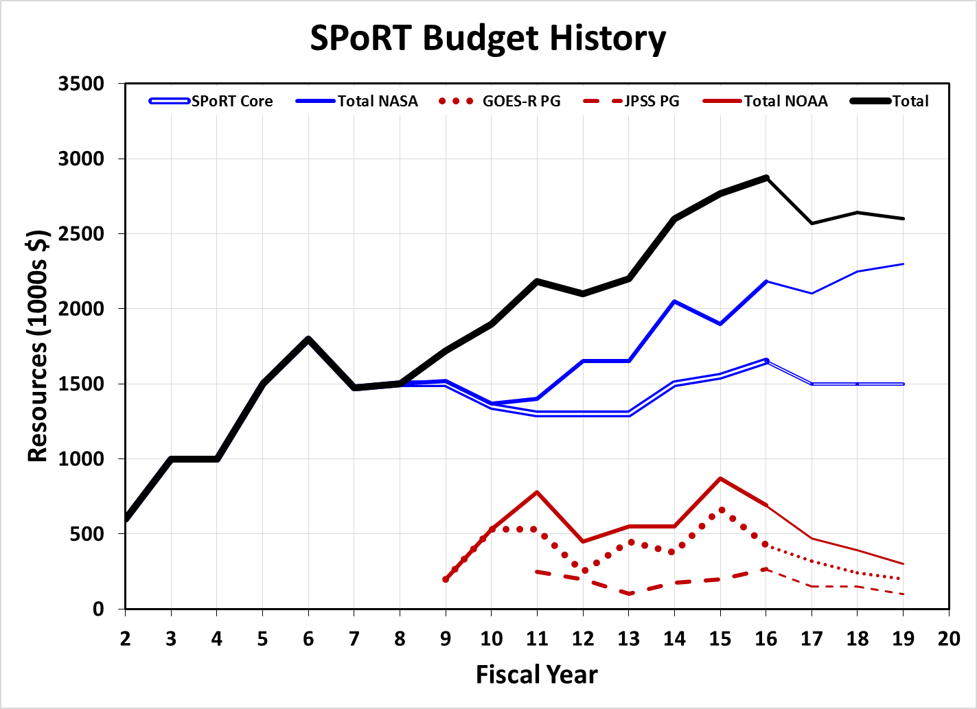
SPoRT Budget Perspective
SPoRT was established in 2002 through an unsolicited proposal from MSFC scientists (Lapenta, S. Goodman, and Jedlovec) as a complement to JCSDA
15th year of successful transition to operations (and applications) activity
SPoRT receives yearly directed funding from NASA R&A Weather Focus Area (Tsengdar Lee) based on 5 year proposal (current proposal is FY15-19)
SPoRT has collaborated with SERVIR and writes competitive ROSES proposals to expand core capabilities/partnerships
SPoRT receives NOAA Reimbursable dollars from the Satellite Proving Grounds through MOU (GOES-R, since 2009) and through Risk Reduction proposals (JPSS, since 2011)
Total of 18 WBS codes for FY16
Potential opportunity to offset NOAA funding reduction by becoming more active in NASA Applied Science activities
Uncertain future of NOAA Satellite PG funding after launch of GOES-R and JPSS

Slide 13
SPoRT Metrics of Success
Successful transitions
Transition and sustained use of products and research capabilities with discernible impact on decision making
Community recognition
Peer recognition as community partner and go-to place for transition of research capabilities to the operational weather community
Adoption of SPoRT paradigm, training methods, and assessment processes
Supportive feedback from end users and collaborative partners
Publications
Peer-reviewed publications for research techniques and transitional capabilities
Publication of assessment reports that include input from collaborative partners and end-user community
Notes:
Successful transitions:
More than 180 references of SPoRT product mentions in AFDs since September 2015.
Community recognition:
GINA now using SPoRT paradigm;
Greg Mandt saying that he has talked to NOAA Cis about working with forecasters in the same way as SPoRT;
Interactive participation with NWS partners, use of SPoRT blog to share use of data
Publications:
Refer to handout; we have 15 peer-reviewed pubs since last SAC Meeting
Have completed 5 assessment reports; 2 pending

Slide 14
SPoRT Metrics of Success
Expanded R2O/R2A collaborative opportunities
Ability to obtain additional funding through peer-reviewed proposal process (e.g., ROSES) or additional directed work from NASA or NOAA program managers
Recognition of SPoRT projects as NASA Early Adopters
Agency and management recognition of success
Individual and group achievement awards
Inclusion of SPoRT accomplishments in the annual GPRAMA report to Congress
Highlights of SPoRT accomplishments by management at internal and external meetings and to the general public
Notes:
Expanded R2O/R2A collaborative opportunities
Agency recognition of success
Awards:
Andrew Molthan: Presidential Early Career Awards for Scientists and Engineers; MSFC Director’s Commendation Honor Award
Jason Burks: MSFC Research and Technology Award
Nepal Earthquake Disaster Response Team: MSFC Group Achievement Honor Award
Lori Schultz: Excellence Award for MSFC S&T Office
Clay Blankenship, Jon Case, Brad Zavodsky: Federal Laboratory Consortium Technology Transfer Award—SMAP Early Adopters
Highlights:
Positive feedback from MSFC Center Management Committee and MSFC Science & Technology Office management during regular briefings
Contributions to NASA HQ Monthly Science Review briefings
Inclusion in AGU/AMS Townhall presentations (Freilich/Kaye)
SPoRT-LIS highlighted in Administrator Bolden’s blog for SC floods

Slide 15
2014 SPoRT SAC Recommendations
SPoRT should look for ways to strengthen their strategic relationships with NASA HQ, NESDIS HQ and NWS HQ to maintain a clearly defined role in transitioning satellite data into NWS operations – regular visits by ESO manager and SPoRT Co-Pis with NASA program managers; briefings to NWS Director; invited presentations at NOAA Testbed / Proving Ground Meetings; visit by NESDIS Director (next week)
SPoRT should seek opportunities for closer interactions with NWS National Centers and other modeling centers…[e.g., ] work with the NWC, WPC, RFCs… – engagement / collaboration with NWC and select RFCs; evaluation of SPoRT-LIS products for flash flood guidance currently ongoing at WPC
SPoRT may want to consider centralized training material outlet with an automatic notification service. SPoRT has a lot of experience communicating with the users using multiple channels. SPoRT may expand these channels to include notification service. – development of a new Training Web Page and Applications Library; development of an Integrated Training concept for AWIPS
…more SPoRT interactions and collaboration with other satellite research groups like NOAA-CREST (CUNY) and NESDIS STAR. – have worked with NESDIS STAR on Snowfall Rate and QPE product assessments; new initiatives related to NUCAPS data; additional opportunities through ROSES NASA Data for Operation and Assessment (NDOA) solicitation

Slide 16
2014 SPoRT SAC Recommendations
…work with the forecasters to find ways to make [RGBs] easier [to use]. Consider such actions as putting a graphic on the image to help identify the type of weather phenomenon in the image. – have developed new dynamic training that allows forecasters to interact with RGB imagery
Web Based Data Delivery, OGC core infrastructure, and cloud architecture directions are very exciting and visionary. The SAC enthusiastically endorse and encourage the movement into OGC/WBDD. Continue to pursue this direction. – continued development of WMS systems and data delivery
Consider using standard approaches such as drought percentiles/indices through formal tools such as LVT, for situational awareness applications. – new real-time percentile product for drought available to select WFOs; implemented Land Verification Toolkit as part of SPoRT-LIS processing and on-the-fly validation
SPoRT should note that the operational approach in data assimilation is to assimilate radiance. Keep in mind that part of the “O2R” concept (using operational system to conduct research where practical) is to enable effective Research-to-Operations transitions. – have reduced focus on assimilation of retrieved profiles; working to identify new areas of collaboration with JCSDA on improving radiance assimilation techniques through ROSES proposals

Slide 17
2014 SPoRT SAC Recommendations
SPoRT should look to cultivate relationships with the Satellite Liaisons – SPoRT now has Dr. Geoffrey Stano as a formal SPoRT Satellite Liaison; enables better interaction with other liaisons, National Centers, and Proving Grounds
Consider using standard approaches such as drought percentiles/indices through formal tools such as LVT, for situational awareness applications. – new real-time percentile product for drought available to select WFOs; implemented Land Verification Toolkit as part of SPoRT-LIS processing and on-the-fly validation
SPoRT should note that the operational approach in data assimilation is to assimilate radiance. Keep in mind that part of the “O2R” concept (using operational system to conduct research where practical) is to enable effective Research-to-Operations transitions. – have reduced focus on assimilation of retrieved profiles; working to identify new areas of collaboration with JCSDA on improving radiance assimilation techniques through ROSES proposals
Expand collaboration efforts with non-traditional partners and explore emerging service sectors will likely broaden SPoRT’s reach, visibility, and value. As long as staffing and resources allow these activities to remain viable without adversely impacting existing commitments, see no reason to oppose this direction. – engagement with select new partners and strategic vision for broader community engagement to be discussed at this meeting

