Slide 1
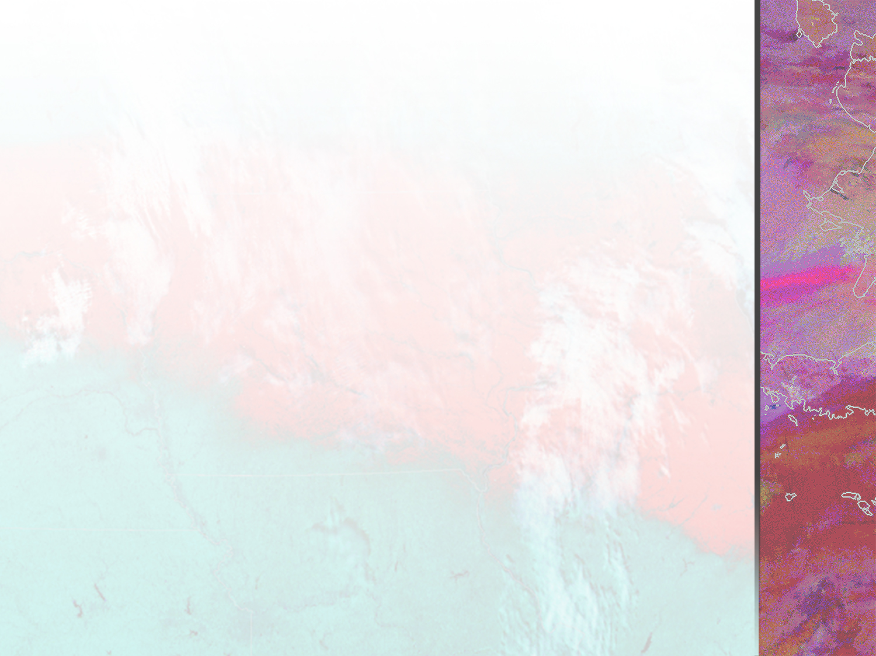


Overview of Recent
Remote Sensing
Activities
Science Advisory Committee Meeting 26 July 2016
Dr. Emily Berndt
Contributions from: Nicholas Elmer, Kevin Fuell, Frank LaFontaine, Anita Leroy, Kevin McGrath, Aaron Naeger, Andrew Molthan, Lori Schultz, Matt Smith, Geoffrey Stano, Brad Zavodsky

Slide 2
Outline
Global Precipitation Measurement Products
Passive Microwave Snowfall Rate Product
Aerosol Optical Depth Composite Product
Hyperspectral Infrared Sounder Ozone Products
Gridded NOAA-Unique Combined Atmospheric Processing System (NUCAPS) Activities
Multi-Spectral (RGB) Composites

Slide 3
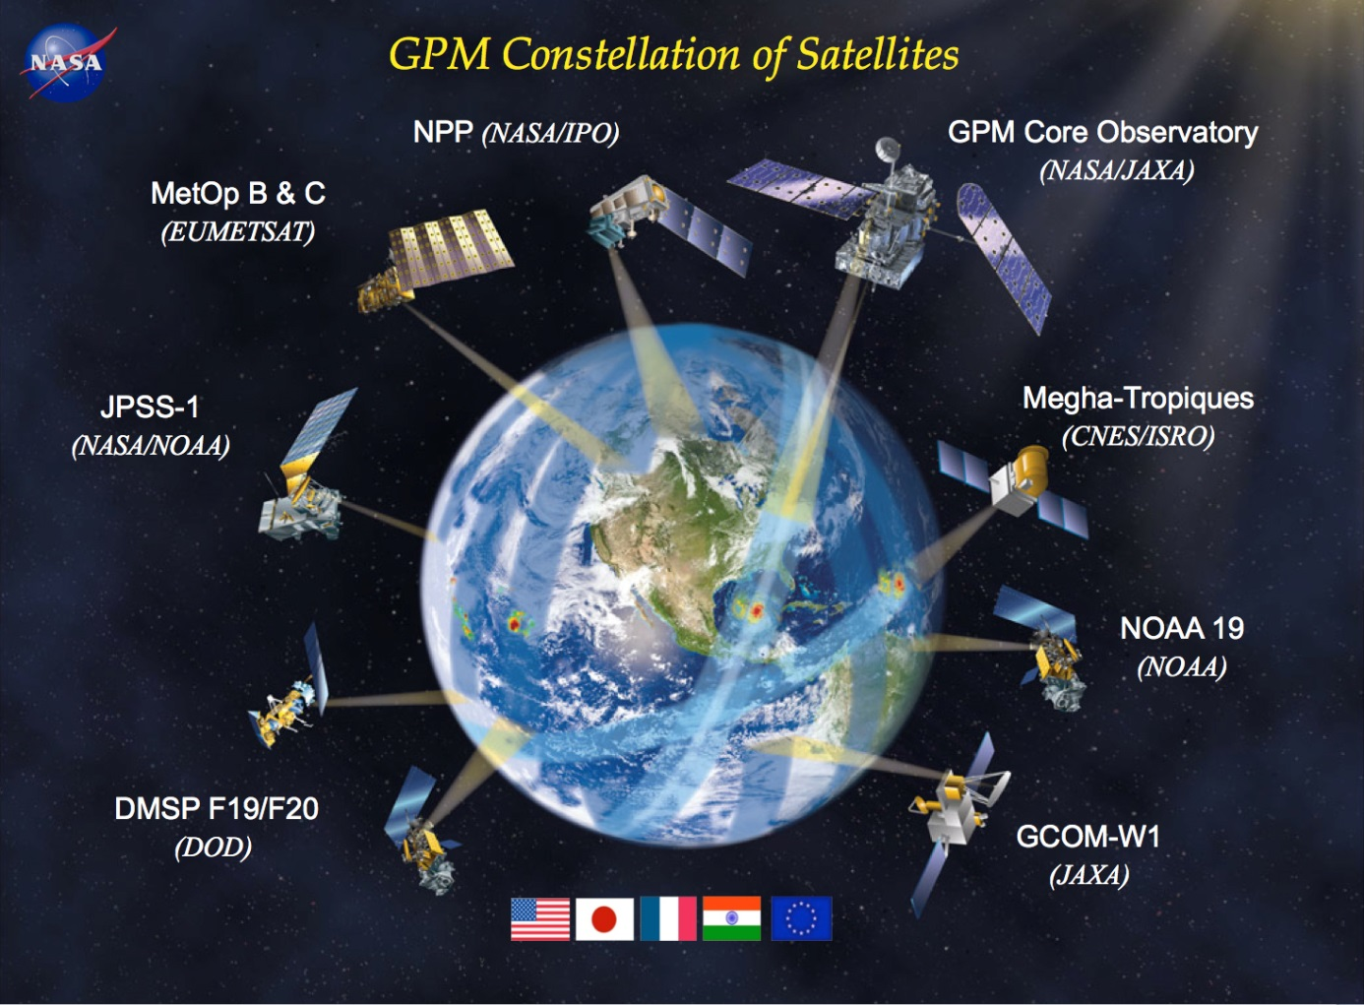
The GPM Constellation
GPM Core (NASA)
GMI
DPR
GPM Constellation Partner Instruments
ATMS (NASA/NOAA)
MHS (NOAA)
AMSR2
SSMIS
SAPHIR
Notes:
SAPHIR is on the “Megha-Tropiques” satellite. Six channels: 183 +/- (6x)

Slide 4
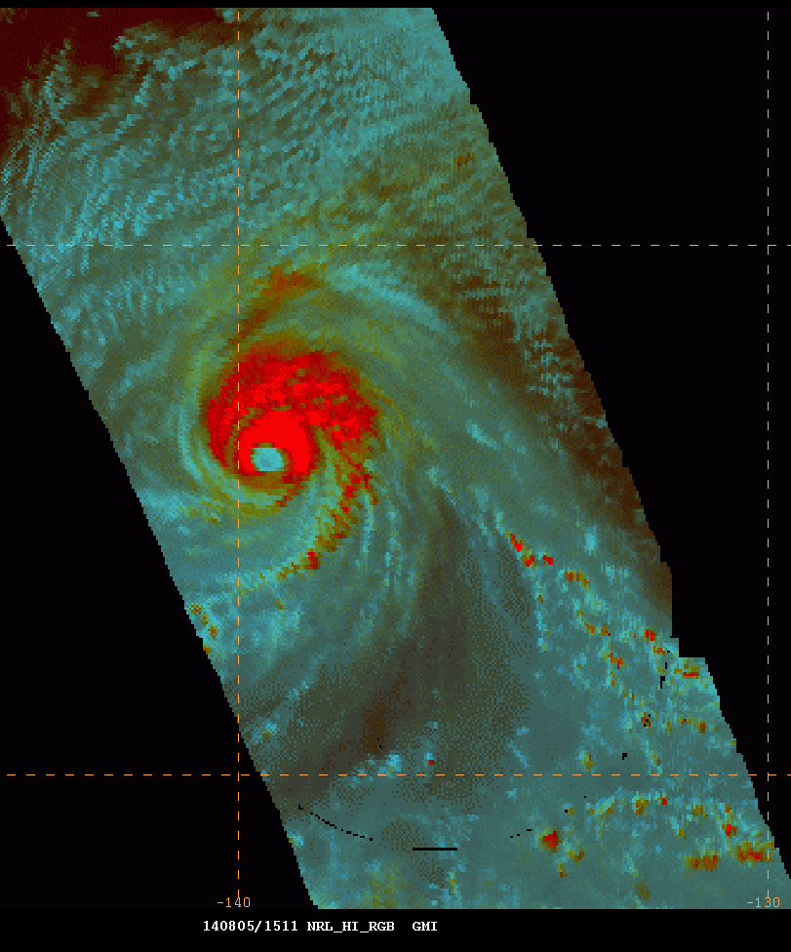
Early GMI Applications
Products provided to NHC and CPHP
  37 GHz H/V/RGB
  89 GHz H/V/RGB
Forecaster Feedback
  Mark DeMaria (NHC) commented that the inclusion of passive microwave data into the NHC/Tropical Proving Ground was one of the most broadly accepted and welcomed data sets.
  Forecaster at CPHC on Hurricane Iselle (Aug 2014): “We've definitely been looking at the GMI imagery on NAWIPS and through the NRL TC webpage”.
89GHz RGB from GPM of Hurricane Iselle in E. Pacific as viewed from NHC NAWIPS display

Slide 5
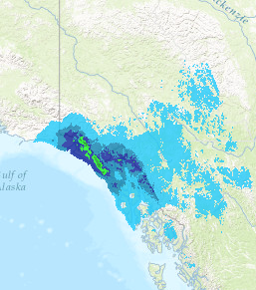

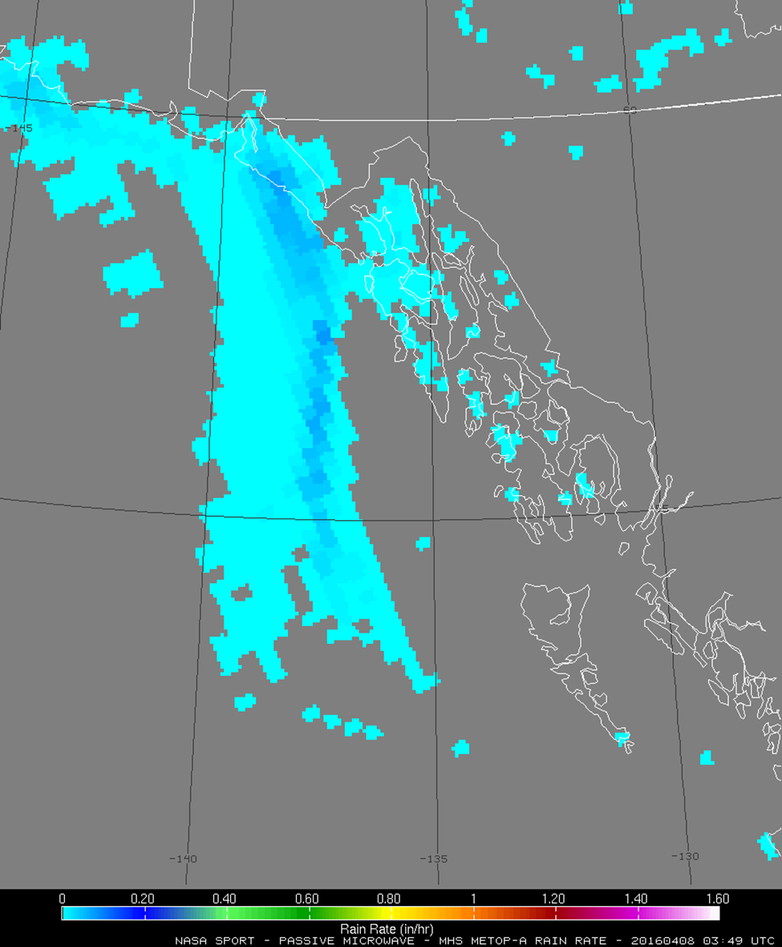
GPM Level 2 Rain Rate
Operational Uses:
Radar- or data-void regions, including offshore
Forecasting/nowcasting rain rates for areal flooding
Assessments:
Southwest US (monsoon)
West Coast (offshore monitoring of atmospheric rivers, fronts)
Alaska WFOs (offshore and radar-void precipitation observations)
Actionable Feedback:
Frequency of overpasses “loopable” at high latitudes
Provides confidence when more than just a “snapshot” is available
24-hr Accumulation
08 April 2016
Juneau, AK
GPM Rain Rates
08 April 2016 (0349 UTC)

Slide 6
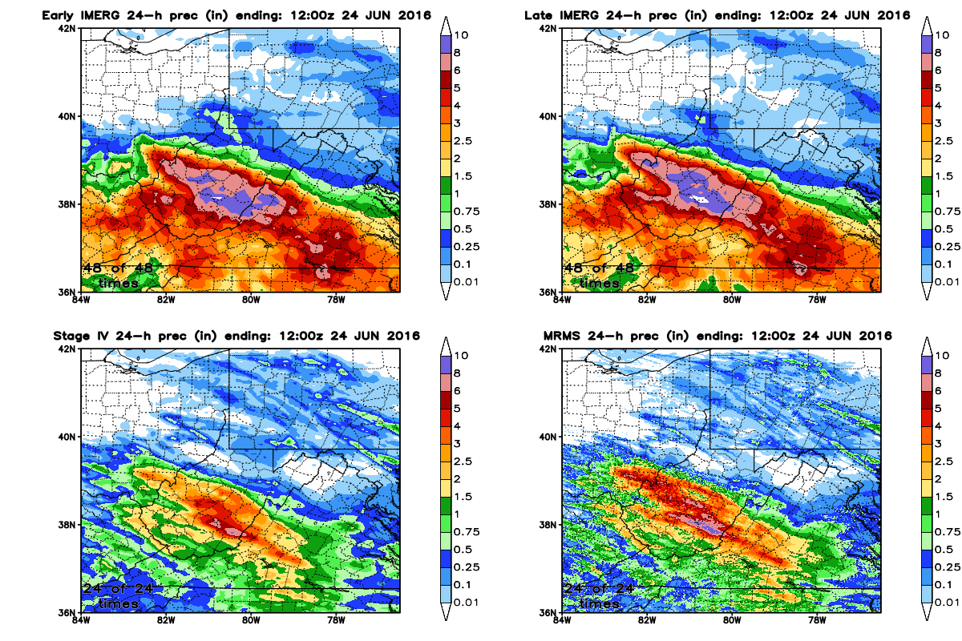
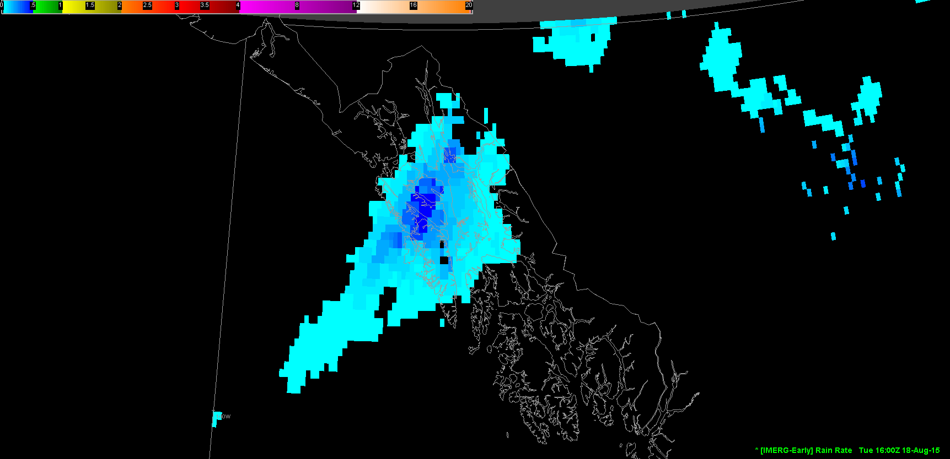
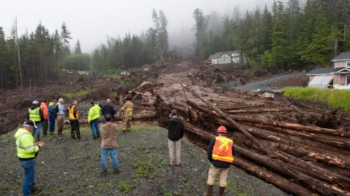
GPM IMERG
24-hr Accumulations
24 June 2016
Available products:
30-min rain rate, 1-hr, 3-hr, 6-hr, 12-hr, and 24-hr accumulations
Applications:
Early product available for forecasting/nowcasting flooding
Late and Final products available for post-event analysis
Potential use in hydrological modeling
Assessments:
River Forecast Centers, Alaska WFOs
Actionable Feedback:
60N-60S domain is limiting
Best use in radar-void regions
James Poulson / The Daily Sitka Sentinel
Area of landslides near Sitka on Baranof Island
(18 Aug. 2015)

Slide 7
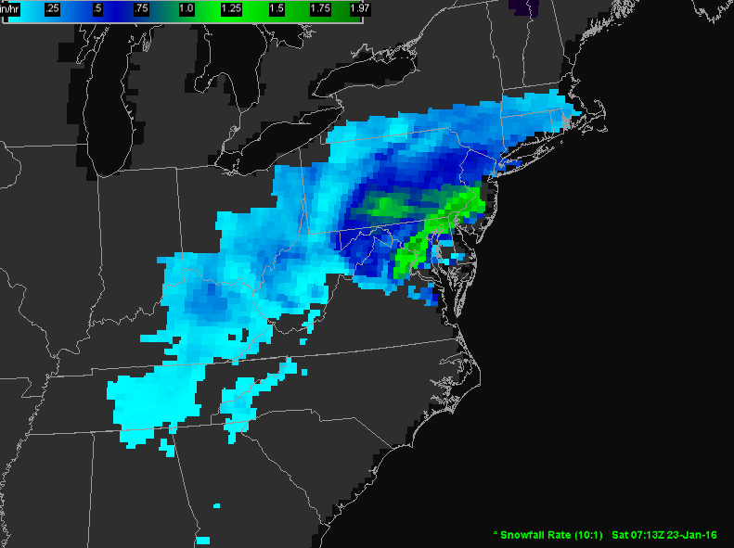
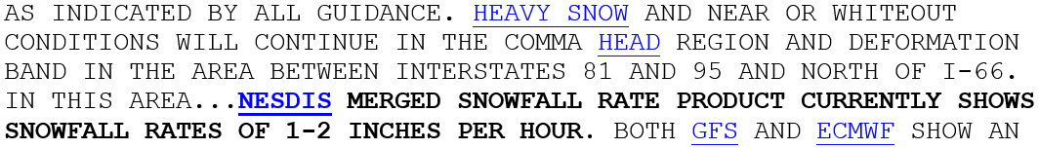
Passive Microwave Snowfall Rate
Collaboration between MSFC/SPoRT and NOAA/NESDIS/STAR funded through ROSES13 NDOA proposal
Product developed by scientists at NESDIS and accelerated into operations by SPoRT
SPoRT has directly contributed:
  guidance on operational perspective (e.g., reduction in data latencies)
  ingest into National Weather Service (NWS) decision support system (AWIPS2)
  training materials
  leadership of product assessment with NWS forecasters
Evaluated by forecasters in ER, SR, WR, and AR in 2015 and 2016
Currently funded by JPSS PG/RR proposal to extend capabilities over ocean and work to support as a future baseline product
1-2”/hr rates shown over DC area
ATMS Snowfall Rate Product displayed in AWIPS2 on 23 January 2016 at 0713 UTC

Slide 8
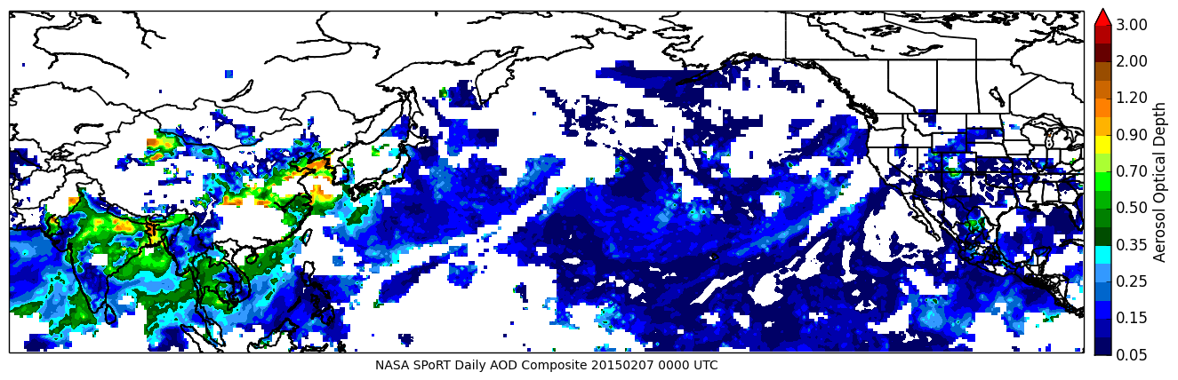
SPoRT AOD Composite Product
Product merges aerosol information from GEO and LEO sensors to provide a comprehensive understanding of the aerosol spatial distribution (Naeger et al., 2016).
  Processed MODIS and VIIRS AOD products
  Developed our own AOD retrieval algorithms for GOES-West and MTSAT-2.
Developed to support aircraft flight planning during the NOAA-led CalWater 2 field campaign over northern California.
  Assisted field investigators in identifying locations where long-range transported aerosols were likely interacting with atmospheric river events.
Elevated AOD during atmospheric river event

Slide 9
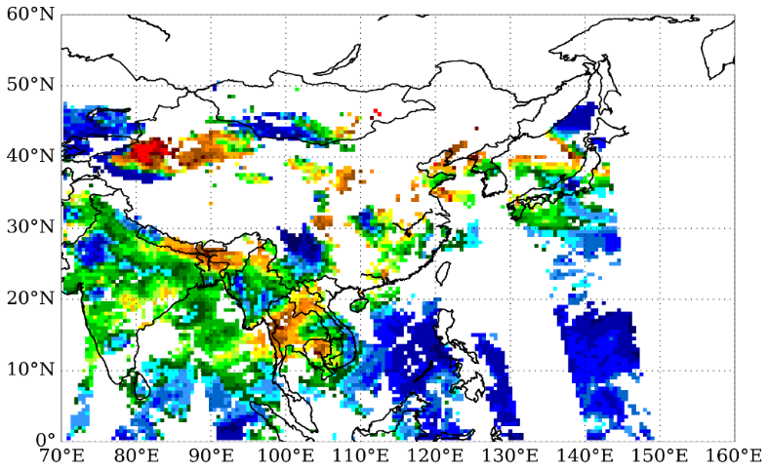
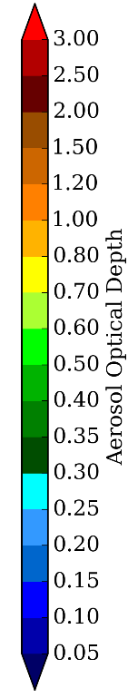
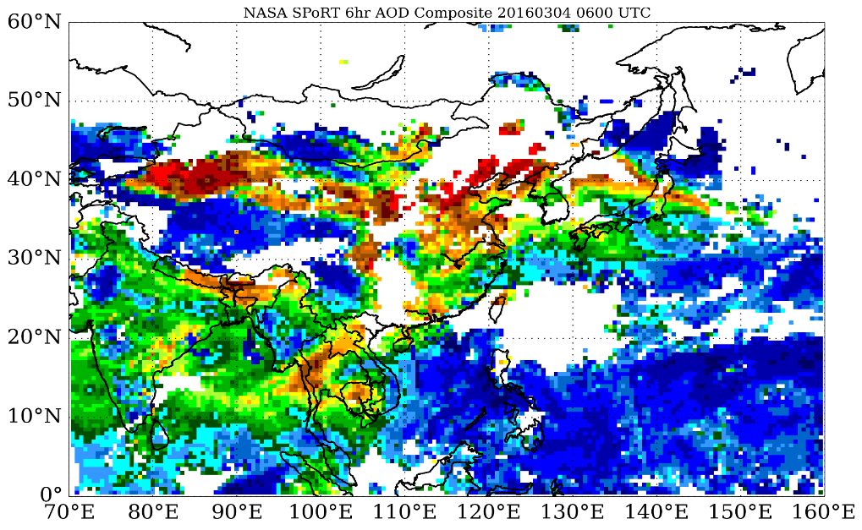
SPoRT AOD Composite Product
Development of an AOD retrieval algorithm for the Advanced Himawari Imager (AHI) onboard Himawari-8 began summer 2015.
  AHI retrieval algorithm implemented into SPoRT AOD Composite product in winter 2015.
  Planned improvements to AHI algorithm in the coming months to prepare for launch of GOES-R.
  Use our improved AHI algorithm to accelerate the development of a GOES-R retrieval algorithm.
Plan to expand the coverage of our product to the eastern United States and possibly to near global coverage in the future (GOES-East and Meteosat).
Dust
Pollution
Cloud
Dust
Pollution
Cloud
AOD Composite product over Asia/western Pacific on 4 March 2016 featuring dust storm over Taklamakan desert and transported dust over eastern Asia. Composite product depicts extent of aerosol contaminated regions much better than MODIS and VIIRS AOD products alone.

Slide 10
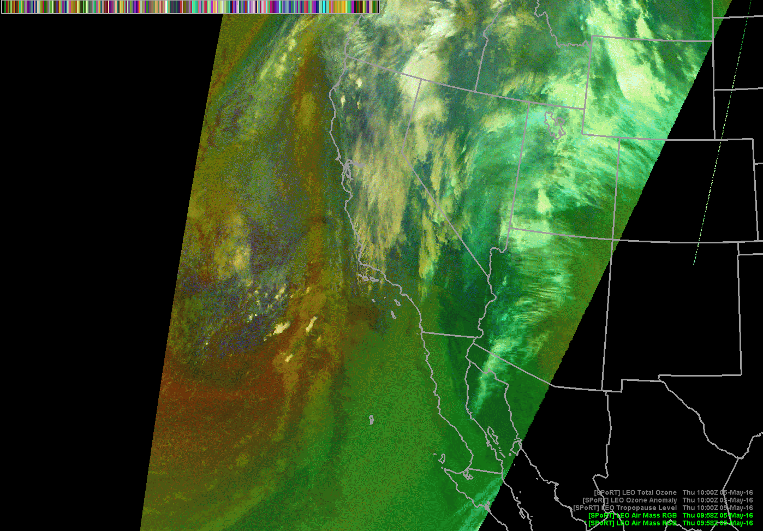
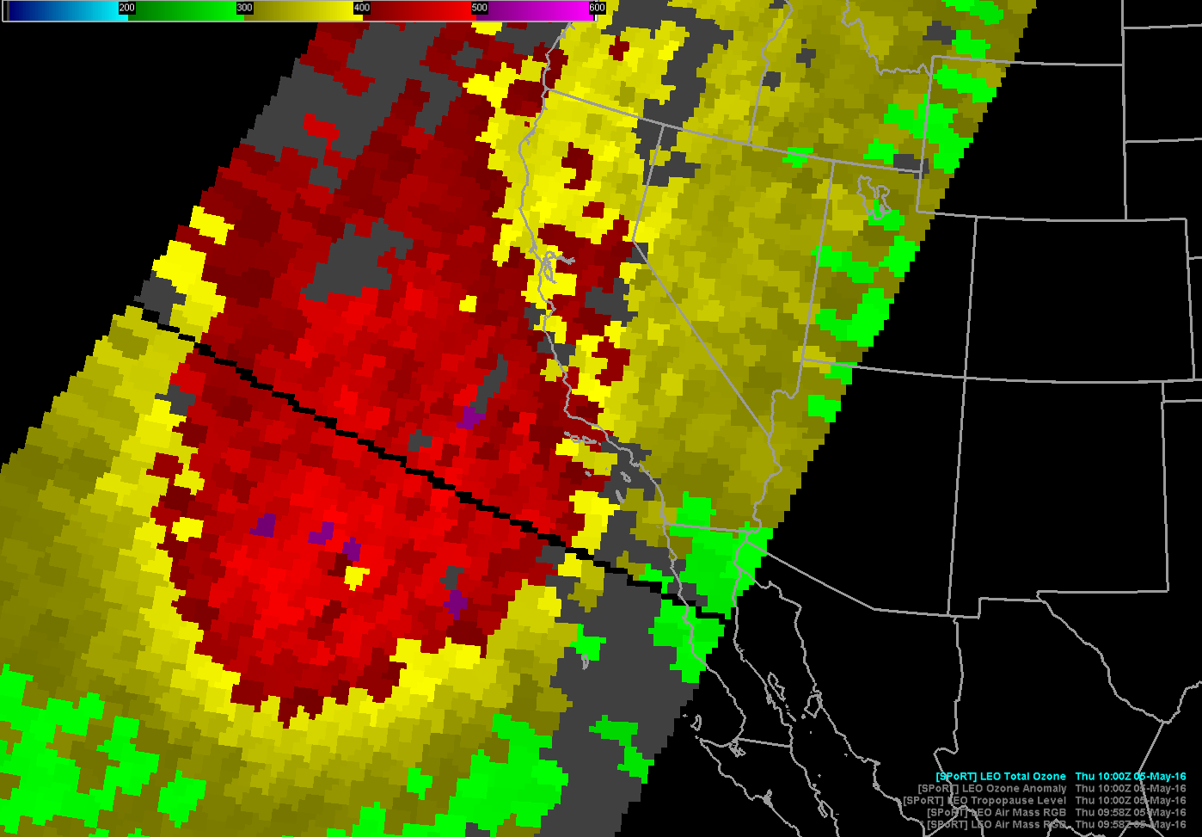
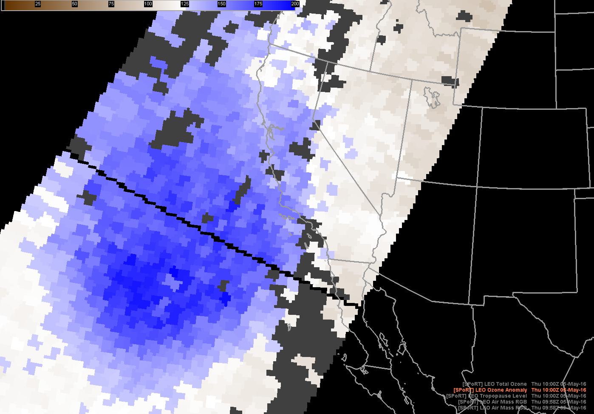
SPoRT Ozone Products
MODIS Air Mass RGB
NUCAPS
Total Column Ozone (Dobson unit)
NUCAPS
Ozone Anomaly (percent of normal)
Forecasters can compare satellite derived ozone to the Air Mass RGB to confirm stratospheric air influence in red/orange regions on the RGB to anticipate rapid cyclogenesis and high impact wind events
Expanded product development to include:
  AIRS (Atmospheric Infrared Sounder)
  IASI (Infrared Atmospheric Sounding Interferometer)
  NUCAPS (Cross-track Infrared Sounder/Advanced Technology Microwave Sounder processed by NOAA-Unique Combined Atmospheric Processing System)
Routinely used at Weather Prediction Center and Ocean Prediction Center
E. B. Berndt, B. T. Zavodsky and M. J. Folmer, "Development and Application of Atmospheric Infrared Sounder Ozone Retrieval Products for Operational Meteorology," in IEEE Transactions on Geoscience and Remote Sensing, vol. 54, no. 2, pp. 958-967, Feb. 2016.
Notes:
To help National Center forecasters gain confidence in interpreting and analyzing the Air Mass RGB, NASA SPoRT created ozone products from the hyperspectral infrared sounders: AIRS, CrIS, and IASI. Forecasters can compare satellite derived total column ozone to the Air Mass RGB to confirm stratospheric air influence in red and orange regions on the RGB. In addition, the ozone anomaly product indicates where the total column ozone is anomalous and shades of blue indicate the presence of stratospheric air and the potential for tropopause folding. The top figure shows a region of high ozone in the north Pacific and some of the same regions are representative of stratospheric air as shown on the ozone anomaly product below. Forecasters use these products in operation with the Air Mass RGB to anticipate rapid cyclogenesis and hurricane-force wind events in the Pacific and Atlantic basins. These examples highlight the value of comparing the Air Mass RGB to model data and other satellite products. When diagnosing complex interactions and learning the breadth of colors on the Air Mass RGB additional data sets can provide insight and confidence in interpreting the RGB.

Slide 11
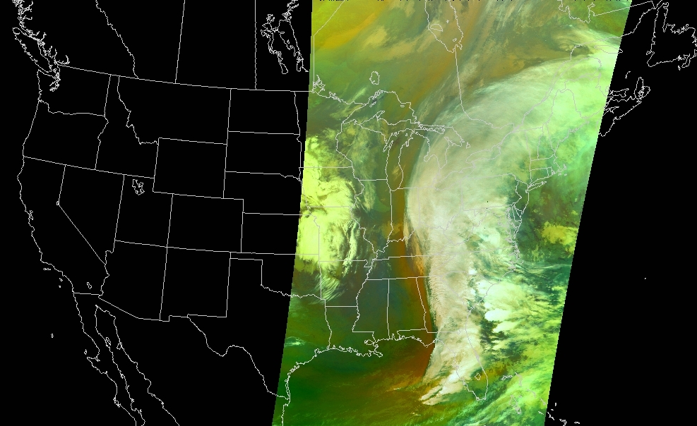
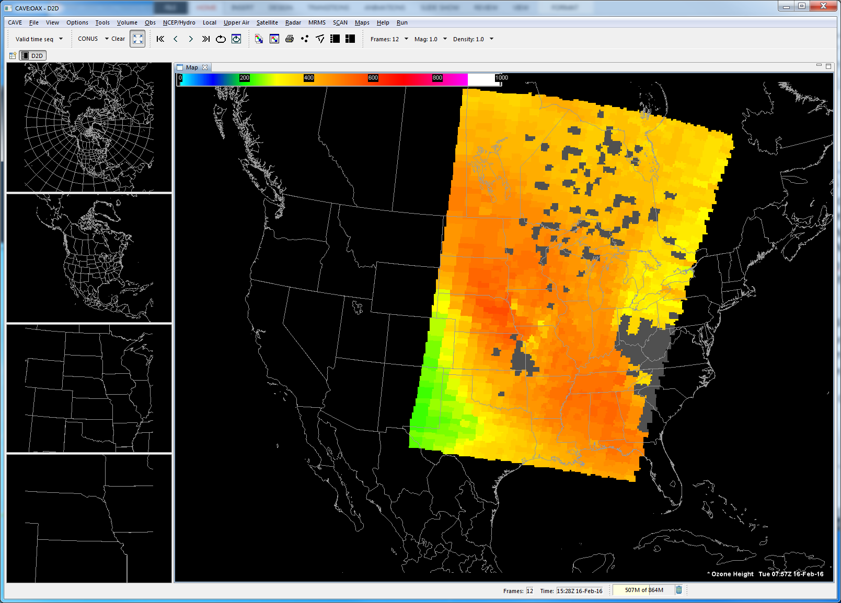
SPoRT Ozone Products
MODIS Air Mass RGB
Exploring new applications with Aviation Weather Center
National Aviation Meteorologists recently began issuing high ozone outlooks to airlines
FAA regulations dictate in-cabin ozone should not exceed 250 parts per billion (ppb) at any time or 100 ppb over a 4 hour flight segment
Forecasters interested in the height of 250 ppb ozone concentration
CrIS/ATMS NUCAPS ozone height product provided in AWIPS-II for testbed activities
NUCAPS
Height of 250 ppb Ozone (mb)

Slide 12
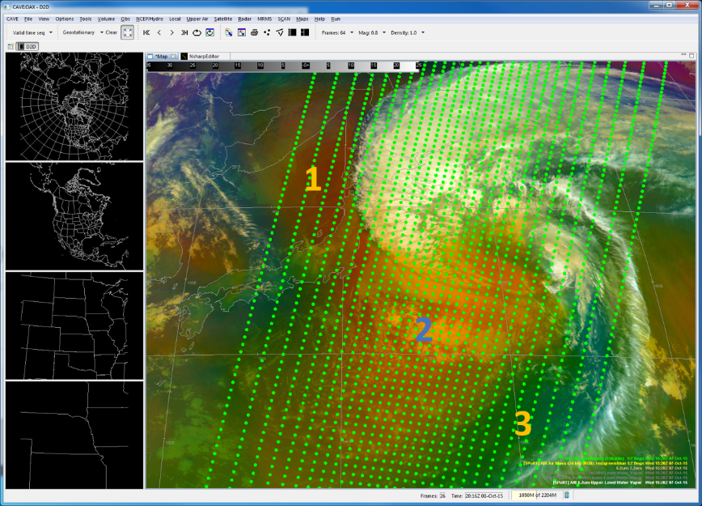
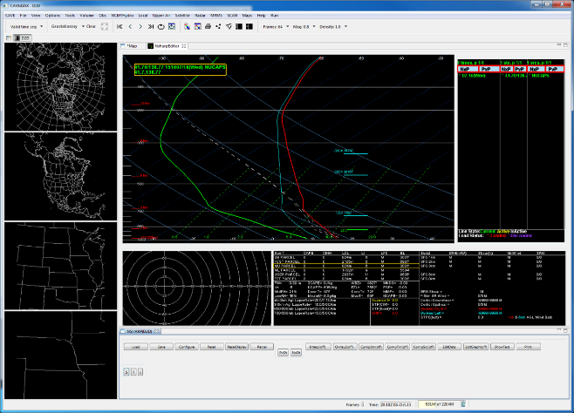
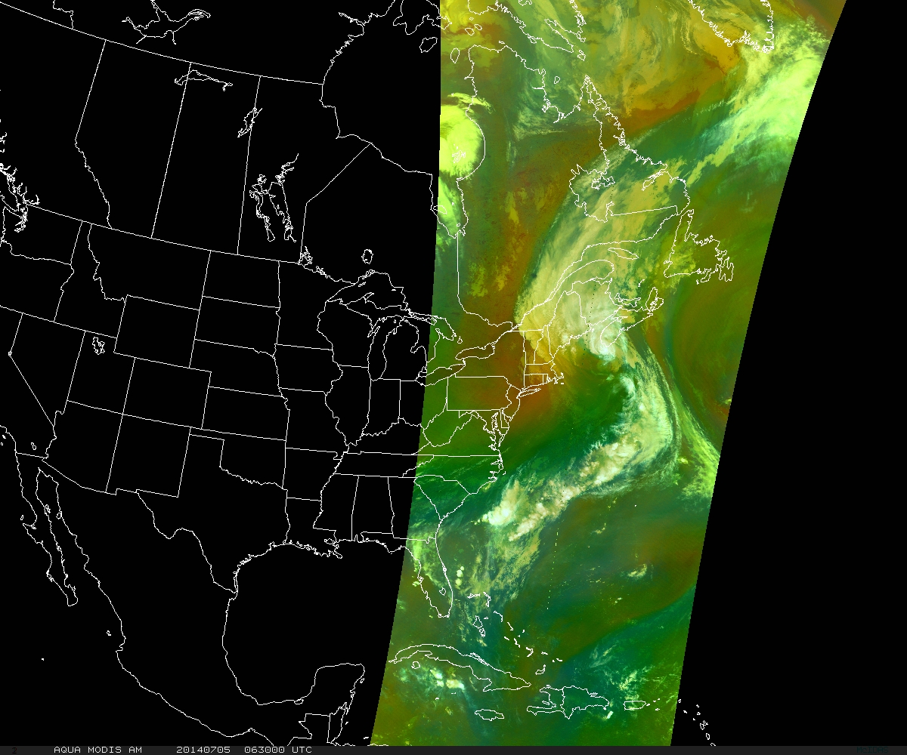
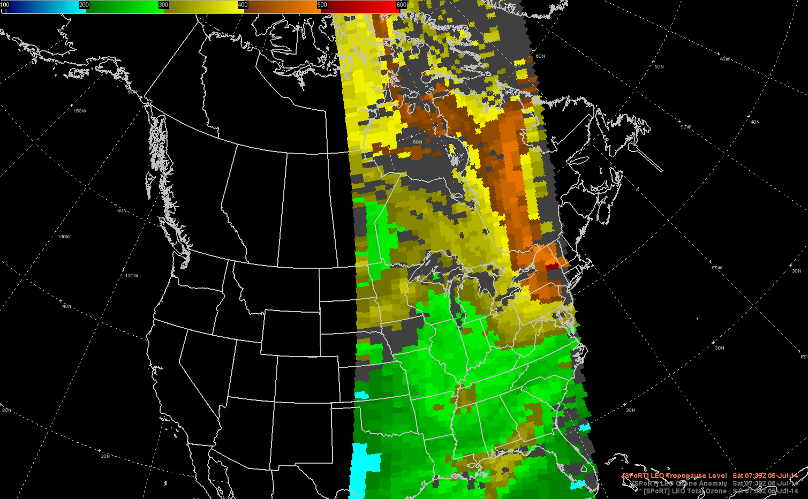
NUCAPS for Extratropical Transition
NUCAPS soundings are already in AWIPS-II and available to forecasters, this project would provide feedback on the benefit of S-NPP/JPSS data for hurricane extratropical transition.
Demonstrate how NUCAPS t, q, and O3 profiles can complement the Air Mass RGB by giving forecasters insight about the vertical distribution of atmospheric variables
Development of tropopause level product to diagnose influence of stratospheric intrusions
A product demonstration is planned for August-October 2016 with NHC, WPC, SAB forecasters
Severe Tropical Storm Choi-wan
AHI Air Mass RGB 1520 UTC 7 Oct 2015
NUCAPS Sounding 1500 UTC Point 1
AQUA MODIS Air Mass
5 July 2014 0635-0645 UTC
NUCAPS Tropopause Level
5 July 2014 0745-0755 UTC
Funded by JPSS PG/RR Program

Slide 13
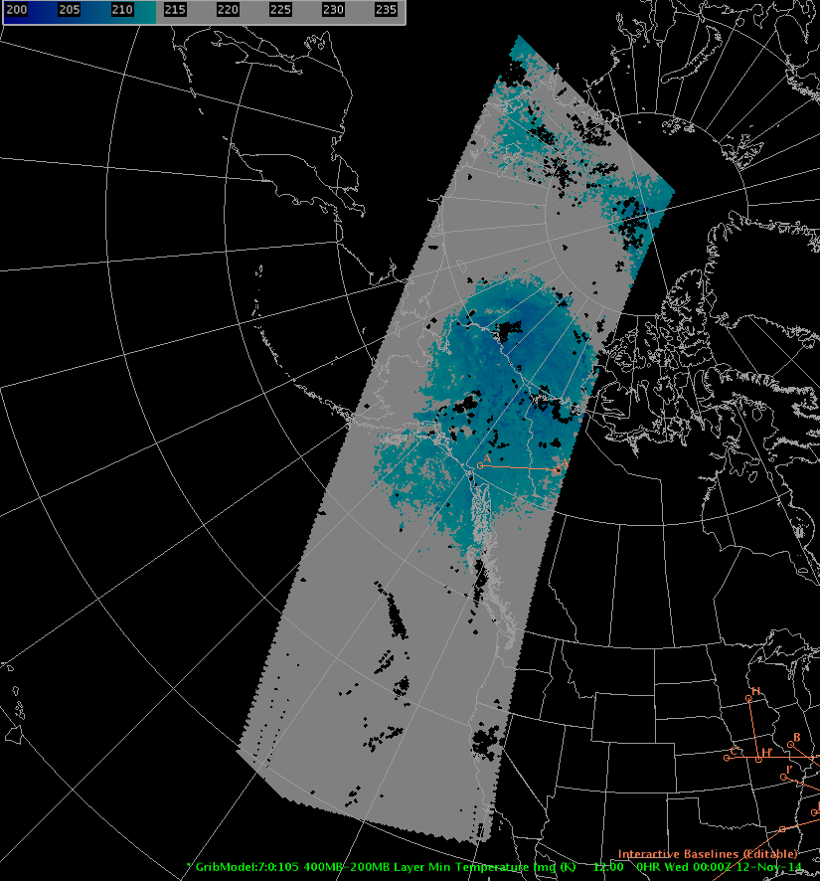
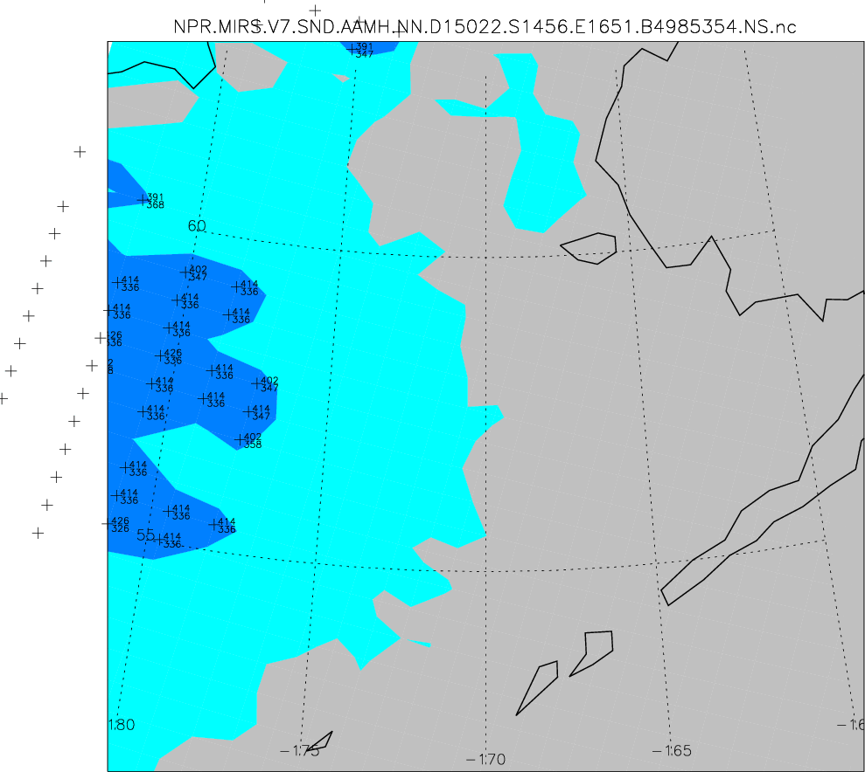
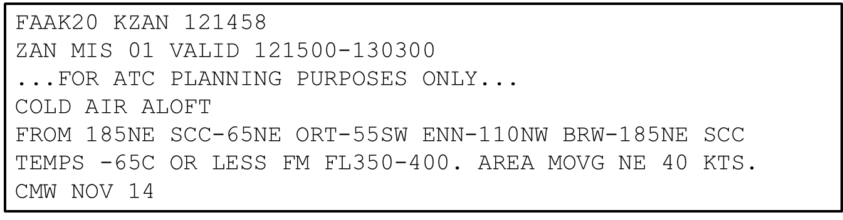
Gridded NUCAPS Activities
Skew-Ts are valuable for some forecast challenges, but visualizing the data in plan view or cross section to identify specific air masses may be more useful for others
Cold Air Aloft (-65°C and below) can lead to freezing airliner fuel and CWSUs provide Meteorological Impact Statements (MIS) to Air Traffic Controllers to direct flights around the 3D air features
NUCAPS will allow forecasters to observe the 3D extent of the cold air where conventional obs are sparse
Leverages SPoRT previous capabilities with IR sounder data to collaborate with CIMSS, CIRA, and GINA to develop a community-backed demonstration product for NWS
Funded through JPSS PG/RR
SPoRT GRIB file from CIMSS gridded data processed at GINA
Sample CWSU MIS
CIRA web display
Notes:
This idea was originally Eric Stevens’s and as part of SPoRT’s participation in the NUCAPS Telecons, we worked with CIMSS (Nadia Smith and Elisabeth Weisz) and CIRA (Jack Dostalek)—who had each developed non-AWIPS2 visualization capabilities for sharing sounder products for looking at Cold Air Aloft—to develop a single, agreed-upon, collaborative product for buy-in with all aspects of the proving ground. SPoRT leveraged its ongoing partnerships in AK along with our AWIPS2 expertise to develop a mechanism to create gridded NUCAPS products that would be displayable in AWIPS2. SPoRT is leading a funded JPSS PG/RR proposal that includes funding for CIMSS, CIRA, GINA, and SPoRT to execute transition of this product into operations and evaluate its value to the Cold Air Aloft forecast challenge.

Slide 14
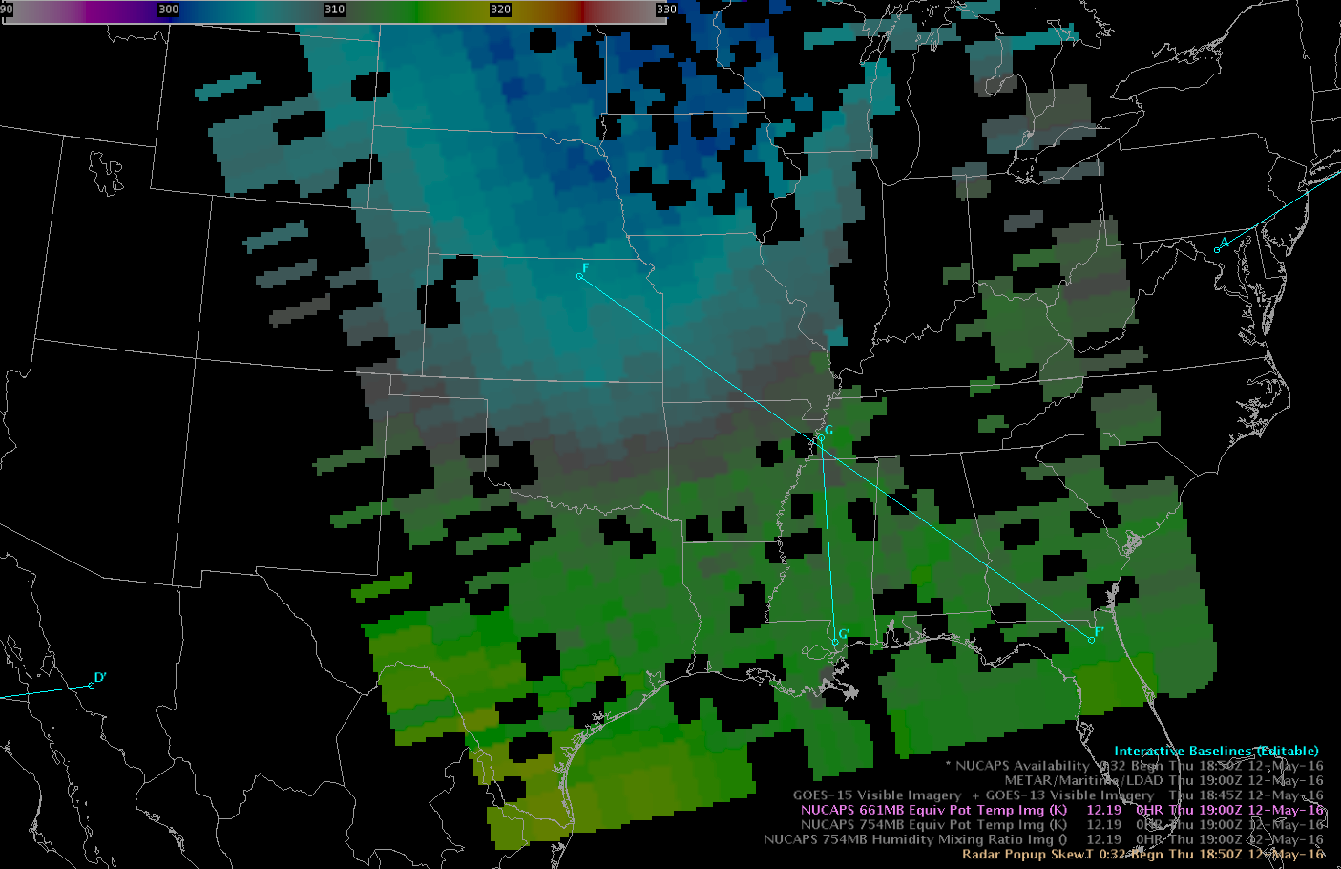
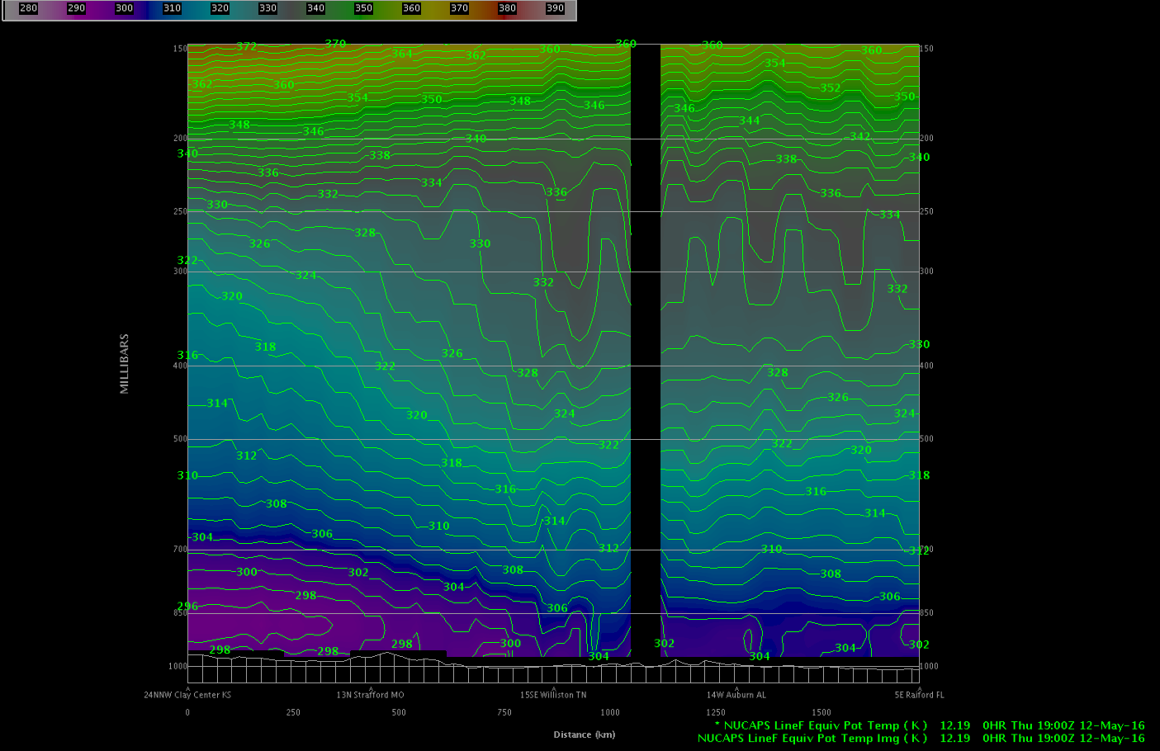
Gridded NUCAPS Activities
Images from GOES-R HWT Blog
Cold front easily identified in Gridded NUCAPS
“This is a cool way to visualize the location and structure of a frontal boundary!”- Jeremiah Pyle NWS Forecaster/HWT EWP
Successfully demonstrated for convective initiation at Hazardous Weather Testbed Experimental Warning Program in Spring 2016
Working with Experimental Product Development Team (EPDT) to baseline into future versions of AWIPS using NUCAPS files coming through SBN
“We recently gained the ability to create cross sections through the NUCAPS swaths. This will be helpful for diagnosing phenomena such as boundaries and convective instability.”
- HWT EWP Participant

Slide 15
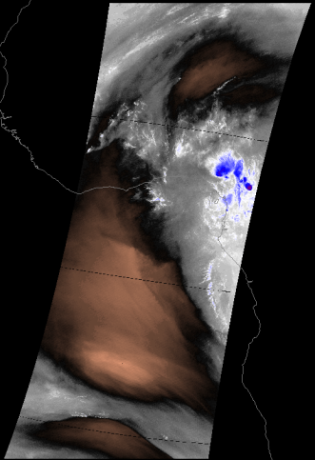
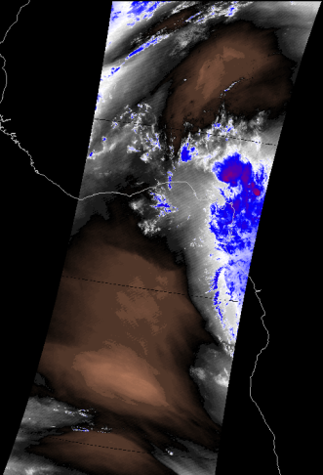
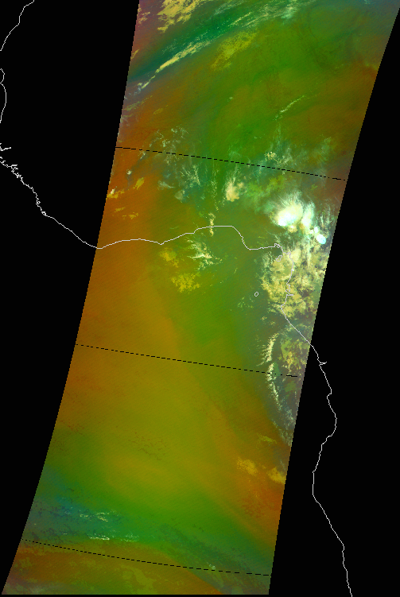
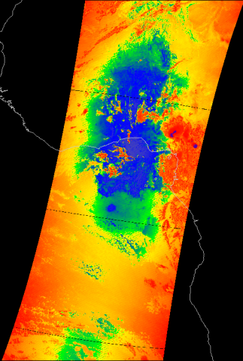
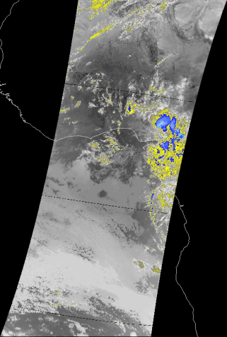
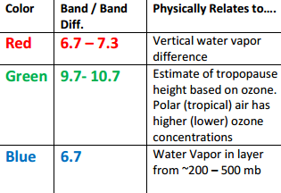
Multi-Spectral (RGB) Composites
Combine information from several channels into composite image for quick analysis of atmospheric features (e.g., airmass characteristics, airborne dust, low clouds/fog, etc.)
Funded by JPSS/GOES-R to demonstrate concepts originally deployed in Europe to NWS forecasters
Original Channels
Final Product: Air Mass RGB
Water Vapor
(6.7 μm)
Water Vapor
(7.3 μm)
Air Mass RGB Recipe
Ozone
(9.7 μm)
Infrared
(11.0 μm)
2014 October 29 0110 UTC
Aqua MODIS Air Mass RGB

Slide 16
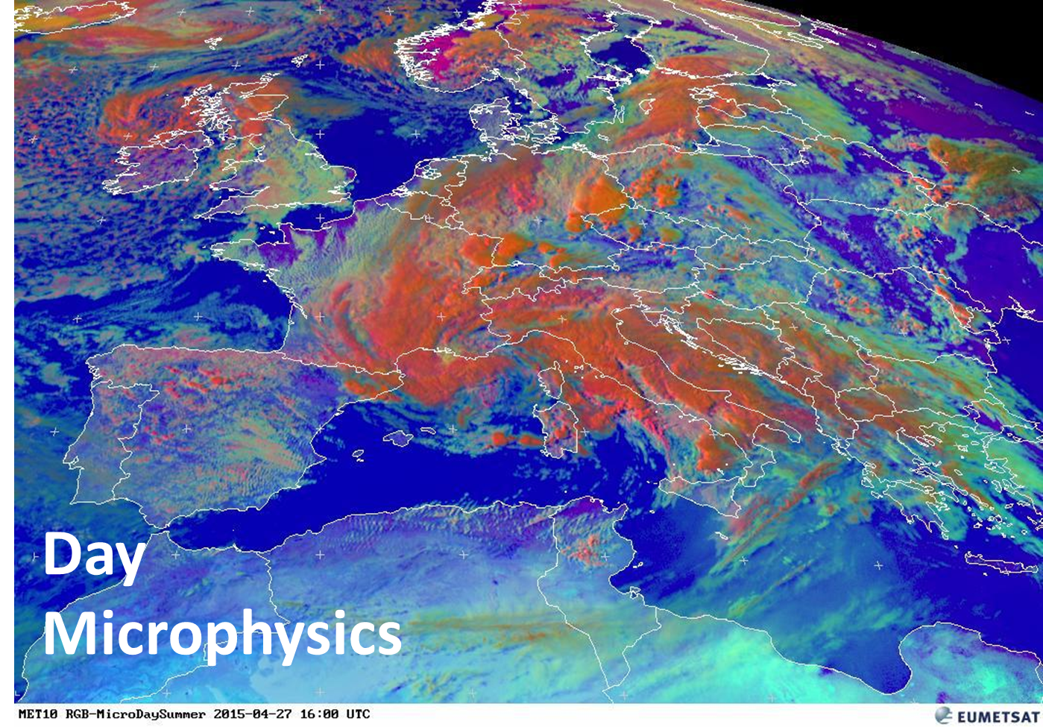
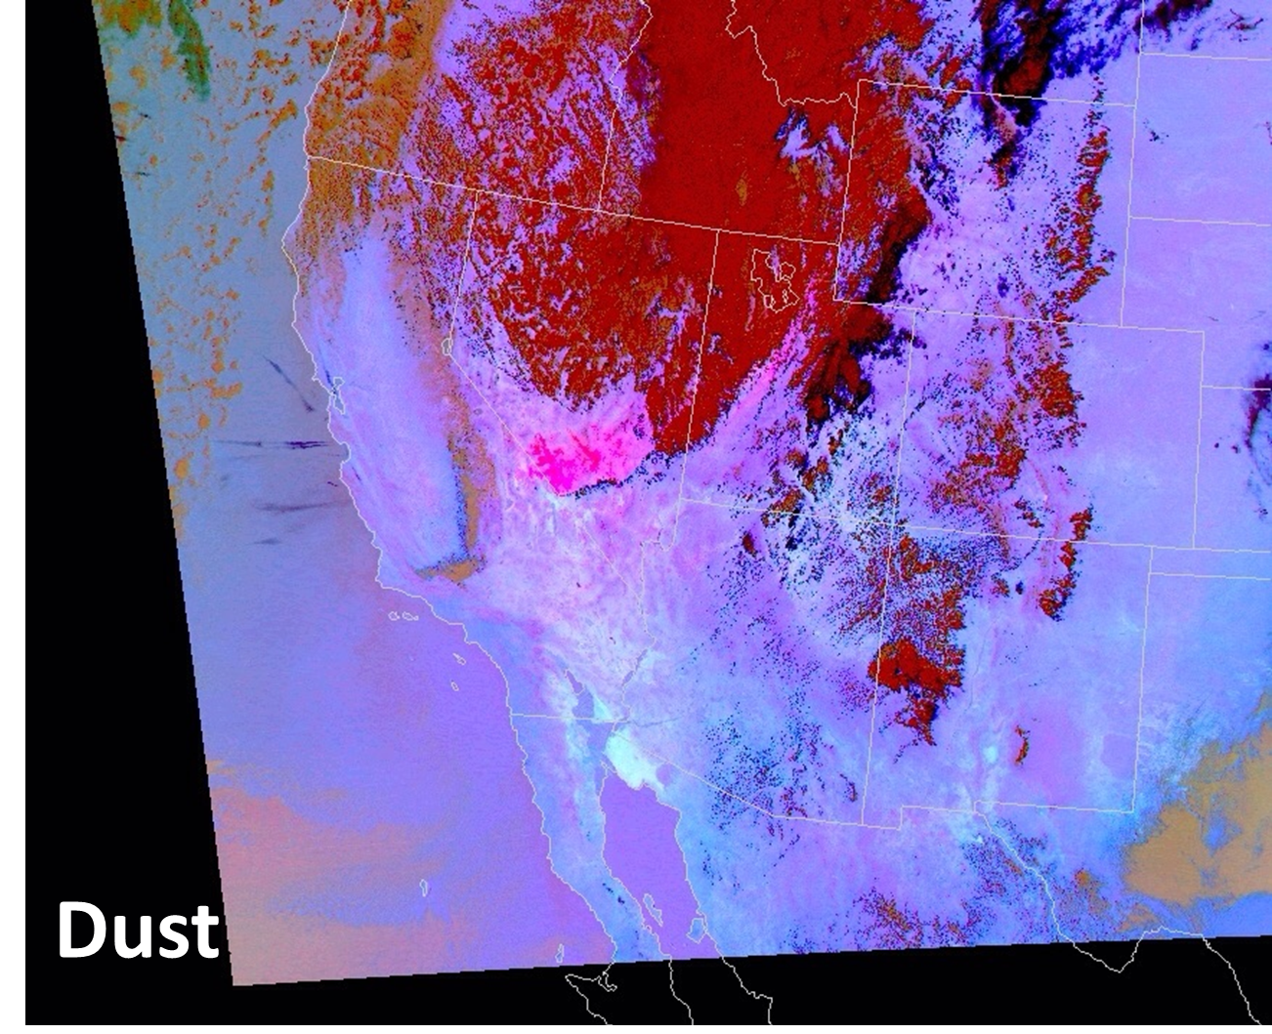
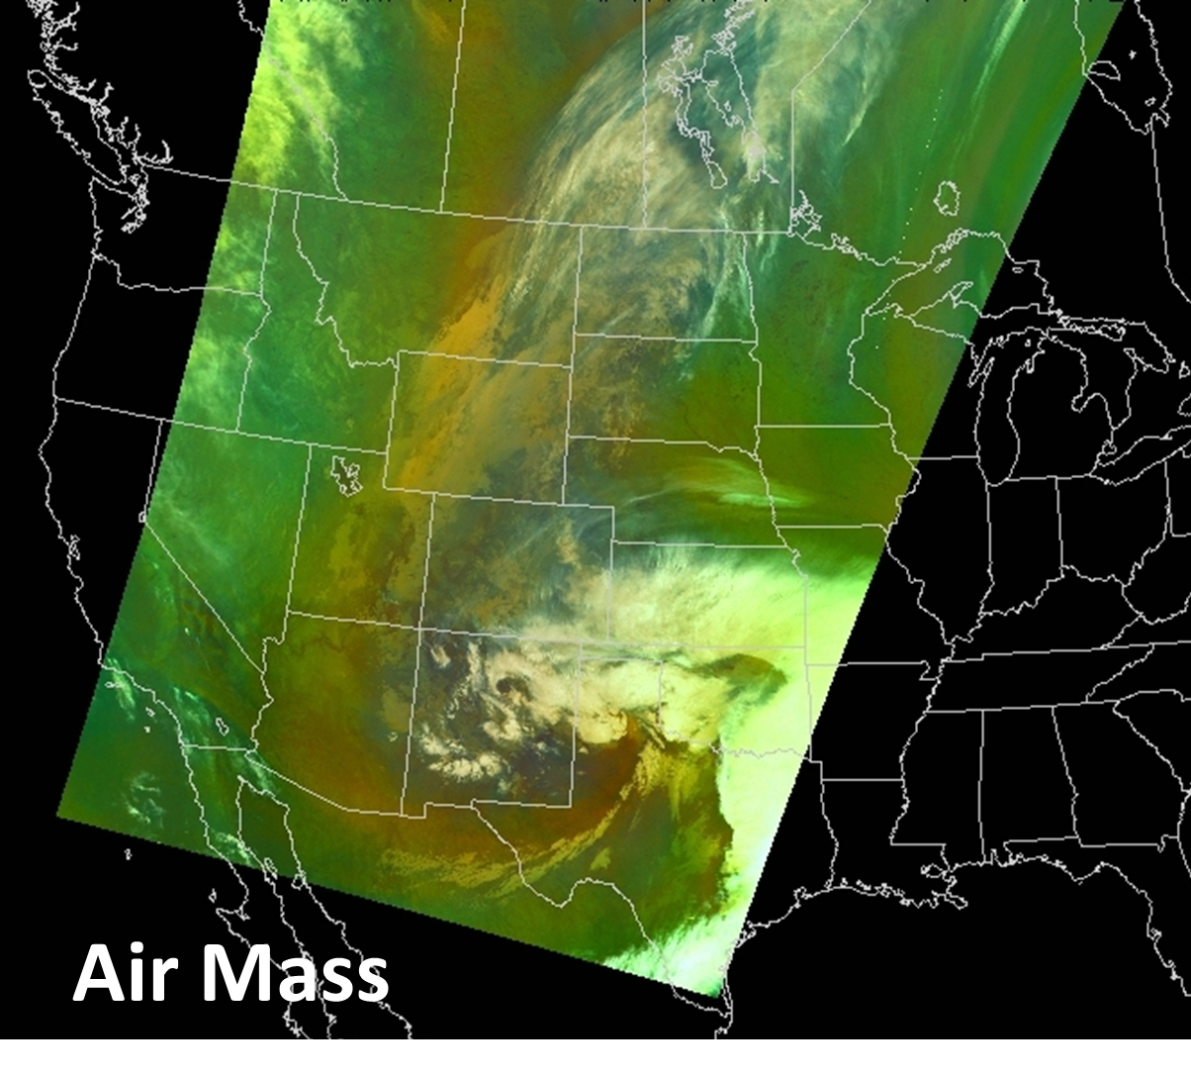
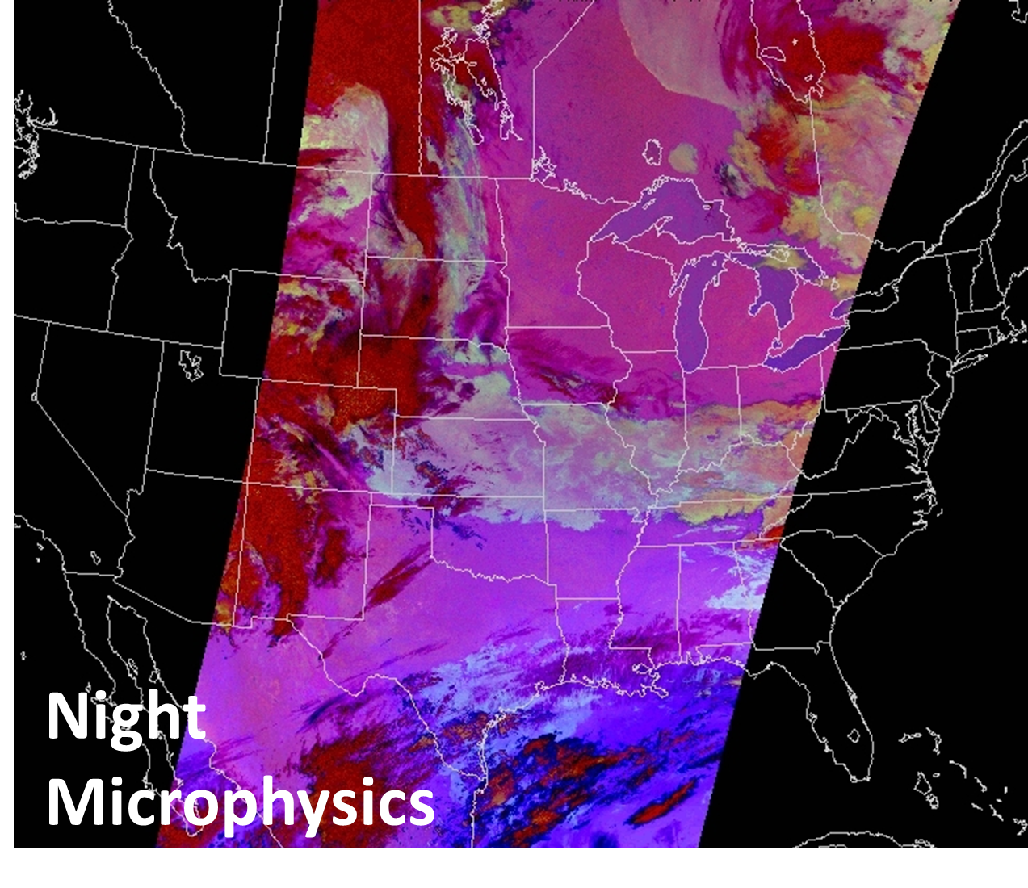
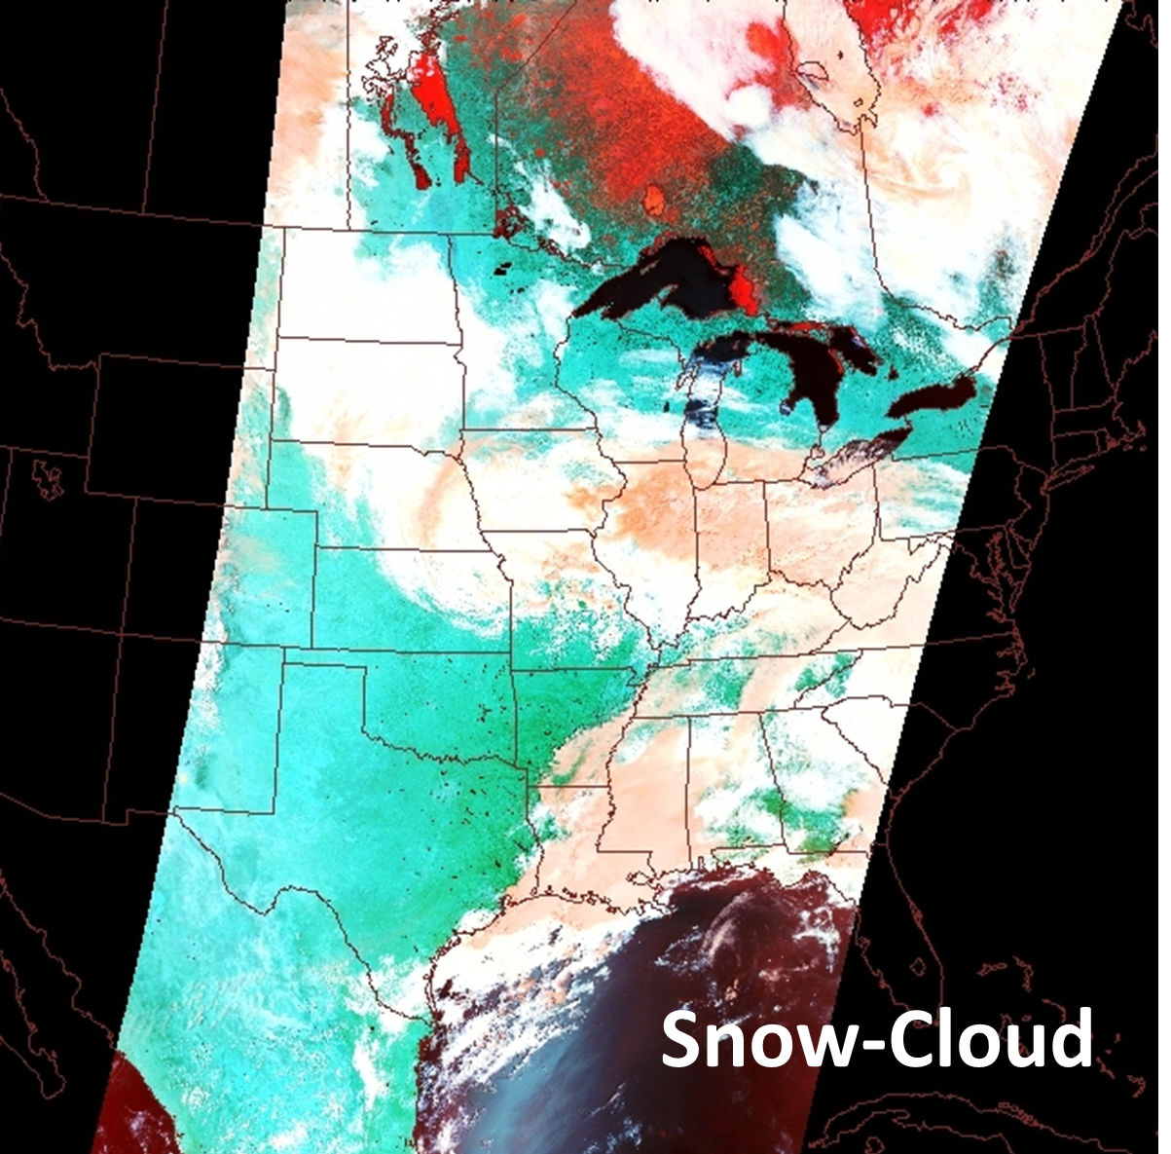
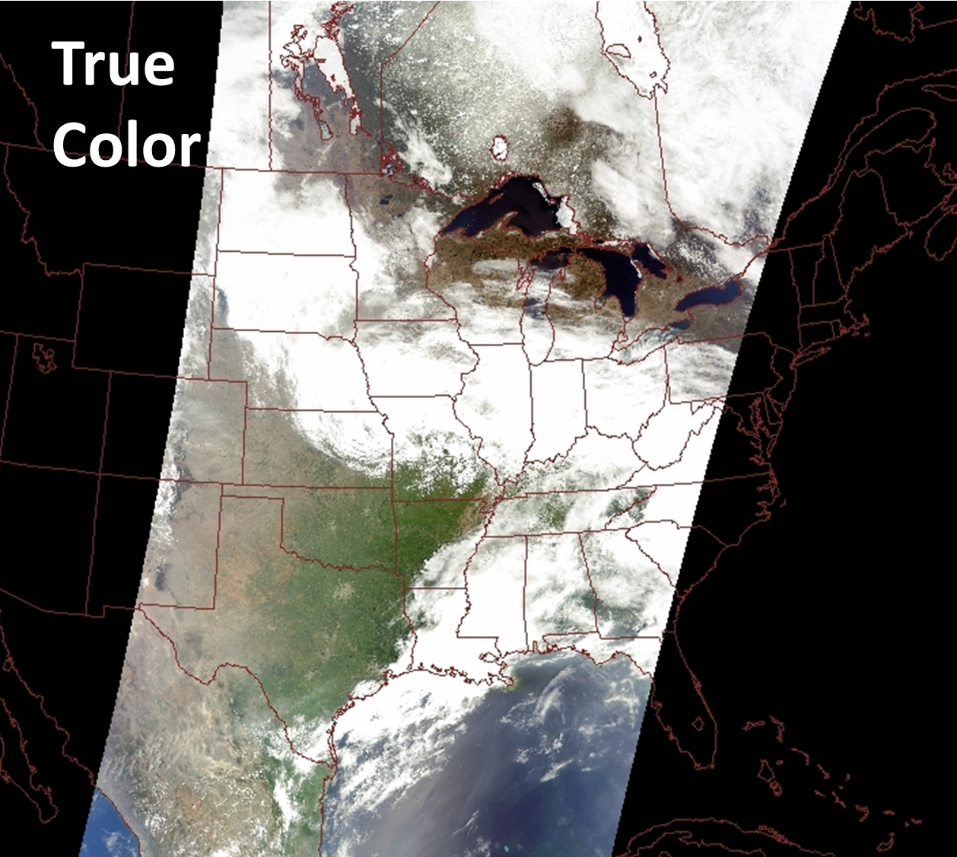
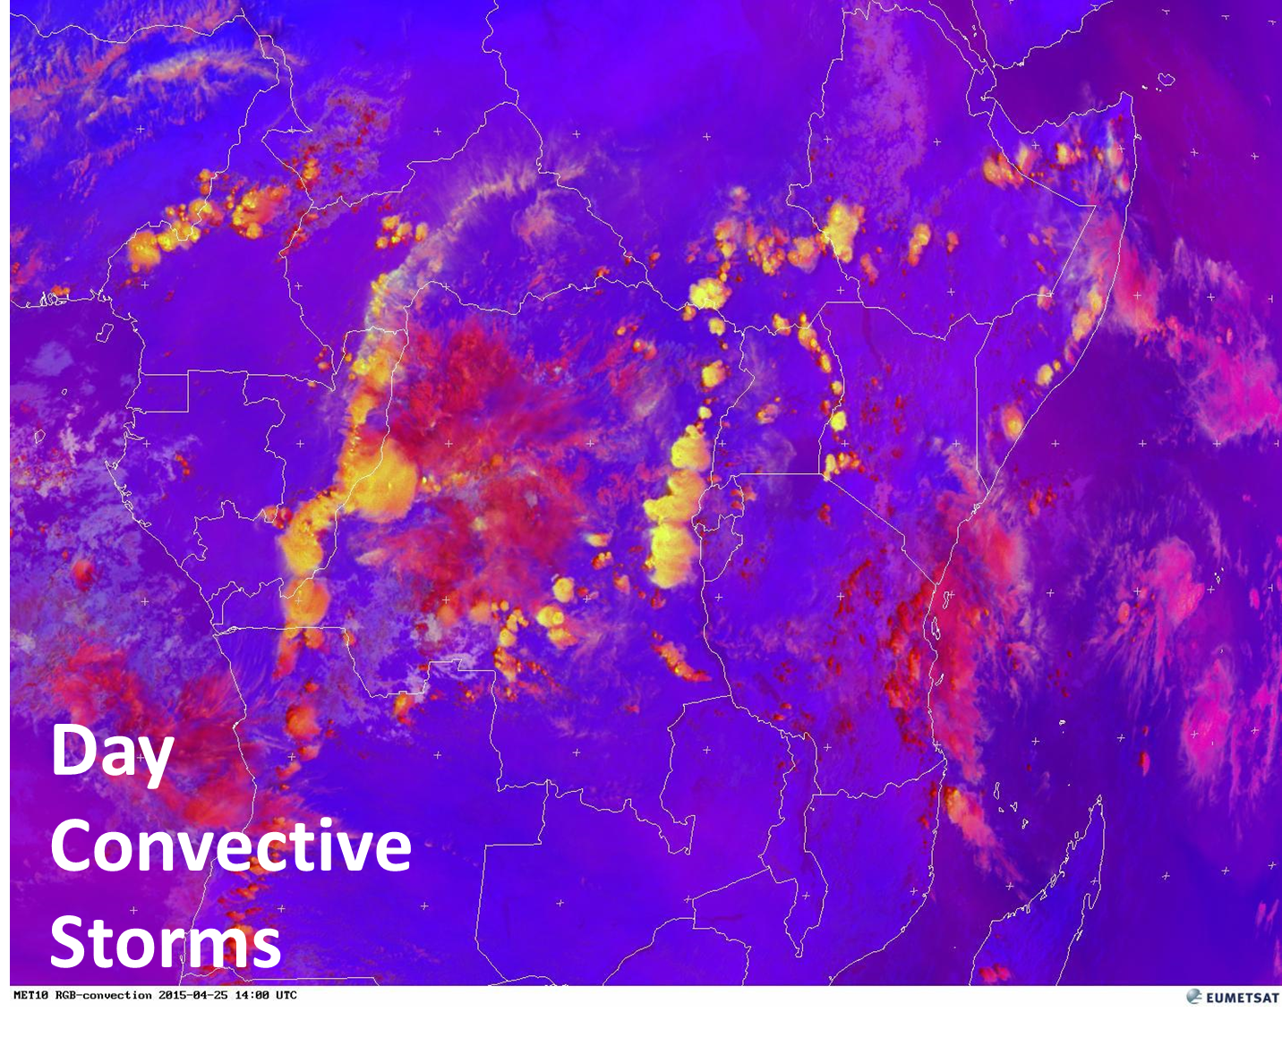
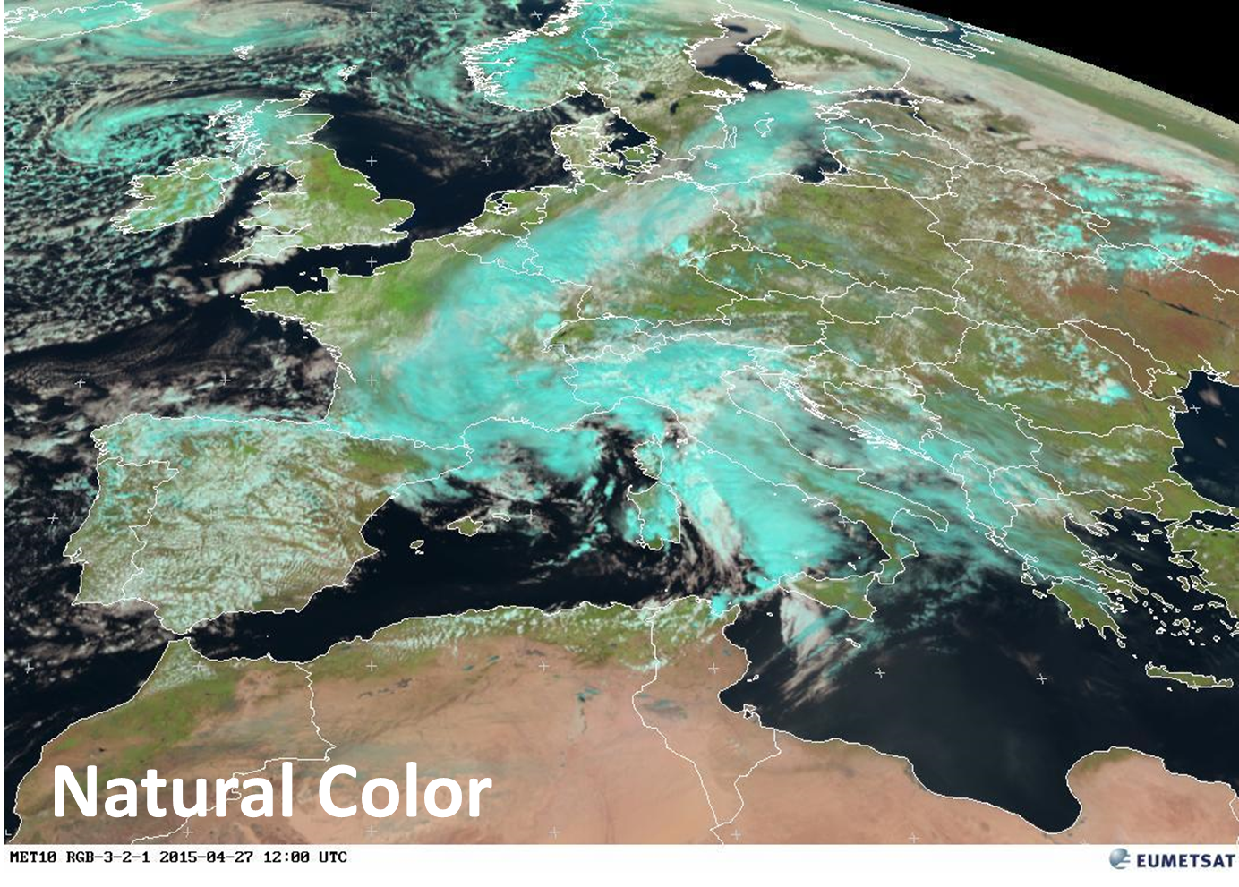
EUMETSAT RGB Best Practices
In the early 2000s, EUMETSAT developed a set of RGB recipes or best practices.
RGB products are qualitative and have a specific applications such as identification of low clouds and fog, dust, convection, air mass characteristics.
SPoRT has worked with the GOES-R/JPSS Proving Grounds to prepare forecasters for the GOES-R era by creating RGB products with MODIS, VIIRS, SEVIRI, AVHRR, and AHI.
RGBs have been successfully integrated into operations in numerous WFOs and National Centers.

Slide 17
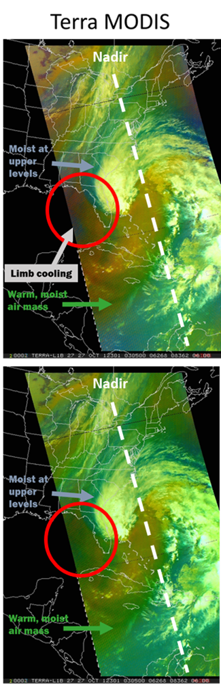
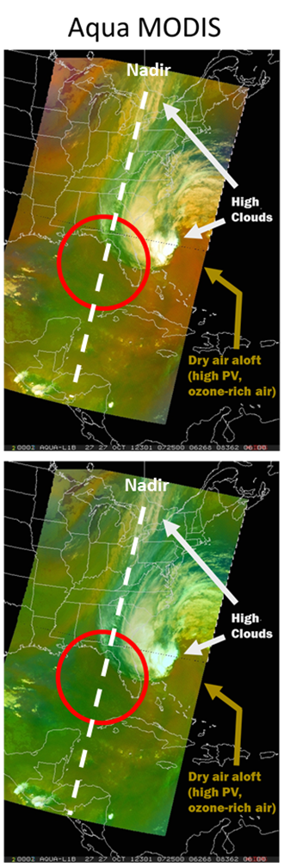
RGB Improvements
Correction technique developed to account for noticeable differences in RGB products
  Limb vs Nadir (Limb cooling)
  Between sensors (spectral differences)
Limb cooling of the thermal infrared and water vapor bands increases absorption by atmospheric constituents at high scan angles and results in brightness temperatures that are cooler at the edge of the swath compared to the nadir view.
Correction technique implemented real-time mid-2015 to thermal infrared and water vapor bands
  Reliable interpretation across the entire swath
  Account for spectral differences across sensors to provide consistent RGB products
Correction improves interpretation of suite of EUMETSAT RGBs across MODIS, VIIRS, and AVHRR
Cold, dry air?
Warm, tropical air
Elmer, N., E. Berndt, G. J. Jedlovec, 2016: Limb Correction of MODIS and VIIRS Infrared Channels for the Improved Interpretation of RGB Composites, Journal of Atmos. And Oceanic Technology, vol. 33, no. 5, pp. 1073-1087.

Slide 18
Dust RGB Adopted into Operations
Dust RGB has had significant operational value in the southwestern US
  Easier to track dust plumes from day to night and differentiate dust from clouds
  Increased forecaster confidence in extent and density of dust plumes has led to better warning and advisory products
  Product a part of normal operations
Policy changes to allow blowing dust to impact ceiling conditions in the TAF
Now issue stand-alone blowing dust advisories and dust storm warnings to the general public
Improved decision support services to state officials who have the ability to forewarn the public with roadway messaging
Forecasters are ready for and prepared for RGBs in the GOES-R era
Fuell, K. K., B. J. Guyer, D. Kann, A. L. Molthan, and N. Elmer, 2016: Next generation satellite RGB dust imagery leads to operational changes at NWS Albuquerque. J. Operational Meteor., 4(6), 75–91.

Slide 19
RGB Activities in Alaska
Successful implementation of SPoRT “Research to Operations/Operations to Research” Paradigm
Targeted product assessments and forecaster feedback have led to additional product development and improvements
Evaluation
NtMicro RGB to differentiate fog from low cloud
Evaluation
NtMicro vs 24-hr Micro RGB for Aviation
Evaluation
24-hr Micro RGB for Aviation
Evaluation
AVHRR NtMicro RGB impacts to Aviation
Evaluation
VIIRS Daytime Microphysics RGB with Alaska
Introduce NtMicro RGB
2012/13 Winter 2014 Winter 2015 Summer 2015 Winter 2016 Summer 2016
Feedback
Product operational impact
Day-time product?
Additional overpasses?
Feedback:
24-hr Micro lacks contrast to other clouds or surfaces
Feedback:
Large to Very large impact
24-hr Micro insufficient in some cases
Feedback:
Additional AVHRR overpasses useful
50+ NtMicro AFD references since Sept 2015
Feedback:
So far product rated high operational impact
Adjust
24-hour Micro RGB
Introduce
24-hour Micro RGB
Adjust
24-hour Micro RGB
Expand NtMicro to AVHRR
Introduce DtMicro RGB

Slide 20
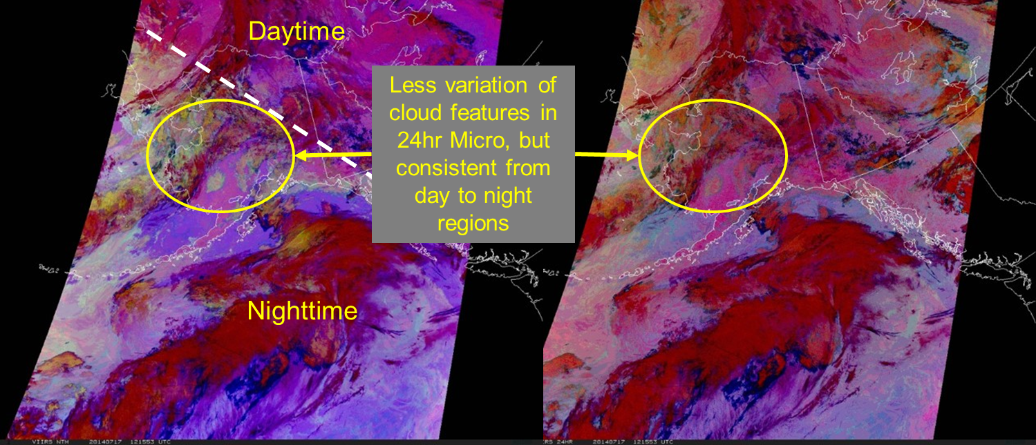
RGB Activities in Alaska
Night-time Microphysics RGB routinely used in operations
Expanded product to AVHRR instrument to allow for more overpasses (NOAA-19, Metop-B) to compliment MODIS and VIIRS
Explored development of 24-hour Microphysics RGB due to limited use of Night-time Microphysics RGB during high-latitude summer
  NtMicro RGB
  12.0µm-10.8µm
  10.8µm-3.7µm
  10.8µm
  24-hr Micro RGB
  12.0µm-10.8µm
  10.8µm-8.7µm
  10.8µm

Slide 21
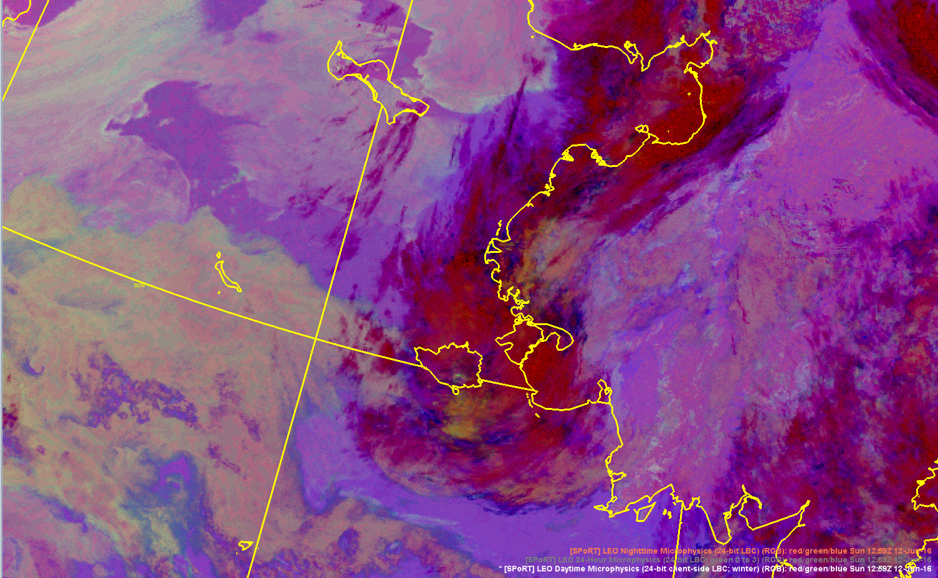
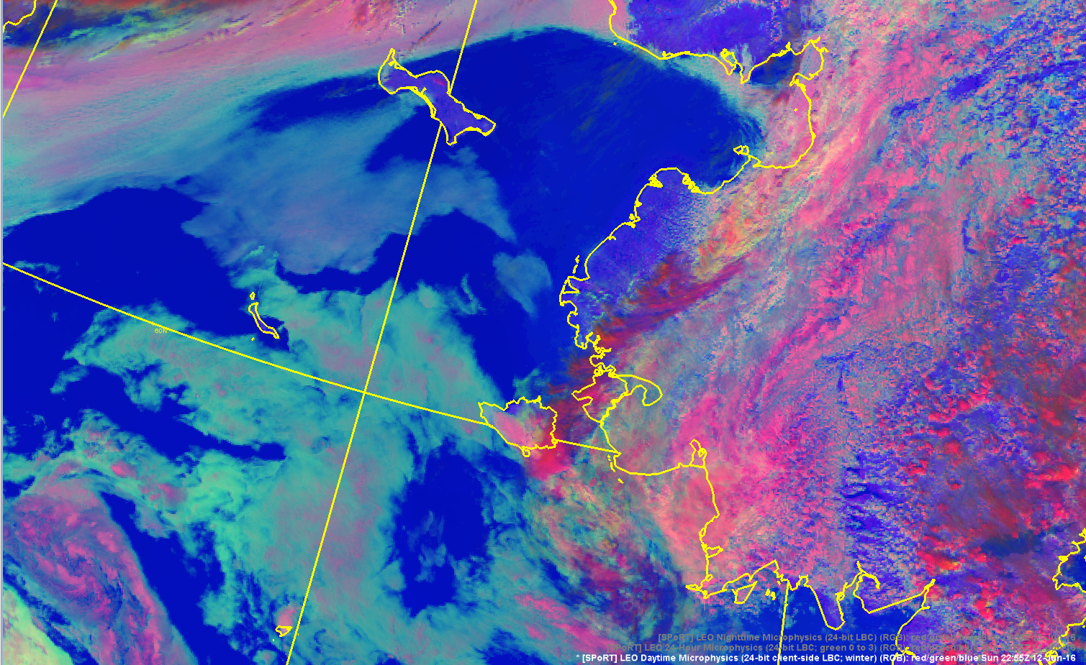
RGB Activities in Alaska
The 24-hr Microphysics is adequate for monitoring features during both day and night but use of the dirty window 8.7 µm band limits the precision due to weak water vapor absorption
Developed the capability to derive the 3.9 µm reflected component to create the EUMETSAT Day-time Microphysics RGB
Use of the NtMicro and DtMicro should provide more precision in tracking low clouds and fog from night to day than the 24-hrMicro due to the use of the 11 - 3.9 µm relationship and 3.9 µm reflected component
SPoRT LEO 12 Jun 2016 1259 UTC
Nighttime Microphysics RGB
SPoRT LEO 12 Jun 2016 2255 UTC
Daytime Microphysics RGB

Slide 22
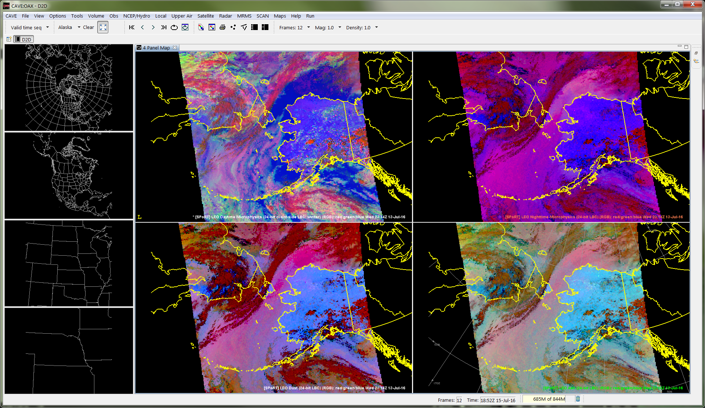
RGB Activities in Alaska
Actively working with Alaska Region to implement client-side RGBs with existing data stream for Himawari-8 AHI, MODIS, VIIRS, and AVHRR
  Developed end-to-end VIIRS processing using CSPP data, and polar2grid, and python
  Moving toward use of community, open source tools
  Use of existing data steams and processing at the data source reduces SPoRT’s processing load
  Eliminated the need for McIDAS, reducing overhead cost and risk
Opportunity to contribute to community processing code
  Added ability to output MODIS Satellite zenith angle in polar2grid
  Needed variable for correction technique
  Code changes accepted by polar2grid team for incorporation in next official software release
VIIRS client-side EUMETSAT RGBs in Alaska
(top left) DtMicro, (top right) NtMicro, (bottom left) Dust, (bottom right) Ash

Slide 23
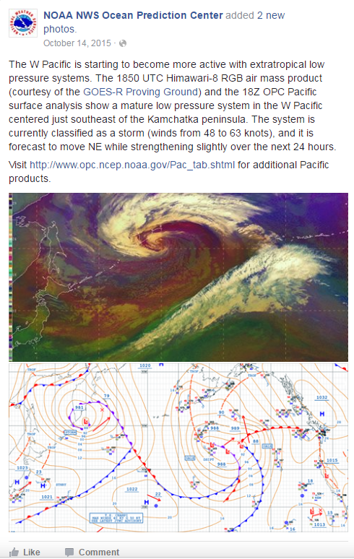
RGBs and Next-Generation Sensors
Expansion of EUMETSAT RGB suite to Himawari-8 AHI
Suite of RGBs provided to National Centers:
  Ocean Prediction Center
  Weather Prediction Center
  NESDIS Satellite Analysis Branch
Routinely used in operations and featured on social media
Used as a proxy for GOES-R in an evaluation with NWS Operations Proving Ground “Evaluating Operational Applications of Multiple Spectral Bands for the GOES-R Era”
  Initial testbed activity for client-side RGB generation
  Discussions to implement AHI client-side RGBs in Pacific and Alaska Regions
  Provided prototype capability for GOES-R client-side RGBs

Slide 24
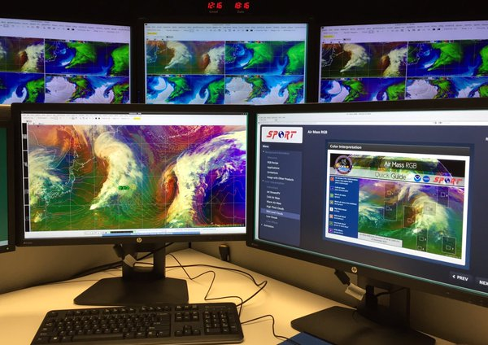

Demonstration with
NWS Operations Proving Ground
Introduce forecasters to multispectral bands in preparation for GOES-R
Give forecasters the opportunity to view and evaluate AHI imagery as a proxy
SPoRT provided AHI case studies, training material, capability for client-side RGB generation and Integrated Training plug-in
SPoRT developed the Integrated Training AWIPS-II plug-in to allow forecasters to view training right in AWIPS-II
Forecasters gave feedback on:
  Utility of single channels and RGB products for specific applications
  Use of the Integrated Training plug-in
  Impact of local dynamic RGB generation on AWIPS-II system performance

Slide 25
Summary
SPoRT has a wide variety of remote sensing activities that span the electromagnetic spectrum
  Passive microwave
  Visible measurements of aerosol optical depth
  Hyperspectral infrared sounders
  Multi-spectral composites
Targeted training and product assessments has led to products adopted into normal operations, product adjustments, and even new product development
SPoRT has successfully engaged with NOAA NWS National Centers, WFOs, the Operations Proving Ground, and the GOES-R/JPSS Proving Grounds to introduce forecasters to innovative products and prepare forecasters for the GOES-R/JPSS era

