Slide 1
Overview of Total Lightning Activities
Geoffrey Stano
Kevin McGrath
Paul Meyer
Kevin Fuell
Christopher Schultz

Slide 2
Lightning Fast Facts
Since 2014 …
1 assessment with all partners (1st with AWC and CWSUs)
2 Visiting Scientist Proposals funded
3 new lightning mapping array collaborators
4 Training modules (2 for GOES-R Foundational Course)
5 new publications (4 published, 1 in review)
3 new end user partners (Peachtree City, Buffalo, Atlanta CWSU)
3 baselined abilities in AWIPS by 2017 (LMA/GLM plug-in, tracking tool)
1 invited presentation to EUMETSAT Convective Week
2 more years at HWT and AWC summer experiment
1 new requested activity from GOES-R: GLM satellite liaison
Notes:
4 published: Moore, Gravelle, Chronis, and Vaughan

Slide 3
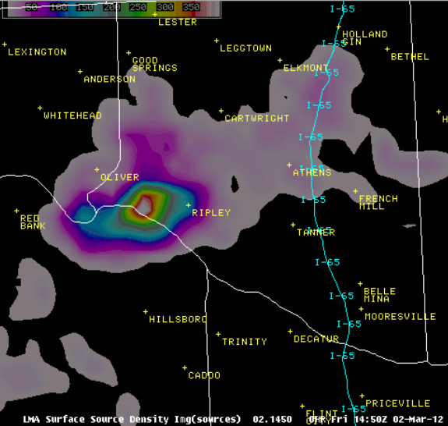
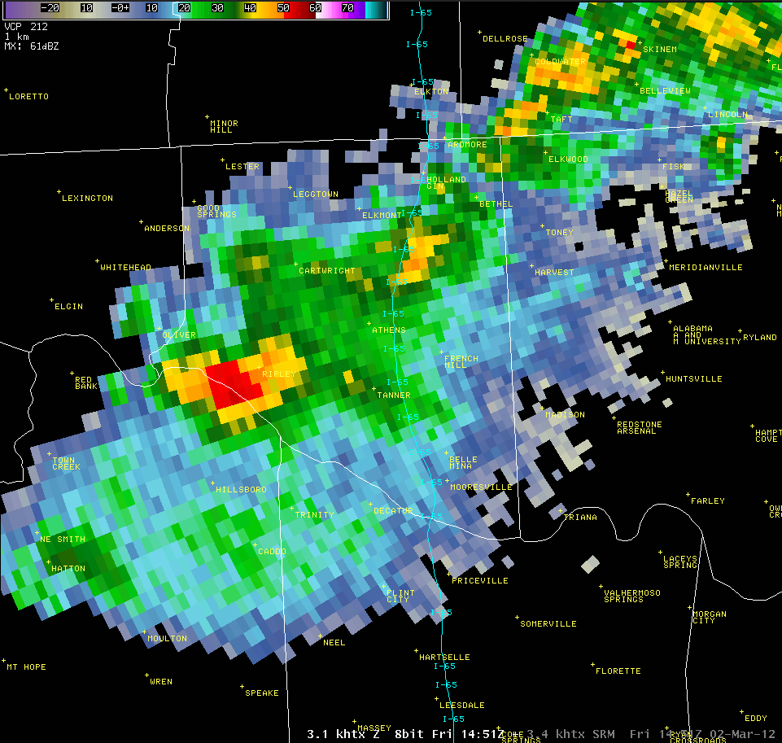
Total Lightning … In a Flash
1450 UTC
Total Lightning
Total Lightning
Intra-cloud and cloud-to-ground
Rapid updates
Physical Reasoning
Driven by updraft in mixed phase region (above -10°C)
Stronger, deeper updrafts
More lightning
Increase = strengthening updraft
Applications
Rapid increases = lightning jumps
Severe wx decision support
Lightning safety: Extent and lead time on first cloud-to-ground
Aviation: Convective activity
Spatial extent
Developing updraft
3.4° Reflectivity
~6100 m (mixed phase region)
1452 UTC
Radar 2 min after lightning obs
Lightning 10s of km from updraft
Large lightning obs with updraft

Slide 4
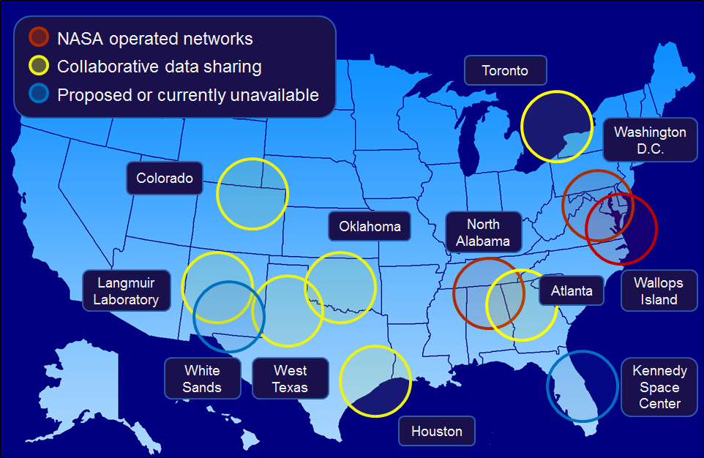
Applications Development Partnerships
SPoRT is collaborating with diverse group
Proving Ground
Satellite liaisons
WFOs
Aviation
NASA Marshall
Emergency Management
Satellite Foundational Course for GOES-R
In-house partnerships, NSSTC expertise

Slide 5
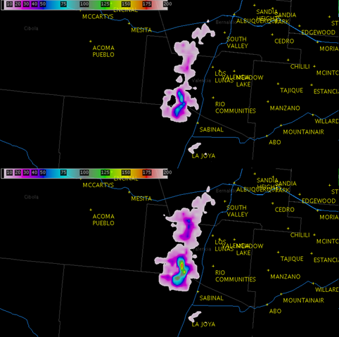
Weather Forecast Office Partnerships
Key Activities
Regular interaction with all partners
2014 assessment
Development of training / science sharing
“Classic” use: Lightning jumps (Example to right)
Wider uses: Lightning safety
New partnerships
WFO Buffalo, Peachtree City, and Atlanta CWSU
2x2 km, 1 min Source Density
2x2 km, 2 min Sum Source Density
Example from WFO Albuquerque
Notes:
Discuss all the uses and how this is preparing for GOES-R/S GLM, include visualization “results” (i.e., 2 min running sum)

Slide 6
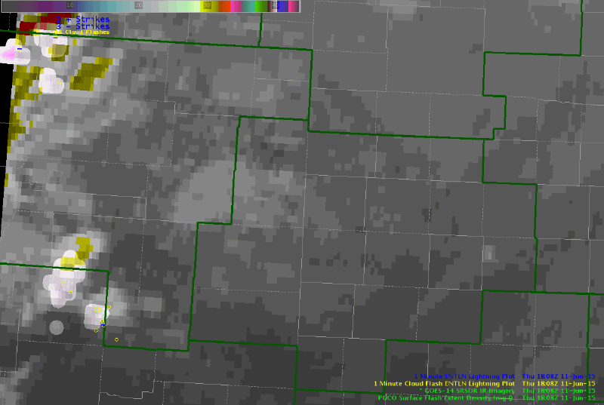
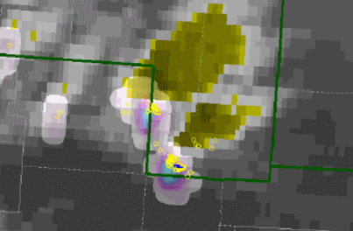
PGLM at the Hazardous Weather Testbed
Train on total lightning
Compare with other data sets (both current and future)
Key Lesson: LMA concepts applicable to 8 km GLM obs
Feedback now on visualization
Pseudo GLM flash extent density
Earth Networks IC/CG flashes
GOES-14 super rapid scan IR
PGLM – Shaded
ENI CGs – Blue
ENI ICs – Yellow circles
From 2015 Hazardous Weather Testbed

Slide 7
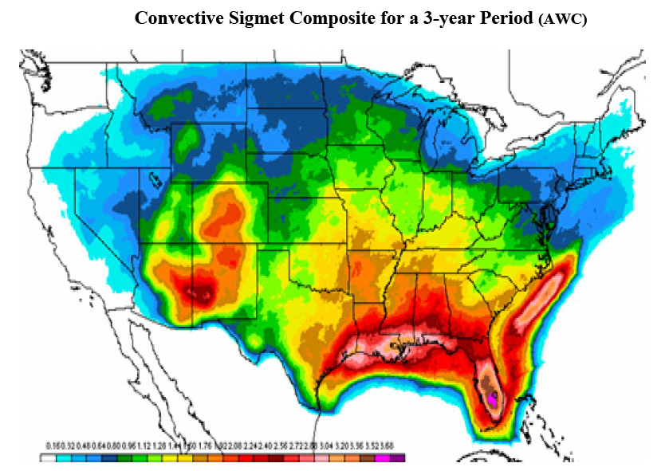
Aviation Weather Center (AWC) Activities
Grew from VSPs
Aviation not widely discussed in Proving Ground
Assess total lightning with Convective SIGMETs
Southwest and Gulf Stream has a high incidence of convective SIGMETs
However …
Poor radar coverage, especially at 16,500 feet.
Major flight corridors
Major flight corridors
Images provided by James Reynolds (CWSU ZAB)
Opportunity to implement alternative data sets

Slide 8
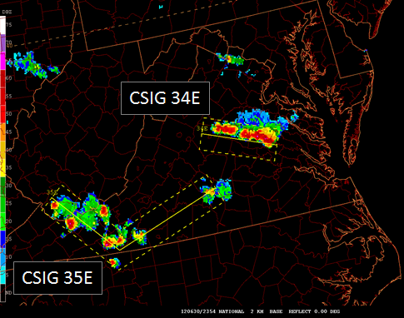
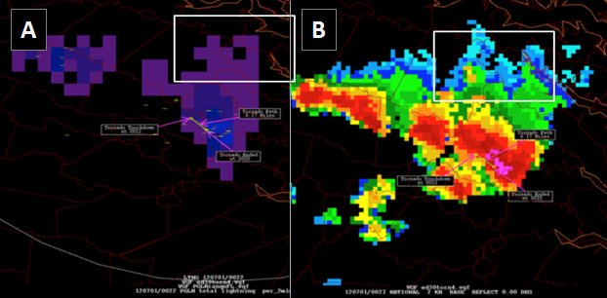
Impacts on AWC Activities
Convective SIGMETS for linear storms (left)
Encompasses highest reflectivity and where storms will go
Mostly ignores stratiform precipitation region (i.e., aircraft continue to fly through)
AWC evaluation of PGLM may change this
Lightning activity well into stratiform region
Aircraft wish to avoid this (maintenance checks, turbulence)
Notes:
Main takeaway – Total lightning has potential to change how CSIGs are done.
Publication underway with AWC

Slide 9
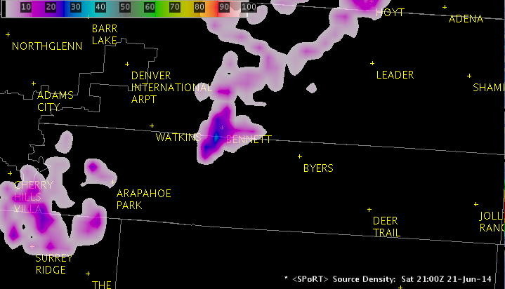
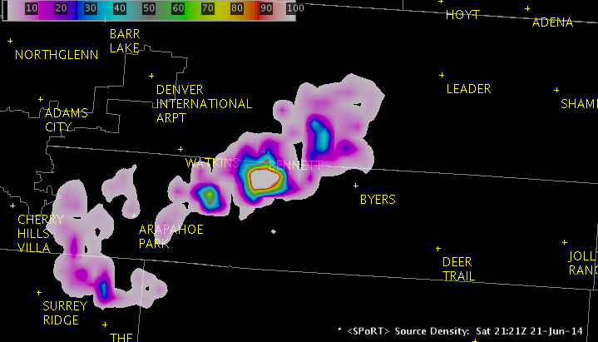
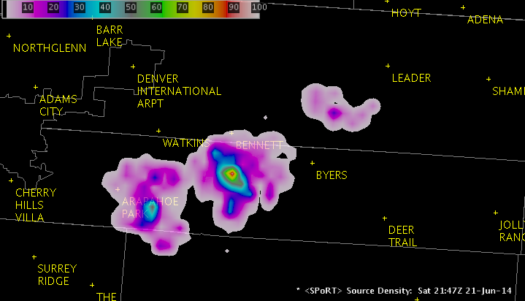
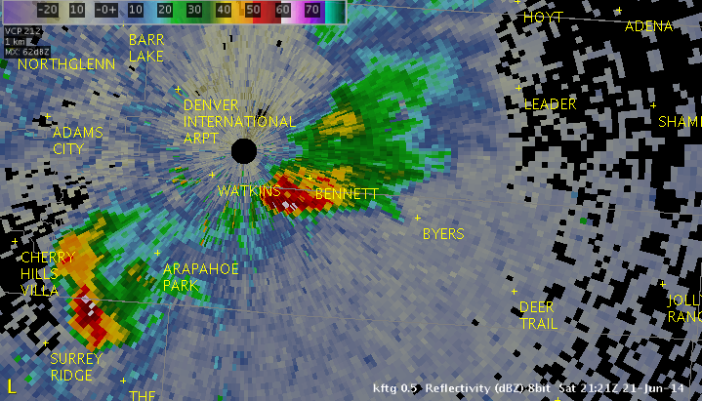
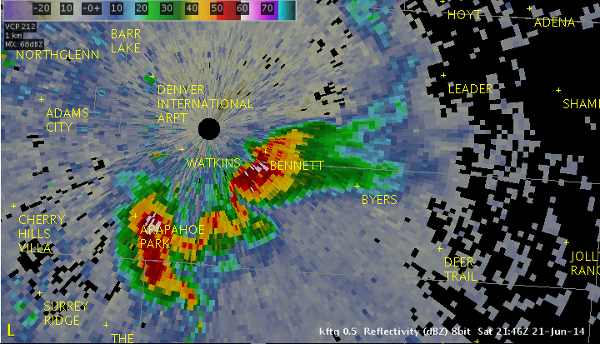
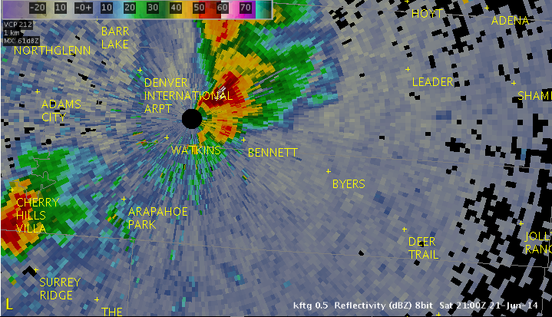
Aviation: Center Weather Service Units
Terminal Radar Approach Control (TRACON) Gate Monitoring
New storm core observed in total lightning observations prior to radar
CWSU informs Traffic Management Unit of impending route closure
Air route is completely closed by convection
Total lightning spatial extent and rapid updates provided additional insight into convective activity
2121 UTC
Gap in storms southeast of Denver International
Allows for continued air traffic within TRACON air space
2147 UTC
2100 UTC
Key findings:
Total lightning useful to monitor convection (extent and duration) to advise Traffic Management Unit
Example from CWSU Denver

Slide 10
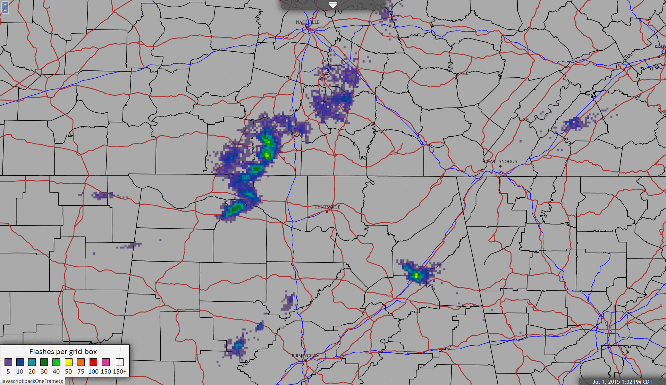
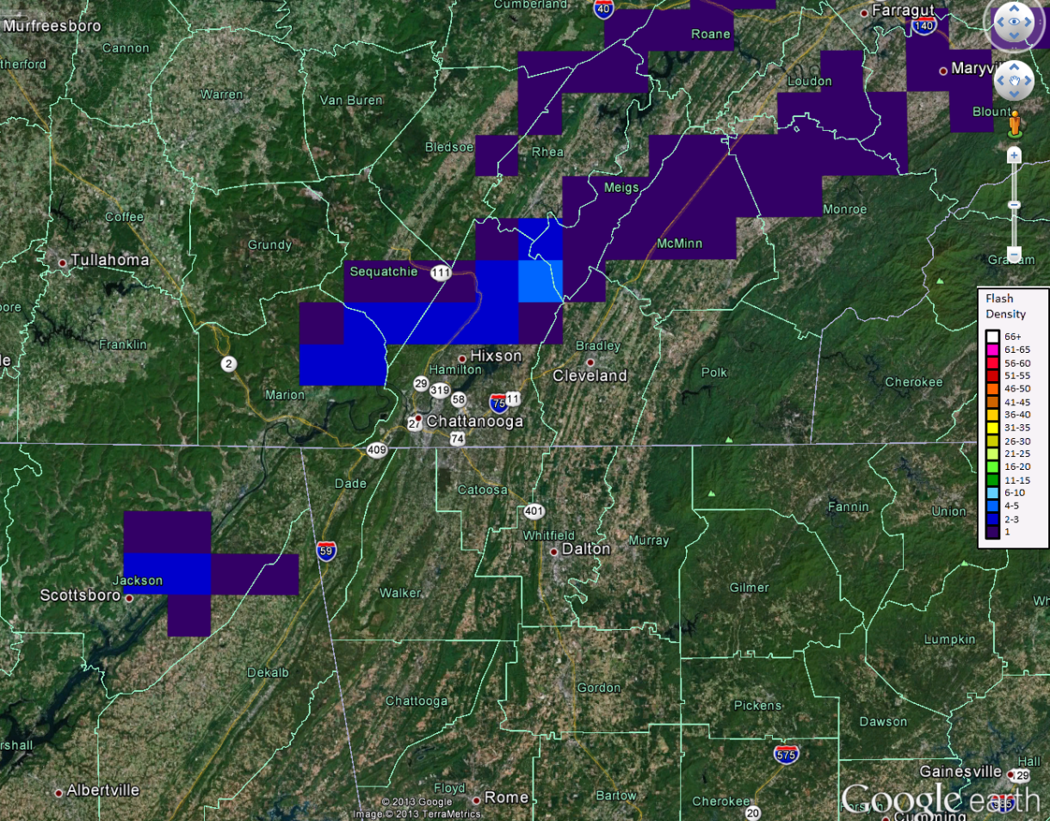
Lightning Safety – Emergency Managers
Initiated by NWS partners to work with emergency managers
Usable by users without AWIPS
Works on mobile devices
Applicable to other data sets (i.e., GLM, Earth Networks, etc.)
Opens collaborations with other users
Tennessee
Chattanooga
1 July 2015
1857 UTC
Hamilton Co.
Alabama
Georgia
Notes:
Explain the earlier Google Earth (started in 2009, to EMA in 2012, pros/cons)
Chattanooga / Hamilton County EMA feedback
Current display greatly improved over original Google Earth display
Three big events: US Women’s soccer exhibition (22 K people), FBI crime scene in July, Ray County nuclear power plant exercise
Tool is used regularly to monitor storm activity – Used on all platforms (phone, tablet, PC) – Tool “keeps us from guessing”
Interest in updating display to include radar, dynamically added range rings
EMA fully endorses effort and looks to aid in formalizing work with NWS, other EMAs, other users

Slide 11
Lightning Safety – Emergency Managers Example
Chattanooga / Hamilton County EMA: August 19 2015
EMA was using the new total lightning display available on iPad
Providing decision support for the U.S. Women’s National Soccer Team game
Monitoring small storms approaching stadium in Chattanooga
Noted lightning activity in approaching storms
EMA, with consultations with NWS Morristown deemed storms a threat
Evacuated stadium (20 thousand spectators) and postponed game 83 minutes

Slide 12
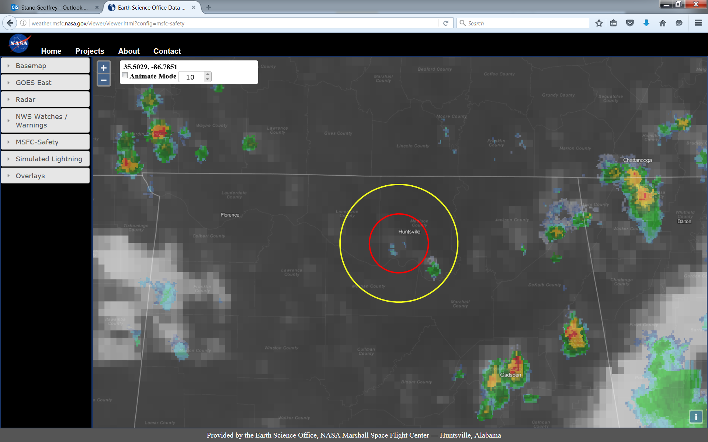
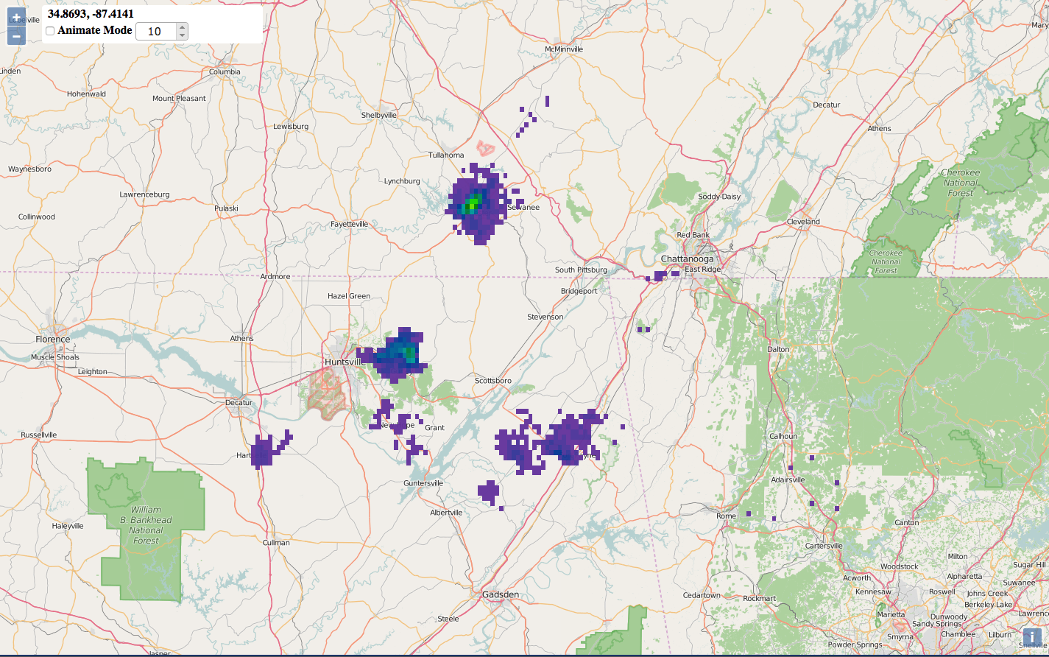
Lightning Safety – Marshall Space Flight Center
New effort: Funded by MSFC Center Innovation Fund
Integrate observations into a single visualization tool
Work closely with MSFC emergency management
Initial Sample Page
10, 20 mi range rings (MSFC)
1st GeoTiff sample in WMS
Radar and IR
Support other NASA Centers
Ultimately could support many non-NWS partners
Notes:
Funded by MSFC now, aim for NASA Centers, could become go-to tool for non-NWS partners (both domestic and international)

Slide 13
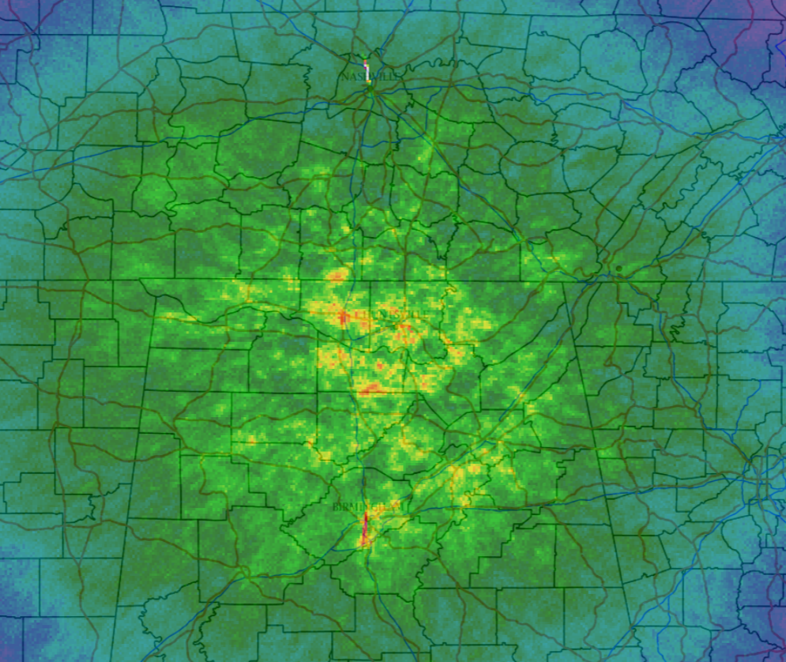
Total Lightning Climatology
Data currently include March 2003 through September 2015
Numerous uses
Allows for data mining (flashes by month, season, time of day, environmental parameters, etc.)
Creates a quality controlled data set for NASA and UAH researchers to easily access
Some fun stats:
3.03 billion sources processed
31.6 million flashes of 10+ sources
Flash initiation density climatology
(Initiation points / 2 km² / year)

Slide 14
Lightning Initiation Algorithm - UAH
Geostationary and radar methods exist to identify/predict 1st lightning flash
Satellite first lightning forecast (up to 60-90 min) with ~75% confidence
Radar first forecast (~10 min) with ~90% confidence
Identify and track growing cumulus in GOES imagery
Calculate first flash Lightning Initiation (LI) satellite fields
If LI is forecasted, produce a polygon downwind from satellite-derived winds valid for 45 minutes
If radar echo forms, continue tracking within the WDSS-II (Lakshmanan et al. 2007); rely on Multi Radar Multi Sensor (MRMS) dataset
If echo surpasses 40 dBZ at –10 C threshold, flag the LI polygon that lightning is imminent.
Validation occurring over U.S. using NLDN datasets.
Combined with HRRR model Lightning Flash Algorithm to predict future lightning flash rates.

Slide 15
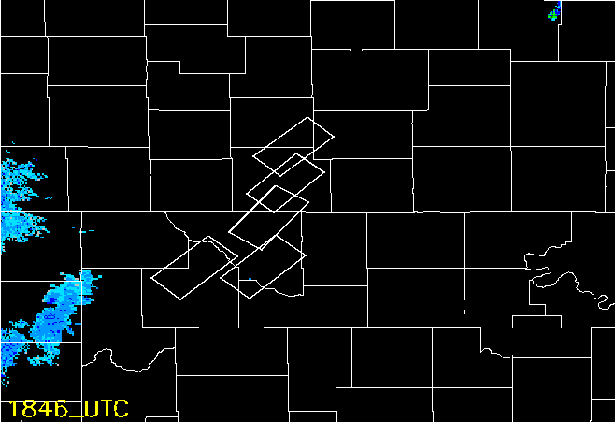
Lightning Initiation
May 9, 2016: Southern Kansas and Northern Oklahoma
Notes:
White boxes denote GOES satellite-based Lightning Threat, valid for 45 min. Purple boxes denote radar-based Lightning Threat, valid for 10 min.

Slide 16
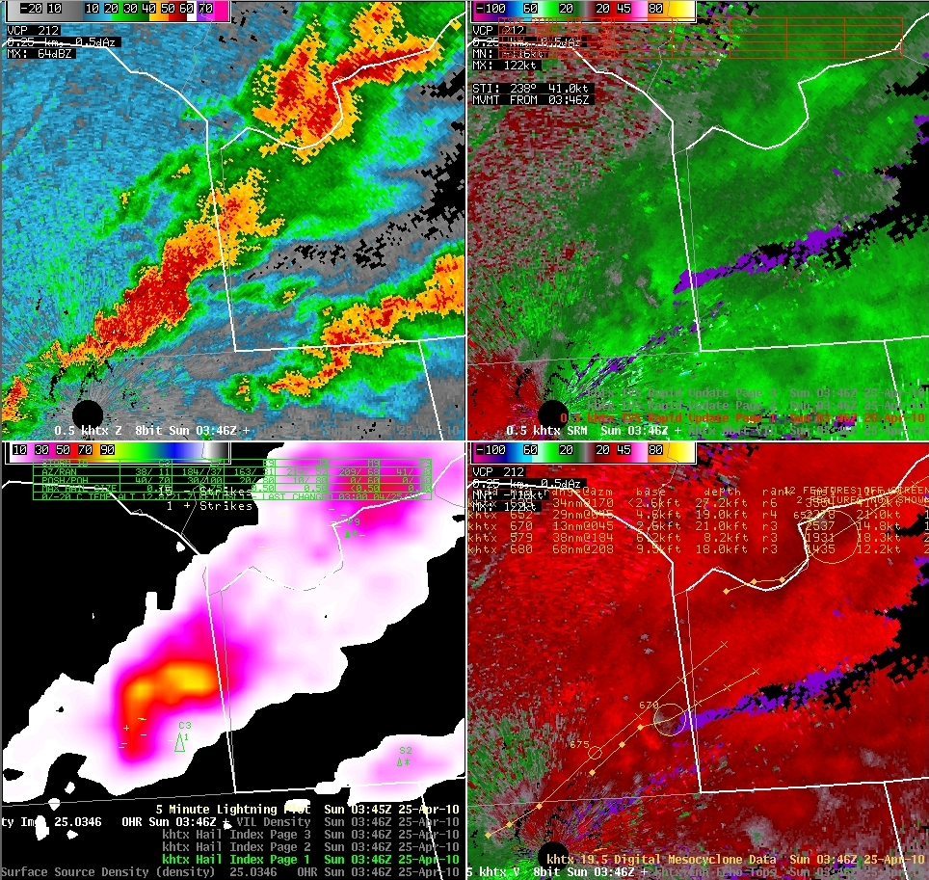
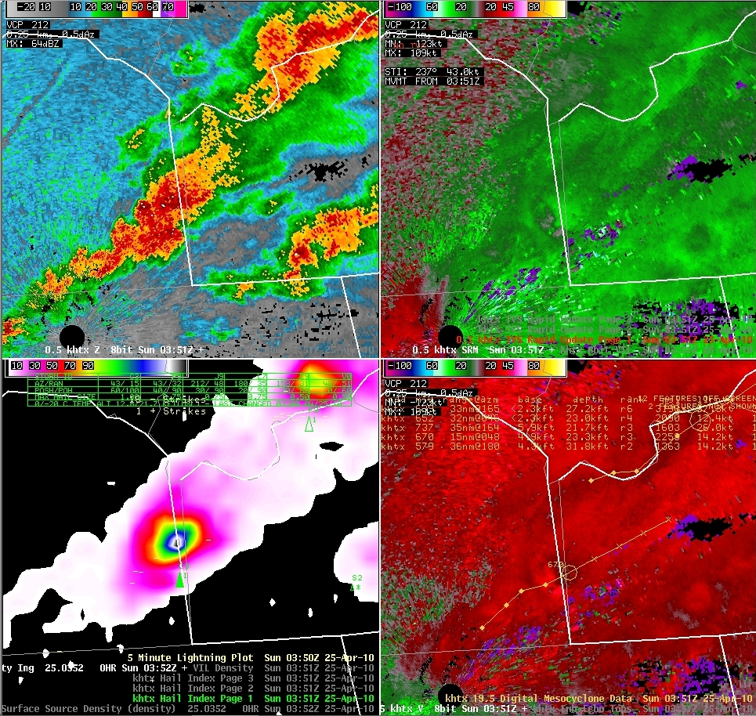
The Lightning Mapping Array Plug-in
Needed way to continue to display lightning mapping array in AWIPS II
Developed plug-in to allow support on legacy and new AWIPS
Coordinated with NWS on vetting the plug-in
First 3rd party plug-in to receive ATAN approval
Now a baseline component
Set stage for SPoRT to develop the GLM plug-in
Lightning jump

Slide 17
Meteogram Trace Tool
First Jump
Moore, OK Tornado
1950 UTC (6 min prior to touchdown)
NOTE: Lightning jump at ~1910 UTC
Joint effort between SPoRT and the Meteorological Development Laboratory
Grew out of National Weather Service Request
Functional on many gridded data (e.g., radar, satellite, models)
1st product evaluated after Operational Readiness Evaluation proposal call
Future work to include the lightning jump algorithm
Baselined AWIPS capability

Slide 18
Preparing for the Future: GLM Activities
GLM Domain for GOES-East or West Positions
Ties All Previous Work Together
LMA collaborations allow for examples in various locations
VSPs paved way for operational collaborations including National Centers and Aviation
Collaborators reaching out for new efforts (i.e., EMA work)
Creates a knowledgeable and diverse group to begin GLM assessments and training
Has led to GOES-R requesting SPoRT as the GLM satellite liaison
OTD + LIS lightning climatology (1995-2005)

Slide 19
GLM Visualizations in AWIPS
10 minute module
Best possible demo of what GLM should look like
1st ever use of GLM proxy in AWIPS
Compare to NLDN, ENI, and LMAs
Builds on SPoRT’s demonstrated strengths
Applications
Integration in AWIPS
Training abilities
Sets stage for future applications training

Slide 20
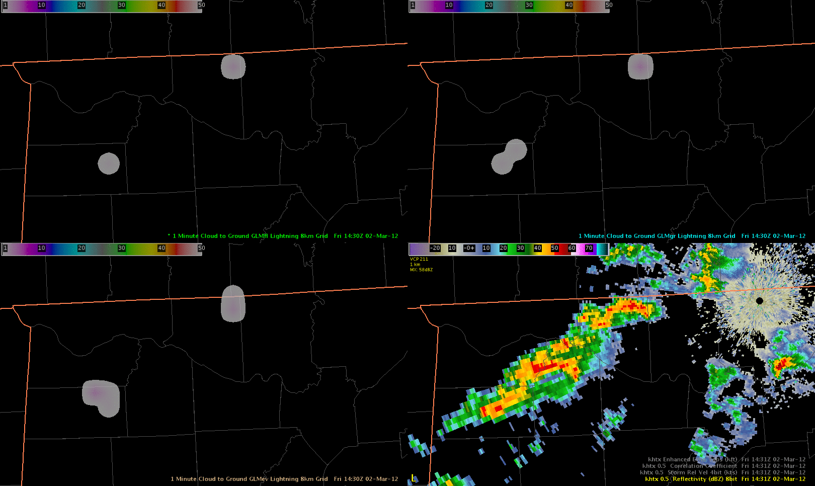
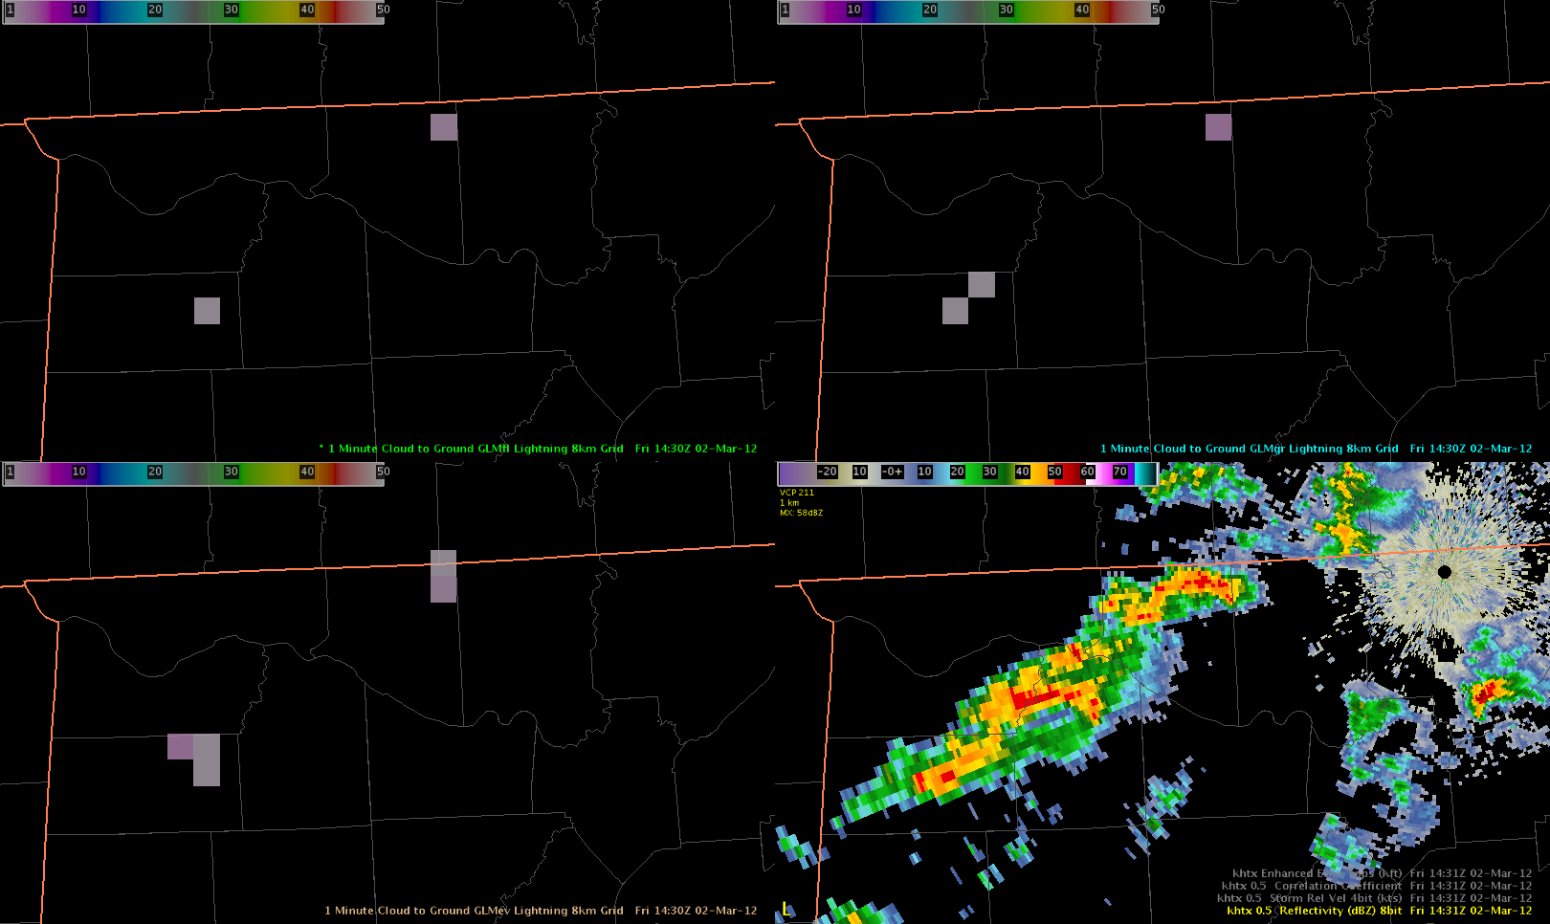
Animated GLM proxy in AWIPS
Flashes
Groups
Flashes
Groups
1 flash
2 groups
Events
Reflectivity
Events
5 events

Slide 21
Future Activities
Continue new role as GLM satellite liaison
Emphasis on GLM training, SPoRT applications library, and integrated quick guides in AWIPS
Pursue opportunities with non-NWS partners (i.e., EMAs)
Expansion of work with Chattanooga / Hamilton County and MSFC
New collaborations: Tropical cyclones with CIRA and NHC
Pursue international collaborations
Already started with Environment Canada
Visiting EUMETSAT in September
Continue to emphasize utility of base lightning data
Aviation emphasis continues with GLM use over Golden Triangle, and CWSU needs (i.e., case study work with CWSU Houston)

Slide 22
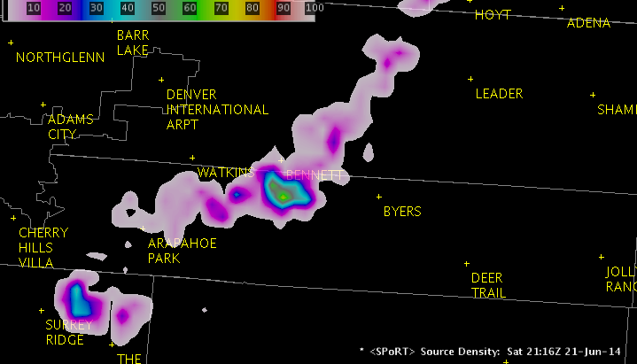
Timeline of Lightning Activities
Timeline of Activities
1996: 1st operational use with WFO Melbourne, Florida (pre-SPoRT)
2002: SPoRT established
2003: SPoRT transition to WFO Huntsville, Alabama and 1st warning
2008: Operational assessment
2009: Development of pseudo-GLM demo product; Begin Hazardous Weather Testbed participation; Initial training module
2010: 1st evaluation of pseudo-GLM
2012: National Centers partnership; Non-severe use emphasis
2013: Partnership with Center Weather Service Units; 8 collaborating LMAs; Begin Aviation Weather Experiment participation; Emergency management collaboration
2014: Aviation use assessment; Operational uses training module
2015: LMA plug-in baselined; Creation of GLM plug-in; Mobile device web display
2016: International with Toronto LMA; EUMETSAT; WMS display for MSFC safety
Training Activities
Basic LMA primer
Three part operational uses module
Lightning jumps / severe weather
Lightning safety
Unusual cases
Demonstration of the pseudo-GLM
Total lightning use for National Centers
Quick guides for LMA and pseudo-GLM
Science expert for COMET GLM module
Visualize GLM in AWIPS for NOAA/NWS
Developing applications library
Applications with GLM (post-launch)

Slide 23
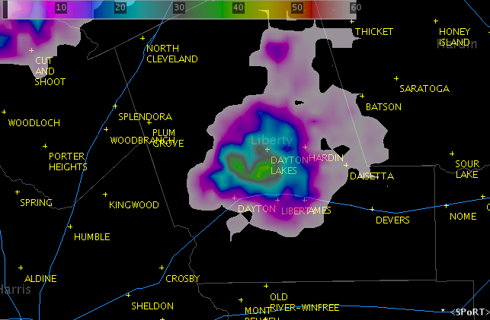
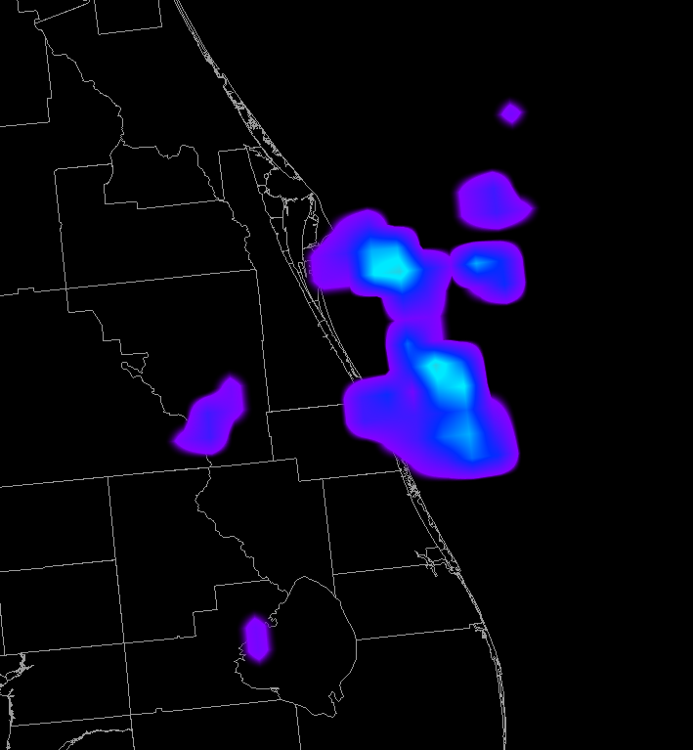
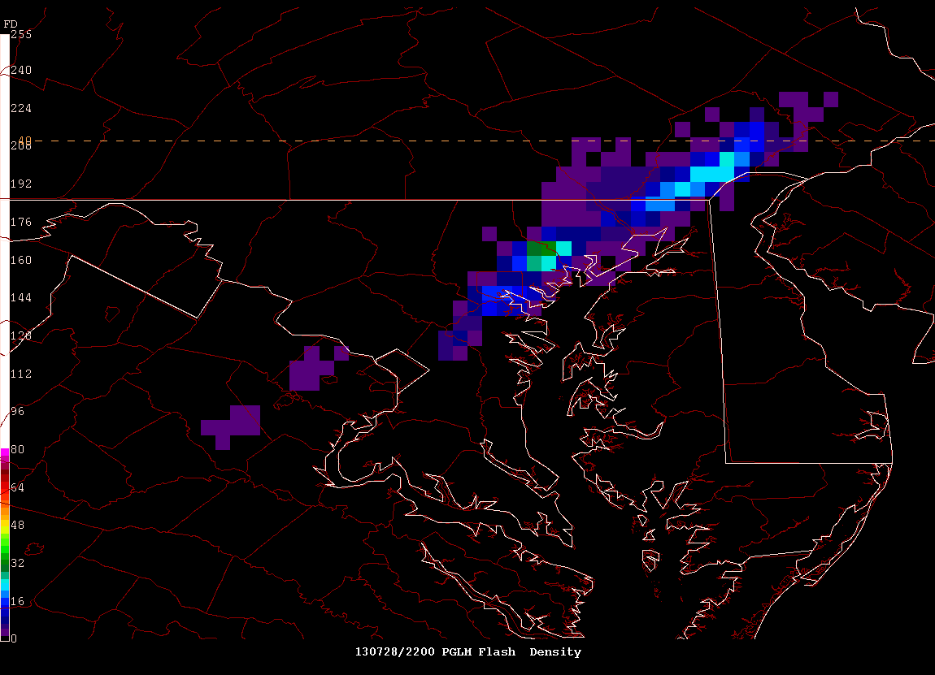
Qualifications for Lightning Applications
NSSTC: Largest concentration of lightning scientists
Developers of OTD, LIS, ISS-LIS, and GLM
Constant interaction between NWS, UAH, and NASA on research and applications
Stano: Enhanced KSC/Cape Canaveral lightning safety, Pseudo-GLM for GOES-R, forged LMA collaborations
Schultz: UAH lightning jump, lightning-radar research

Slide 24
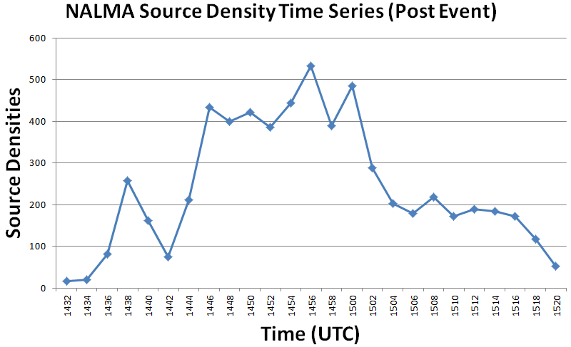
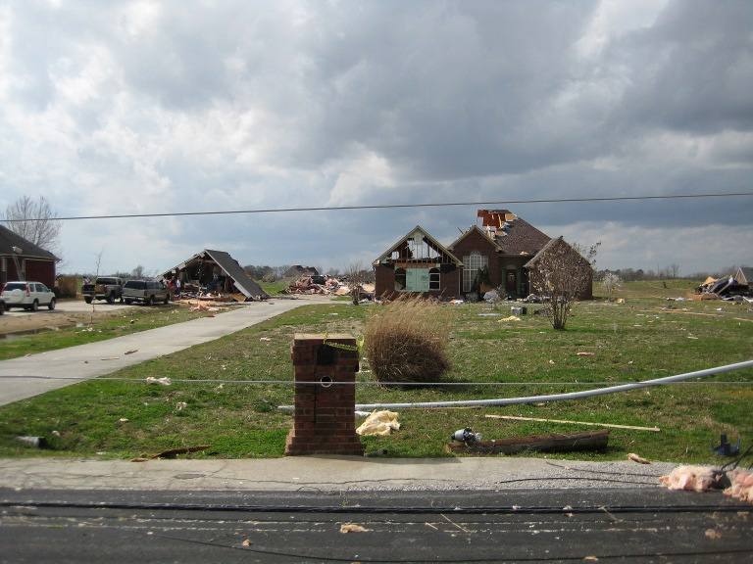
Classic Use – Warning Decision Support
Summary
Favorable storm environment
Total lightning coincided with radar in pointing out main cell
Lightning jump preceded definitive radar signature
Lead time of 24 minutes
No cloud-to-ground trend
Forecaster Quote
“… data from 1446 UTC made it clear that the storm was indeed strengthening.”
Velocity Couplet
Touchdown
Lightning Jump
Debris Signature
EF-3 Tornado (216-266 km/hr)
Photo: National Weather Service

Slide 25
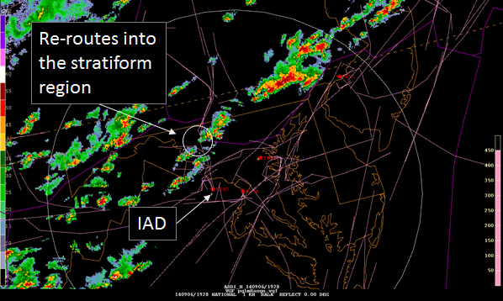
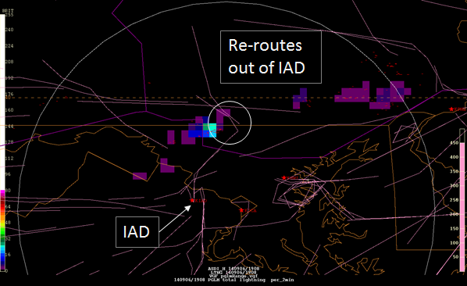
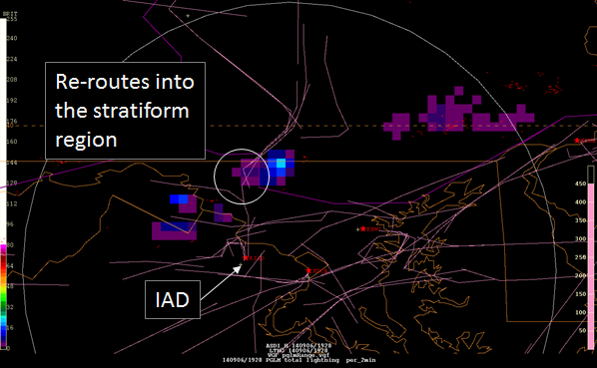
Aviation Weather Center (AWC) Activities
National Aviation Meteorologist located in Washington D.C.
Coordinate with AWC on air route management
Sept. 6, 2014 (1928 UTC): Routing aircraft around storms based on radar through stratiform region (left)
DCLMA pseudo-GLM noting that re-route was into active lightning region (5-10 per two minutes)
No NLDN observations
Risks lightning strike as in ascent/descent phase
Not fatal, but costly maintenance
Notes:
National Aviation Meteorologist – September 6, 2014
Noted storms on radar and began reroutes
1928 UTC noted that reroutes, while in stratiform region were going into active lightning
Lightning not fatal to commercial aircraft, but can result in costly repairs and maintenance checks

Slide 26
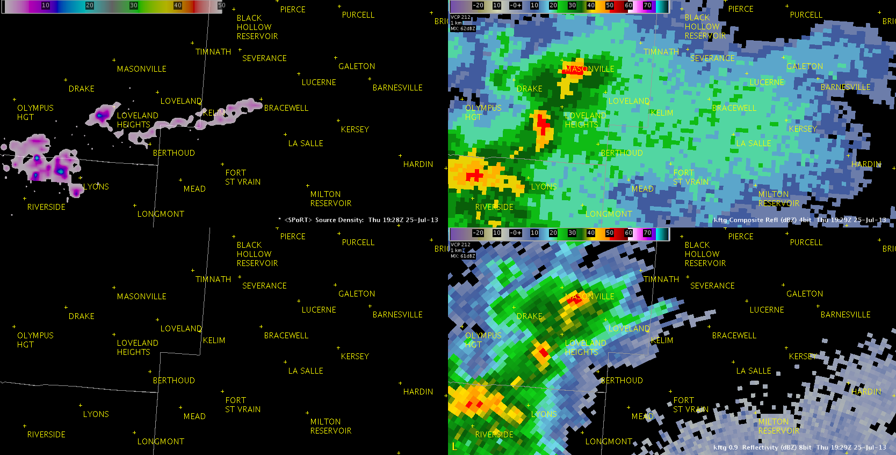
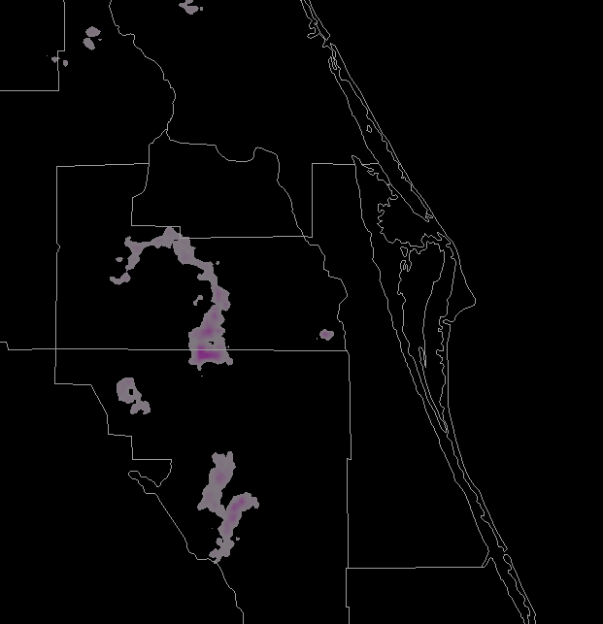
Extended Flashes
Source Densities
Composite Reflectivity
AWIPS II – 1928 UTC
Extended ~42 miles (67.5 km)
Originated in storm core
Extended through weak reflectivity region
0.9° Reflectivity

Slide 27
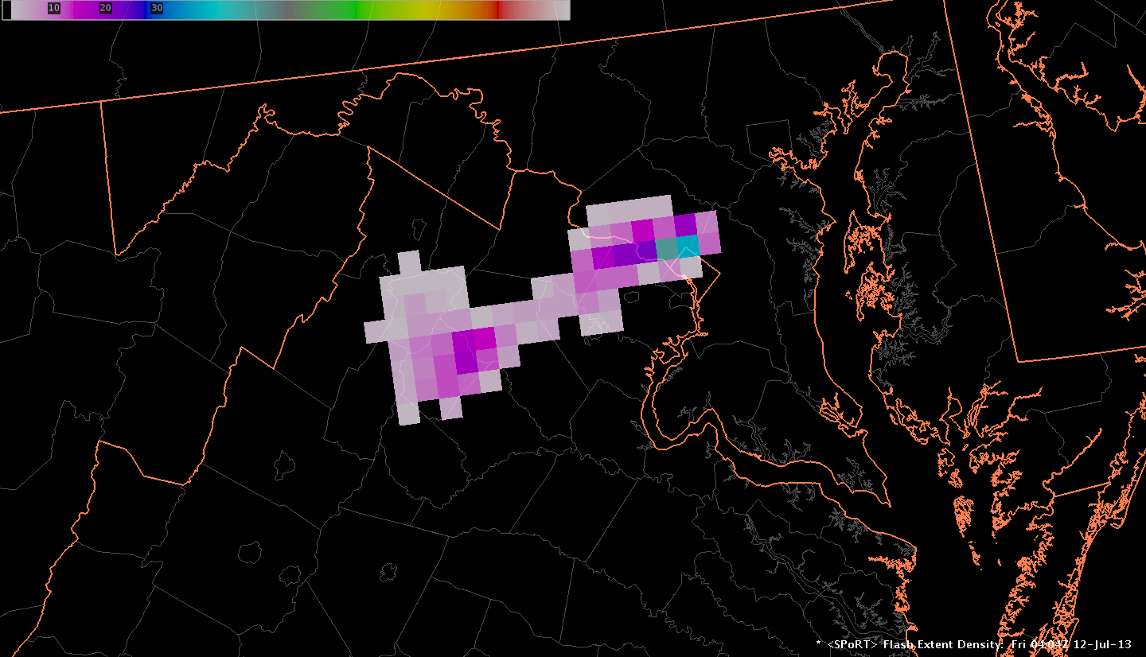
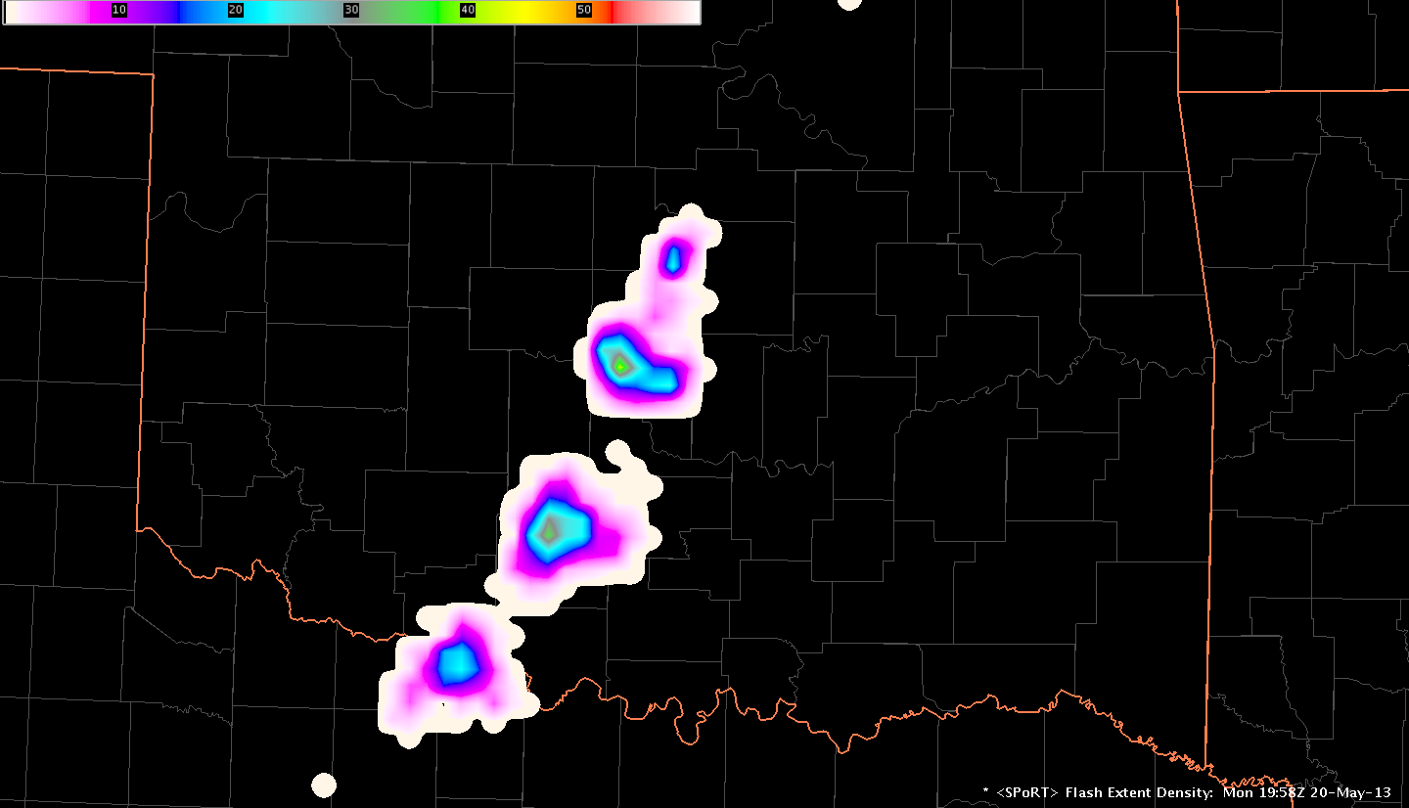
GOES-R Proving Ground – Pseudo Geostationary Lightning Mapper (GLM)
Prepare forecasters for GLM
Counts lightning flashes, one of the GLM products
Pseudo GLM only uses ground-based VHF data
GLM is optical based
Pseudo GLM is for training
Flash rate trends
Cellular flash density patterns
Washington D.C. (non-interpolated)
Oklahoma
(interpolated)

Slide 28
Total Lightning … In a Flash
Total Lightning
Intra-cloud AND cloud-to-ground
Total Lightning Activity
31 Individual Storms
Cloud-to-Ground Strikes
Inter-Cloud Flashes

Slide 29
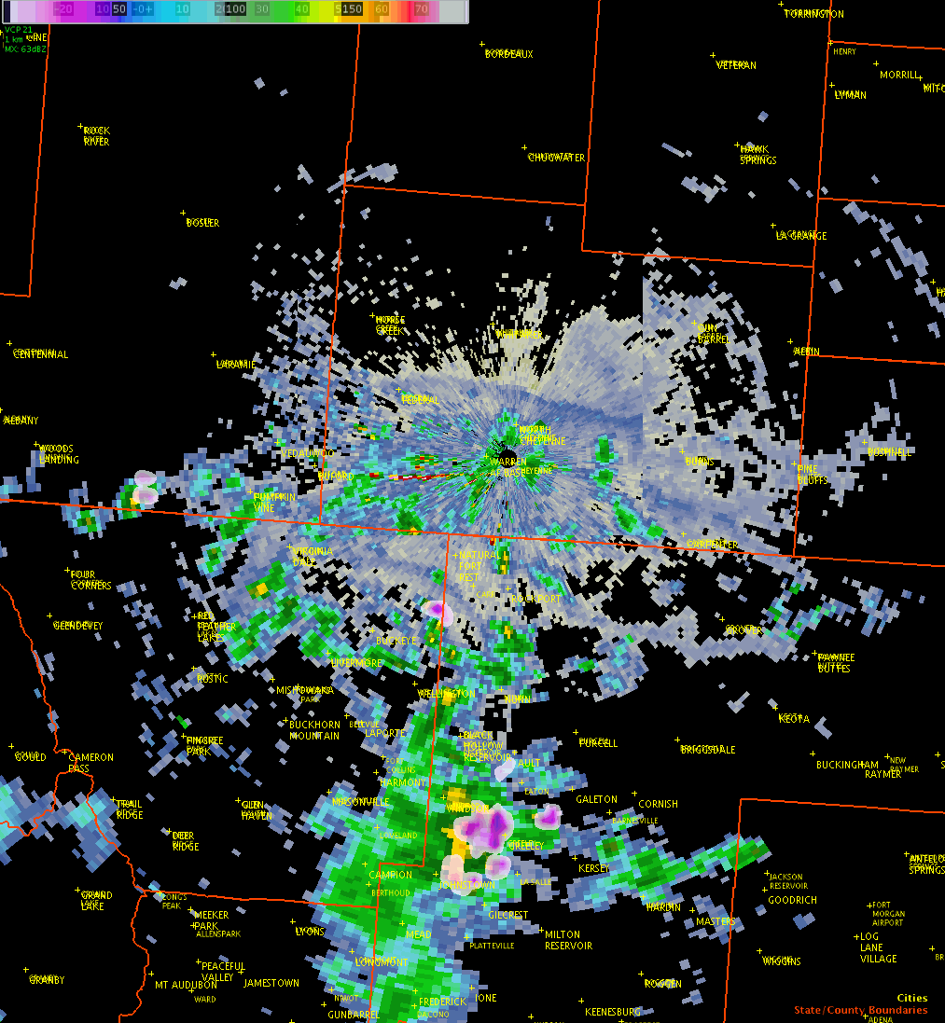
Lightning Safety – NWS Incident Support
Cheyenne Frontier Days Rodeo
Largest outdoor rodeo in world
10 days, thousands of visitors
“The WFO was providing weather support to the Laramie County Emergency Manager on the evening of July 20th. Convection developed south of Cheyenne, moving north producing some total lightning. The activity remained greater than 15 miles from Frontier Park and [the data] proved extremely useful in enhancing situational awareness and forecast confidence throughout the event.

