Slide 1



Future Modeling and Data Assimilation Activities
Bradley Zavodsky, Andrew Molthan, Jonathan Case, Clay Blankenship, Aaron Naeger, Nicholas Elmer, Jayanthi Srikishen

Slide 2
Outline
Transition SPoRT-LIS to Noah-MP
R2O for GSFC Research into SPoRT-LIS
NASA R2O Into National Water Model
Ensemble Modeling Initiatives
International Collaborative Experiment – PyeongChang Olympic Paralympic (ICE-POP)
Regional Seasonal Forecasts
Aerosols for cloud/precipitation dynamics and radiative transfer modeling
Reduction of emphasis on hyperspectral IR retrieved profile assimilation

Slide 3
Develop SPoRT-LIS with Noah-MP
NOAA LSM activities are migrating to the Noah-Multiphysics (Noah-MP) land surface model
Continued development of SPoRT-LIS products will occur, including a Noah-MP run that will either replace or create a mini-ensemble for the current Noah version (similar in concept to the NLDAS-2)
  Noah-MP enables connectivity to the National Water Model (NWM)
  Plan to implement a NWM configuration of SPoRT-LIS using Noah-MP
  Provides more consistent input land surface fields to Elmer’s WRF-Hydro studies
  Groundwater model in Noah-MP enables assimilation of total terrestrial water
Allows the opportunity to investigate satellite-based land products, such as Leaf Area Index (LAI), that may allow SPoRT to develop future composite modeling products
Will continue coordinating with GSFC/NCAR team on coupling LIS and WRF-Hydro capabilities

Slide 4
R2O for GSFC Research into SPoRT-LIS
GSFC has performed substantial research into assimilation of various datasets into the LIS
  Snow water equivalent
  Irrigation
Leverage ongoing collaborations with NU-WRF/LIS team at GSFC to identify datasets that have had positive impacts in publications and integrate real-time data download, ingest into SPoRT-LIS, and disseminate capabilities to partners
Improvements to these characterizations may aid in better representation of drought/flood percentile product over the Central Plains and Mountain West

Slide 5
NASA R2O Into National Water Model
Continue research activities to demonstrate NASA datasets in National Water Model (NWM)
  SAC Member Joe Santanello has a NASA-funded project to link LIS and WRF-Hydro in ESMF
  NWS Director Dr. Louis Uccellini expressed his desire to see the NASA LIS linked to perform data assimilation of land surface datasets into the NWM
Develop offline, pseudo-operational version of the NWM in collaboration with modelers at the NWC to allow NASA researchers to testbed NASA-funded research in the operational environment
  Invited presentation to the NASA Applied Sciences Water Resources
  Hydrology modeling civil servant position to open shortly in USAJobs
From: Gochis et al. (2016) presentation to NWM developers/implementers

Slide 6
Ensemble Modeling Initiatives
Continued development/investigation of the impact of NASA datasets and physics for regional-scale model for scientific evaluation of land surface impacts on model VORTEX-SE
  Implement day-after ensemble for study of days of interest for different convective modes related to VORTEX-SE
  Investigate use of virtualization (e.g., Docker) for setting up collaborative ensemble capabilities across NASA Centers or organizations and how we can help NWS with evolving local modeling concept
MAP proposal submitted with Toshi Matsui (GSFC/UM) to investigate ensemble forecasting for extreme events; opportunities to further deploy MET Scripts
Pursue development of a NASA regional ensemble with high-resolution datasets (LIS, SST, GVF) to support launch operations
  SPoRT collaborated with AMU to develop a deterministic local NWP system for flight ops used during Orion test flight in December 2014
  Included in Natural Environments Day of Launch Working Group to pursue funding from KSC/WPP launch support groups
Development of daily south-Asia deterministic and on-demand convection-allowing ensemble system using NU-WRF to identify regions favoring intense thunderstorms
  Case and Bell Co-Is on SERVIR Applied Science Team proposal led by Dr. Patrick Gatlin (MSFC)

Slide 7
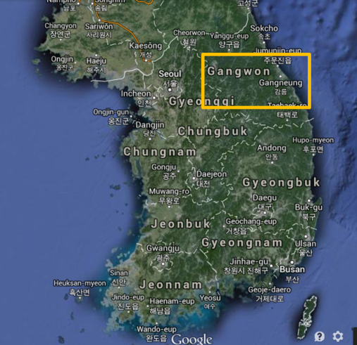
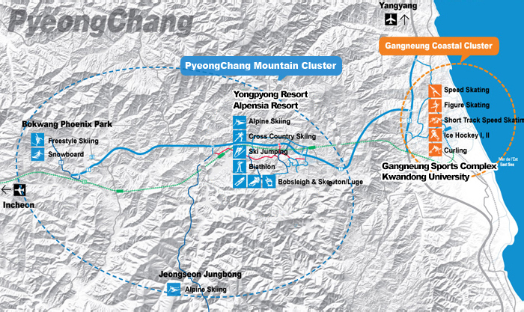
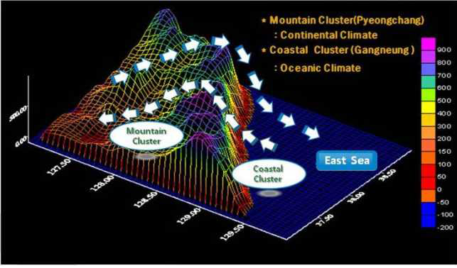
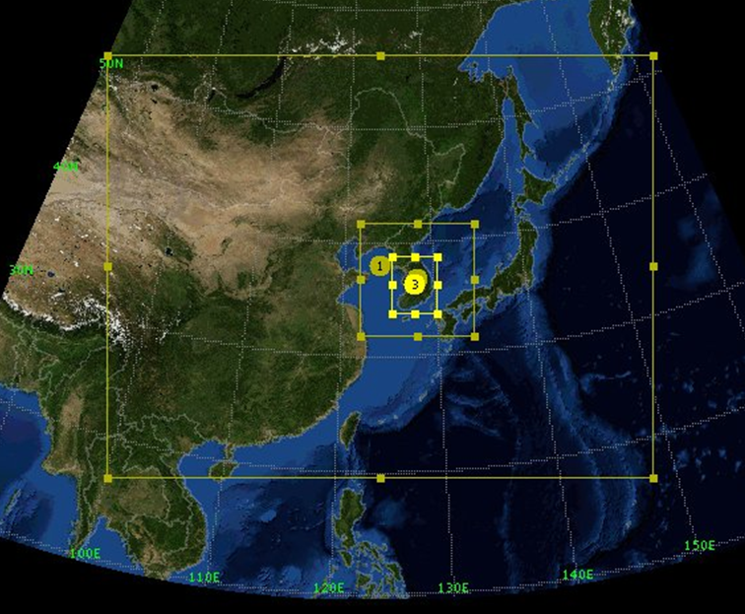
ICE-POP
Leverage GSFC/SPoRT NU-WRF collaborations and new SPoRT processing cluster to conduct daily NU-WRF simulations toward forecasting winter QPF over large topographic gradients.
Real-time distribution using FTP and/or WMS to submit member to international ensemble of forecasts with NASA-developed model physics and datasets (e.g., SPoRT SST, LIS) in daily forecast mode for experimental evaluation during Olympics.
Determine governing model physics/resolution required to improve predictability in coastal/orographic snow events.
Leveraging Core funding with supplemental funding

Slide 8
Regional Seasonal Forecasts
Extend capabilities developed during NASA Downscaling project
Partner with MSFC’s Brent Roberts to investigate applications of seasonal-scale numerical model downscaling for domestic and international partners
  Brent has developed an operational climate product called ClimateSERV that is a global, bias-corrected, daily (to 180dy), downscaled forcing for all 105 operational NMME ensembles
  Use dynamic downscaling approach to increase spatial resolution and capture some smaller scale features
  Investigate extended forecasts for the National Water Model that use atmospheric forcing from these spatially downscaled runs to provide additional guidance on areas where flooding may occur
  Collaborate with SERVIR to reach international partners for agriculture/food security applications
Jon Case is a Co-I on a “High Mountain Asia” proposal that includes a dynamic downscaling component to investigate precipitation and hydrologic impacts in the Himalayas that can be used to flesh out some of these concepts

Slide 9
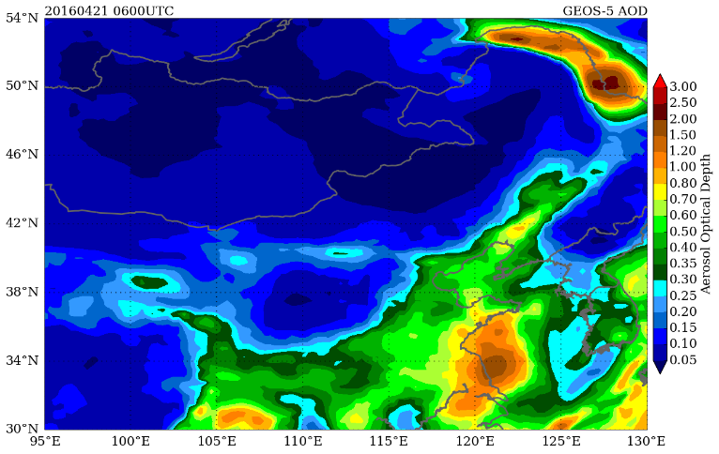
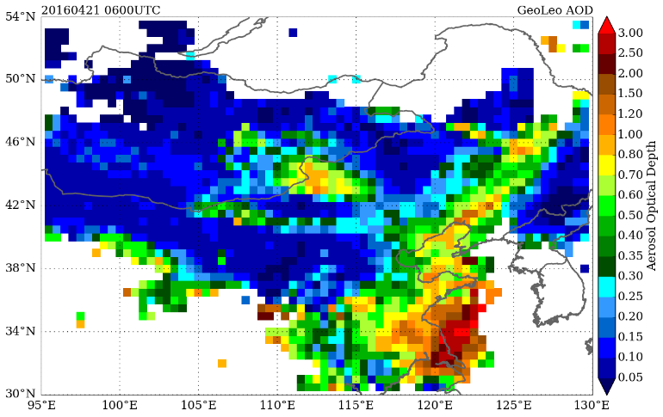
Aerosols for Clouds and RTM
Leverage AOD composite product to investigate regional aerosol impacts on cloud/precipitation NWP
  New aerosol-aware microphysics schemes may allow for better use of remotely-sensed aerosol data
  Have written a number of well-scored proposals that have not been selected for funding
Investigate aerosol-affected radiances in GSI
  Submitted a NDOA proposal to the JCSDA Area to enhance collaborations with GMAO on how aerosols are handled for IR radiances
  Use data from future missions (e.g., TEMPO) to enhance AOD products to determine aerosol impacts on CRTM for IR radiances
SPoRT AOD product captures some aerosols not produced in GEOS-5

Slide 10
Reduction in Hyperspectral IR Profiles
Since its inception, SPoRT has had expertise in assimilation of retrieved temperature and moisture profiles from hyperspectral IR sounders (e.g., AIRS, IASI, CrIS) into regional models
Previous SAC noted that the community from global to local models have moved on to radiance assimilation, for which NASA and NOAA have invested substantial resources, so the operational users for this type of assimilation is reduced
Last two leads for this type of work have migrated into larger leadership positions and success in filling contractors/students to fill that void has not had much success
Should SPoRT continue to pursue research into demonstrating hyperspectral IR profiles on regional/local modeling?

