Slide 1
Applied Science Activities
Andrew Molthan
Jordan Bell, Tony Cole, Lori Schultz

Slide 2
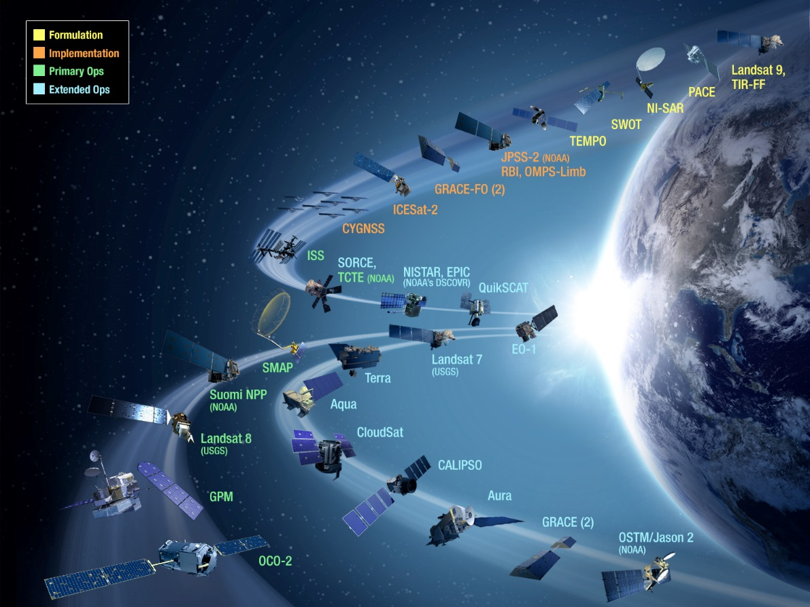
Participation in NASA Applied Science/Early Adopter Activities
SPoRT has capabilities that are funded by core funding, but continually are leveraging our resources to reach current and new end users through our R2O paradigm
These Applied Science Activities include:
Early Adopter Activities for Upcoming Missions
ROSES Awards in Applied Science and other competed awards
Directed Applied Science: Disasters Program activities

Slide 3
Participation in NASA Applied Science/Early Adopter Activities
SPoRT has participated in Early Adopter and Application Workshop Activities as a way to help promote use of NASA datasets with current and potential operational decision makers
S-NPP
Kevin Fuell and Andrew Molthan hosted an Application Workshop for S-NPP in Huntsville
GPM
Invited speaker at 2nd Applications Workshop
SMAP
Early Adopter for integration of SMAP into SPoRT-LIS for NWS forecasters
Used connections gained here to formulate successful SMAP Utilization proposal
CYGNSS
Participation in applications workshop
TEMPO
Mike Newchurch (UAH) and Brad Zavodsky hosted 1st Application Workshop for TEMPO
ICESat-2
Early Adopter for use of ICESat-2 data for NOAA model validation and potential situational awareness for seasonal winter ice accumulation
Hosting an Early Adopter Focus Session on Land/Sea Ice applications at SPoRT in November
NISAR
Participated in the 2015 SAR Mission Applications Workshop

Slide 4
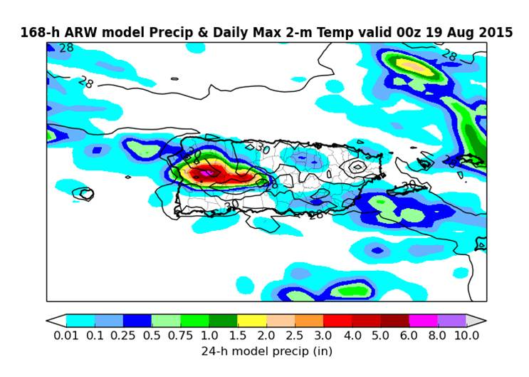
Modeling Support for Vector-Borne Disease Forecasting
Traditional public health studies/outlooks are done using retrospective climate data without the spatial resolution to capture island-scale temperature and precipitation features that drive mosquito vectors
MSFC Post-Doc developed a dynamic mosquito model for predicting Aedes Aegypti vectors
SPoRT linked NRT, high-resolution NU-WRF run with SST, LIS, and GVF to supply forecasts of temperature and precipitation
Funded by MSFC Center funds in FY15 and 16 to build out real-time linkages between the model for operational deployment

Slide 5
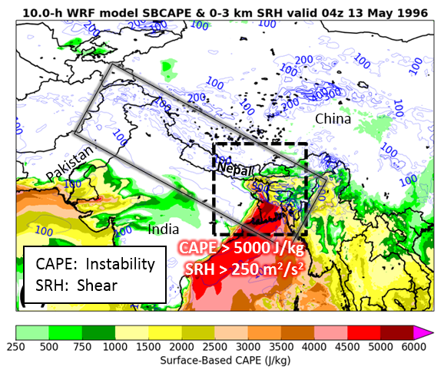
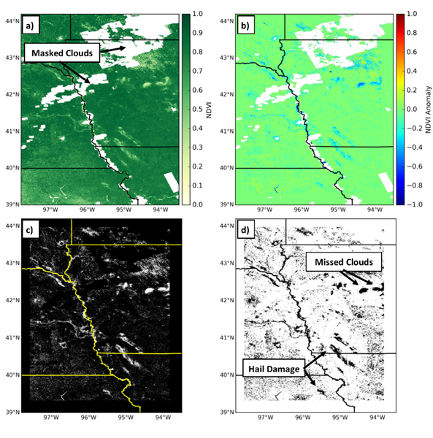
SERVIR Applied Science Team
SPoRT is a close collaborator with the SERVIR program, both through being name subject matter experts and through solicited funding opportunities.
SPoRT Team members were part of 4 of the 48 teams that reached the Step-2 stage in the 2015 SERVIR Applied Science Team ROSES call
1 of the 4 Step-2 proposals were selected
“Monitoring Intense Thunderstorms in the Hindu-Kush Himalayan Regions”
Proposal features SPoRT expertise in modeling through a unique approach and expertise in satellite remote sensing in severe weather damage evaluation.

Slide 6
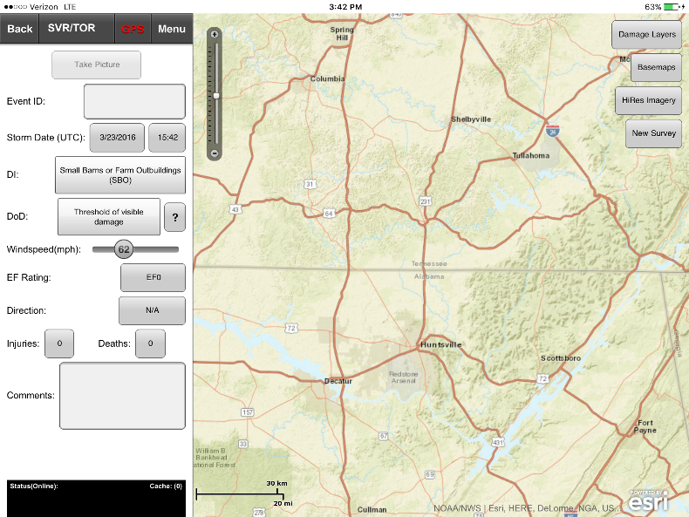
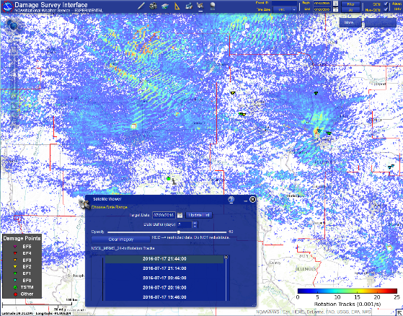
Enhancement of NWS Damage Assessment Toolkit (DAT)
with Earth Remote Sensing Data
The Damage Assessment Toolkit (DAT) is a GIS-based browser and mobile application that is being phased into the NWS to support storm damage surveys.
Mobile application:
EF-Scale descriptions with accompanying Degrees of Damage imagery are preloaded and available for reference out in the field
Takes advantage of the built in camera and geo-tagging capabilities
Web Browser:
Multiple dataset overlays available to help with post-event analysis
Personnel in office can quality control points while survey team still in the field

Slide 7
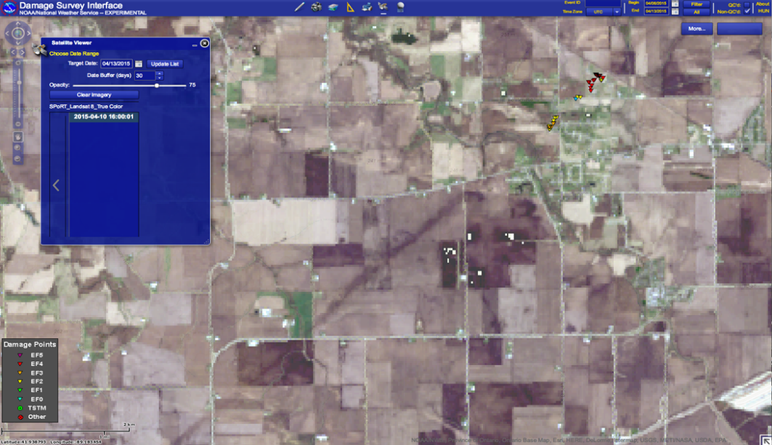
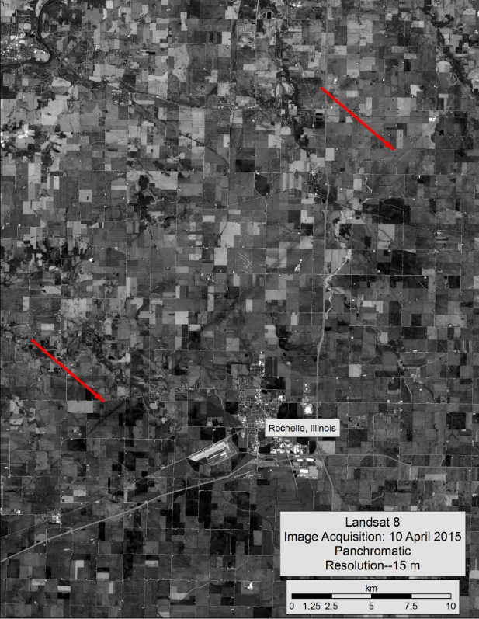
Enhancement of NWS DAT with Earth Remote Sensing Data
SPoRT was awarded a 3-year Applied Sciences Disasters project to help develop, transition, and implement satellite remote sensing into the NOAA/NWS Damage Assessment Toolkit.
Implementation of NASA remote sensing datasets into the DAT: MODIS, Landsat, EO-1, ASTER
Working with the USGS Disasters team, acquire, process and make available high-resolution commercial imagery.
Develop extensive and thorough training on how to load and interpret the imagery correctly, as well as understand the strengths and limitations of each.
Work with offices, as needed to troubleshoot
Transition the fully implemented code to NWS Central Region for testing and evaluation.
PUBLIC INFORMATION STATEMENT...UPDATED
NATIONAL WEATHER SERVICE CHICAGO IL
1247 AM CDT WED APR 15 2015
...NWS DAMAGE SURVEY RESULTS FOR 04/09/15 TORNADO EVENT...
NWS METEOROLOGISTS HAVE NOW CONFIRMED SEVEN TORNADOES ACROSS
NORTH CENTRAL ILLINOIS FROM THE EVENING OF APRIL 9. NWS CHICAGO
WOULD LIKE TO EXPRESS APPRECIATION TO NASA SPORT FOR THE SATELLITE
IMAGERY...NOAA REMOTE SENSING DIVISION FOR THE HIGH RESOLUTION
AREAL PHOTOGRAPHY...THE CIVIL AIR PATROL FOR AREAL
PHOTOGRAPHY...AS WELL AS THE ILLINOIS STATE POLICE AND THE MCHENRY
COUNTY EMERGENCY MANAGEMENT AGENCY FOR THEIR AREAL DAMAGE PHOTOS
AS WELL. ALL OF THIS REMOTE SENSING DATA ALONG WITH THE GROUND
SURVEYS WERE INSTRUMENTAL IN IDENTIFYING THE TORNADO PATHS LISTED
BELOW AS WELL AS THE DAMAGE INTENSITY.

Slide 8
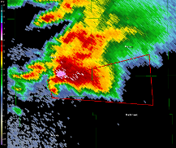
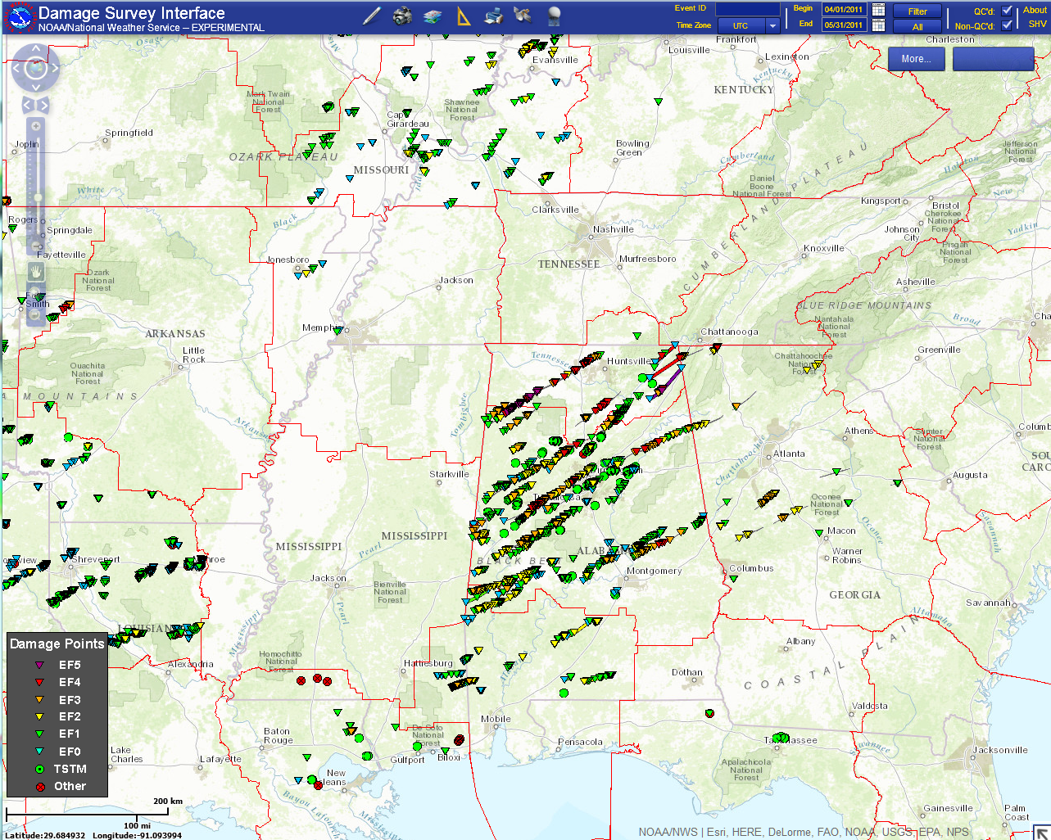
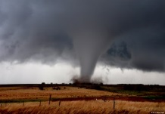
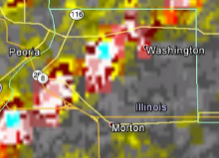
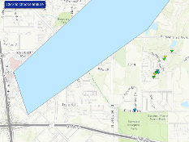
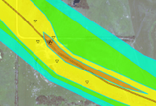
Enhancement of NWS DAT with Earth Remote Sensing Data
Warning Issued
Event Occurs
Potential Damage Area Identified
NSSL WDSS-II: On Demand
Survey Conducted
Survey Refined, and Improved

Slide 9
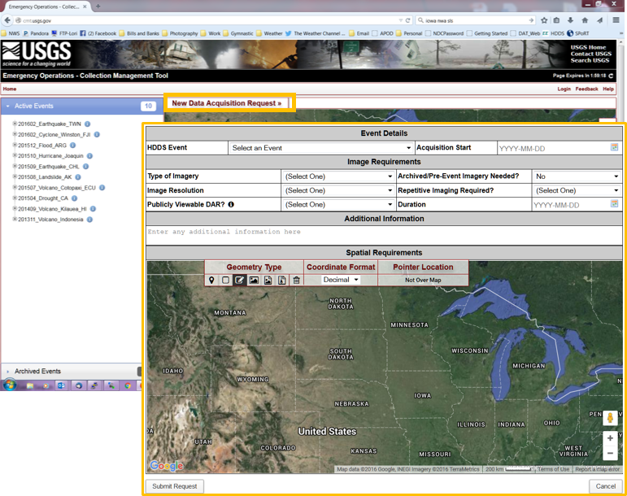
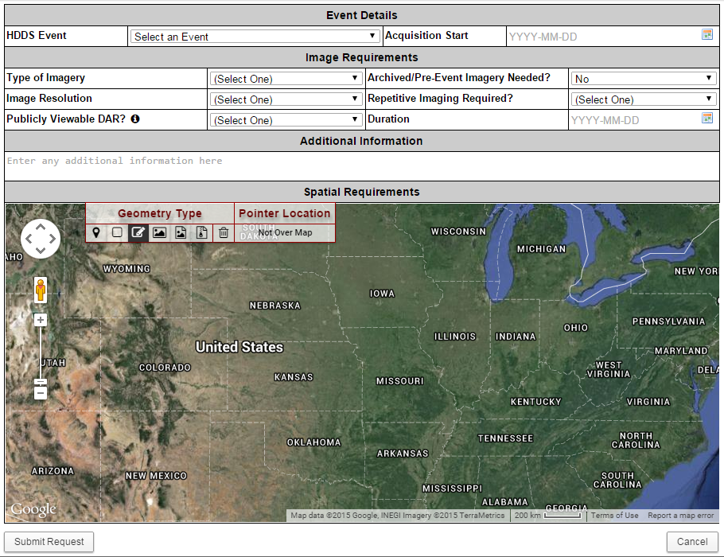
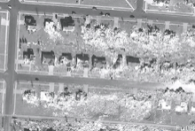
Enhancement of NWS DAT with Earth Remote Sensing Data
Warning Issued
Event Occurs
Potential Damage Area Identified
NSSL WDSS-II: On Demand
Image Request
USGS Collection Management Tool
Survey Conducted
Imagery Collected and Uploaded to DAT
Survey Refined, and Improved

Slide 10
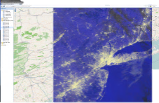
Enhancement of NWS DAT with Earth Remote Sensing Data
Disaster Imagery
Warning Issued
GIS Application
Event Occurs
Potential Damage Area Identified
NSSL WDSS-II: On Demand
Ingest Server
Impact-Based
Decision Support Services
Image Request
USGS Collection Management Tool
Survey Conducted
Web Clients
Imagery Collected and Uploaded to DAT
WMS and Tile Cache
Smartphones and Tablets (e.g. DAT)
Survey Refined, and Improved

Slide 11
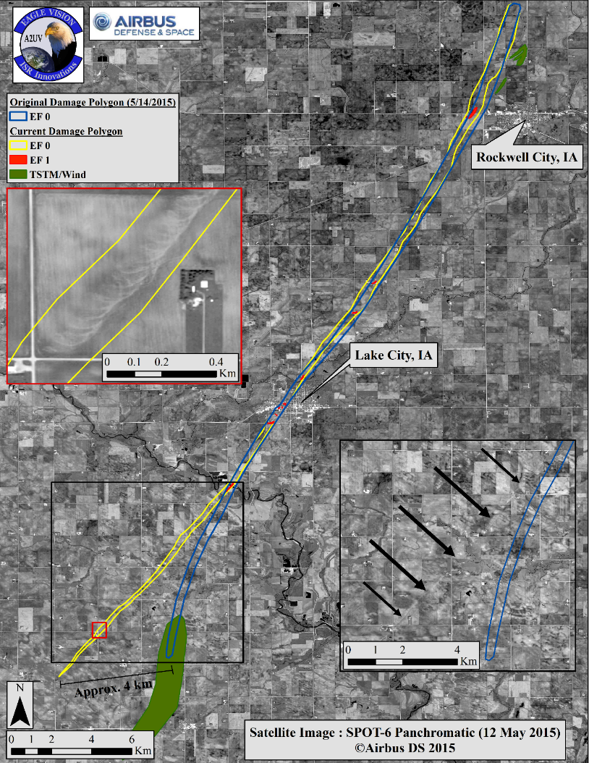
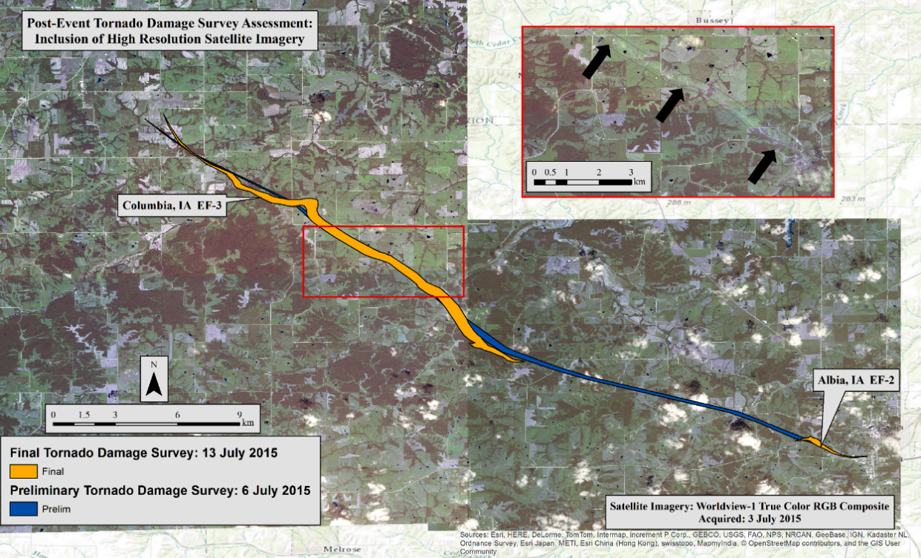
Enhancement of NWS DAT with Earth Remote Sensing Data
Partnership with WFO Des Moines has resulted in many programmatic changes in how SPoRT acquires and produces imagery and data, and has helped to refined interactions with the USGS Hazard Distribution System personnel to continue to improve and streamline the entire process.

Slide 12
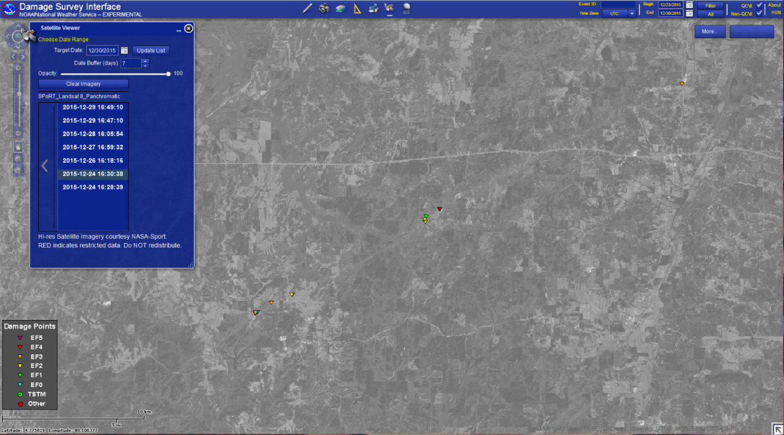
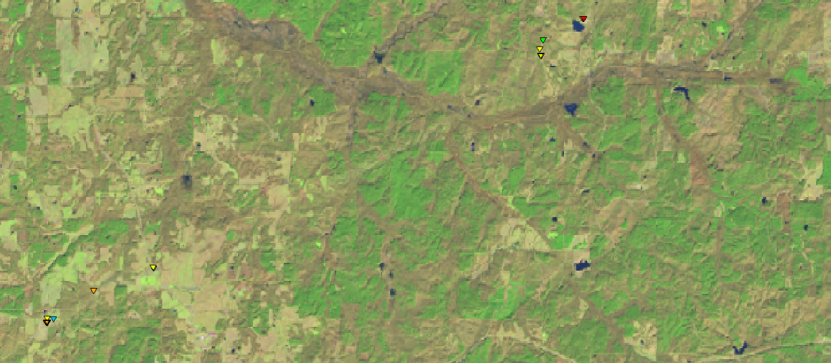
Enhancement of NWS DAT with Earth Remote Sensing Data
23 December 2015, EF-4 Tornado in Mississippi
Landsat 8 2015-12-24 16:30:38
Panchromatic (left) & Natural Color (below)

Slide 13
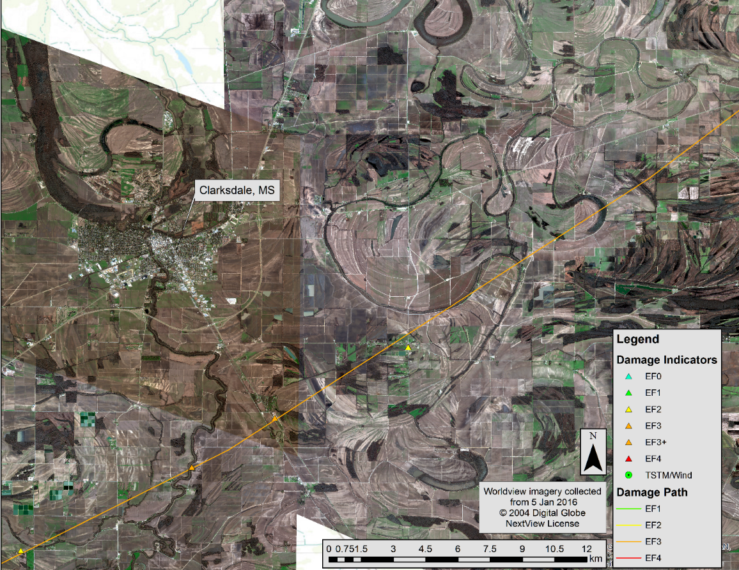
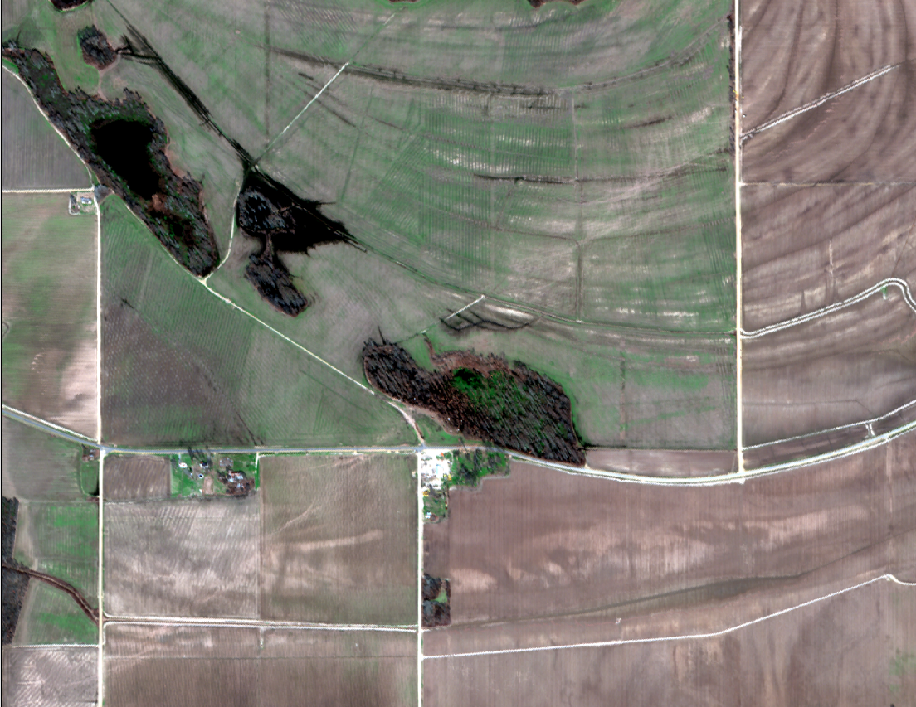
Enhancement of NWS DAT with Earth Remote Sensing Data
Worldview imagery from the southern portion of the EF-3 track, near Clarksdale, MS.
Collected on 5 January 2016

Slide 14
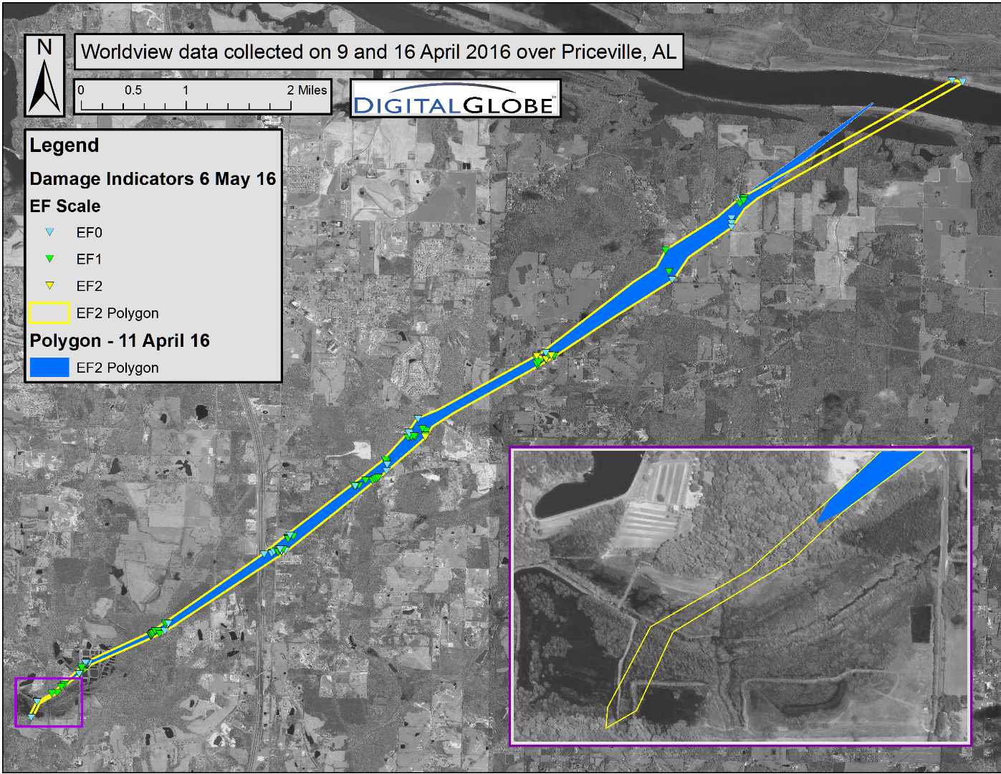
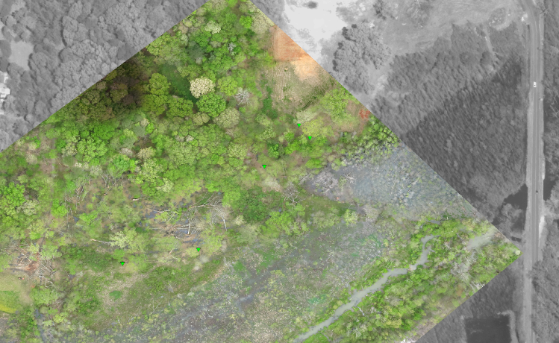
Enhancement of NWS DAT with Earth Remote Sensing Data
EF-2 Tornado in Morgan County, AL -- 31 March 2016
NWS Huntsville, using both high-resolution satellite data and UAS-gathered imagery to refine both the start and end points of the EF-2 track.
UAS imagery captured on 13 April 2016 and demonstrated within the DAT application.
Used with permission from enRgies

Slide 15
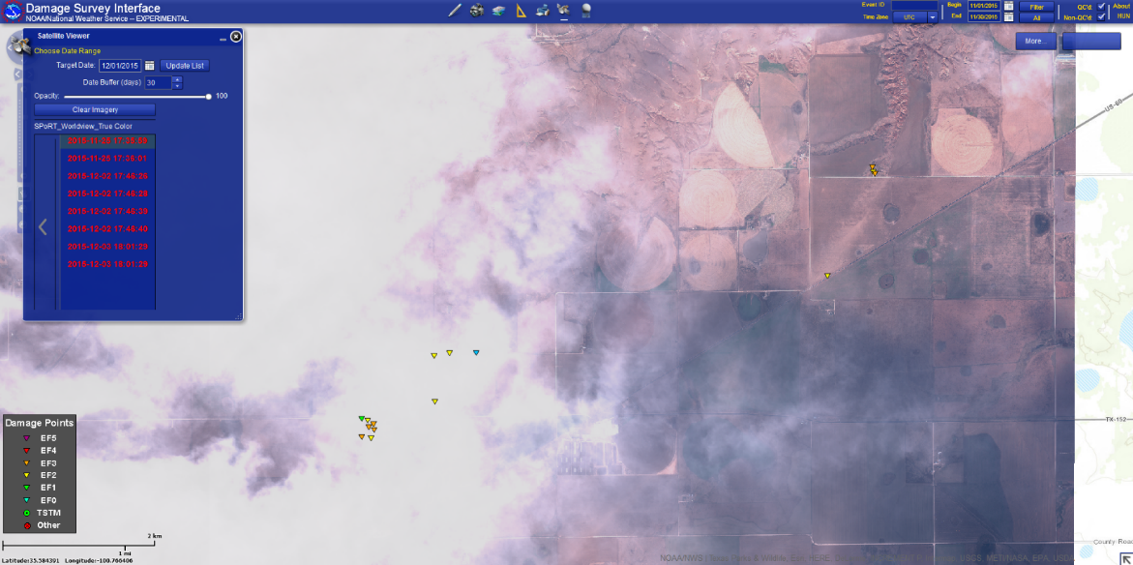
Enhancement of NWS DAT with Earth Remote Sensing Data
Caveats
Landsat, EO-1, ASTER, MODIS and VIIRS are freely available, yet latencies exist
Landsat 7/8 16 day repeat cycle
Swath width
ASTER/EO-1 are targetable, yet must be requested
MODIS/VIIRS: reduced resolution can hinder damage detection
Restricted datasets requested by USGS
High resolution increases the chances of damage detectability yet availability of imagery is limited by satellite orbits, priority of targets
Optical imagery can be blocked by haze, clouds, snow, etc., obscuring any visible damage

Slide 16
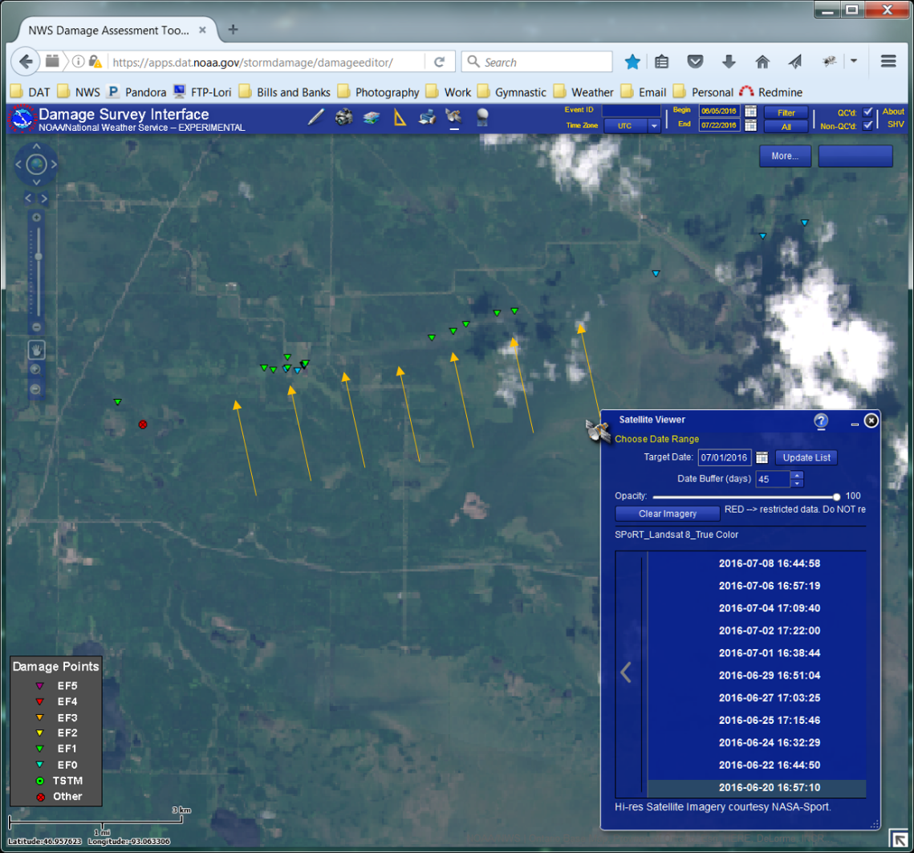
Enhancement of NWS DAT with Earth Remote Sensing Data
Summary
Optical satellite imagery has been successfully used to help locate and refine tornado tracks across the full EF spectrum
Resolution and storm behavior affect detectability
Need cloud free conditions
Landsat, MODIS, VIIRS, ASTER, EO-1 sensor data are freely available and uploaded to the DAT automatically after processing
Restricted, high resolution imagery must be requested through the USGS using the Collection Management Tool (cmt.usgs.gov)
Once received, uploads automatically to the DAT after processing
Cannot be shared publically

Slide 17
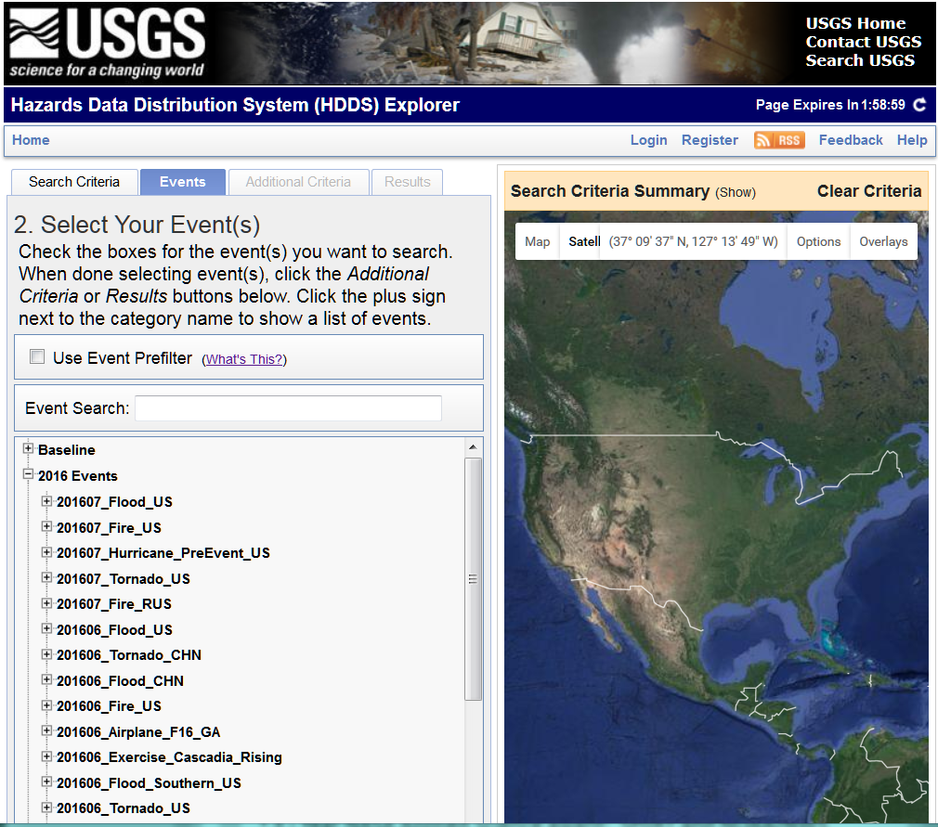
Enhancement of NWS DAT with Earth Remote Sensing Data
This project has allowed for expanded relationships with the USGC and the Disaster Response Team at the EROS Center in Sioux Falls, SD
SPoRT has worked with USGS to implement fully automated download, processing and product creation for Landsat 7 ETM+, Landsat-8, ASTER and EO-1 imagery
True Color, False Color, NDVI, Panchromatic
Extensive collaborations between SPoRT and USGS have emerged for implementing nearly full automation of download, processing and product creation for high-resolution commercial imagery
Geolocation corrections to the NRT data feed implemented locally are now being processed at EROS for all HDDS end-users.
Refinement of data access protocols for NWS personnel
Improvements to product production at EROS for all end-users (in progress)

Slide 18
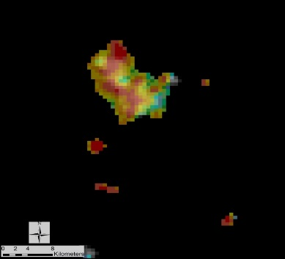
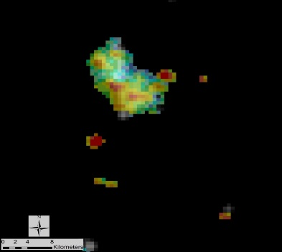
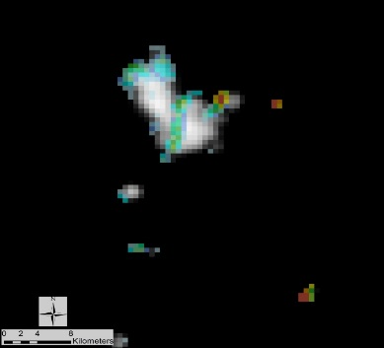
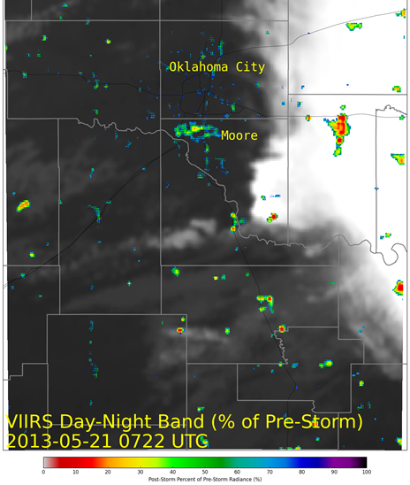
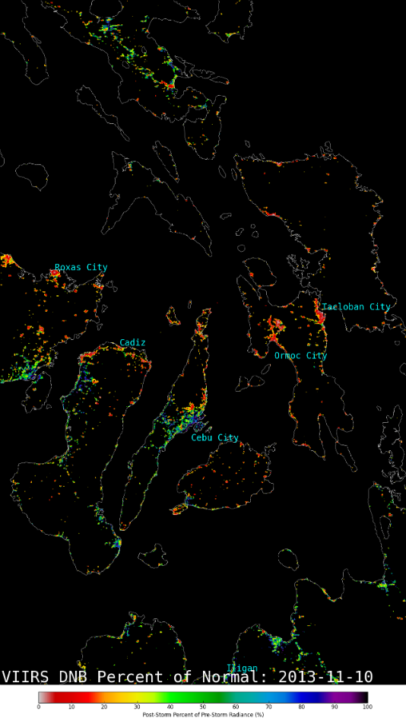
VIIRS DNB to Diagnose Missing Lights due to Power Outages
The city of Iquique, Chile after a 8.2 magnitude earthquake occurred on 1 April 2014
2 April 2014
3 April 2014
7 April 2014
Tropical Storm Haiyan 10 November 2013
Moore Tornado
20 May 2013
False color composite of pre- and post-storm VIIRS DNB imagery over New York and New Jersey following Superstorm Sandy (reproduced from Molthan et al. 2013)
SPoRT had been producing power-outage maps in an ad-hoc manner
Core funding allowed for a graduate student to pursue better methods

Slide 19
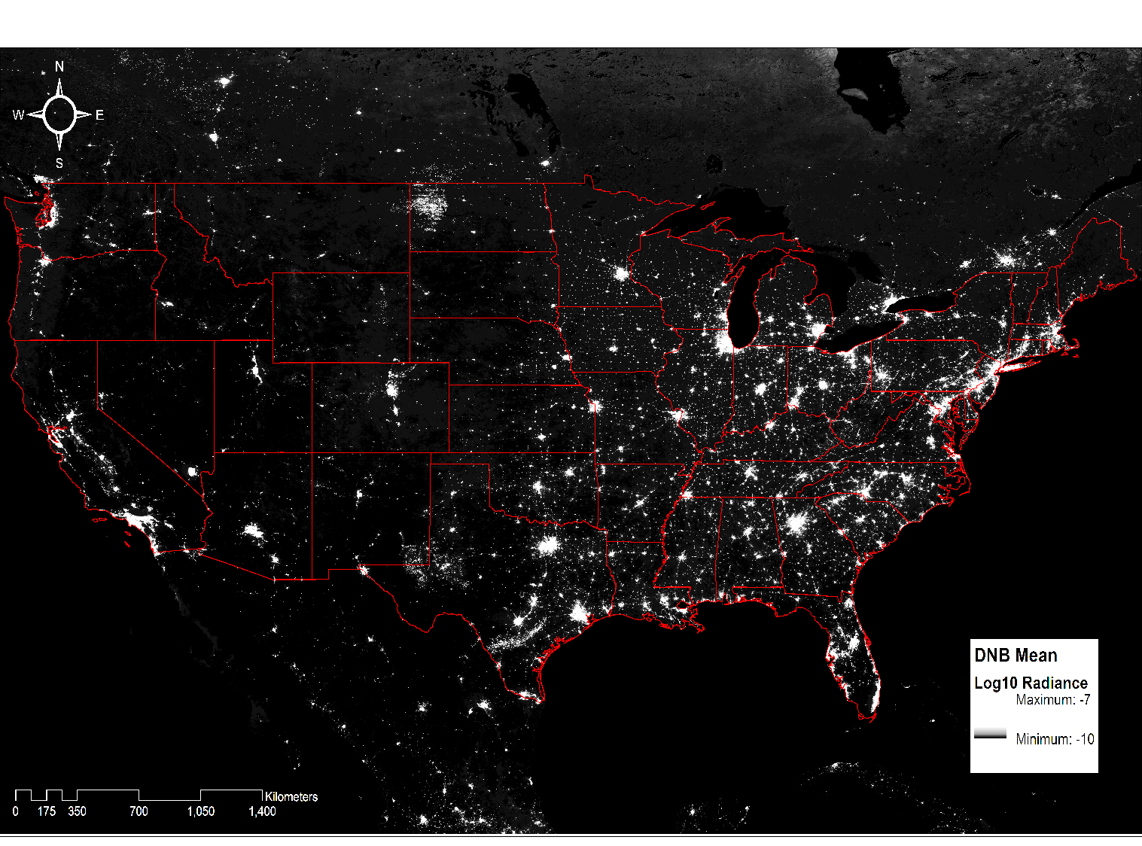
Gridded VIIRS DNB Products
1 km, nightly gridded DNB product (Román et al. 2015)
Key data layers include:
Raw TOA radiances (nW m⁻²)
Lunar BRDF-corrected radiances (nW m⁻²)
VIIRS Cloud Mask (VCM)
VIIRS Snow Cover Binary Map
Collaboration with Dr. Miguel Román at Goddard Space Flight Center (GSFC).
Jan. 19, 2012 – Dec. 31, 2015
Lunar BRDF correction allows subtraction of lunar reflectance from images.

Slide 20
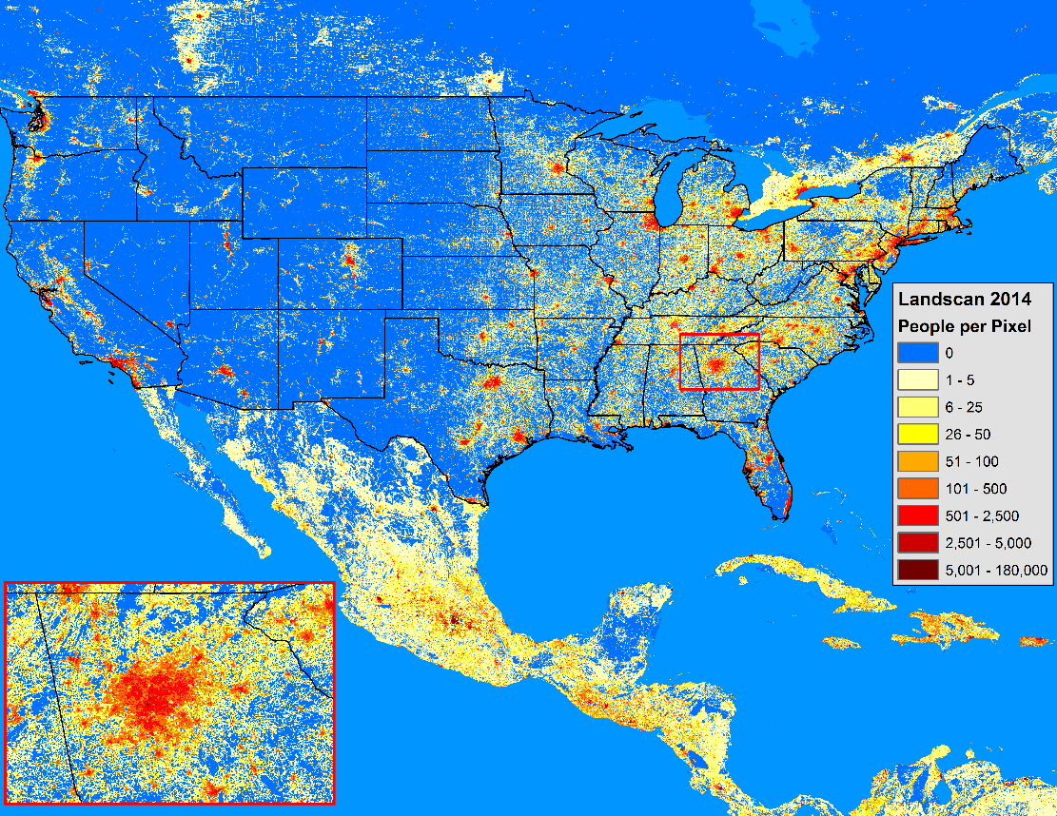
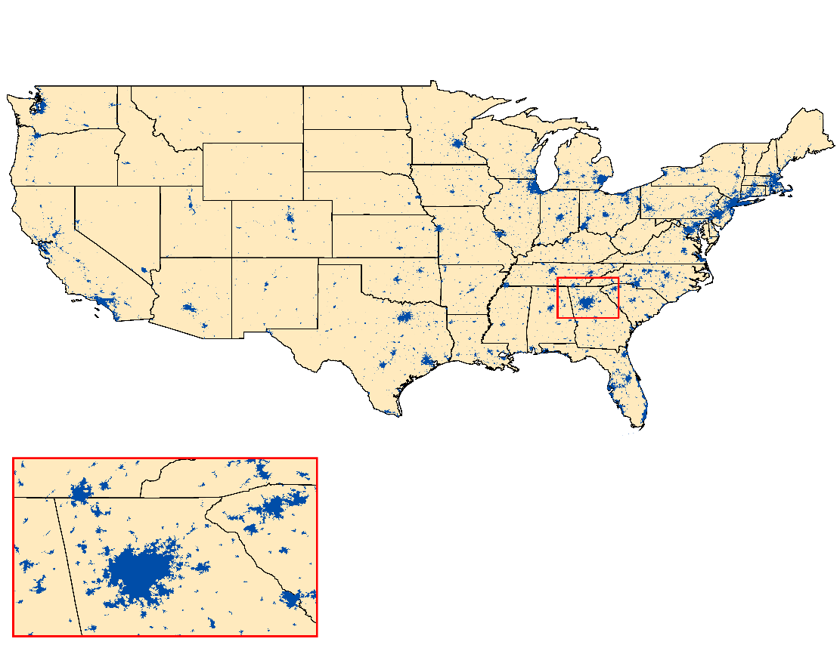
Ancillary Data Sets
Landscan 2014
Represents the ambient population per 1 km grid cell – globally.
http://web.ornl.gov/sci/landscan/
US Census Bureau’s Metropolitan and Micropolitan Statistical Areas map
Shapefile delineating areas by population.
Used to define the spatial extent of individual cites.
http://www.census.gov/population/metro/

Slide 21
Temporal City Light Variability

Slide 22
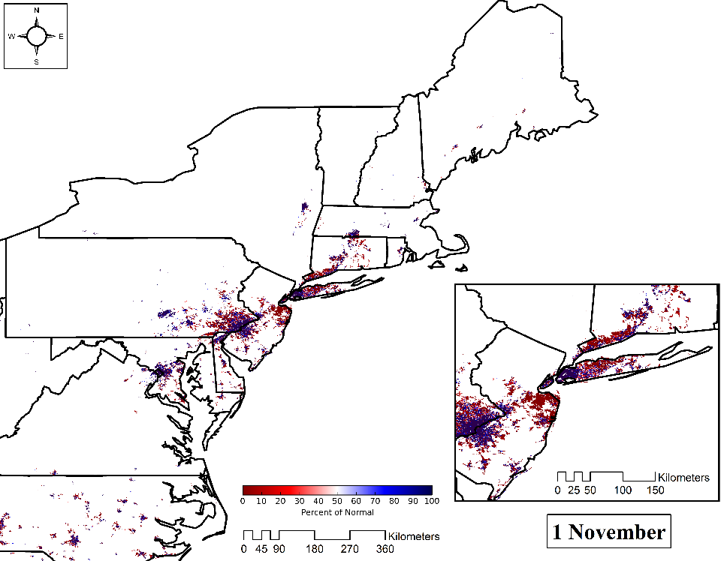
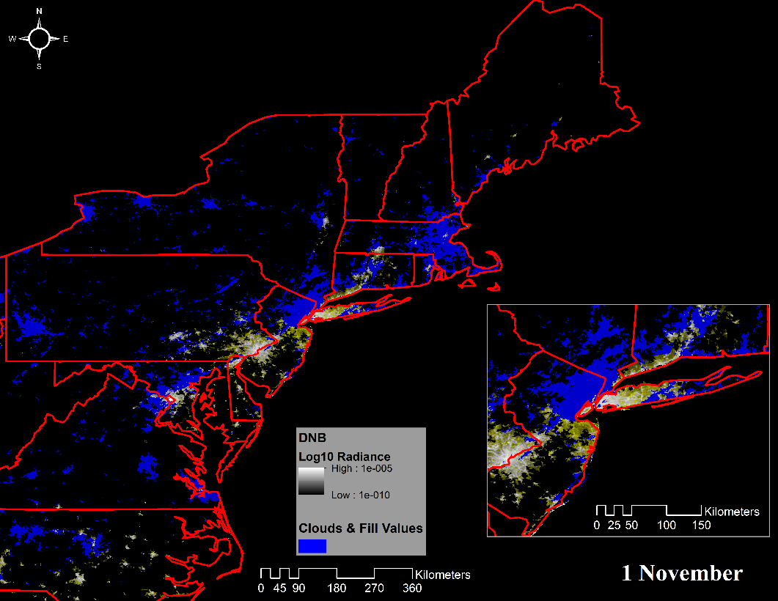
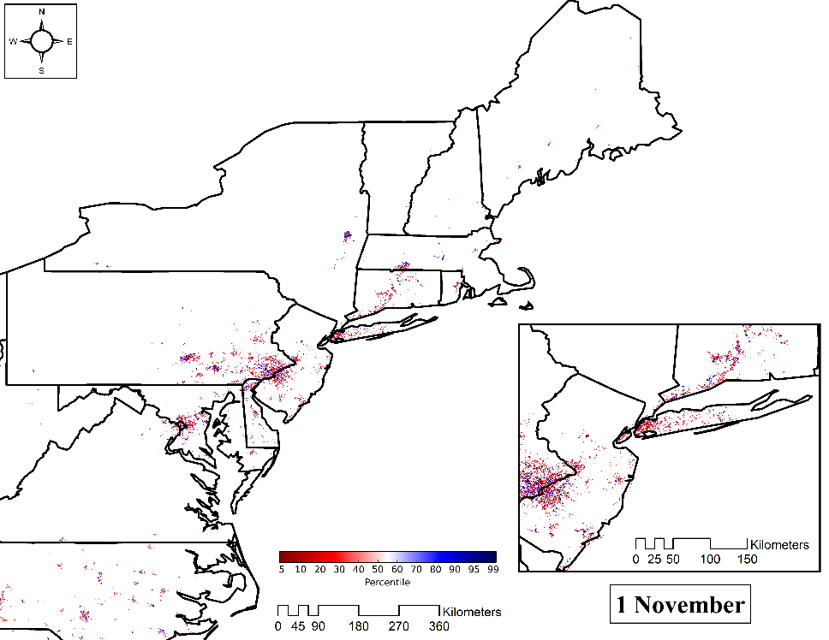
Outage Estimation Products: Qualitative and Quantitative

Slide 23
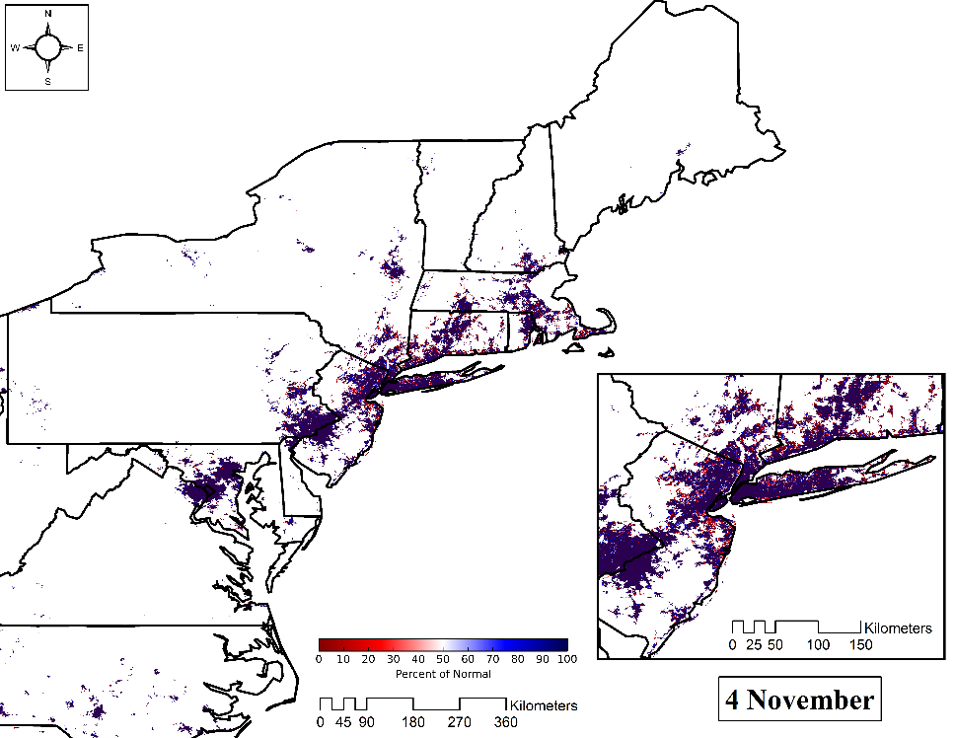
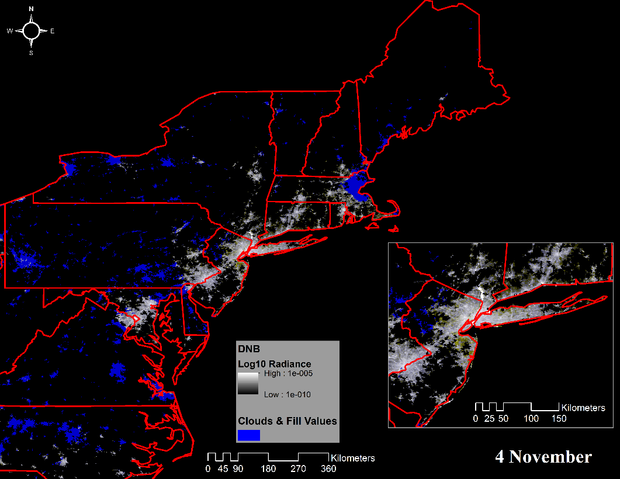
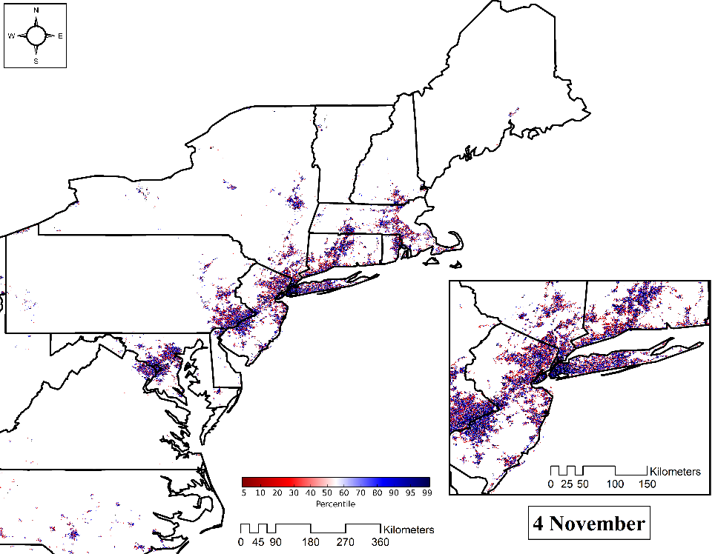
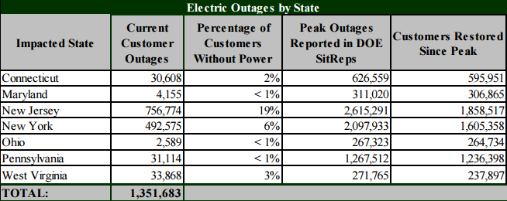
Outage Estimation Products: Qualitative and Quantitative

Slide 24
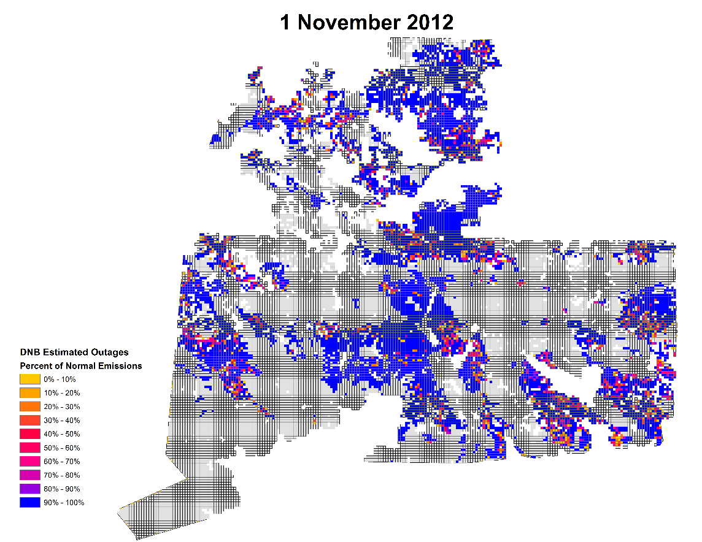
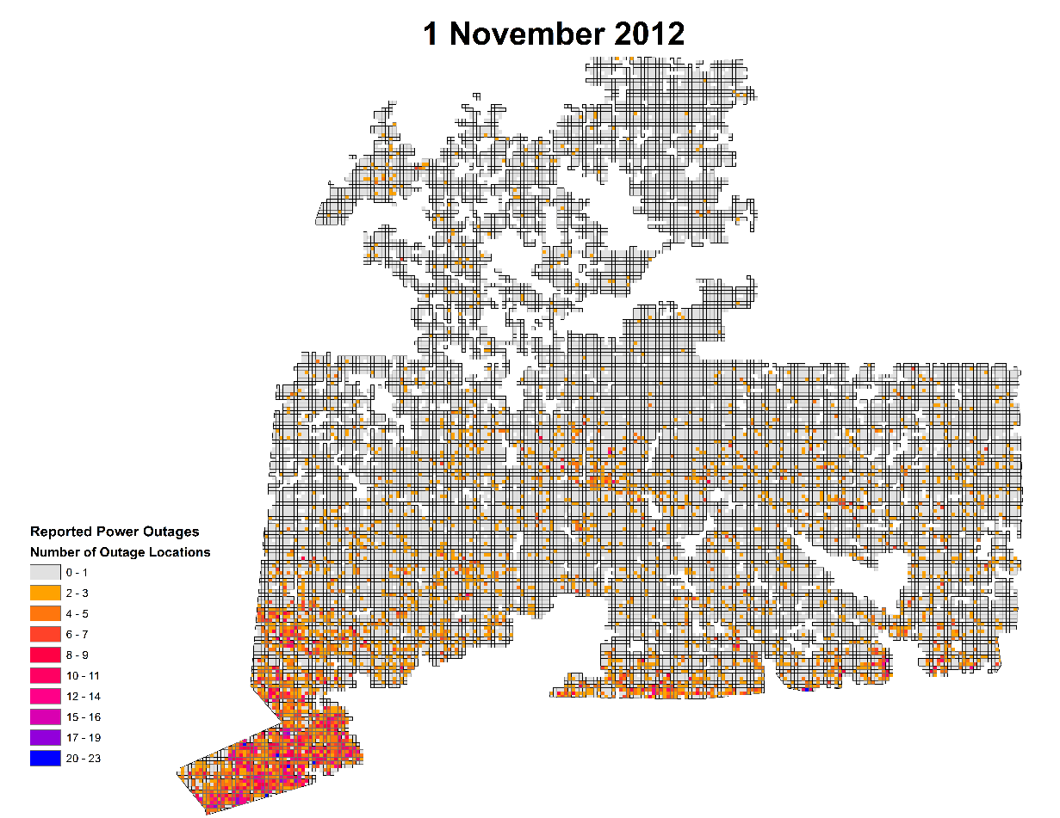
Outage Validation and Future Collaborations
Collaborations with Dr. David Wanik at the University of Connecticut’s EverSource Energy Center provides pixel-level outage reports to better validate DNB outage products

Slide 25
Nepal Earthquake—2015
A 7.8 earthquake devastated the country of Nepal in late April 2015
NASA Applied Sciences: Disaster Program responded with many centers using their strengths and expertise to acquire imagery and derive products.
MSFC/SPoRT served as the lead on optical sensors and tasking EO-1. This was done in coordination with SERVIR and their partners.
In order to better serve a semi-coordinated effort, SPoRT set up a data portal to serve as central hub for information and data-sets.
As a result of these efforts, later in 2015 organizational meetings were held to better coordinate the Applied Sciences: Disasters Program and the associated responses for various types of disasters

Slide 26
Applied Science: Disasters Team
Beginning in FY16, NASA’s Applied Science: Disasters Program has established an Agency-wide Disaster Response Plan (DRP) to facilitate multi-Center engagement in disaster response efforts.
Led by Dr. David Green/HQ, Disasters Program Manager, the plan provides support for various Centers to contribute their capabilities to a broader, coordinated effort to engage with disaster response organizations, both domestic and international.
Coordinators reach into their Centers and provide their capabilities to the broader team to support response efforts. MSFC draws upon SPoRT, SERVIR and the MSFC Earth Science data center (GHRC)
Event
Applied Science: Disasters Program
Dr. David Green, Manager
Disaster Response Plan Activates!
(Selection of Lead Coordinator)
(end users)
JPL
ARC
MSFC
LaRC
GSFC
Coordinators:
Michael Goodman (ZP10)
Andrew Molthan (ZP11)
MSFC/ZP11 Capabilities

Slide 27
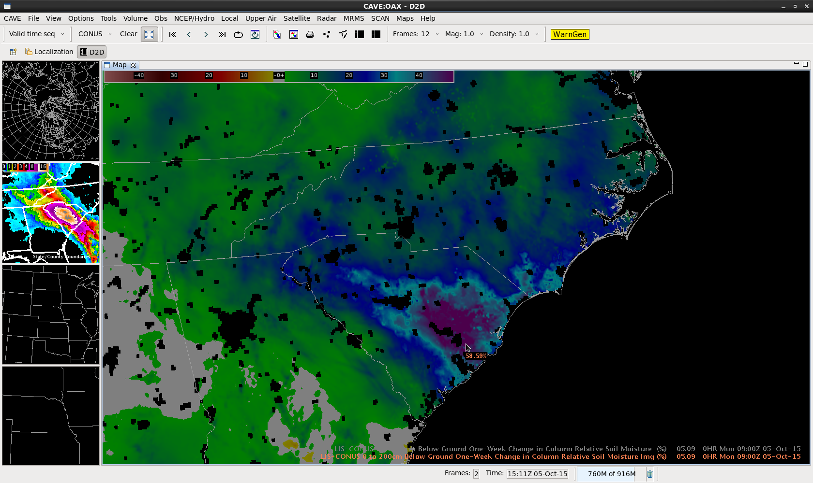
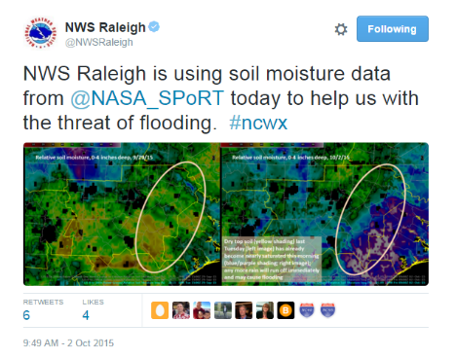
South Carolina Flooding—2015
A unique meteorological setup occurred in early October with Hurricane Joaquin setting up over the Bahamas and an atmospheric river stalling over the Carolinas.
After some areas of South Carolina received more than 15 inches of rain, various optical and SAR platforms obtained imagery over the state. The imagery would later be relayed to FEMA.
This would be our first interaction with FEMA, which would be ramped up in later flooding events
SPoRT was able to provide soil moisture data from the SPoRT LIS to the South Carolina Forest service through the WMS by the way of the USGS HDDS portal.

Slide 28
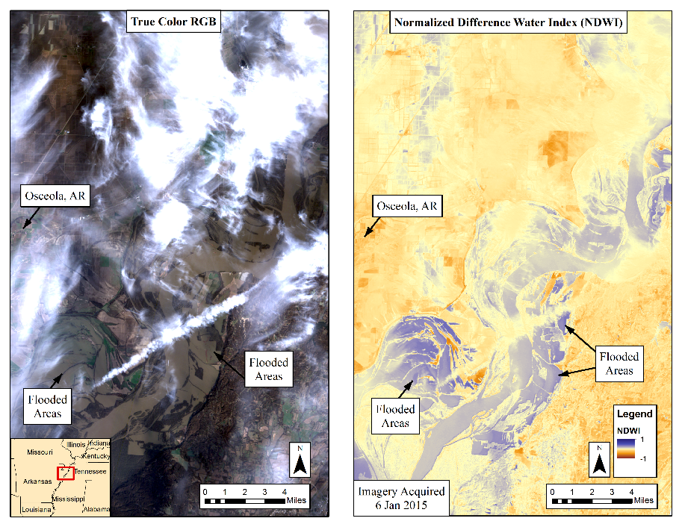
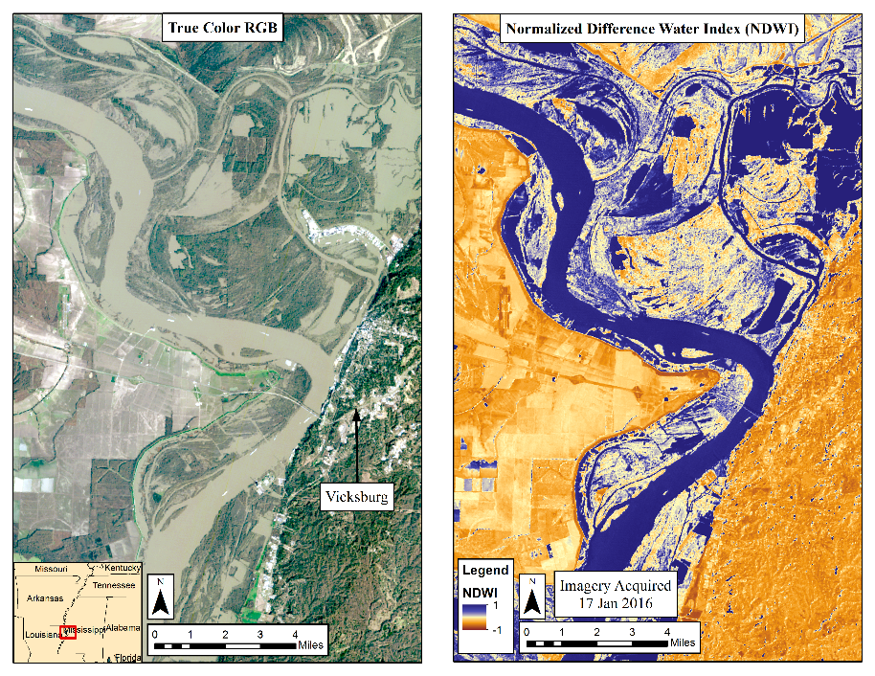
Mississippi River Flooding—2016
Severe thunderstorms and heavy rainfall impacted a large majority of the United States during the last week of 2015 and into early 2016.
Flooding in Missouri and along the Mississippi River prompted a response to help provide FEMA with imagery. MSFC was the lead on coordinating these activities
Both optical imagery and SAR sensors were tasked, processed, and passed to officials at FEMA.
As a result, FEMA invited NASA to FEMA HQ for a hotwash and to understand areas of where NASA could potentially help to address the challenges facing FEMA

Slide 29
Development of SAR Capabilities
In late 2020, NASA and the Indian Space Research Organization (ISRO) will launch the N NASA-ISRO Synthetic Aperture Radar (SAR) mission, or NISAR
SAR satellite based platforms have been prevalent for several decades, but this will be NASA’s first mission since the early 1990s
SAR functions regardless of sky conditions, an advantage over optical
SPoRT is currently taking advantage of the European Space Agency’s current Sentinel 1 mission and data from JAXA to develop capabilities
S1 is a 2 satellite platform providing 6 day repeat cycle with data freely available
SPoRT is focusing on disaster applications with SAR combined with data from optical sensors and other SPoRT products
Flooding
Severe Weather
Wildfires

Slide 30
ALOS 2 HV image from X September 2015
ALOS 2 HV image from X January 2016
ALOS 2 HV difference map
JAXA Flood Map using ALOS-2 data. Blue is detected open water and red is water in inundated forests.

Slide 31
Extra Slides

Slide 32
Enhancement of NWS DAT with Earth Remote Sensing Data
Graduate work performed to provide additional products to the DAT, as some NWS offices keep unofficial surveys of hail. Remote sensing observations can provide support to those performing surveys. Could additionally help spread to USDA and insurance sector
Work compared Normalized Difference Vegetation Index (NDVI) change to anomaly detection in NDVI and Land Surface Temperature (LST) products from MODIS observations
Similar skill scores were obtained late growing season events, but anomaly detection show strength for early season events
Continuing to pursue product in Near-Real Time (NRT), despite several challenges data latency. Additionally, plan to begin testing product using Landsat-8, Sentinel 1A/B and 2A/B.
Testing on other severe weather types has been considered as well.

Slide 33
a
b
IA
IA
Hail Streak
NE
NE
Sentinel 1 image from 6 June 2016 focusing on Western Iowa. Low dB values across the agricultural indicate that very little vegetation is present.
Sentinel 1 image from 30 June 2016 over same area as in a. Higher dB values indicate that more vegetation is present across the domain. Noticeable streak is present. Severe storms impacted with numerous hail reports on 17 June 2016
Absolute difference image showing changes in dB values across the domain. The streak see very little change.
c
IA
Hail Streak
NE

