Slide 1
Current Data Delivery and Visualization
Kevin McGrath Paul Meyer Matt Smith Science Advisory Committee July 2016

Slide 2
Decision Support Systems
Support for various DSSs
AWIPS
Branched into NAWIPS in 2010 (NHC/TAFB, AWC, SPC, OPC/SAB/WPC)
AWIPS II
Google Earth
Fluency
Incorporating non-standard datasets
Site-specific configuration (ingest, menus, labels, color maps, sampling, derived parameters, etc.)
Data provider
Generate products in DSS-specific formats
Delivery mechanisms (LDM, FTP, web)

Slide 3
AWIPS II
Designed to be extensible and open
Easier to incorporate non-standard datasets (don’t have to “fake” the system)
Develop custom plug-ins as necessary (ingest and/or display)
Supports 24-bit color depth
SPoRT-supported perspectives:
D2D
National Centers Perspective (migration from NAWIPS)
Member of NCP RGB working group
Ensured continuity of SPoRT products as collaborative partners migrated from AWIPS
Modified datasets to be compatible with both AWIPS and AWIPS II
Migration is complete
Participate in biweekly NWS AWIPS II developer telecons

Slide 4
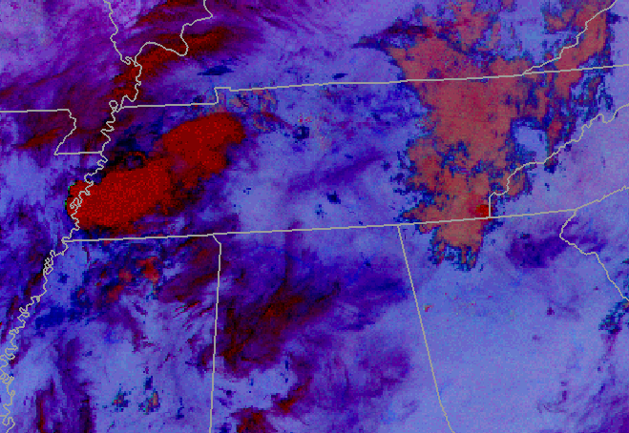
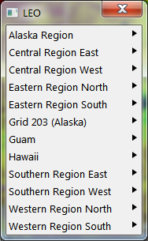
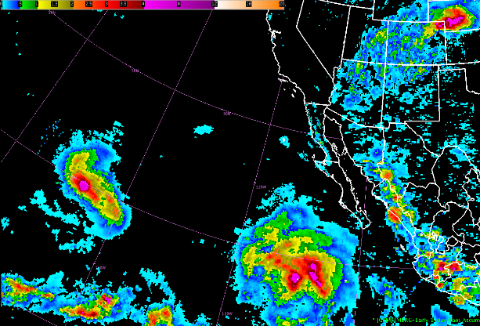
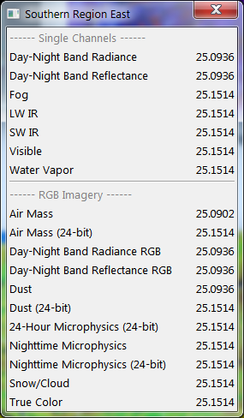
AWIPS II: NASA Datasets
GPM 89 GHz RGB
MODIS Nighttime Microphysics RGB
IMERG 1-Day Precipitation Accumulation
NASA Land Information System: Relative Soil Moisture

Slide 5
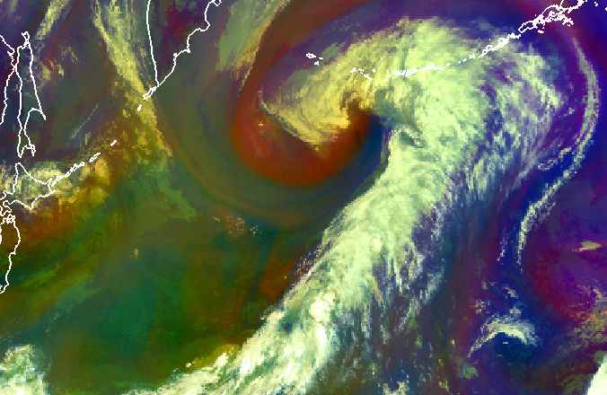
AWIPS II: Client-Side RGBs
RGBs are currently pre-generated by SPoRT in 8-bit color
EPDT developed code to generate 24-bit RGBs on request
Python “Derived Parameters” code calculates the R-G-B channels using single-band source data and EUMETSAT “recipes”
Benefits:
Much greater color fidelity over legacy 8-bit pre-generated products
Ability for end-users to modify the recipes (if so desired)
Reduces latency caused by external product providers
Successfully evaluated concept using Himawari AHI data at OPG (Spring 2016)
Working to baseline in preparation for GOES-R
Python Code Example: AHI Air Mass Recipe
Database
Red: 6.2 μm – 7.3 μm
Green: 9.6 μm – 11.2 μm
Blue: 6.2 μm (inverted)
8-bit Single- Channel Data
3x8-bit Arrays
24-bit Visualization

Slide 6
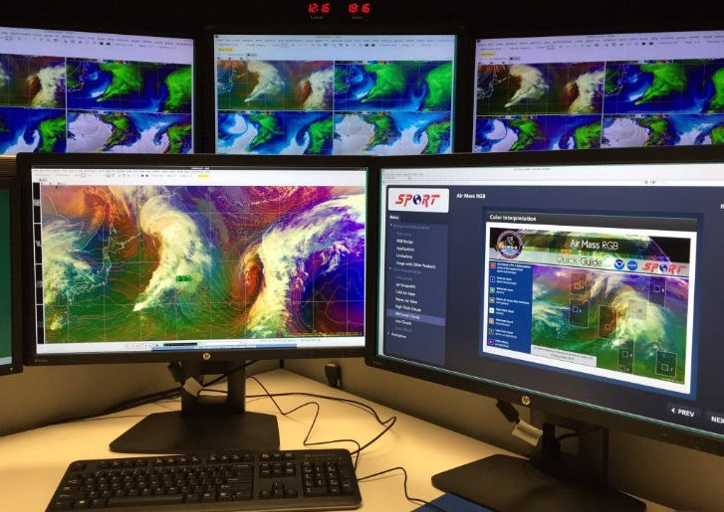
AWIPS II: Integrated Training
Provides product-specific training from within AWIPS II
Material presented in a hierarchical list based on applicability to current product
Feedback based on 5-star scale
Supports various media types
PDF
Articulate Presenter
HTML
MP4/AVI
Training to reside on central server (VLab)
Deployed capabilities to OPG for assessment in Spring 2016
SPoRT authored various training modules for AHI RGB products
Continuing collaboration with Jason Burks to baseline
Search Results
AHI Air Mass RGB Quick Guide at OPG

Slide 7
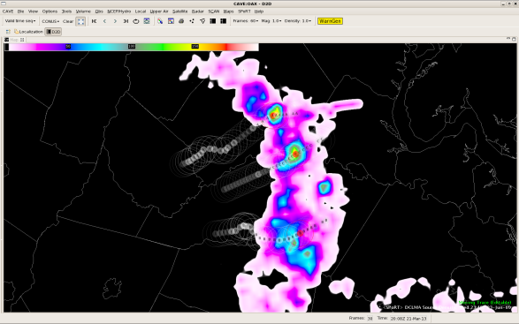
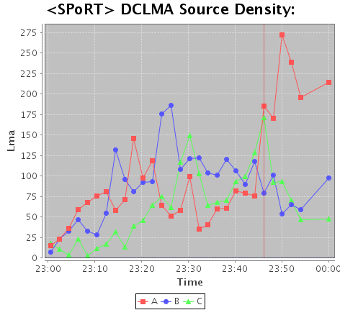
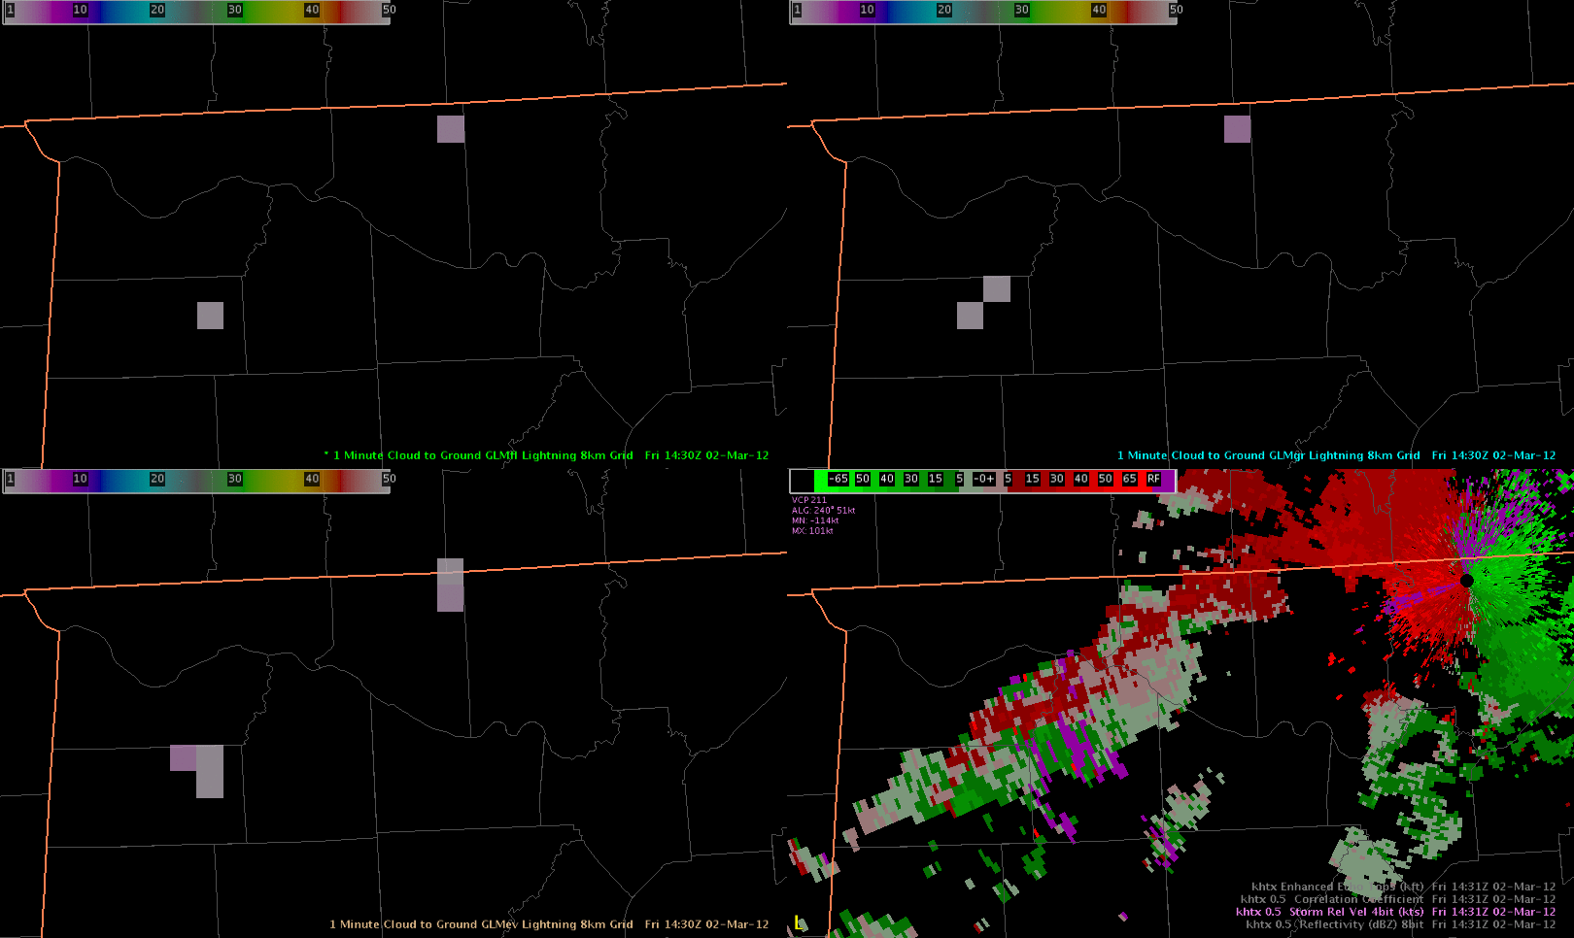
AWIPS II: Additional Baselined Plug-ins
LMA Decoder
Tracking Meteogram
Initially developed to track trends in LMA data for identifying lightning jumps
Supports myriad of products
GLM Decoder
LMA Data
Tracking Meteogram
Proxy GLM Data

Slide 8
AWIPS II: Experimental Products Devel. Team (EPDT)
General need for AWIPS II development training within community
Goals:
Create an environment to share AWIPS II development knowledge
Develop technical expertise of AWIPS II within NASA, NOAA CIs, and NWS
Create AWIPS II plug-ins: Ingest, Display, Analysis
Provide feedback to NWS on:
External development process
Governance of locally developed AWIPS II software
Created in 2013; Leveraged SPoRT core funding to start, now funded by GOES-R and JPSS Proving Grounds
Support from NWS
Participating organizations:
NWS Regions and WFOs
NOAA Cooperative Institutes (and SPoRT)
MDL and GSD
Raytheon
GOES-R PG AWIPS II developers

Slide 9
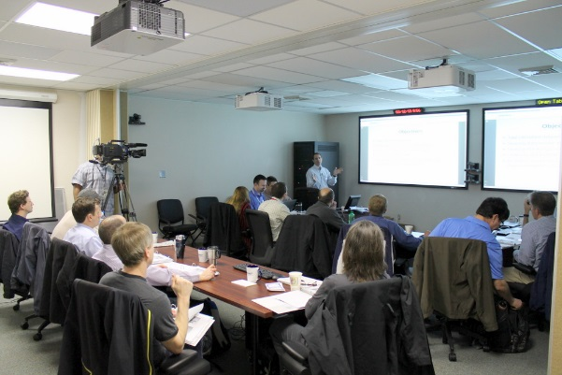
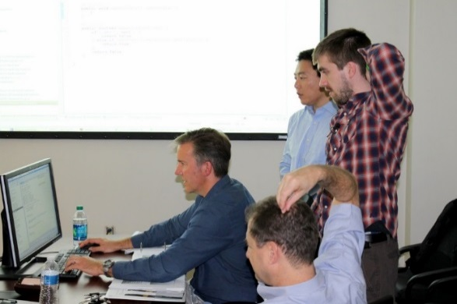
AWIPS II: EPDT Learning Structure
Bi-weekly Conference Calls
Prepare for initial hands-on learning
Supplemental topics
Classroom Training
Learn to develop a plug-in from ingest to display
Hands-on learning
Raytheon developers provide visualization training
Code Sprint
Participants pick project and “learn by doing”
Work on projects in small groups
Groups help each other
Side effects of AWIPS II development may include persistent head-scratching.

Slide 10
Future of AWIPS II Development
Lead 24-bit RGB and lightning areas
Provide leadership for Integrated Training deployment
Continue collaboration with Jason Burks
EPDT
Transitioned oversight to CIRA in 2016 following departure of Jason Burks
SPoRT to provide:
Input and guidance
Technical support
Continue to assist with hands-on learning and code sprints
JPSS Code Sprint: Fall
Classroom Training: Winter/Spring
AWIPS II configuration management: Fall 2016

Slide 11
IT Infrastructure Improvements
Upgrades and improvements:
FTP Server
Web Server
LDM Servers
GOES Ingestors
GOES-R Ground Station (Fall 2016/Winter 2017)
Modeling cluster
Additional development and real-time product machines
Virtualization
Migration from McIDAS to Python-based
Polar2grid
Submitted code modifications to developers

