Slide 1
Future Data Delivery and Visualization
Paul Meyer
Kevin McGrath
Lori Schultz
Jordan Bell

Slide 2
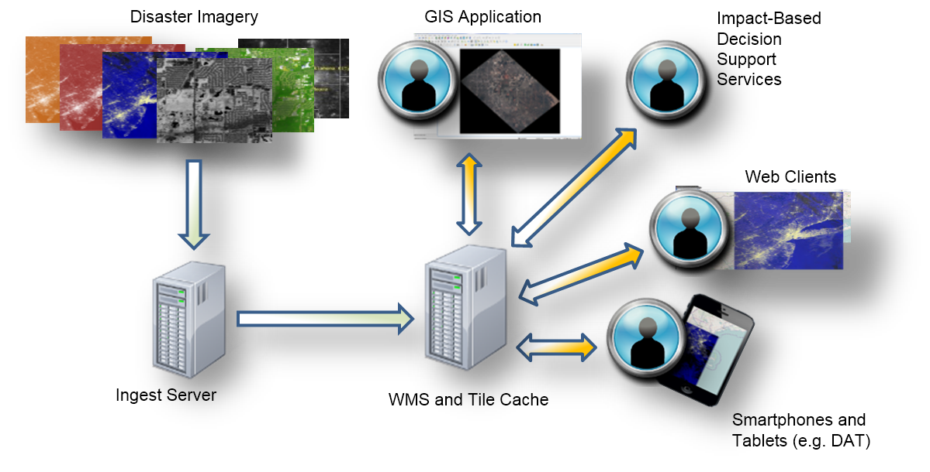
Future Plans
Continue to provide SPoRT products via our web interface (http://weather.msfc.nasa.gov/sport)
Provides some interactivity with the products
Continue to provide SPoRT products via LDM and FTP
Continue to provide SPoRT products via AWIPS II and our support and development of AWIPS II capabilities
Expand our ability to serve SPoRT products to non-AWIPS customers
Web Map Services are a logical choice
Allows for greater interaction with the data products
Broader dissemination mechanism for a broader community

Slide 3
Web Map Service
Web pages are good for the general public, but we should establish a robust Web Map Service capability for our peers
Advantages:
Data is georeferenced and georectified
Data may be used by tool sets such as ArcGIS, Qgis
Data may be incorporated into web-based mapping systems
Data may be layered with other data
Data may be cascaded by other WMS servers (proxy)
Data may have various styles applied
Geophysical values may be represented instead of a “pretty picture”

Slide 4
First Web Map Service Capability

Slide 5
Data Dissemination
Stand up additional WMS servers and promote our most pedigreed (mature) SPoRT data products to WMS services
Assessing individual servers vs. NASA Cloud services
Provide GOES-R Geostationary Lightning Mapper (GLM) data
Establish Federal Geographic Data Committee (FGDC) standards for those products
Conduct broader outreach to other Agencies

Slide 6
Demonstration
Historic GOES imagery web page
SPoRT web page and real-time data products
Interactive viewer with WMS data products

Slide 7
Interactive GOES Satellite Viewer

Slide 8
SPoRT Home Page

Slide 9
Real-time VIIRS Dynamic Content Page

Slide 10
In-house WMS-based Viewer

