Slide 1


Applications of the Land Information System (LIS)
Jonathan Case
Fifth Meeting of the Science Advisory Committee
18-20 November, 2009
National Space Science and Technology Center, Huntsville, AL
transitioning unique NASA data and research technologies to operations

Slide 2
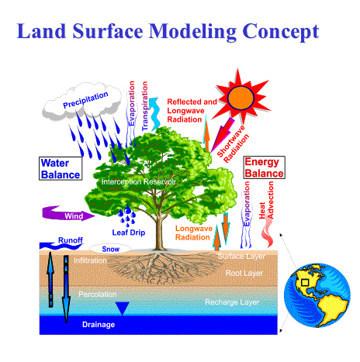
LIS: Relevance to NASA/SPoRT
NASA asset developed by GSFC
LIS benefit to SPoRT end-users
  LSM fields for model initialization
  Diagnostics for short-term forecasts of
  temperatures and/or convective initiation
LIS framework is capable of incorporating NASA EOS datasets
  MODIS-derived land cover
  Assimilation of AMSR-E soil moisture
transitioning unique NASA data and research technologies to operations

Slide 3


Accomplishments since 2007 SAC Meeting
2007 SAC Recommendations:
“…look at some non-quiescent cases….Move toward a systematic evaluation with satellite and radar”
Verification study of daily WRF runs from summer 2008: Focus on precipitation
Configured real-time 3-km LIS
  Hourly output
  Used to initialize NWS Miami WRF runs
Publications and presentations
  J. Hydrometeor. (2008)
  Annual AMS meetings (2008, 2009)
  WRF Users Workshops (2008, 2009)
transitioning unique NASA data and research technologies to operations

Slide 4
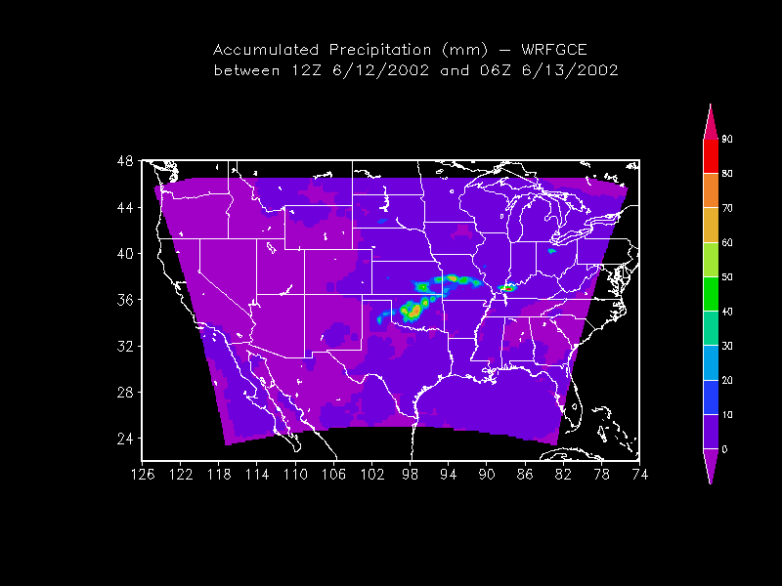
High-Level Overview of LIS
Uncoupled or
Analysis Mode
Coupled or
Forecast Mode
Station Data
WRF
Global, Regional
Forecasts and
(Re-) Analyses
ESMF
Land Surface Models
(LSMs)
Noah,VIC, SIB, SHEELS
Satellite Products
Data Assimilation
(θv, LST, snow)
LSM First Guess /
Initial Conditions
transitioning unique NASA data and research technologies to operations

Slide 5
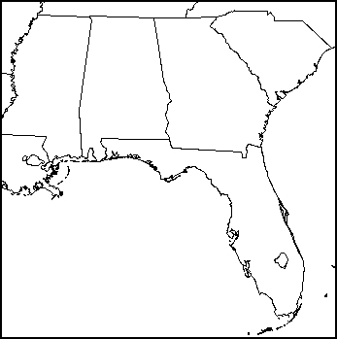

Approach and Methods
Daily 27-h WRF simulations over SE U.S.
  4-km grid spacing, 03z initializations
  81 total forecasts from Jun – Aug 2008
  Control: Initial / boundary conditions
  from NCEP 12-km NAM model
  Experiment: LIS LSM and MODIS SST
  initialization data (LISMOD)
Evaluation and Verification
  Focus on (convective) precipitation verification
  Meteorological Evaluation Tools (MET)
  Method for Object-Based Diagnostic Evaluation (MODE)
Case studies of severe convection with GSFC/NSSL
ny = 311
nx = 309
transitioning unique NASA data and research technologies to operations

Slide 6

LIS Spin-up Run and WRF Initialization
Run LIS/Noah offline from Jan 2004 to Sep 2008
  Same soil and vegetation parameters as in WRF
  Same horizontal resolution, but different grid
    Simulates a realistic real-time setup
  Atmospheric forcing used to drive LIS/Noah:
    3-hourly Global Data Assimilation System analyses
    Hourly Stage IV radar + gauge precipitation
  Run long enough for soil to reach equilibrium state
Initialize WRF land surface with LIS output and MODIS SSTs
transitioning unique NASA data and research technologies to operations

Slide 7
Validation Against SCAN Soil Moisture Obs
LIS (solid lines w/ labels) consistently drier than Control/NAM
  Reduced moist bias in top model layer (blue)
  Reduced RMSE in top 2 model layers (red)
  Increased dry bias in lower layer (green)
Apples vs. Oranges comparison (obs level vs. model layer)
transitioning unique NASA data and research technologies to operations

Slide 8
10 Jun 2008 Sensitivity Example
0-10 cm soil moisture SST Differences
transitioning unique NASA data and research technologies to operations

Slide 9
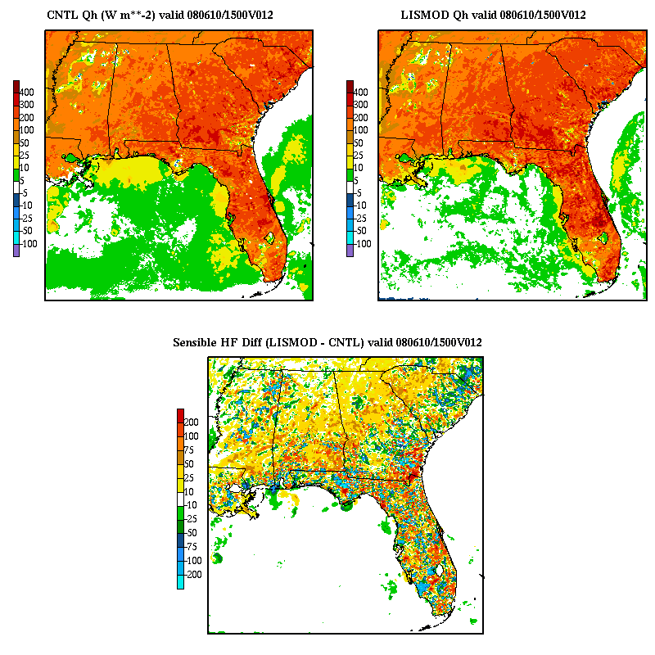
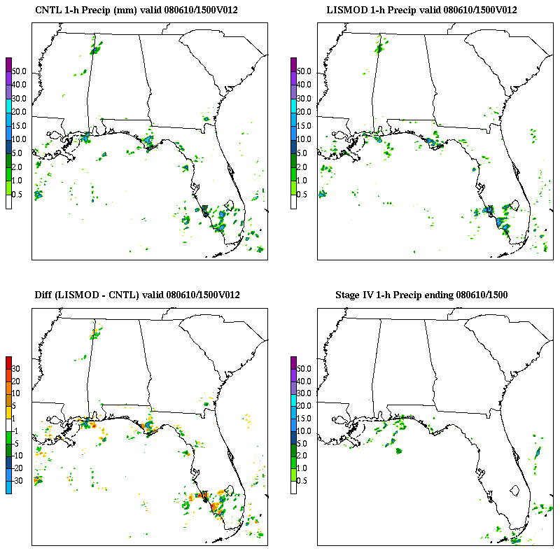
10 Jun 2008: 12−24 hour forecasts
Sensible Heat Flux 1-hour Precipitation
CNTL
LISMOD
DIFF
Stage IV
transitioning unique NASA data and research technologies to operations

Slide 10
1-h Traditional Precip Verification
(12−24 hours; Jun−Aug 2008)
WRF has an overall high bias
LISMOD reduces bias, esp. mid-AM to early-PM
(12−18 h; 15−21z)
WRF generally has low skill (right)
LISMOD incrementally improves skill

Slide 11
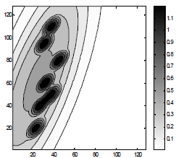
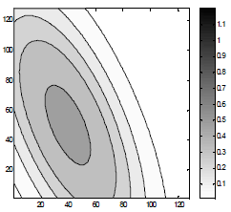
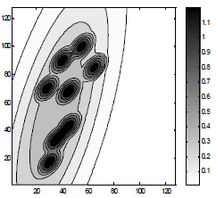
Traditional Precip Verification Problem
[from Baldwin et al. (2001), NWP/WAF conf.]
obs
Fcst #1
Fcst #2
Both forecasts have same bias
Using traditional measures, forecast #2 has larger RMS error & lower threat score
Which forecast is “better”?
Need non-standard verification method!
transitioning unique NASA data and research technologies to operations

Slide 12
MET/MODE Object Verification
Precipitation “objects” identified based on several spatial attributes
Forecast objects matched to obs objects (i.e. “hit”) based on
  Distance between objects
  Similarities in spatial attributes
In our use of MODE, fcst object must be within 80 km of obs object
  Ensures that convection on Florida’s West Coast does not get matched with convection on East Coast
≤ 80 km
Fcst Precip
Obs Precip
transitioning unique NASA data and research technologies to operations

Slide 13
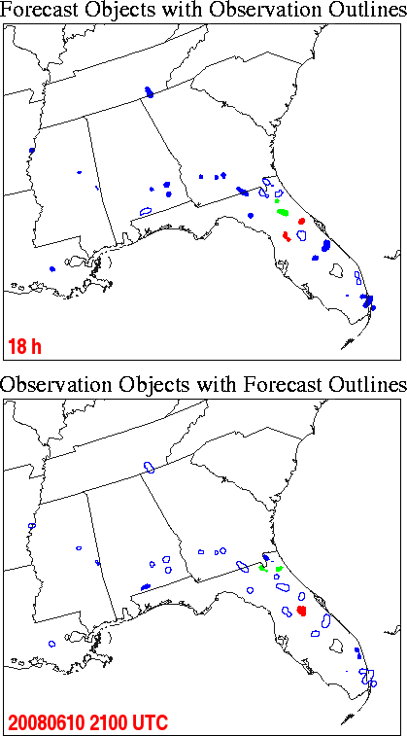
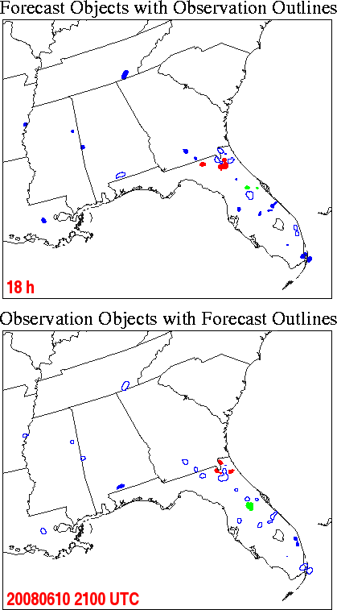
10 Jun: MODE 10-mm/(1 h) Precip Objects
Matched
Forecast
Objects
(“hits”)
Control
LISMOD
Matched
Observed
Objects
transitioning unique NASA data and research technologies to operations

Slide 14
10 Jun: MODE 10-mm/(1 h) Precip Objects
Un-matched
Forecast
Objects
(false alarms)
Control
LISMOD
Un-matched
Observed
Objects
(misses)
transitioning unique NASA data and research technologies to operations

Slide 15
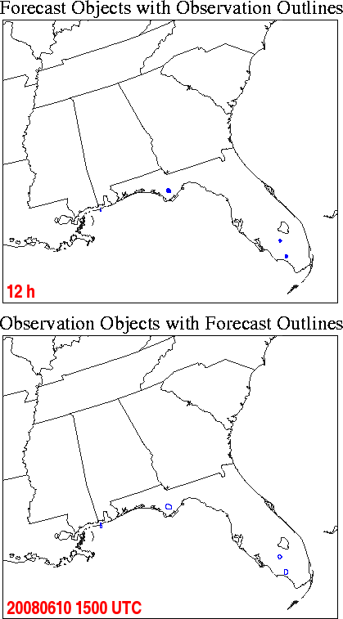
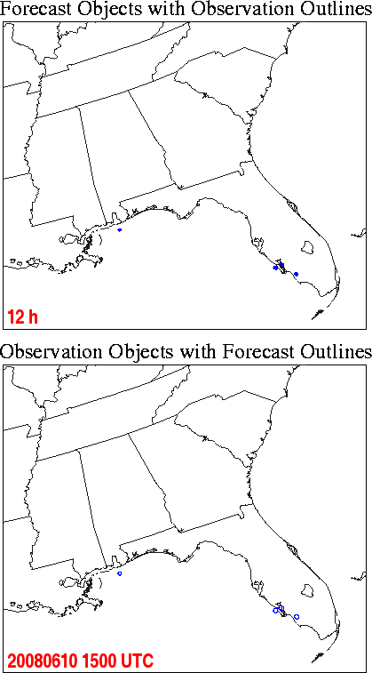
10 Jun: MODE 10-mm/(1 h) Precip Objects
 | Control |  | LISMOD
Fcst hour | Grid Area Match | Grid Area Un-match | Grid Area Match | Grid Area Un-match
12 | 0 | 115 | 0 | 115
13 | 0 | 93 | 0 | 64
14 | 0 | 222 | 0 | 108
15 | 0 | 492 | 0 | 474
16 | 0 | 802 | 232 | 587
17 | 388 | 544 | 606 | 653
18 | 419 | 1039 | 470 | 711
19 | 108 | 1122 | 186 | 916
20 | 318 | 680 | 271 | 674
21 | 394 | 301 | 382 | 646
22 | 0 | 596 | 110 | 424
23 | 28 | 632 | 30 | 501
24 | 0 | 328 | 0 | 417
Control
LISMOD
transitioning unique NASA data and research technologies to operations

Slide 16
MODE 1-h Precip Object Verification:
(Un-)Matched Differences by Model Run, 12−24 h Forecasts
Quantity (mean # grid points per model run) | Control | LISMOD | Difference (LISMOD – Control) | % Change
5-mm Matched | 11,911 | 12,045 | 134 | 1.1%
5-mm Unmatched | 17,750 | 17,175 | -575 | -3.2%
10-mm Matched | 2,456 | 2,562 | 106 | 4.3%
10-mm Unmatched | 6,798 | 6,538 | -260 | -3.8%
25-mm Matched | 60 | 60 | 0 | 0%
25-mm Unmatched | 549 | 505 | -44 | -8.0%
Quantity | # Forecasts Improved | # Forecasts Degraded
5-mm matched | 39 | 41
5-mm unmatched | 56 | 25
10-mm matched | 37 | 39
10-mm unmatched | 48 | 33
25-mm matched | 13 | 8
25-mm unmatched | 46 | 32
transitioning unique NASA data and research technologies to operations

Slide 17
Case Studies of Severe Convection
WRF runs using NASA assets
  28 March 2007 tornado outbreak
  LIS + Goddard radiation physics
  improved convective forecasts
  Additional cases to be run using NSSL/WRF operational domain
NASA Unified WRF, coupling of:
  Satellite data simulator unit
  Land Information System
  NASA/Goddard physics in WRF
  Atmos. chemistry (GO-CART)
  NASA GEOS-5 global model
NASA/LIS:
More robust
convection in
TX Panhandle
NASA/
LIS
CNTRL
transitioning unique NASA data and research technologies to operations

Slide 18
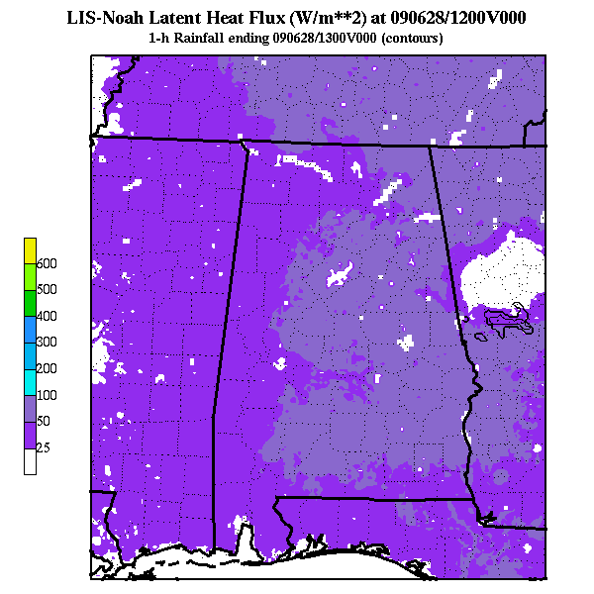
Real-time LIS/Noah at SPoRT
3-km LIS over southeast U.S.
  Spin-up run; restarts 4x per day
  Hourly output posted to ftp site
LIS option in WRF Environmental Modeling System (EMS), v3
  LIS initializations at NWS Miami, FL
LIS output for diagnostics
  Readily displayable in AWIPS II
  NWS BHM: Convective initiation
  Other short-term forecasting issues
  (low temps, fire weather, etc.)
transitioning unique NASA data and research technologies to operations

Slide 19
Summary and Conclusions
Simulation methodology using NASA data and tools
  LIS land surface + MODIS SST composites
  High-resolution representation of land/water surface, consistent with local & regional model resolution
  Precipitation verification using object matching techniques in MET
  Improvements to 1-hour daytime precipitation
  Decrease in over-prediction of precipitation
    Likely related to overall drier LIS soil moisture
Implemented real-time LIS runs at SPoRT
  Initialize LSM fields in WRF EMS
  Possible diagnostics for short-term forecasting
transitioning unique NASA data and research technologies to operations

Slide 20
Future Work
Submit SE U.S. verification study to Wea. Forecasting
Incorporate MODIS vegetation fraction
  Test in offline LIS and LIS/WRF coupled runs
Explore diagnostic utility of real-time LIS
  Collaboration with NWS Birmingham, AL
  Extend Koch and Ray (1997) convergence
  zones study to include LSM boundaries
Support NWS offices using real-time LIS
  WRF EMS model initialization
  Ingest into AWIPS II for diagnostics
transitioning unique NASA data and research technologies to operations

Slide 21
Backup Slides
transitioning unique NASA data and research technologies to operations

Slide 22
Validation Against SCAN Soil Temperatures
transitioning unique NASA data and research technologies to operations

Slide 23
Obligatory Point Verification
2-m/10-m Bias
2-m/10-m RMSE
LISMOD is slightly warmer/drier than the Control during the day
Marginally larger RMSE
Little to no differences in wind errors and MSLP (not shown)
transitioning unique NASA data and research technologies to operations

Slide 24
3-h Traditional Precip Verification:
(3−27 hours; Jun-Aug 2008)
WRF has an overall
high bias
LISMOD reduces bias
some, esp. during day-
light hours (12-24 h)
WRF generally has low
skill (Heidke SS, right)
LISMOD incrementally
improves skill

Slide 25
MODE 1-h Precip Object Verification:
Area Matched vs. Area Un-matched: All forecasts
transitioning unique NASA data and research technologies to operations

