Slide 1


Impact of AIRS Radiances and Profiles on WRF Forecasts
Bradley Zavodsky
Shih-Hung Chou
William McCarty (GMAO)
Fifth Meeting of the Science Advisory Committee
18-20 November, 2009
National Space Science and Technology Center, Huntsville, AL
transitioning unique NASA data and research technologies to operations

Slide 2
Relevance to NASA/SPoRT
SPoRT focuses on improvements to short-term, regional weather forecasts using unique NASA products and capabilities
One method to improve forecasts is through assimilation of satellite observations
  Atmospheric Infrared Sounder (AIRS) is NASA’s most state-of-the-art sounder
  Assimilation of AIRS data improves global forecasts (JCSDA, GSFC)
  Limited work to show utility on regional scale forecasts
Radiances can support national modeling centers that run regional models
Profiles can support smaller, regional modeling centers
  Not enough expertise to run radiance assimilation
  Not enough computational resources to run complex radiative transfer algorithms
Use of profiles and radiances in regional modeling systems may influence operational centers (such as NCEP)
  Positive results may cause them to pursue use of observations they otherwise might have ignored
  SPoRT will likely not transition code or capabilities to these centers
Lessons learned can be applied to current and future hyperspectral sounders such as IASI (EUMETSAT) or CrIS (NOAA/NASA)
transitioning unique NASA data and research technologies to operations

Slide 3
Profile Accomplishments Since 2007 SAC
“SPoRT should migrate away from ADAS as soon as possible; GSI or something more mainstream would definitely be preferable”
  Began using WRF-Var in autumn/winter 2007
“SPoRT should take into consideration their computing resources”
  Use Goddard NCCS Discover supercomputer for processing
“SPoRT took SAC’s recommendation to move from the Pacific to their domain, but there has only been one case”
  Continue to use CONUS domain with SEUS emphasis
  37-day case study period from 17 January – 22 February 2007
AIRS profiles yield improved precipitation, temperature, and moisture forecasts
Conference Papers
  2007 EUMETSAT (Amsterdam)
  2008, 2009 WRF User’s Conferences (Boulder)
  2009 AMS (Phoenix)
Draft of journal paper revealed some limitations to the methodology
transitioning unique NASA data and research technologies to operations

Slide 4
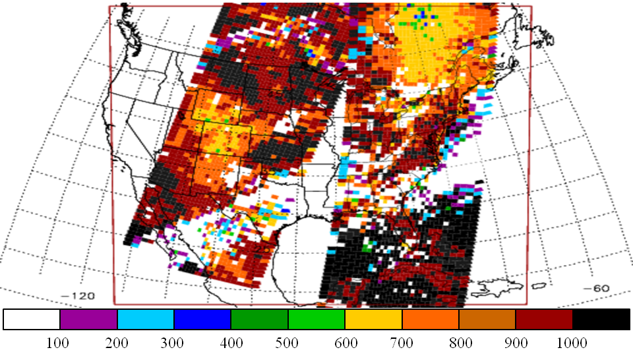
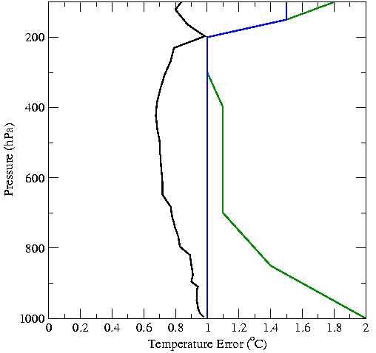
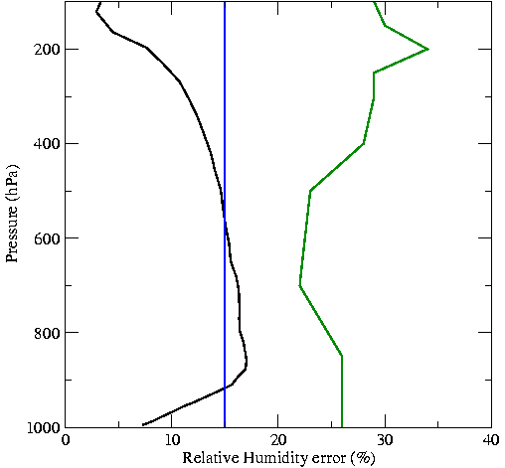
Profiles Methodology
AIRS QI’s for 17 Jan 2007
L2 Version 5 temperature and moisture profiles
28-level standard product
Land and water soundings w/ separate errors
Quality control using P_{best} value in each profile
Sensitivity study assimilating only AIRS profiles
Current Analysis Error Characteristics
BKGD
AIRS water
AIRS land
B-matrix from “gen_be”
WRF initialized with 40-km NAM at 0000 UTC (cold start)
12-km analysis and model grid
Short WRF forecast used as background for analysis
transitioning unique NASA data and research technologies to operations

Slide 5
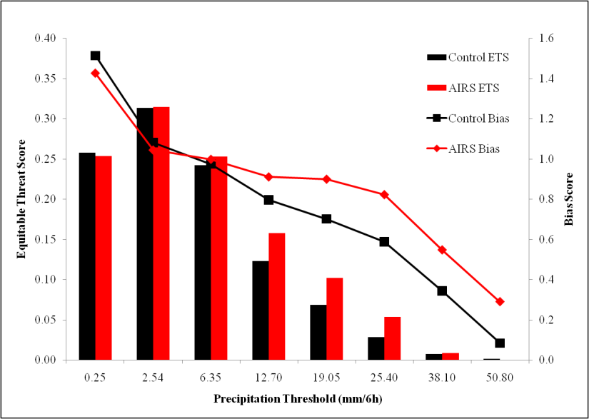
Profile Precipitation Verification
Combined forecast results for 12-48 hr forecasts of precipitation
Equitable Threat Score shows forecasted and observed precipitation matches
  Improvement at all thresholds except lightest
  Best results for moderate thresholds (28% at 12.7 mm/6h, 14% at 19.05 mm/6h, 90% at 25.40)
Bias score shows F/O
  Improved (closer to 1) for all thresholds
transitioning unique NASA data and research technologies to operations

Slide 6
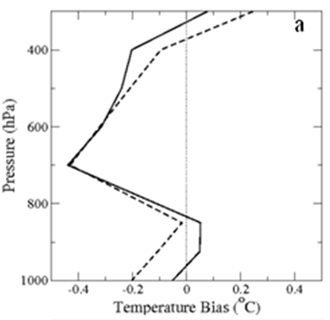
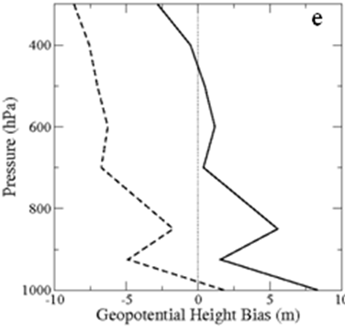
Profile Comparison to NAM Analyses
CNTL
AIRS
Temperature and height bias for combined 12-48 h forecasts compared to NAM analyses
Lower level warming; upper level cooling resulting in improved forecasts
Geopotential height shifts throughout the entire troposphere
  Improves mid- and upper-level heights; degrades low level heights
  Larger than expected MSLP analysis increments the main culprit
  Improve lower level heights/surface pressure to improve entire column bias
transitioning unique NASA data and research technologies to operations

Slide 7
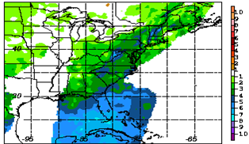
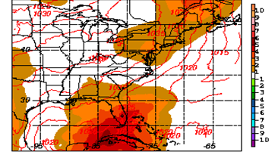
AIRS Profile Analysis Impact
100 hPa Innovations (AIRS-BKGD)
MSLP Analysis Increment (ALYS-BKGD)
100 hPa AIRS is cooler than the background (especially south of 30ºN)
Analysis lower levels warm to compensate for upper-level cooling
Temperature decrease leads to atmospheric expansion resulting in higher surface pressure and heights
  Upper level AIRS profiles are too cold over Gulf of Mexico
  Model vertical resolution too coarse near tropopause

Slide 8
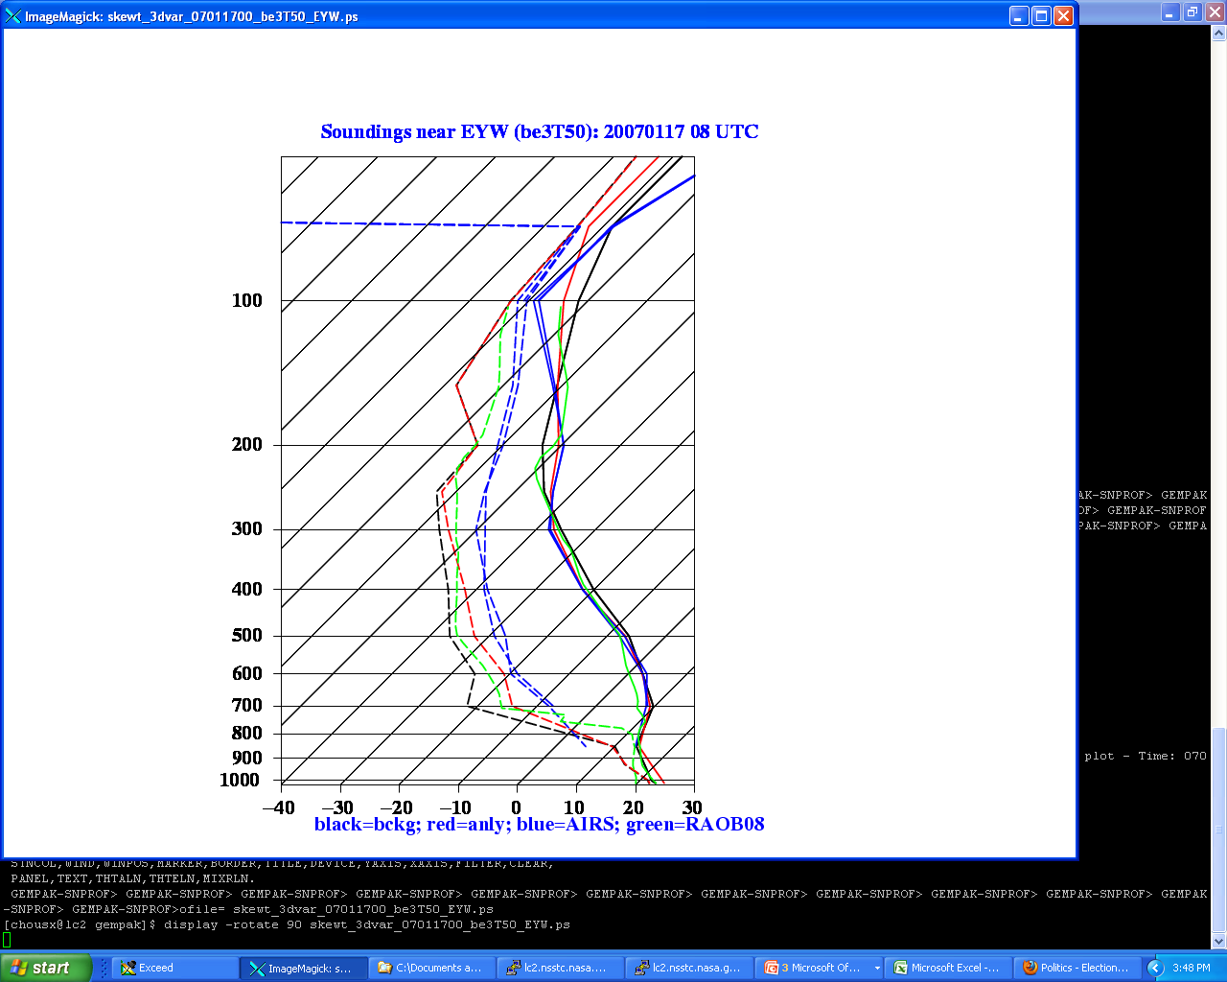
Cold AIRS Profiles Near Tropopause
Key West Soundings at 08 UTC on 17 January 2007
Consistent pattern in profiles for much of January-February 2007 timeframe
AIRS is approximately 3-7ºC cooler than background over Gulf of Mexico at 100 hPa
Impact from best part of profile (mid-troposphere) is reduced
Others have not used profile data above 400 hPa (Auligne, personal communication), but there is valuable information at these levels
Better handling of observations (and their errors) at upper levels is necessary
WRF BKGD
NAM ICs
RAOB
AIRS
transitioning unique NASA data and research technologies to operations

Slide 9
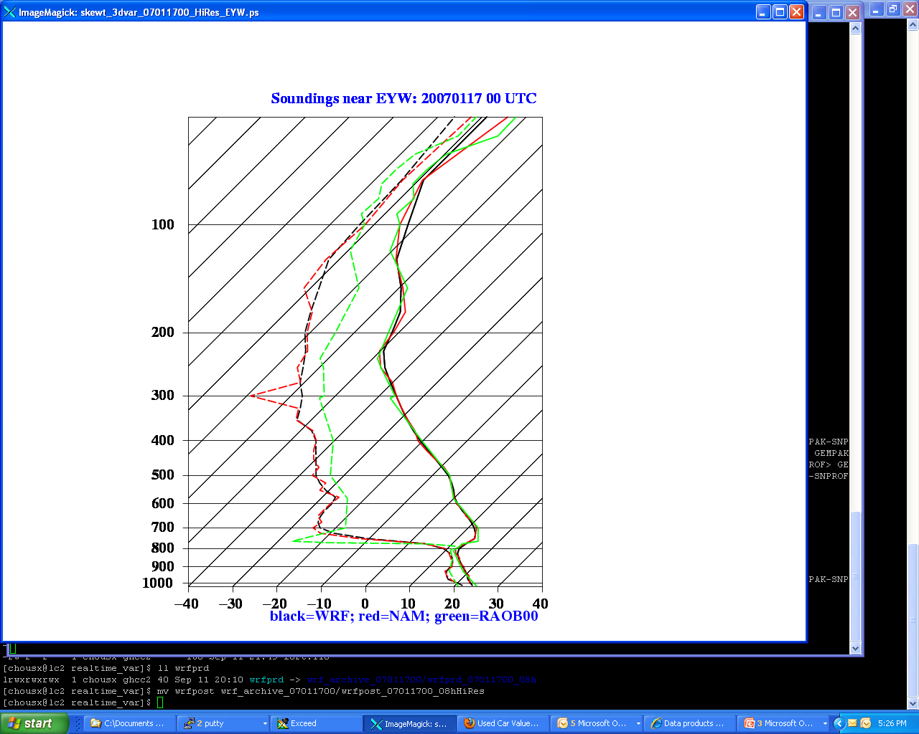
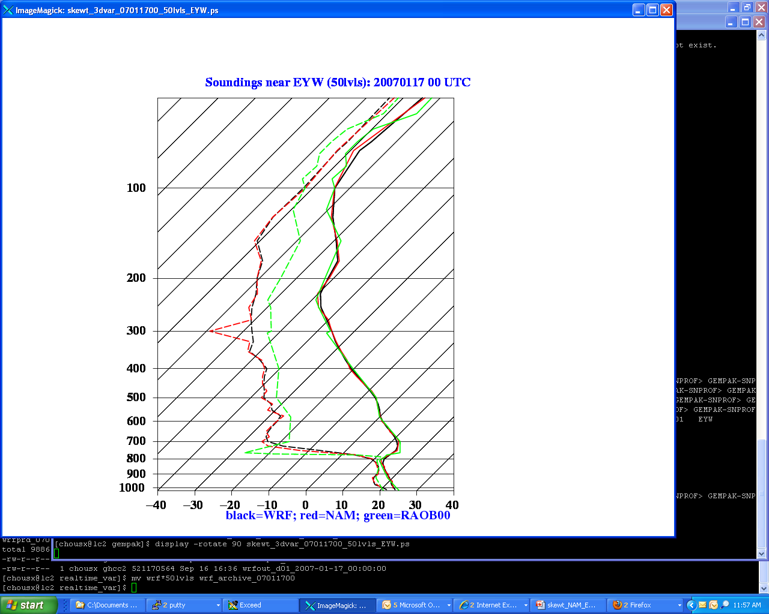
Vertical Resolution of Analysis Grid
Model/Ob Soundings near Key West 1/17/07
37-level resolution not adequate to capture all features in initial conditions (ICs)
Interpolation of NAM initial conditions to WRF led to the background field being 2-3ºC too warm
  analysis balance compensates cold change aloft by warming other levels
  large changes to surface pressure
  Higher heights throughout vertical column as seen in bias shift
Select model levels that are representative of both initial conditions and observations to reduce interpolation errors
37 Sigma Levels
50 Sigma Levels
NAM ICs
WRF BKGD
RAOB
transitioning unique NASA data and research technologies to operations

Slide 10
Radiance Accomplishments Since 2007 SAC
Outlined AIRS radiance in regional forecasting system project at 2007 SAC Meeting
Completed one-week case study from April 2007
Implemented CO₂ Sorting technique in version of operational GSI/NAM
  Channel selection for usable radiances above cloud level
  Test impact of less conservative cloud top detection algorithm within
Conference Papers/Publications
  2007 EUMETSAT (Amsterdam)
  Journal of Geophysical Research (2009)
CO₂ Sorting Technique
Selection of Usable Channels
transitioning unique NASA data and research technologies to operations

Slide 11
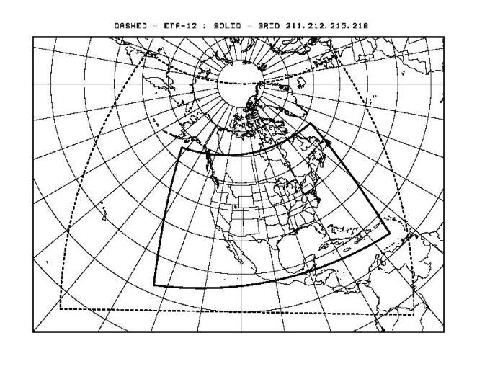
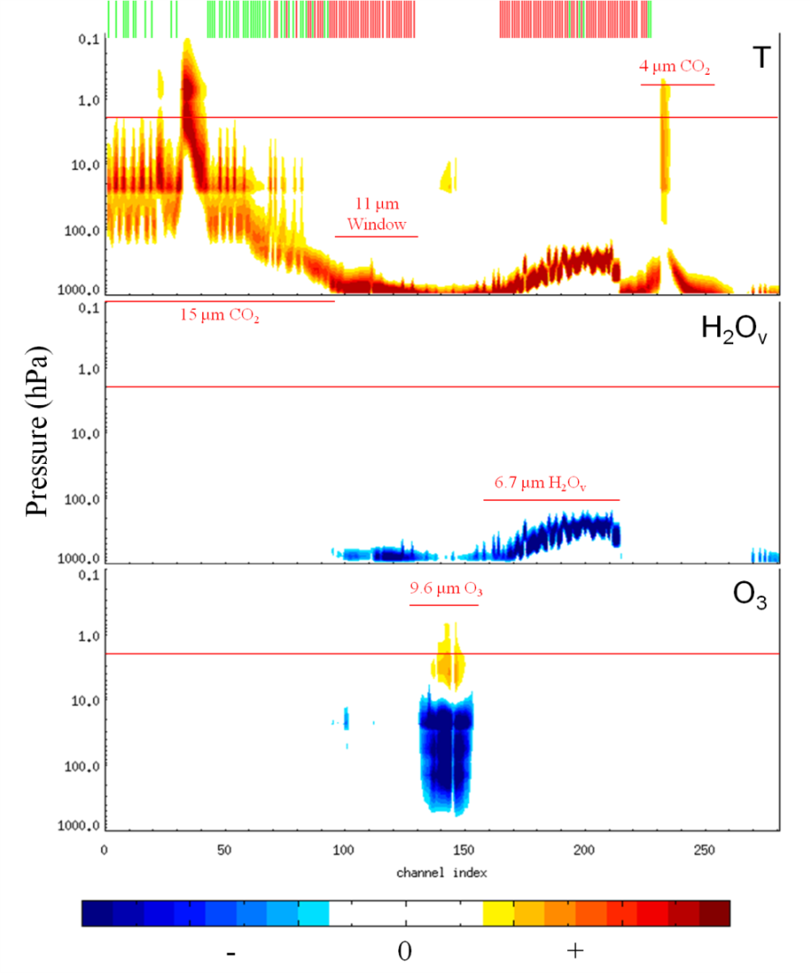
Methodology (Radiances)
Run on operational 12-km NAM grid (WRF-NMM)
Gridpoint Statistical Interpolation (GSI) 3D-Var analysis
3-hr forecast cycling
48-hour forecasts run every 6 hours
103 (red) of the 151 operational channels (green) used in the global system
NAM model top is 2 hPa, so no ozone or 4μm channels are used
Control forecasts (CNTL) use conventional obs, sat winds, GOES radiances, HIRS, microwave sounder radiances, and radar data
AIRS forecasts (AIRS) use same data sets as CNTL but add in AIRS radiances
transitioning unique NASA data and research technologies to operations

Slide 12
Comparison to Independent Dataset
Correlation
CNTL
AIRS
GOES-11 Channel
Analysis validation against GOES-11 brightness temperatures
Correlation between clear-sky observed brightness temperatures and brightness temperatures calculated from the analysis
Positive improvement in correlation among all channels with notable improvements to
  Sounder channel 1 (stratosphere CO₂)
  Sounder channel 2 (upper-troposphere CO₂)
  Sounder channel 12 (upper troposphere H₂O_{v})
transitioning unique NASA data and research technologies to operations

Slide 13
Height Anomaly Correlation
500 hPa Z-Anomaly Correlations
  Height anomaly is defined as:
    : geopotential height at grid point
    : latitudinal mean of geopotential height
  Calculated as the correlation between a forecasts and their corresponding analyses
  Forecast improvements (at 48 hours) of:
    2.4 hours at 500 hPa
    1.9 hours at 1000 hPa
1000 hPa Z-Anomaly Correlations
transitioning unique NASA data and research technologies to operations

Slide 14
Radiance Precipitation Verification
  Results combine all forecasts
  Bias scores show
    < 5% improvement/degradation to for all thresholds < 25mm/6h
    Improvement for the 25mm/6h threshold (7%)
    Equitable Threat Scores show
      Negligible impact for thresholds < 15mm/6h
      Significant improvements of 6%, 6%, and 8% for the three thresholds ≥ 15mm/6h
transitioning unique NASA data and research technologies to operations

Slide 15
CO₂ Sorting Verification
Validation Dataset
  Separation Point, a nonphysical quantity, is difficult to validate directly from MODIS or CloudSat
  Manually created for a variety of environments derived from short-term NAM forecasts
  13-18 January 2006
Distributions
  Calculated separation point biased towards high clouds, but shows some skill for low clouds (top right)
  Validation data shows notable peak for low separation point (high clouds) (bottom left)
Conservative with reduced skill at lower cloud heights (top left; bottom right)
Calculated - Validation Separation Points
CO₂ Sorting Separation Points
Validation Separation Points
Joint Histogram
transitioning unique NASA data and research technologies to operations

Slide 16
Summary/Conclusions
SPoRT seeks to improvement short-term, regional weather forecasts using unique NASA products and capabilities
SPoRT uses profiles and radiances from NASA’s AIRS hyperspectral sounder to determine the impact of these instruments on sensible weather parameters
Assimilation of profiles into WRF-Var produced improvements in precipitation and lower-level temperature forecasts but some inconsistencies must be further investigated
Assimilation of radiances into GSI produced improved height anomaly correlations and precipitation forecasts; use of CO₂ sorting technique yielded improved forecast results over inherent technique
Use of profiles and radiances in regional modeling systems may influence operational centers (such as NCEP)
transitioning unique NASA data and research technologies to operations

Slide 17
Future Work
AIRS profile work will use lessons learned for a final experiment to be concluded no later than summer 2010 (peer-reviewed journal article draft already prepared)
June 2007 SAC recommended focus on IASI as a legacy instrument for CrIS
  Lessons learned from work with AIRS will be applied to IASI
  Investigate quality of IASI profiles
  Begin using GSI for IASI profile assimilation activities for more consistency with operational centers
  Proposal to JCSDA to investigate direct (i.e. “apples-to-apples” comparison of IASI profiles and radiances on operational forecasting)
Development of a 3D analysis product incorporating AIRS and IASI data over the oceans that can be used for nowcasting or for initializing local forecast runs
Lessons learned and code infrastructure developed from both AIRS and IASI can be applied to CrIS upon launch
transitioning unique NASA data and research technologies to operations

