Slide 1


The Lightning Warning Product
Dennis Buechler
Geoffrey Stano
Richard Blakeslee
Fifth Meeting of the Science Advisory Committee
18-20 November, 2009
National Space Science and Technology Center, Huntsville, AL
transitioning unique NASA data and research technologies to operations

Slide 2
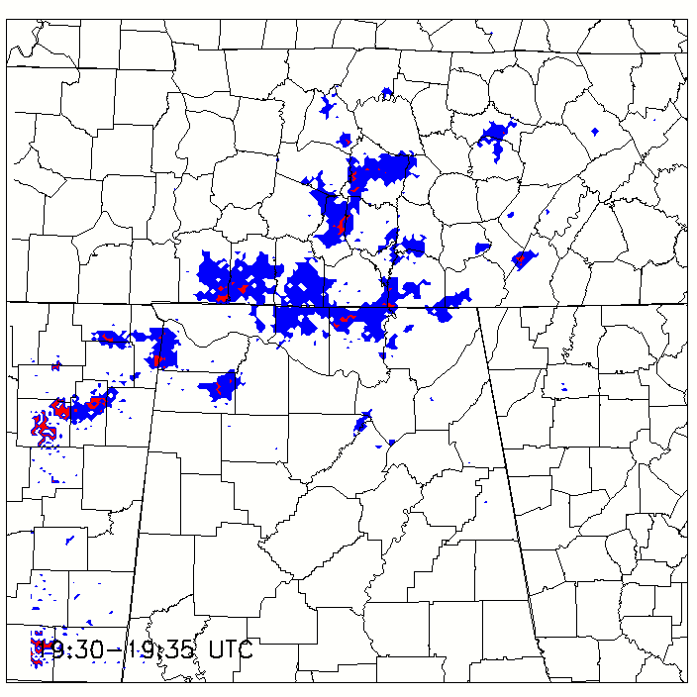
2007 SAC Meeting
Explore other nowcasting applications for total lightning data
  Lightning warnings/alerts
  First CG nowcasting
Eye towards future GOES-R GLM applications
Blue pixels indicate LMA detected lightning activity in last 5 min: red indicates cloud-to-ground lightning.
transitioning unique NASA data and research technologies to operations

Slide 3
Accomplishments since SAC 2007 Meeting
Refereed Publication
  Darden, Nadler, Carcione, Stano, and Buechler, 2009: BAMS
Meetings/Conferences
  AMS Meteorological Applications of Lightning Data, 2008
  NWA Annual Meeting, 2007,2008
  Southern Thunder, 2009
  GOES-R Risk Reduction Workshop, 2009
transitioning unique NASA data and research technologies to operations

Slide 4
Background
Lightning accounts for 23.5% of weather related deaths in the U.S. (62 per year). Most people tend to be struck by lightning near beginning or end of storm life-cycle.
Lightning also impacts operations for range and other activities
Weather related storm death causes in U.S. (Storm Data)
transitioning unique NASA data and research technologies to operations

Slide 5
Relevance to NASA/SPoRT
Nowcasting lightning probability [> 30 min]
  NWS interested in using for TAFs
Uses data from NASA’s NALMA
Prototype capabilities for GLM
transitioning unique NASA data and research technologies to operations

Slide 6
Approach and Methodology
Analyze various case studies using gridded NALMA source data
Derive probabilities based on whether lightning activity was occurring
Determine time lag in lightning probability
transitioning unique NASA data and research technologies to operations

Slide 7
Lightning Warning Product
Provide gridded fields of lightning probability
  Extend out to 30 minutes
  Probability in 5 minute intervals
  Additional probability for cloud-to-ground strikes
Use data from NALMA as GOES Lightning Mapper (GLM) proxy
  Preparing for GOES-R
transitioning unique NASA data and research technologies to operations

Slide 8
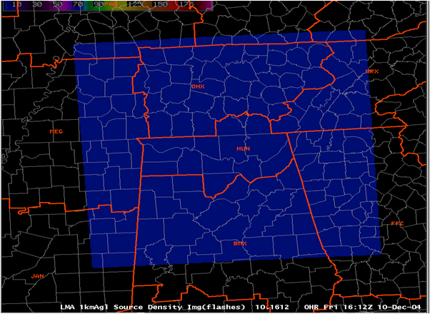
Only Using Lightning Data
NALMA Domain
Lightning must already be occurring (i.e., not forecasting first lightning)
10 km resolution (GLM)
NALMA Domain 460 by 460 km
transitioning unique NASA data and research technologies to operations

Slide 9
Current Lightning Warnings
Current lightning warnings are mostly for locations or regions (KSC, airports)
These usually have a watch when lightning occurs within a specified distance (~20 nm)
The watch changes to a warning as lightning gets closer (10 nm)
Some NWS offices issue “excessive lightning alerts”
transitioning unique NASA data and research technologies to operations

Slide 10
27-28 August 2003 Case Study
10 km resolution grid
1 min time resolution
Grouped NALMA sources into flashes
A grid point is incremented by 1 when at least 1 source from a flash occurs in it
Also examined NLDN CG data
Storm movement minimal on this day
transitioning unique NASA data and research technologies to operations

Slide 11
Lightning Activity for Entire Domain
transitioning unique NASA data and research technologies to operations

Slide 12
Lightning Probability with Time
Probability of More Lightning Given Grid Box Has Lightning Now
transitioning unique NASA data and research technologies to operations

Slide 13
Lightning Probability Product
transitioning unique NASA data and research technologies to operations

Slide 14
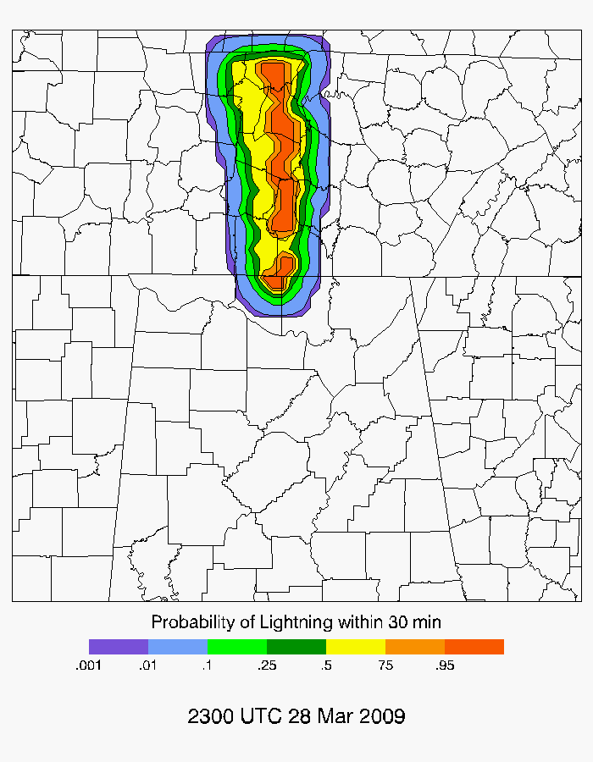
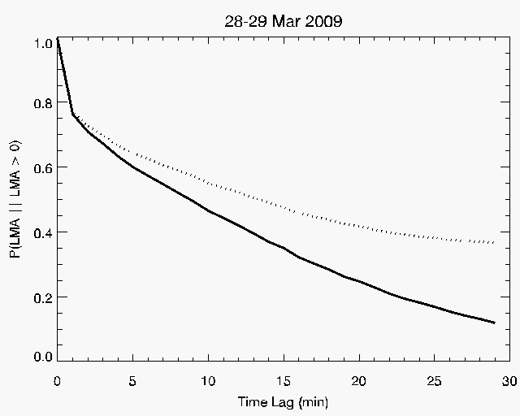
Lightning Probability Product
Line with embedded supercells
Probability of More Lightning Given Grid Box Has Lightning Now
transitioning unique NASA data and research technologies to operations

Slide 15
Lightning Probability Product
Statistics for lightning occurring within next 30 minutes (1% probability contour)
All lightning
  POD 0.92
  CSI 0.69
  FAR 0.26
CG lightning
  POD 0.95
  CSI 0.12
  FAR 0.88
transitioning unique NASA data and research technologies to operations

Slide 16
Additional Enhancements
Incorporate cell tracking algorithm
Estimate first lightning probability
  Model
  Satellite
  Radar
User feedback
transitioning unique NASA data and research technologies to operations

Slide 17
1st IC to 1st CG Time
transitioning unique NASA data and research technologies to operations

Slide 18
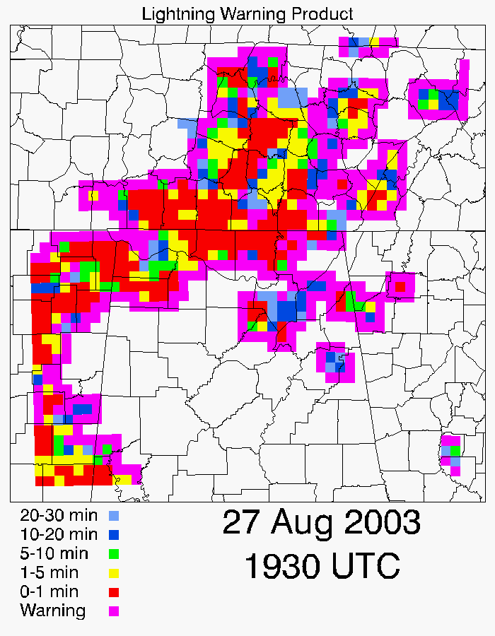
New product- time since last lightning
Current lightning safety recommendation: Stay indoors for 30 minutes after the last thunder clap
Product shows the time elapsed since the last lightning occurrence
Need to determine optimum grid size, etc.
transitioning unique NASA data and research technologies to operations

Slide 19
Future Work
Use GLM proxy data
Investigate alternate products and visualizations
Provide displays to NWS
Estimate first lightning probability
  Model
  Satellite
  Radar
transitioning unique NASA data and research technologies to operations

Slide 20
Questions?
transitioning unique NASA data and research technologies to operations

