Slide 1
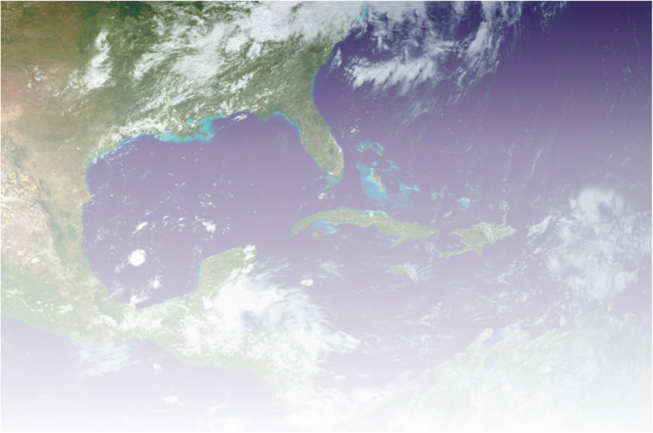
Forecasting Lightning Threat Using Cloud Models With Explicit Convection
Eugene W. McCaul, Jr.
USRA Huntsville
Fifth Meeting of the SPoRT Science Advisory Committee
18-20 November 2009
National Space Science and Technology Center, Huntsville, AL
Photo, David Blankenship
Guntersville, Alabama

Slide 2
Relevance to NASA/SPoRT
Uses NASA North Alabama LMA network data as ground truth for calibration of WRF output lightning proxies
Supports NASA goals for GOES-R Proving Ground efforts

Slide 3
Accomplishments since last SAC
Completed, published WRF-based lightning threat algorithm: McCaul et al. (2009), W&F, 24, 709-729.
W&F paper highlighted as Paper of Note in BAMS, 90, 772.
Presented method at several conferences: AMS 24th Severe Storms Conf., Savannah, GA (2008); Southern Thunder Workshop, Cocoa Beach, FL, (2009)
Commenced analysis of additional simulations to test and improve generality of methods (CAPS 2008 ensembles; new NASA runs in anticipation of 2010 NSSL Spring Program)

Slide 4
Research Objectives
Given that high-resolution WRF forecasts can capture the
character of convective outbreaks, we seek to:
Create WRF forecasts of LTG threat (1-24 h), based on
2 proxy fields from explicitly simulated convection:
- graupel flux near -15 C (captures LTG time variability)
- vertically integrated ice (captures LTG threat area)
Calibrate each threat to yield accurate quantitative peak
flash rate densities
3. Also evaluate threats for areal coverage, time variability
Blend threats to optimize results
Examine sensitivity to model mesh, microphysics

Slide 5
Advantages
Methods based on LTG physics; should be robust and regime-independent
Can provide quantitative estimates of flash rate fields; use of thresholds allows for accurate threat areal coverage
Methods are fast and simple; based on fundamental model output fields; no need for complex electrification modules

Slide 6
Caveats: Disadvantages
Methods are only as good as the numerical model output; models usually do not make storms in the right place at the right time; model saves at >15 min sometimes miss LTG jump peaks
Small number of cases means uncertainty in calibrations
Calibrations should be redone whenever model is changed (pending studies of sensitivity to mesh, model microphysics, to be studied here)

Slide 7
Case: 30 March 2002 Squall Line plus Isolated Supercell

Slide 8
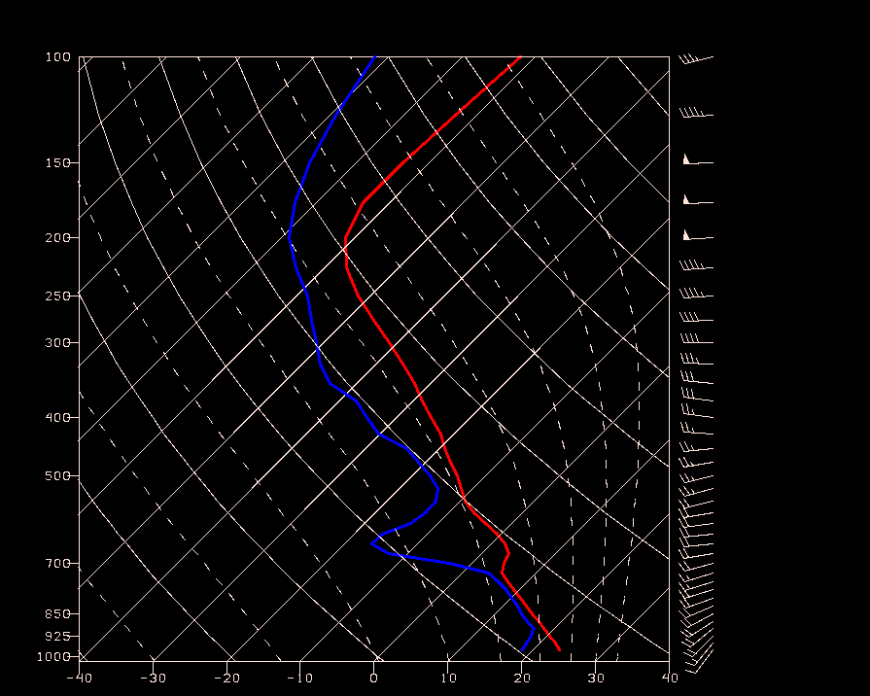
WRF Sounding, 2002033003Z
Lat=34.4
Lon=-88.1
CAPE~2800

Slide 9
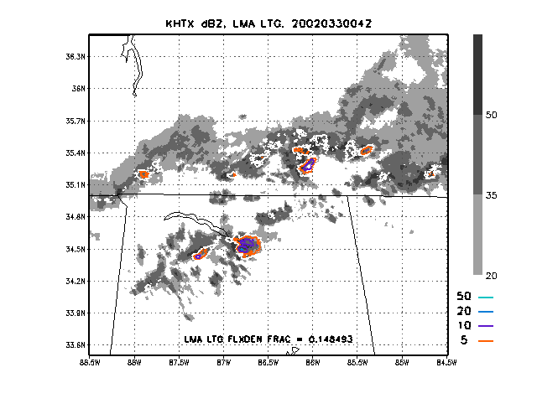
Observations: 30 March 2002, 04Z

Slide 10
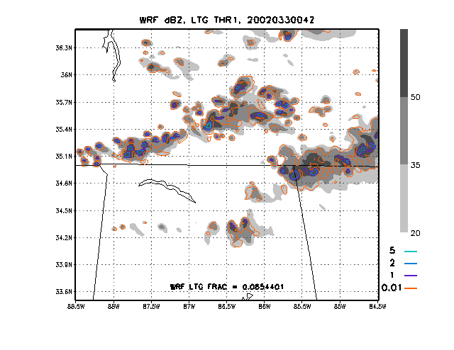
WRF LTG Threat 1: 30 March 2002, 04Z

Slide 11
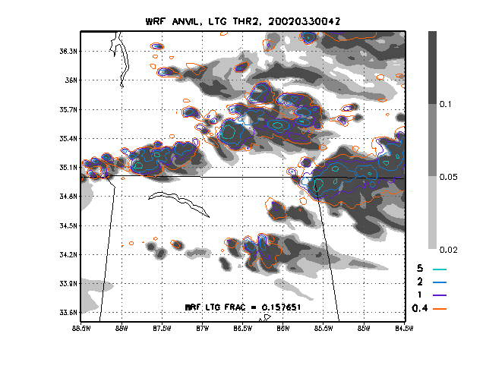
WRF LTG Threat 2: 30 March 2002, 04Z

Slide 12
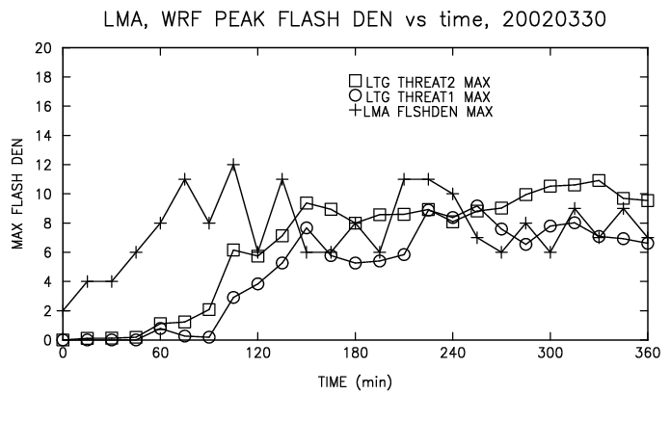
Domainwide Peak Flash Density Time Series
30 March 2002

Slide 13
Construction of blended threat: 1. Threat 1 and 2 are both calibrated to yield correct peak flash densities 2. The peaks of threats 1 and 2 tend to be coincident in all simulated storms, but threat 2 covers more area 3. Thus, weighted linear combinations of the 2 threats will also yield the correct peak flash densities 4. To preserve most of time variability in threat 1, use large weight 5. To ensure areal coverage from threat 2, avoid very small weight 6. Using 0.95 for threat 1 weight, 0.05 for threat 2, is good

Slide 14
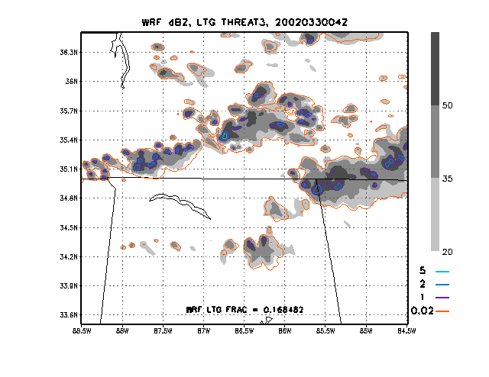
WRF LTG Threat 3; dBZ: 2002033004Z Blended

Slide 15
Ensemble studies, CAPS case 20080502: 1. Tornadic storms in MS after 20Z on 20080502 2. NALMA saw only peak FRD ~ 4 fl/km²/(5 min) due to range 3. Results obtained for 10 ensemble members (see table): - several members didn’t finish (computer issues) - consider only data from t > 16 hr - model output available only hourly - to check calibrations, must use decimated 1-h LMA data - Threat 1: always smaller than Threat 2 - Threat 2: values look reasonable for severe outbreak - Threat 1: more sensitive to grid change than Threat 2

Slide 16
Results, CAPS ensemble, 20080502
Experiment name | Peak Threat 1 | Peak Threat 2
cn | 4.1 at t=17 hr | 6.7 at t=24 hr
c0 | 4.0 at t=23 hr | 8.0 at t=23 hr
n1 | 6.6 at t=21 hr | 9.4 at t=22 hr
n2 | 5.0 at t=24 hr | 7.6 at t=24 hr
n3 (short expt) | 2.5 at t=16 hr | 6.7 at t=16 hr
n4 | 7.1 at t=29 hr | 9.2 at t=25 hr
p1 | 7.2 at t=21 hr | 8.4 at t=21 hr
p2 | 5.5 at t=22 hr | 8.1 at t=20 hr
p3 | 6.4 at t=23 hr | 8.9 at t=23 hr
p4 | 3.6 at t=23 hr | 7.6 at t=21 hr

Slide 17
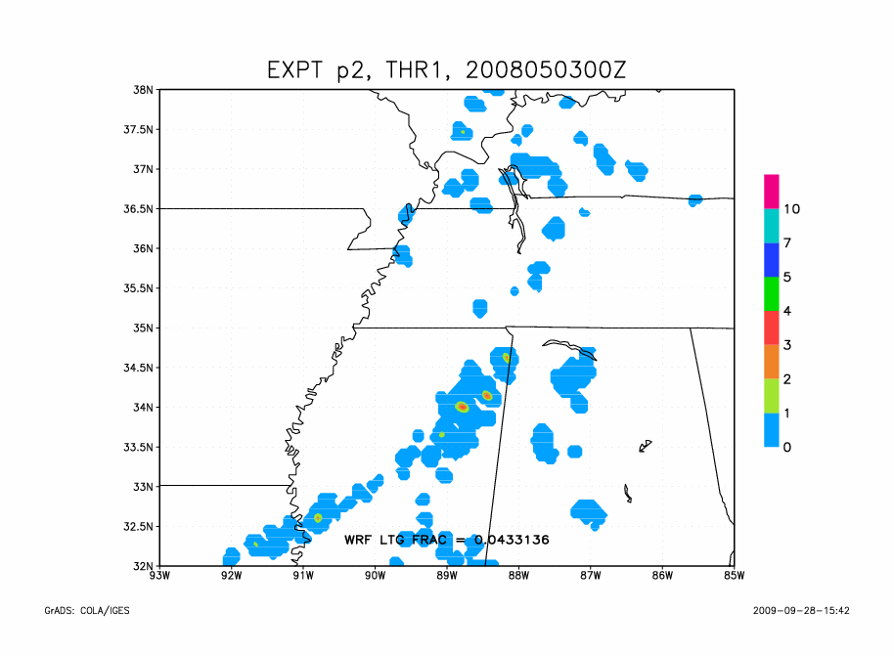
CAPS p2, Threat 1: 2008050300Z

Slide 18
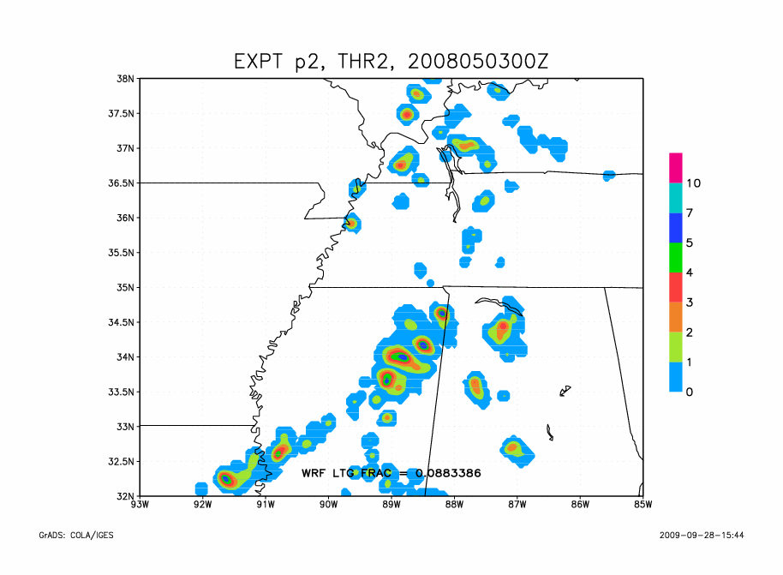
CAPS p2, Threat 2: 2008050300Z

Slide 19
Ensemble findings (early): 1. Currently testing algorithm on CAPS 2008 4km WRF runs 2. Mixed sensitivity to changes in grid mesh, model physics - Threat 1: too small, more sensitive (grid sensitivity?) - Threat 2: appears nearly independent of model changes - Strategy: boost Threat 1 to equal Threat 2 peak values before blending to create Threat 3 3. First look at another case confirms results from 20080502 4. Examine additional case days to establish generality

Slide 20
Future Work: 1. Examine more simulation cases, with added diversity, to improve generality of algorithms; test at NSSL Spring Program 2010 2. Test newer versions of WRF, when available: - more hydrometeor species - double-moment microphysics 3. In future runs, examine fields of interval-cumulative wmax, and associated hydrometeor and reflectivity data, not just the instantaneous values; for save intervals > 15 min, events happening between saves may be important for LTG jumps 4. Be aware of opportunities for devising data assimilation strategies for LTG data

Slide 21
Acknowledgments: This research was funded by the NASA Science Mission Directorate’s Earth Science Division in support of the Short-term Prediction and Research Transition (SPoRT) project at Marshall Space Flight Center, Huntsville, AL. Thanks to collaborators Steve Goodman, NOAA, and K. LaCasse and D. Cecil, UAH, who helped with the recent W&F paper (June 2009). Thanks to Gary Jedlovec, Rich Blakeslee, and Bill Koshak, NASA, for ongoing support for this research. Thanks also to Paul Krehbiel, NMT, Bill Koshak, NASA, Walt Petersen, NASA, for helpful discussions.

