Slide 1


Gary Jedlovec
Evolution SPoRT Products to End Users
History and SPoRT paradigm
Selected product examples
Future products
transitioning unique NASA data and research technologies to operations

Slide 2
SPoRT Paradigm
We don’t just “throw unique data over the fence” to an end user!
SPoRT Paradigm
  Match observations/capabilities to forecast problems
  Develop / assess solution in “testbed”, transition to decision support system
  Training, assessment and impact
History of SPoRT Products to WFOs
  First MODIS image in AWIPS in Feb 03; suite of product to disseminate to 3 WFOs
  LMA data to HSV in Apr 03; improve lead time for occurrence of severe weather
  MODIS suite expanded to include coastal WFOs who were excited about high resolution SSTs leading to MODIS SST composite
  Share tools with extended product dissemination efforts (e.g. Univ. of Wisconsin)
  MODIS SSTs and AIRS profiles and radiances used to improve initializations for weather forecasting models resulting in improved forecasts
Current State of SPoRT Products
  Over 30 products from MODIS, AMSR-E, AIRS, NALMA, GOES in AWIPS - 15 WFOs
  MODIS SSTs incorporated into V3 of WRF EMS
transitioning unique NASA data and research technologies to operations

Slide 3
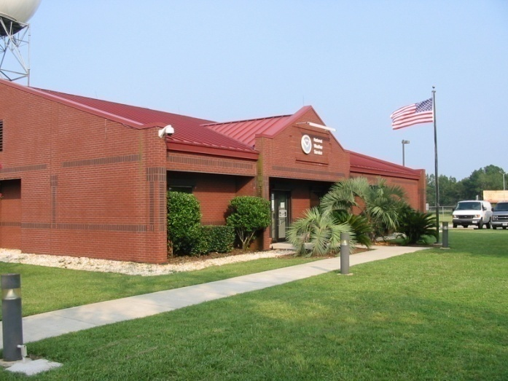
SR WFO Forecast Problems
NWS Southern Region - common short-term forecast problems
  timing and location of thunderstorms and severe weather
  diagnostic analysis of current conditions (esp. at night)
  morning minimum temperatures (and its local variations)
  detection and monitoring of fog, smoke, fires
  coastal weather processes (sea breeze convection / temperatures)
  development / movement of off-shore precipitation processes – tropical systems
  gap filler in data void regions – atmospheric rivers of moisture
transitioning unique NASA data and research technologies to operations

Slide 4
Products to End Users
INSTRUMENT / PRODUCT | RESOLUTION | END USER | DSS | FORMAT
MODIS
Ch. Imagery (vis, 3.9, 6.7, 11 µm) | 4 km, 1 km, 500 m (state), 250 m (WFO scale) | Selected WFOs | AWIPS, AWIPSII | netCDF, McIDAS
Multispectral composite images –natural/false color | 4 km (CONUS), 1km (regional), 500m (state) | Selected WFOs | AWIPS, AWIPSII | netCDF, McIDAS
Derived image products
clouds (mask, CTP, phase) | 4 km (CONUS) | Selected WFOs | AWIPS, AWIPSII | netCDF, McIDAS
fog / low cloud (11 – 3.9 µm ) | 4 km (CONUS), 1 km (regional) | Selected WFOs | AWIPS, AWIPSII | netCDF, McIDAS
LST, SST, LI, TPW | 4 km (CONUS), 1 km (regional) | Selected WFOs | AWIPS, AWIPSII | netCDF, McIDAS
Temporal composite images
SST, chlorophyll | 4 km, 2 km, 1 km | HWT, WFOs | AWIPS, II, others | netCDF, GRiB
Non-image data
fire and burn areas | CONUS | WFOs | AWIPS II | shape file
AMSR-E
Rain rate, cloud water | 5 km (CONUS); 21 km | WFOs | AWIPSII | netCDF
SSTs | 38 km (CONUS) | WFOs | AWIPS | netCDF
Total lightning data
NALMA/DCLMA total lightning source densities | 2 km / 2 minutes 1 km/ 1 minute | Selected WFOs | AWIPS, AWIPSII | netCDF, GRiB
transitioning unique NASA data and research technologies to operations

Slide 5
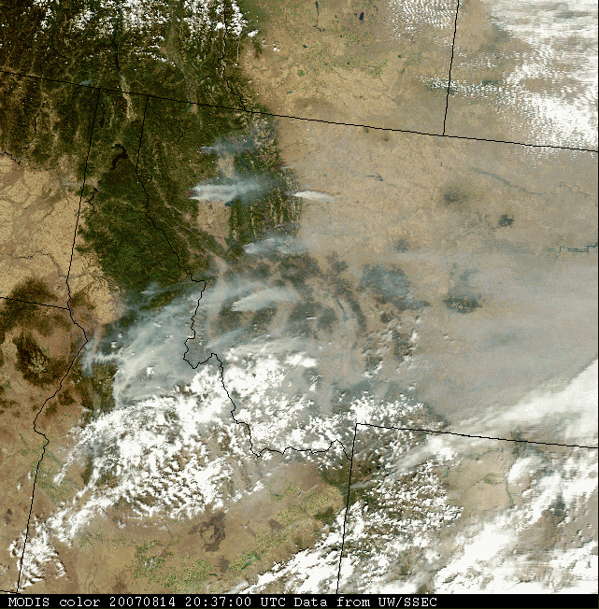
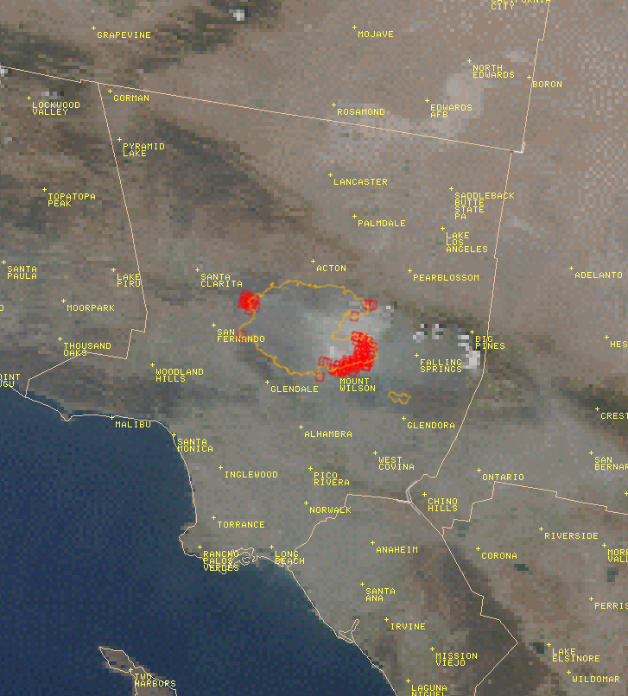
Fire Weather / Disaster response
Incident meteorologists at WFOs work closely with other agencies to provide weather support for disaster response
  hurricanes
  severe weather
  local flooding
  fire weather support
Wildfire support and response:
  fire weather forecasts
  spot forecasts of conditions
MODIS data in AWIPS
  smoke mapping
  hot spot and burn area – data from other agencies
USFS burn area and MODIS hot spots
transitioning unique NASA data and research technologies to operations

Slide 6
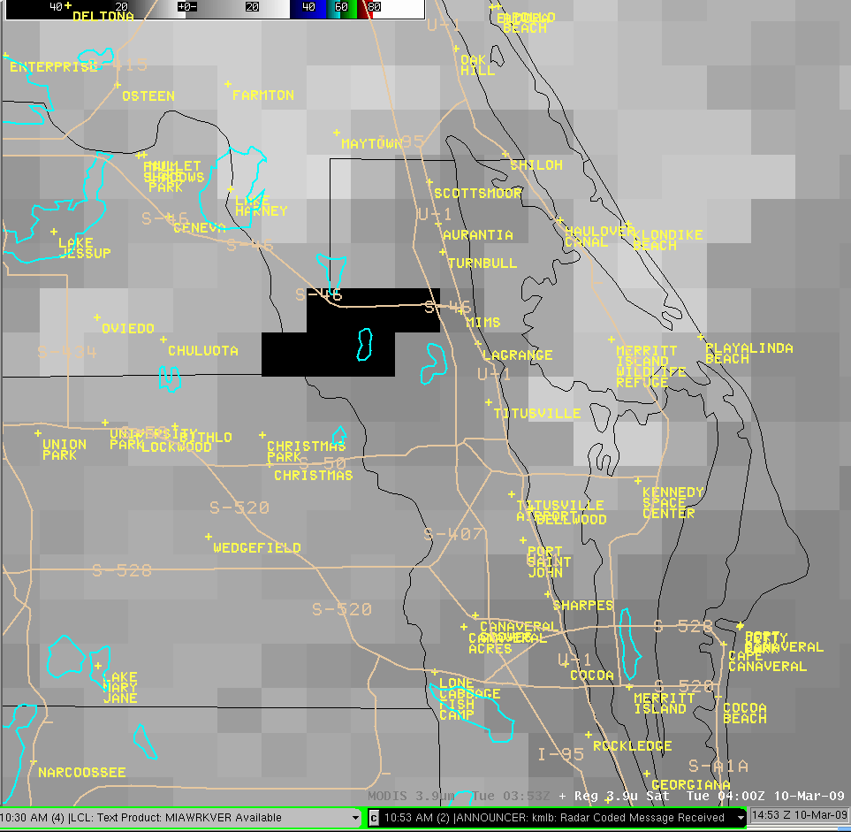
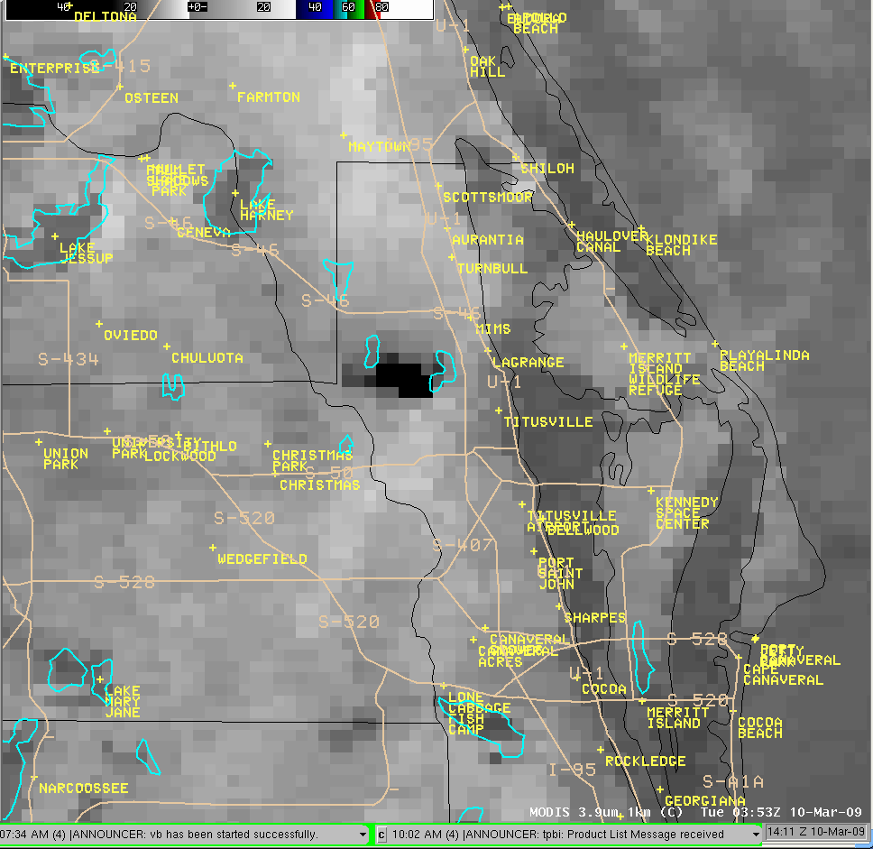
MODIS “hot spot” Imagery
March 11, 2009
MODIS thermal imagery alone improves identification / location of fire “hot spots” leading to better incident meteorologist support
MODIS infrared imagery 1411 UTC isolates fire “hot spots”
GOES infrared imagery 1453 UTC poorly isolates fire “hot spots”
transitioning unique NASA data and research technologies to operations
March 11, 2009

Slide 7
Products to End Users
INSTRUMENT / PRODUCT | RESOLUTION | END USER | DSS | FORMAT
Combined Instrument products
MODIS/AMSR-E SST composite | 1 km (NA coastal regions) | Coastal WFOs | AWIPS, AWIPSII | netCDF, McIDAS
POES/GOES SSTs | 9 km (NH) | TWC / WFOs | AWIPS, AWIPSII | netCDF, McIDAS
Blended TPW (from CIRA) | 16 km (NH) | Selected WFOs | AWIPS, AWIPSII | netCDF, McIDAS
MIMIC TPW (from UW) | 10 (NH) | The Weather Channel | --- | GeoTIFF
GOES
Channel imagery(vis, IR,WV) | 1 km, 4 km | The Weather Channel | --- | GeoTIFF
Aviation products (fog depth, icing, cloud base -NESDIS) | 4 km (CONUS) | Selected WFOs | AWIPS, AWIPSII | netCDF, McIDAS
GOES-R
GLM proxy extent density | 10 km / 2 minutes | SPoRT | AWIPSII | GRiB
ABI proxy imagery (vis, IR, WV) | 500 m, 1 km | SPoRT | AWIPSII | McIDAS
Miscellaneous
WRF LIS daily forecasts w/ MODIS SSTs (NSSL/HWT) | 4 km (CONUS) | Selected WFOs | AWIPS, AWIPSII | GRiB
Surface analysis (T, Td, RH, wind, SSTs) – SPoRT ADAS | 2 km | Selected WFOs | AWIPS, AWIPSII | GRiB
transitioning unique NASA data and research technologies to operations

Slide 8
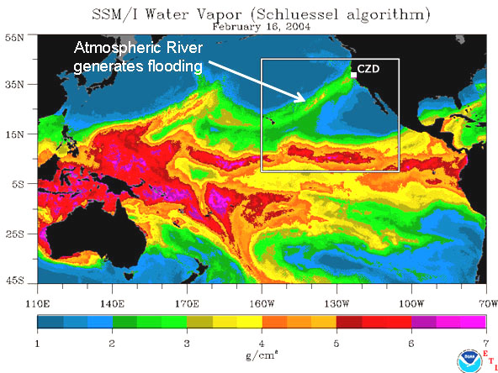
Moisture Information in Data Voids
Ocean regions, Mexico, and Gulf of Mexico are relatively sparse w.r.t weather observations
Heavy precipitation associated with “atmospheric rivers” of moisture from tropics
Total precipitable water (TPW) and anomaly product used to monitor moisture sources in data sparse regions
  combined SSM/I, AMSU, GPS observations (CIRA/CSU & NESDIS)
  4 times daily, anomaly is departure from previous week’s values
AIRS analyses for 3-dimensional water vapor mapping over Pacific
transitioning unique NASA data and research technologies to operations

Slide 9
Future Products and Dissemination
  Expansion to additional WFOs –AWIPS II makes it a lot easier
    Roam and zoom “Google Earth” type of environment – one big region
    Easily make products available to Regions via LDM
    More flexibility with data and displays in AWIPS II
  Transition existing EOS observations to AWIPS II
  NPP / NPOESS observations – CrIS and VIIRS
  Additional forecast problems – new WFOs and / or new measurements
    Air quality forecasts – AOD products from MODIS, forecasts
    Fire weather / disaster response – imagery / active fire and burn areas
    Land-falling hurricanes – observations and models
    Observations in data void regions (atmospheric rivers off Pacific coast)
  Re-occurring problems
    Convective initiation – nowcasting and WRF / LIS (improve w/ EOS data)
    Lightning forecasts
transitioning unique NASA data and research technologies to operations

