Slide 1


MODIS Applications
Kevin Fuell, Geoffrey Stano, Gary Jedlovec
Fifth Meeting of the Science Advisory Committee
18-20 November, 2009
National Space Science and Technology Center, Huntsville, AL
transitioning unique NASA data and research technologies to operations

Slide 2
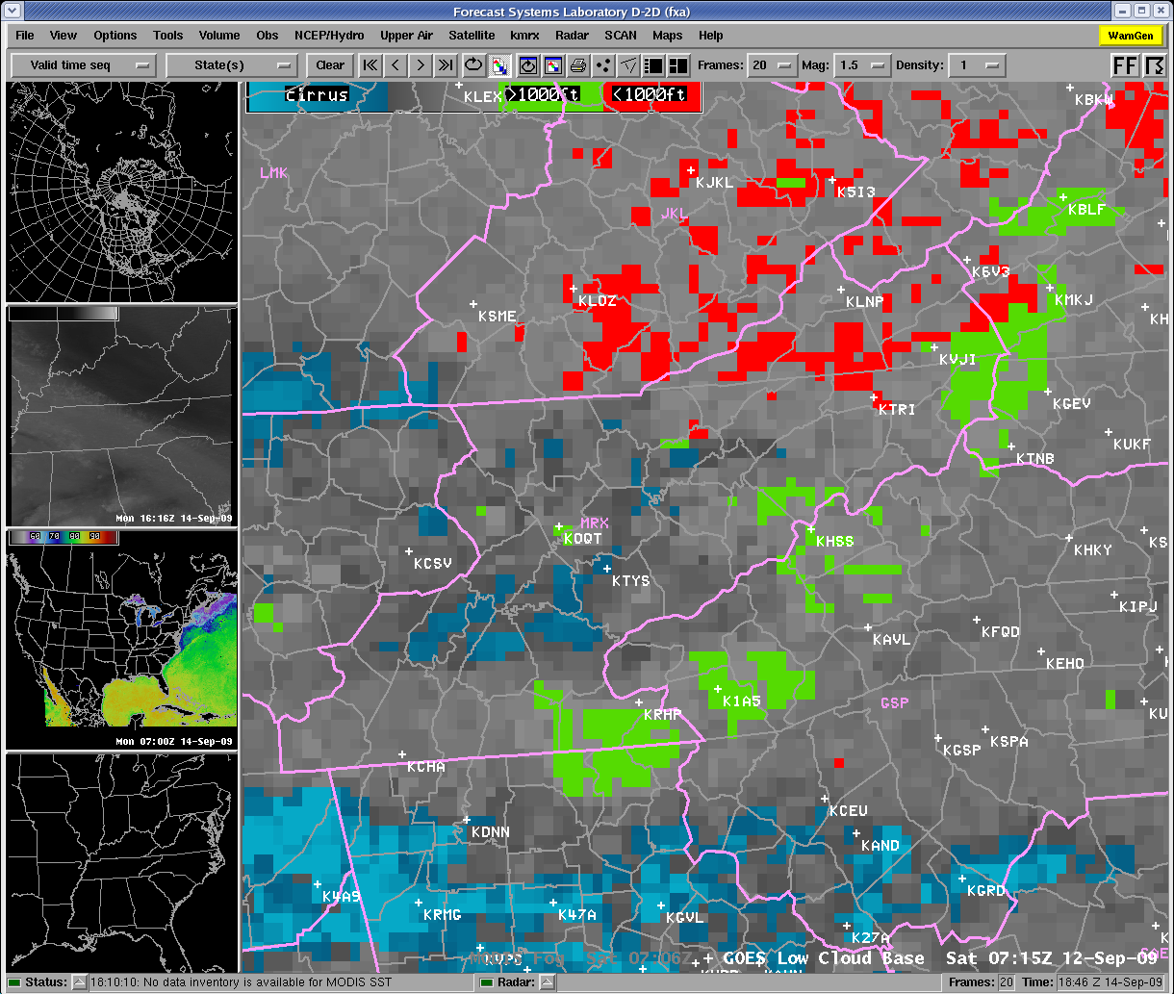
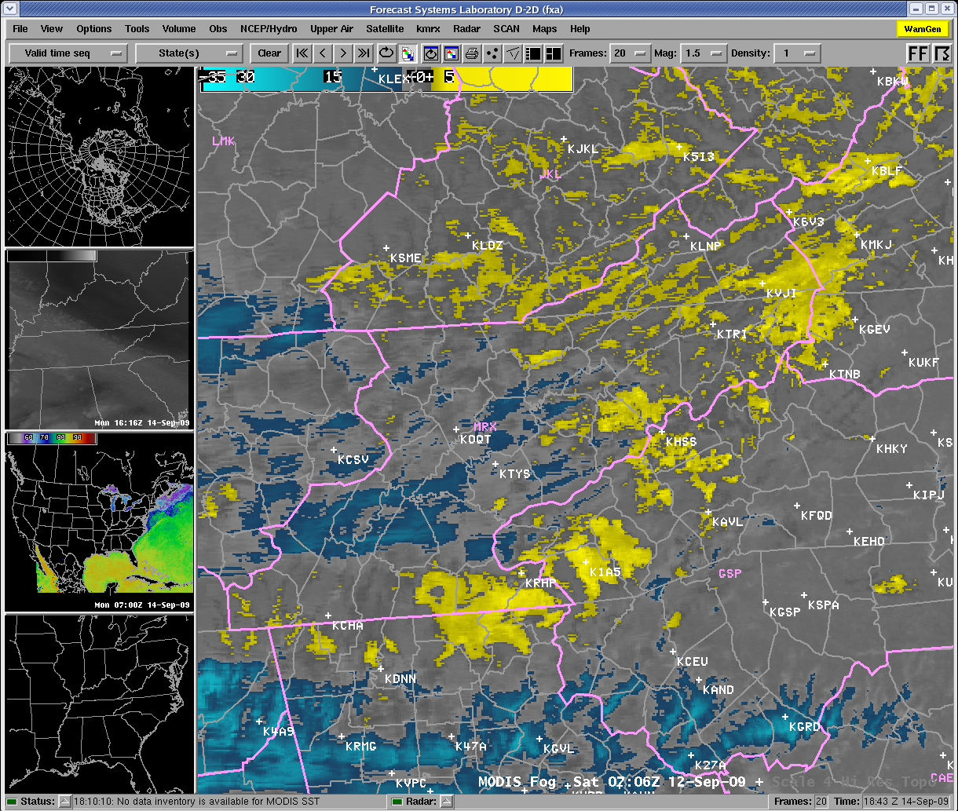
Relevance to NASA/SPoRT
“It’s our misssion!”
  Supports SPoRT mission of applying NASA EOS data to short-term forecast operations
“I was blind…but now I see.”
  High resolution imagery adds value to a forecast problem by providing greater detail over more coarse data
“Veggies with your steak & potatoes”
  Complements the standard products forecasters use
“A glimpse into the future.”
  Demonstrates future NPOESS and GOES capabilities to promote “readiness” and priority of products
transitioning unique NASA data and research technologies to operations
Notes:
“It’s our misssion!”
Supports SPoRT mission of applying NASA EOS data to short-term forecast operations
“I was blind…but now I see.”
High resolution imagery adds value to a forecast problem by providing greater detail over more coarse data
“Vegies with your steak & potatoes”
Compliments the standard products forecasters use
“A glimpse into the future.”
Demonstrates future NPOESS and GOES capabilities to promote “readiness” and priority of products

Slide 3
Relevance to NASA/SPoRT
“It’s our mission!”
“I was blind…but now I see.”
“Veggies with your steak & potatoes”
“A glimpse into the future.”
transitioning unique NASA data and research technologies to operations
Notes:
“It’s our misssion!”
Supports SPoRT mission of applying NASA EOS data to short-term forecast operations
“I was blind…but now I see.”
High resolution imagery adds value to a forecast problem by providing greater detail over more coarse data
“Vegies with your steak & potatoes”
Compliments the standard products forecasters use
“A glimpse into the future.”
Demonstrates future NPOESS and GOES capabilities to promote “readiness” and priority of products

Slide 4
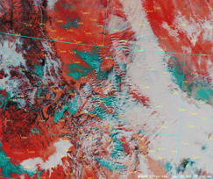
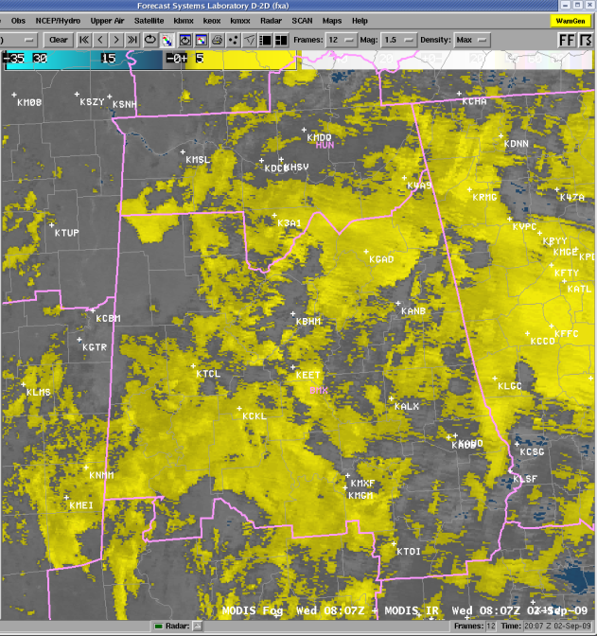
Accomplishments Since 2007 SAC
Figure from AMS 2009 conf. paper
More than twice the number of WFOs using MODIS
  They volunteered to collaborate
  – i.e. SPoRT seen as a valued partner
Conf. paper on False Color product w/ end user as lead author
Completed Intensive Study Period for MODIS “Fog” product
MODIS products being used in NWS Graphical Forecast Editor
User feedback for MODIS fog continues the transition process
transitioning unique NASA data and research technologies to operations
Notes:
Expansion of WFOs from 5 to 14
Greater potential for feedback
Conf. paper on False Color product w/ end user as lead author
Evaluations by the user, not SPoRT alone
Completed Intensive Study Period for MODIS “Fog” product
2007 SAC Recommendation: “SPoRT should be more proactive in getting comments from the users”
MODIS being used in NWS Graphical Forecast Editor
Feedback indicated that application of MODIS can be limited by temporal frequency . Use in GFE alleviates this issue to some degree

Slide 5
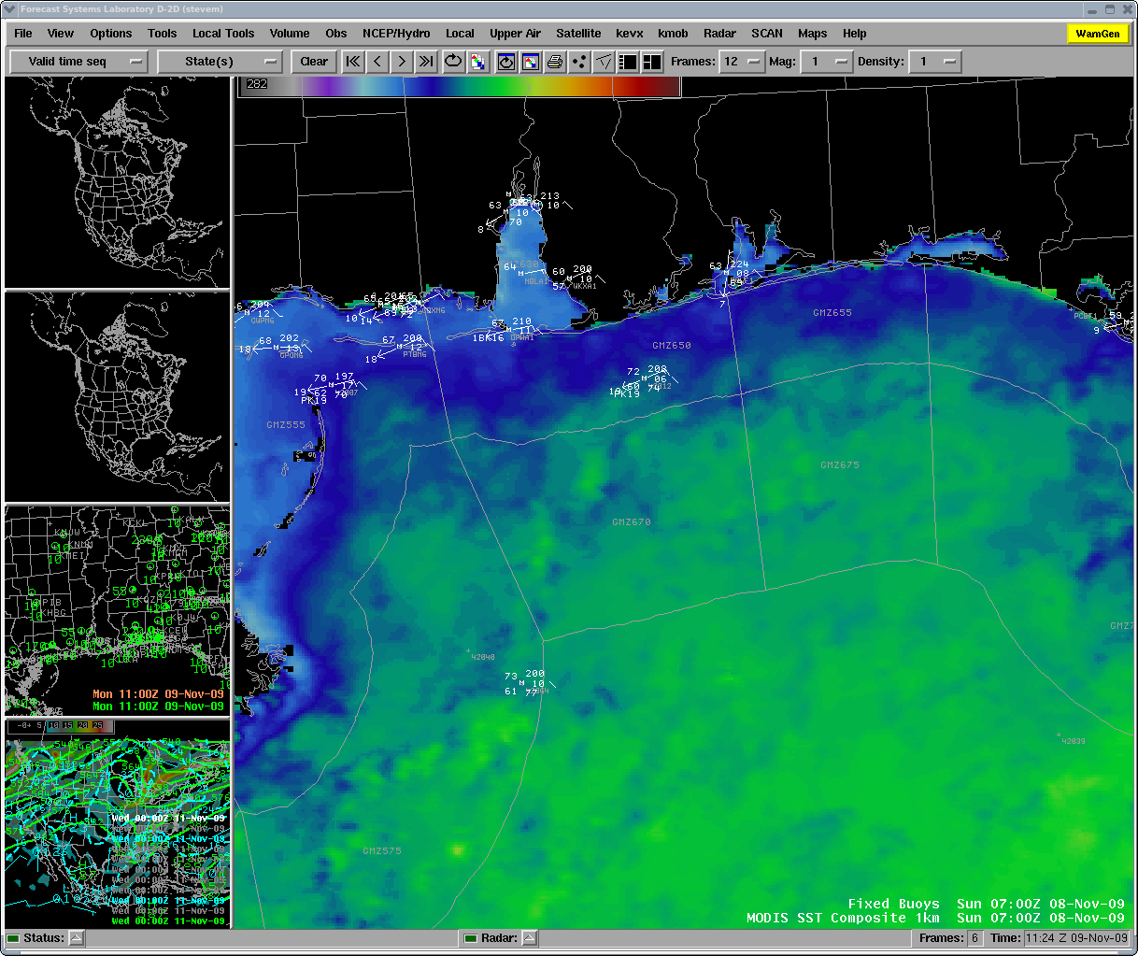
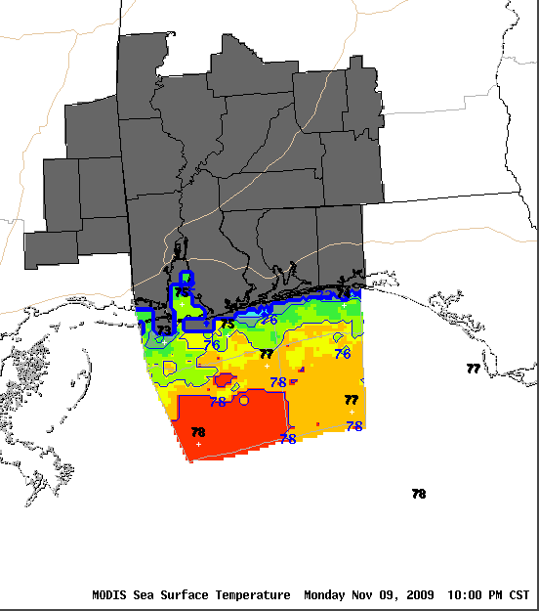
Approach / Methodology
MODIS in AWIPS/D-2d for use with other data such as buoys/C-MANs
Provide MODIS data in users decision support system (e.g. D-2d, GFE )
  MODIS combined w/ other data adds greater awareness to the forecast issue
  Use the MODIS high resolution to better interpret the more coarse GOES data
Interact regularly with users to discuss their experiences and share case examples from other partners
  Overcome temporal issues by using MODIS within the Graphical Forecast Editor for either initialization or adjustments of forecast grids
Iterate with users to improve product and transition
MODIS SST composite in the Graphical Forecast Editor (GFE)
transitioning unique NASA data and research technologies to operations
Notes:
Main points:
Present MODIS as a complimentary product.
Regular interaction with users evaluates MODIS effectiveness.
Answer: Can product be adjusted to better fit forecast issue, or is there another more appropriate product.
Provide MODIS data in users decision support system (e.g. D-2d, GFE )
MODIS combined w/ other data adds greater awareness to the forecast issue
Use the MODIS high resolution to better interpret the more coarse GOES data
Interact regularly with users to discuss their experiences and share case examples from other partners
Overcome temporal issues by using MODIS within the Graphical Forecast Editor for either initialization or adjustments of forecast grids
Iterate with users to improve product and transition

Slide 6
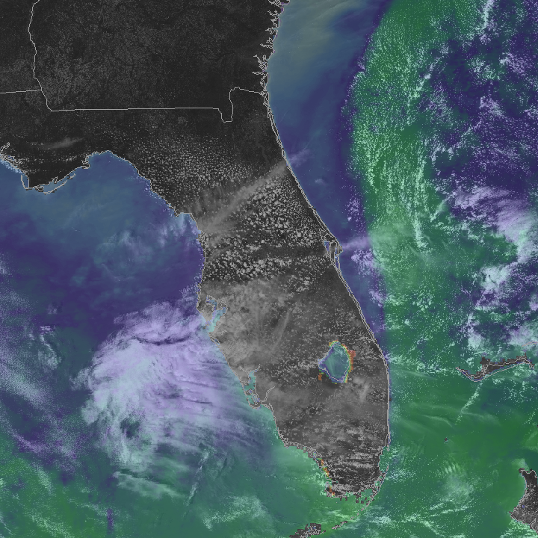
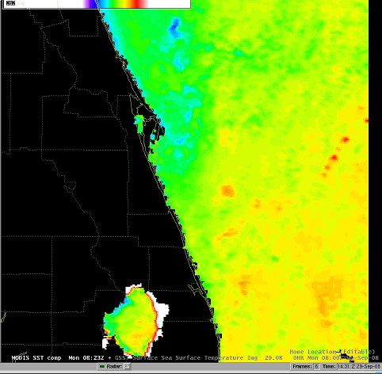
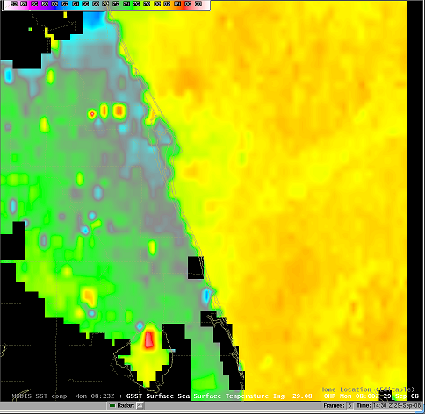
MODIS SSTs
Diagnostic and gridded uses
  West Wall of the Gulf Stream (MLB)
  Support of Shuttle missions by SMG
  Fog forecasting due to potential sea fog development (CRP)
  Commercial fishing (WorldWinds)
“Gulf Stream location information is vitally important to our thriving marine community, from both a safety and an economic perspective.” – Tony Cristaldi, NWS MLB
MODIS SST
GOES
SST
transitioning unique NASA data and research technologies to operations
Notes:
MODIS SST composites are used for more than just NWP.
Feedback from XXX regarding West Wall of Gulf Stream shows diagnostic use.
The Corpus Christi office also have used the product to examine the potential for sea fog.
Others such as WorldWinds provide this data to the marine community for commercial fishing purposes.

Slide 7
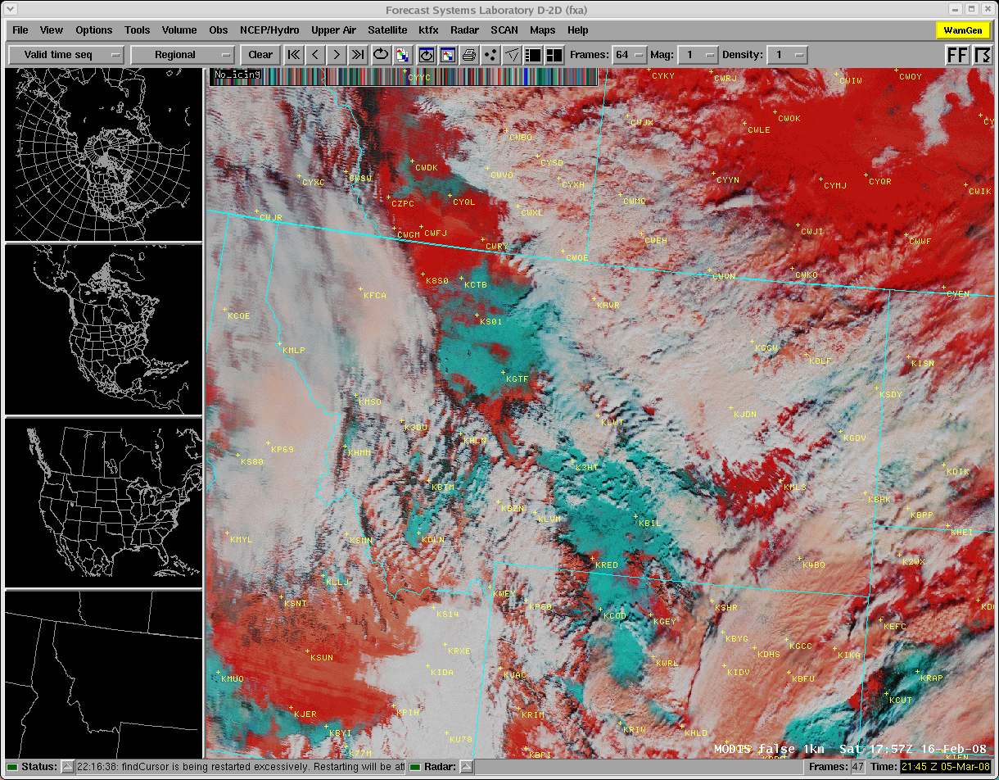
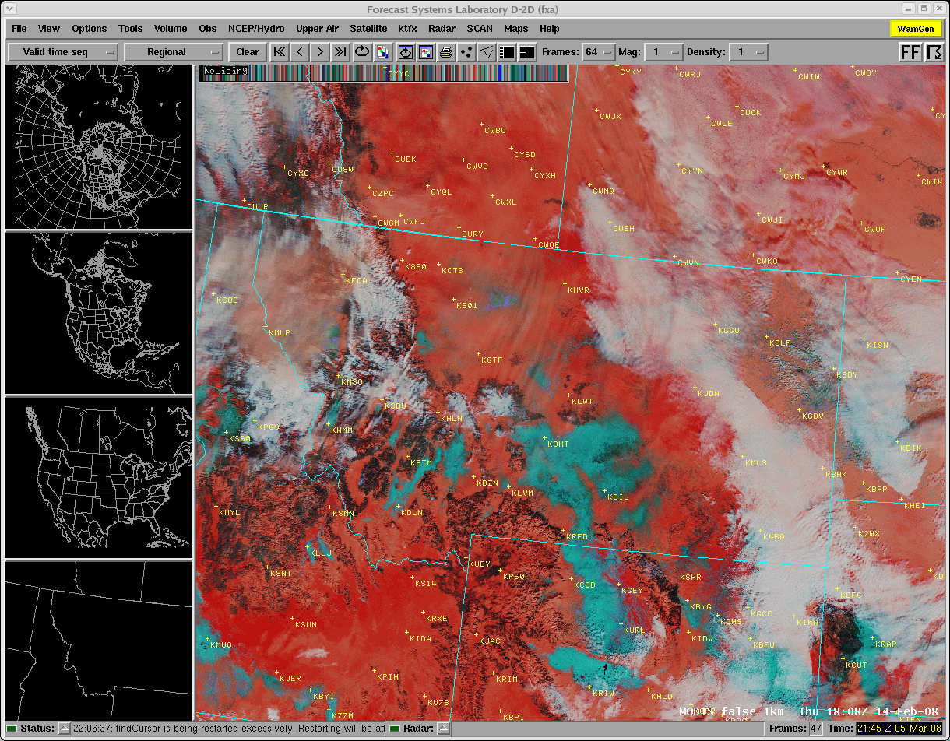
MODIS False Color - GFX
Forecast Concerns:
How much area has melted?
Rapid melt of snow fills creeks and streams
(only took 2 days to melt)
Flooding may occur in small areas or in larger areas that are down stream, such as river valleys
Canada
MT
ID
WY
transitioning unique NASA data and research technologies to operations

Slide 8
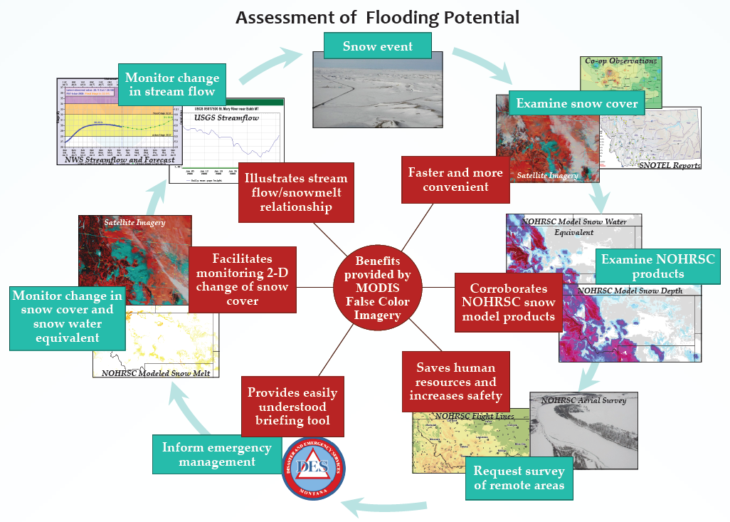
MODIS False Color - GFX
  “saves time and resources while complimenting other products”
Notes:
False Color Composite
GFX application to hydrometeorology (use part of poster)
“saves time and resources while complimenting other products”
potential modification for a change product or addition of snow water equivalent

Slide 9
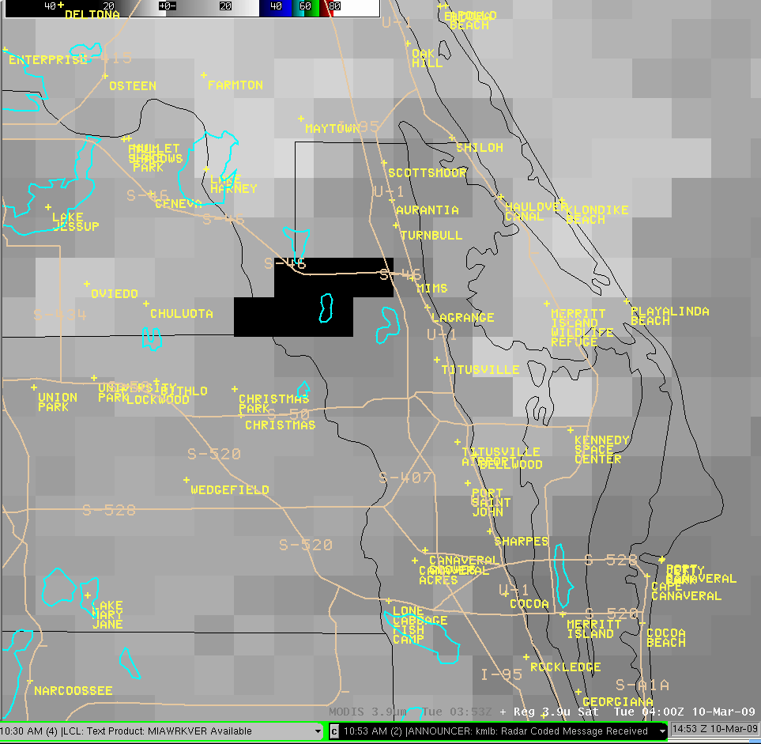
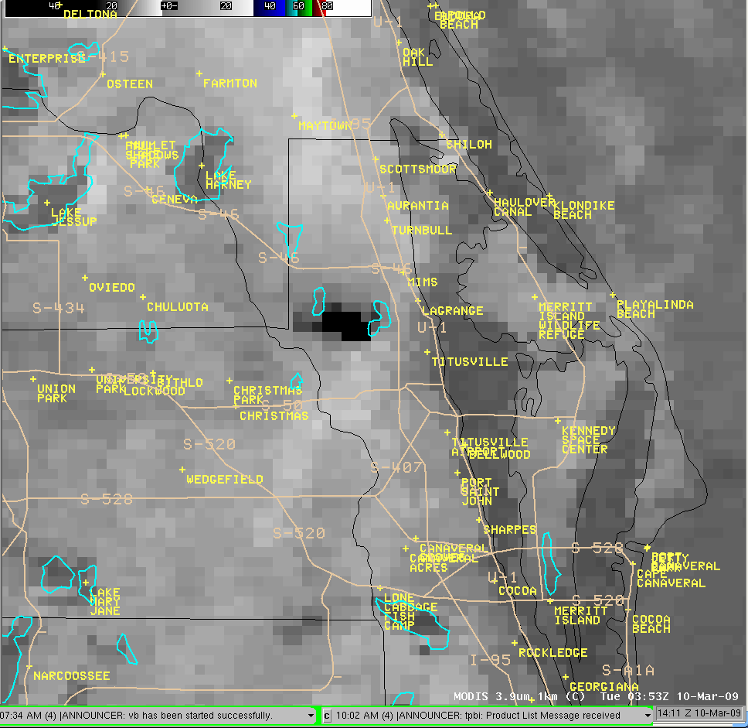
MODIS 3.9um: Wildfire Monitoring
Example submitted by the Melbourne, FL WFO from March 2009. GOES navigation in error and area too large. MODIS provides correct location and better hot spot area definition.
transitioning unique NASA data and research technologies to operations

Slide 10
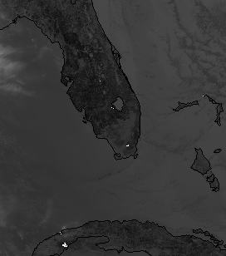
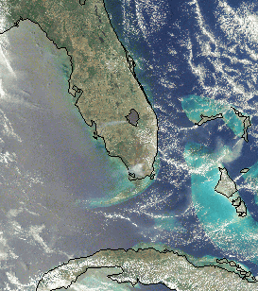
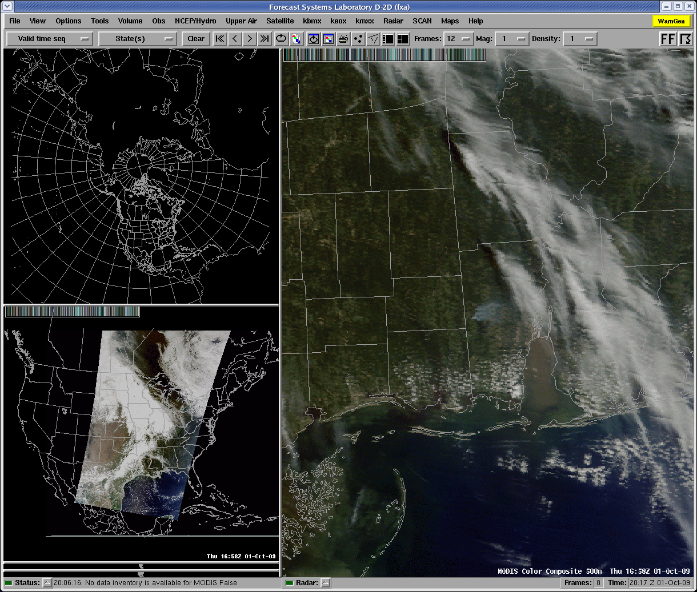
True Color Composite
MODIS 3.9µm
MODIS True Color
October 1,2009
From Jeff Medlin – SOO at MOB
“These definitely help when briefing.”
May 7, 2008 - From Pablo Santos – SOO at MFL
“Composite VIS (500m) and 250m showed in great detail earlier this afternoon smoke plume associated with fire on western side of Lake Okeechobee. This enabled us to more accurately depict areas affected by the plume in our Hazardous Weather Outlook. ”
transitioning unique NASA data and research technologies to operations
Notes:
True Color Composite (combined with 3.9)
MFL application to fire wx awareness of smoke plume
“providing details for situational awareness not previously seen”
future work to include MODIS burn areas on composite via shapefiles

Slide 11
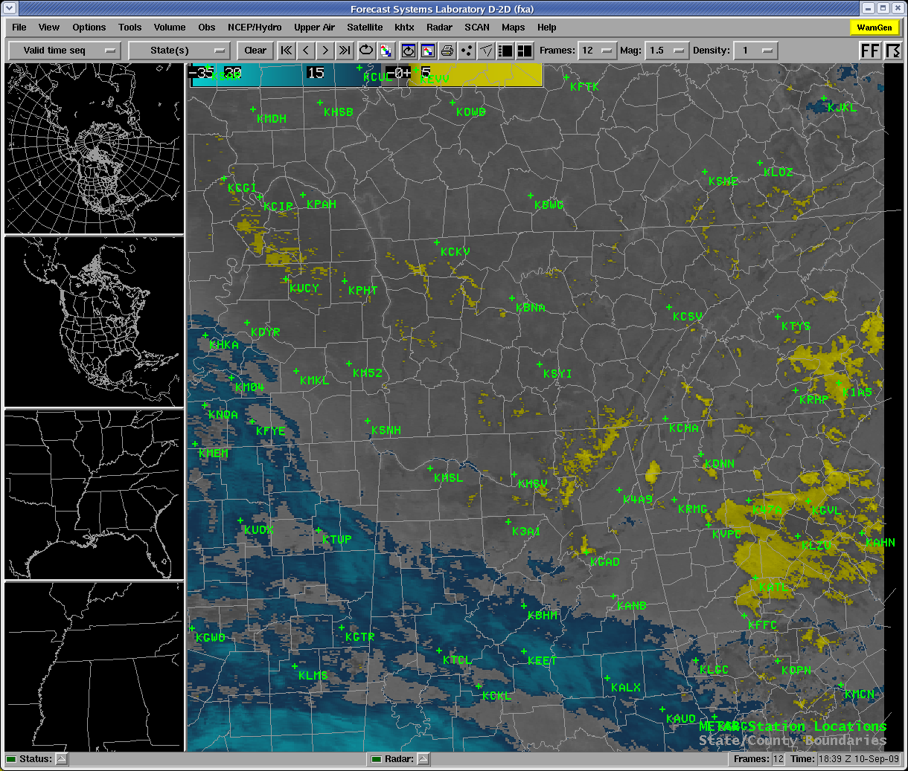
MODIS Spectral Difference – “Fog”
Complementary to GOES
Feedback: ABQ, MRX, BMX, HUN, OHX
High resolution provides greater awareness, increases confidence in decisions
Feedback from users leading to improved product
transitioning unique NASA data and research technologies to operations
Notes:
“Fog” product
follow on to and compliment of GOES LCB/FD
assessments – ABQ, MRX, BMX (not sure how much to say here and how much to leave for the Assessments talk)
“high resolution provides greater awareness, combined with higher frequency it might increase lead time”
discussions leading to modifications that may better filter out low clouds from the product while leaving fog areas

Slide 12
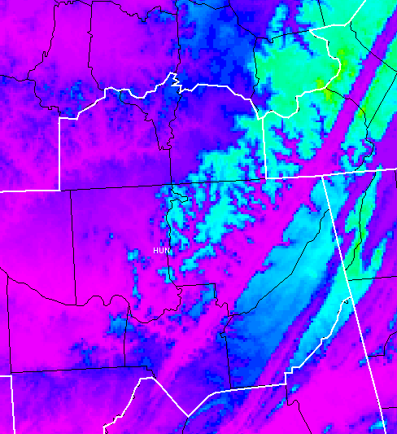
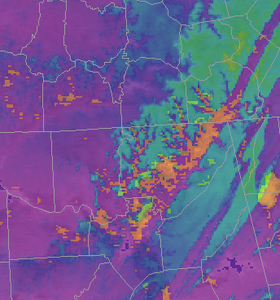
MODIS “Fog” Product – HUN WFO
Can see good correlation with topo at lower and high terrain areas.
TN River and valleys near Sand Mtn (HUN)
Elk River (OHX, HUN)
September 10, 2009 at ~0700Z
transitioning unique NASA data and research technologies to operations

Slide 13
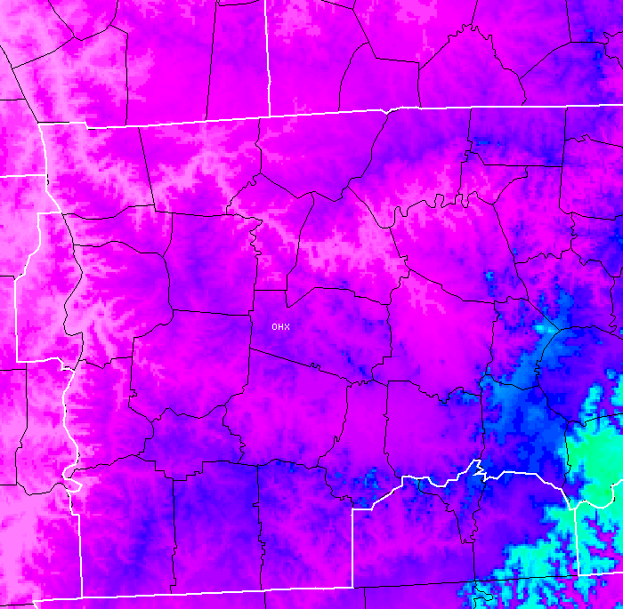
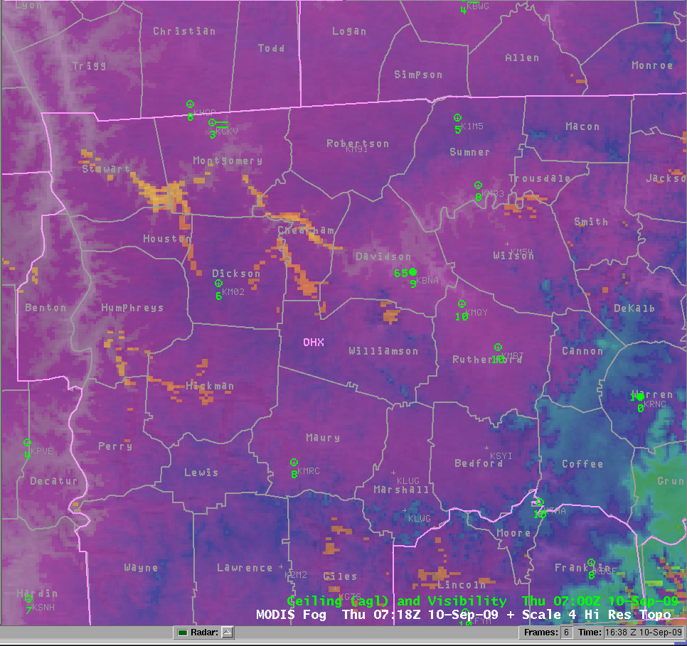
MODIS “Fog” Product – HUN WFO
Can see good correlation with topo at lower and high terrain areas.
Cumberland River (OHX)
Duck River (OHX)
Elk River (OHX, HUN)
September 10, 2009 at ~0700Z
transitioning unique NASA data and research technologies to operations

Slide 14
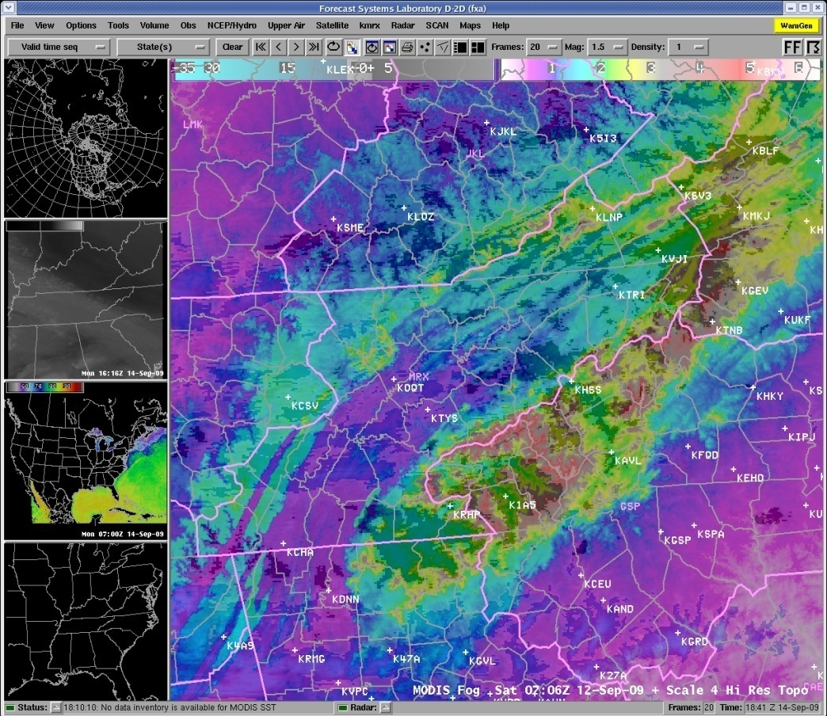
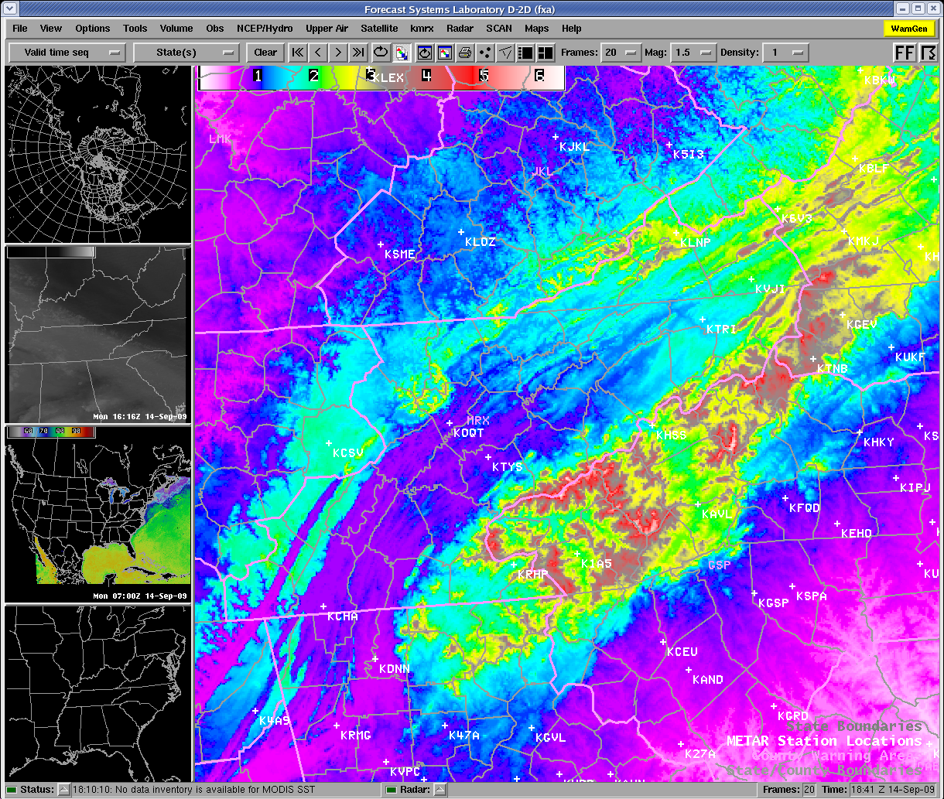
Many fog areas by ~3 A.M.
Good correlation with topography
Even elevated valleys indicate fog
Numerous valleys and streams in Morristown/Knox., TN WFO with fog.
Fog often between observations.
To Left: changed the yellow “fog” to be black and combined with topo

Slide 15
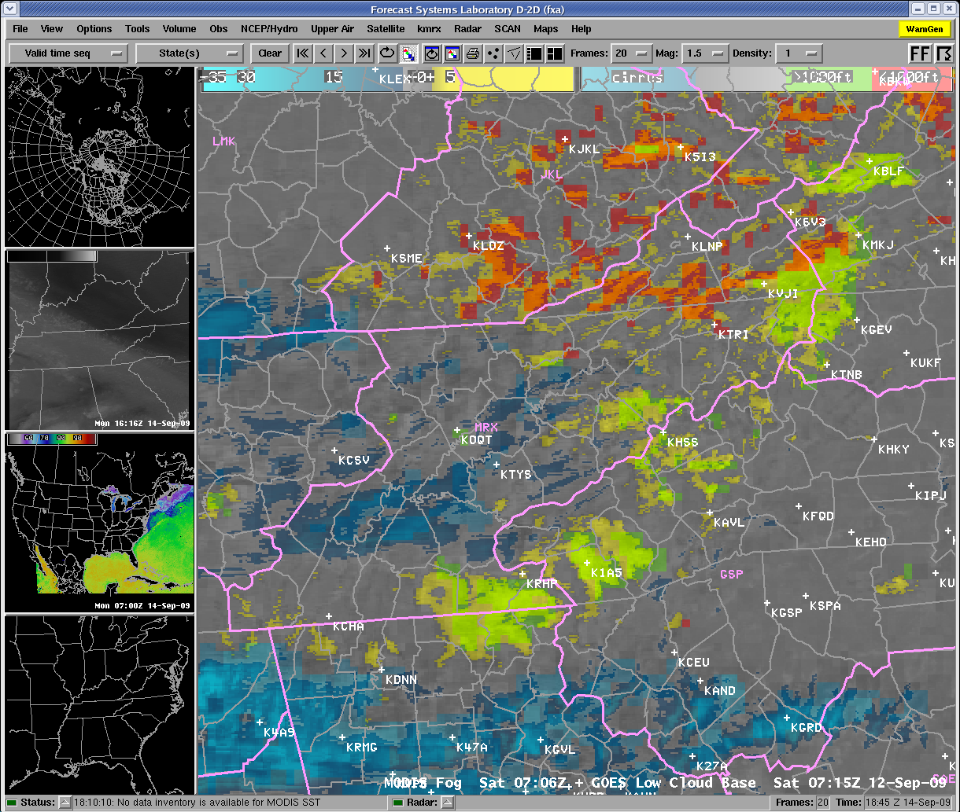
GOES LCB indicating ceiling >1000ft over App. Plateau
MODIS indicates likely fog in the elevated valleys at this time
GOES later indicated lower ceilings (i.e. fog)
All times at 705Z for MODIS and 715Z for GOES LCB

Slide 16
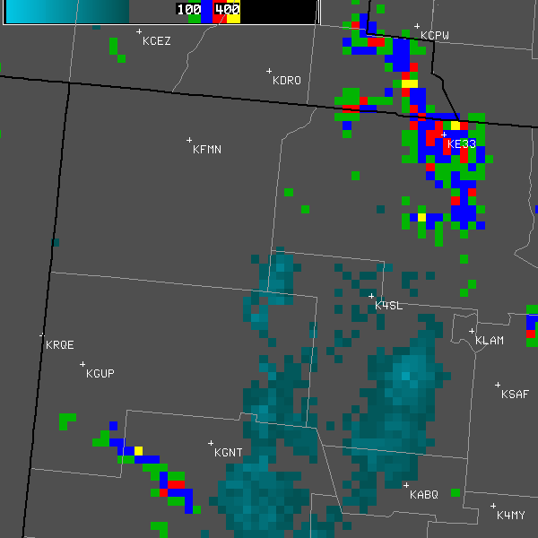
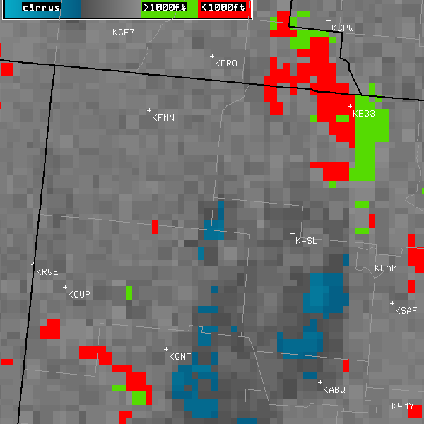
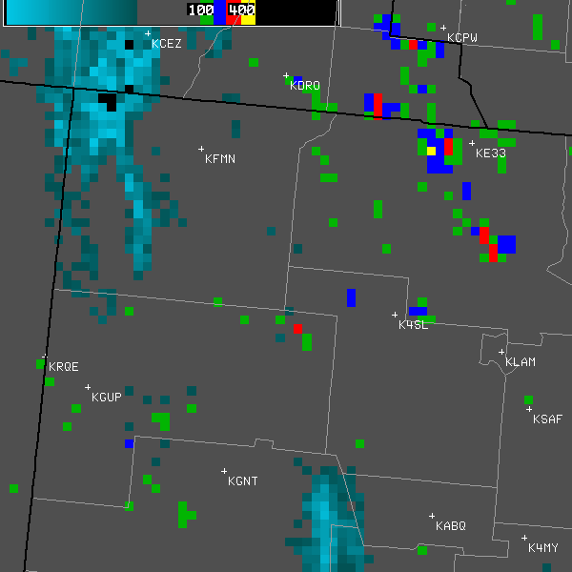
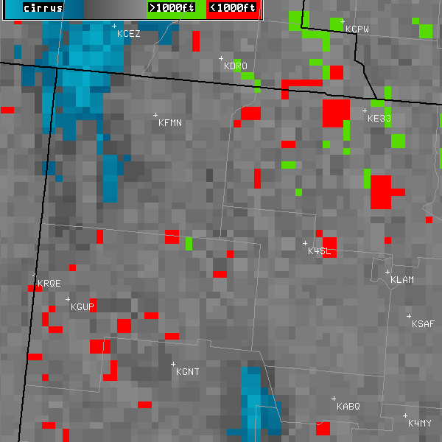
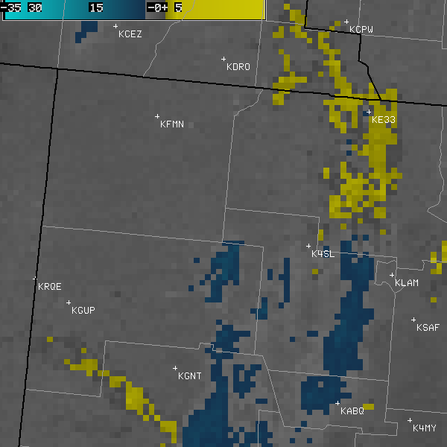
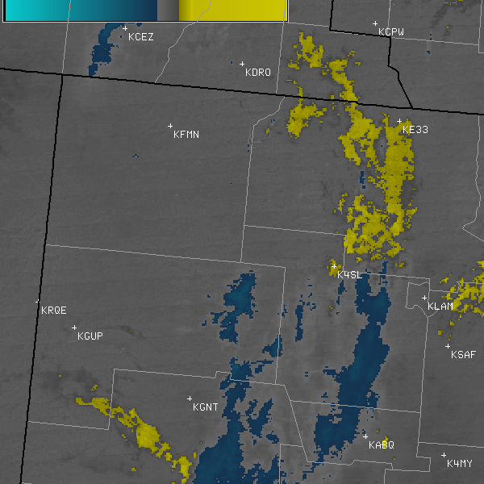
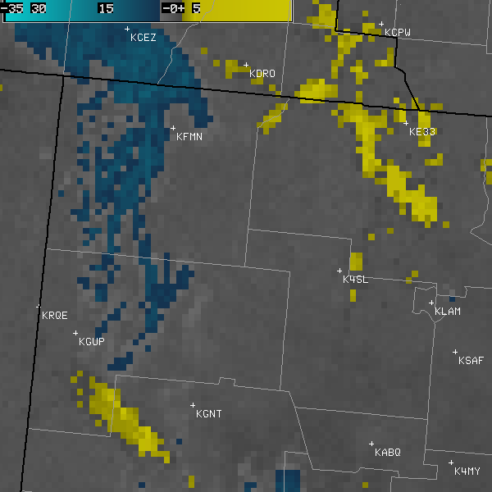
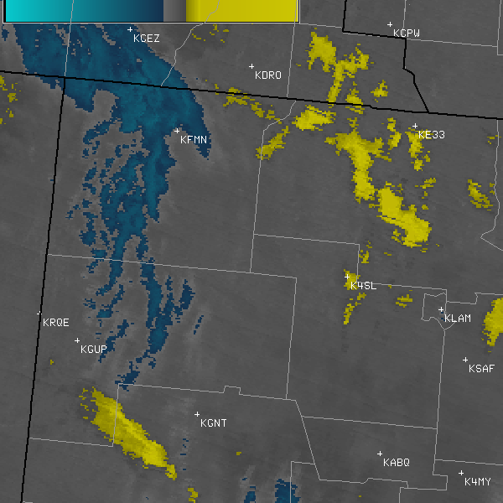
MODIS Spectral Difference – “Fog”
Fog Depth LCB
Fog Depth LCB
0515 Z
0915 Z
KGUP 091053Z AUTO 00000KT 10SM CLR M09/M11 A3001 RMK AO2 SLP183 T10891111 KGUP 091006Z AUTO 00000KT 3SM BR CLR M11/M12 A3003 RMK AO2 KGUP 091000Z AUTO 00000KT 1 3/4SM BR CLR M11/M12 A3002 RMK AO2 KGUP 070953Z AUTO 00000KT 10SM CLR M16/M18 A3015 RMK AO2 SLP301 T11611178 KGUP 070853Z AUTO 00000KT 7SM CLR M14/M16 A3015 RMK AO2 SLP295 T11441161 53006 KGUP 070849Z AUTO 00000KT 2 1/2SM BR CLR M15/M17 A3014 RMK AO2 KGUP 070820Z AUTO 00000KT 5SM BR CLR M15/M17 A3013 RMK AO2 KGUP 070810Z AUTO 00000KT 1 3/4SM BR CLR M16/M18 A3013 RMK AO2 KGUP 070753Z AUTO 00000KT 10SM CLR M15/M17 A3012 RMK AO2 SLP286 T11501167
0521 Z
0934 Z
MODIS 4km MODIS 1km
MODIS 4km MODIS 1km
transitioning unique NASA data and research technologies to operations

Slide 17
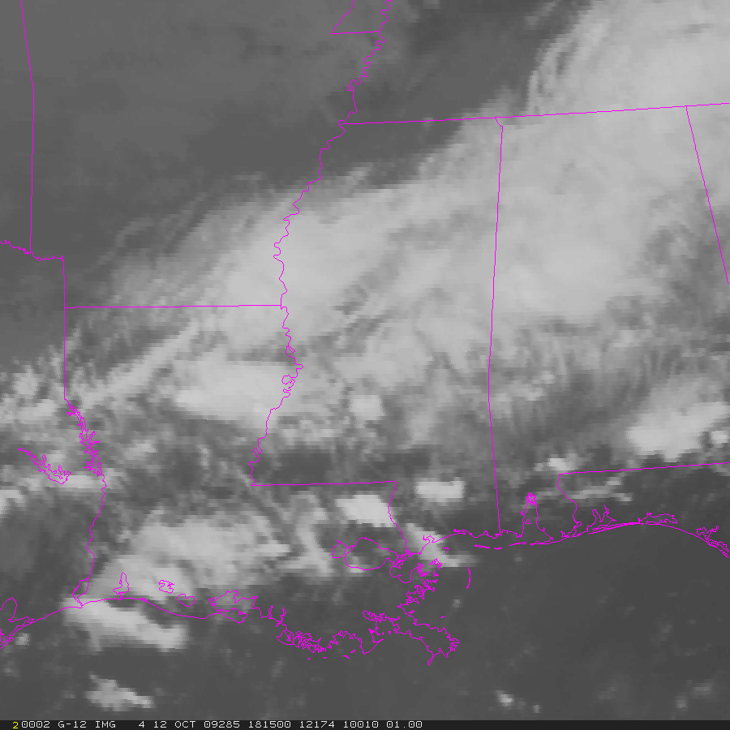
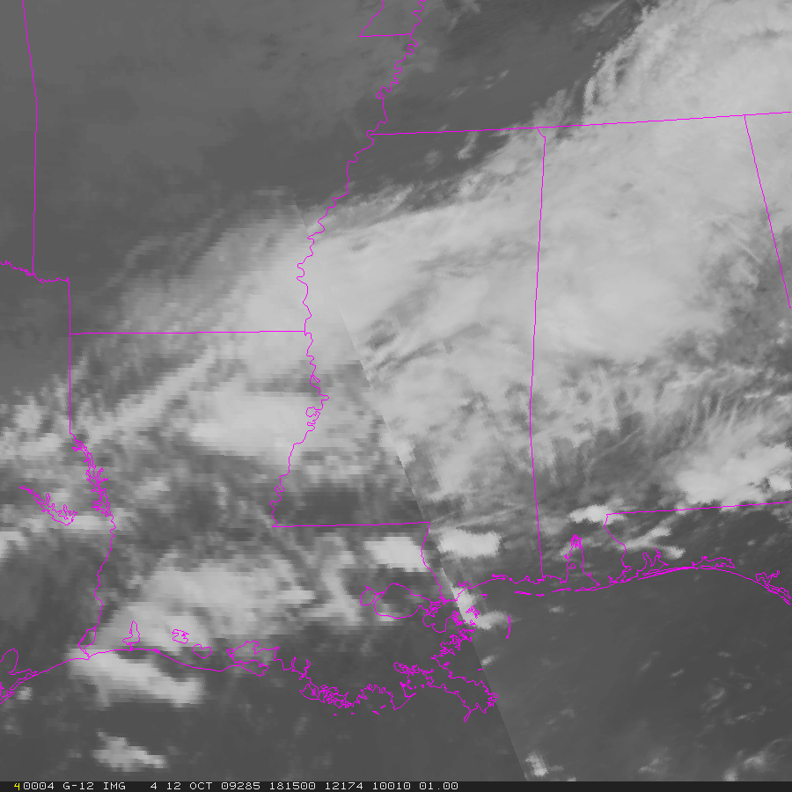
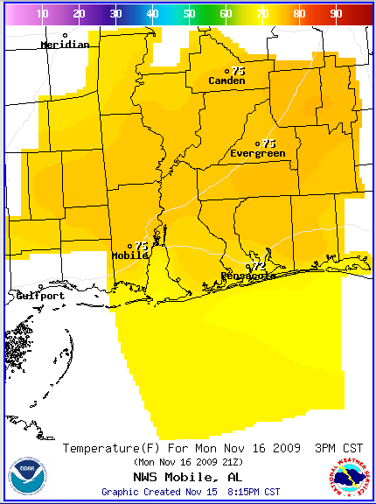
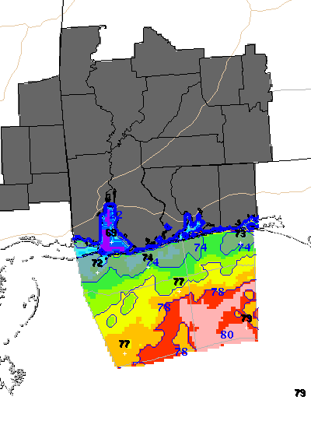
Addressing User Feedback…. Temporal Issue
Temporal Issue
  standard – use MODIS to better interpret the more coarse GOES
  can’t loop it, won’t use it
  option 1: use within GFE to initialize, alter, or verify Grids
    avoids temporal issue to large extent
  option 2: insert MODIS imagery/products into GOES data when and where appropriate (i.e. the Hybrid)
    provides continuity so can loop it
    will be most effective in AWIPS II
MODIS/GOES Hybrid -11um IR (1km/4km)
GOES
MODIS
transitioning unique NASA data and research technologies to operations

Slide 18
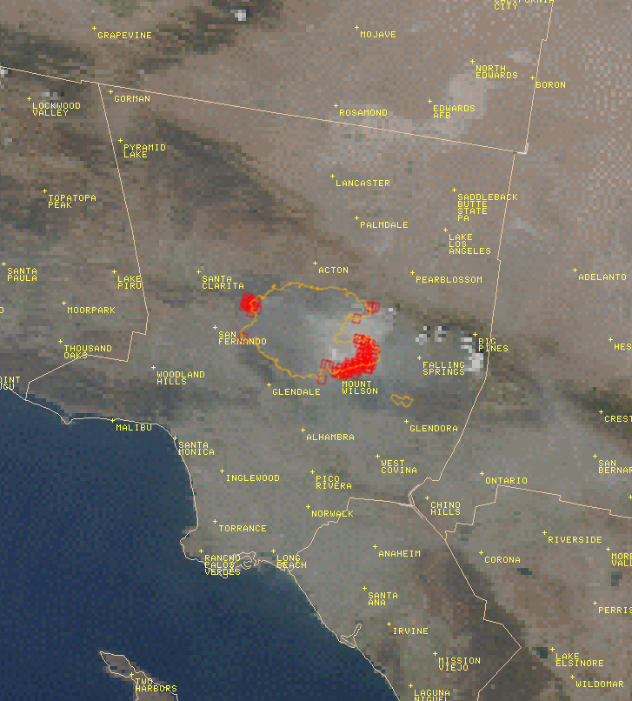
Future Work
MODIS True Color with burn areas, hot spots, and smoke
  Next Generation of False Color Product
    SWE via AMSR-E
  MODIS Shapefiles to complement True Color
  Improved “Fog” Product
  Hybrid products for multi-channel composite imagery
  Expansion of LST product to western partners
    ABQ and SMG
transitioning unique NASA data and research technologies to operations
Notes:
MODIS True Color with burn areas, hot spots, and smoke

