Slide 1


Operational Use of Lightning Mapping Array Data
Geoffrey Stano, Dennis Buechler, and
Christopher Darden
Fifth Meeting of the Science Advisory Committee
18-20 November, 2009
National Space Science and Technology Center, Huntsville, AL
transitioning unique NASA data and research technologies to operations

Slide 2
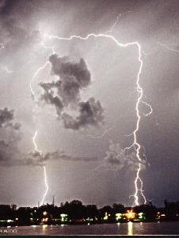
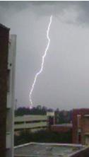
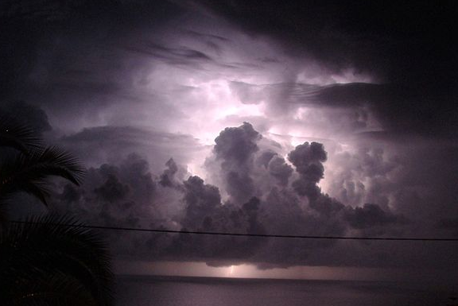
Relevance to the SPoRT Program
Supports the NWS mission
  Protect life and property
Lightning Mapping Array (LMA) does this with:
  High temporal and spatial resolution
  Strong relation to storm strength
Supports future SPoRT goals
  LMA is basis for Geostationary Lightning Mapper demonstration data
transitioning unique NASA data and research technologies to operations

Slide 3
Approach: What is Total Lightning?
Cloud-to-Ground Strikes
Total Lightning Activity
Inter-Cloud Flashes
31 Individual Storms
transitioning unique NASA data and research technologies to operations

Slide 4
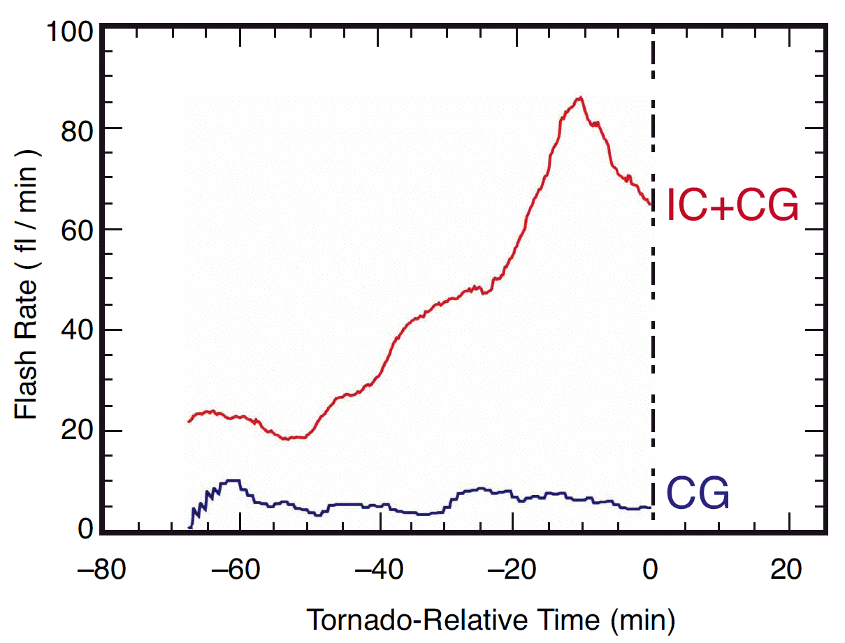
Approach: Total Lightning Benefits
Notice intra-cloud and CG trends
Intra-cloud shows clear trend
Cloud-to-ground is steady
Correlates with:
Storm updraft strength
Incipient severity
Updraft Intensifies
Vortex Spin-up
transitioning unique NASA data and research technologies to operations

Slide 5
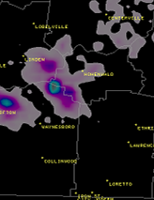
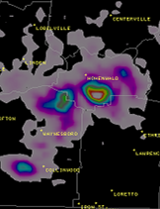
Methodology
EF-1
Leverage work on lightning research at NSSTC
  Lightning jumps (Gatlin 2009, Schultz 2009)
  Lightning warning (Buechler)
  Lightning threat (McCaul)
  GLM proxy (AWG)
Apply total lightning knowledge
  Correlation to storm intensity
  Jumps precede severe weather
  Combination = Better safety!
Source Density
Warning Issued
Lightning Jump
transitioning unique NASA data and research technologies to operations

Slide 6
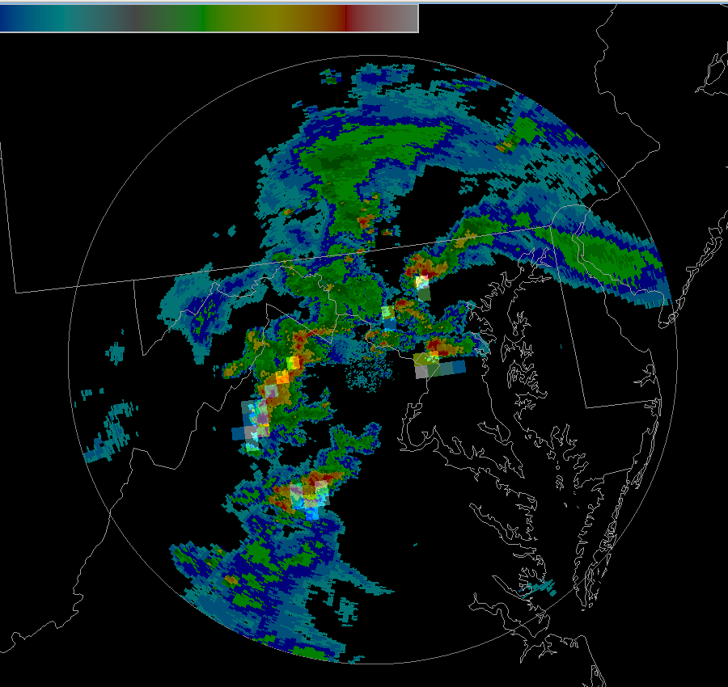
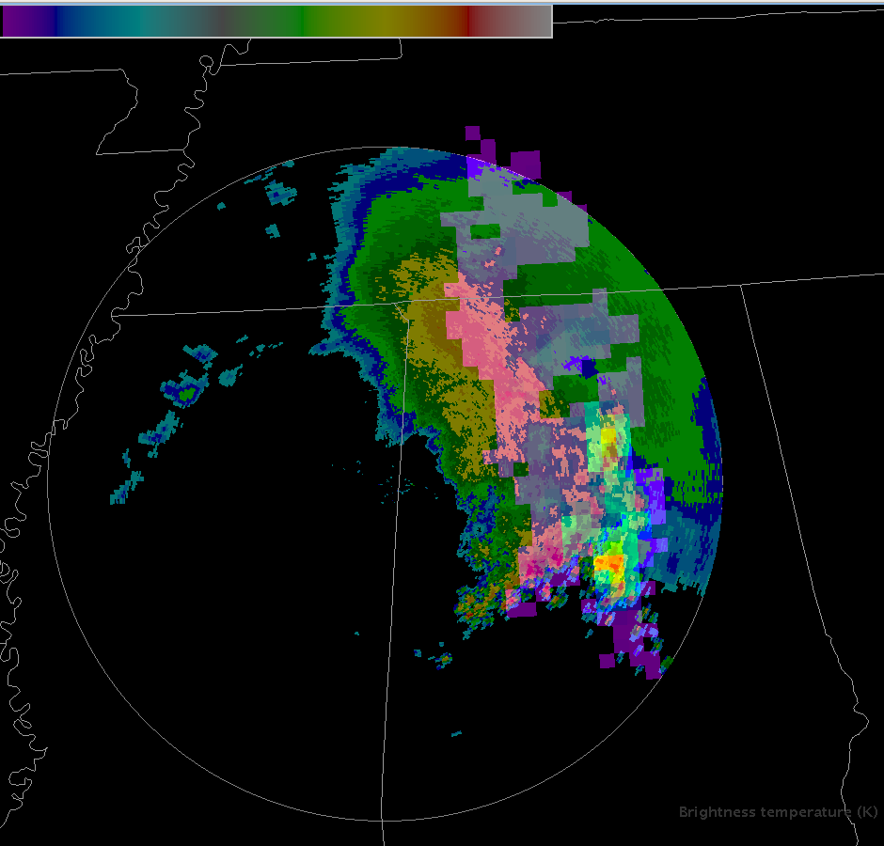
SPoRT Accomplishments
“Tie research to an operationally funded program” – 2007 SAC
Efforts are supported by the GOES-R Proving Ground
  Develop demonstration data for GLM
  Develop visualizations of these GLM data
Multiple spin-off advantages
  AWIPS II development expertise
  Incorporate more than North Alabama LMA
  Greater SPoRT program recognition
transitioning unique NASA data and research technologies to operations

Slide 7
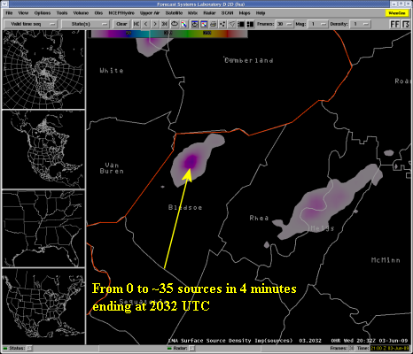
SPoRT Accomplishments
“Put lightning back in forefront of SPoRT” – SAC 2007
Multiple examples
Two new NALMA partners
  Morristown, Tennessee
  Peachtree City (Atlanta), Georgia
Improved product reliability
  Liaison activity within SPoRT
  Advocates within the WFOs
  End result: Increased user commitment
Morristown display posted to Wide World of SPoRT blog
transitioning unique NASA data and research technologies to operations

Slide 8
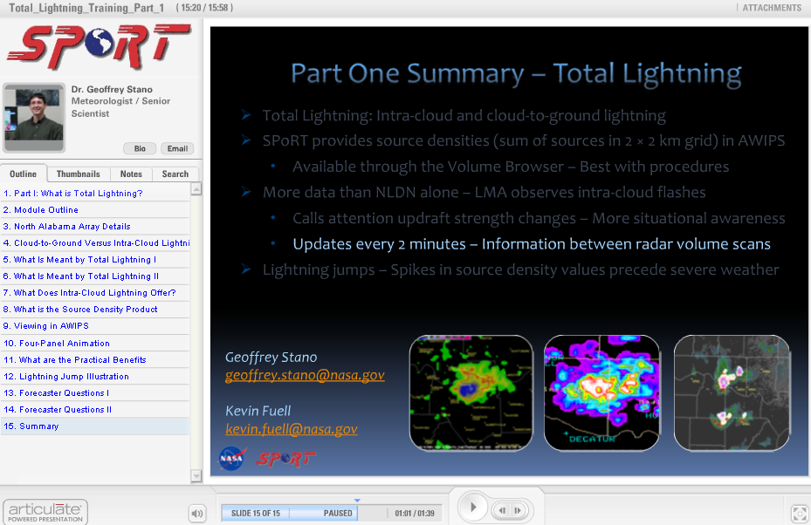
SPoRT Accomplishments
Training module released
  Well received – credited with increased use of total lightning data
Training gives:
  Increased user feedback
  Improved reliability of data
  Development of BAMS article
  Conference collaborations
transitioning unique NASA data and research technologies to operations

Slide 9
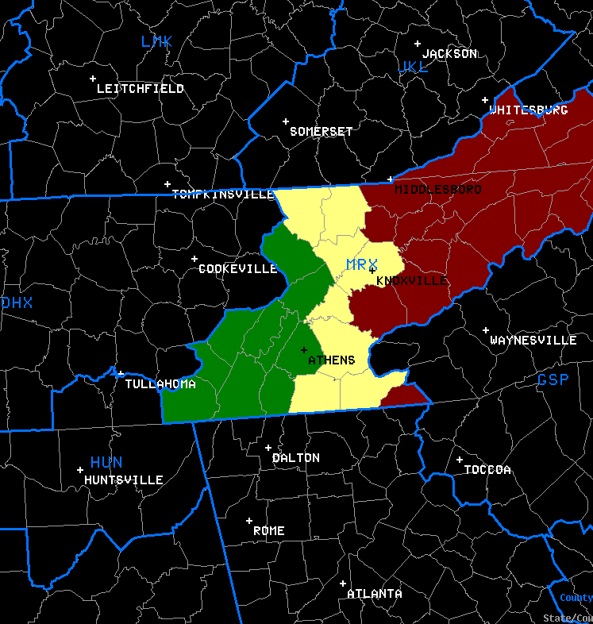
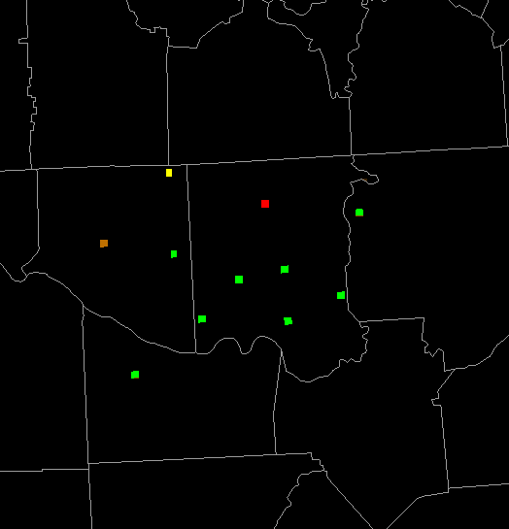
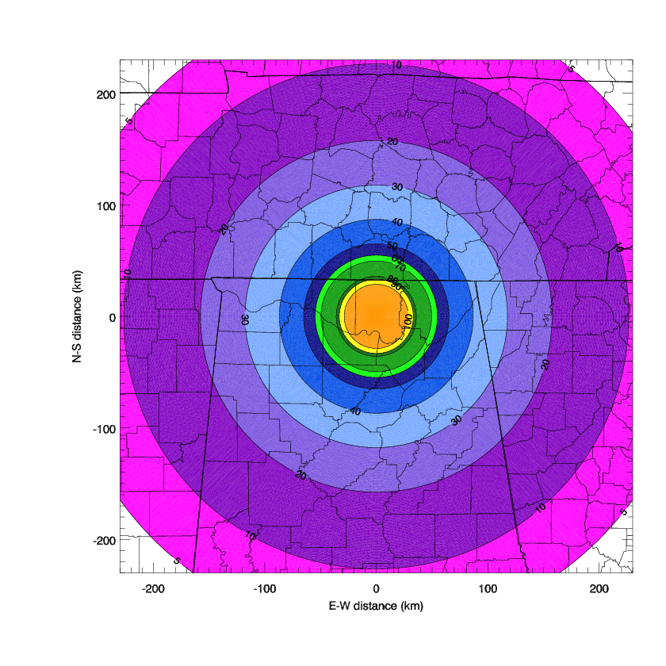
SPoRT Accomplishments
Morristown County Warning Area Use
NALMA Station Status
Spring 2009 Assessment
  Supported earlier assessments
  Good situational awareness tool
  Suggested new products
    Detection efficiency map
    County Warning Area use
    Station status
Based on percentage of total sources observed by station every 2 min
Basic Detection Efficiency
transitioning unique NASA data and research technologies to operations

Slide 10
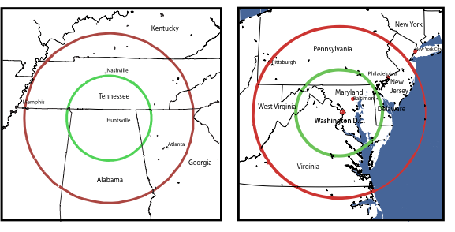





SPoRT Accomplishments
SPoRT expertise recognized
  Provide data to GOES-R Proving Ground
  Invitation as total lightning expert for the Experimental Warning Program
  Request by Storm Prediction Center for real-time data
  Request for national training module development
Data sent to Spring Program
Spring Program Partners
transitioning unique NASA data and research technologies to operations

Slide 11
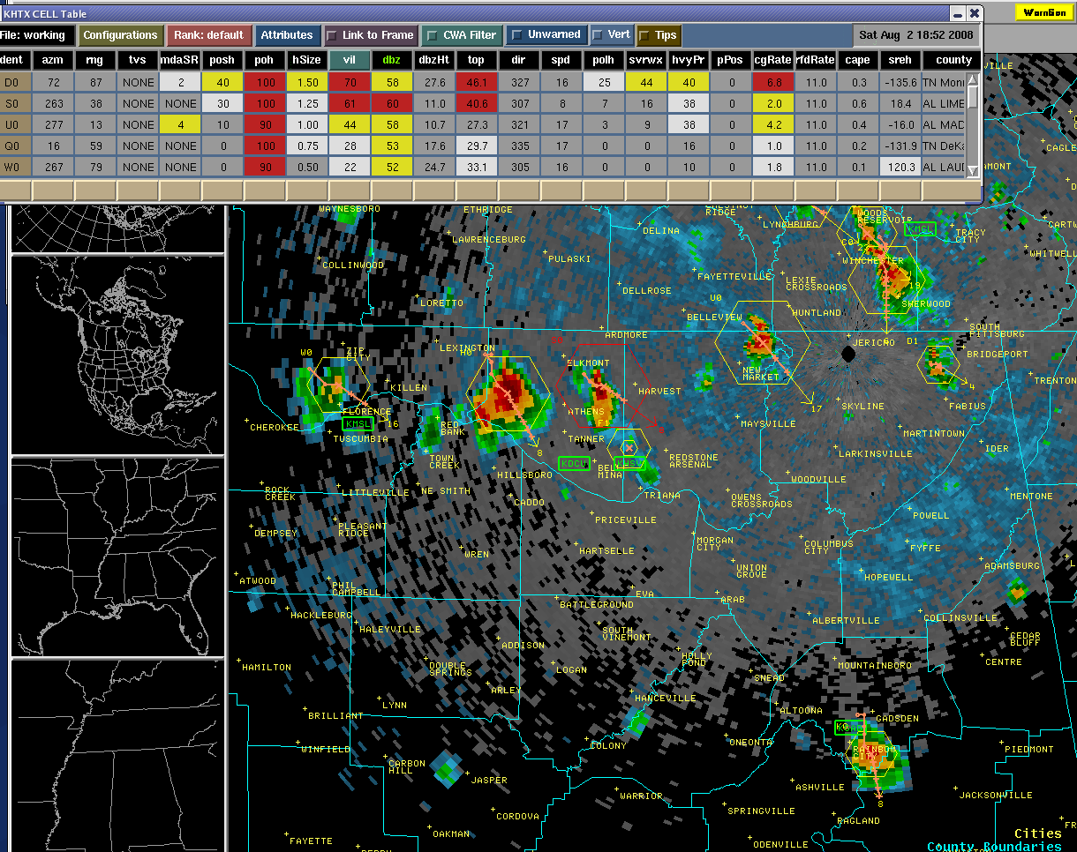
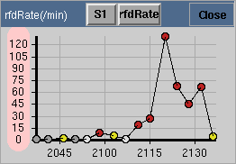
Current Efforts: SCAN
System for Convection Analysis and Nowcasting
Results from forecaster feedback
  Want to see trend of LMA data
  Currently unavailable in real-time
Mamoudou Ba (MDL) is main collaborator
  Tracks radar cells
  Associates LMA to cells
  First applied to Washington D.C. LMA
  Implementing at Huntsville
transitioning unique NASA data and research technologies to operations

Slide 12
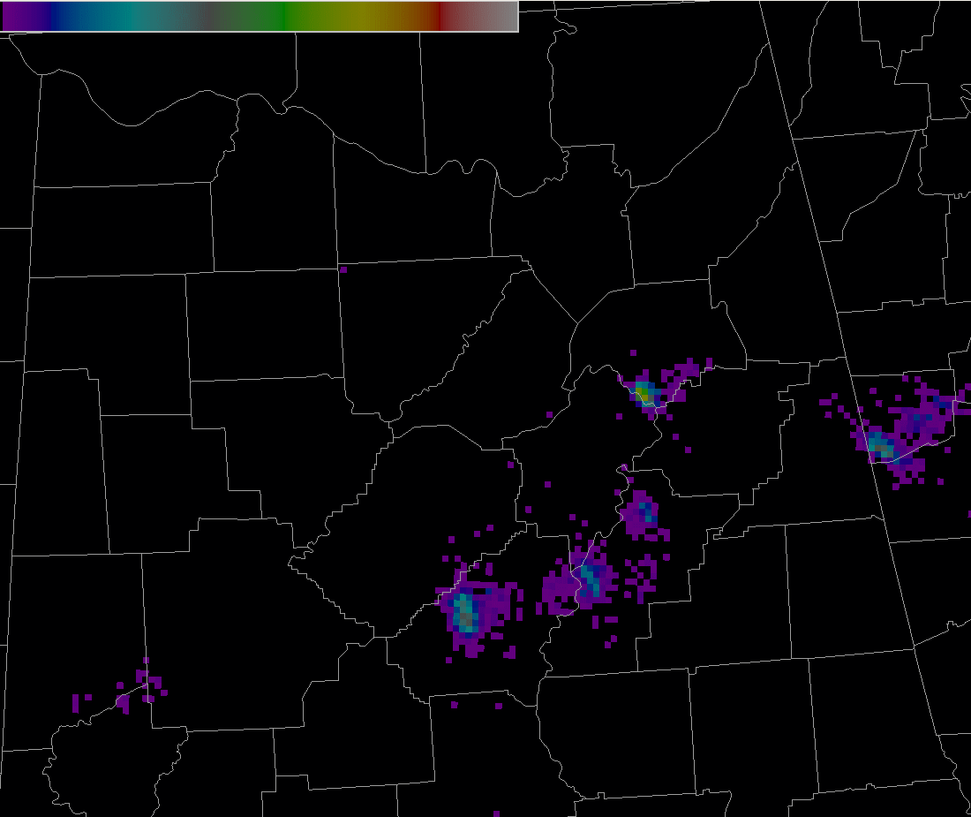
Current Efforts: AWIPS II
SPoRT proactively preparing for future
  Demonstrating AWIPS I to AWIPS II
  SPoRT leading the community
  Learning new capabilities
AWIPS II will provide new abilities
  Improved data displays
  More fidelity (less smoothing of data)
  Easier identification of lightning jumps
NALMA in AWIPS II
transitioning unique NASA data and research technologies to operations

Slide 13
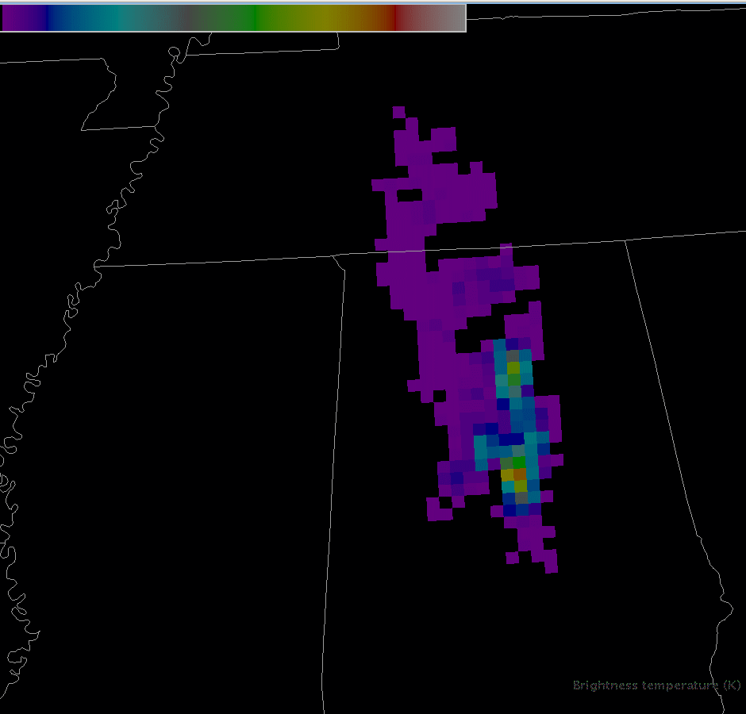
Current Efforts: Pseudo GLM
GOES-R Proving Ground
Stand-in product until release of official AWG GLM proxy
Spin-off utility
  AWIPS II demonstration
  Refine process for Spring Program
Pseudo GLM Flash Extent
(AWIPS II)
transitioning unique NASA data and research technologies to operations

Slide 14
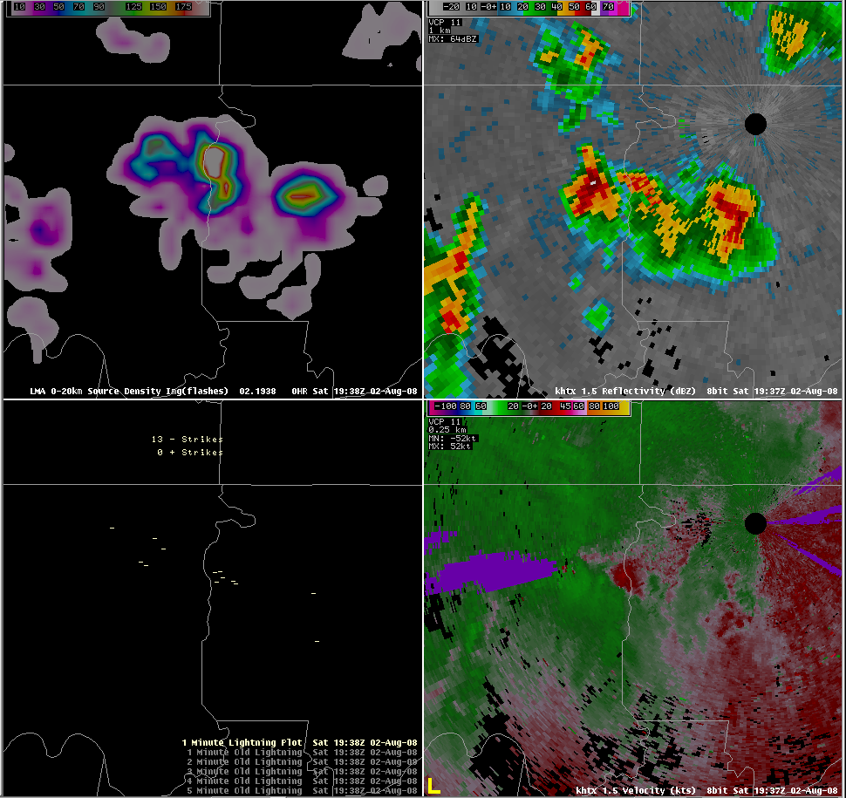
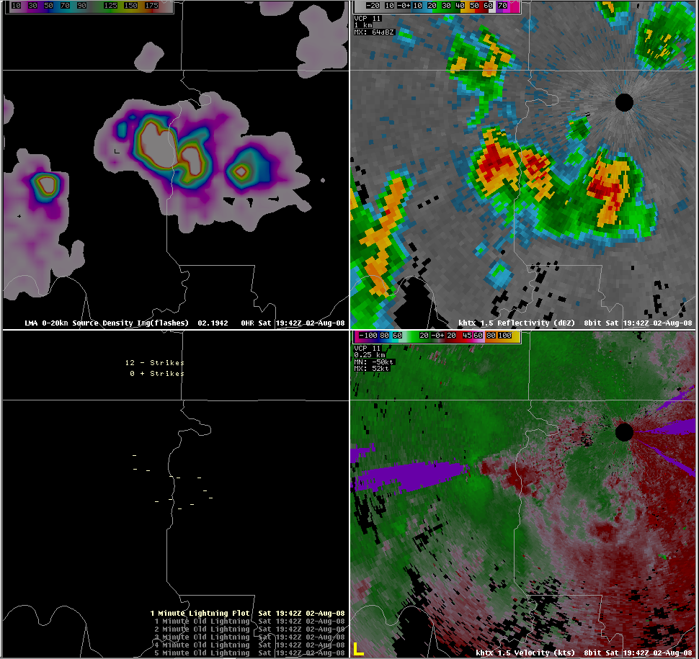
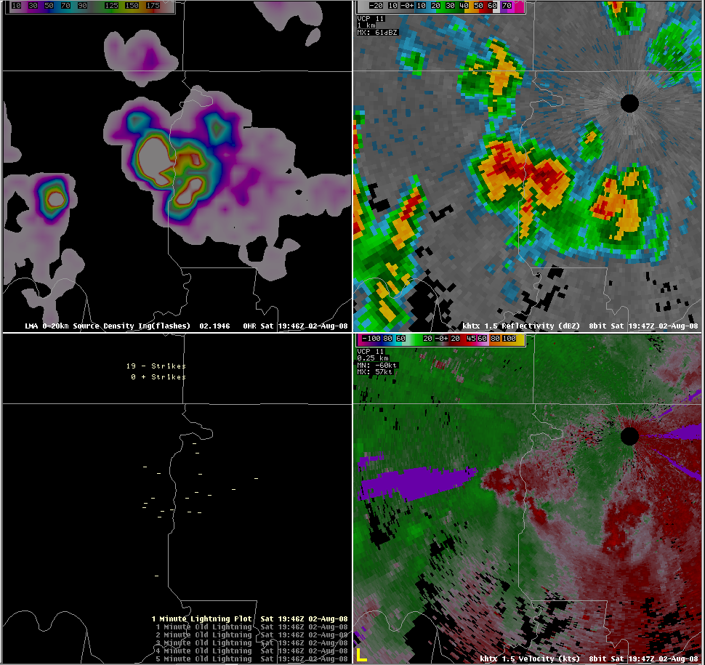

Impact: Operational Utility
Source Densities
Reflectivity
~ 50 sources
Modest reflectivity
250+ sources
Modest reflectivity
250+ sources
Strong Signature
Lightning Jump
Severe hail began 4 minutes later
Radar Velocity
Still no CG strikes
Still no CG strikes
No CG strikes
1938 UTC
2 Aug 2008
1946 UTC
2 Aug 2008
1942 UTC
2 Aug 2008
Cloud-to-Ground Strikes
Notes:
14
Discuss the lightning jump, but also refer to lightning safety issues – flash extent, first CG, etc.
Here is a still image from the previous loop at 1938 UTC on August 2, 2008. The cells in the center of each panel are active and already require attention. However, let’s observe what the lightning mapping array shows. On the western edge, there is a small cell with a source density of approximately 50 sources per two square kilometers. This is an active storm, electrically, although the radar reflectivity is modest. Additionally, there are no cloud-to-ground strikes associated with this cell.
Now we will step ahead four minutes to 1942 UTC. Notice the dramatic increase in source densities, which have easily topped 250 sources. This dramatic increase is called a lightning jump. This is the feature to look for as a precursor to severe weather. The lightning mapping array jump is very important here as the reflectivity remains unchanged and this cell has still not generated a single cloud-to-ground strike.
When we step forward another four minutes to 1946 UTC, we see that the lightning mapping array data have given several minutes advanced warning about the strengthening of this particular cell. The source densities remain high. The big change is that the radar signature is now very strong. Thanks to the lightning mapping array, we as forecasters were already paying attention to this cell. The cloud-to-ground data continue to show no activity, although two strikes were recorded at 1944 UTC. This clearly shows that the observed lightning jump is of great use for determining whether or not a storm is strengthening. Finally, severe hail was produced four minutes later at 1950 UTC. Overall, the lightning mapping array provided eight minutes of advanced lead time before this storm went severe.
This case has provided several details to consider.
Lightning jumps are the key feature to look for with lightning mapping array data. These are a large increase in the source density values.
Lightning jumps often precede severe weather, from tornadoes to hail, to mircobursts.
The lightning mapping array observes intra-cloud flashes that the NLDN cannot detect.
The source density data update every two minutes.
This gives the forecaster two or three updates for every radar volume scan.
The additional data can enhance your warning decision making process. In this example, the source density data indicated the rapid strengthening of a cell eight minutes in advance of severe weather.
Essentially, the lightning mapping array helps draw attention to strengthening storms.

Slide 15
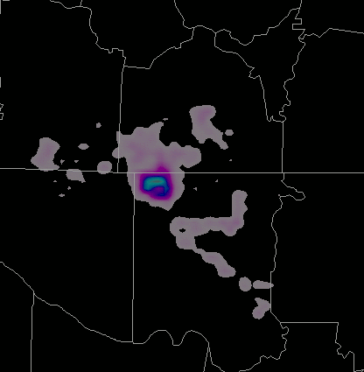
Impact: Operational Utility
Several operational impacts
Better severe weather warnings
  Enhanced lead times
  Reduced false alarms
Enhanced situational awareness
  Easily monitor multiple storms
Improved lightning safety
  Lead time before first cloud-to-ground
  Observe extent of lightning flashes
40 km Flash
transitioning unique NASA data and research technologies to operations

Slide 16
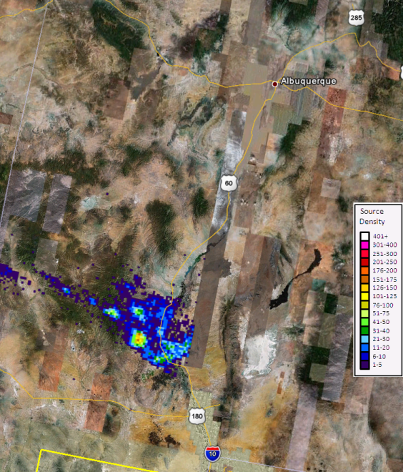
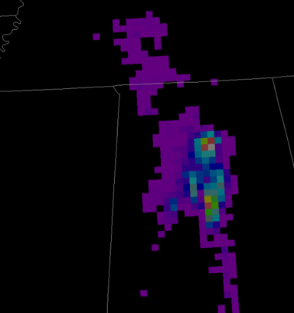
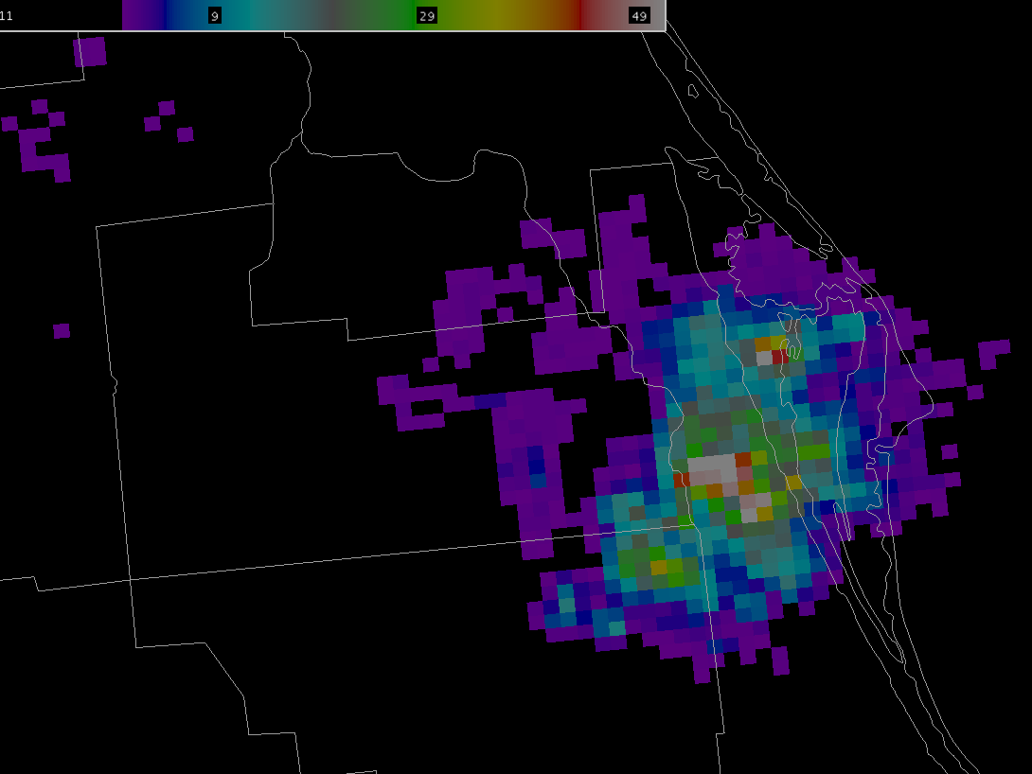
Future Work
White Sands, NM Network
Pseudo GLM and AWG proxy
Continue AWIPS II
Product evaluation
  1 vs 2 km
  1 vs 2 min
  Source vs flash density
  Time since last flash
Expand collaborations with the KSC LDAR II and WSLMA
Continue Spring Program and GOES-R Proving Ground
Pseudo GLM
KSC Network
transitioning unique NASA data and research technologies to operations

