Slide 1


Total Lightning AWIPS II Operational Demonstration
Geoffrey Stano, Matt Smith, and Kevin Fuell
Fifth Meeting of the Science Advisory Committee
18-20 November, 2009
National Space Science and Technology Center, Huntsville, AL
transitioning unique NASA data and research technologies to operations

Slide 2
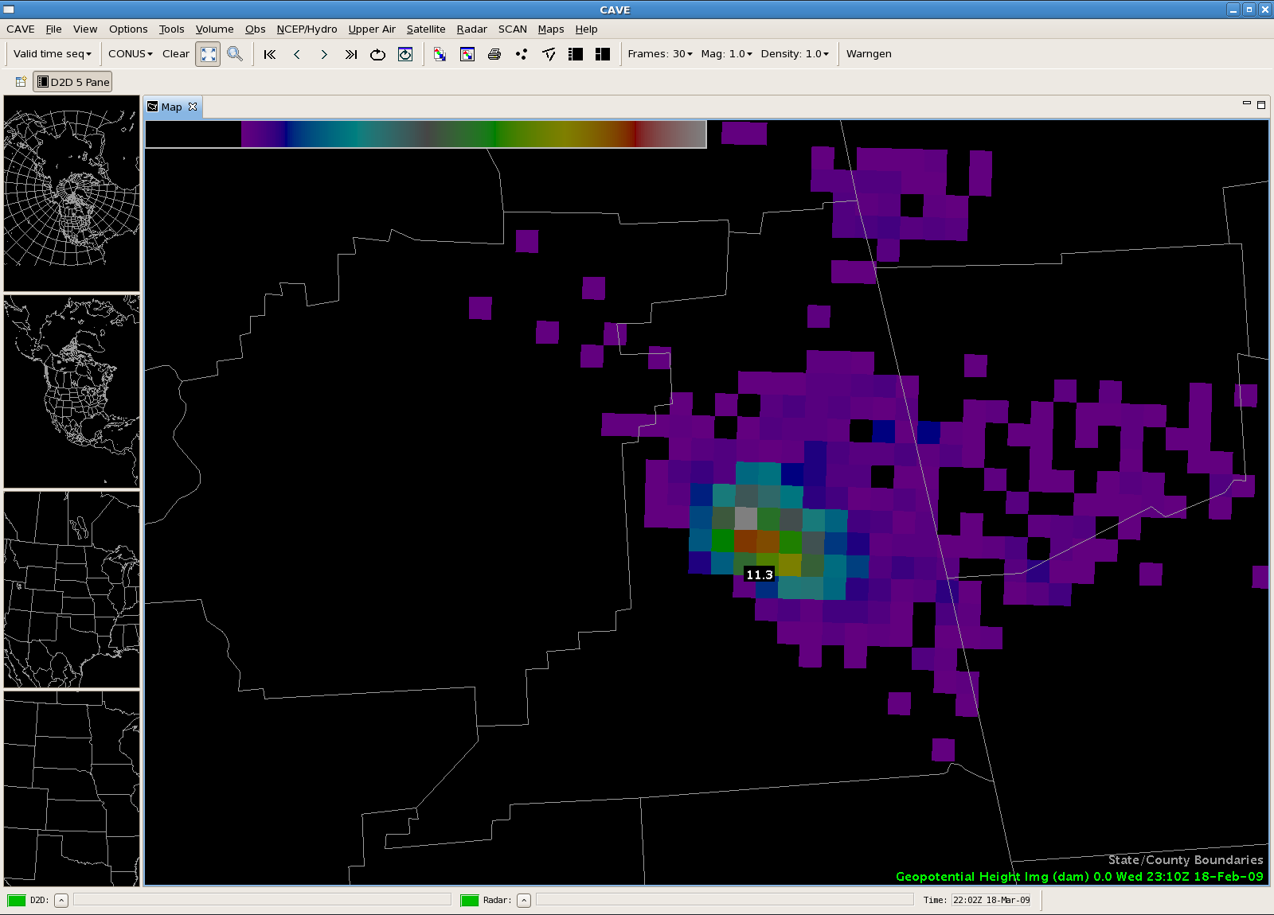
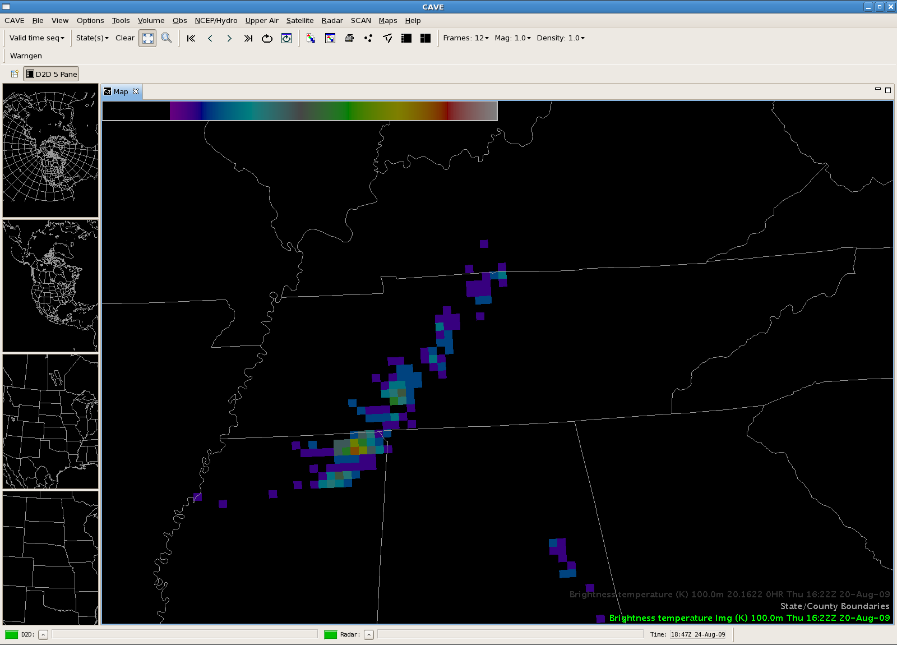
SPoRT Accomplishments
Developed display capabilities
  Ground based lightning mapping array
  Pseudo Geostationary Lightning Mapper
  All efforts in near real-time
Leading development community
  Request to provide capabilities to GOES-R Proving Ground and the Spring Program
NALMA
Pseudo
GLM
transitioning unique NASA data and research technologies to operations

Slide 3
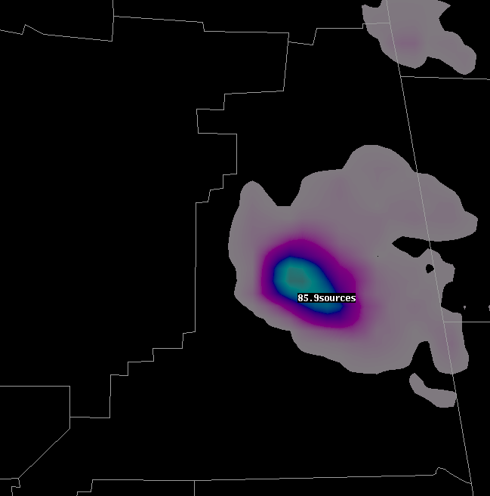
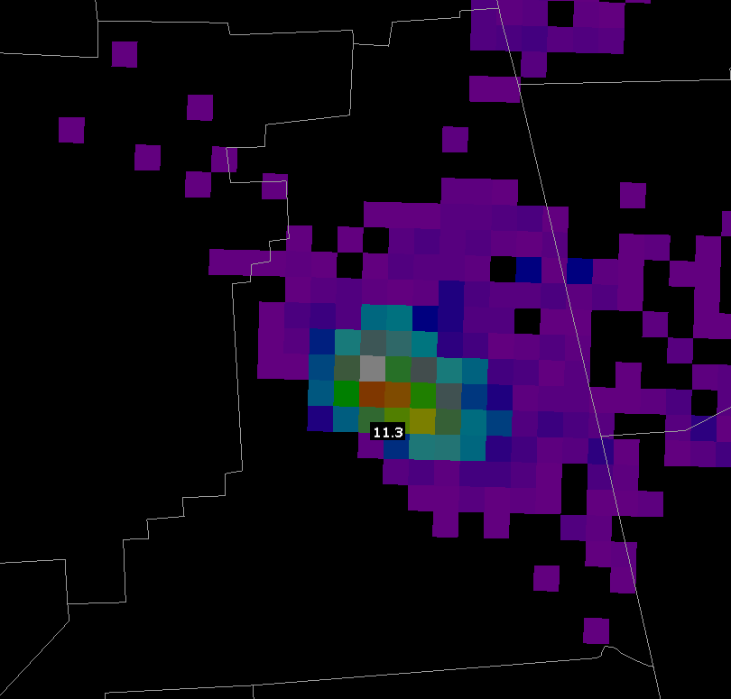
AWIPS II Advantages over AWIPS I
AWIPS versus AWIPS II
  AWIPS smoothes data
  AWIPS II preserves raw data
  Lightning maxima preserved
Advantages
  Improved detection of lightning jumps
  Improved awareness of storm electrification
Bottom line: Improved lightning safety!
AWIPS – 86 sources
AWIPS II – 113 sources
transitioning unique NASA data and research technologies to operations

Slide 4
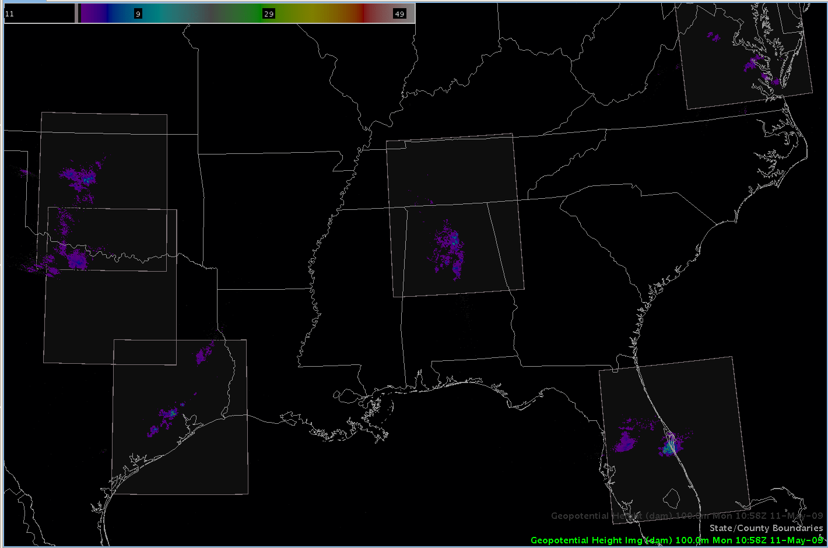
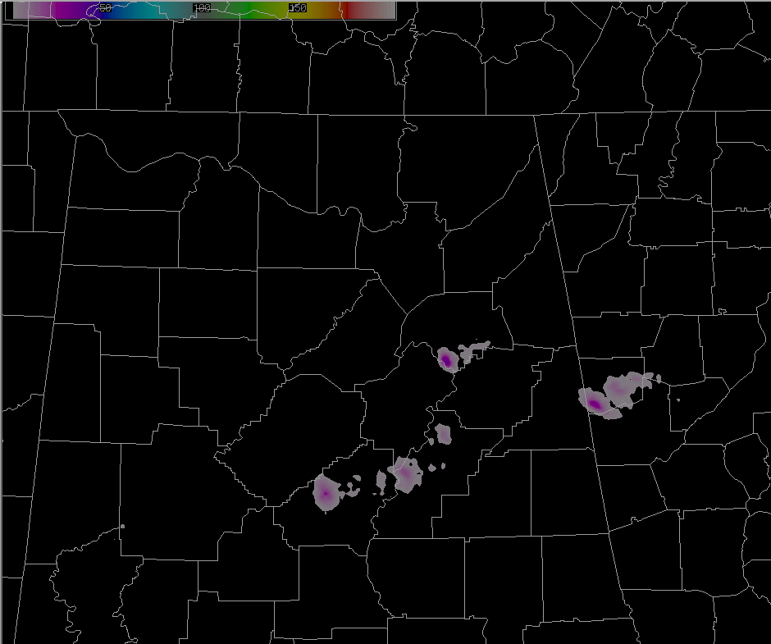
AWIPS II Advantages over AWIPS I
AWIPS II – Flexible display
AWIPS – Relatively fixed display
transitioning unique NASA data and research technologies to operations

Slide 5
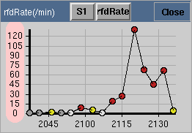
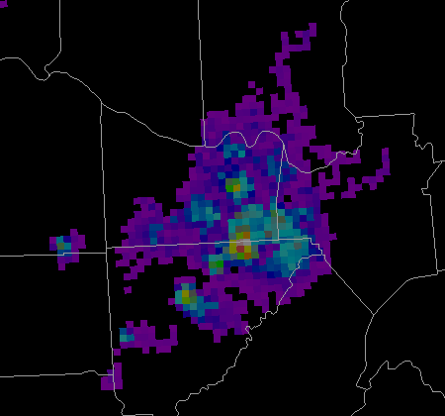
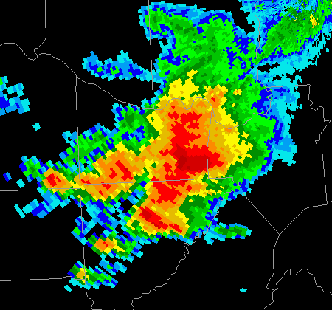
Future Lightning Work
Source Density
Radar Reflectivity
Real-time trending
Tie in to automatic lightning jump algorithm
transitioning unique NASA data and research technologies to operations

Slide 6
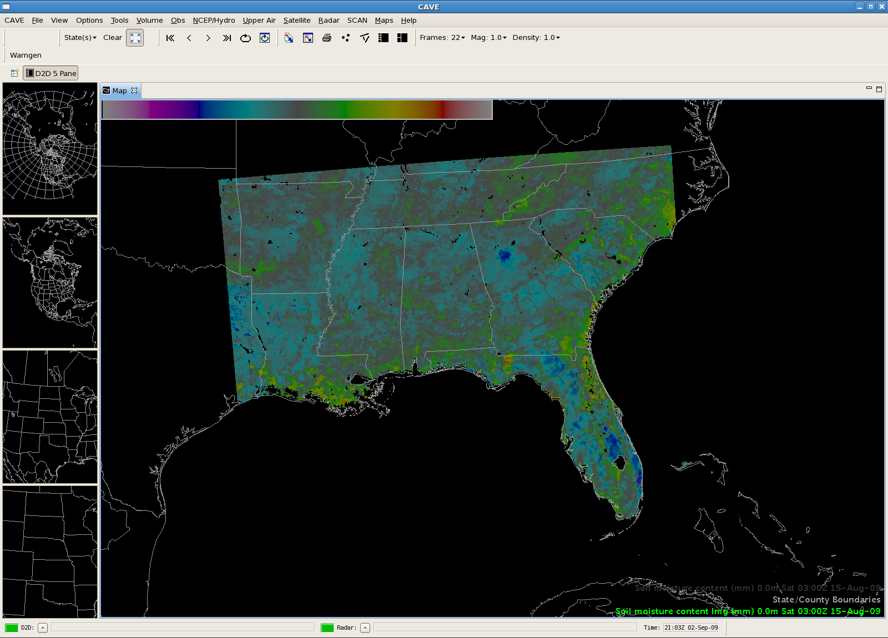
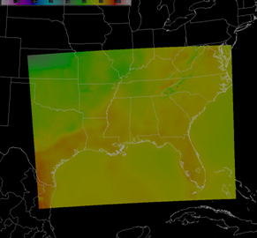
Other Gridded Data
ADAS
LIS
NSSL WRF
Lightning Threat
SPoRT ADAS
Land Information System
transitioning unique NASA data and research technologies to operations

Slide 7
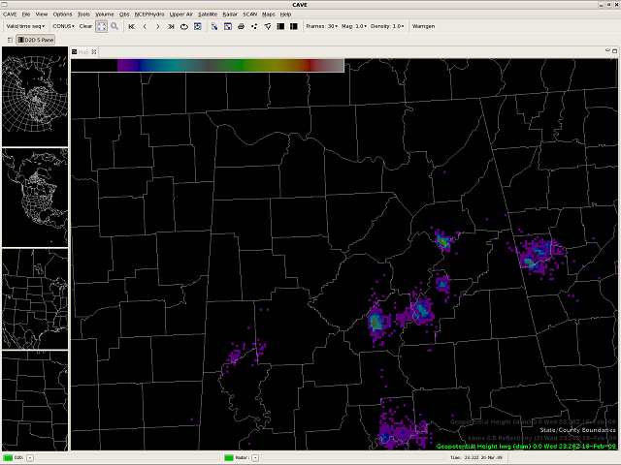
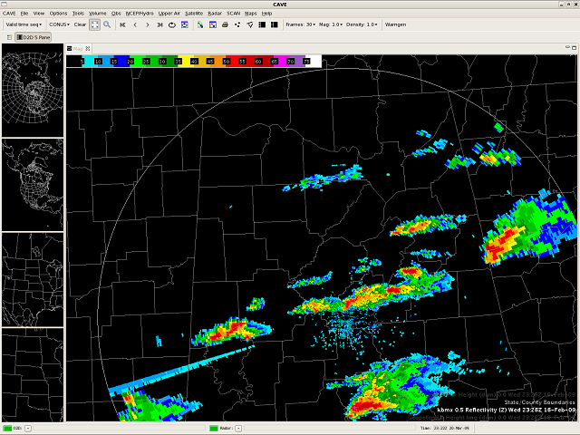
Relevance to SPoRT
SPoRT proactively preparing for future
  Maintain paradigm supporting end user’s decision support system
SPoRT is leading with lightning
NWS transitioning in 2010
AWIPS II has display advantages
  More flexibility
  Higher fidelity for data
  Potential new capabilities
transitioning unique NASA data and research technologies to operations

Slide 8
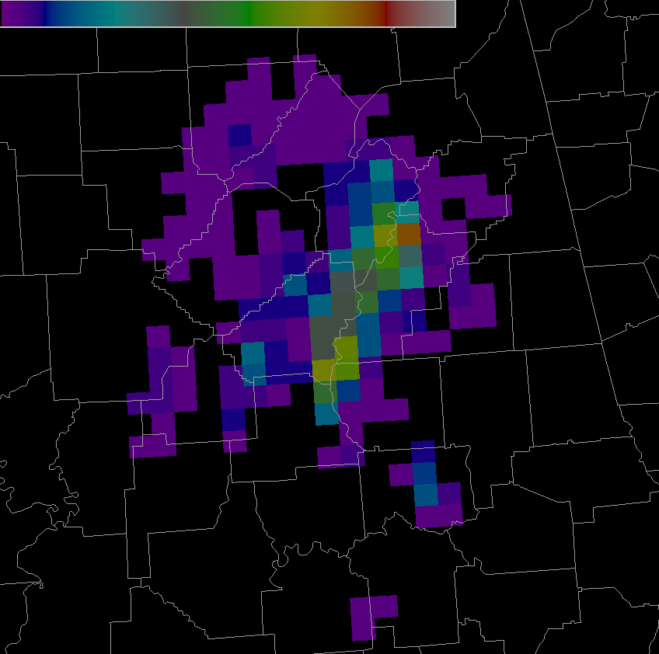
Slide Title
Provide a GLM example
transitioning unique NASA data and research technologies to operations

