Slide 1


Product Training
Kevin Fuell, Geoffrey Stano
Fifth Meeting of the Science Advisory Committee
18-20 November, 2009
National Space Science and Technology Center, Huntsville, AL
transitioning unique NASA data and research technologies to operations

Slide 2
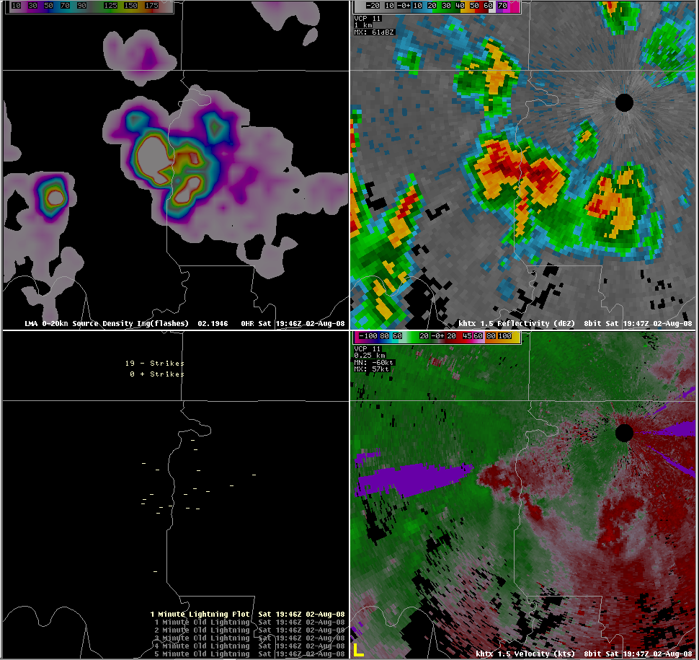
Relevance to NASA/SPoRT
What does “source density” mean?
The “T” in SPoRT does not stand for “training” so why do it?
Key part of supporting the transition of products
  Provide information on products to be tested and evaluated
  Communicate to other partners the lessons learned from initial testing
  Demonstrate utility and application to a forecast issue
Bottom line: These are adult learners who mainly want to know how to apply the product in the workplace.
Why use it with radar?
I can apply it to more than just svr wx? Really?
Total? Meaning it shows the CGs that the NLDN misses?
transitioning unique NASA data and research technologies to operations
Notes:
Adult learners: While the science details are interesting, they want the application to their work.
- Need science background for this, but detailed science training is provided by other groups.

Slide 3
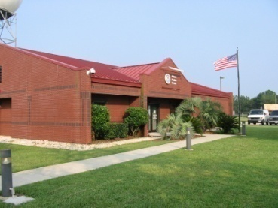
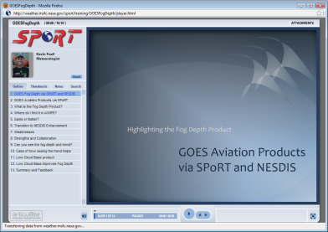
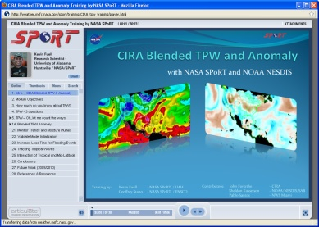
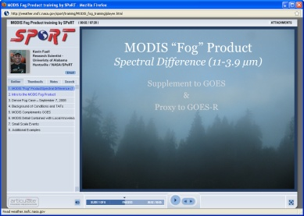
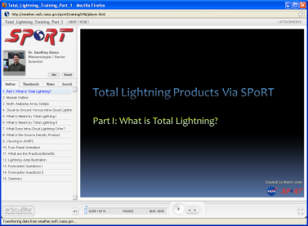
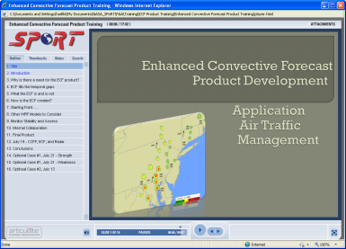
Accomplishments since 2007 SAC
2007 SAC Recommendation…
Product presentations and discussions
  HUN operations area
  Bi-monthly coordination calls
  Visits to WFOs
Articulate Presenter implemented
  Modules created for:
  GOES Aviation Products
  MODIS Fog
  Total Lightning I/II
  CIRA Blended TPW
  Enhanced Convective Forecast (FAA)
‘SPoRT should be more proactive in its
interaction with WFOs, maintaining
advocates for the data products in each
office, actively solicit user feedback on
products, and make more regular office
visits.’
transitioning unique NASA data and research technologies to operations
Notes:
From 1-chart
Development of web-based modules for MODIS, Total Lightning, CIRA Blended TPW, GOES Aviation products
Short, science lectures delivered during 9 site visits outside of HUN and via bi-monthly coordination calls on topics of MODIS, AMSR-E, LIS, LMA, WRF-EMS, ADAS, GOES Aviation

Slide 4

Approach / Methodology – Kinesthetic Learning
Science Sharing and co-location visits at HUN
  Reminder of product(s) SPoRT provides and forecast application
  Answer questions
  Display real-time data for discussion
Bottom line: Hands on with users to better understand the gaps in product knowledge and/or application – hence, can develop more effective training materials for all SPoRT partners
transitioning unique NASA data and research technologies to operations

Slide 5
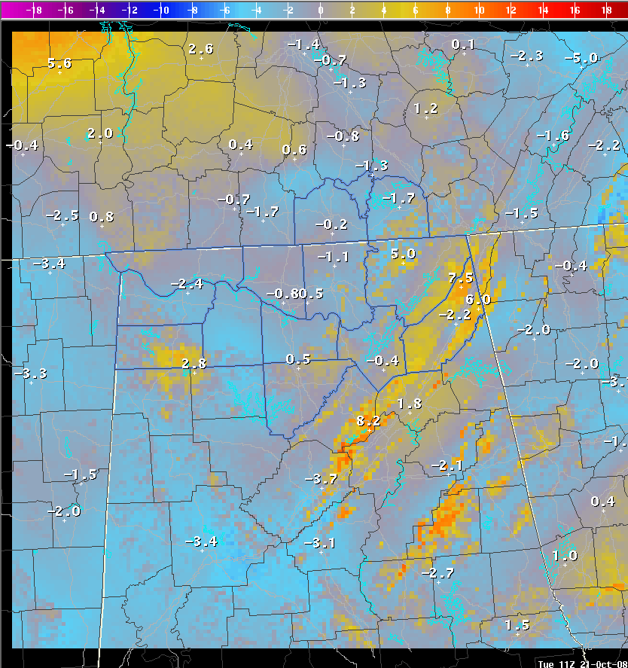
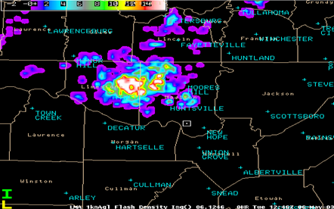
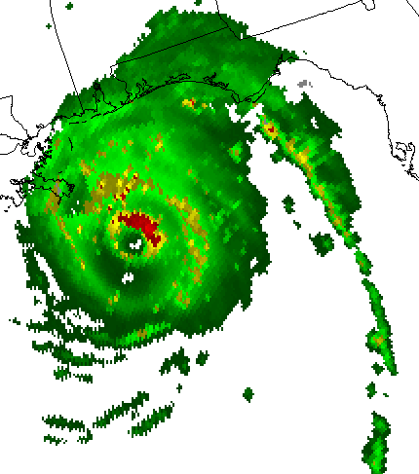
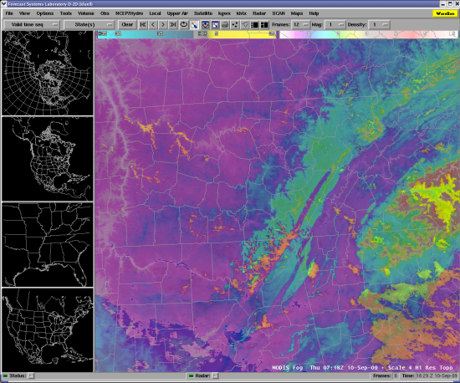
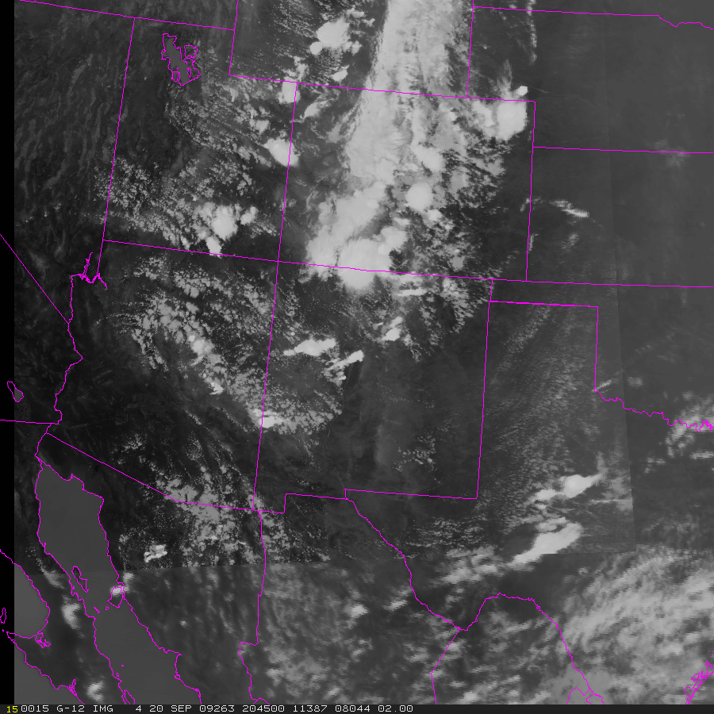
Approach / Methodology – Teletraining
Bi-monthly Coordination Calls
  Present training on a relavent topic (seasonal, new product, reminder)
  Attendees hear what other users are doing (peer-to-peer learning)
Bottom line: Regular communication and training to keep collaborations strong and consistent. Leads to better evaluation of product.
MODIS in GFE
April 2009
NALMA
April 2009
AMSR-E
June 2009
MODIS “Fog”
August 2009
MODIS/GOES Hybrid
October 2009
transitioning unique NASA data and research technologies to operations

Slide 6
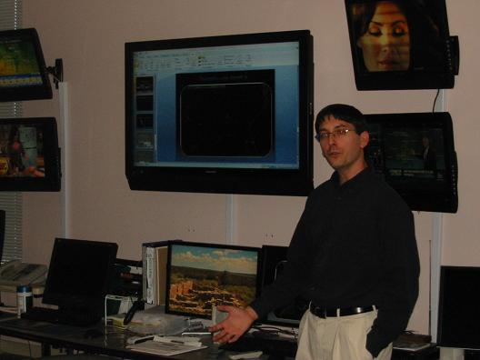
Approach / Methodology –Audio/Visual Learning
Visits to WFOs
  Present training on specific products that apply to high priority forecast items for that office
  Identify SPoRT advocate(s) at each WFO who can relay training to other staff forecasters
  Provides SPoRT with first hand information on how data is applied and the user perceived value
  Bottom line: Shows our commitment to understanding how NASA EOS data best applies to their forecast issues.
transitioning unique NASA data and research technologies to operations

Slide 7
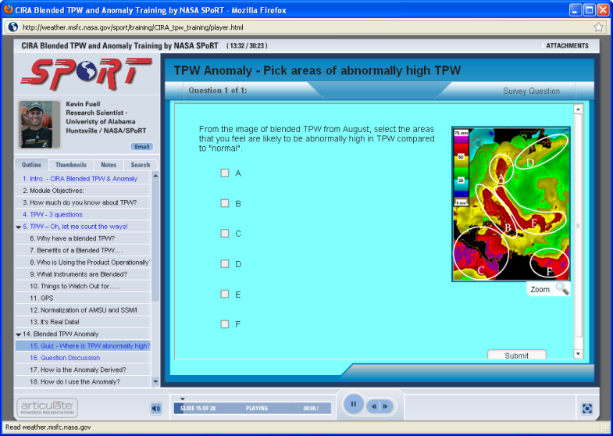
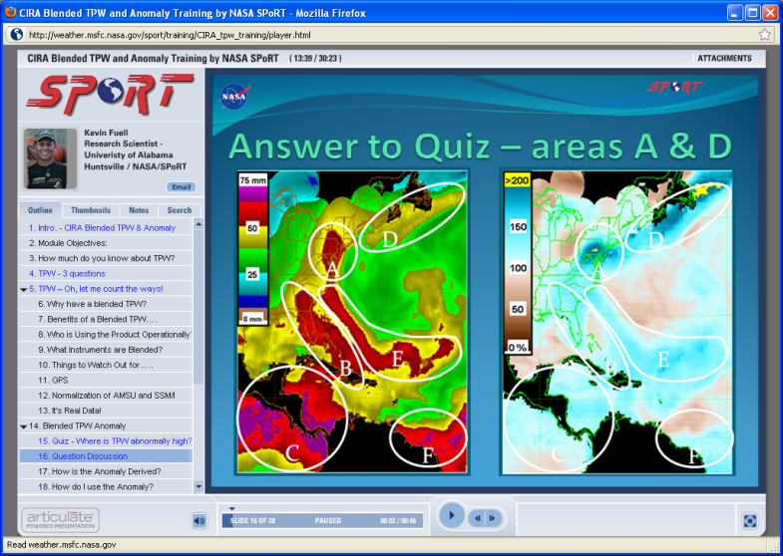
Approach / Methodology –
Distance Learning
Development of short, easily digestible training modules that are web-based and incorporate simple instructional design methods.
  Articulate Presenter
  Bottom line: Provides training to a variety of learning styles, is interactive, and is tailored to end users.
Example of inserting interactive questions to reinforce learning and allow user to confirm their understanding.
transitioning unique NASA data and research technologies to operations
Notes:
Instructional design examples:
Use of quiz at beginning to module to test what the user knows. They might be surprised to find they do not know as much as they thought.
An interactive question where the user applies what was just discussed. Helps reinforce what was being training and allows the user to confirm that they have the right grasp of the topic.

Slide 8
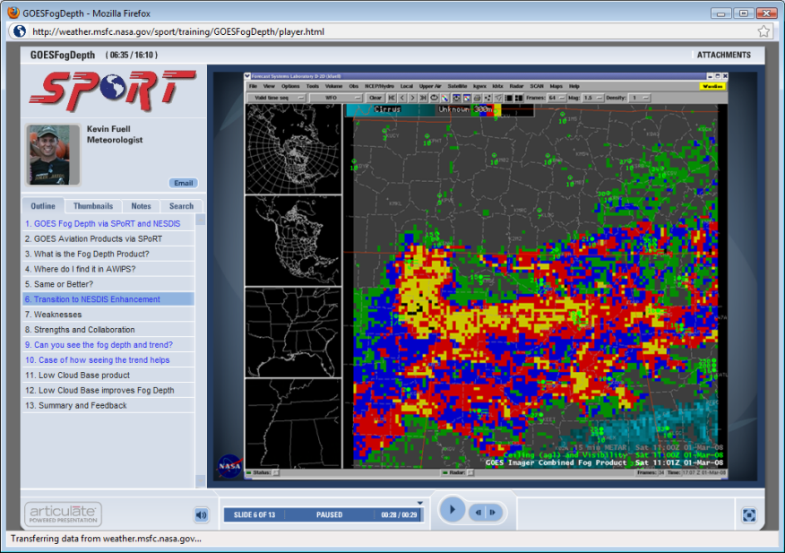

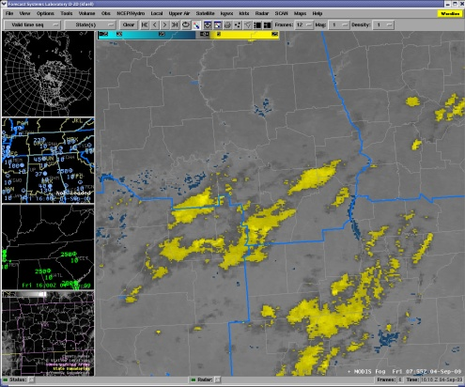
Aviation Product Training
NESDIS asked SPoRT to transition GOES Low Cloud Base and Fog Depth products
  Developed 15 minute module and introduced MODIS Fog product during evaluation
User feedback indicates interest in MODIS high resolution fog product
  Developed 8 minute module on MODIS Spectral Difference (i.e. Fog)
Graphics: screen grab of a interior page of module
MODIS “Fog”
at 1km resolution vs. 4km GOES
transitioning unique NASA data and research technologies to operations
Notes:
Collaborating with NOAA/NESDIS and at the same time discussing NASA EOS data (win, win)

Slide 9
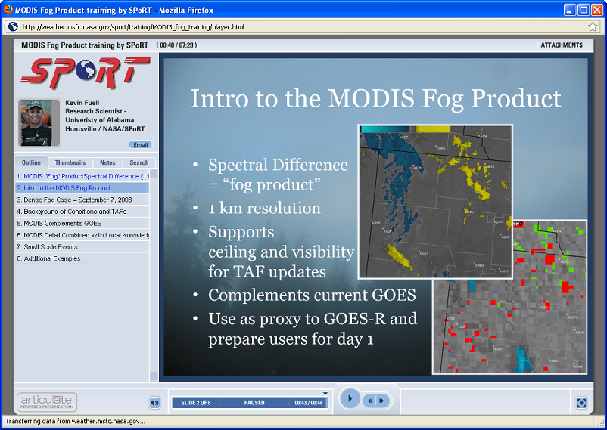
MODIS Fog
Demo
Created as a lead into evaluation
Increase learning by…….
  Time/Energy cost - Short, concise
  Relevant - demonstrates application with user-provided examples
  Pre-existing Knowledge - Illustrates how it adds value to standard data
  Diversity of Learning – Provides audio, visual, text, and further resources
User feedback leading to improvements in MODIS fog product and a follow up training module
http://weather.msfc.nasa.gov/sport/training/MODIS_fog_training/launcher.html
transitioning unique NASA data and research technologies to operations

Slide 10
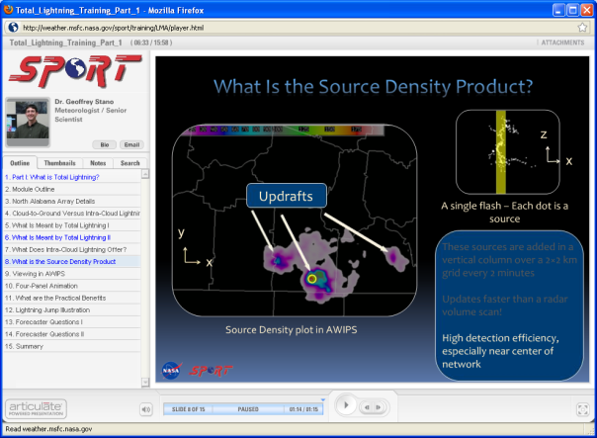
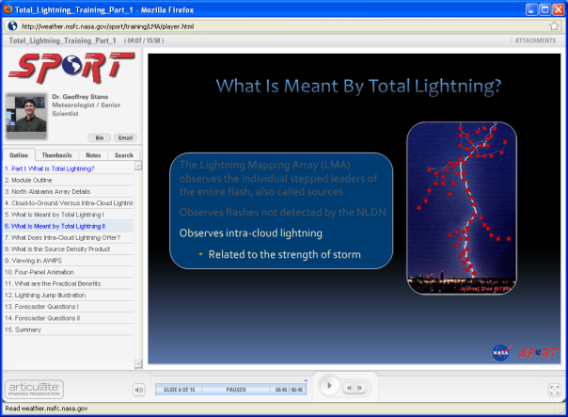
Total Lightning Training I
Stems from delivering presentations during several site visits
  Crafted from user discussions and examples
Educates users of CG vs total lightning
  What is “source density”?
Describes applications
Uses total lightning with radar
~15 minutes
Demo page 6 and 8
http://weather.msfc.nasa.gov/sport/training/LMA/launcher.html
transitioning unique NASA data and research technologies to operations

Slide 11
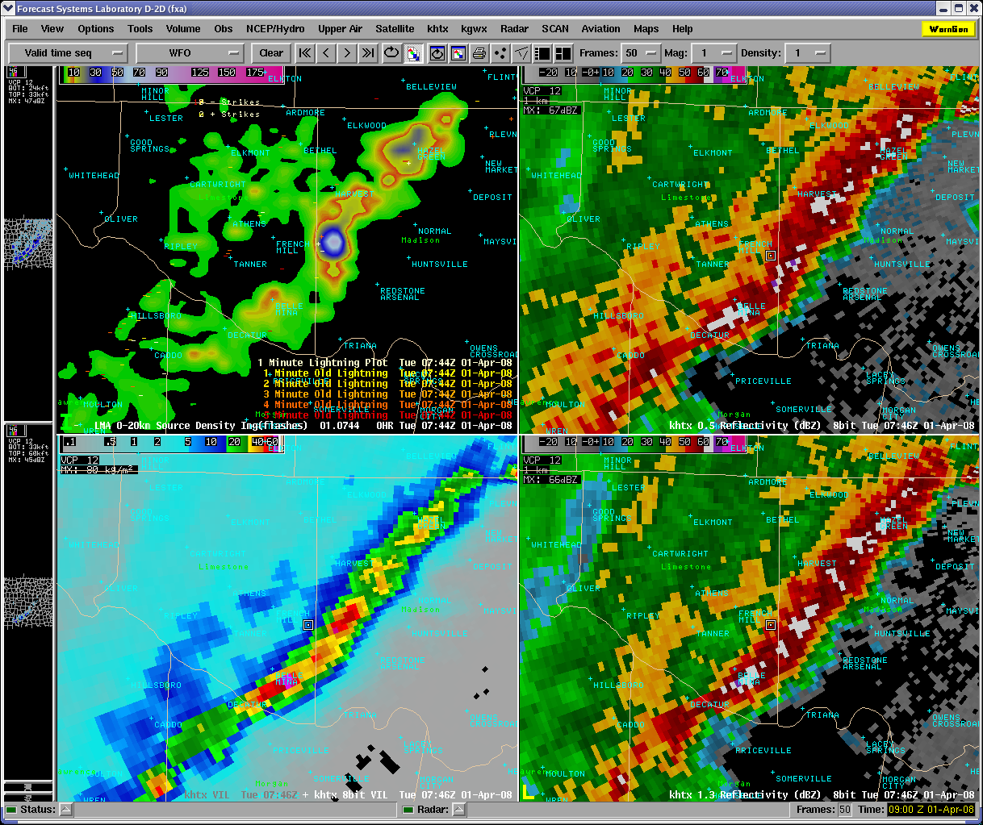
Total Lightning Training II
Work in progress
More detailed cases of using “source density” product – simulation/scenario based
  First CG
  Classic severe wx
  Marginal severe to non-warning event
Examples from WES cases by HUN will be used in module
Source density, VIL, Reflectivity 0.5, 1.3
transitioning unique NASA data and research technologies to operations

Slide 12
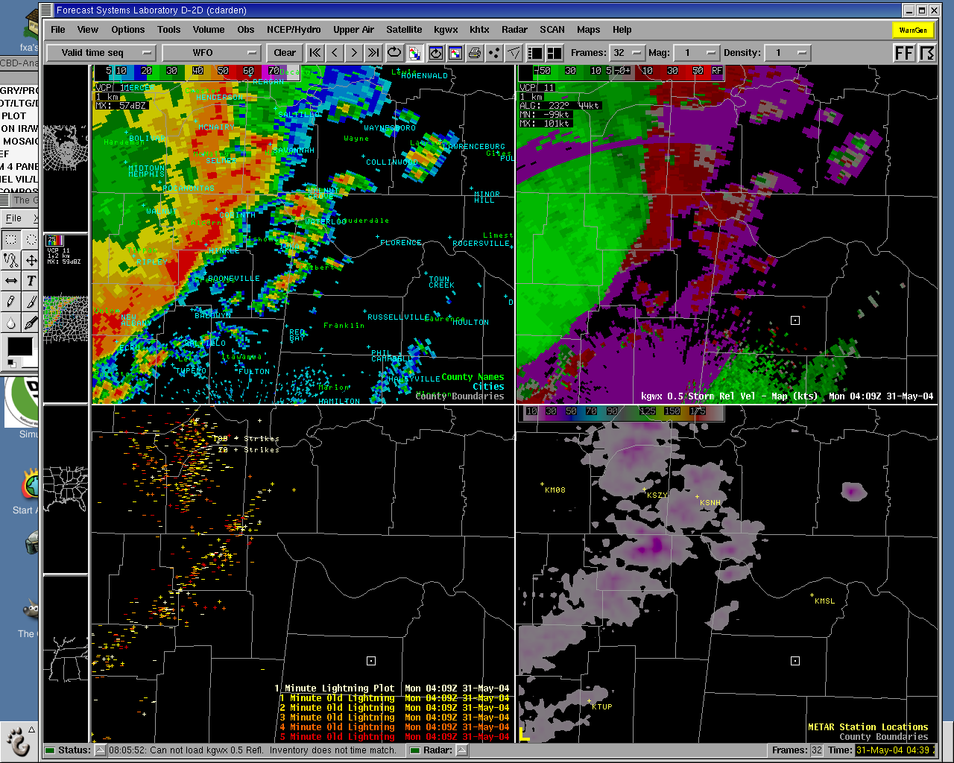
Total Lightning Training II
0409 UTC
Developing Convection
No CGs observed
10-20 LMA sources
transitioning unique NASA data and research technologies to operations

Slide 13
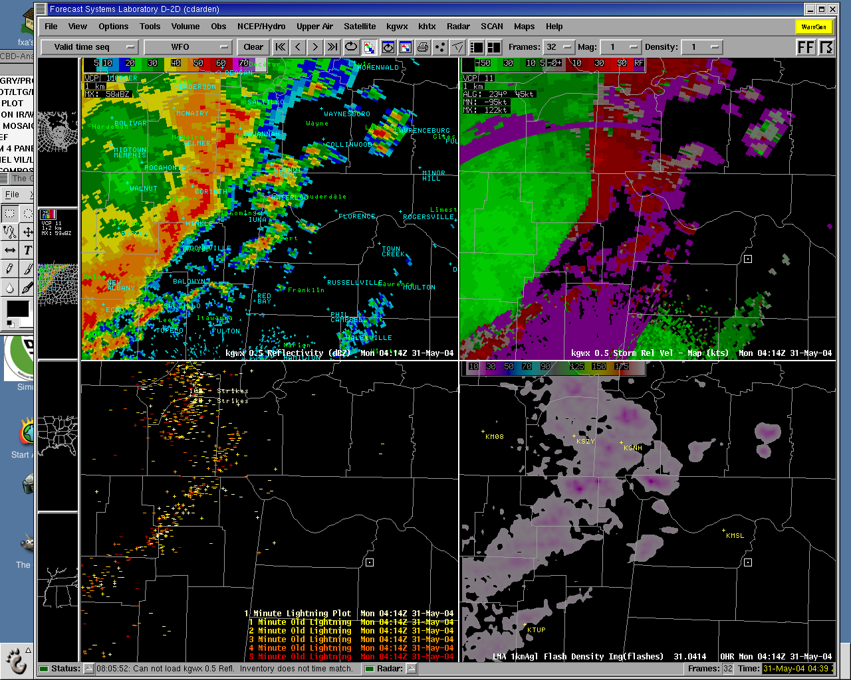
Total Lightning Training II
0414 UTC
Notice CG activity where there was none previously
transitioning unique NASA data and research technologies to operations

Slide 14
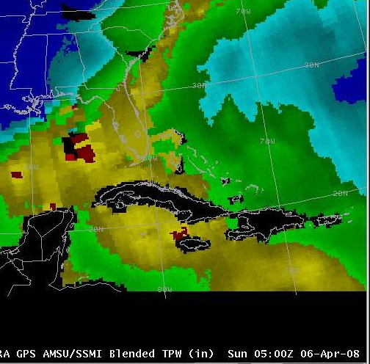
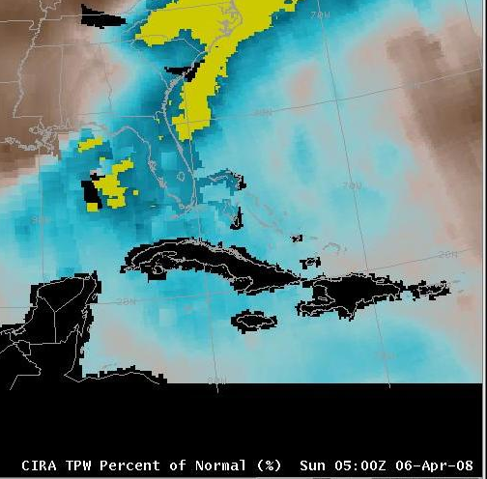
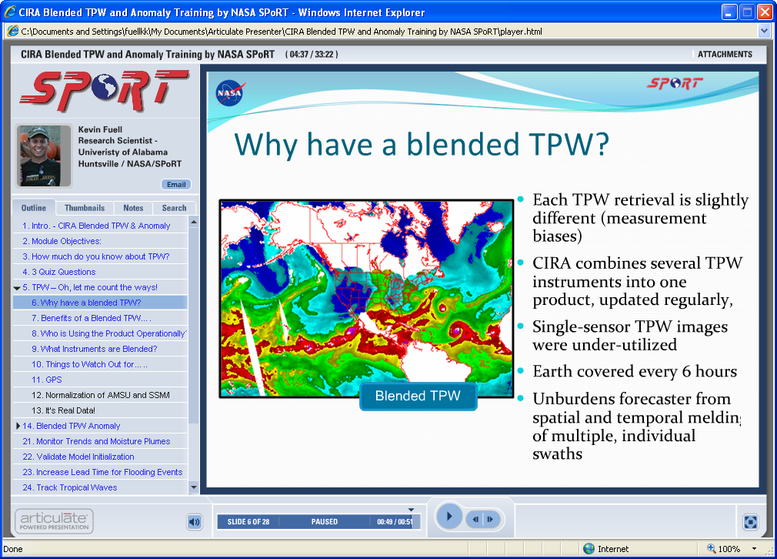
CIRA Blended TPW
CIRA asked SPoRT to distribute its Blended TPW and associated Anomaly product
Several SPoRT WFOs provided feedback of positive value
Mutli-agency effort to create training led by SPoRT
  Product content from CIRA experts
  Cases from SPoRT users
  Application from national center uses
Module is 30 minutes
Working w/ NWS to incorporate in NOAA’s Learning Mgmt System
Miami, FL submitted case of increased lead time to flooding
transitioning unique NASA data and research technologies to operations

Slide 15
Training to support FAA project
SPoRT was a partner in efforts to create and assess an Enhanced Convective Forecast (ECF) product aimed at forecasters supporting Air Route Traffic Control Centers (summer 2008)
  Product was not fully understood by end users during initial evaluation
  SPoRT quickly created an informational training module to increase knowledge and improve evaluation of product.
SPoRT’s new capability filled project need for quick training
transitioning unique NASA data and research technologies to operations
Notes:
SPoRT provides value to the evaluation of products by development of tailored training.
SPoRT was able to gather information quickly from product developers and provide training to various sites for various users to go through when on shift. The module was created in a matter of days to quickly fill a need in the project.

Slide 16
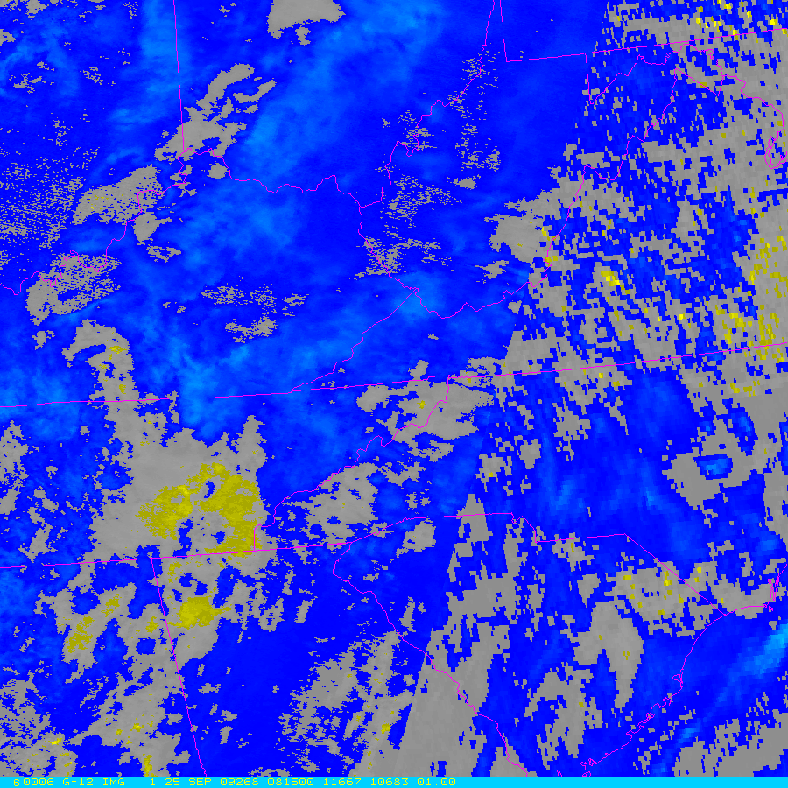
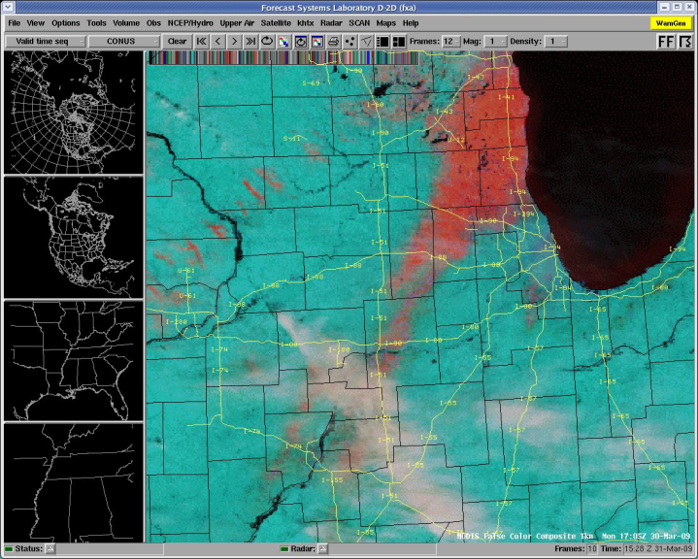
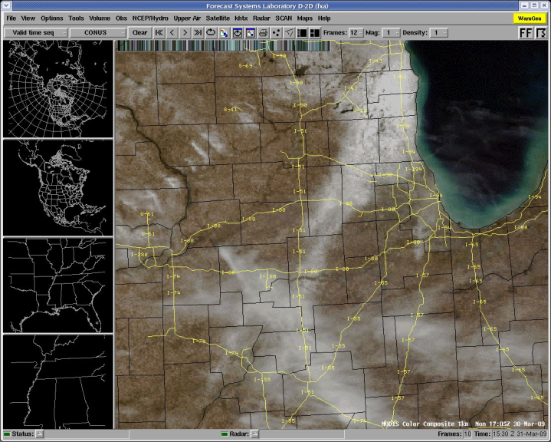
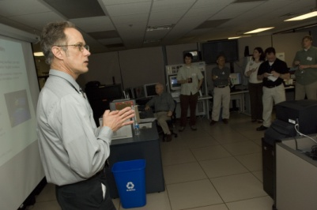
Future work - Training
MODIS /GOES Hybrid of derived or multichannel products
Increase individual Science Sharing and Feedback sessions with WFOs for specific products via telecon
Continue creating a library of short training modules for SPoRT suite
Develop training with GOES-R Proving Ground partners
  Possible ABI-proxy product module
  Per request of PG partners – we are in the process of creating a total lightning module that will include GLM-like products
MODIS
GOES
transitioning unique NASA data and research technologies to operations

