Slide 1


SPoRT’s Web Presence
Bradley Zavodsky Erik Reimers
Andrew Molthan Paul Meyer
Geoffrey Stano Jaclyn Shafer
Fifth Meeting of the Science Advisory Committee
18-20 November, 2009
National Space Science and Technology Center, Huntsville, AL
transitioning unique NASA data and research technologies to operations

Slide 2
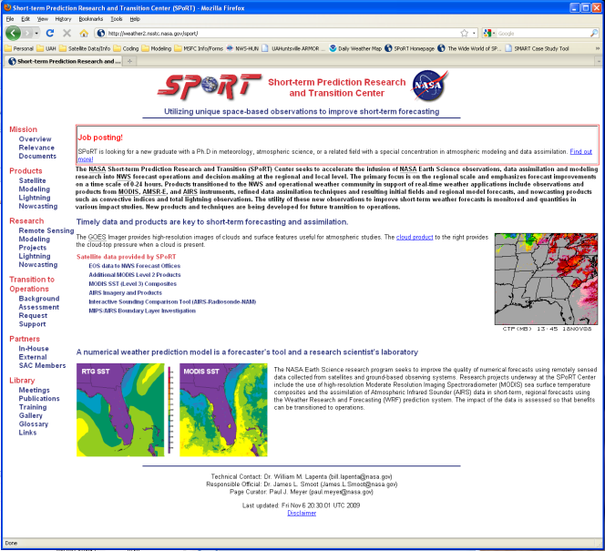
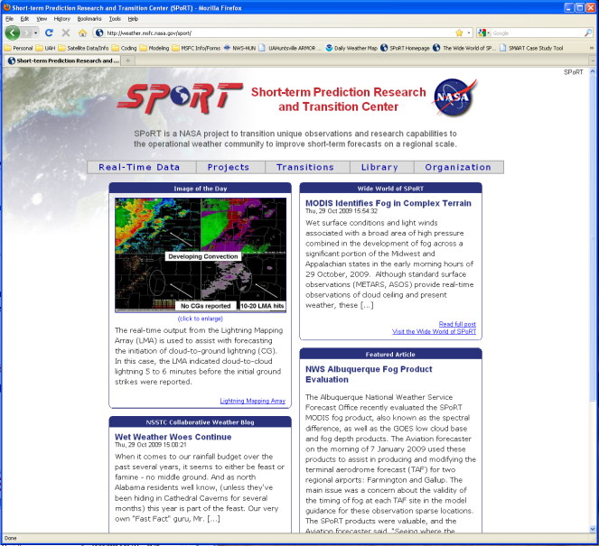
Purpose of SPoRT Web Presence
Specific SAC recommendation from June 2007 Meeting:
  9. Have SPoRT facilitate feedback between users and developers
Many in the scientific community use the web, blogs, and social networking sites
Innovative communication strategies update program progress and advertises expertise/activities
Web-based communication tools are more efficient for day-to-day interactions between SPoRT, its partners, and its collaborators
Newsletters, conferences, and journals are only accessible to a few who have shown interest in the program
People who might not know about or interact with SPoRT can learn about us on their own schedule
Two-way communication possible through news-article format and online comment sections
transitioning unique NASA data and research technologies to operations

Slide 3

SPoRT Website http://weather.msfc.nasa.gov/sport
Mission:
  Disseminate information to partners and external community
  Chronicle progress, products, and ongoing research at SPoRT
“One stop shop” for any information regarding SPoRT activities
Goal:
  Share training modules with partners
  Share journal and conference papers community
  Easy to access/use online surveys and survey results
  Monitor real-time data products
  Share results and updates of work with collaborators
Statistics:
  Website redesign launched December 2, 2008
  Average of 3,153 unique IP addresses per month served by SPoRT website in 2009
  Average of 102,250 hits per month (pages & images)
transitioning unique NASA data and research technologies to operations

Slide 4
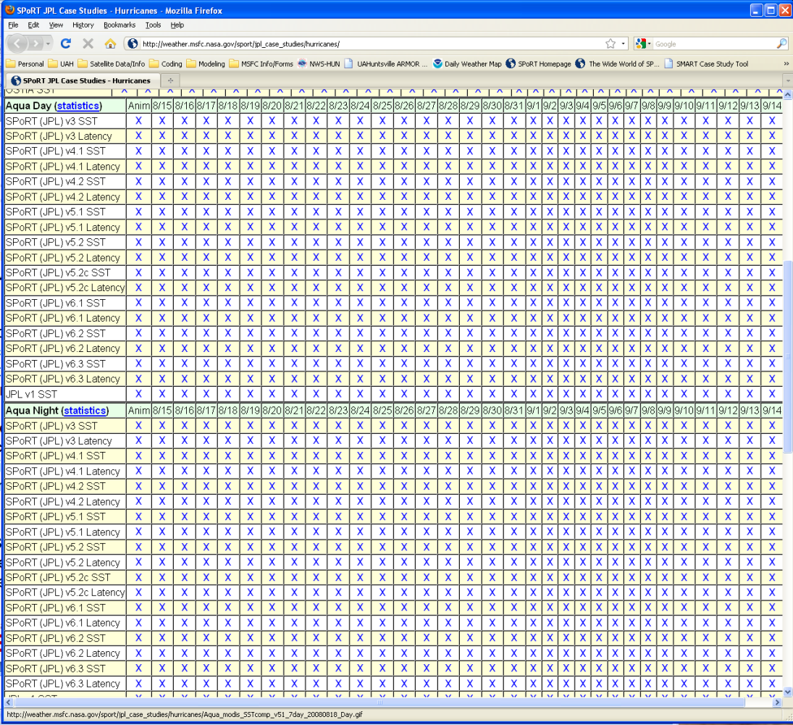
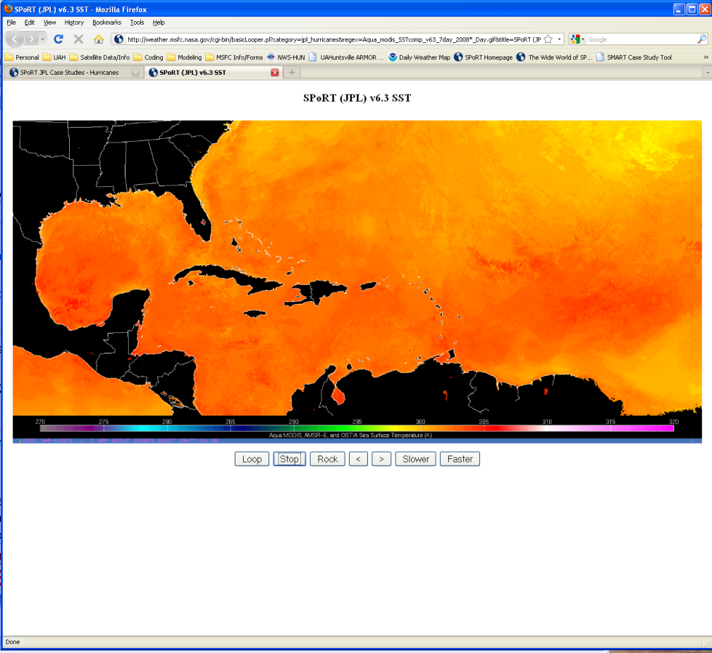
Example: SPoRT JPL SST Products
SPoRT and JPL collaborate on a SST composite product
Images are generated for case studies and posted to SPoRT website
Scientists from both SPoRT and JPL can view large quantity of images in an organized format without email traffic
No link from SPoRT page; not found via search engine
transitioning unique NASA data and research technologies to operations

Slide 5
The Wide World of SPoRT http://vortex.nsstc.uah.edu/sportblog
Mission:
  Fostering interaction between product developers and end users
Currently hosted through a partnership with UAH
“The Wide World of SPoRT” encourages two-way communication between SPoRT and its partners
Goal:
  Include short articles with figures that demonstrate the value of SPoRT products in operations
  Registered users can exchange comments
  1-2 posts per week keep end users informed about products and research
Statistics:
  Began in March 2009
  25 registered accounts including 15 SPoRT partners
  Several direct posts by NWS WFOs
    Albuquerque, NM (3)
    Huntsville, AL (2)
    Morristown, TN (2)
    Nashville, TN (1)
    Corpus Christi, TX (1)
    Houston, TX (1)
  Many others posted on behalf of WFOs offering feedback
  Available to the public and visited regularly by WFOs, regional HQs, NASA, NESDIS, NOAA
transitioning unique NASA data and research technologies to operations

Slide 6
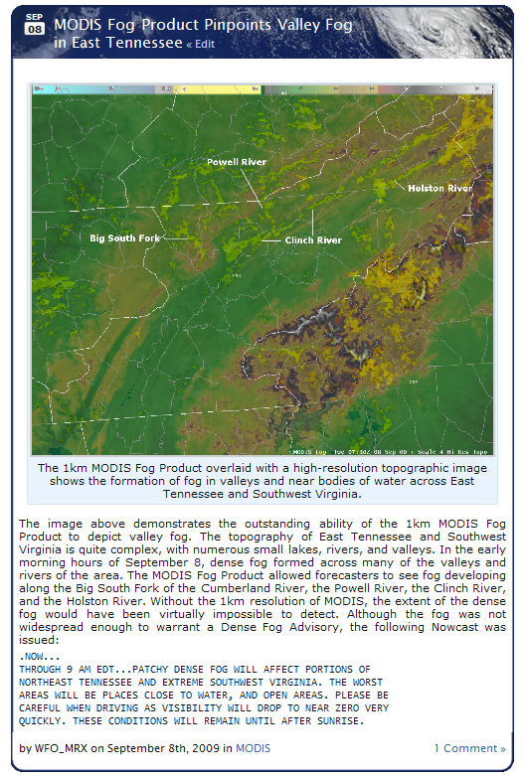
Example: Morristown, TN (MRX)
The NWS WFO in Morristown, TN evaluated the MODIS fog product
  Product provides unique capabilities in complex terrain
  Demonstrate using a figure showing MODIS and terrain in AWIPS
  Feedback about resulting issuance of a short term forecast advisory
SPoRT researchers can comment on post and add other examples of where the product would be useful
Potential partners can see how others are using NASA data to aid in issuing public advisories
transitioning unique NASA data and research technologies to operations

Slide 7
Become a “Fan” of SPoRT on Facebook! http://www.facebook.com/NASA.SPoRT
Social networking is popular and increasingly explored by scientists
Fan pages on Facebook allow an organization to broadcast updates and receive feedback from end-users
60% of fans are NWS employees
Most are under 35
Other organizations on Facebook:
  NASA (10,384 fans)
  NASA Marshall (3,209 friends)
  NOAA (2,173 group members)
  AMS (1,821 group members)
  Dr. Lubchenco, NOAA Administrator (1,783 fans)
  National Weather Service (1,296 members)
  National Weather Association (496 members)
  NASA SPoRT (103 fans)
Benefits to SPoRT:
  Direct updates of SPoRT progress to interested parties who choose to subscribe
  Entries from Wide World of SPoRT blog automatically posted on Facebook via RSS feed
  Allows for quick, short updates between other NASA SPoRT publications
Low Cost and Risk, High Reward
  Minimal maintenance required from SPoRT
  Requires a Facebook user to place as the administrator and basic advertising to encourage folks to “become a fan of SPoRT on Facebook!”
  Easy outreach to the general public and scientific community
transitioning unique NASA data and research technologies to operations

Slide 8
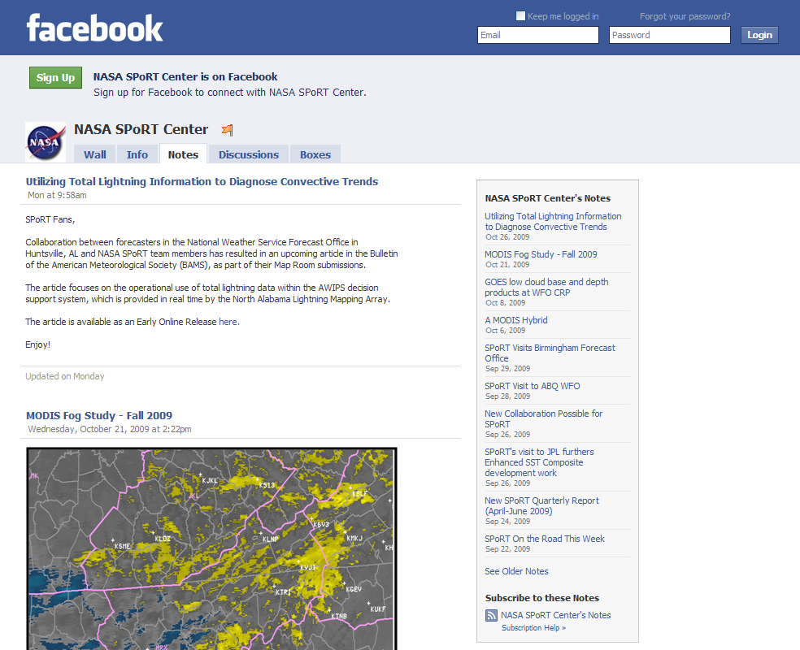
Example: The Facebook Fan Page
Journal Article Announcement
Previous Announcements
“The Wide World of SPoRT”
Non-Facebook Subscriptions
transitioning unique NASA data and research technologies to operations

Slide 9
Conclusions/Future Work
Many in the scientific community use the web, blogs, and social networking sites
Innovative communication strategies updates program progress and advertises expertise/activities:
  SPoRT website
  “Wide World of SPoRT” Blog
  Facebook Page
Web-based communication tools are more efficient for day-to-day interactions between SPoRT, its partners, and its collaborators
Allow two-way communication between SPoRT researchers and end-users
The SPoRT website and blog will evolve as the program evolves
Continue to advertise via word-of-mouth and social networking
Merge communication strategies and to form a more integrated web presence
transitioning unique NASA data and research technologies to operations

