Slide 1
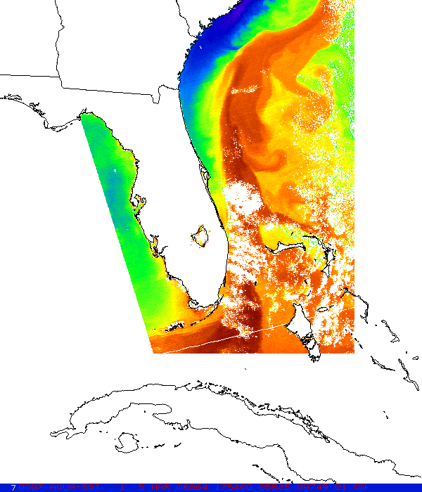
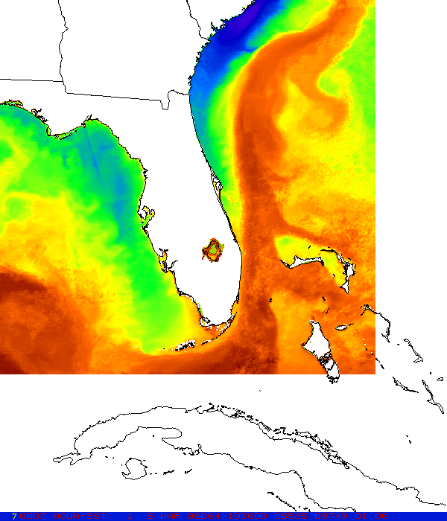
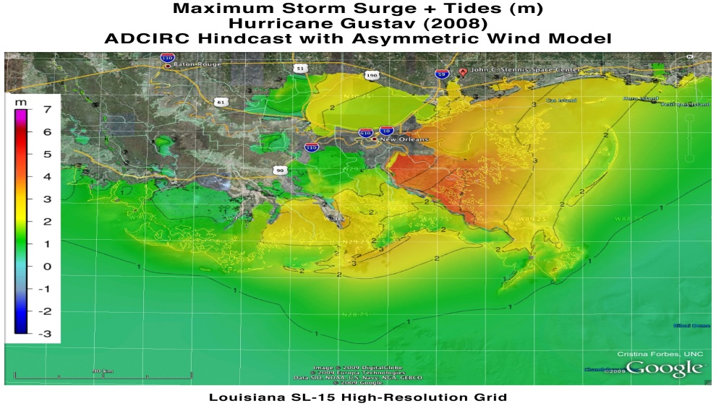
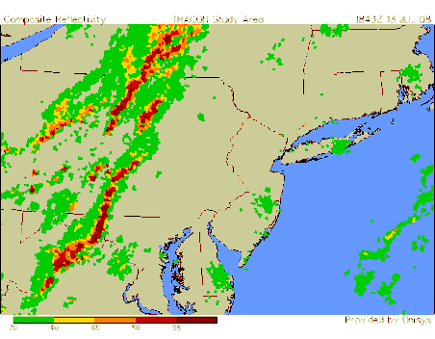
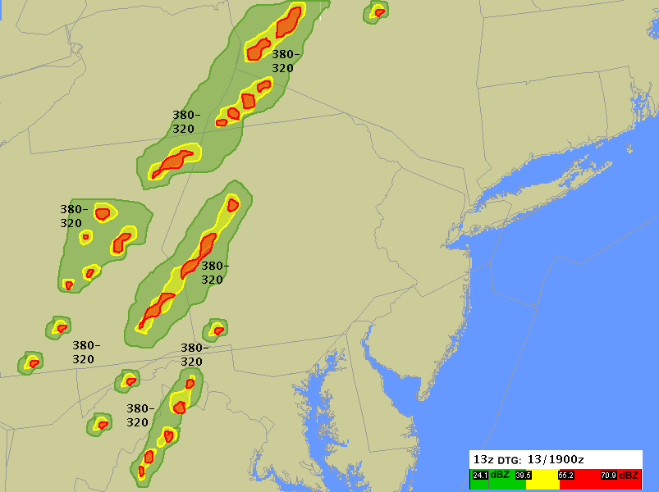


Other Related Activities
Gary Jedlovec
Single image
MODIS Composite
12 17 22 27
transitioning unique NASA data and research technologies to operations

Slide 2
Role of Other Funding
(Non SPoRT “Core”)
Leverage off SPoRT core capabilities to address other forecast issues and / or to extend activities to other users – helps fulfill SPoRT vision
Draws on SPoRT expertise (data, remote sensing, AWIPS, etc.) or partner relationship to help others accomplish more for less
Diversified funding sources helps maintain core staff (expertise) during valleys in core funding
transitioning unique NASA data and research technologies to operations

Slide 3
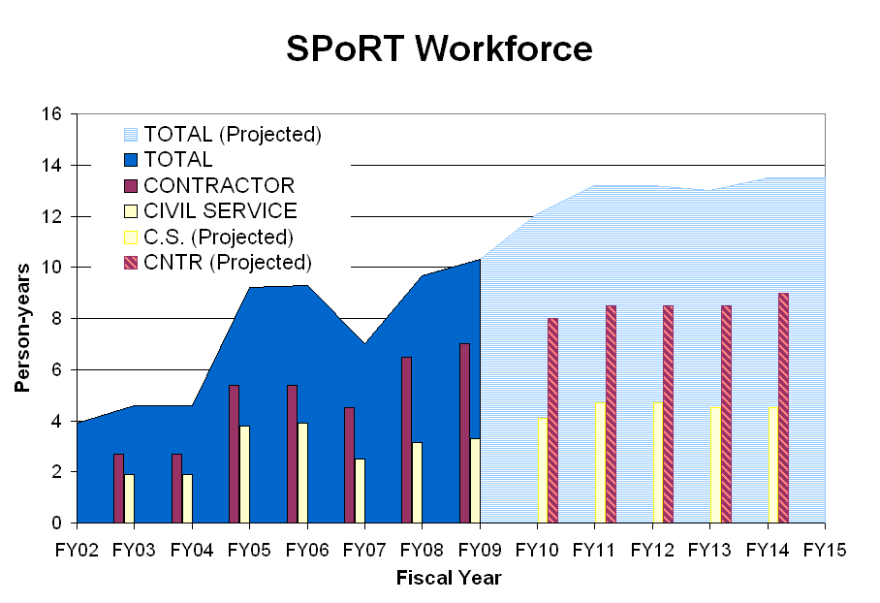
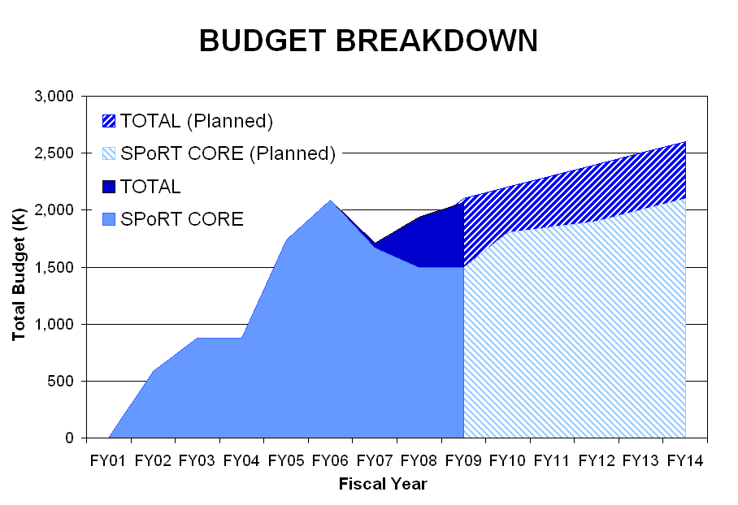
Manpower and Funding
Not looking for budget review but provides perspective and insight!
Diversified funding source since 2007 to help maintain expertise and build depth in project capabilities
C.S. and liaison loss
Full Cost
Loss of Goodman / Lapenta reduced C.S. staff – took two plus years to build up
Ramp up at research scientist level much quicker
Lean EOS Budget
transitioning unique NASA data and research technologies to operations

Slide 4
Other Related Funded Activities
ROSES 07
JPL – Vazquez - Enhanced SST composites product disseminated by the PO DAAC
Mecikalski (UAH) – applications of NASA data to improve FAA tactical forecasts of CI
ROSES 08
Jones (StormCenterCom.) - NASA data in EVTT collaboration tool for NWS/FEMA
Jones (StormCenterCom.) - NASA data in EVTT collaboration tool for GOMA partners
Lidard (GSFC) – help integrate / upgrade land representation in coupled WRF / LIS
ROSES 09 (pending)
Molthan (NASA/SPoRT) - Improve WRF microphysical cloud parm. MODIS / CloudSat
Mattocks (UNC) - Storm surge tool for Gulf Coast states for changing climate scenarios
Others
Valenti (WorldWinds, Inc.) - Generation of a chlorophyll composite product (2008)
Jedlovec (NASA) - Enhanced convective forecasts in support of air traffic planning - 2008 (FAA)
transitioning unique NASA data and research technologies to operations

Slide 5
Enhanced MODIS /AMSR-E Composite SST
Motivation
Coastal WFOs have identified need for high resolution SST product to help with forecast issues
Previous SPoRT composite SST product (MODIS only) has limitations under extended periods of clouds
Partnered with the physical oceanography team at JPL (ROSES 2007) – MODIS and AMSR-E, CONUS coverage, bias correction and error weighting
Single image
MODIS Composite
12 17 22 27
Use near real-time L2P data stream (JPL) for MODIS and AMSR-E passes more passes
  expand product coverage
  pixel by pixel quality estimates and bias
  slight additional delay in data access – tolerable
  better cloud / rain detection
  Aqua data coarse resolution with no data near coast
Algorithm changes - latency, error, and resolution weighted product
Operational product disseminated as part of GHRSST data stream at JPL
transitioning unique NASA data and research technologies to operations

Slide 6
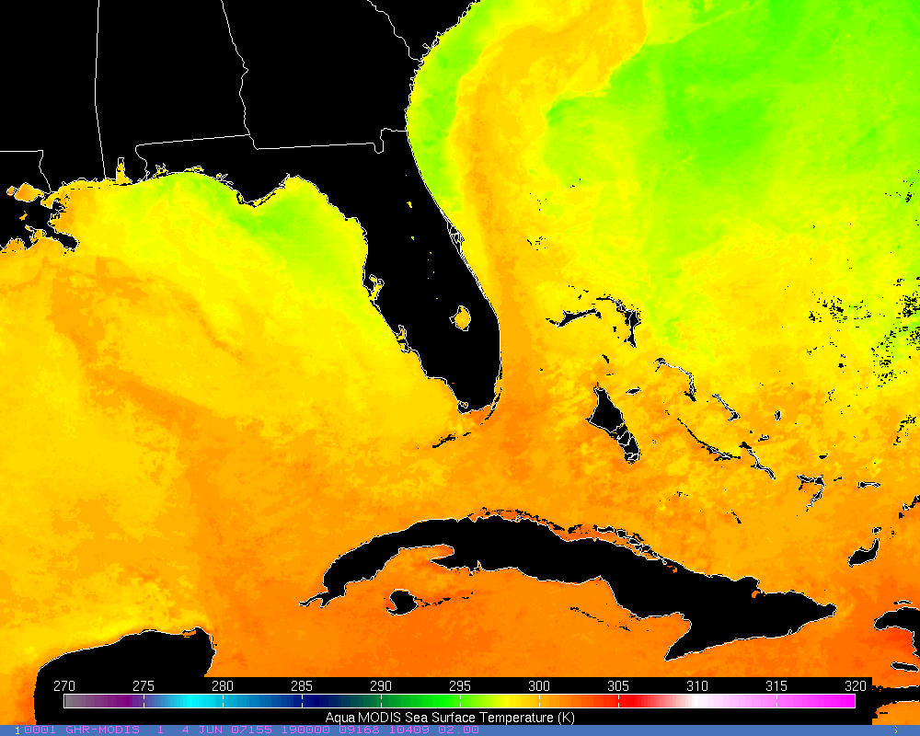
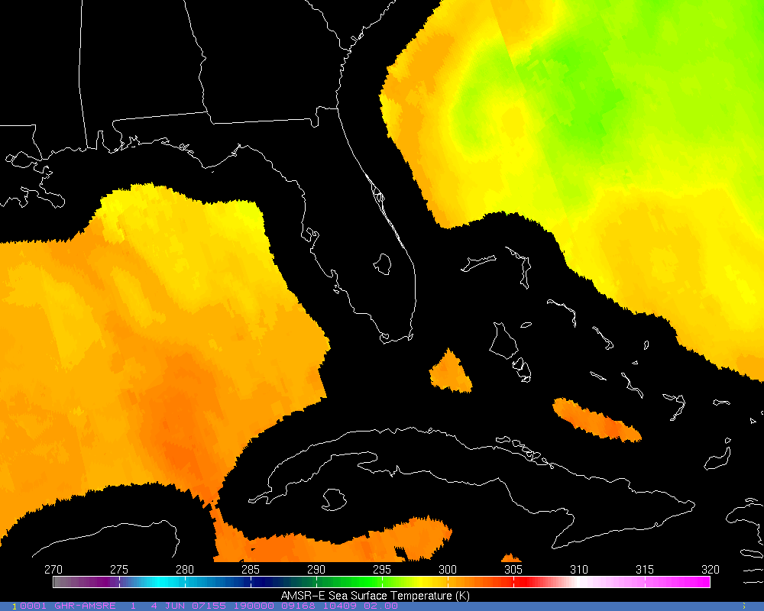
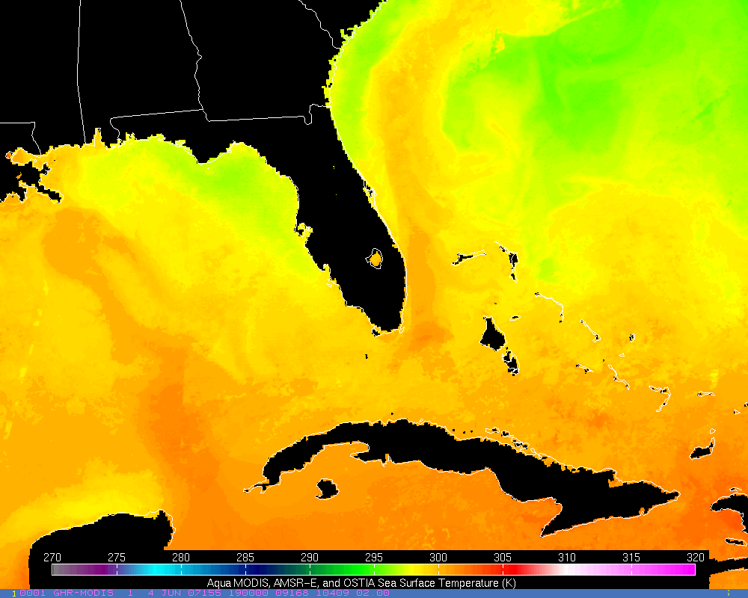
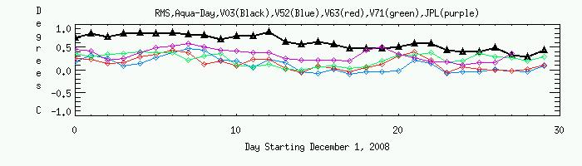
Enhanced Composite SST Example
Enhanced approach combines MODIS and AMSR-E data for the previous week in a latency –weighted compositing scheme
6-4-07 - Aqua
MODIS Day
6-4-07 - Aqua
AMSR-E Day
6-4-07 – Aqua Day
MODIS/AMSR-E
OSTIA Fill
MODIS Composite SST
AMSR-E Composite SST
MODIS/AMSR-E +
Enhanced MODIS / AMSR-E composite SST product validated against drifting and fixed buoys in various regions / seasons
  Biases reduced by over 50% (to ~0.2K) with significant reduction in RMS error
BIAS
Atlantic Ocean
transitioning unique NASA data and research technologies to operations

Slide 7
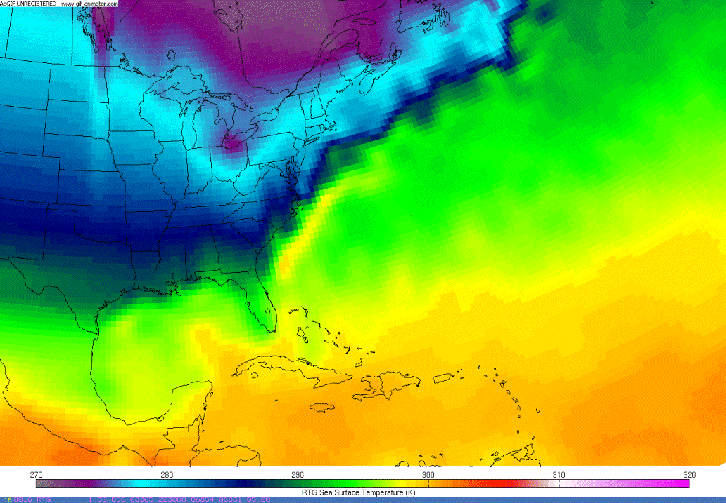
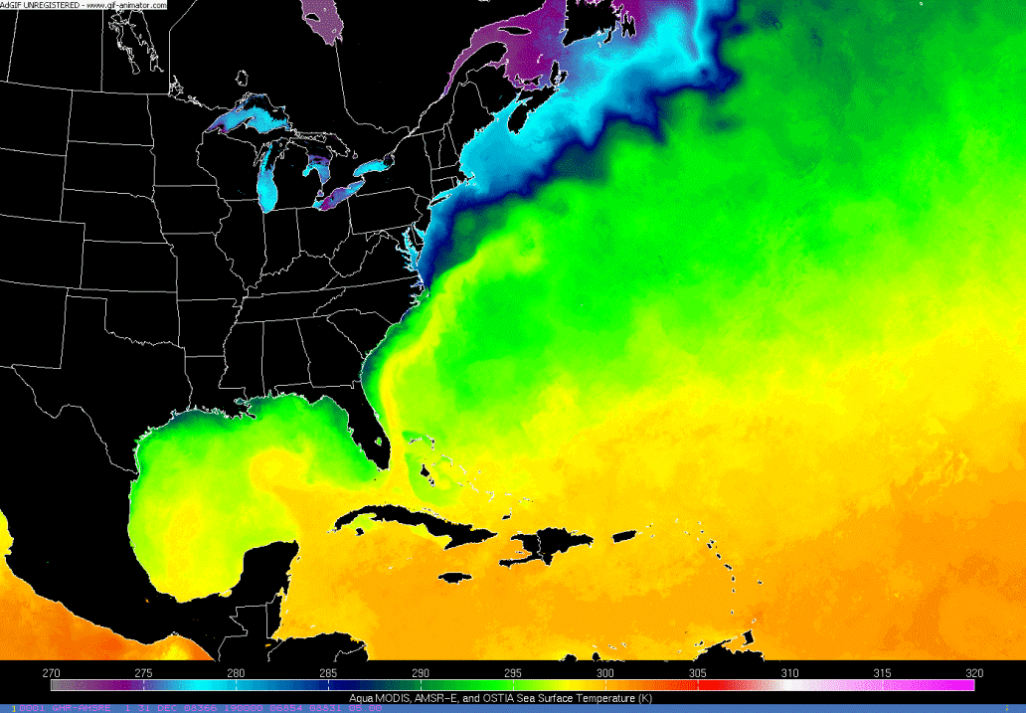
Enhanced Composite SST Example
Enhanced approach combines MODIS and AMSR-E data for the previous week in a latency –weighted compositing scheme
RTG
MODIS/AMSR-E
Aqua - Day
6-4-07 - Aqua
MODIS Day
6-4-07 - Aqua
AMSR-E Day
6-4-07 – Aqua Day
MODIS/AMSR-E
OSTIA Fill
MODIS Composite SST
AMSR-E Composite SST
MODIS/AMSR-E +
Loop of RTG and MODIS/AMSR-E SSTs for December 2008.
Enhanced MODIS / AMSR-E composite SST product validated against drifting and fixed buoys in various regions / seasons
  Biases reduced by over 50% (to ~0.2K) with significant reduction in RMS error
BIAS
Atlantic Ocean
transitioning unique NASA data and research technologies to operations

Slide 8
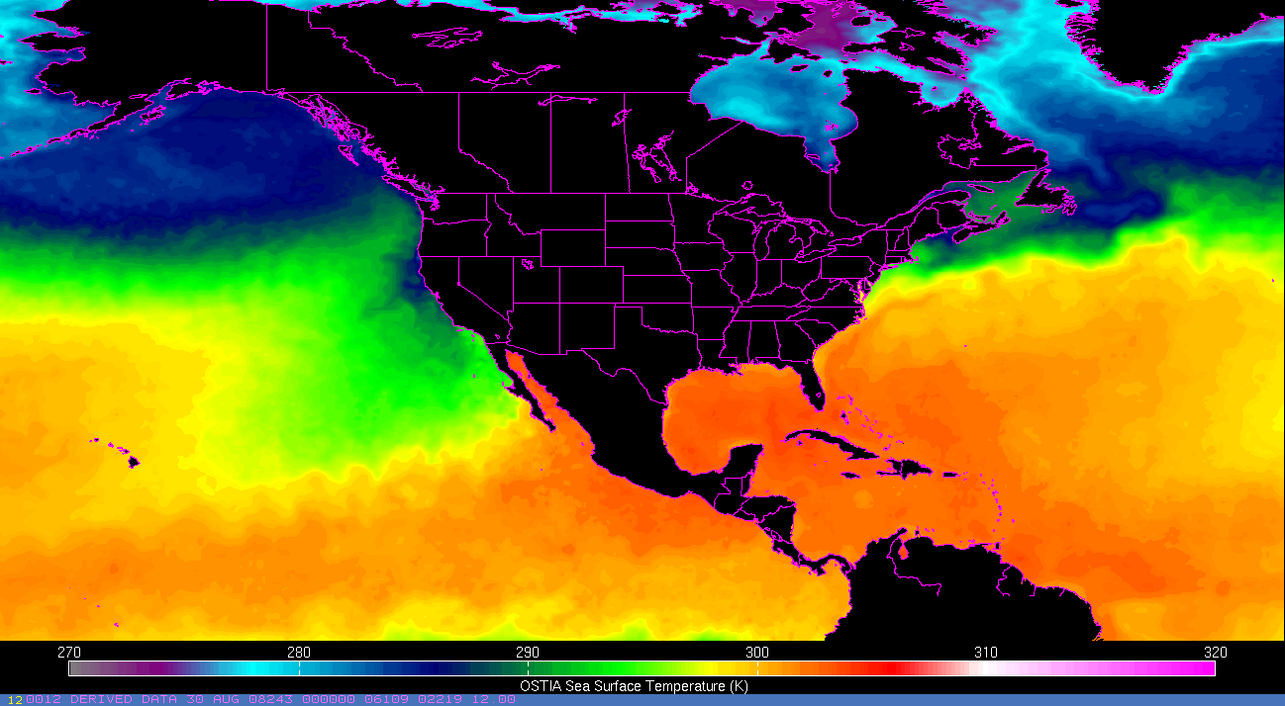
Enhanced SST Composite Summary
High resolution SSTs provide a valuable data source for regional weather forecast models and validation studies
This collaboration with JPL and its Physical Oceanography DAAC improves on previous technique to generate composite SST product
Enhancements include use of GHRSST L2P data stream
  access to all EOS passes for MODIS and AMSR-E
  cloud masking / confidence flags / bias correction
  latency / error / resolution weighted compositing algorithm
Near real-time CONUS product available (beta now from SPoRT) from JPL in January 2010
4x / day product captures major component of the diurnal cycle of SST – use may add value to subsequent forecasts
Many requests for real-time and historical product
transitioning unique NASA data and research technologies to operations

Slide 9
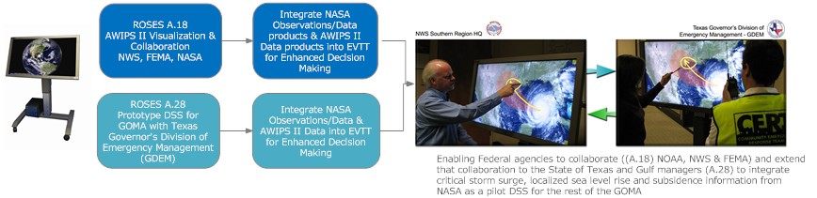
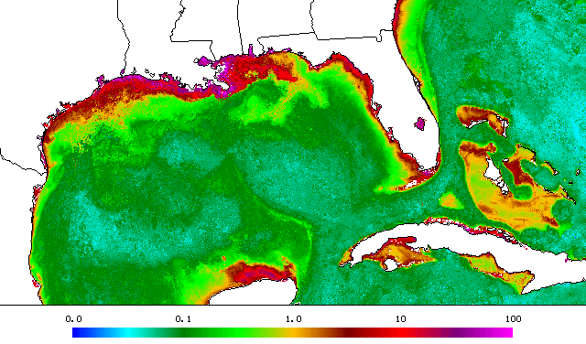
NASA Data in EVTT Collaboration Tool
Working with Storm center Communications (D. Jones) to bring NASA data and AWIPS II output into the EnviroVision Touch Table (EVTT) collaboration environment for natural disaster preparedness and warning
  Gulf of Mexico Alliance (GOMA) partners and Texas Governors Division of Environmental Management
  FEMA / NWS SR
High-resolution Chlorophyll Composite
Partnered with WorldWinds, Inc to apply (SST) compositing approach / technology to MODIS chlorophyll product from USF and available through SPoRT
  WorldWinds, Inc. disseminates product to public – http://www.worldwindsinc.com/chlorophyll.htm
  Transition to PO.DAAC data stream for broader applications in near future
transitioning unique NASA data and research technologies to operations

Slide 10
Summary
SPoRT seeks other funds to leverage off SPoRT core capabilities to address other forecast issues and / or to extend activities to other users
SPoRT is readily becoming recognized as the “go to place” for transition of research capabilities to operations for short-term forecasting activities
Draws on SPoRT expertise (data, remote sensing, AWIPS, etc.) or partner relationship to help others accomplish more for less
Diversified funding sources helps maintain core staff (expertise) during valleys in core funding
transitioning unique NASA data and research technologies to operations

