Slide 1
GOES-R Proving Grounds
Matt Smith, Kevin Fuell, Geoffrey Stano
Fifth Meeting of the Science Advisory Committee
18-20 November, 2009
National Space Science and Technology Center, Huntsville, AL

Slide 2



Background
GOES-R Proving Grounds Activities
Lightning Team at NASA/MSFC
LMA
SPC Spring Program
Proxy needs are key
Notes:
PG – to bridge the gap between research and operations. – coordinating with RR and AWG
Proving grounds began in 2008 by NOAA to prepare for the next generation GOES satellites
Invited to 2009 GOES-R PG meeting, mostly for ABI and GLM – for our WFO partners. We will perform assessment/training for our partners – and for NOAA. We’ve taken on the role of providing the near-real-time - w/r/t Wisconsin’s WES case studies (lightning in particular – but also ABI proxy).

Slide 3
SPoRT South/Southeast Focus for GOES-R Products
Forecast Issues
Relevant GOES-R product/data
Diagnosing changing weather
Diagnosing low clouds and fog
Local temperature forecasts
Visibility reductions from smoke and fire weather
Lead time for severe weather
Sea breeze impact
Diagnosing severe weather and heavy precipitation
Convective weather forecasts
Regional precipitation forecasts and off shore weather
ABI – high res. imagery and derived products
ABI – enhanced channel difference imagery
ABI – Land Surface Temperature
ABI – Color composites, active fires and burn areas
GLM – Total lightning, and lightning threat
ABI – Local models initialized with surface parameters and SST
ABI & GLM – Blended TPW & Extent Density
ABI – Local modeling initialized with veg. parameters, and SSTs, and assimilated cloud track winds
T(p), q(p), 3D fields of met. variables from model forecasts improved with radiances or profile information

Slide 4


Proving Ground Objectives
Transition Algorithm Working Group results
Available to Risk Reduction efforts
Transition and evaluate GLM proxy
Training for GLM proxy products
Provide use in NWS next generation display (AWIPS II)
Assist with near-real-time ABI demo

Slide 5
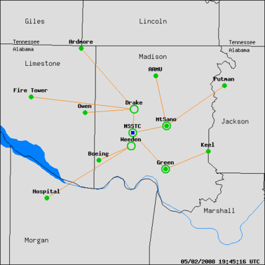
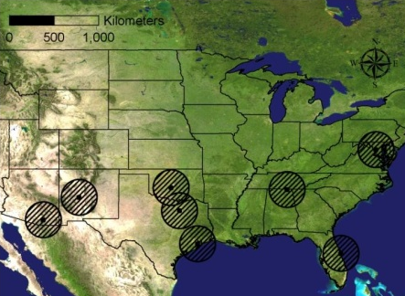
Lightning Mapping Array
LMA and LDAR networks
North Alabama LMA network
Notes:
KSC, Houston, & FTW is LDAR. Tucson is neither.

Slide 6
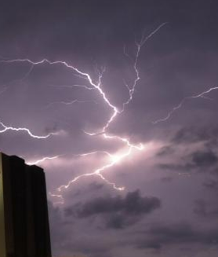
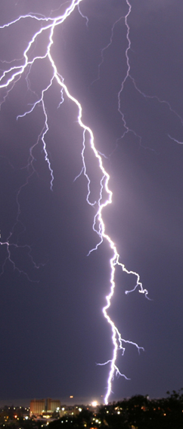



The 2009 Spring Program
Combination of several activities
  Experimental Warning Program
  Experimental Forecast Program
  GOES-R Proving Ground
Used a GLM proxy
  Data from DC, North Alabama, and Oklahoma
  Source density “smeared” to larger grid
  Used in real-time to monitor storms and issue warnings
Notes:
The smeared LMA product at SP 09 wasn’t optically-based (flash-based) and wasn’t ground-based (source-based).

Slide 7
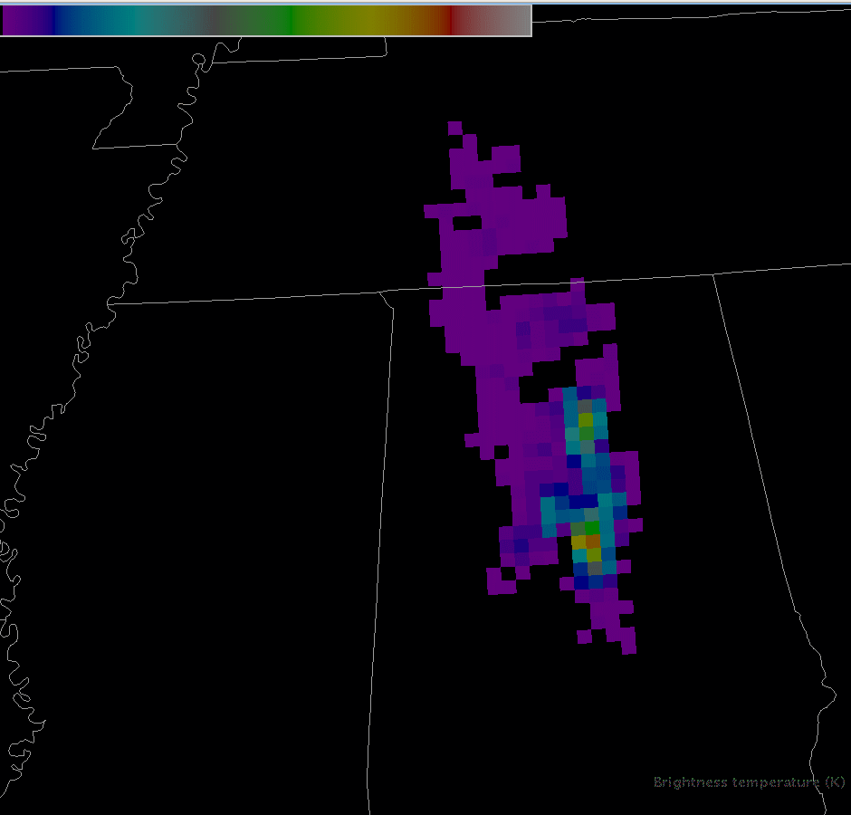
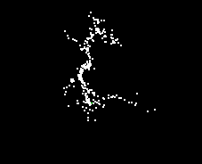
First Order GLM Proxy Products
Several lessons learned
  Need flash-based GLM proxy
  Must be available for 2010 program
  Great deal of forecaster interest
This is being developed by SPoRT and partners in Huntsville
  Access to AWG
  Many lightning experts
  AWIPS II development efforts
Incorporate AWG work
Familiarize forecasters
Find additional visualizations
AWG: Only flashes with >15 sources used
Notes:
The GLM product must be flash based: sources -> flashes -> binned into GLM-proxy-like product
AWG will create final proxy

Slide 8
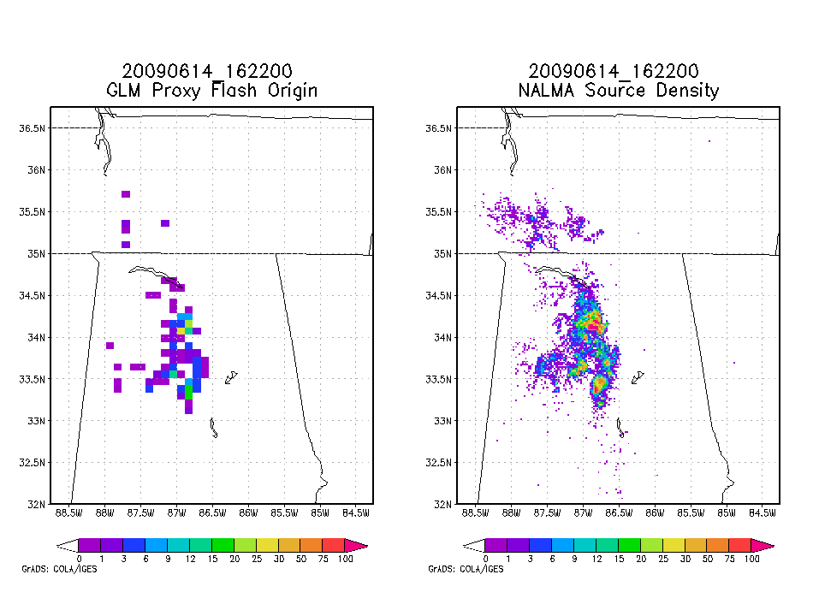
Flash Origin Density – GLM pseudo-Proxy
Notes:
Line of storms with stratiform anvil to the Northwest, is not visible in the origin image
Shows up clearly in the extent image

Slide 9
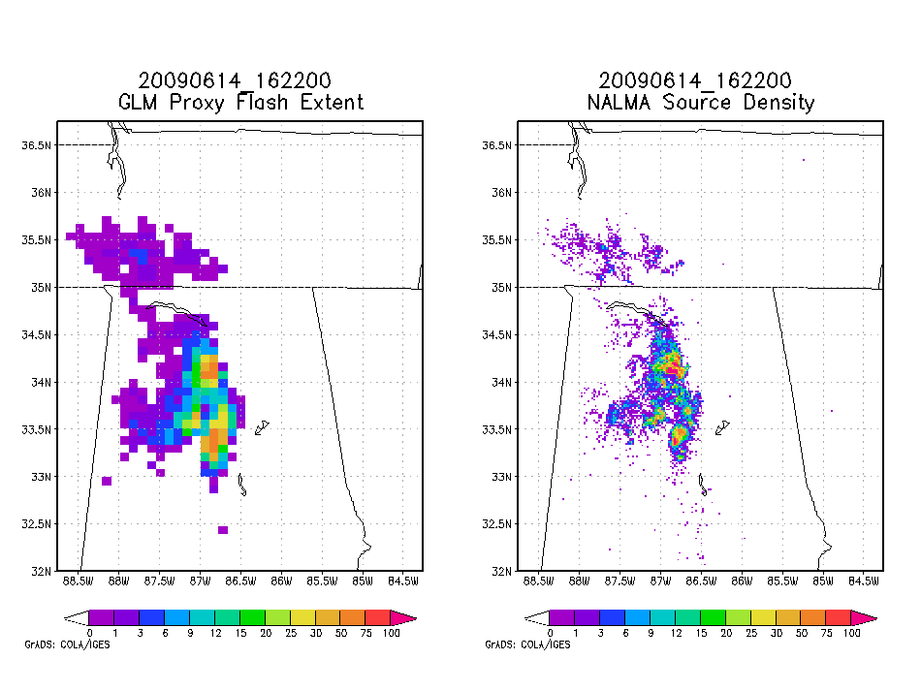
Flash Extent Density – GLM pseudo-Proxy
Notes:
Line of storms with stratiform anvil to the Northwest, is not visible in the origin image
Shows up clearly in the extent image. Full electrification is seen
The extent images are more popular already.

Slide 10
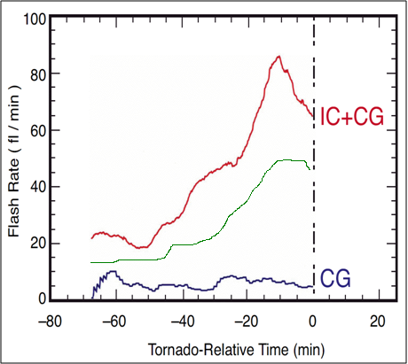
What is the Practical Benefit?
Q: Will GLM be able to imitate the powerful results from LMA?
A: ?
SPoRT is leading the effort to find out.
Updraft Intensifies
GLM?
Vortex
Spin-up
Notes:
10
It has been stated several times that the source densities can be used to infer storm strength and severity. This will give an example of how. Notice the trends of intra-cloud lightning, in red, and cloud-to-ground lightning, in blue, leading up to a tornado touchdown in the graphic provided. The additional intra-cloud observations show a clear trend. The source densities are increasing as the vortex “spins-up” and the updraft intensifies. Conversely, the cloud-to-ground observations show no clear change leading up to the touchdown. This shows that the intra-cloud flashes correlate with the storm updraft strength as well as the incipient storm severity. This source density “jump” is noted in advance of many severe weather occurrences.
Green line is speculation. Will there be a jump and a decrease before severe wx?

Slide 11
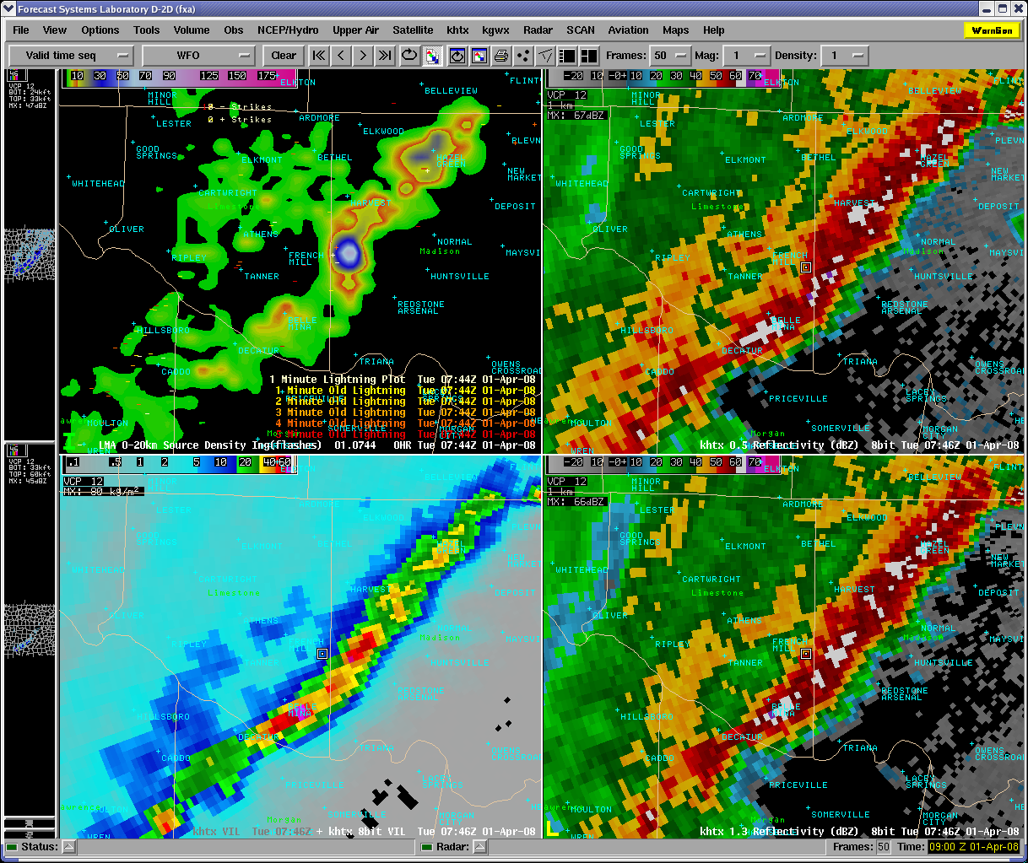
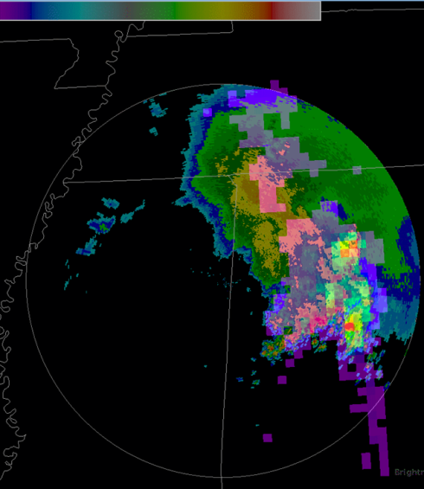
A Training Scenario
Source density, VIL, Reflectivity 0.5, 1.3
Source Density ⬄ Updraft velocity
Other products not always indicative of cell intensity
AWIPS II will allow better viz
Electrification forecast value still being explored
NALMA
Pseudo GLM
(Flash Extent w/ Radar)

Slide 12
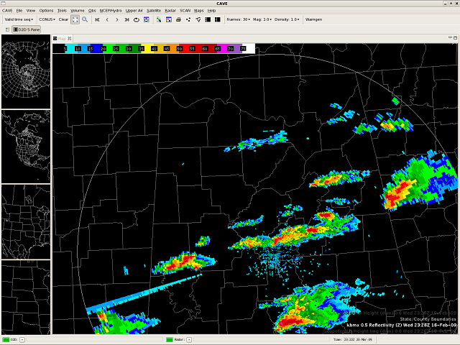
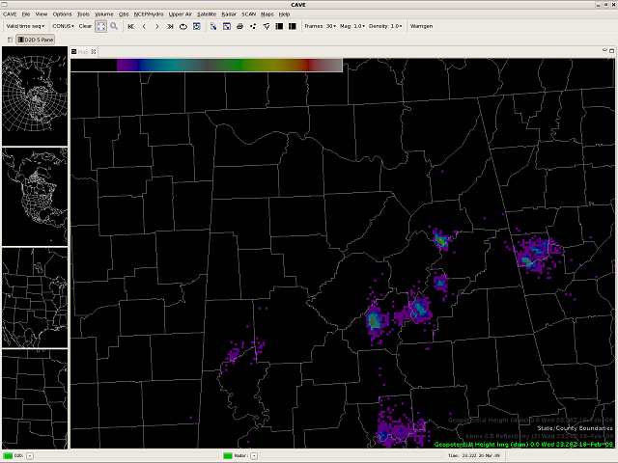
Benefits to the Proving Ground
SPoRT’s efforts to ingest products into AWIPS II are preparing for the future of visualization by NWS (SPoRT core activities)
SPoRT is developing expertise with AWIPS II (McIDAS plug-in)
Training to support Spring Programs
Radar
NALMA
Notes:
Bullet Number 1 ???

Slide 13
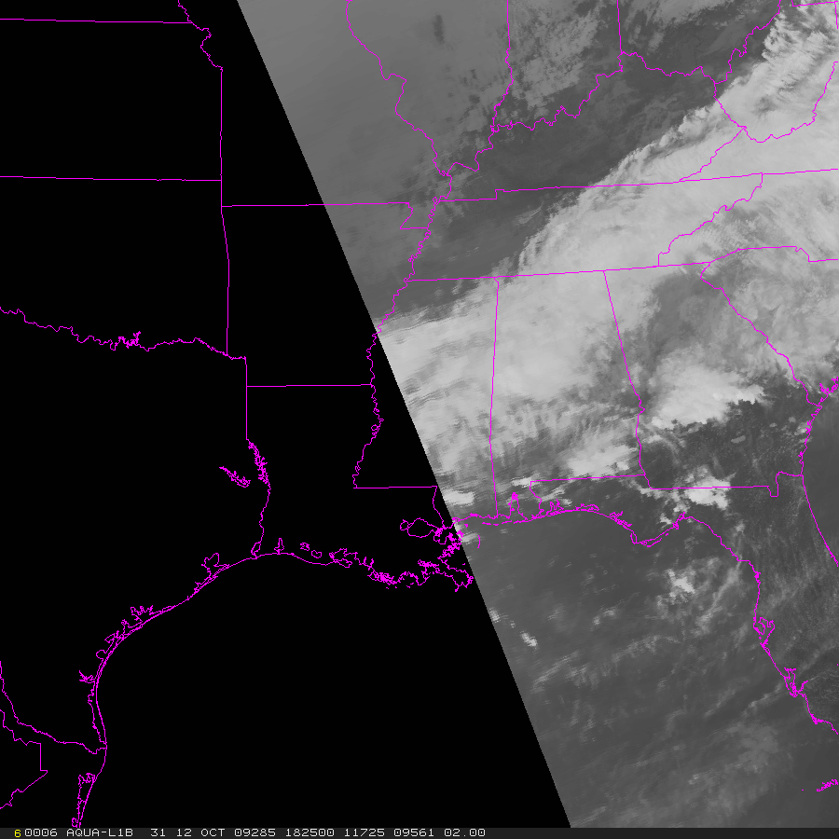
Classic MODIS situation
MODIS IR 1km – 1825Z, Oct 12, 2009

Slide 14
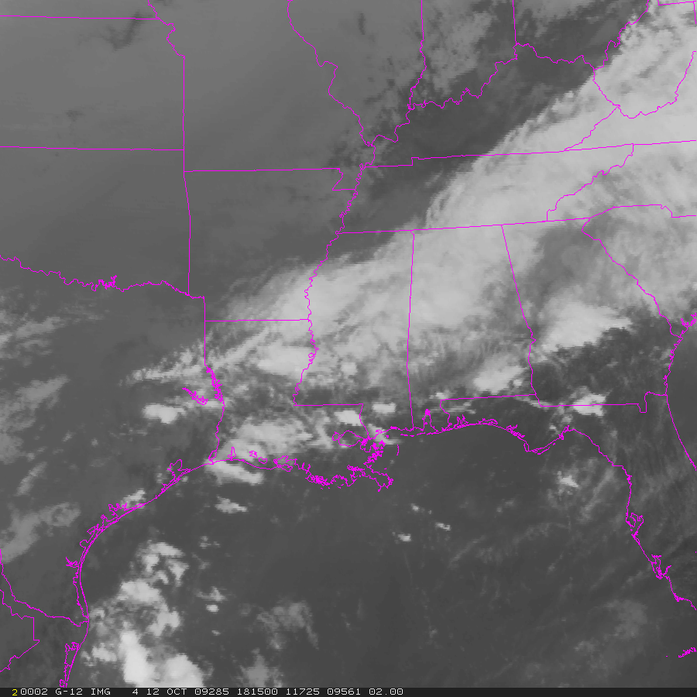
The standard: GOES
GOES IR 4km – 1815Z, Oct 12, 2009

Slide 15
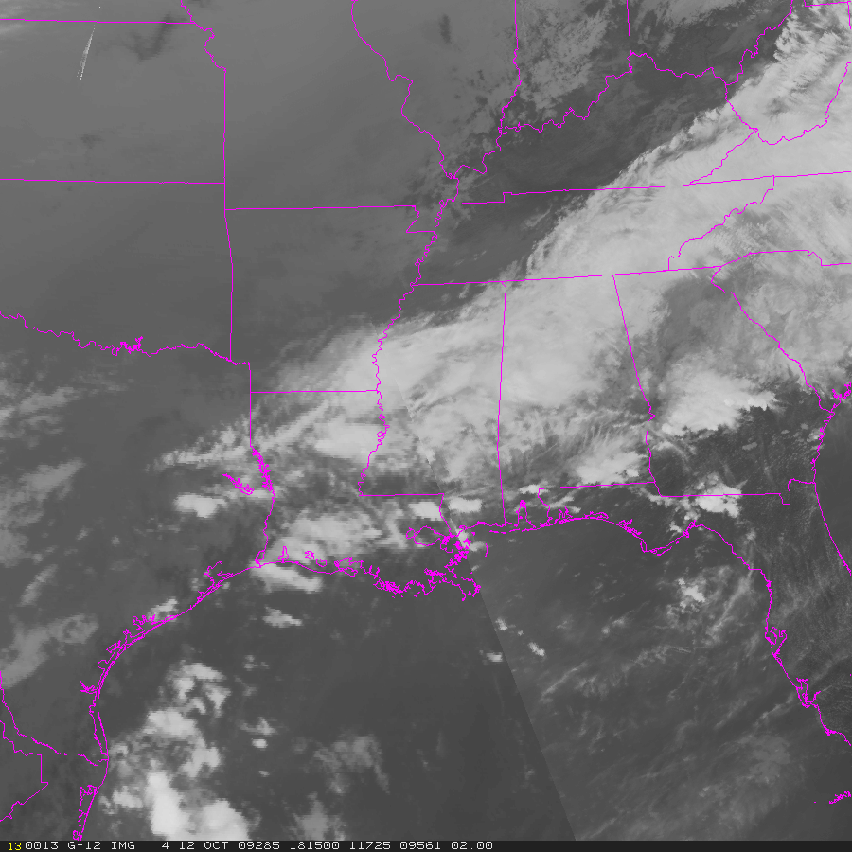
A solution: MODIS/GOES hybrid
MODIS/GOES IR 1km – 1815Z, Oct 12, 2009

Slide 16
AWIPS – Image Combination
In AWIPS - a GOES and MODIS image can be combined in D2-d, but transparency of each blurs the high resolution detail from MODIS
In AWIPS II, we are able to pan and zoom freely.

Slide 17
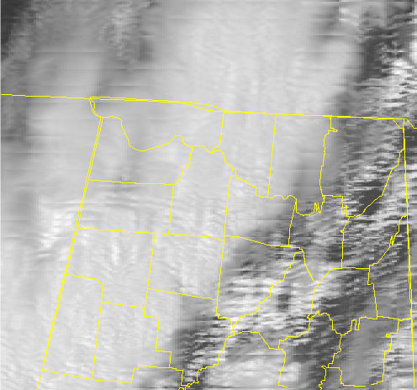
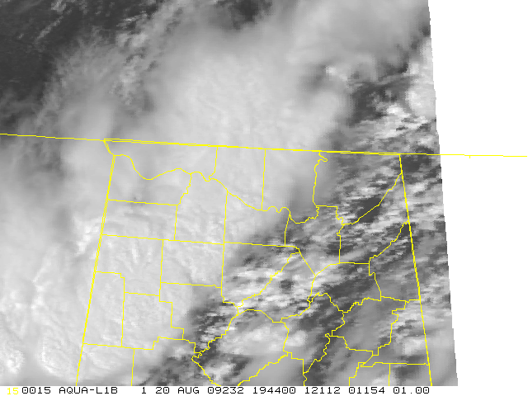
MODIS Bowtie Correction
Edges of the MODIS swath suffers from “bowtie effect”
McIDAS algorithm being used to fix bowtie in near real-time
Returns the full image to a usable state at county level scales
1944 Z MODIS 500m VIS original image
1944 Z MODIS 500m VIS after bowtie fix

Slide 18
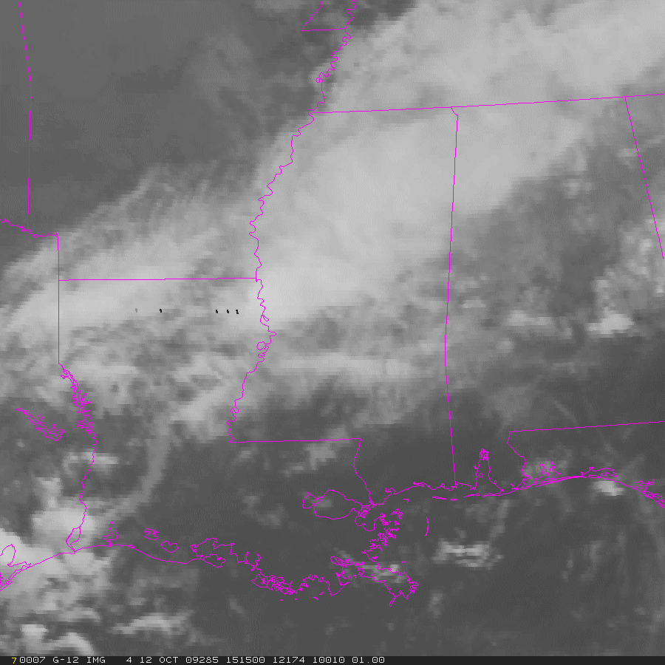

Looping makes the difference
GOES IR 4km
1515-2115Z, Oct 12, 2009
MODIS/GOES Hybrid IR 1km
1515-2115Z, Oct 12, 2009
Notes:
Putting on the glasses

Slide 19
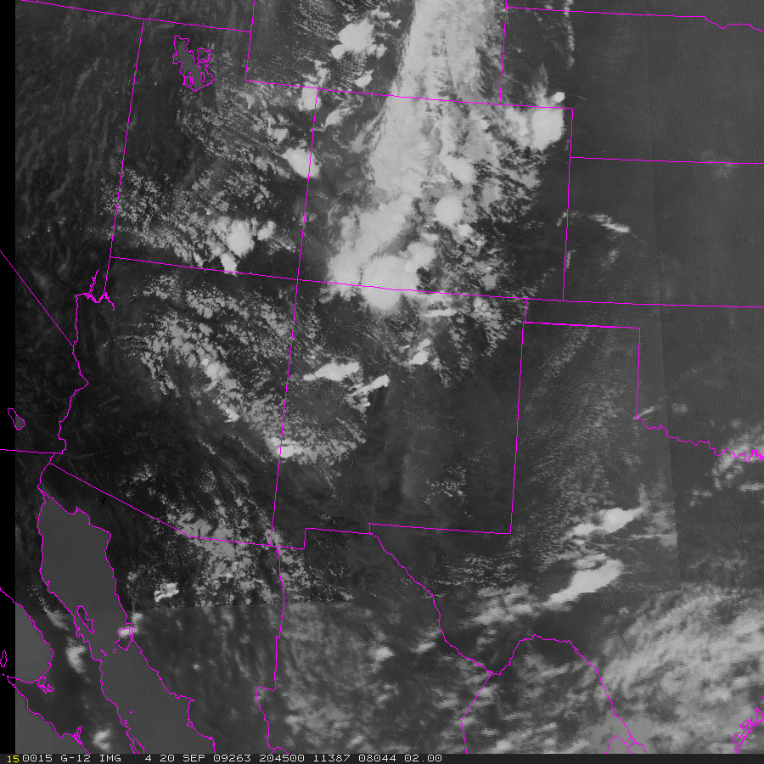
MODIS/GOES Hybrid as proxy to ABI
1445Z – 2045 Hybrid with bowtie correction
“Near real-time” product being produced half-hourly for
IR (11um):
4km GOES / 1km MODIS
VIS :
1km GOES / 500m (250m) MODIS
Water Vapor:
4km GOES / 1km MODIS
Alternate to case-based proxy data work being done by others, but SPoRT is open to other real-time products for PG users
Showcases capabilities of AWIPS II
Notes:
Pull out one image

Slide 20
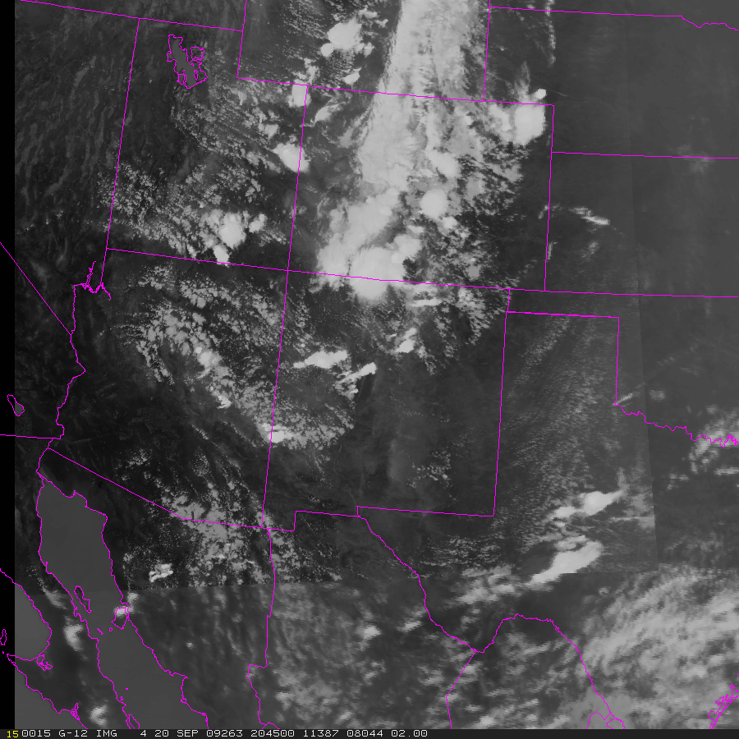
MODIS/GOES Hybrid as proxy to ABI
2045Z Hybrid with bowtie correction
Image over CO has greater detail - for diagnosis of convection
GOES fills in the regional view for continuity
MODIS
GOES
GOES

Slide 21
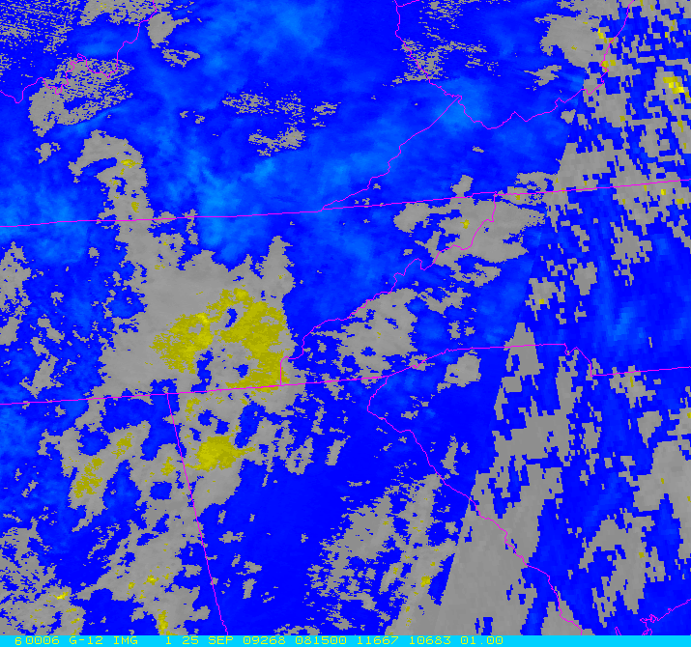
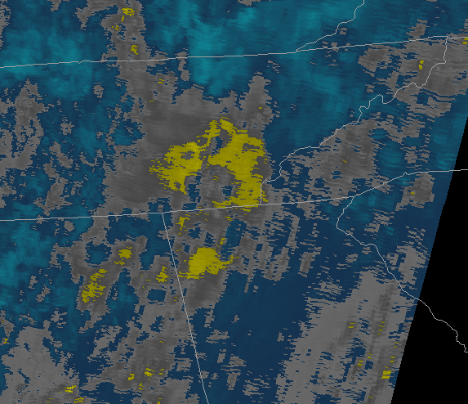
MODIS/GOES Hybrid for Derived Products
0815Z Hybrid of “Fog” product, bowtie fixed
Presently, producing half-hourly 11µm hybrid
Future, look to derived products such as the fog or TPW, etc.
Long Range, develop a hybrid of a multi-channel product
MODIS in AWIPS without fix

Slide 22
GOES-R PG Future Work
  Transition and evaluation of proxy products from PG members to forecast issues of S/SE WFOs
  Contribute expertise on total lightning in operations based on partnerships with AWG and RR and past work over several years with WFOs
  Use of proxy data for multi-channel or composite product development, as needed for S/SE forecast issues (comments have been positive)
  Lightning threat forecast product from WRF-ABI run
  Integrate into new AWIPS II DSS
  Use both real and proxy data to understand impacts of data assimilation / model initialization
  Assist in SPC Spring Programs

Slide 23
Questions?

Slide 24
Backup slides

Slide 25
Transition Efforts
(the SPoRT Paradigm)
Match products to problems
Make products available to forecasters in their DSS
Develop and implement product training
Conduct assessment on utility of product in operations
Document usefulness of product to address specific forecast need
Examples of transitioned products include MODIS SST and Fog products, GOES aviation products, and CIRA TPW.

Slide 26
MODIS/GOES Hybrid as proxy to ABI
1445Z – 2045 Hybrid with bowtie correction
GOES provides the background to more smoothly loop the data
Higher resolution MODIS inserted at closest time to simulate what ABI would provide.
Difference in quality from 4km and 1km data is readily apparent
MODIS data in 1845Z and 2045Z

