Slide 1


SPoRT Numerical Modeling Work: Current and Future Activities
Jonathan Case
SPoRT / NWS Partner Workshop
3 March 2010
transitioning unique NASA data and research technologies to operations

Slide 2
Key Focus Areas
SST Impact Studies
  WRF Environmental Modeling System (EMS)
  Gulf of Mexico/Atlantic regions/Great Lakes (new)
Land Surface Modeling
  Improved model initializations
  Land surface fields for diagnostic purposes
Experimental WRF output fields
Contributions to WRF EMS
Evaluating Cloud Microphysics Schemes
transitioning unique NASA data and research technologies to operations

Slide 3
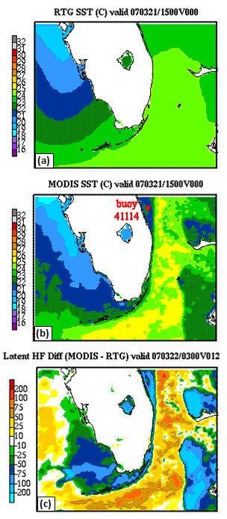
SST Impact Studies
Miami, FL multi-month model sensitivity
  4-km WRF-NMM model within EMS
  RTG vs. MODIS initialization; Feb−Aug 2007
  Case studies and point verification statistics
Enhanced SPoRT SST composite
Additional real-time impact case studies
  SPoRT partners currently using MODIS SSTs
  in WRF EMS
NSSL/WRF multi-month parallel runs
  May to Aug 2009
  Verification using NCAR/MET tools
transitioning unique NASA data and research technologies to operations

Slide 4
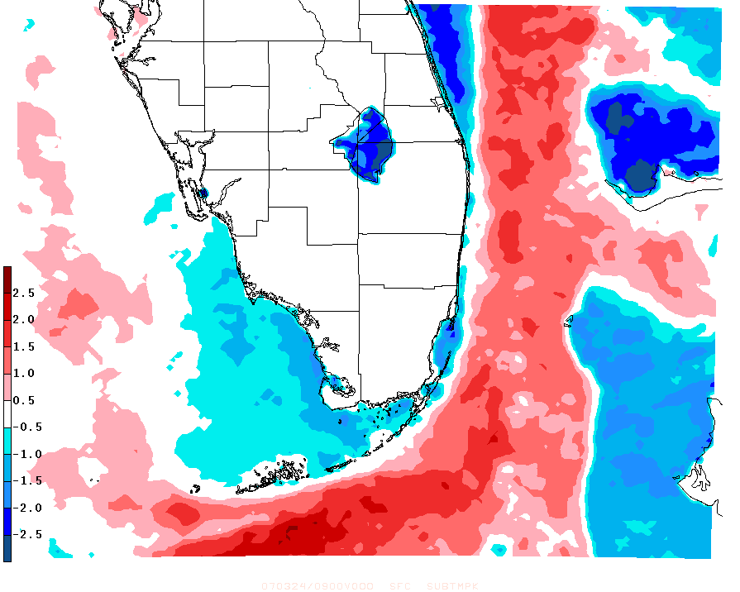
Miami, FL Case Study: 24 March 2007
(NE Flow Surge Case)
Enhanced cold to warm SST gradient (in easterly flow)
MODIS – Control Sea Surface Temperature [°C]
24 Mar 2007 0900 UTC Simulation
transitioning unique NASA data and research technologies to operations

Slide 5
Miami, FL Case Study: 24 March 2007
(14-h Forecast Divergence Impact)
Under easterly flow, near-surface winds cross from cooler to warmer SSTs in the MODIS run
Winds accelerate and result in enhanced surface divergence
Consistent with LaCasse et al. 2008 findings
transitioning unique NASA data and research technologies to operations

Slide 6
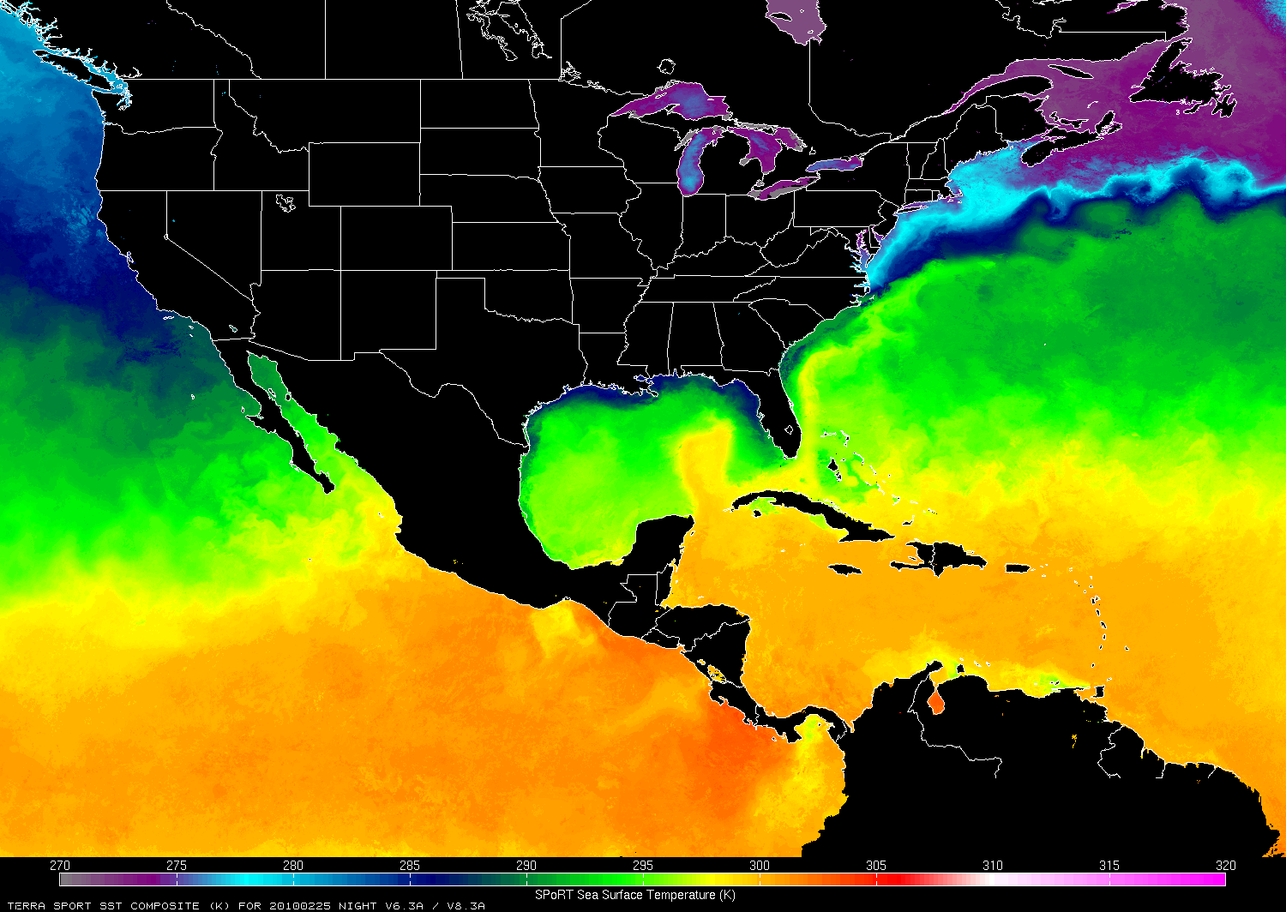
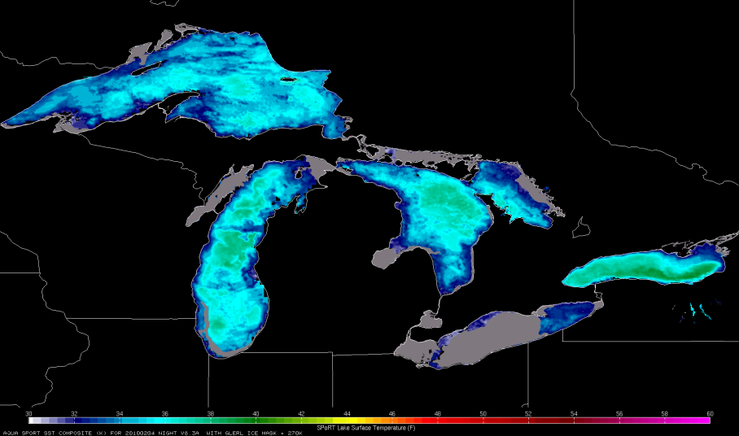
Enhanced SPoRT SST Composite
Multi-sensor technique
  MODIS + AMSR-E + OSTIA
  Reduced latency
  Reduced SST errors
Full-resolution, 1-km spacing
Special analysis over Great Lakes
Default option in WRF EMS v3.1
NOAA/GLERL Ice Mask
transitioning unique NASA data and research technologies to operations

Slide 7
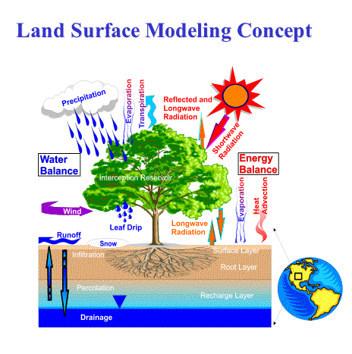
Land Surface Modeling with LIS
NASA Land Information System (LIS)
  Overview of LIS
  LIS output to initialize WRF model
Precip Verification Study over SE U.S.
  LIS land surface initialization vs.
  interpolated NAM
  Application of non-standard
  verification methods
Real-time LIS/Noah at SPoRT
  Output to initialize WRF EMS runs
  Diagnostics for NWS BHM CI study
transitioning unique NASA data and research technologies to operations

Slide 8
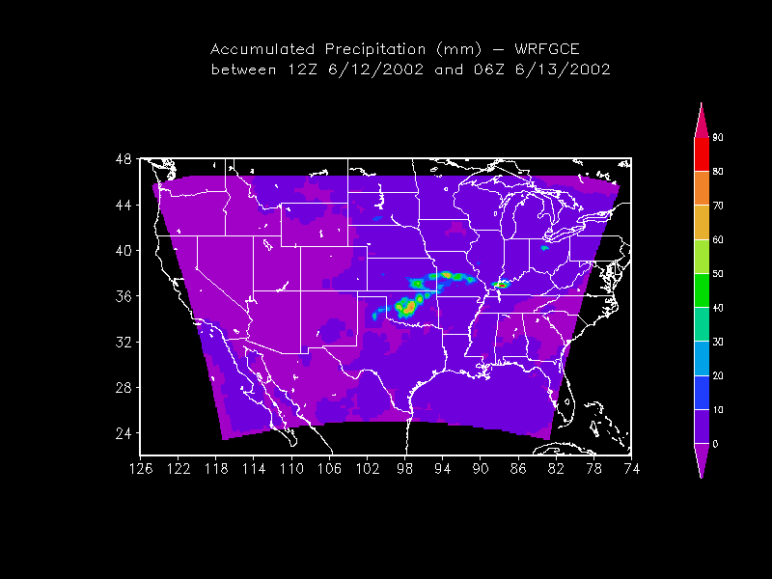
High-Level Overview of LIS
Uncoupled or
Analysis Mode
Coupled or
Forecast Mode
Station Data
WRF
Global, Regional
Forecasts and
(Re-) Analyses
ESMF
Land Surface Models
(LSMs)
Noah,VIC, SIB, SHEELS
Satellite Products
Data Assimilation
(θv, LST, snow)
LSM First Guess /
Initial Conditions
transitioning unique NASA data and research technologies to operations

Slide 9
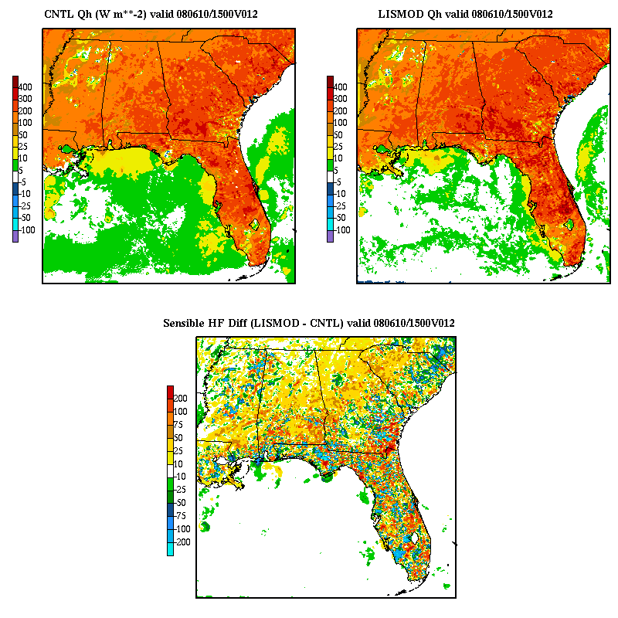
10 Jun 2008 Comparison
0-10 cm soil moisture Sensible heat flux

Slide 10
MET/MODE 1-h Precip Object Verification:
(Un-)Matched Differences by Model Run, 12−24 h Forecasts
Quantity (mean # grid points per model run) | Control | LISMOD | Difference (LISMOD – Control) | % Change
5-mm Matched | 11,911 | 12,045 | 134 | 1.1%
5-mm Unmatched | 17,750 | 17,175 | -575 | -3.2%
10-mm Matched | 2,456 | 2,562 | 106 | 4.3%
10-mm Unmatched | 6,798 | 6,538 | -260 | -3.8%
25-mm Matched | 60 | 60 | 0 | 0%
25-mm Unmatched | 549 | 505 | -44 | -8.0%
Quantity | # Forecasts Improved | # Forecasts Degraded
5-mm matched | 39 | 41
5-mm unmatched | 56 | 25
10-mm matched | 37 | 39
10-mm unmatched | 48 | 33
25-mm matched | 13 | 8
25-mm unmatched | 46 | 32
transitioning unique NASA data and research technologies to operations

Slide 11
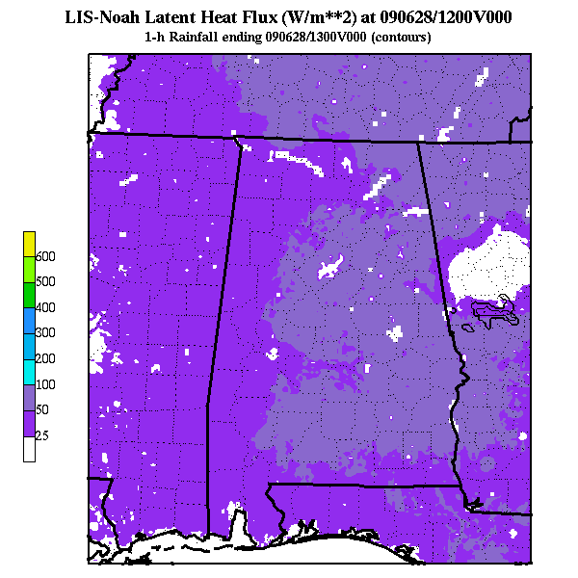
Real-time LIS/Noah at SPoRT
3-km LIS over southeast U.S.
  Spin-up run; restarts 4x per day
  Hourly output posted to ftp site
LIS option in WRF EMS, v3.1
LIS output for diagnostics
  Readily displayable in AWIPS II
  NWS BHM: Convective initiation
  Other short-term forecasting issues
  (low temps, fire weather, etc.)
Future plans
  Expand 3-km to near CONUS
  1-km high-res nest for BHM CI study
transitioning unique NASA data and research technologies to operations

Slide 12
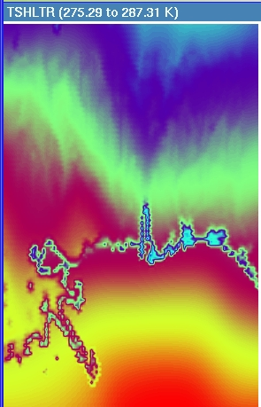
Improved Initial 2-m Temp in WRF EMS (NMM) using SPoRT SSTs and Land Surface fields
LAPS/NAM
transitioning unique NASA data and research technologies to operations

Slide 13
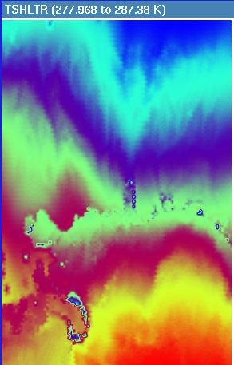
Improved Initial 2-m Temp in WRF EMS (NMM) using SPoRT SSTs and Land Surface fields
LAPS + SPoRT SSTs
transitioning unique NASA data and research technologies to operations

Slide 14
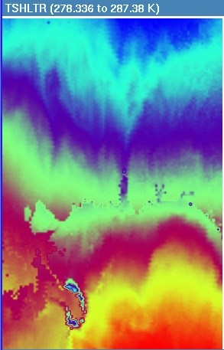
Improved Initial 2-m Temp in WRF EMS (NMM) using SPoRT SSTs and Land Surface fields
LAPS + SPoRT SSTs
+ LIS Tskin
transitioning unique NASA data and research technologies to operations

Slide 15
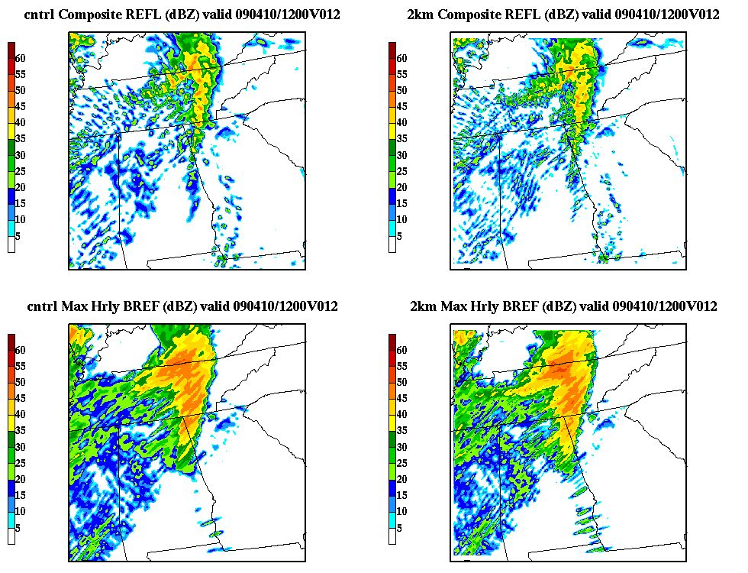

Experimental WRF Output Fields:
10 Apr 2009 Hail/Tornado outbreak
transitioning unique NASA data and research technologies to operations

Slide 16
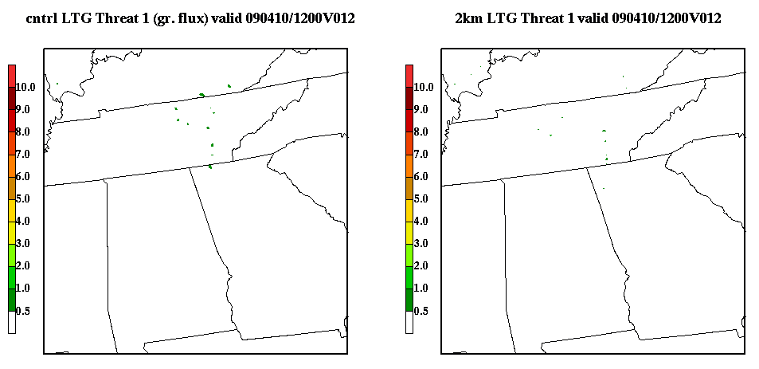
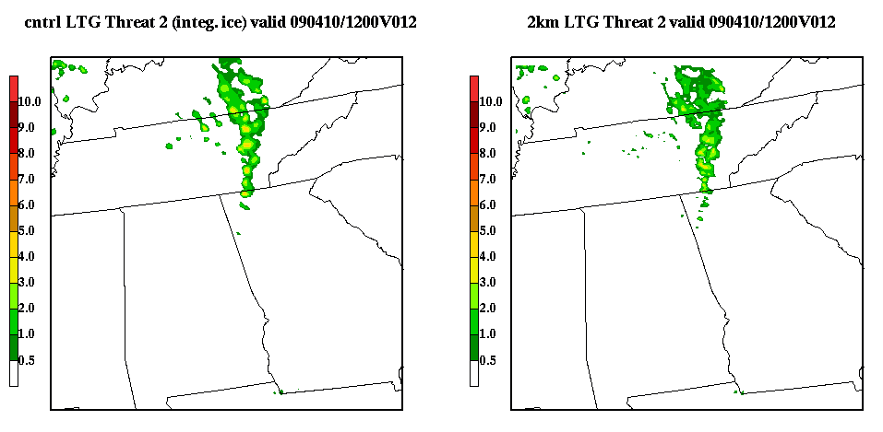
Experimental WRF Output Fields:
10 Apr 2009 Hail/Tornado outbreak
transitioning unique NASA data and research technologies to operations

Slide 17
Contributions to the WRF EMS v3.1
Access to SPoRT datasets for initializing model
  High-res, 1-km SST datasets (--sfc sstsport)
  LIS land surface initialization fields (--lsm lis)
  Great Lakes sea ice mask (--sfc icegl)
Experimental output fields (Dembek – ARW core)
  Max output interval base reflectivity
  Max output interval 10-m wind speed
  Max output interval updraft helicity
  Max output interval updraft/downdraft speed
  Forecast lightning threats* (currently NSSL/WRF only)
transitioning unique NASA data and research technologies to operations

Slide 18
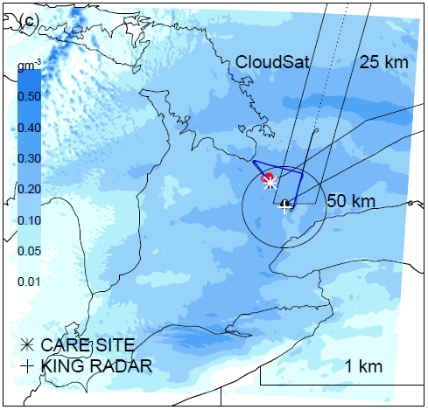
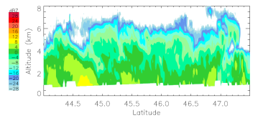
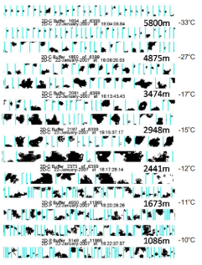
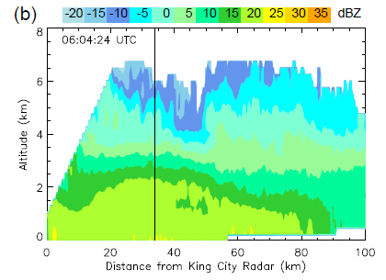
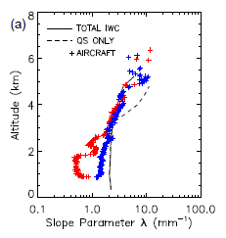
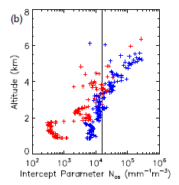
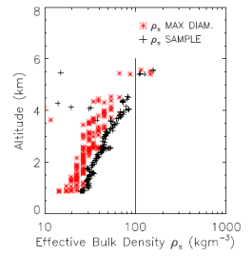
Evaluating Cloud Microphysics Schemes in the WRF Model
Problem Statement
High resolution forecast models employ various microphysics schemes with diverse assumptions
These assumptions require validation, to ensure that resulting QPF and cloud prediction is physically correct
Objectives
Evaluate the performance of assumptions within the NASA Goddard single-moment microphysics scheme
Identify opportunities for improvements, and determine means for implementing changes
Assumptions Evaluated / Suggested Changes
Spherical shape assumption for crystals is not supported by observations
    Move to non-spherical mass-diameter relationships
    Allows for variable density of snowfall
Use of a fixed distribution intercept lacks vertical variability
    Allow for temperature dependence to improve the representation of naturally occurring size distributions
WRF + NASA Goddard Scheme
CloudSat
King City C-Band Radar
Aircraft Measurements
λ
N_{os}
ρ_{s}
Snow Crystal Size Distributions and Bulk Density vs. Assumptions
Evaluating the snow crystal assumptions currently made within the NASA Goddard scheme.
transitioning unique NASA data and research technologies to operations

Slide 19
Exploring New Microphysics Schemes in the WRF Model
Problem Statement
QPF is sensitive to ice processes, related to properties of crystals and graupel
New schemes use non-spherical crystal shapes and improved representation of riming
SPoRT can evaluate by leveraging NASA data
Top
SUNY Stony Brook scheme where snow properties are locally modified by riming where cloud water is present
Bottom
University of Washington scheme that predicts 7 crystal habits (3 shown) that contribute to snow, with separate effects for riming
DENDRITES
SECTOR PLATES
“COLD TYPE”
TOTAL SNOW CONTENT
Each figure is from a 60 minute WRF simulation of an idealized 2D squall line.
transitioning unique NASA data and research technologies to operations

