Slide 1
Use of MODIS SST for Space Shuttle Operations Support
March 3, 2010
SPoRT Collaborative Partners Workshop
Brian Hoeth – Lead Forecaster
NWS Spaceflight Meteorology Group
Johnson Space Center, Houston, TX

Slide 2
Presentation Outline
Overview of SMG Shuttle operations
  “This is who we are and this is what we do”
  NASA Weather Flight Rules
General Use of MODIS SST
  Offshore stratocumulus -> low cloud ceilings
  Offshore showers
  “AFD” examples
SST example during Shuttle launch operations
  Snapshot pictures of IR Satellite and MODIS SST
  Audio Clip of Weather Briefing to NASA Flight Director
  Satellite Loop of what happened

Slide 3
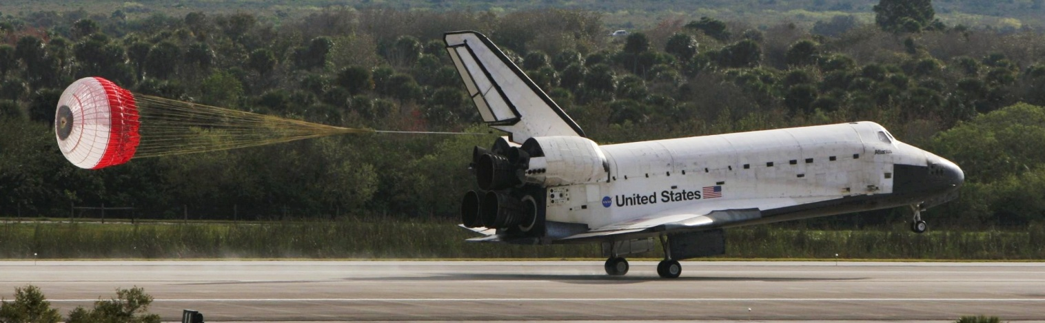
SPACEFLIGHT METEOROLOGY GROUP
Quick Look
DOC / NOAA / NWS Unit
  Reimbursable agreement between NASA and NOAA / NWS
  5 Lead Forecasters, 3 Technique Development Unit Meteorologists,
  MIC, Admin Assistant
Forecasts and Weather Support for Shuttle Landings and Simulations
  Launch Aborts (CONUS and TAL); On-orbits; End-of-Mission landings
  Upper wind forecasts for ascent loads and descent analysis
  Briefings to Flight Directors, Astronauts, Mission Management Team
  Weather documentation and verification

Slide 4
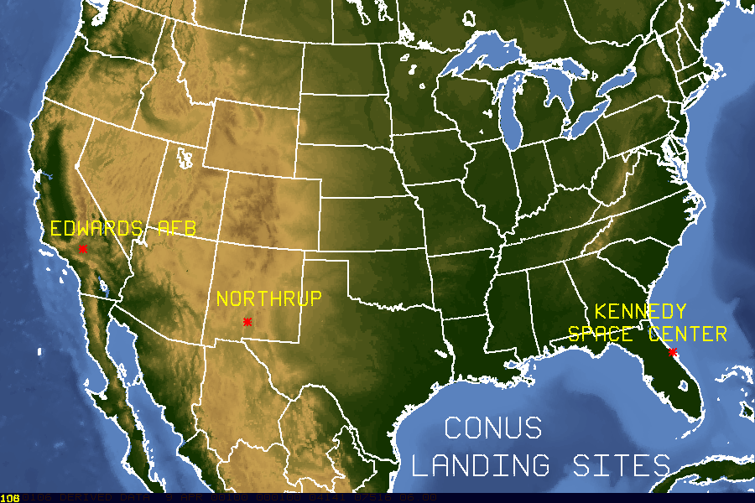
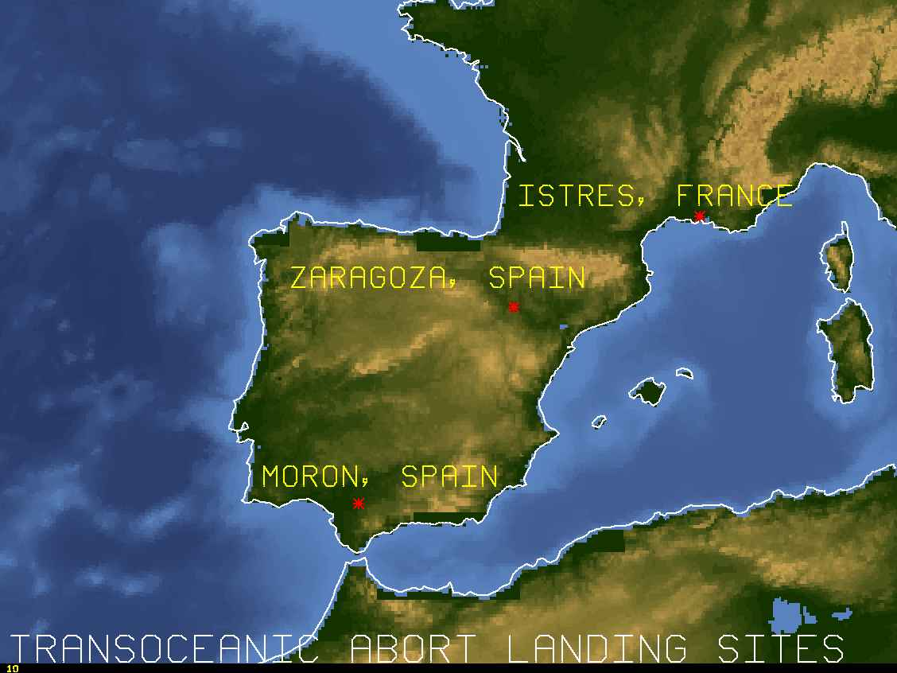
CONUS Landing Sites
Kennedy Space Center (KSC)
Edwards AFB, CA (EDW)
White Sands Space Harbor, NM (WSSH) -> Northrup Strip (NOR)
Transoceanic Abort Landing Sites (TAL)
Zaragoza, Spain (ZZA)
Moron, Spain (MRN)
Istres, France (FMI)

Slide 5
SHUTTLE WEATHER FLIGHT RULES
DAYLIGHT END OF MISSION (EOM) LANDING AT KENNEDY SPACE CENTER
NOTE: Flight Rules vary depending on landing site, day vs night, type of landing, and duration of mission.
* Cloud ceiling limits for Return to Launch Site (RTLS) on launch day >= 5,000 ft
** Precipitation limits for RTLS on launch day >= 20 nm
PARAMETER | LIMITS
Cloud Ceiling Height | *8,000 feet
Visibility | 5 Statute Miles
Crosswind | 15 knots
Headwind | 25 knots
Tailwind | 15 knots
Average vs. Peak Wind Difference | 10 knots
Precip / TSTM | **None within 30 nautical miles

Slide 6
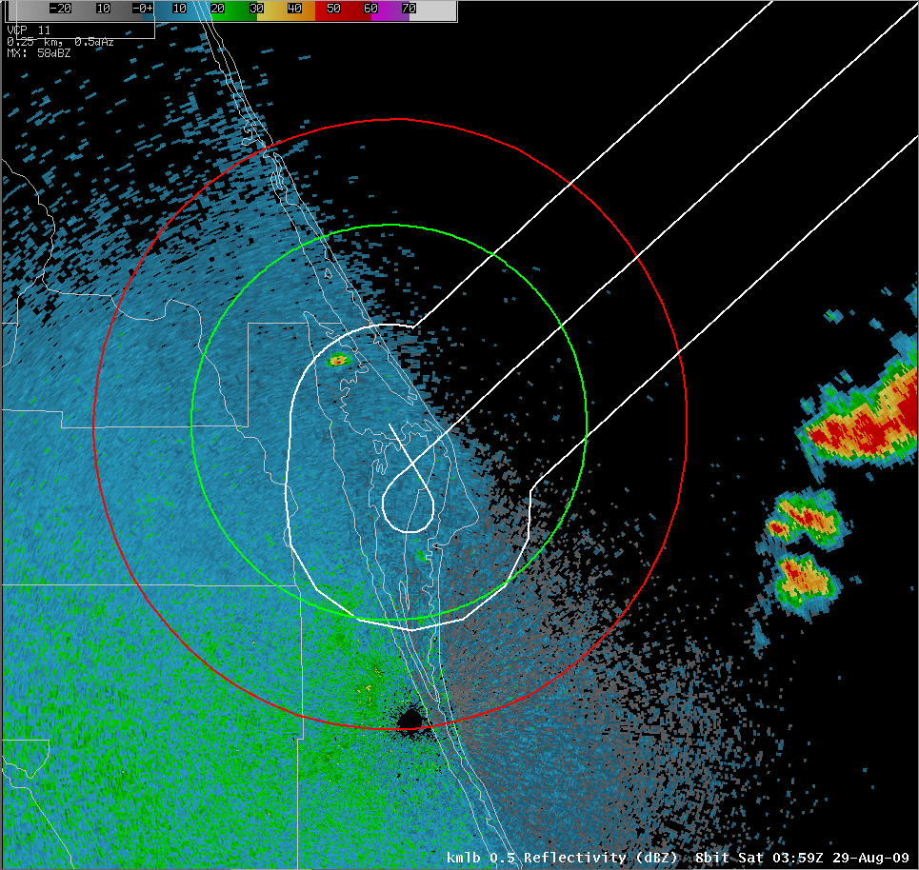
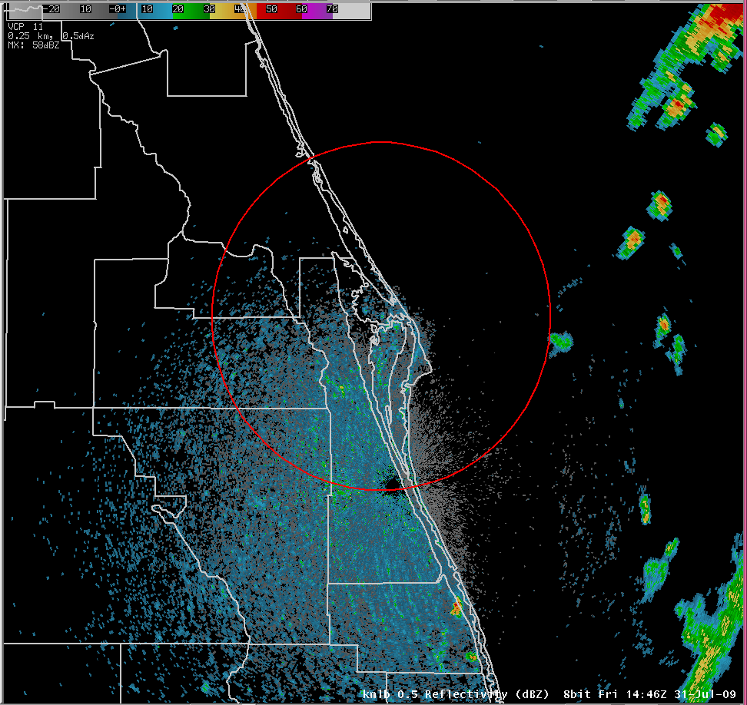
General Benefits of SST product
Stratocumulus clouds
Offshore stratocumulus clouds line up fairly well with the “Gulf Stream”
Rainshowers / Thunderstorms
“Gulf Stream” acts as a convergence boundary
High Pressure in Atlantic east of KSC -> southeast flow

Slide 7
In-House AFD Example #1
“Kind of interesting today with respect to clouds. Over the Gulf of Mexico...cloudy areas correlate very well with warmer SSTs however virtually no correlation between cloudy areas and warmer SSTs on the Atlantic side. Seeing no decrease in stratocu whatsoever coming over the cooler waters towards the western Florida coast. In fact...some areas are showing an increase in the stratocu as it approaches the coast. Obviously some other mechanism going on here...now if I can just figure it out!”
“Looking at LAPS soundings from just offshore...the inversion has lifted from around 4k feet at 12Z this morning when there were virtually no clouds over the cooler waters to around 8k feet this afternoon. Cross sections also show decent omega in the 4-8k foot range this afternoon with negative boyancy below this level. Maybe the higher the inversion...the less influence the cooler water has. “
“Now getting increasing line of showers along initial convergence line moving onshore with cloud tops to about 11k feet. Water vaport showing shortwave moving over east-central Fl so maybe this was mechanism for lifting the inversion. "

Slide 8
In-House AFD Example #2
“KSC...sfc high over OH continues to move east ward towards mid-Atlantic states. FL winds should begin the swing around to the east then south-southeast tonight. Aftn radar has has some -SHRA along the west wall of the Gulf Stream. Fading in and out with the SST composite and visible satellite shows this nicely. Mean steering flow overnight should parallel the coast so I don't expect any PCPN concerns for tonight although a stray -SHRA could skip barely inside 30 over the water. “

Slide 9
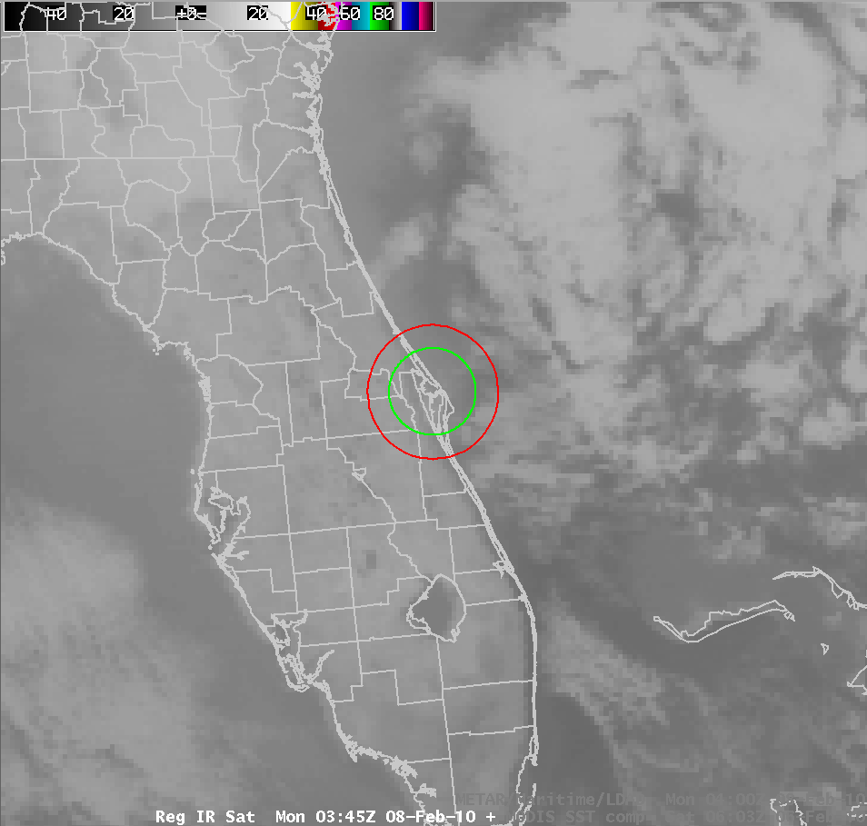
Stratocumulus/SST example

Slide 10
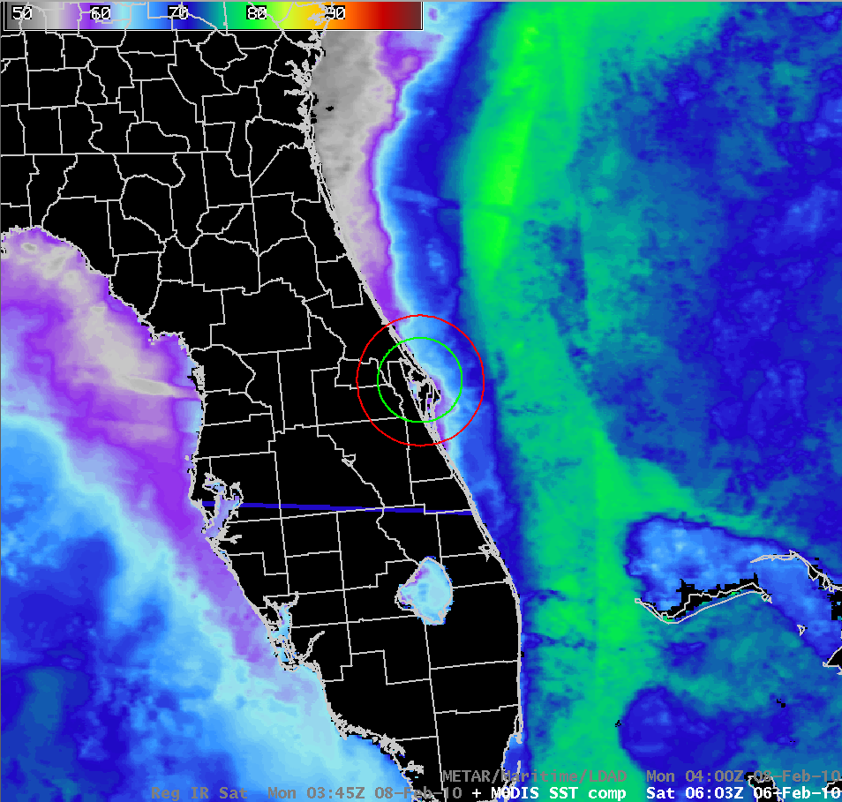
Stratocumulus/SST example

Slide 11
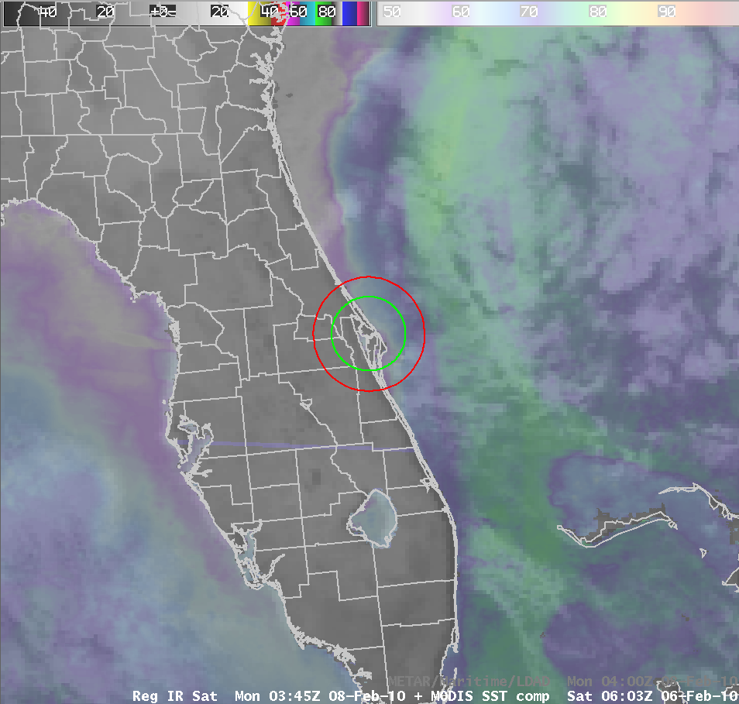
Stratocumulus/SST example

Slide 12

Audio Clip – 8 Feb 2010 Shuttle Launch
SMG Weather Briefing to NASA Flight Director
Example of associating offshore stratocumulus clouds to MODIS SSTs
  Flight Director prompts forecaster for SST data
  Forecaster fades the combined satellite and SST data in and out

Slide 13
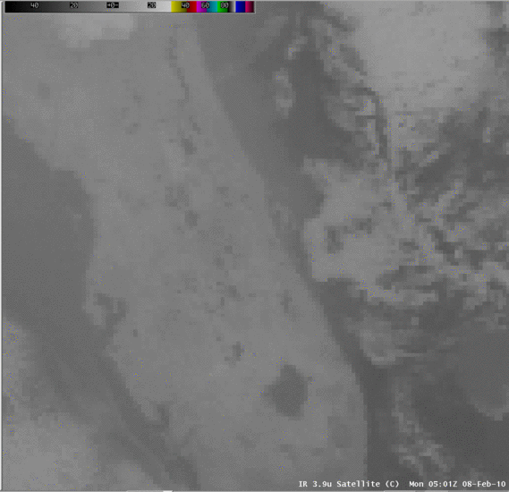
So What Happened?

Slide 14
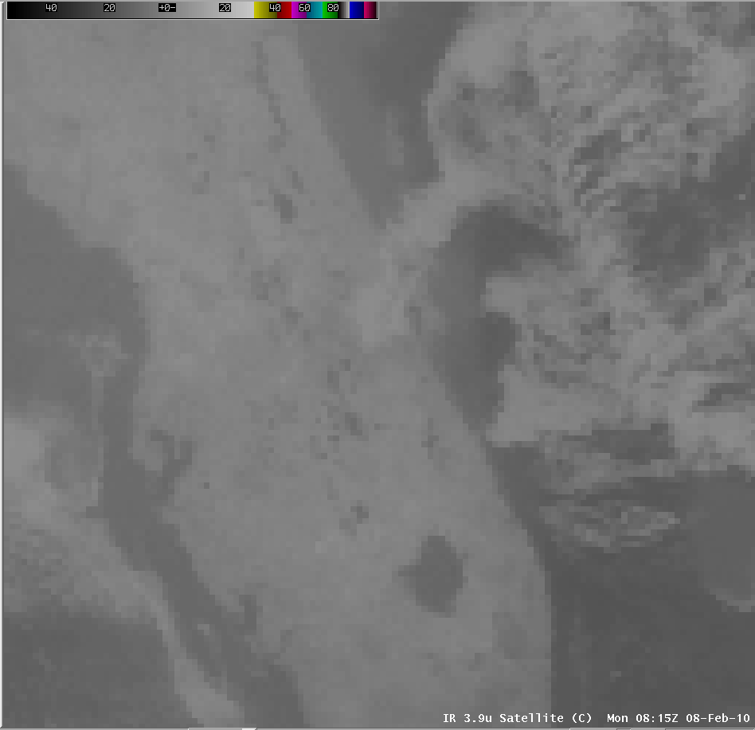
Launch-1 Hour Infrared (3.9 Micron) Satellite Image
0815 UTC on 02/08/10
~3,500 to 4,000 ft ceiling
moved through the Shuttle Landing Facility (KTTS) and the Cape Balloon Facility (KXMR)
Time (UTC) | KTTS | KXMR
0755 | BKN033 | BKN040
0810 | SCT035 | OVC039
0825 | SCT035 | OVC039
0840 | SCT035 | FEW040
0850 | BKN035 | CLR
0855 | BKN035 | FEW039
0900 | SCT038 | CLR
0905 | SCT039 | CLR
KTTS
KXMR

Slide 15
Summary
Using the SST product, SMG has been able to associate certain weather phenomena w/ the “Gulf Stream”
  Stratocumulus clouds / low ceilings
  Rainshowers / Thunderstorms
SST product very useful for SMG forecasters as visual aid!
  Fading in/out of satellite (or radar) + SST
  Used to brief NASA Flight Directors, astronauts, & other customers
Can’t explain away/answer all weather questions w/ SST
  SST good for general use, but oftentimes other phenomena in play
  WARNING! WARNING! ->
    Customer DOES try to use SST in situations that do not apply

Slide 16
Questions?/Suggestions?
Contact:
Brian.Hoeth@noaa.gov

