Slide 1
Use of MODIS False Color to Monitor Snowfall, Snow melt and Thermal Belts
Gina Loss – Service Hydrologist
Dave Bernhardt – Science & Operations Officer
Great Falls, Montana

Slide 2
Why MODIS to monitor snow and river ice?
Montana is rural with a low population density
Remote sensing best to appropriately determine the transition of snow cover and river ice in remote areas,
  Problem - Visible imagery does not clearly differentiate snow from clouds.
  MODIS false color composite does differentiate snow from clouds
Result is improved assessments of flooding potential with rapid melt and runoff
Notes:
The rural nature and low population density of Montana create difficulties in the evaluation of snowfall and river ice. Remote sensing provides the best opportunity to appropriately determine the transition of snow cover and river ice in remote areas, however, visible imagery does not clearly differentiate snow from clouds.
The Great Falls WFO (Weather Forecast Office) has been assessing the use of the MODIS (Moderate Resolution Imaging Spectroradiometer) false color composite created by the Short-term Prediction Research and Transition (SPoRT) Center at NASA/Marshall Space Flight Center to monitor snow cover and river ice. It is expected the false color composite can lead to improved assessments of flooding potential during post event conditions where rapid melting and runoff are anticipated.

Slide 3
MODIS False Color Composite
Composites one visible and two infrared channels
Highlights features with infrared signature differences
Snow and clouds have reflective differences above 1.4μm
  Especially near the 1.6μm and 2.13μm MODIS channels
Compositing a visible channel with these two infrared channels creates an image that distinguishes snow and clouds
Notes:
MODIS false color imagery composites one visible and two infrared channels to highlight features with infrared signature differences. Snow and clouds have reflective differences above 1.4μm, especially near the 1.6μm and 2.13μm MODIS channels. Compositing a visible channel with these two infrared channels creates an image that clearly distinguishes snow and clouds.

Slide 4
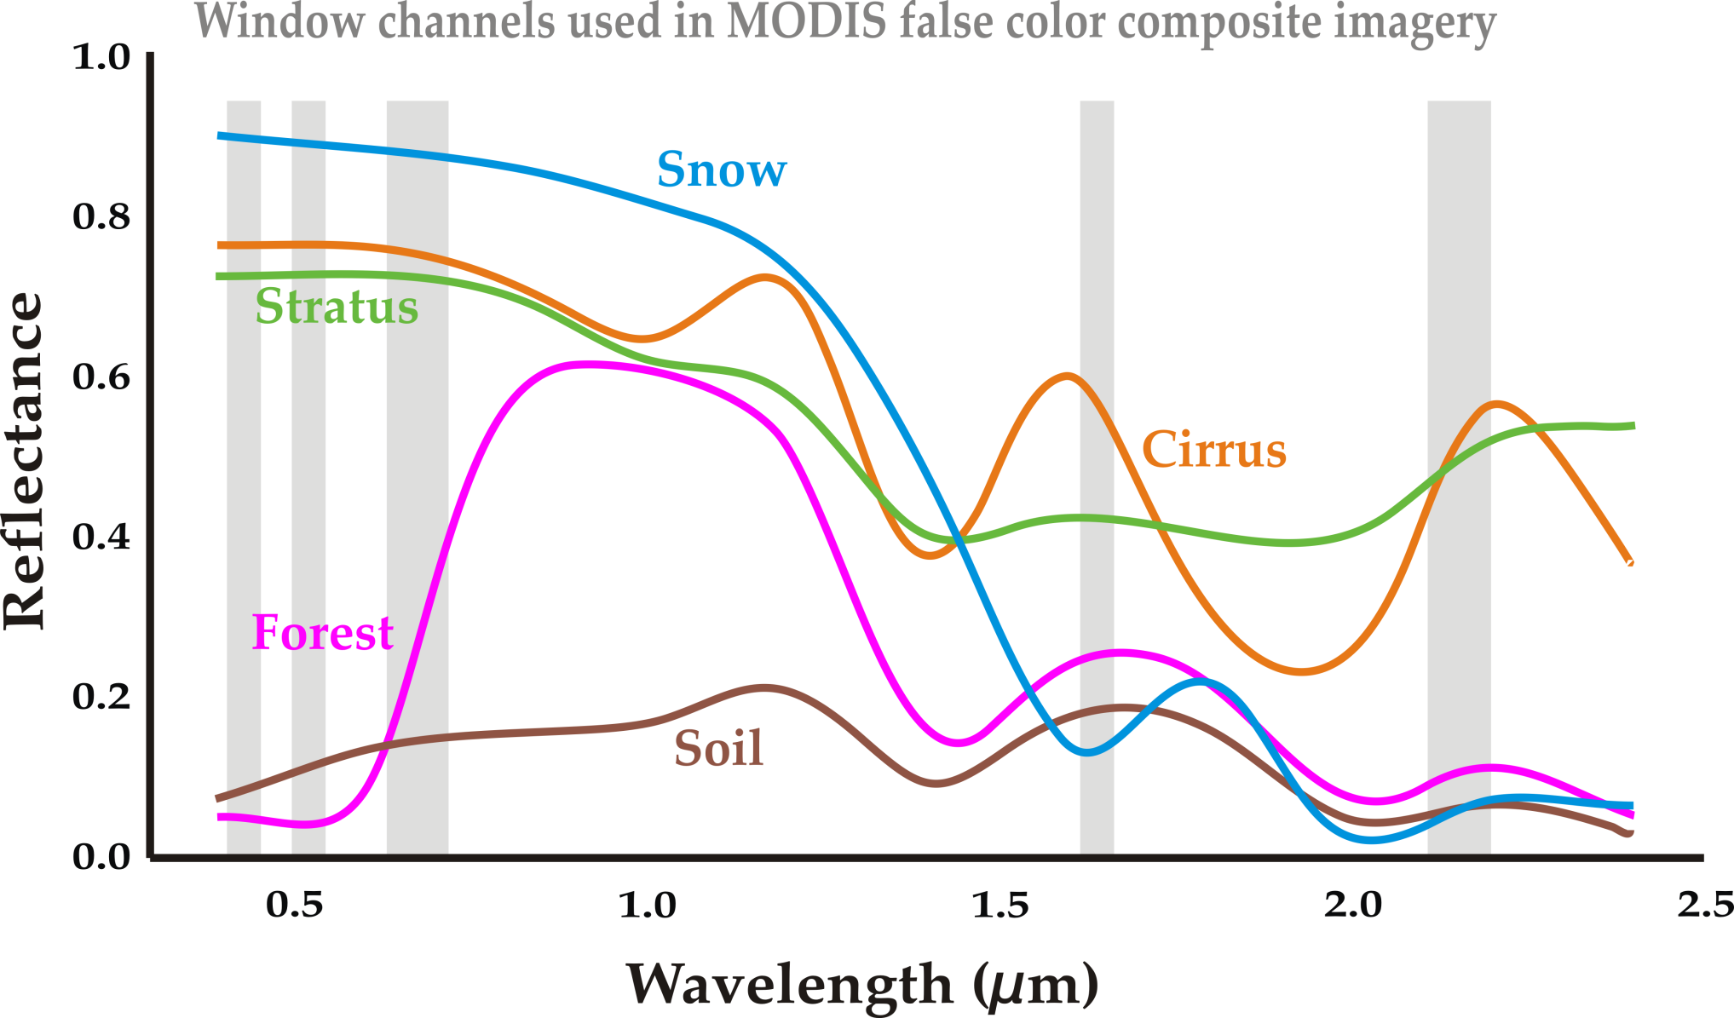
Notes:
Typical reflectance for naturally occurring features. Spectrally, snow is different from clouds at wavelengths greater than 1.4µm and particularly near the 1.6µm and 2.3µm MODIS channels.

Slide 5
Comparison to Other Satellites
 | MODIS | AVHRR | GOES
Spatial Resolution (meters) | 500 | 1000 | 1000
Channels used to produce snow products | 7 | 3 | 1 broadband
Images per day | 1-2 | 3-6 | 20
Notes:
MODIS offers an increase in spatial as well as spectral resolution over GOES (Geostationary Operational Environmental Satellites) and AVHRR (Advanced Very High Resolution Radiometer). The result is a detailed view of surface and atmospheric features.
Great Falls is at a relatively high latitude and at the edges of both GOES East and West. The remapping of data results in a north-south and east-west blurring of details. The 1000 meter resolution for the GOES is nominal and probably more appropriate for other areas… probably closer to 1500 meters for Montana.
GOES imagery can be looped to show stationary snow features vs. moving clouds, however, there are still issues with semi-stationary clouds such as fog, lenticular formations, and orographically induced stratus.

Slide 6
Comparison to Other Satellites
Montana at a relatively high latitude and at edges of both GOES East and West
  Remapping of data results in a north-south and east-west blurring of details
GOES imagery can be looped to show stationary snow features vs. moving clouds
  Still issues with semi-stationary clouds
    Fog
    Lenticular formations
    Orographically induced stratus
Notes:
MODIS offers an increase in spatial as well as spectral resolution over GOES (Geostationary Operational Environmental Satellites) and AVHRR (Advanced Very High Resolution Radiometer). The result is a detailed view of surface and atmospheric features.
Great Falls is at a relatively high latitude and at the edges of both GOES East and West. The remapping of data results in a north-south and east-west blurring of details.
GOES imagery can be looped to show stationary snow features vs. moving clouds, however, there are still issues with semi-stationary clouds such as fog, lenticular formations, and orographically induced stratus.

Slide 7
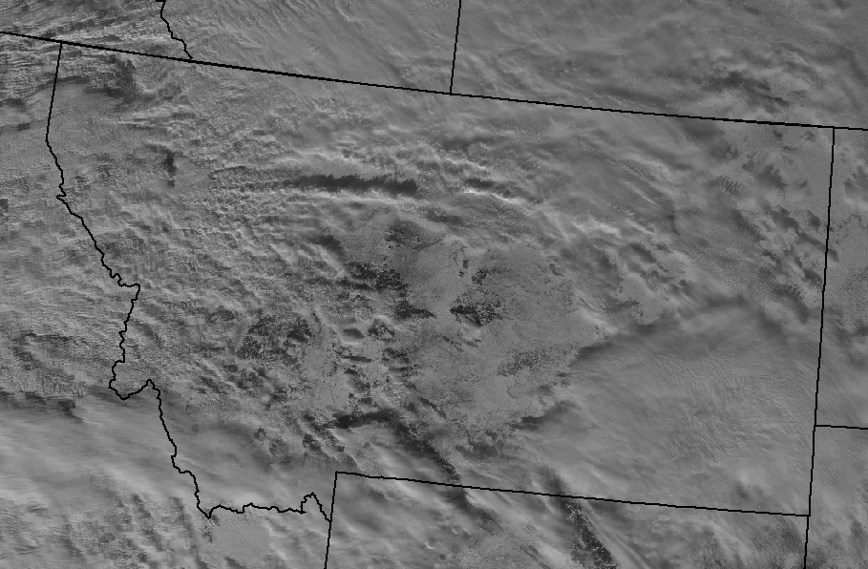
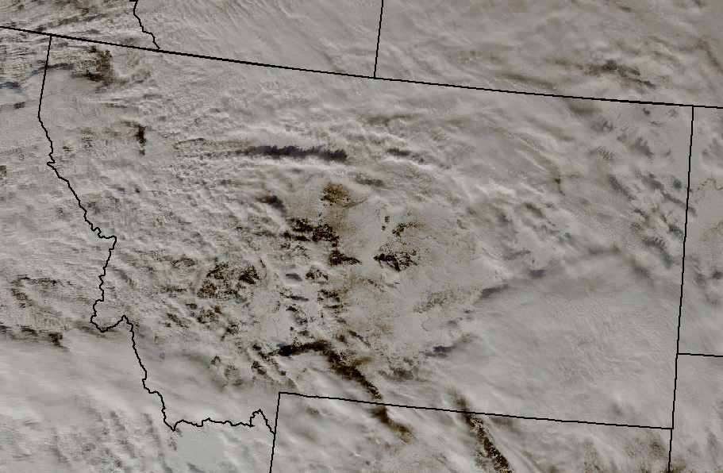
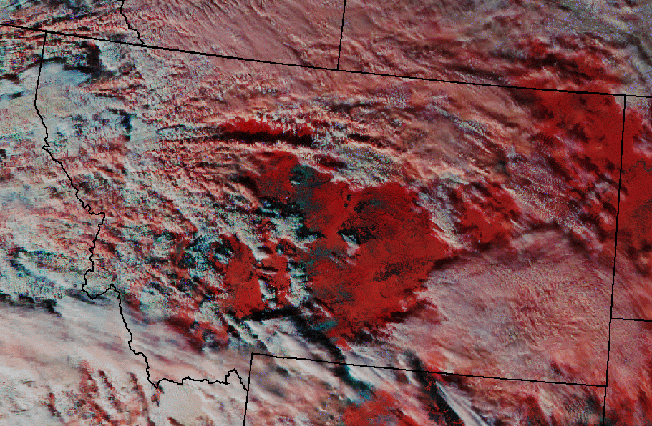
Assessment Samples
Clouds
Clouds
Bare Ground
Snow
Bare Ground
Snow
Snow in
Forest
Snow in
Forest
Snow
Cirrus
Snow
Cirrus
Clouds
Clouds
Visible Image
Natural Color Image
Clouds
Bare Ground
Snow
Snow in
Forest
Snow
Cirrus
Clouds
False Color Image
Notes:
Snap-shot comparison of snow and cloud cover as seen by MODIS visible, natural color and false color.
Visible image — White snow and clouds blend as they would if viewed by the human eye.
Natural color image — Composite of three visible channels. White snow and clouds blend, again, as they would if viewed by the human eye.
False color image — Composite of one visible and two infrared channels. Snow (red), clouds (white) and bare ground (blue-green) are distinct.

Slide 8
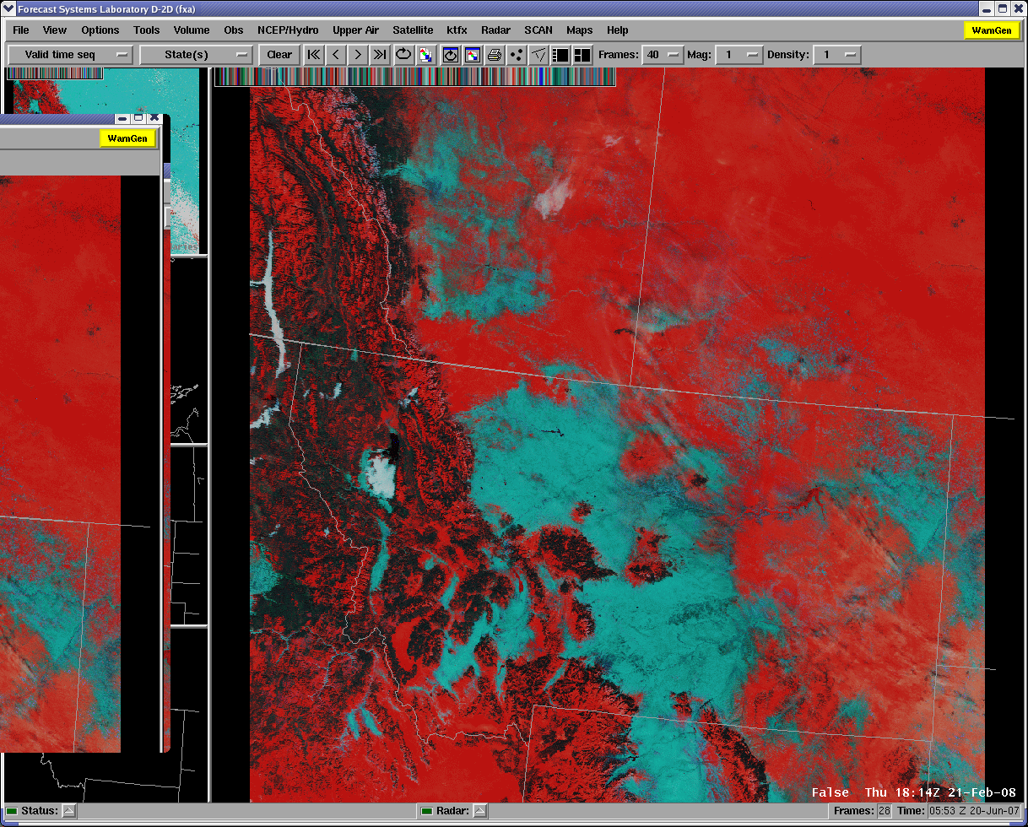
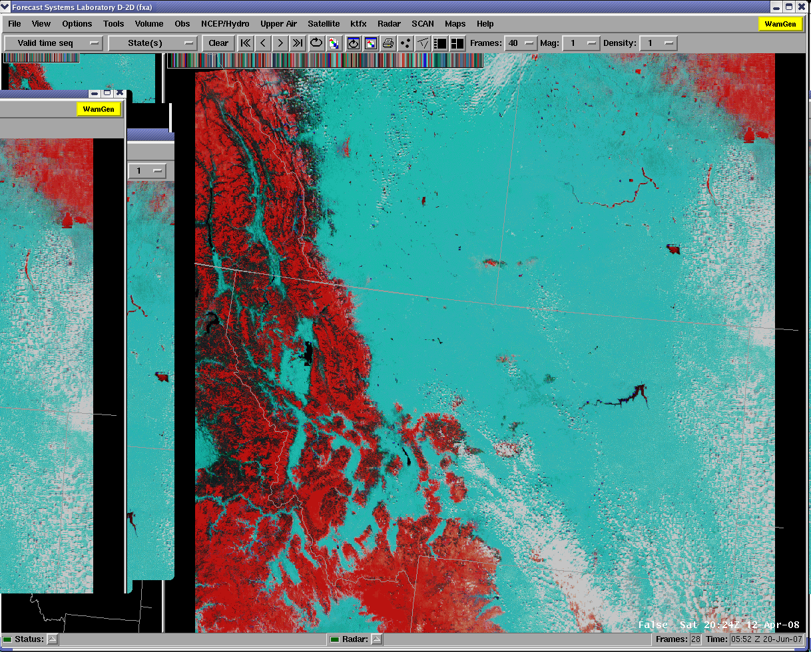
River Ice Monitoring Samples
Valley Fog
Bare Ground
Snow in Forests
Snow
Snow in Forests
River and
Lake Ice
Rotting River and
Lake Ice
Clouds
Bow-tie
Effect
Lake Ice
River Ice
Rotting
Lake Ice
Snow
Snow in Forests
Snow in Forests
Clouds
February 21, 2008
April 12, 2008
Notes:
Montana snow and river ice observations and comparisons using MODIS false color imagery February 21, 2008 (left) and April 12, 2008 (right).

Slide 9
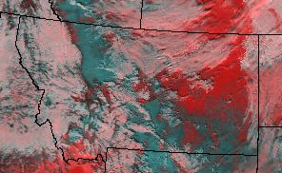
2004 Case Assessment
February 19, 2004
Milk River
Poplar River
Missouri River
Notes:
February 19, 2004
Widespread snow cover over northeast/east Montana. Observations show areas with snow depths of 2 feet or more and snow water equivalents of 6 to 8 inches. Significant flooding of Milk and Poplar Rivers forecasted with melt. Extensive briefing of emergency management officials begins.

Slide 10
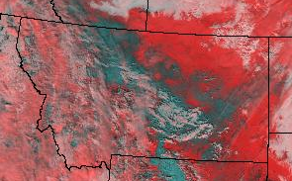
2004 Case Assessment
March 4, 2004
Milk River
Poplar River
Missouri River
Notes:
March 4, 2004
Snow melt beginning. Imagery shows significant loss of snow south of Missouri River. No flooding reported, however snow water content was not as great in this area as in northeast Montana. Concerns for flooding continue for northeast Montana.

Slide 11
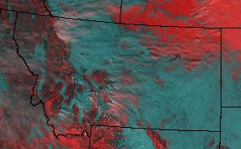
2004 Case Assessment
March 11, 2004
Milk River
Poplar River
Missouri River
Notes:
March 11, 2004
Melt not occurring uniformly. Snow south of Missouri and Milk Rivers virtually gone while widespread snow remains north. Skewed spatial distribution of melt and influx of water to rivers expected to reduce chances of significant river flooding.

Slide 12
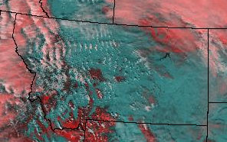
2004 Case Assessment
March 18, 2004
Milk River
Poplar River
Missouri River
Notes:
March 18, 2004
Imagery and observations show melt has slowed. Snow now gradually retreating north of the Missouri and Milk Rivers. Slowing of melt will allow more gradual influx of water to rivers, further reducing the chance of significant flooding.

Slide 13
2004 Case Assessment
March 25, 2004
Milk River
Poplar River
Missouri River
Notes:
March 25, 2004
Snow cover north of the Missouri and Milk Rivers nearly gone. During the course of the snowmelt event, only minor flooding occurred.

Slide 14
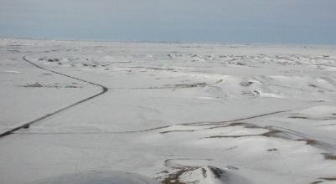
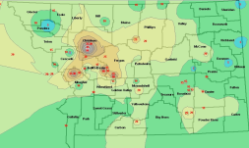
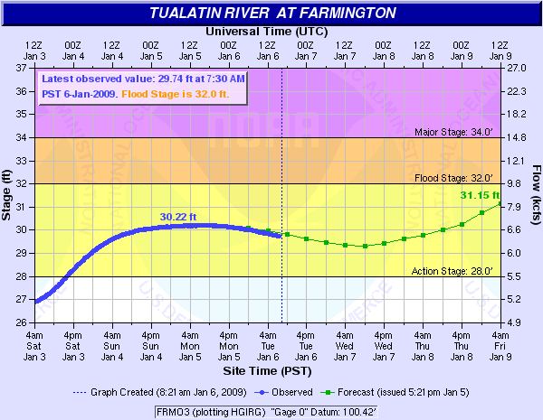
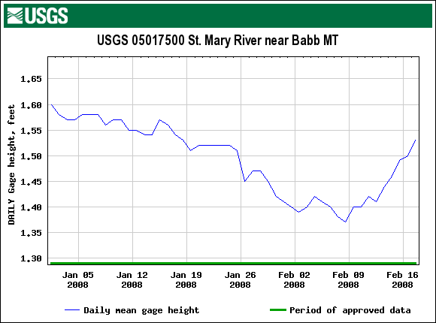
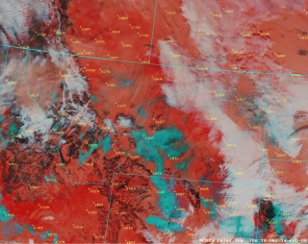
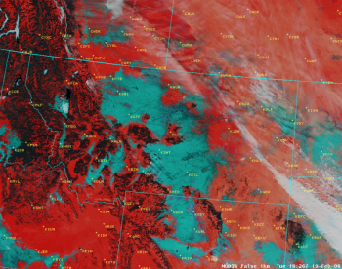
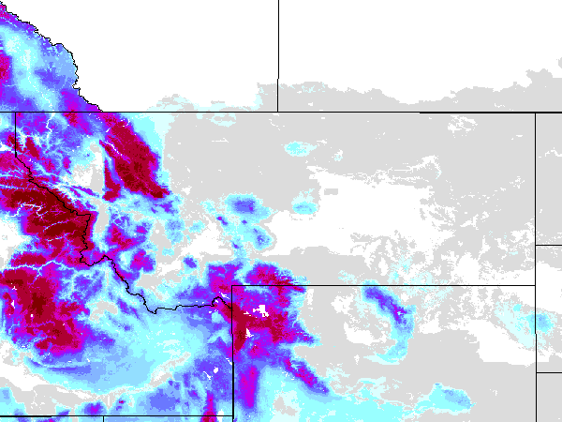
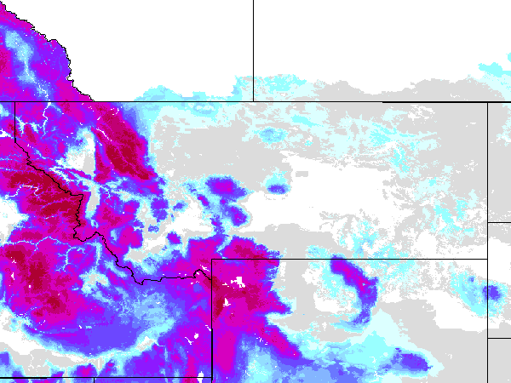
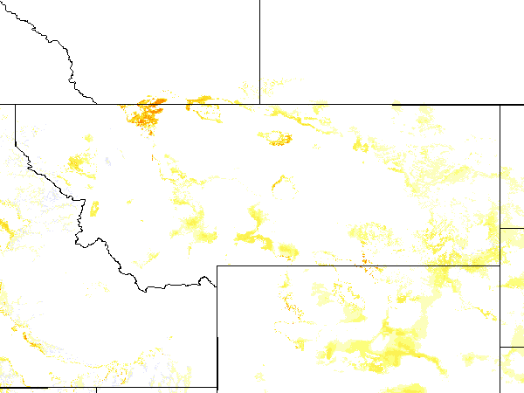
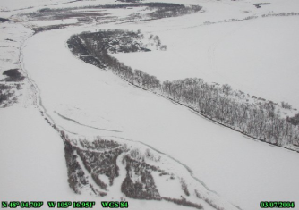
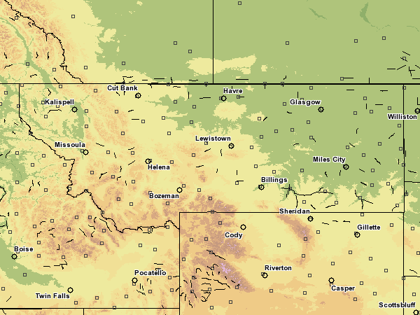
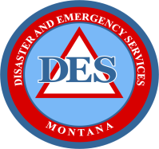
Assessment of Flooding Potential
Snow event
Monitor change in stream flow
Co-op Observations
Examine snow cover
USGS Streamflow
NWS Streamflow and Forecast
Illustrates stream flow/snowmelt relationship
Faster and more convenient
SNOTEL Reports
Satellite Imagery
Satellite Imagery
NOHRSC Model Snow Water
Equivalent
Facilitates monitoring 2-D change of snow cover
Benefits
provided by MODIS
False Color Imagery
Examine NOHRSC products
Corroborates NOHRSC snow model products
NOHRSC Model Snow Depth
Monitor change in snow cover and snow water equivalent
Saves human resources and increases safety
NOHRSC Modeled Snow Melt
Provides easily understood briefing tool
NOHRSC Aerial Survey
NOHRSC Flight Lines
Inform emergency management
Request survey
of remote areas

Slide 15
Findings - Advantages
Complete overview of snow cover extent
  High spatial and spectral resolution
  Information for areas void of surface data
  Indicates primary areas of concern when complemented with supplemental data from ground measurements
Often eliminates need for field surveys during potentially dangerous situations
Observation of snow cover transition
  Speed and extent of snowmelt provide insight to areas with possible flooding concerns
View of ice on rivers and lakes
  Ice formation and degradation provide insight on locations of possible ice jams and related flooding
Corroborates information provided by NOHRSC (National Operational Hydrologic Remote Sensing Center) snow models
Notes:
Field surveys…. with spring, ground can thaw and MT has a particularly sticky gumbo soil…very easy to get stuck!

Slide 16
Findings – Disadvantages
Cloud cover blocks view of surface
  Visible and infrared spectrums
  Significant snowfall/snowmelt can occur under cloud cover and full extent may not be viewable for days
Images per day limited
  Polar-orbiting satellite provides only a few images daily
‘Bow-tie’ effect blurs images
  Satellite field of view overlap produces data repetition at image edge
  Algorithm to remove this effect will be available soon
Notes:
Few images daily is probably sufficient in most cases. Exception might be in cases of rapid melt.

Slide 17
Conclusions
MODIS false color image useful in monitoring snow cover and river ice extent
Used as a complement to other tools
  NOHRSC snow water equivalent data
  Soil saturation and temperature conditions
Imagery did lead to improved assessments of flooding potential during post snow and ice events with rapid melting and runoff
  Provided information for rural and remote areas
  Staff able to determine and focus on those areas of greatest concern
Imagery often eliminated the need for field surveys
  Saves time and resources
  Keeps personnel safe during potentially dangerous situations.

Slide 18
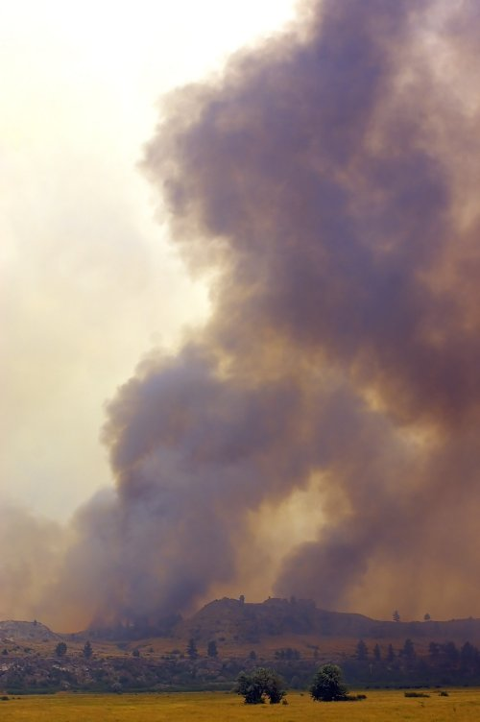
Fire Threats
Fires always a concern to NWS forecasters
Numerous specialized forecasts provided for data sparse locations to support wildfire suppression
  Need all possible observations – including satellite
Notes:
Picture of a fire from two seasons ago just east of Billings. One day after it started, it caused I-90 to close. This fire grew extremely quickly and as a result, BYZ provided forecast support before all normal resources arrived. So it’s not the incident meteorologists that deal with significant fires – it is also the local office. This true beyond Montana as well.
Many of the forecasts are in areas with limited data so satellite data can play a bigger role. The next few slides will show you how....

Slide 19
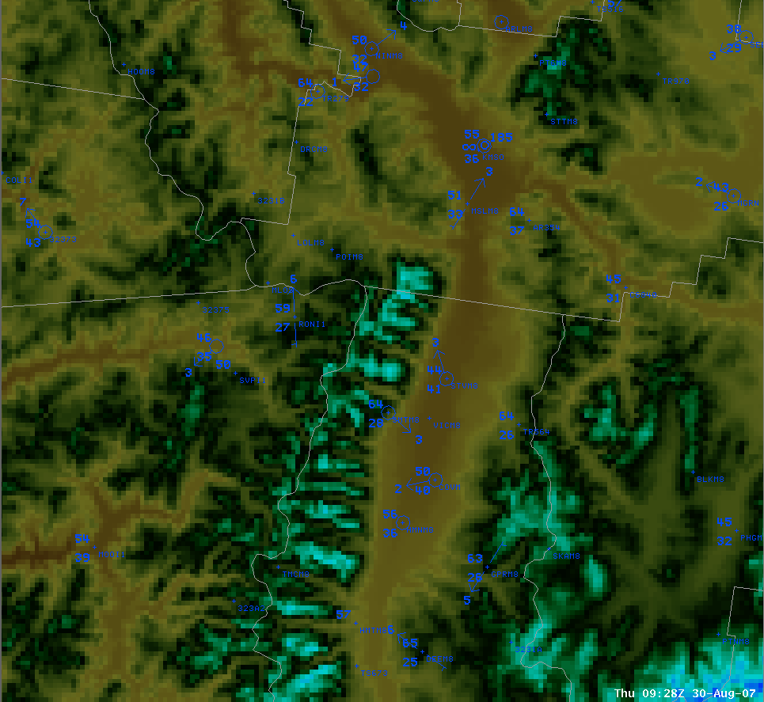
Topography Western Montana
Bitterroot Valley
Bitterroot Mountains
Sapphire Mountains
Notes:
Shown is a topographic map of western Montana near Missoula. Focus on the Bitterroot Valley and surrounding terrain.

Slide 20
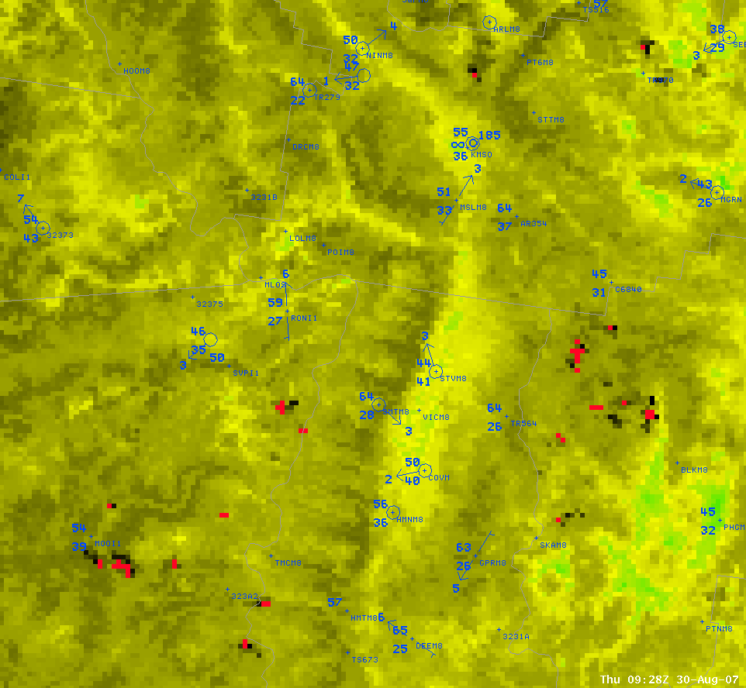
Even Warmer Slopes
Cool Valley
Warm Mountain
MODIS 3.7 micron 0930 UTC 30Aug2007
Notes:
This is the 3.7 micron MODIS imagery at 1km for the exact same location for 30 Aug 2007.
While this may not be the most appropriate way to use the 3.7 micron, it can show some interesting thermal features which does have some relationship to the surface observations plotted in blue. The bright red pixels are fires, but focus your attention to the yellow and green shading in the valley, which is where the MODIS is showing the coolest temperatures. The mountains are warmer than the valleys, but even more interesting is the mid slope warmth or thermal belt that is depicted. From a fire perspective, this is important because often the thermal belt helps keep nocturnal fire activity higher than one may expect. The surface observations density is not nearly close enough to resolve these details.
Don Moore (then BYZ SOO) performed extensive analysis of MODIS IR (both 3.7 and 11 micron) with surface observations. He felt that while he wouldn’t want to take the satellite values verbatim as near surface air temperatures, he did feel it gives a reasonable idea to spatial details we couldn’t observe otherwise.

Slide 21
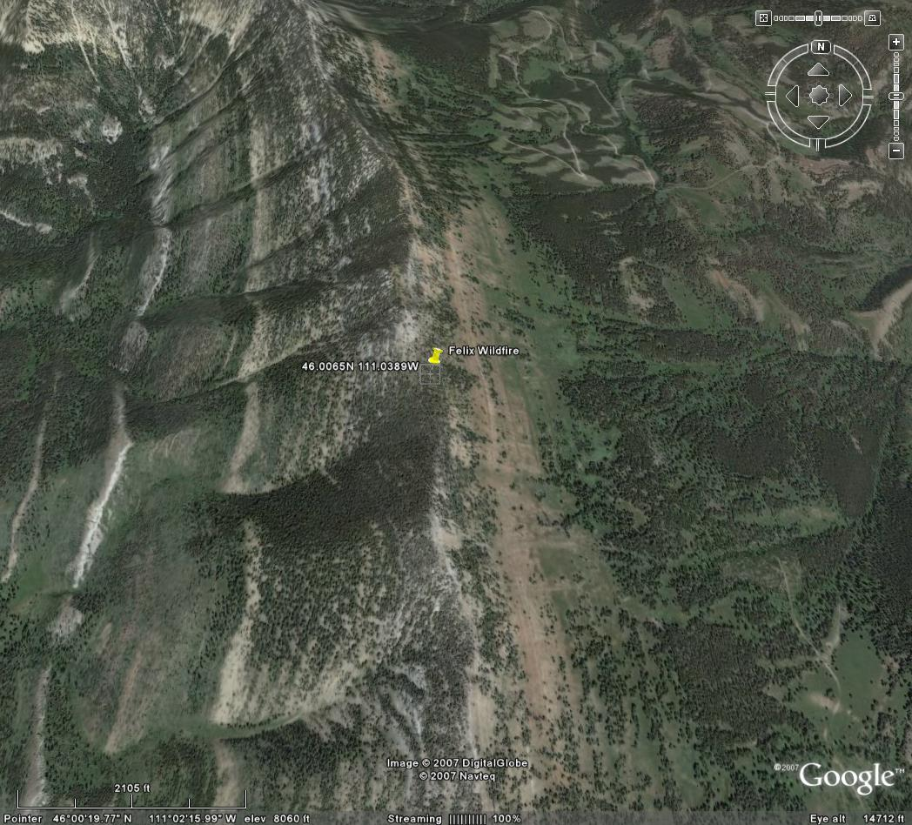
04 Jul 2007 Felix wildfire near the top of Bridger Range, northeast of Bozeman, MT
Notes:
Real life scenario. A lightning strike starts a fire near the top of the mountain which is too small to be detected by satellite. Folks are sent out on a long hike to do suppression. The forecast office gets a 5 a.m. call from them wanting to know about weather impacts the next few days. There aren’t any observations at the fire, so what can we tell them?

Slide 22
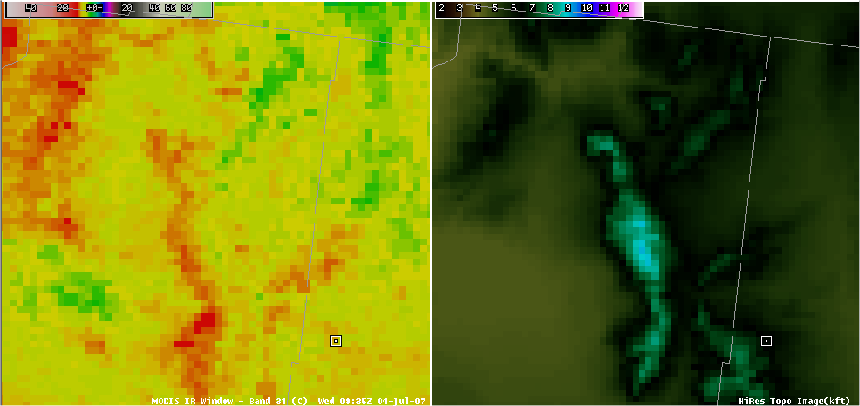
MODIS IR and AWIPS Topography
Pronounced thermal belt west slopes
Felix Wildfire
Notes:
Per the MODIS imagery, You’ll likely see greater nocturnal fire activity if that fire makes it to the west slopes than if it stays on east slopes. Once could also assume there also is a half way decent westerly nocturnal drainage wind on the west slope where the east slope may be less.

Slide 23
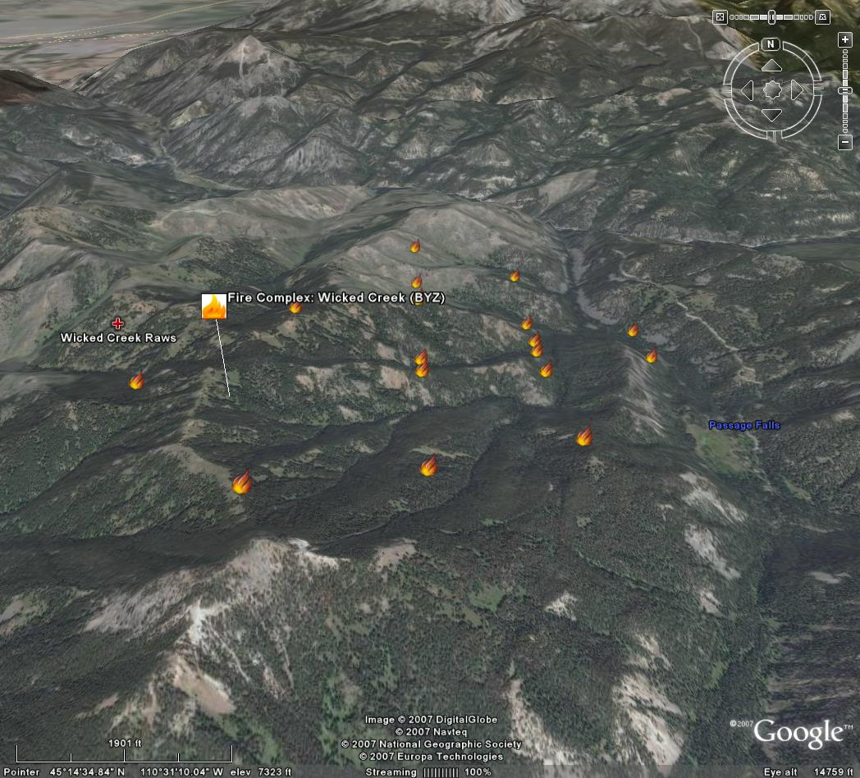
MODIS Derived hot spots depicted in google earth
Notes:
Another real life scenario. Lightning started numerous small fires which the forest service described as being “messy”. This Google Earth image shows the location of the MODIS derived hot spots over a 24 hour period. Since the fires are scattered across rugged terrain and a variety of microclimates, a single point forecast wouldn’t do justice to the actual weather. MODIS imagery can provide some help in understanding the area better.

Slide 24
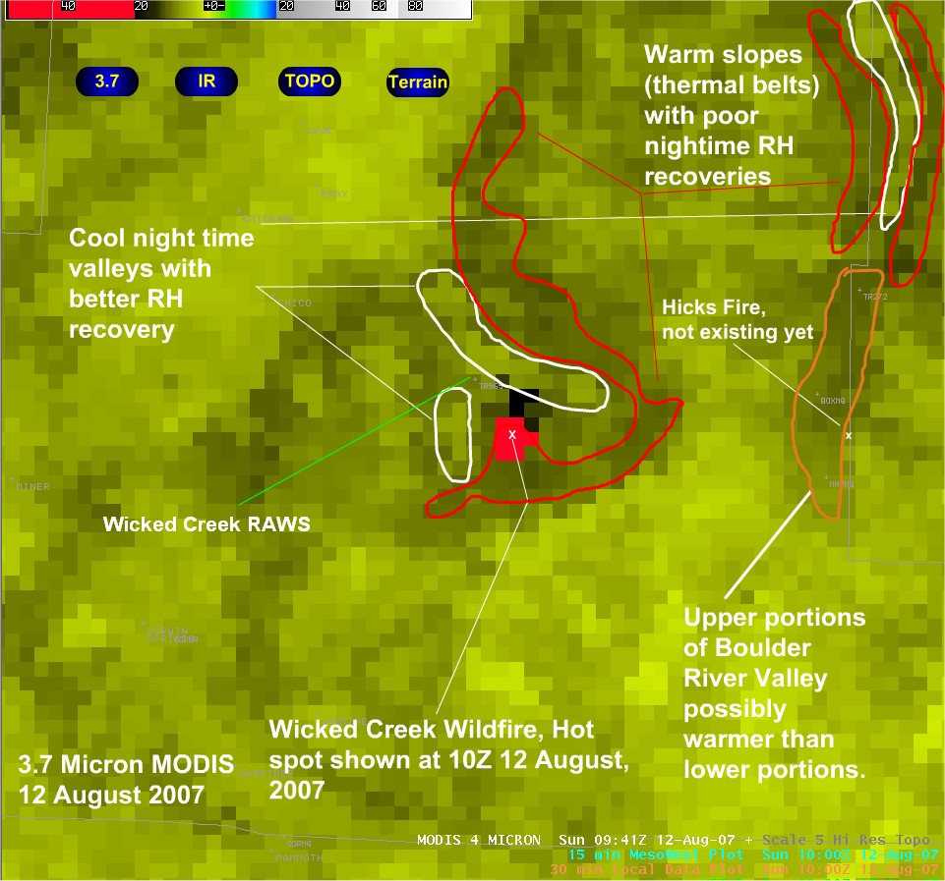
Notes:
The hot spot shown here on the 09Z MODIS shows the fire in the morning burning actively in the thermal belts, outlined in red.
This imagery gives a better feel for these different microclimates that can’t be easily known otherwise. So when the folks on the fire are saying that the camp below the fire had lots of dew in the morning but the fire burned actively all night long we can explain why.

