Slide 1
An Overview of Summer Convection over Central Alabama
Kevin Laws
National Weather Service
Birmingham, Alabama

Slide 2
Background
Pop-up thunderstorms common during summer.
Once thought to be random.
Birmingham WFO issue 20-30% POP for the entire CWA.
Not very useful to public, nor very accurate.
Goal: To improve upon summertime precipitation forecasts and dispel the myth of random summertime thunderstorm activity

Slide 3
Steps to Improvement
SUMMER 1
Attempt to identify boundaries for summertime convection
Dispel the myth of “Random” summertime thunderstorm development
Use detailed surface analyses, along with remote sensing operational tools (GOES, NEXRAD) for boundary identification
Collaborate with the SPoRT Center to develop an operational forecasting methodology using all available tools and future products
SUMMER 2
SUMMER 3
SUMMER 4

Slide 4
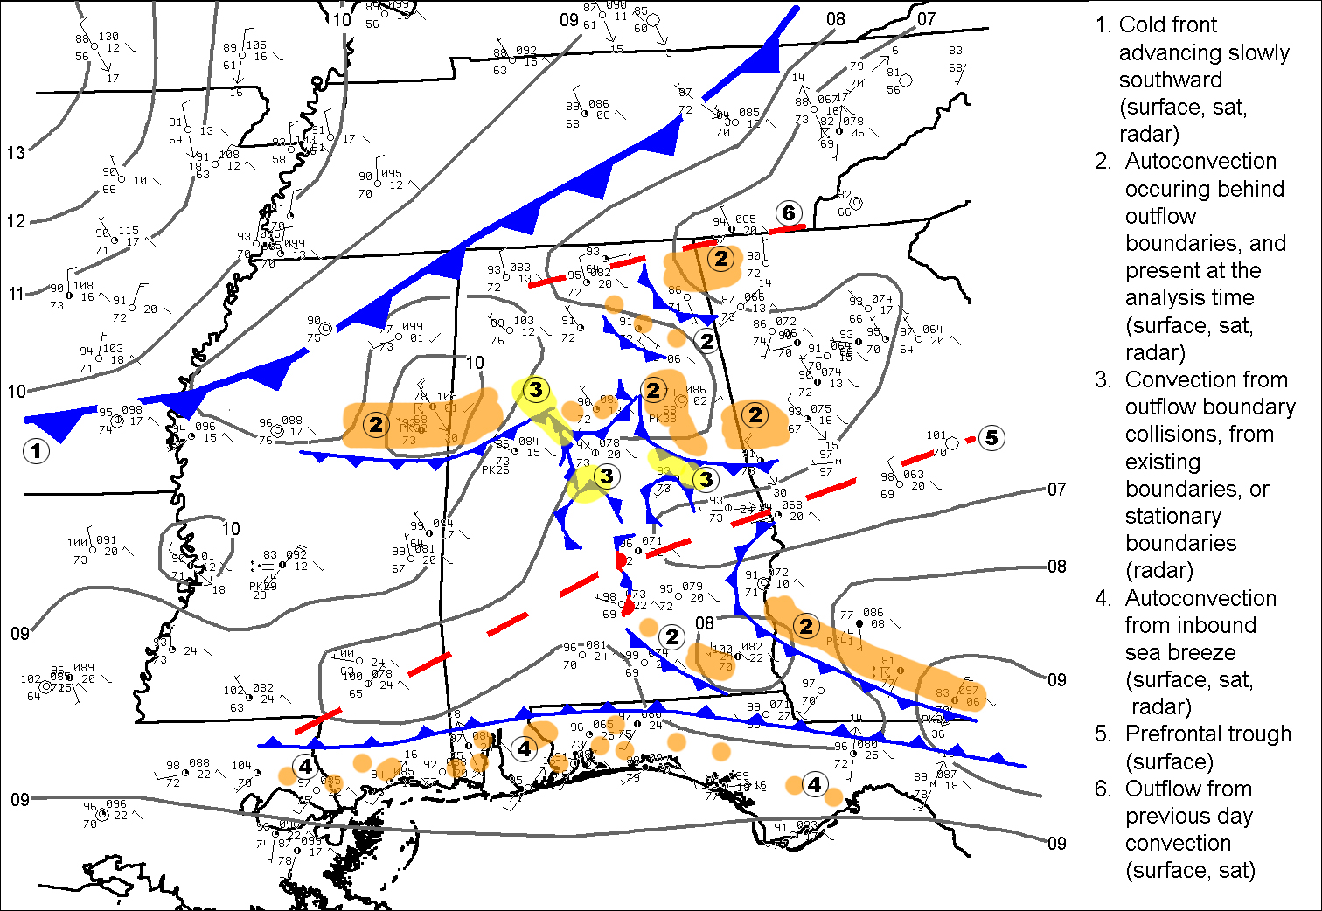
Notes:
Not your typical summer day that we thought. No Bermuda High chilling to our east. Lots going on, synoptic cold front (fairly rare), numerous interacting outflow boundaries, sea breeze coming from the Gulf of Mexico, Pre-frontal trough shows up upon analyzing pressure. LOTS GOING ON!

Slide 5
Boundary Statistics from 2009

Slide 6
Steps to Improvement
SUMMER 1
Attempt to identify boundaries for summertime convection
Dispel the myth of “Random” summertime thunderstorm development
Use detailed surface analyses, along with remote sensing operational tools (GOES, NEXRAD) for boundary identification
SUMMER 2
Introduce SPoRT LIS data as a potential data source for identifying mainly unknown boundaries
Develop experimental graphical short term forecasts with forecast polygon areas indicating where convective initiation is likely
SUMMER 3
SUMMER 4

Slide 7
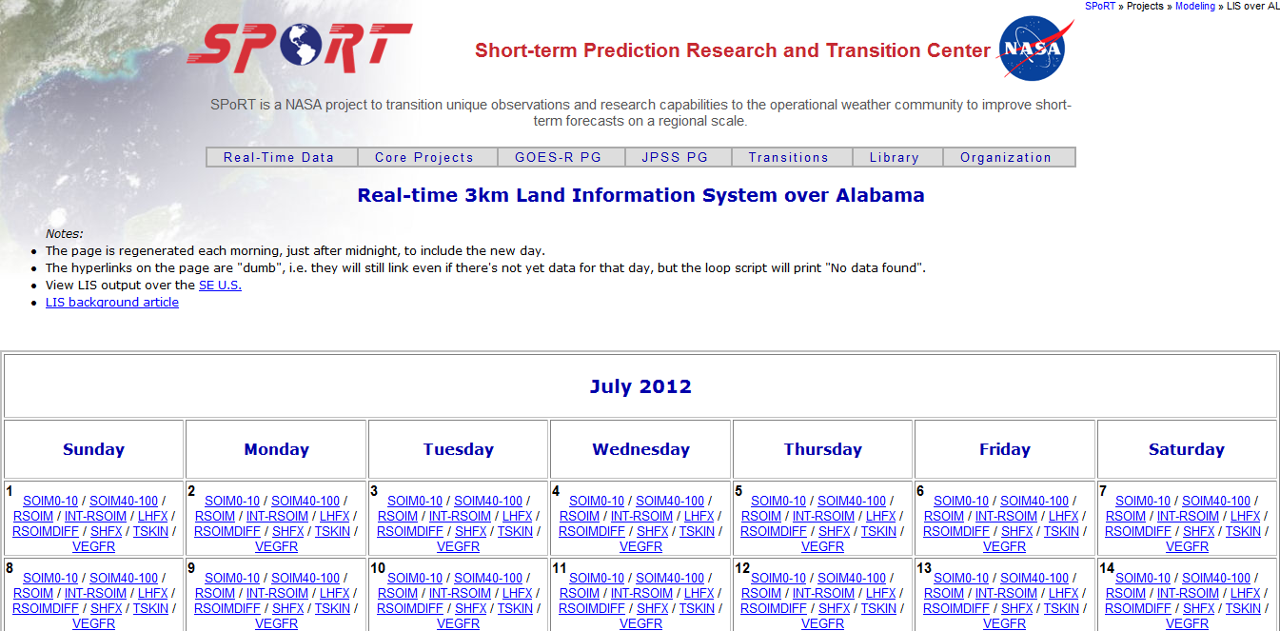
Land Information System (LIS)
Notes:
Land Information System (LIS) is a software framework for high performance land surface modeling and data assimilation.

Slide 8
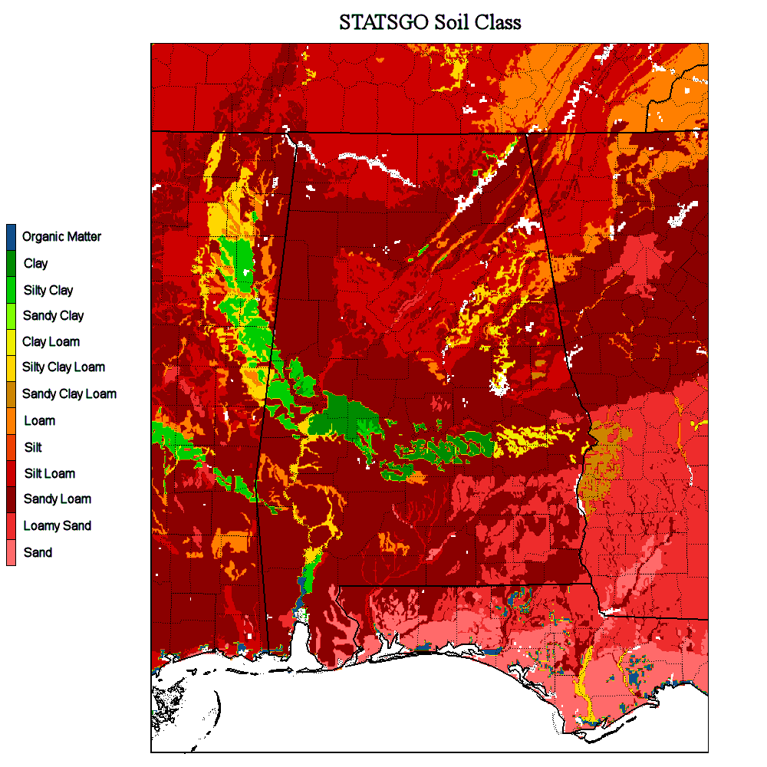
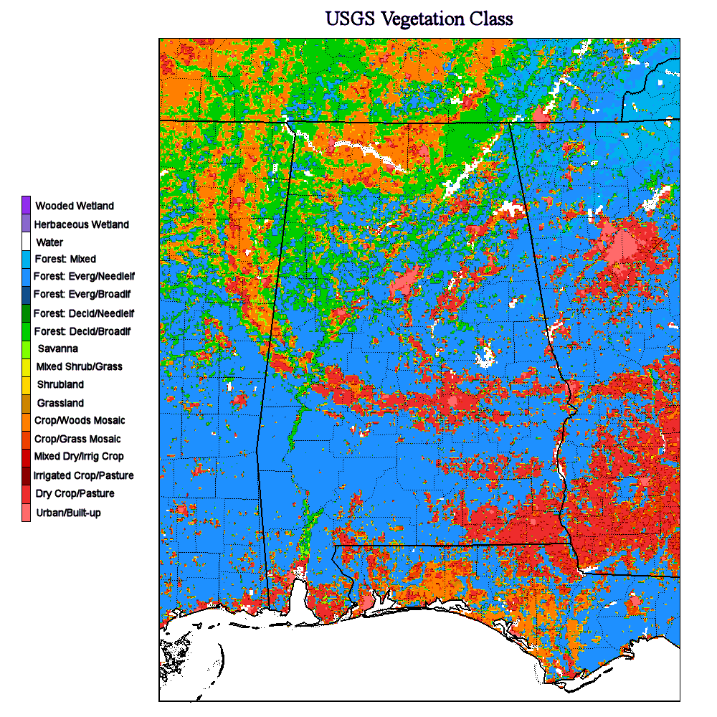

Slide 9
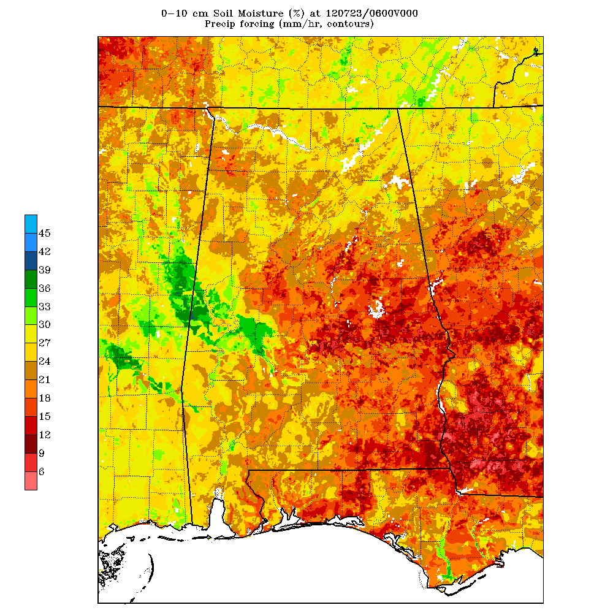

Slide 10
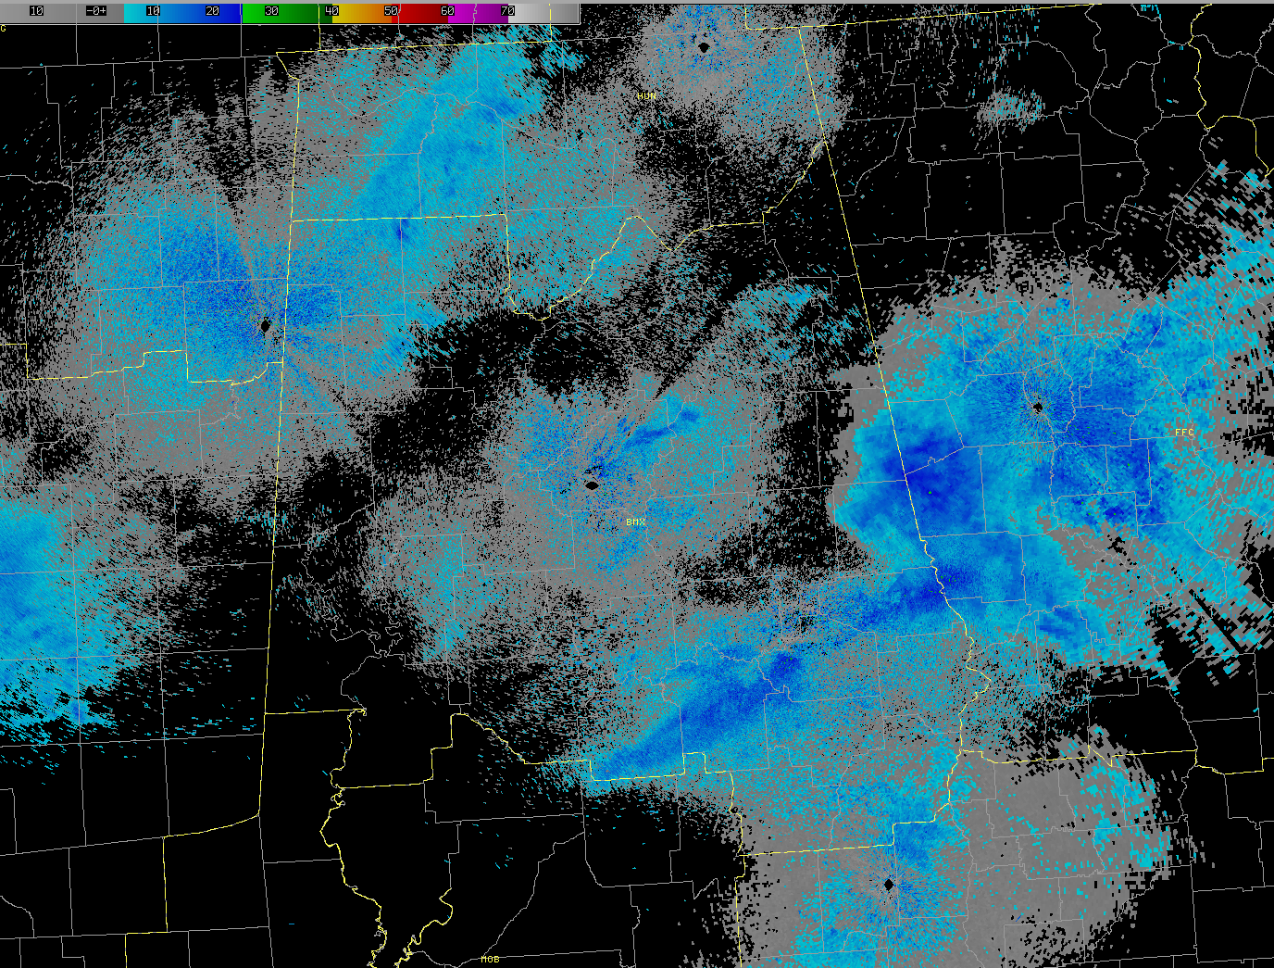

Slide 11
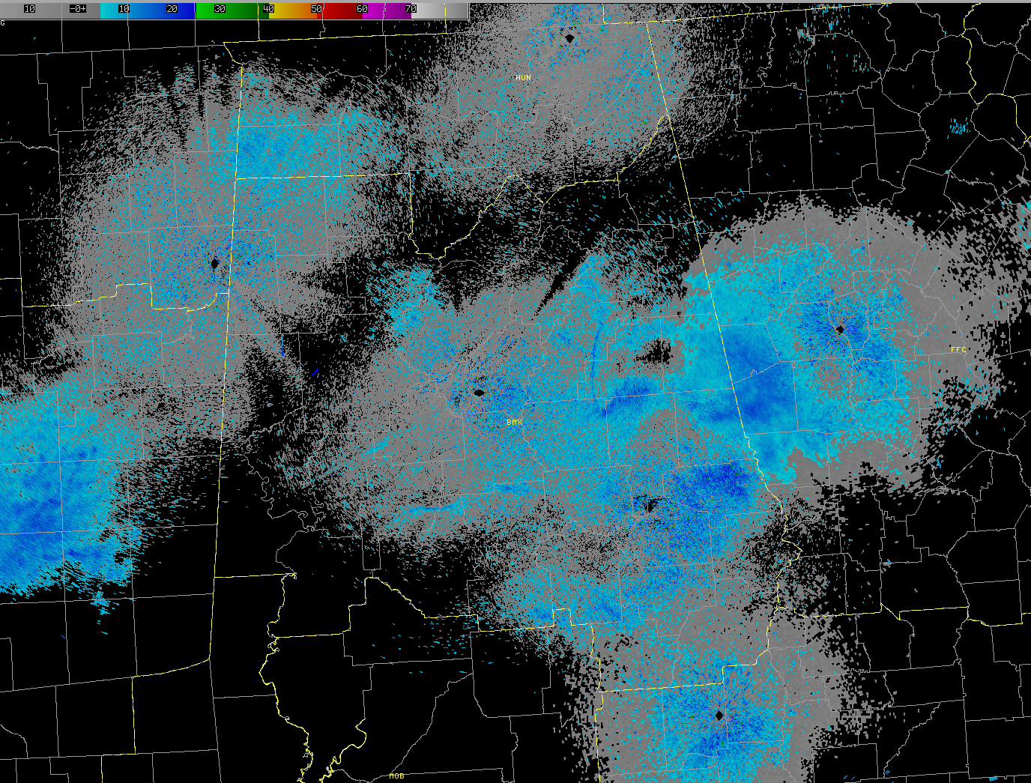
Notes:
Just an example of identifying outflow boundaries on radar

Slide 12
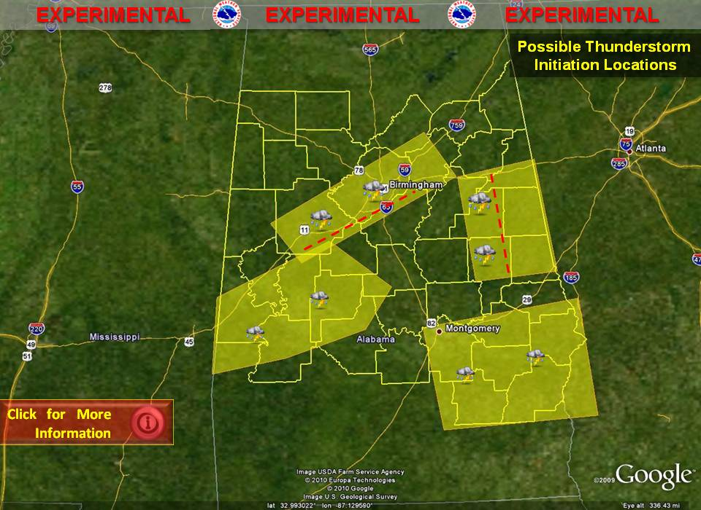
This is an experimental graphicast depicting the areas where thunderstorms
could first develop this afternoon. The graphic is part of a larger project devoted
to the improvement of summertime forecasting throughout the southeast.

Slide 13
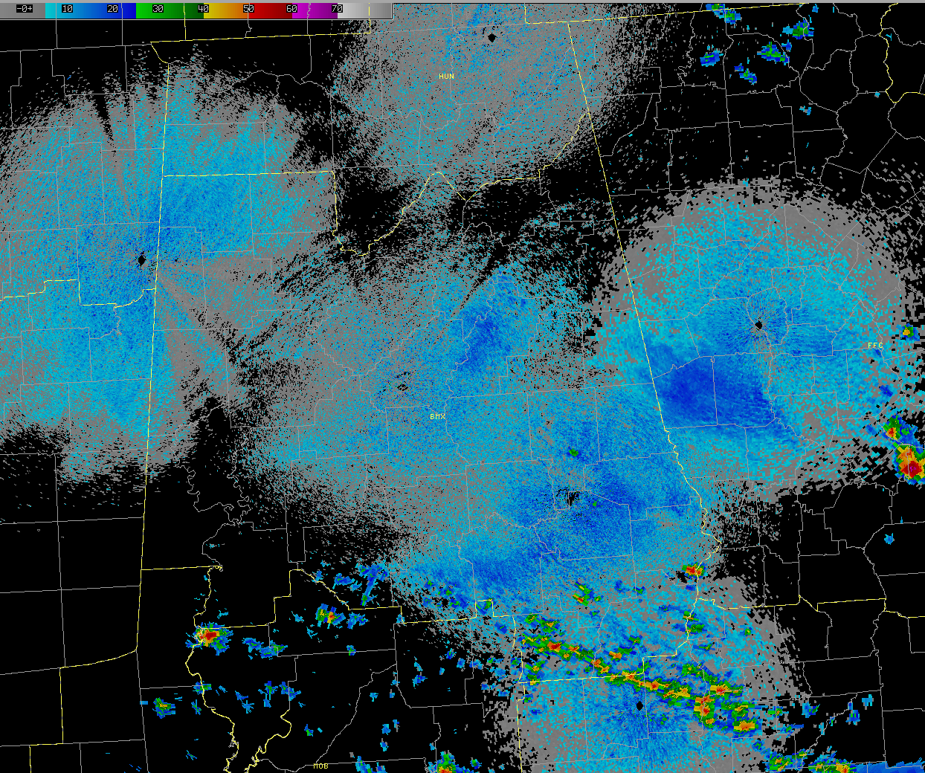

Slide 14
Boundaries
Notes:
After Summer 2, we now have decreased our number of “Unknown Boundaries” down to 4. With help of the NASA LIS data, we were able to greatly improve our analyses of these boundaries.

Slide 15
Steps to Improvement
SUMMER 1
Attempt to identify boundaries for summertime convection
Dispel the myth of “Random” summertime thunderstorm development
Use detailed surface analyses, along with remote sensing operational tools (GOES, NEXRAD) for boundary identification
SUMMER 2
Introduce SPoRT LIS data as a potential data source for identifying mainly unknown boundaries
Develop experimental graphical short term forecasts with forecast polygon areas indicating where convective initiation is likely.
SUMMER 3
Refine the use of products (surface analysis, NEXRAD, GOES, and featured LIS products).
Go digital…introduce GFE experimental POP grid. Show improvement from the midnight shift to the morning update POP
SUMMER 4

Slide 16
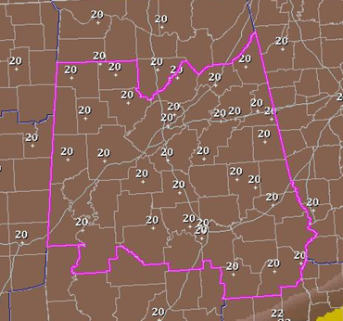
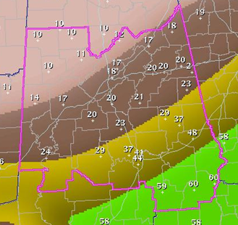
Initial POP
Experimental POP
Notes:
Typical summer day in Alabama. NWS goes with a blanket of 20% POPs.

Slide 17
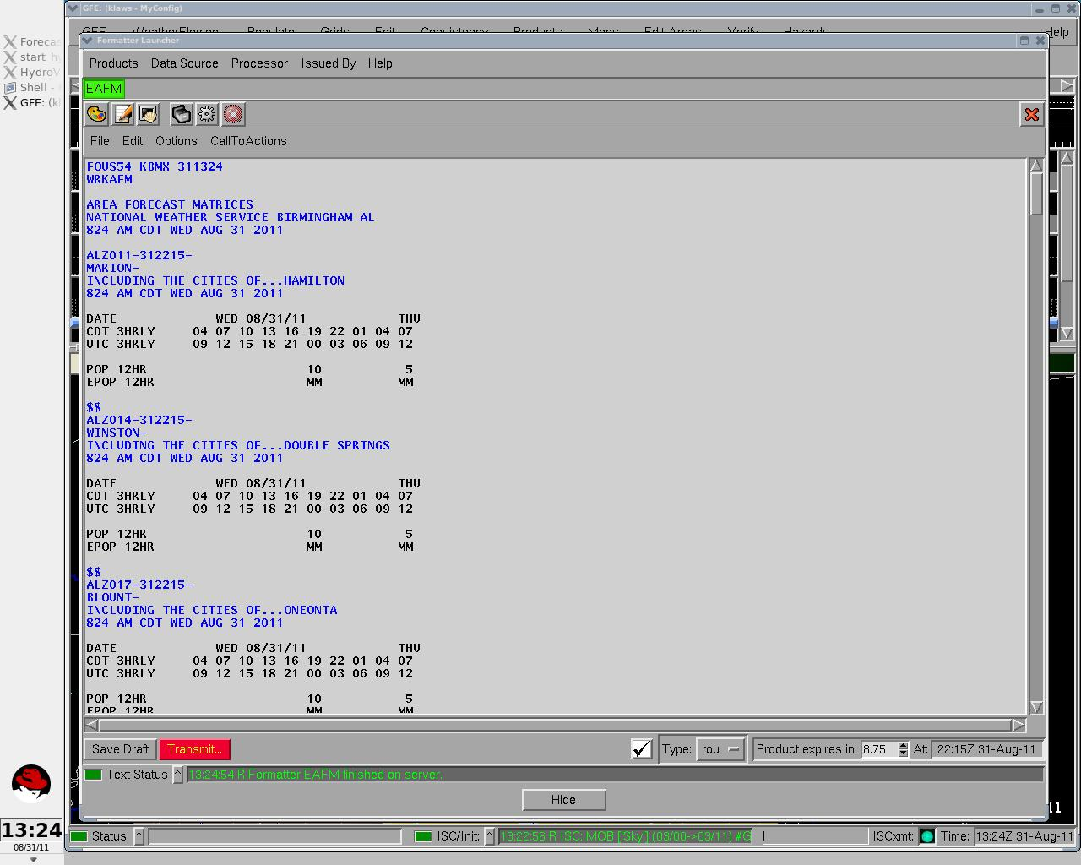
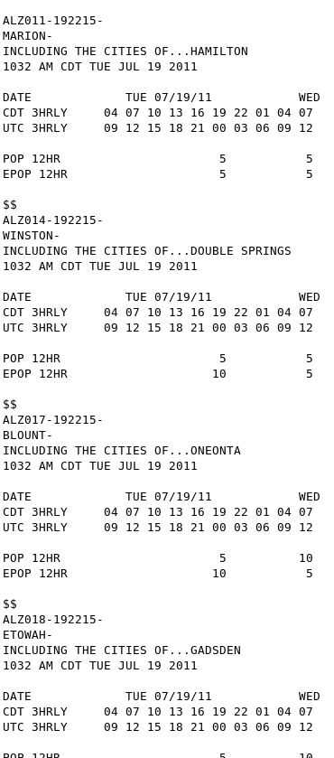
Notes:
Verification done on county-basis. Entered in midnight pop – or POP as well as Midnight PoP – OR EPOP – used these files to verify

Slide 18
Summer 4 - Operational
Every morning, look at:
SFC analysis (temp & moisture gradients, troughs, pressure, fronts)
Radar (outflow boundaries)
Satellite (differential heating boundaries)
NASA LIS Data (Soil Moisture – moisture boundaries)
Where are the most favorable areas for convective initiation?
Create graphicast with location of boundary and favorable area indicated
Update POP Forecasts Grids accordingly on the GFE
Verify later using radar images
Notes:
My Summer – This goes fully operational

Slide 19
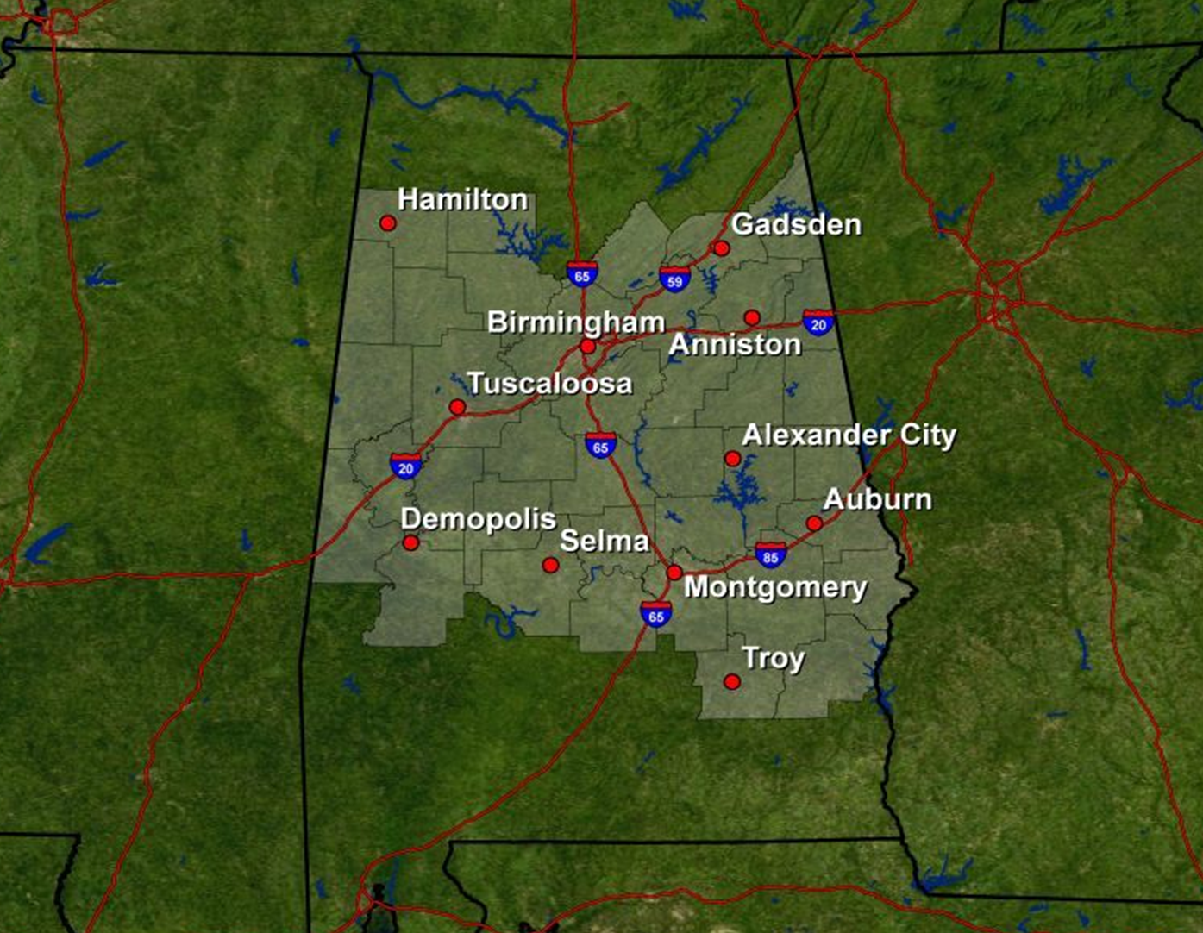
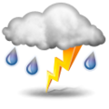
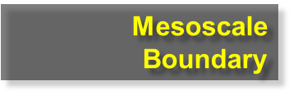
Today
Isolated-scattered showers and storms in the afternoon…best chance in the northeast

Slide 20
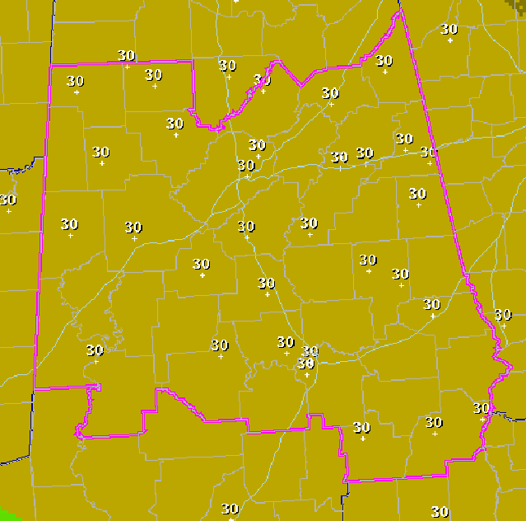
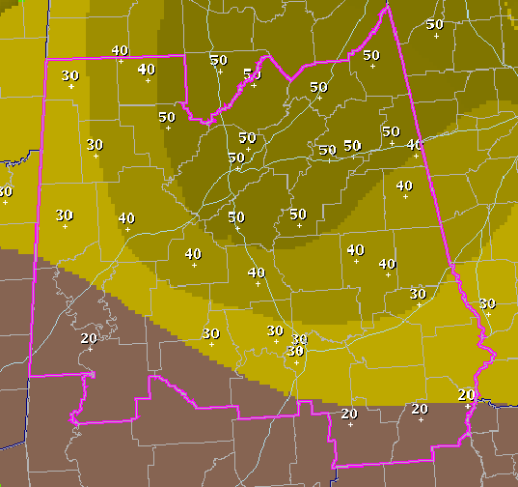
Midnight POP
Updated POP

Slide 21
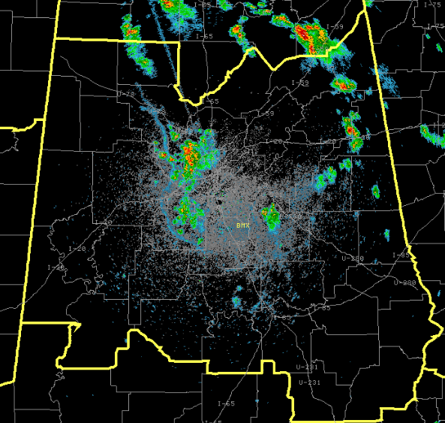
1834 UTC
1912 UTC
2007 UTC
2048 UTC

Slide 22
Updated POP Skill Scores
June
July
Aug
June
July
Aug
2011
2012

Slide 23
Updated POP vs. Climatology
June
July
Aug
June
July
Aug
2011
2012

Slide 24
Results
Accuracy of the updated POP forecasts greatly exceeded those of the original forecasts without regard to the boundary analysis.
Summertime pop-up thunderstorms are not random.
Simply putting in the time in the morning to look through all of these products and go through this process can greatly improve forecast accuracy.
Improvements were well-received by general public.

Slide 25
Project Takeaways
Summer weather is a lot more complex than we first thought. The idea of the standard Bermuda high doesn’t necessarily dominate the summer weather pattern.
Convective Initiation has endless applications
Forecaster buy-in from the initial start date. AFD improvement, forecasting techniques, intimate with the current weather and short-term forecast.

