Slide 1
An Investigation of North Alabama Lightning Mapping Array data and usage in the real-time operational warning environment during the March 2, 2012 severe weather outbreak in northern Alabama
Kristopher D. White
Geoffrey T. Stano
Brian Carcione

Slide 2
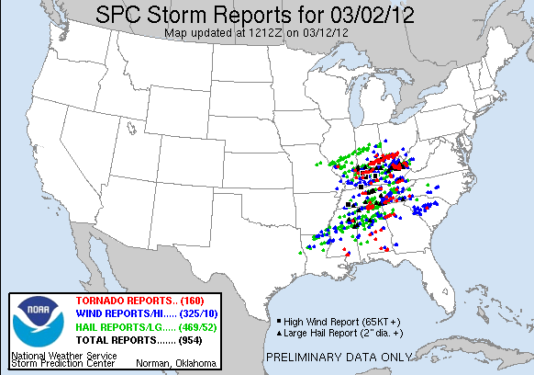
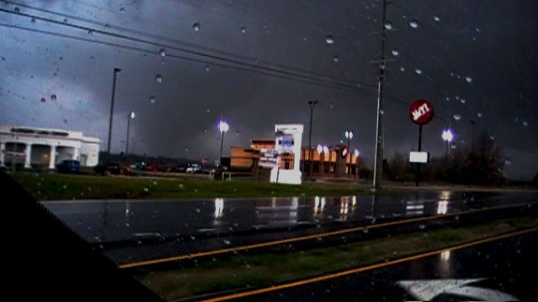
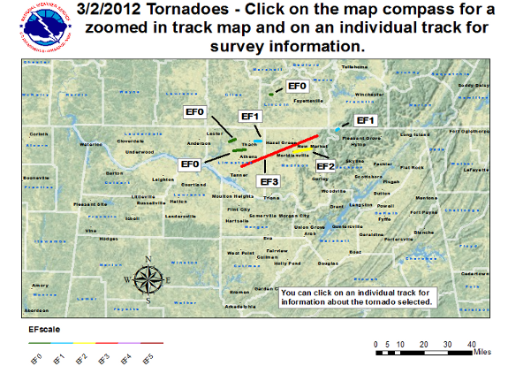
March 2, 2012 Event Overview
Severe weather began ~9 am CST
7 Tornadoes
1 EF3
1 EF2
2 EF1
3 EF0
41 Reports of Severe Weather
1 report 4.25” hail (softball size)
2 reports 2.75” hail (baseball size)

Slide 3
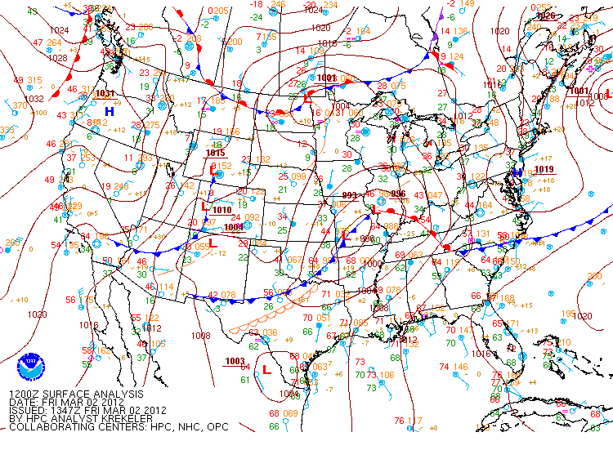
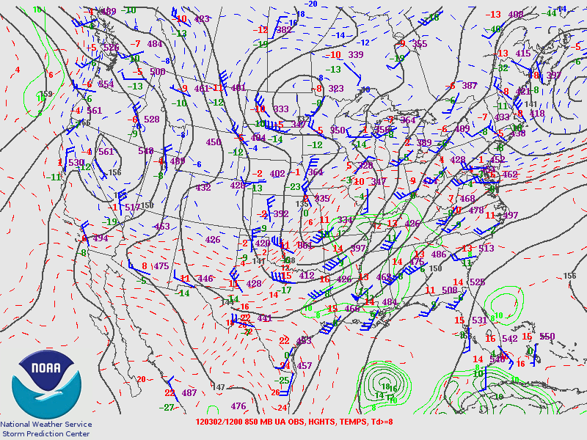
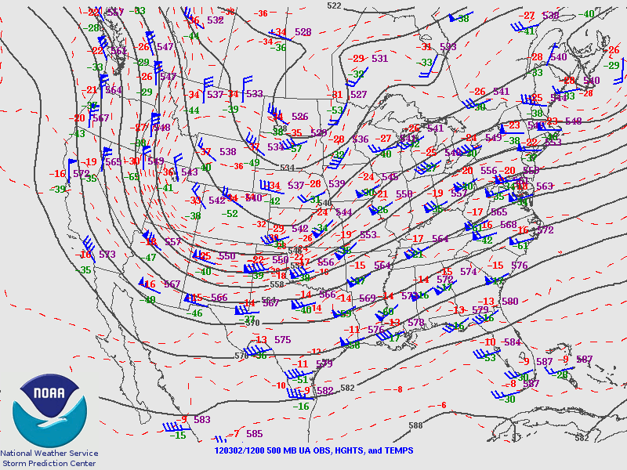
March 2, 2012 Event Overview
Surface analysis at 12Z shows low pressure over the Ozarks and SSW flow ~10 kts
850 mb analysis at 12Z shows trough in Midwest and SW flow ~30 kts
500 mb analysis at 12Z shows trough over the Great Plains and SW flow ~75 kts

Slide 4
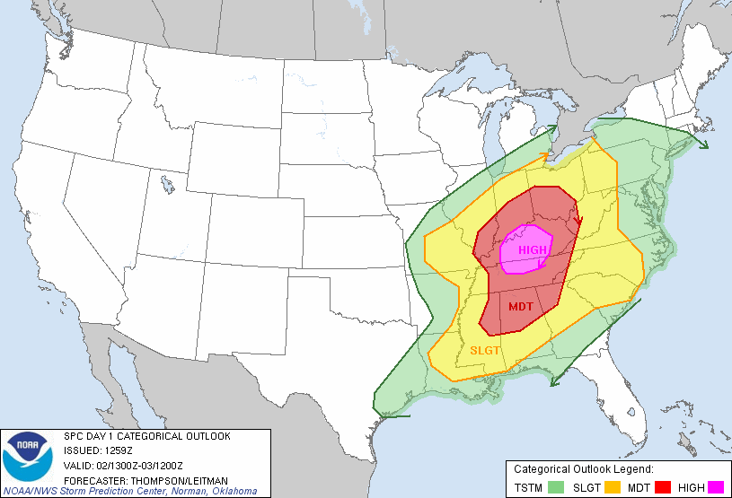
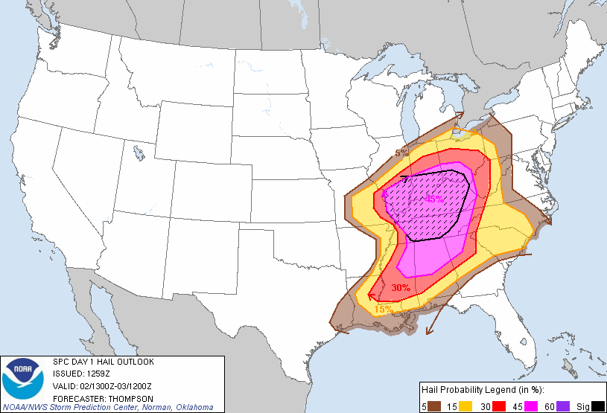
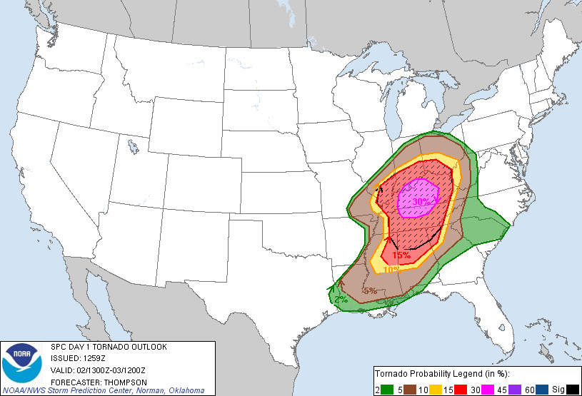
SPC Day 1 Outlooks
13Z SPC Day 1 Categorical Outlook
13Z SPC Day 1 Hail Outlook
13Z SPC Day 1 Tornado Outlook

Slide 5
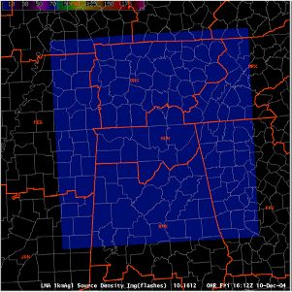
The North Alabama Lightning Mapping Array
Array Sensors (VHF)
Array Sensor (NSSTC)
Communications relays
Creation in 2001, data transition to HUN in 2003
Provides total lightning
Proxy for GLM
Huntsville
NALMA Domain

Slide 6
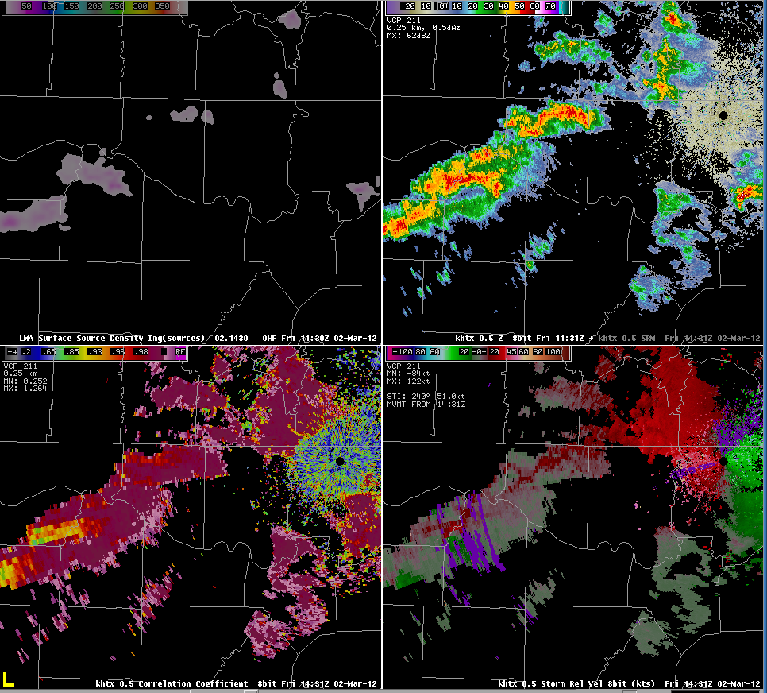
LMA Data in the March 2, 2012 Severe Weather Event
0.5 degree radar imagery at 1430Z (830 am CST)
Low source values from the LMA in NW Alabama at start
LMA
Reflectivity
Correlation Coefficient
Storm-relative Velocity

Slide 7
LMA Data as a supplemental decision support tool in the March 2, 2012 Severe Weather Event
0.5 degree radar imagery from 1430Z (830 am CST) to 1512Z (912 CST)
LMA
Reflectivity
Notice the time step of the LMA data is every two minutes
Correlation Coefficient
Storm-relative Velocity

Slide 9
LMA Data as a supplemental decision support tool in the March 2, 2012 Severe Weather Event
0.5 degree radar imagery from 1430Z (830 am CST) to 1514Z (912 CST)
LMA
Reflectivity
Correlation Coefficient
Storm-relative Velocity
1451Z - First severe weather warning issued
1505Z - First severe weather report, 1 inch hail
1512Z - 1.75 inch hail and 70 mph winds reported by law enforcement

Slide 10
LMA Data as a supplemental decision support tool in the March 2, 2012 Severe Weather Event
3.4 degree radar imagery from 1430Z (830 am CST) to 1514Z (912 CST)
LMA
Reflectivity
LMA
Reflectivity
Correlation Coefficient
Storm-relative Velocity
1415Z - First severe weather warning issued
Correlation Coefficient
Storm-relative velocity
1505Z - First severe weather report, 1 inch hail
1512Z - 1.75 inch hail and 70 mph winds reported by law enforcement

Slide 11
LMA Data and the 1st morning tornado of the March 2, 2012 Severe Weather Event
0.5 degree radar imagery from 1456Z (856 am CST) to 1604Z (1004 CST)
LMA
Reflectivity
LMA
Reflectivity
Correlation Coefficient
Storm-relative Velocity
1510Z - Tornado touch down
Correlation Coefficient
Storm-relative velocity
~1548 – Tornado reaches peak EF3 intensity
1600Z - Tornado lifts

Slide 13
LMA Data and the 2nd morning tornado of the March 2, 2012 Severe Weather Event
0.5 degree radar imagery from 1456Z (856 am CST) to 1604Z (1004 CST)
LMA
Reflectivity
LMA
Reflectivity
Correlation Coefficient
Storm-relative Velocity
1606Z - Tornado touch down
Correlation Coefficient
Storm-relative velocity
~1610Z – Tornado reaches peak width, EF2 intensity
1615Z - Tornado lifts

Slide 14
Summary and Future Work
LMA source density data exhibited the typical increase before the onset of severe weather and were a useful tool in early warning operations.
LMA source densities showed the typical spike (>300% increase) and then decrease before the 1st tornado. The tornado occurred during much of the “lull” in activity, but then ramped up intensity after a secondary peak occurred.
LMA source densities also showed a spike (>300% increase) followed by a decrease in values before the onset of the 2nd morning tornado. However, this tornado continued and intensified as a secondary peak in source densities was occurring. Further tornadic activity apparently did not occur after this secondary peak had ended and source densities decreased.
Preliminary investigation of afternoon supercells shows relatively small total lightning activity and low LMA values.

Slide 15
Questions?

